Slide 1



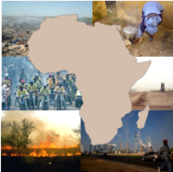




Emissions inventories in Africa
Sekou KEITA
University Peleforo Gon Coulibaly Korhogo, Côte d’Ivoire
Email: sekkeith@yahoo.fr

Slide 2
DACCIWA inventory version1
METHODOLOGY: Anthropogenic source inventories: fuel consumptions (FC) are combined with emission factors (EF) to derive emission inventory at the country level using “bottom-up” approach (E = FC * EF* CE)
FC DATA
Period 1990-2015
Fossil fuel and biofuel
United Nations database (UN) 1990-2015, 54 African countries and 22 fuels
International Energy Agency data (IEA) 1990 – 2015, 28 African countries
Two wheel vehicles
Two-wheel numbers and FC based on Assamoi and Liousse, (2010) and DHS data.
Waste burning
WB = P × MSWp × Pfrac x Bfrac = WB_{residential} +Wb_{dump} (IPCC, 2006; Wiedinmyer et al. 2014)
EF DATA
Provided from ground field measurements in Africa (Keita et al., 2018) and literature
Including combustion sources :
DOMESTIC FIRE
CHARCOAL MAKING
TRAFFIC
INDUSTRY
POWER PLANT
WASTE BURNING
FLARING
SPATIAL DISTRIBUTION OF EMISSION (0.1° x 0.1° resolution)
Domestic fire: Population density given by CIESIN (Gridded Population of the World Future Estimate: GPWFE)
Road traffic: African country road networks given by Africa infrastructure, (2009) and EDGAR road networks
Power plant : African power plant networks given by Africa infrastructure, (2009)
Flaring : DMSP and VIIRS

Slide 3
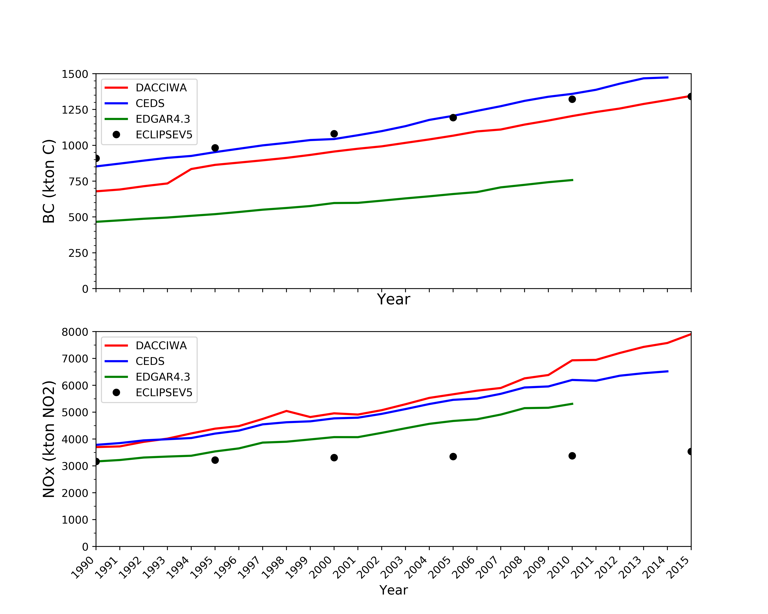
Emission trend and comparisons
African BC and NOx emission trend from 1990 to 2015
Emissions are globally increasing over the period 1990-2015.
There are some differences between this regional inventory and other global inventories dues to choice of EF and activity data
This work has been published in Earth System Science Data journal
African Anthropogenic Emissions Inventory for gases and particles from 1990 to 2015, (Keita et al. 2021 https://doi.org/10.5194/essd-13-3691-2021)

Slide 4
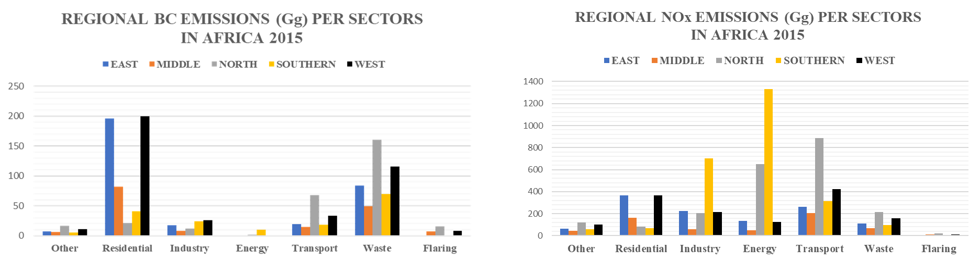
African sectoral emissions by region
A few features :
BC, OC, CO, VOCs : importance of domestic fires, waste burning, transport …
NOx, SO₂ : importance of energy, industry and transport
BC and OC in West and East Africa : domestic fires
NOx in South Africa : energy, industry
North Africa : Transport and Waste

Slide 5
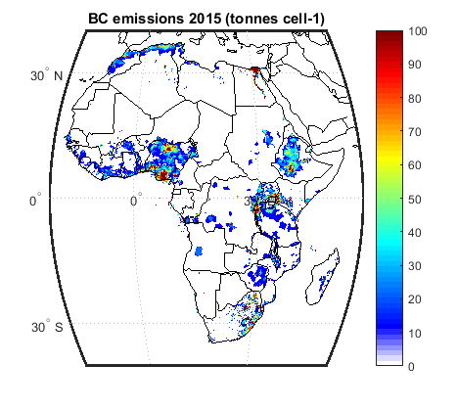
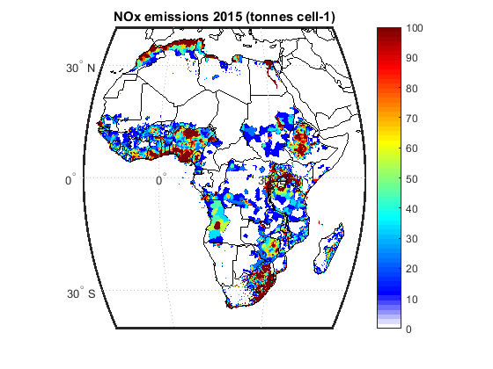
Emission spatial distribution
1353 Gg BC
7906 Gg NOx
Figure: Spatial distribution of total anthropogenic BC and NOx emissions in 2015

Slide 6
DACCIWA inventory version 2
METHODOLOGY: Anthropogenic source inventories: fuel consumptions (FC) are combined with emission factors (EF) to derive emission inventory at the country level using “bottom-up” approach (E = FC * EF* CE)
FC DATA
Period 2010-2018
Come from the same sources than version 1 but updated
EF DATA
For GHG
CO₂ EF from Keita et al. (2018) for residential, commercial, road transport and open waste burning;
CO₂ and CH₄ emission factors from Akagi et al. (2011) for charcoal making and solid waste burning, and from Doumbia et al. (2018) for gas flaring.
For all other sources, we used default emission factors from IPCC (2006)
For air pollutants
We have used the same values than in version 1
Combustion sources :
Energy
- Power plant
- Flaring
- Residential
- Commercial and services
Industry
- Industrial process
Transportation
Waste
- Open solid waste burning
Non combustion sources :
Energy
- oil and gas fugitive emissions
- coal mining fugitive emissions
Others
- Agricultural soils
SPATIAL DISTRIBUTION (0.1° x 0.1° resolution)
Same proxies than in version 1 but updated
For non combustions sources, we used CAMS-GLOB-ANT proxies

Slide 7
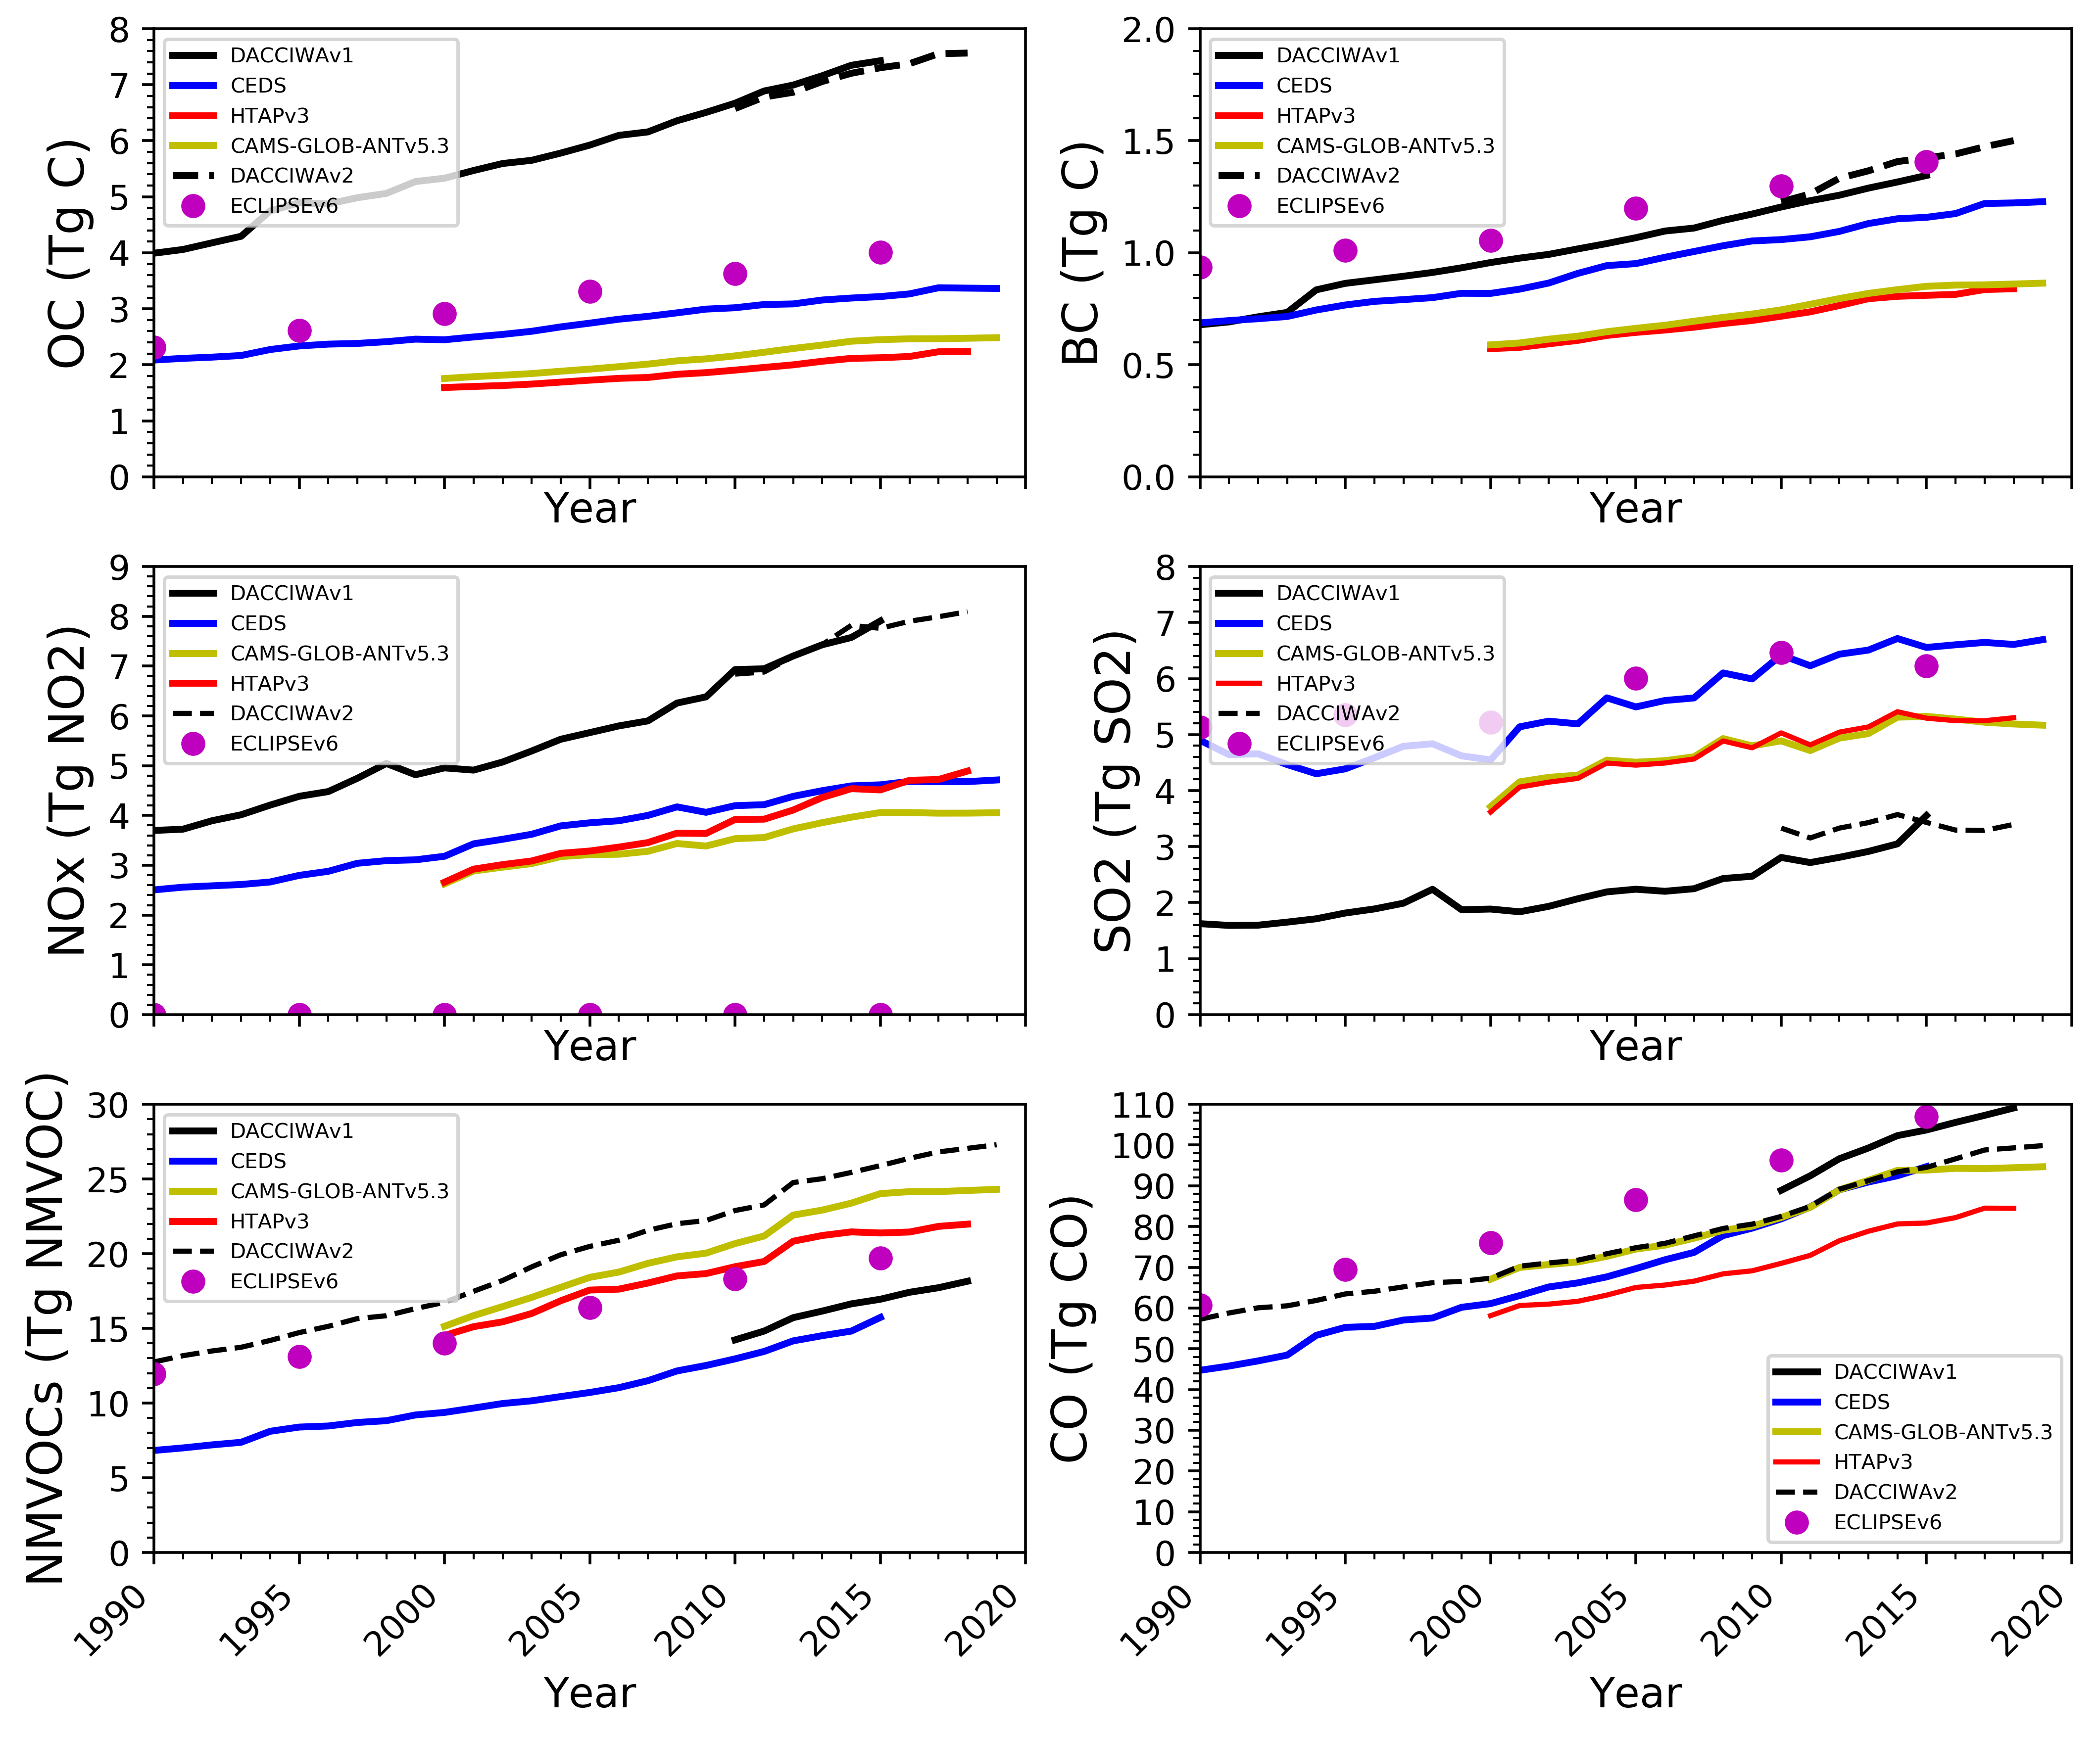
Comparison of air pollutant emissions between DACCIWAv2 and global inventories (1990-2018)
There are some differences between our regional inventory and global inventories
Differences due to the reasons previously mentioned
The highest relative differences observe between our both version 14 % (SO2) follow by NMVOC (10 %).
Highest relative difference : HTAPv3 – Dacciwav2 for OC (71%) ; SO2 (54%)

Slide 8
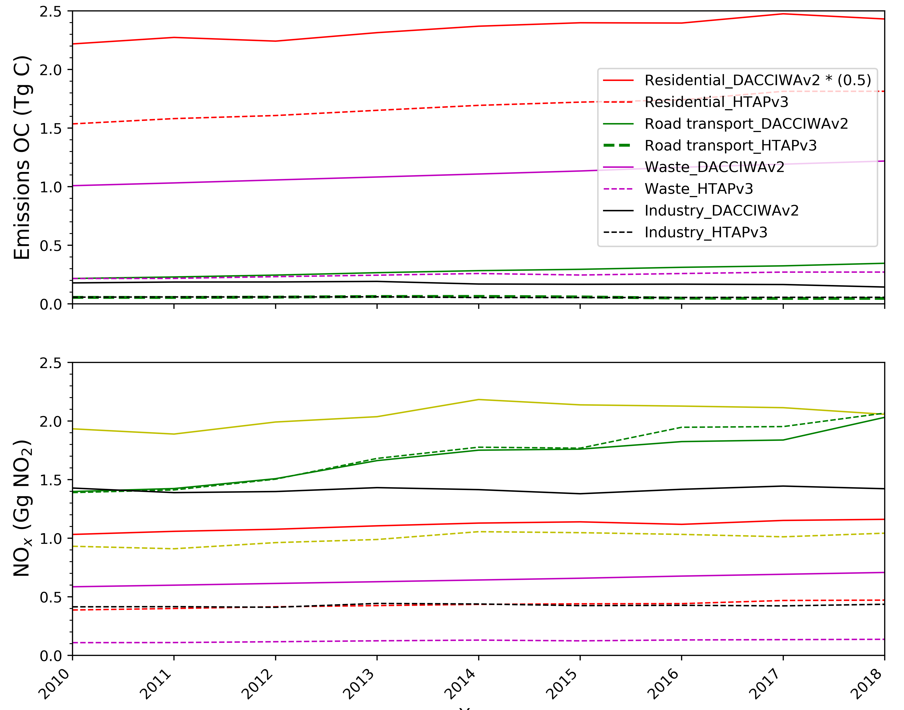
Comparison of OC and NOx emissions between DACCIWAv2 and HTAPv3
DACCIWAv2 inventory developed in the frame of CoCO2 project for the period 2010-2018 for CO₂ and CH₄ also with air pollutants. Yearly Netcdf files for CO₂_ff , CO₂_bf , CH₄ and air pollutants are available on ECCAD site https://eccad3.sedoo.fr/.
Large differences for sectoral emissions :
OC (residential :64%, waste : 78%, road : 80%, industry : 67%)
NOx (waste : 81%, industry : 70%, residential : 61%, energy : 51%, road : 2%)
NOx emissions from road roughly the same

Slide 9
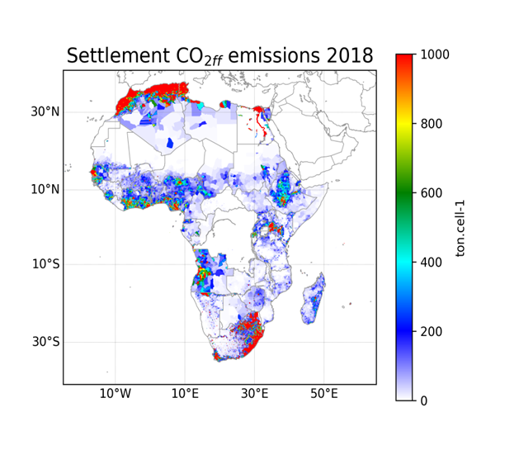
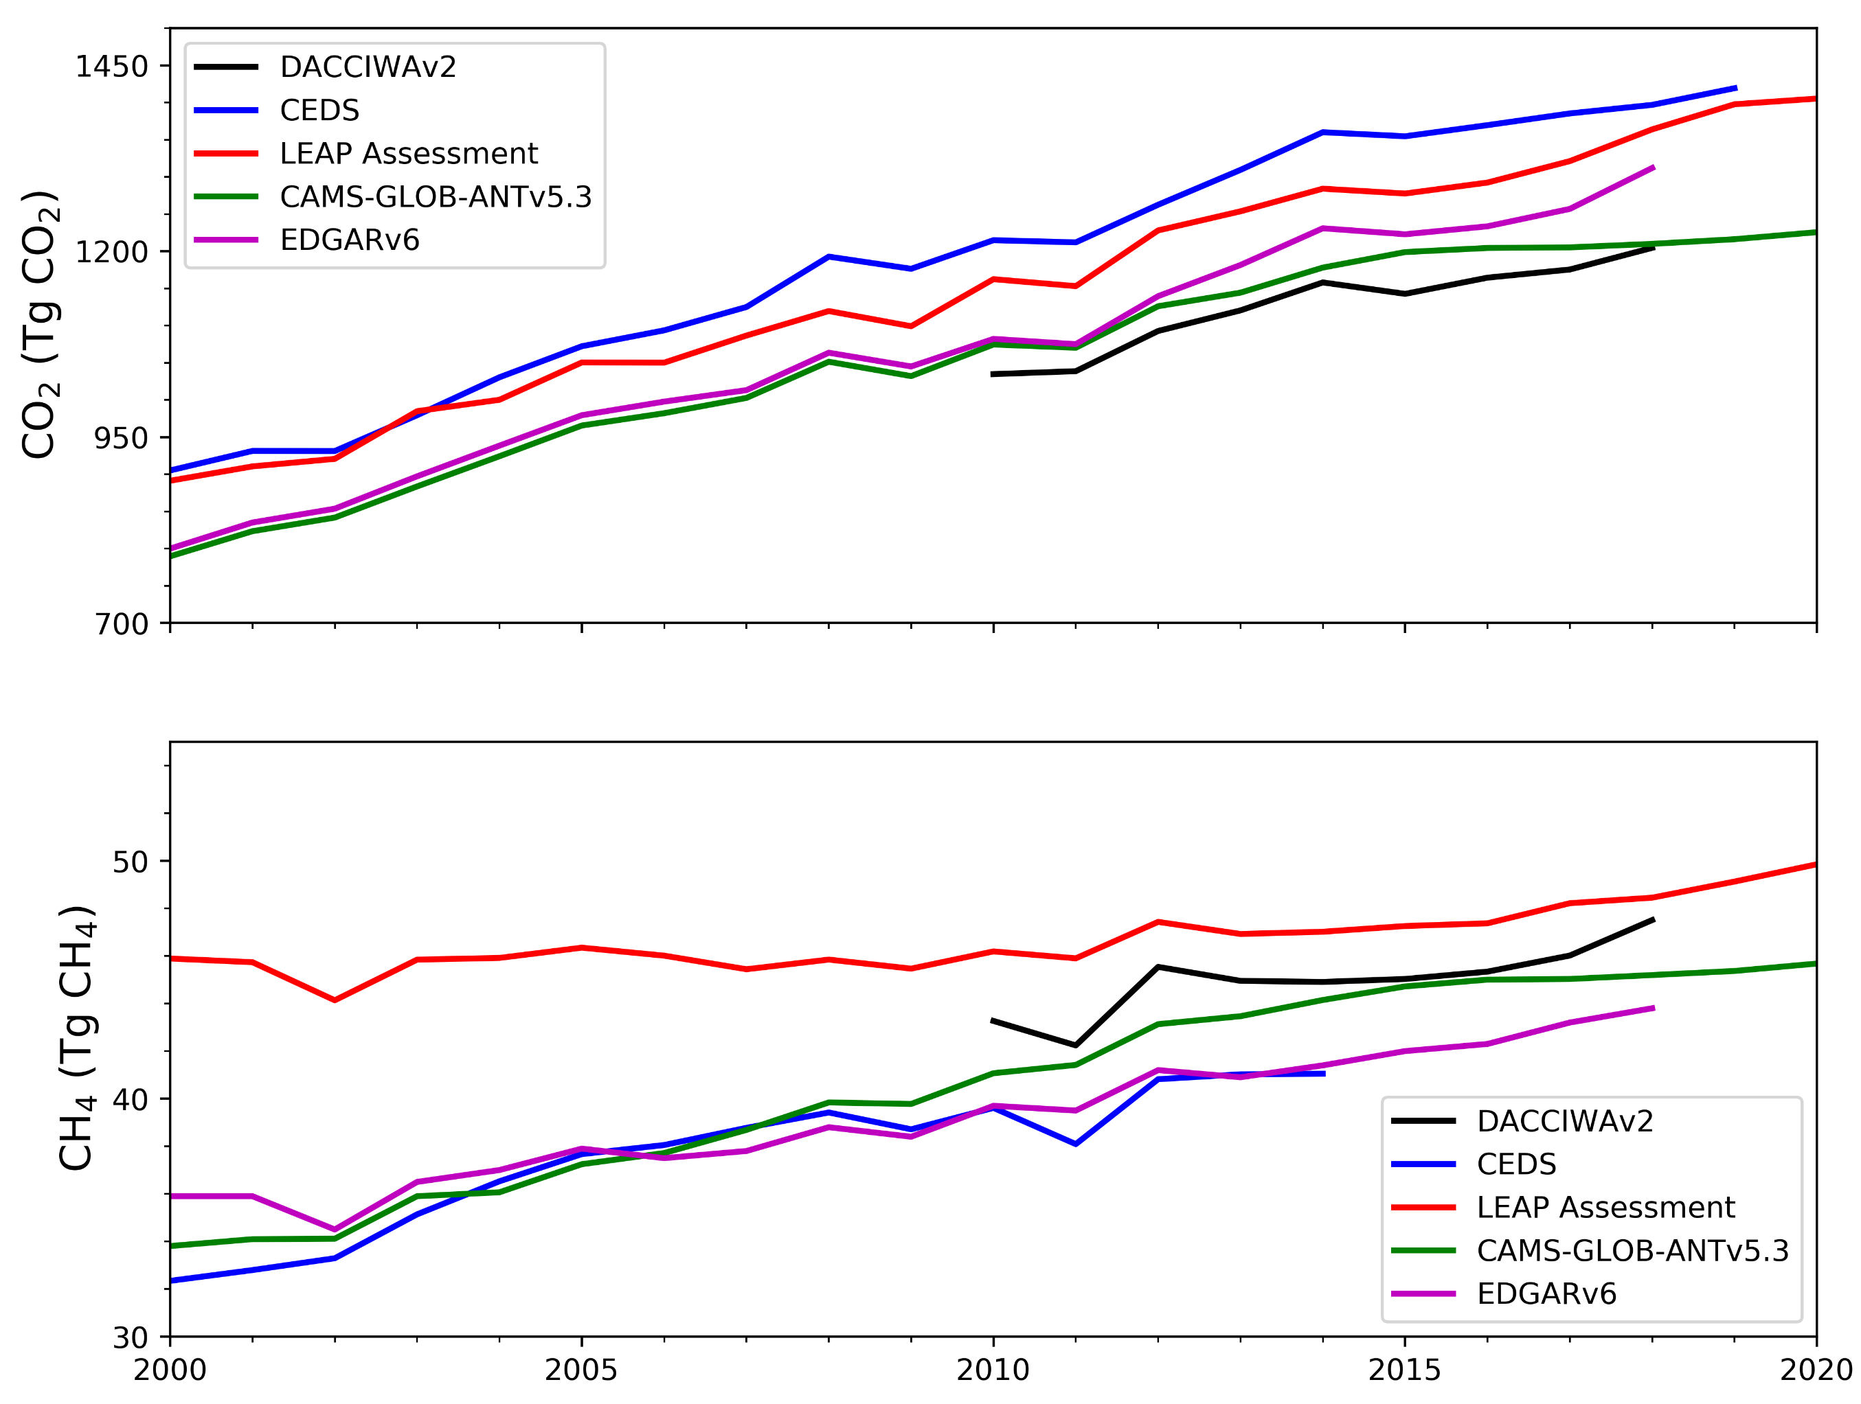
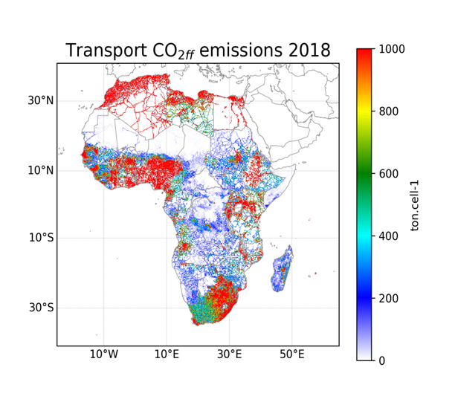
Some results : DACCIWA inventory v2
Sectoral Spatial distribution of CO_{2_ff} emissions
Comparison of GHG emissions with some inventories

Slide 10
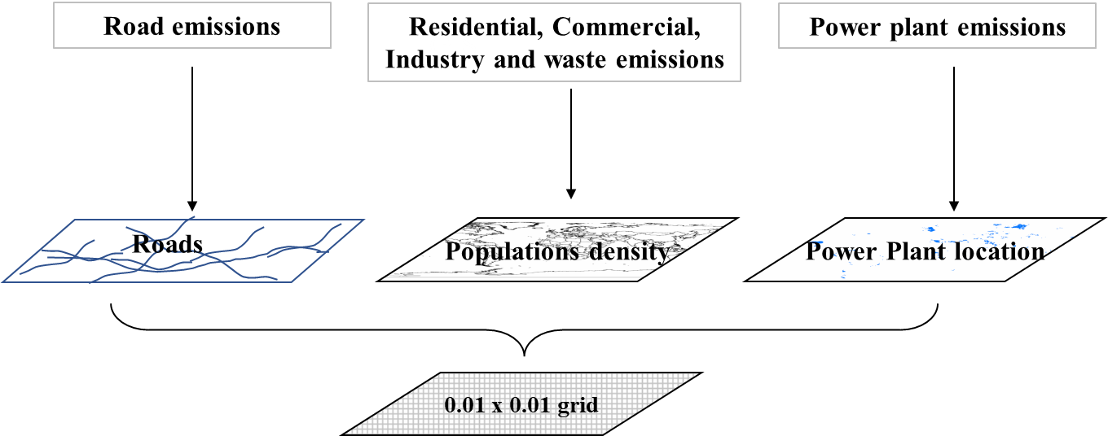
URBAN: Abidjan emission inventory
METHODOLOGY and SPATIAL DISTRIBUTION OF EMISSIONS IN ABIDJAN
FC: fuel consumption (city and national database)
EF: Keita et al., 2018 for BC and OC and literature for others
Bottom-up approach : E(g) = FC(kg) x EF(g/kg) x CE
Traffic: road density combined with road occupancy by vehicle types
Residential and commercial: population density combined with poverty indices per communes in Abidjan
Waste and Industry : population density
Power plants : real locations
=> For these 3 sources, downscaling of the national inventory from Keita et al. (2021)
NB: used as input data for WRF-Chem model (see Gnamien et al. 2024)
Keita et al. (2018) Particle and VOC emission factor measurements for anthropogenic sources in West Africa, Atmospheric Chem. Phys., 18(10), 7691–7708, doi:10.5194/acp-18-7691-2018.

Slide 11
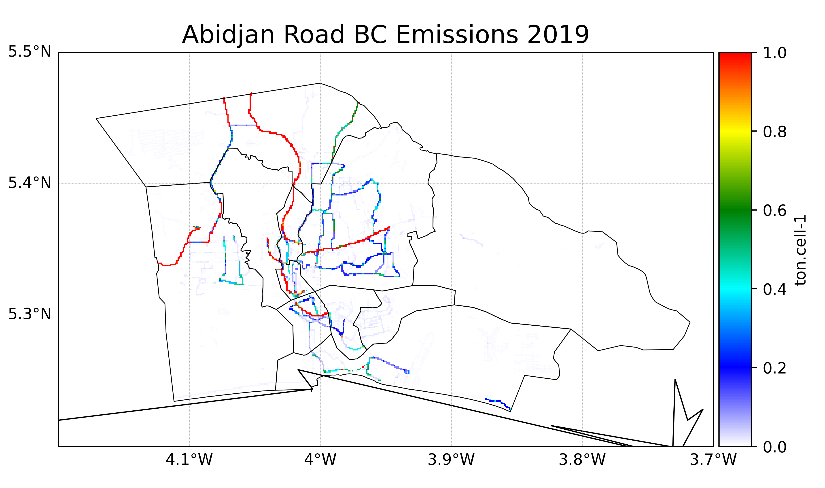
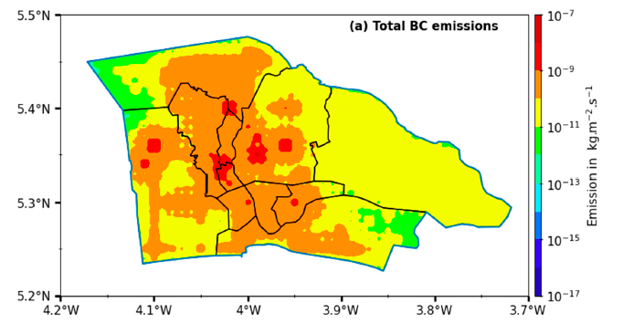
URBAN: Abidjan emission inventory
EMISSIONS SPATIAL DISTRIBUTION
Emissions are spatially allocated to 1 km x 1 km at Abidjan scale
2198.8 tons
Gnamien et al. 2024 Chemical characterization of urban aerosols in Abidjan and Korhogo (Côte d’Ivoire) from 2018 to 2020 and the identification of their potential emission sources,
Environ. Sci.: Atmos., 3, 1741–1757, https://doi.org/10.1039/D3EA00131H
80.4% of emissions on main roads, 17.2% on secondary roads and 2.5% on other types of roads
The highest emissions of the domestic sector are found in densely populated areas

Slide 12
Conclusions
Dacciwav1 provides detailed regional estimates of BC, OC, SO₂, NOx, CO, VOC for the period 1990-2015 in yearly 0.1° x 0.1° maps (available on ECCAD http://eccad.aeris-data.fr/ )
Dacciwav2 provides detailed regional estimates of CO₂ff, CO₂bf, CH₄, BC, OC, SO₂, NOx, CO, VOC for the period 2010-2018 in yearly 0.1° x 0.1° maps including both combustion and non combustion sources (available on ECCAD http://eccad.aeris-data.fr/ )
Provides urban emissions estimates of BC, OC and SO₂ for the period 2014-2019 in yearly 0.01° x 0.01° maps for Abidjan
AFE working group on Africa emissions in GEIA (http://www.geiacenter.org/analysis/working-groups) will allow to gather all regional information specific in Africa to improve emission inventories (next meeting in July 2022).

Slide 13
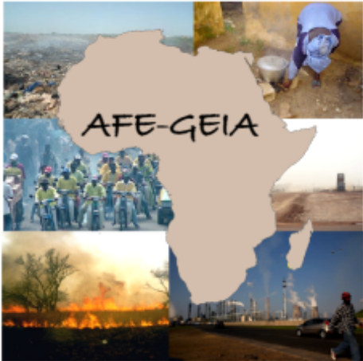
Working group AFrican Emissions (AFE)-GEIA
If you are interested to join AFE group, please contact us !
Contacts:
Sekou Keita: Côte d’Ivoire, sekkeith@yahoo.fr
Mogesh Naidoo: South Africa , mogeshnaidoo@gmail.com
Cathy Liousse : France, cathy.leal-liousse@aero.obs-mip.fr
THANK YOU !

