Slide 1
Integrated observations:
On the importance of continuous/long-term comprehensive observations
Markku Kulmala
University of Helsinki, Finland
INAR/PHYSICS

Slide 2
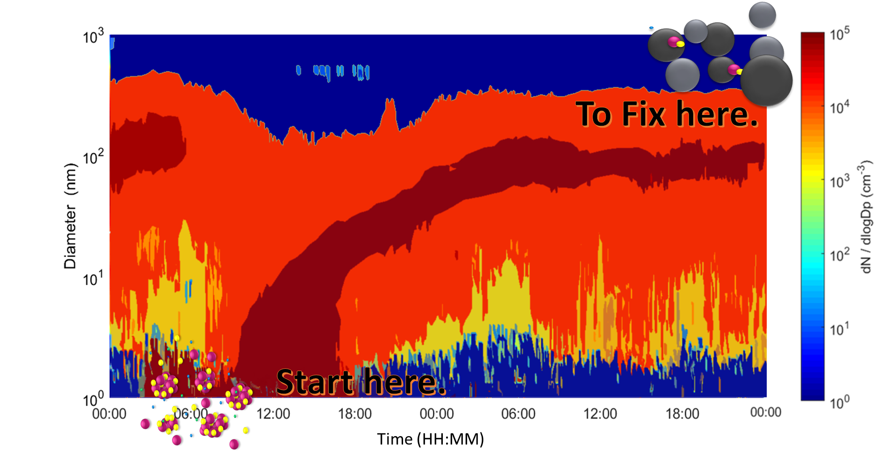
C
Key knowledge gaps
Aerosol size distribution
Haze
Aerosol particle size in diameter (nm)
Vapor condensation
Solution needed
Multiphase chemistry
2/10

Slide 3
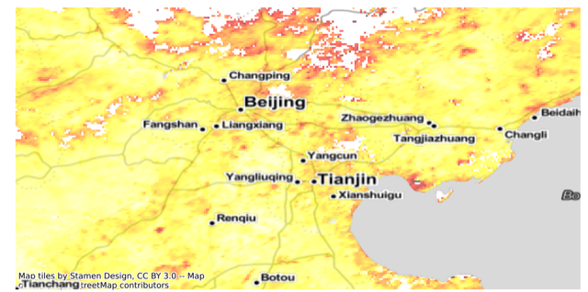
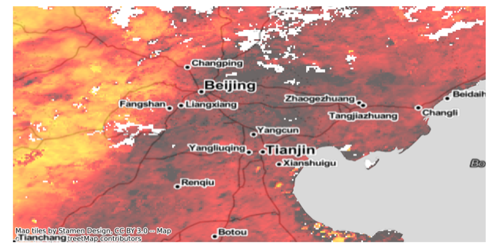
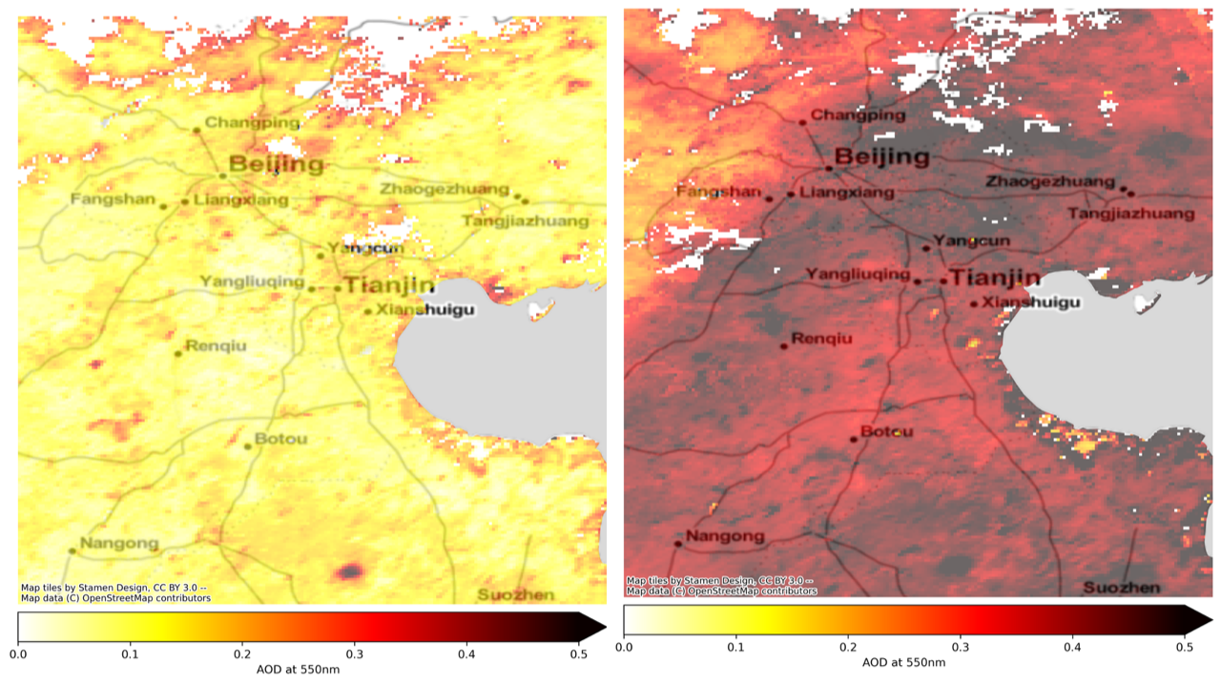
Key knowledge gaps
Aerosol particle size in diameter (nm)
Next day
0.5
22.2.
coupling
23.2.
Meteorology
AOD
Aerosol Optical Depth (AOD, MODIS Satellite)
0.0
3/10

Slide 4
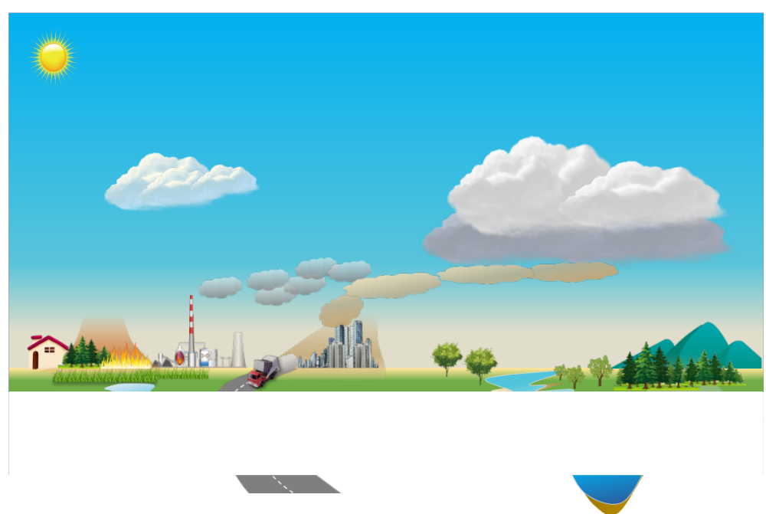
Major Challenge - to understand airborne production
Direct emission
straightforward to cut
Airborne production
    often dominating but difficult to master
very non-linear processes
complex coupling with meteorology & climate
gases
aerosol
particles
aerosol
particles
4/10

Slide 5
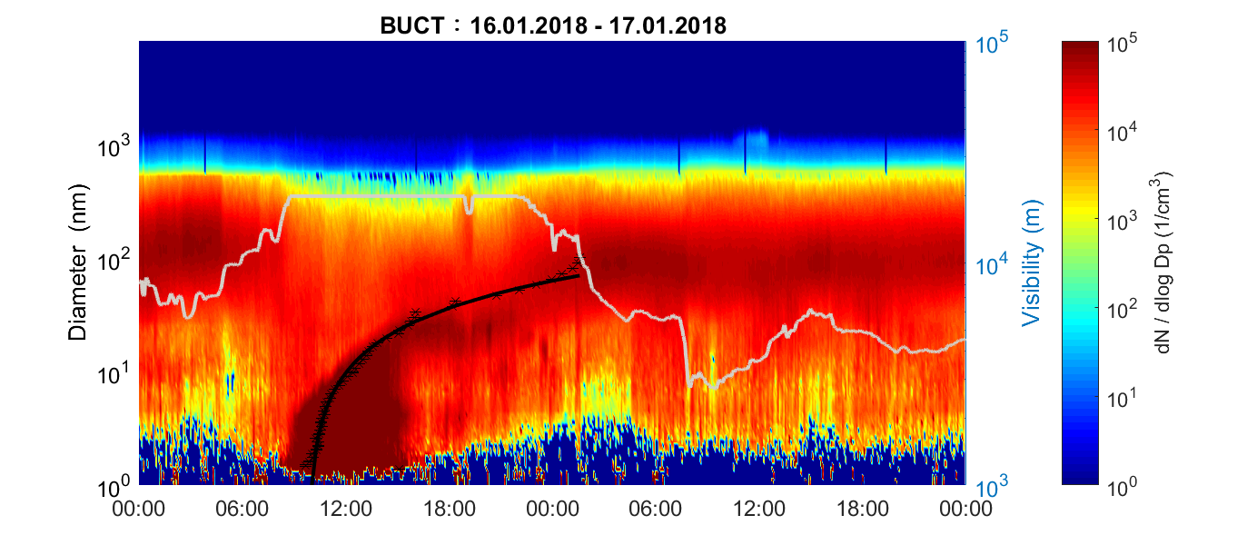

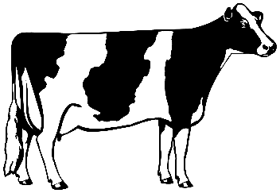

SA + DMA mechanism: Lei Yao et al. 2018
Science
> 80 % airborne
Heterogenous
chemistry
LVOC
H₂SO₄ + DMA
NH₃
Hygroscopity
SO₂
VOCs
Primary particles
NH₃
DMA
DMA
VOCs
BLH - air pollution feedback: Petäjä et al., 2016, Sci Rep
Kulmala et al., 2023, Faraday Discussion

Slide 6


Slide 7

CONTRIBUTION TO Solving GRAND CHALLENGES
We have natural greenhouse effect
  Without it the mean surface T ca - 18 ºC
  Now ca 14 ºC
  Climate is changing but how?
Climate
change
DISCIPLINES
Natural Sciences
Social Sciences
Medicine
Technology etc
PEEX / IEAS / TWAS Science Diplomacy; Open data
WMO/GAW Global SMEAR ICOS, ACTRIS, eLTER
From ideas to implementation
Earthquakes
Volcanoes
Air quality
Energy
Fresh water
Biodiversity
loss
Ocean
acidification
Epidemic
diseases
Deforestation
Food supplies
Chemicalisation
Demography / Population /Urbanization

Slide 8
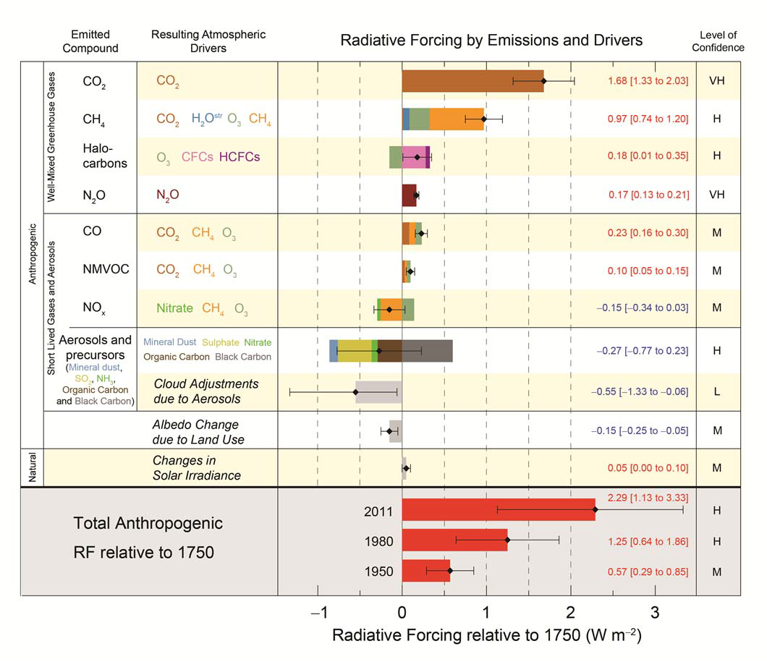
INTEGRATED APPROACH:
THE GLOBAL EARTH OBSERVATORY / GLOBAL SMEAR
Current observations (see IPCC 2013) are fragmented:
Greenhouse gases
Aerosols
Air quality
Ecosystems
Climate
…
Future aspiration: Integrated approach
  To understand feedbacks
  To reduce uncertainties
  To mitigate and adapt effectively

Slide 9
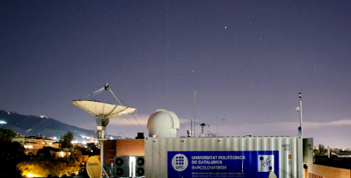
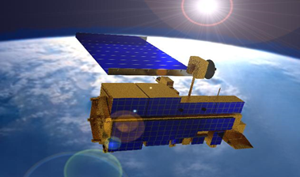
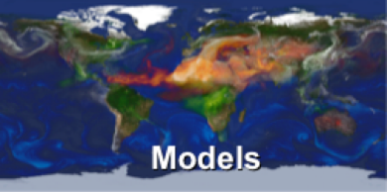
MULTIDIMENSIONAL, MULTIDISCIPLINARY, MULTISCALE APPROACH TO ANSWER GRAND CHALLENGES
Ground-based data
Satellite data
Clear and ambitious vision / from deep understanding to practical solutions
Empirical measurements and modelling /
from observations to new theories
From research to innovations /
economic growth and human wellbeing
Provides details
CURRENT STATE
• Initial Conditions
• Assimilation
Provides context
Complete
the picture
Multiscale Models

Slide 10
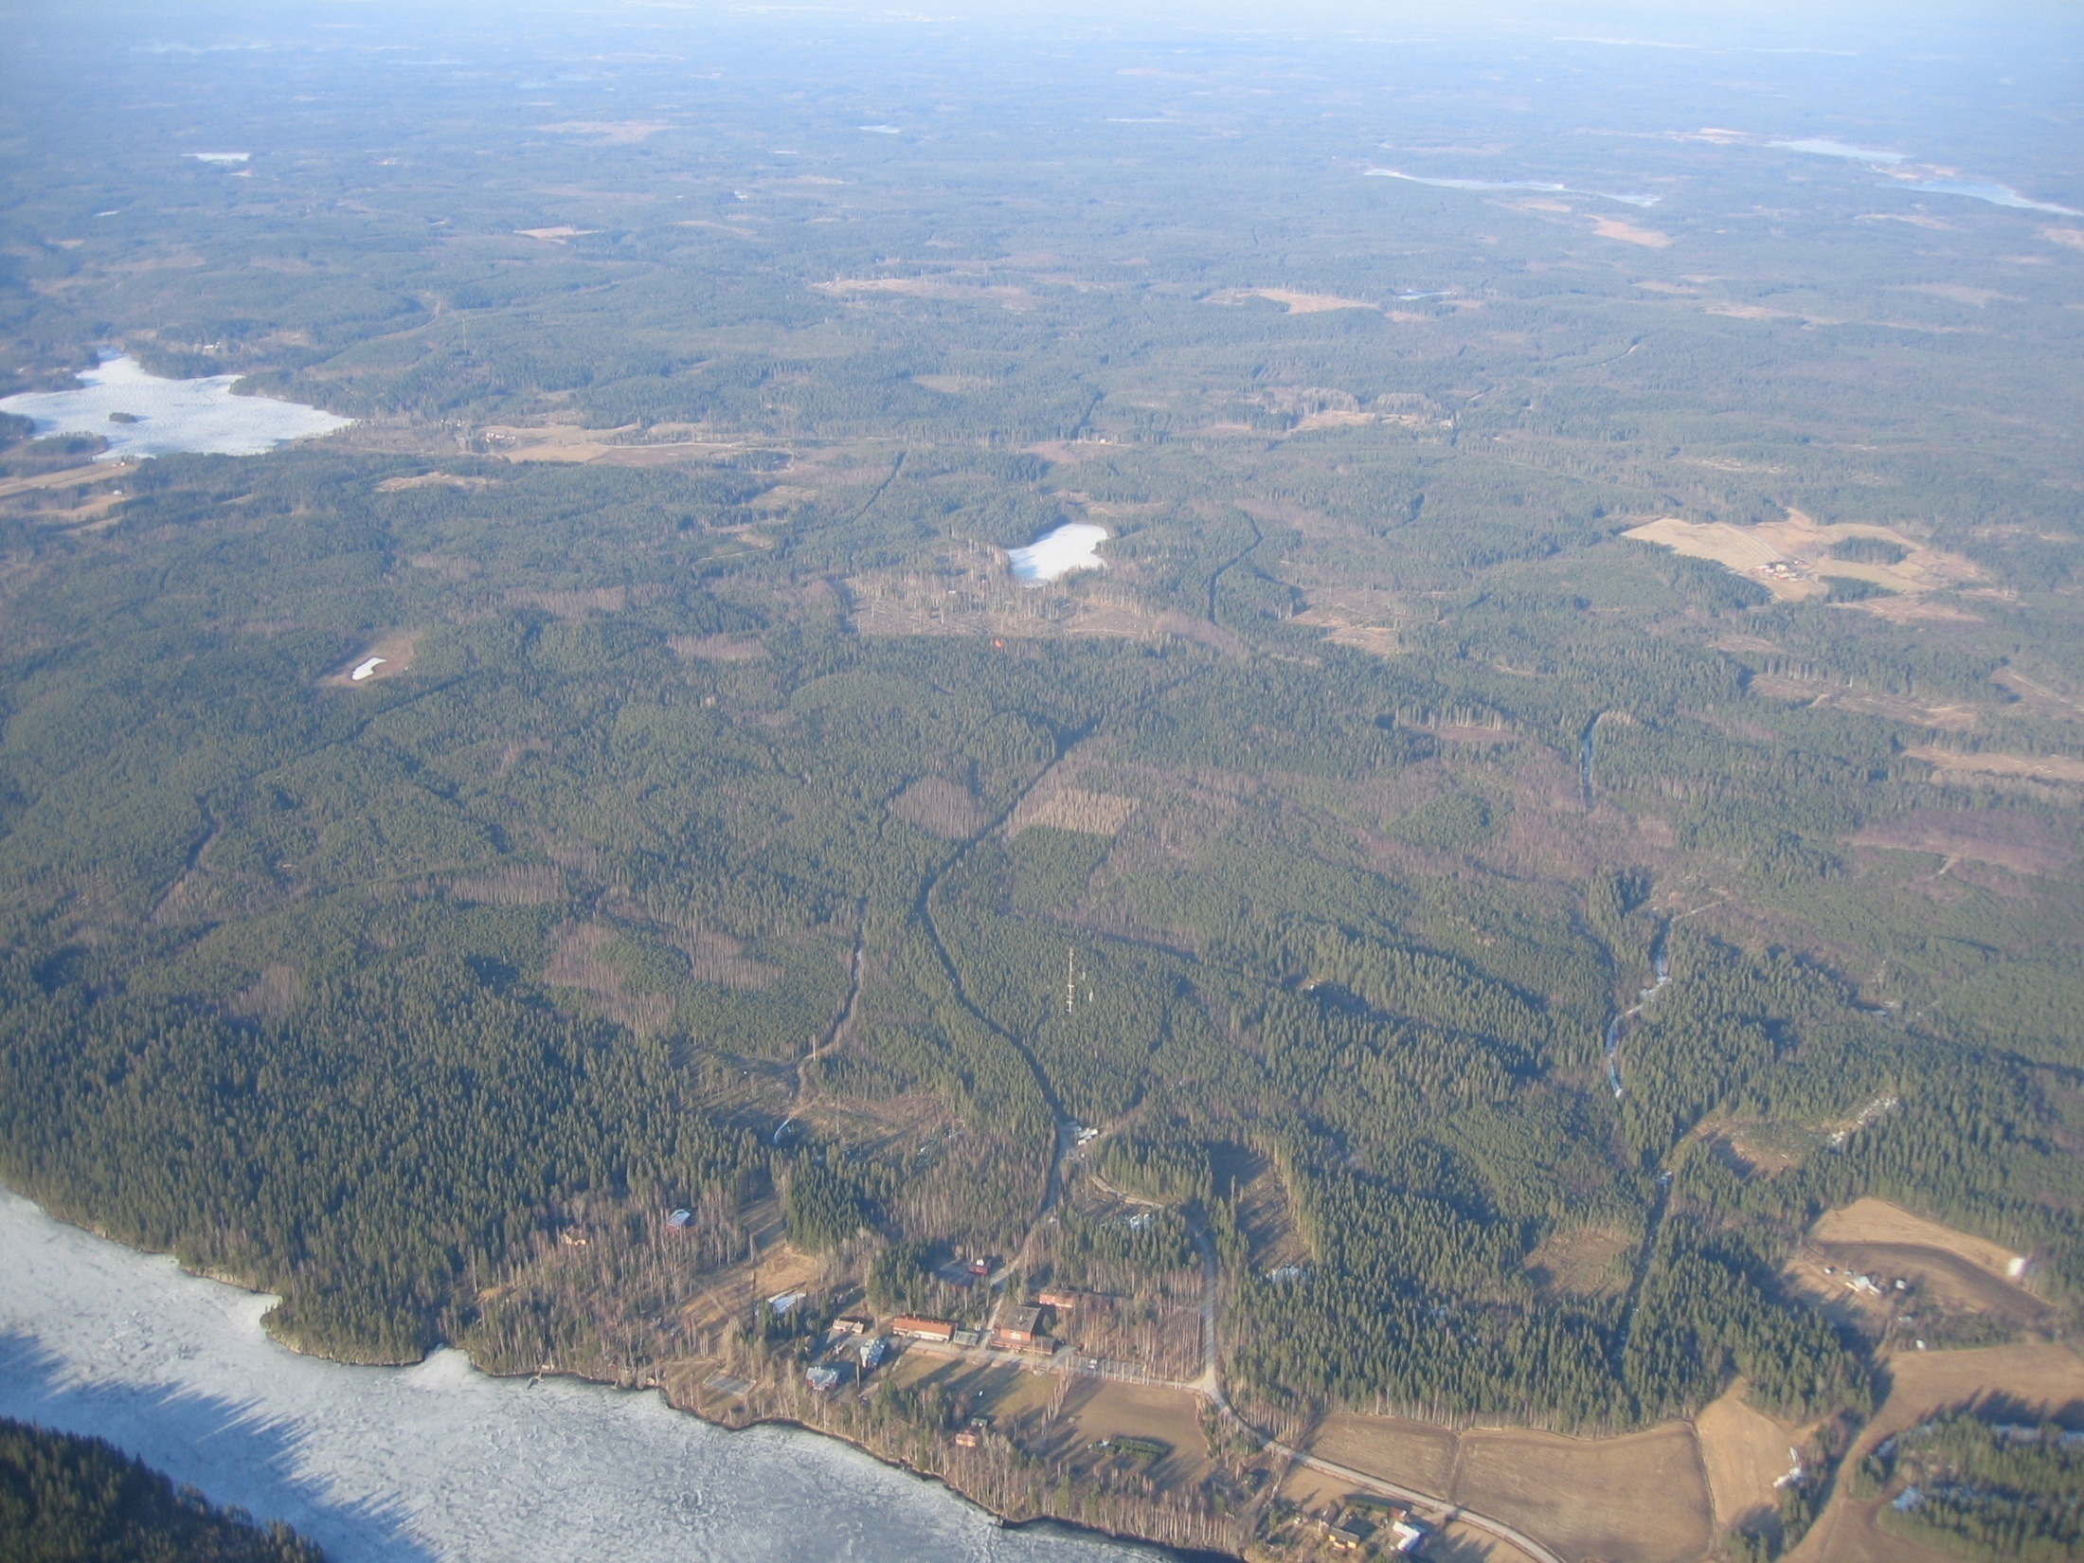
SMEAR II-station (boreal forest, country side)

Slide 11
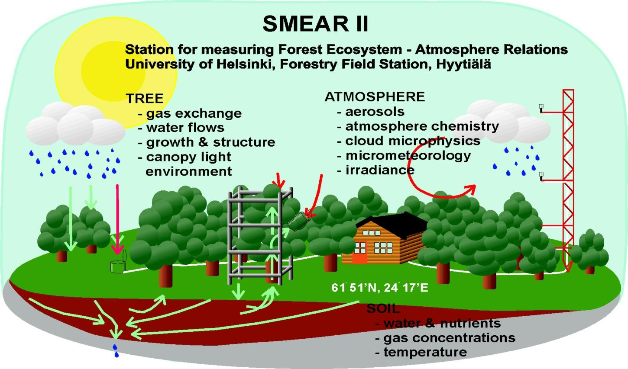
CONTINUOUS, COMPREHENSIVE OBSERVATIONS
  SMEAR II: Big Data
  1 min data:
  > 1e10 points
  1 s data:
  > 7e11 points
  10 hz flux data
Over 1200
different
variables
Lakes
URBAN
Peatlands
Site for ICOS, ACTRIS, eLTER, ANAEE, LifeWatch, …
Also WMO, EMEP, CARBOEUROPE, NITROEUROPE, EUCAARI, PEGASOS, …

Slide 12
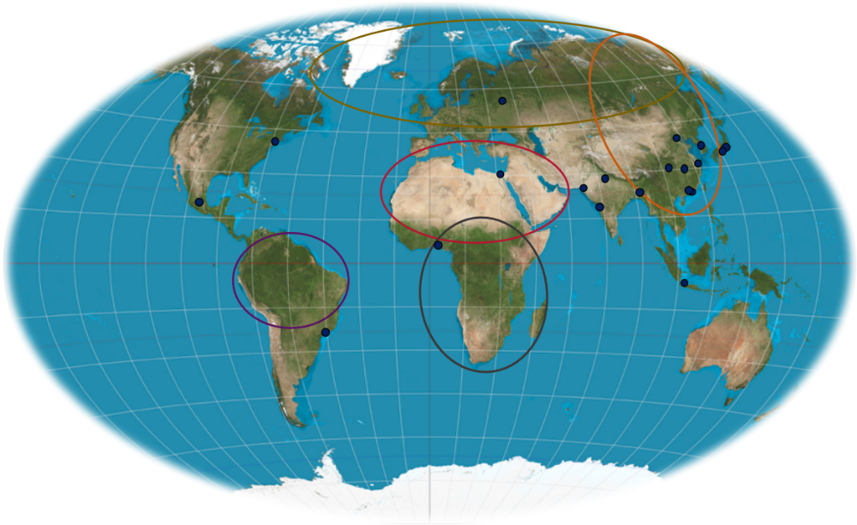

THE POTENTIAL OF SMEAR CONCEPT:
GLOBAL COMPREHENSIVE FEEDBACK ANALYSIS
Clouds
aerosol effects
+ 6 %
Diffuse radiation
Global Radiation
+ 1.5 %
Photosynthesis
Carbon sink
Volatile organic compounds
+ 6 %
CARBON SINK PLUS
VOCs, Aerosols, clouds, precipitation, albedo
Max 1.8 x carbon sink (Hyytiälä / SMEAR II results)
Uncertainties
=> observations / models
Arctic-Boreal PEEX area
Eastern Asian PEEX area
Amazonas
Sahara + EMME region
Africa
20 largest metropolitan areas
+ 0.7 %
CO₂
+ 10 ppm
+ 8 %
Kulmala et al., 2014, BER

Slide 13

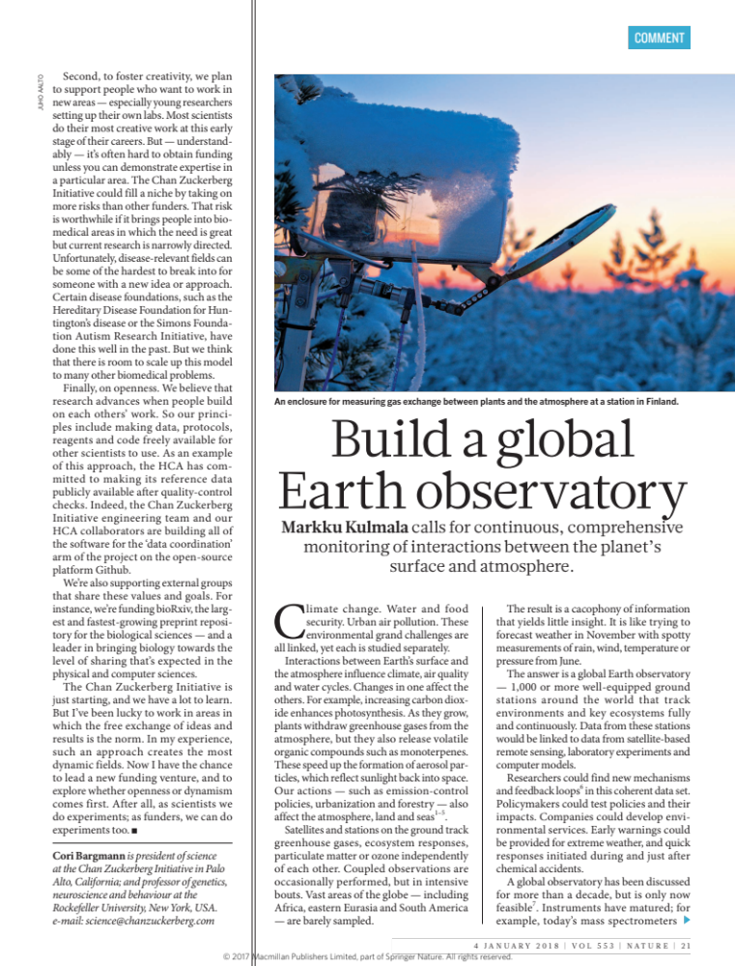
Nature (2015), Nature 526, 497–499 Nature (2018), Nature 553, 21–23
To meet global grand challenges: The answer is a global Earth observatory — 1,000 or more well-equipped ground stations around the world that track environments and key ecosystems fully and continuously
Researchers could find new mechanisms and feedback loops in this coherent data set
Policymakers could test policies and their impacts
Companies could develop environmental services
Academician, Professor Markku Kulmala
University of Helsinki, Faculty of Science, Institute for Atmospheric and Earth System Research (INAR) / Physics
markku.kulmala@helsinki.fi

Slide 14
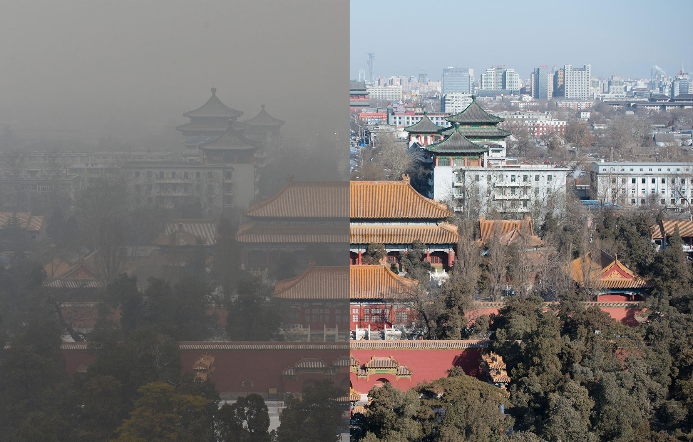
Beijing, China

Slide 15
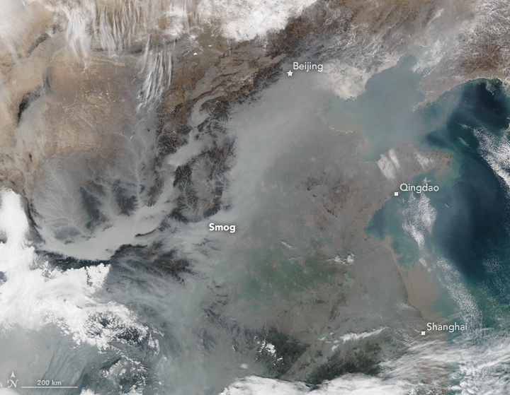

Slide 16
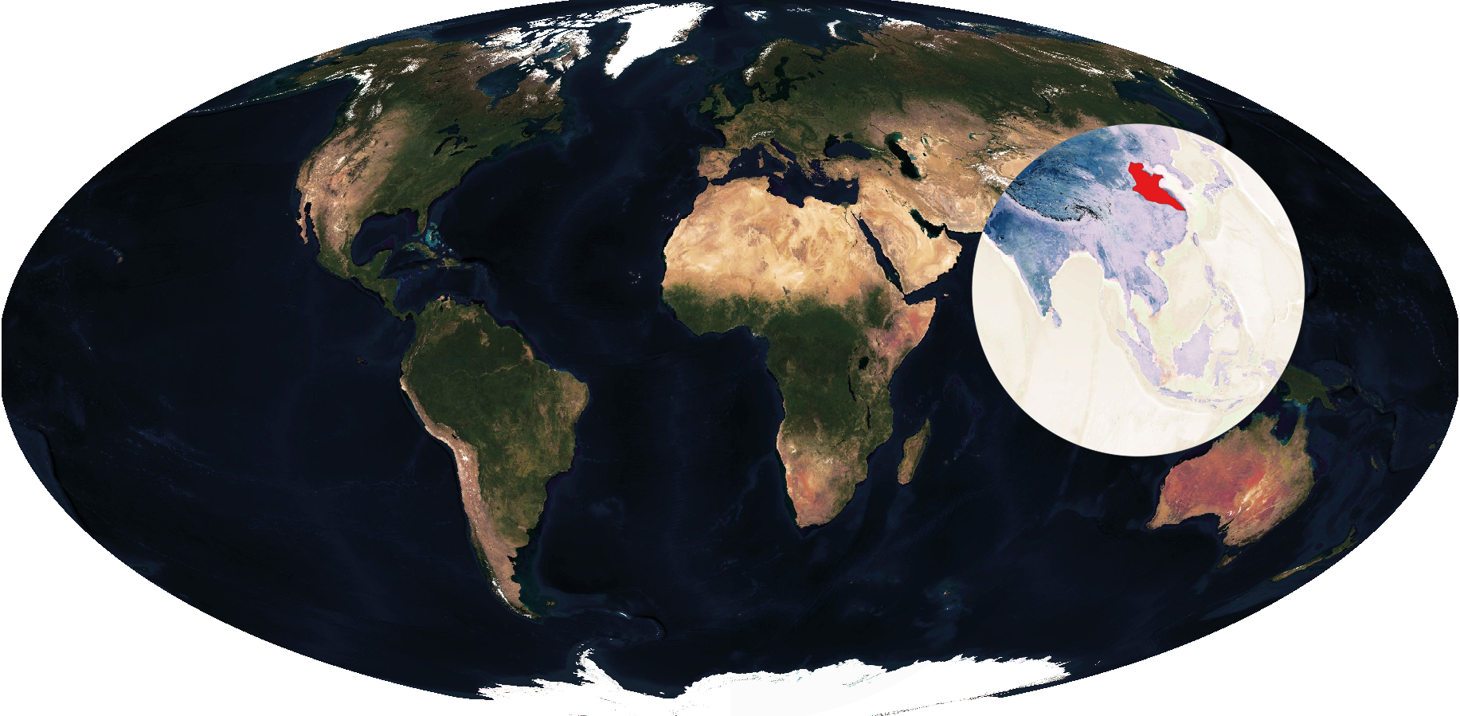
China Gigacity - A living lab for haze study
10% of global population
Beijing
Xi’an
Shanghai
Knowledge for global development, especially global south
Kulmala & Ding et al., 2021, ACP; MODIS
16/10

Slide 17
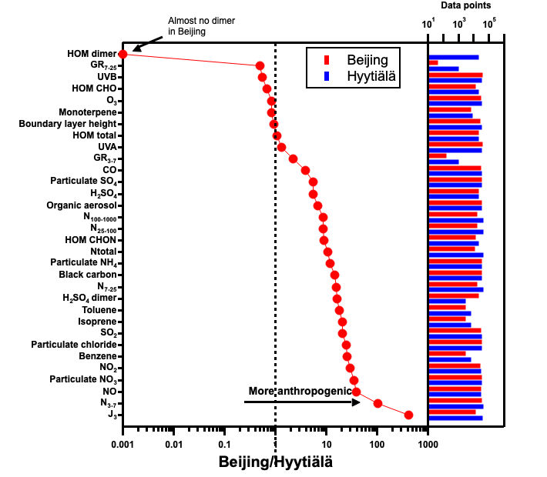
Beijing vs Hyytiälä Polluted / Clean

Slide 18
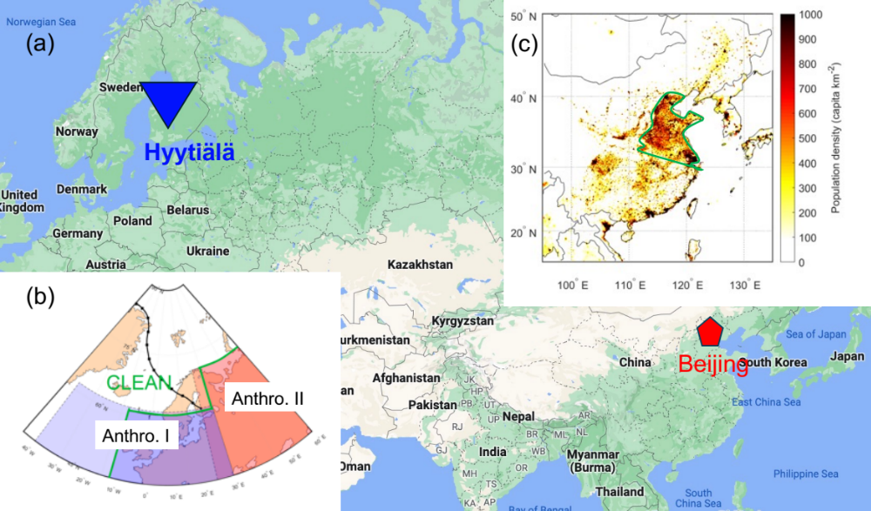

Slide 19
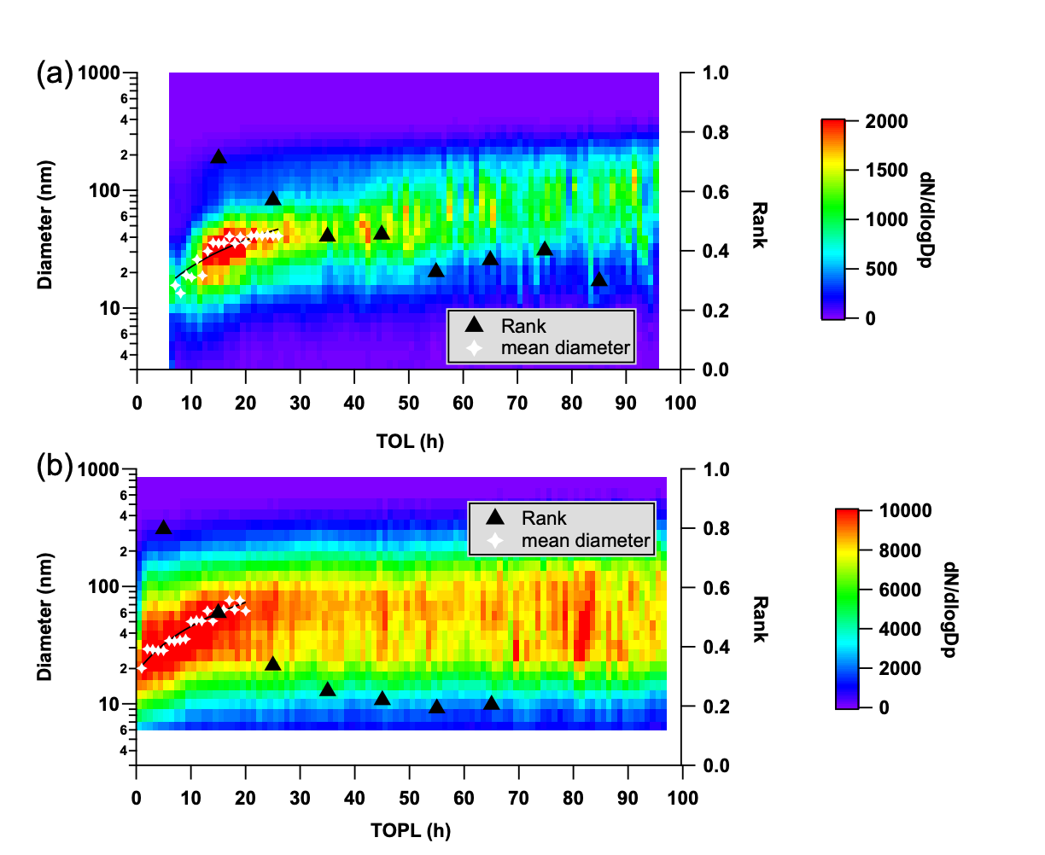
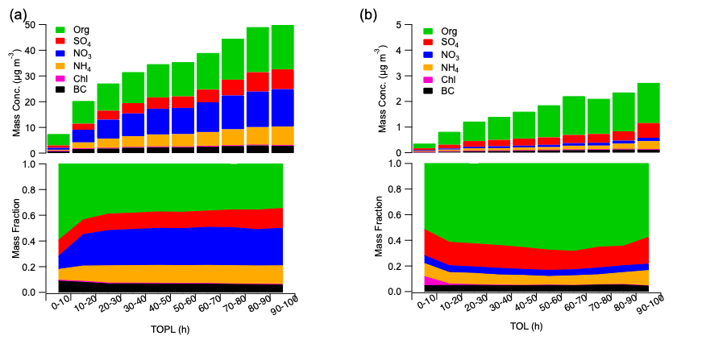
Time over land / Time over polluted land

Slide 20
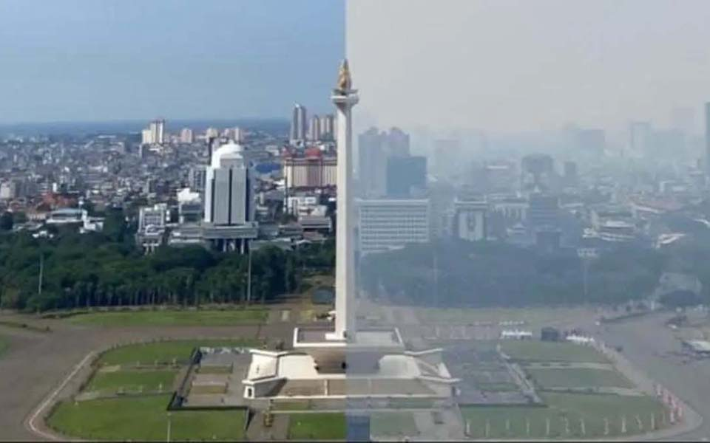
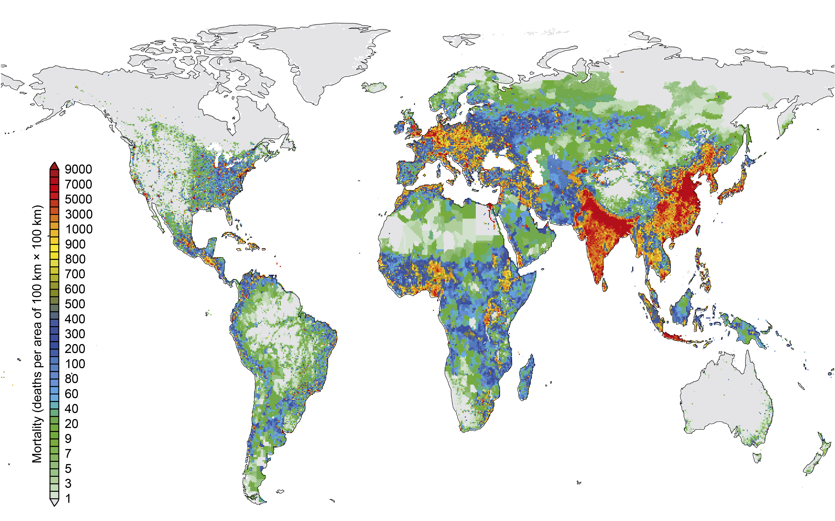
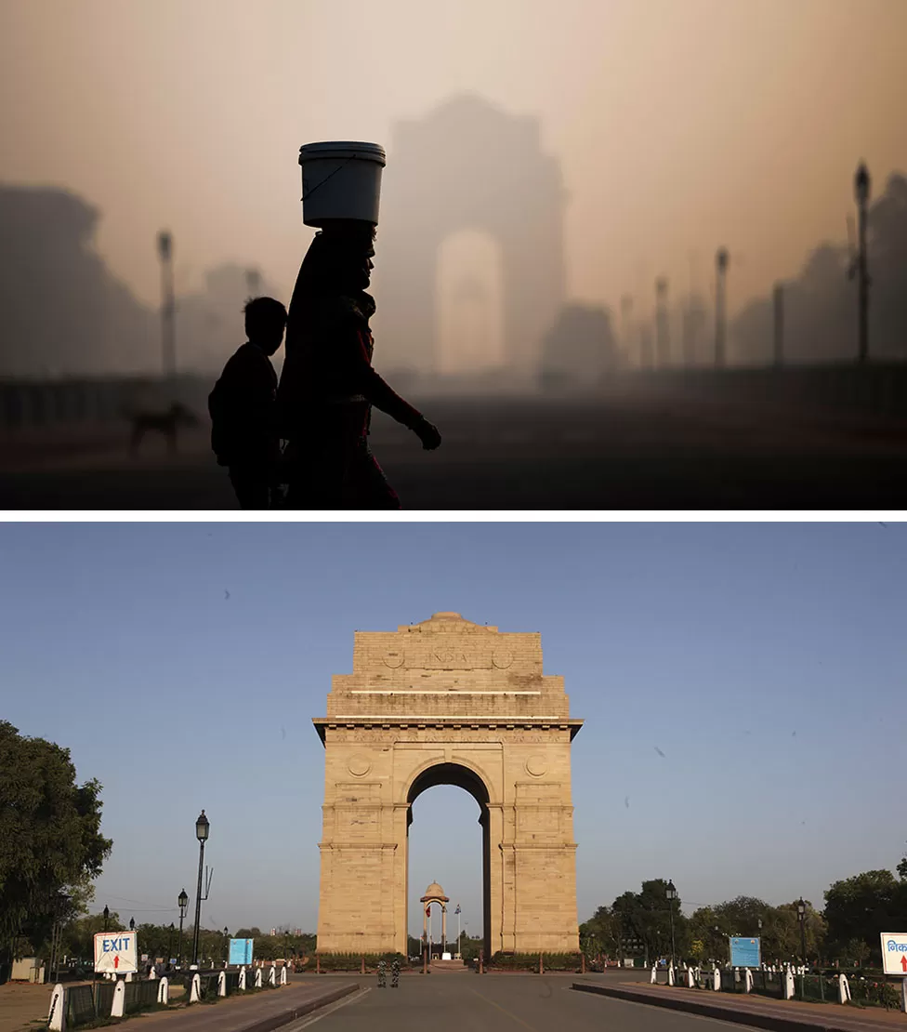
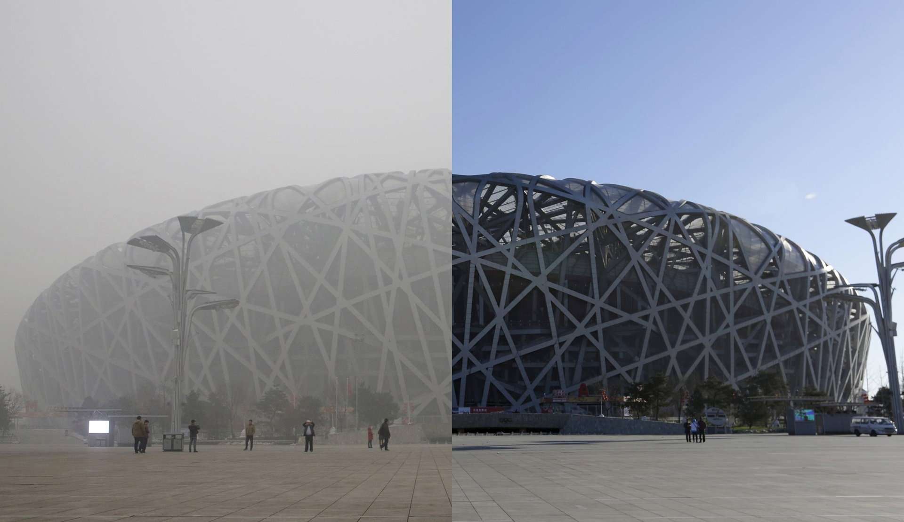
Haze - Air Pollution “Cocktails”
Atmospheric aerosol particles with strong health and climate impact
Up to 9 million pre-mature deaths caused by aerosol pollution in 2019
Haze vs. clear blue sky
Jakarta
Delhi
Beijing
Aerosols remain the largest uncertainty in climate assessment (IPCC, 2021)
Ni & Cheng 2023; Burnett PNAS 2018; GBD Lancet 2020
20/10

Slide 21
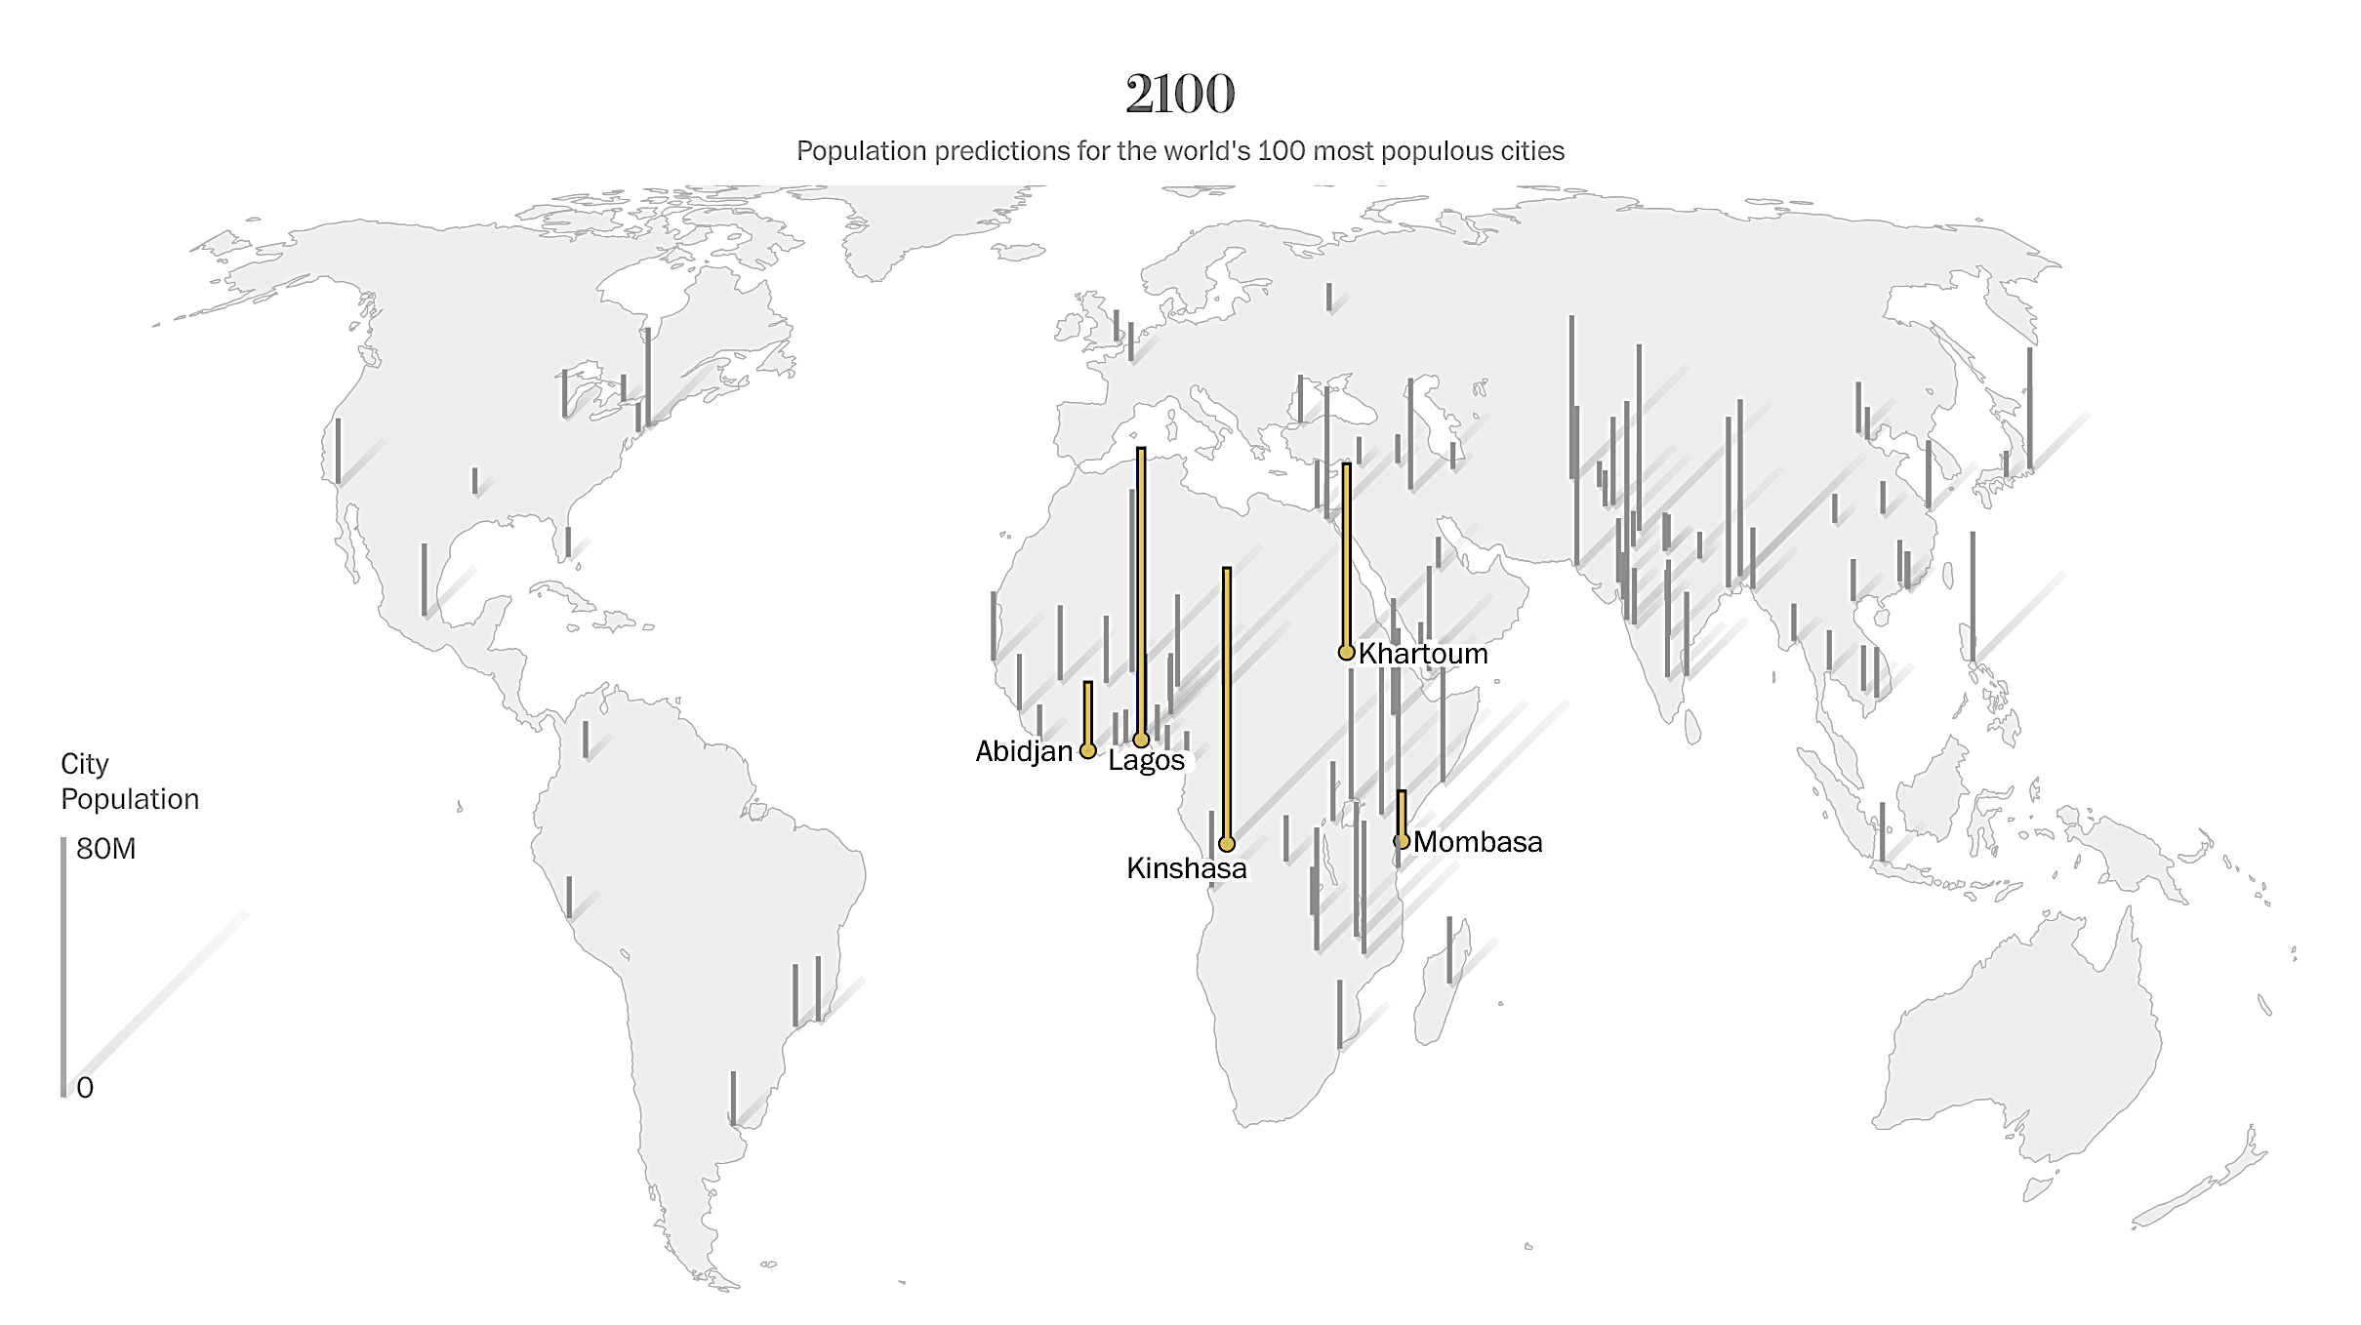
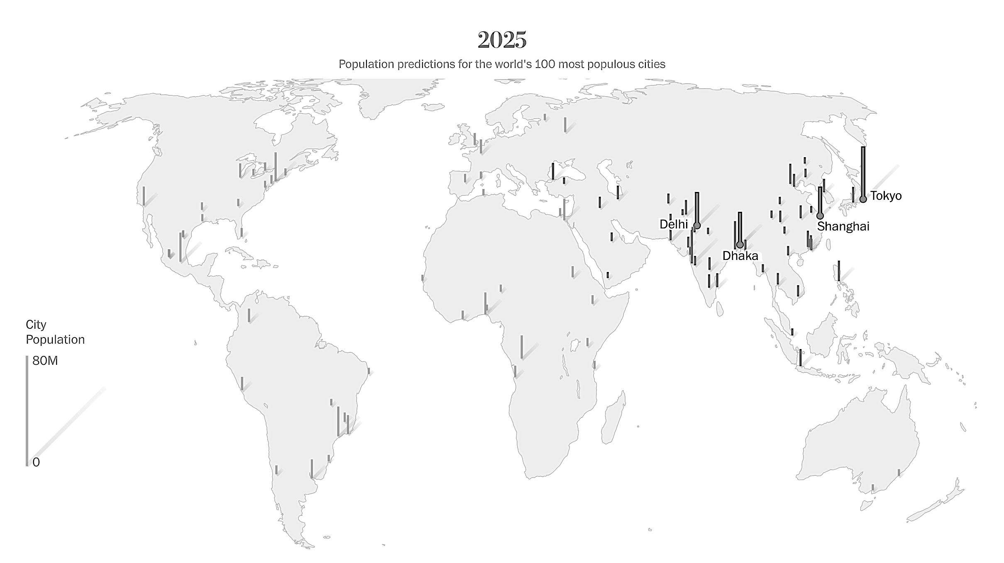
China Gigacity - Paradigm for other global gigacities
Knowledge for global development, especially global south
DANIEL HOORNWEG and KEVIN POPE, Population predictions for the world’s largest cities in the 21st century, Environment & Urbanization, 2016.
https://journals.sagepub.com/doi/pdf/10.1177/0956247816663557

Slide 22
https://twas.org/
The World Academy of Science
Members over 120 different countries
Potential for very big impact in Global Grand Challenges
Climate expert education (Ph.D. level) with local Universities

Slide 23
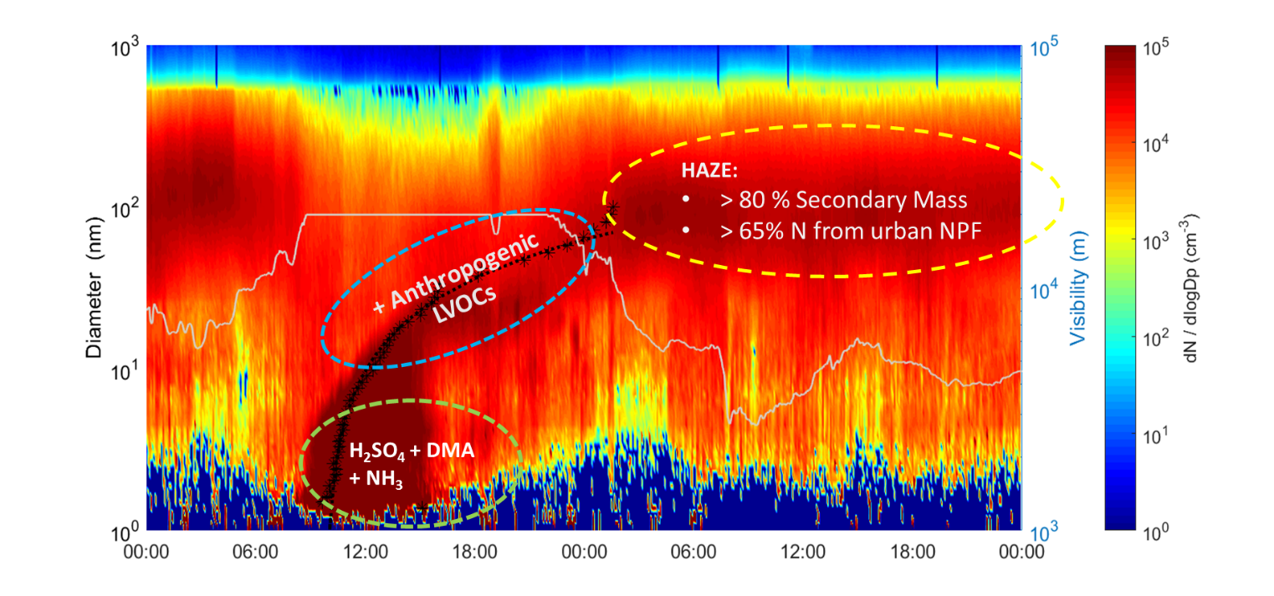
HAZE FORMATION
+Nitrates
Kulmala et al., 2021, Faraday Discussion

