Slide 1



Air Quality Management Case studies:
Challenges and Lessons Learned
Training Course on Seamless Prediction of Air Pollution in Africa​
Science Workshop, September 30, 2024
Luisa T. Molina

Slide 2
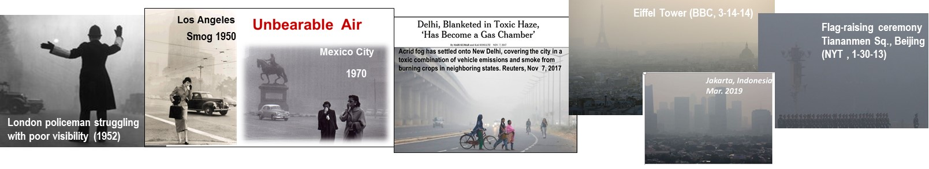
Poor air quality is a common problem in cities and urban complexes
Eiffel Toer (BBC, 3-14-14)
A flag-raising ceremony in Tiananmen Square, Beijing (NYT , 1/30/13)
Flag-raising ceremony Tiananmen Sq., Beijing (NYT , 1-30-13)
1970
London policeman struggling with poor visibility (1952)
London Killer Fog,
Dec 1952
Urban air quality is strongly influenced by several factors, including geographical location, demography, meteorology, atmospheric processes, and the level of industrialization and socioeconomic development.
Although some regions around the world have achieved substantial progress in tackling air pollution, many cities are still struggling with environmental degradation, air pollution, traffic congestion, inadequate urban infrastructure, and lack of basic services for their residents.
Maintaining economic growth, while creating sustainable livable cities for all, is the biggest challenge facing many cities today.
As centers of economic growth, social and cultural activities, higher education, and technology innovation, these cities also offer unique opportunity to manage the growing population sustainably while reducing air pollution, minimizing greenhouse gas emissions, and bringing many social benefits.
Learning from the experiences and good practices in other regions is important.

Slide 3
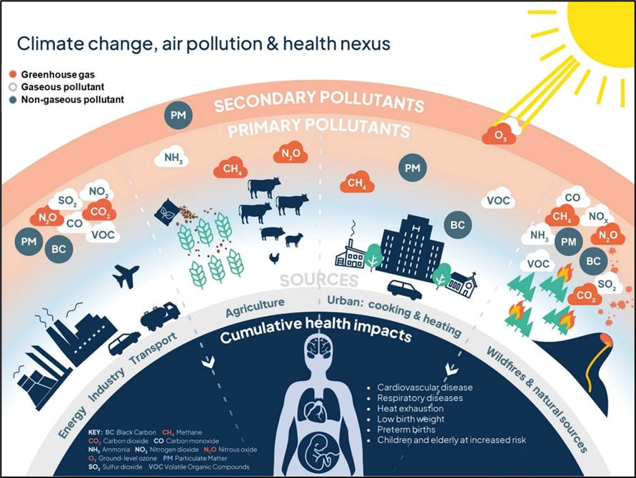
Air pollution, climate change and health risks
Emissions around the world are caused by a wide variety of anthropogenic and natural sources.
Many of the same sources emit both air pollutants and greenhouse gases.
The emitted species can undergo complex atmospheric processing, e.g., NO_{x} and VOCs are transformed in the presence of sunlight to produce O₃ and secondary PM.
Air pollution has short- and long-term impacts for human health, including respiratory disease, stroke, and heart attack. Low-income and rapidly industrialized countries are worst affected.
Air pollution and climate change are closely interlinked, including emissions sources, atmospheric chemistry, and impacts on human health and ecosystems.
Simultaneously addressing the two issues would deliver health and environmental benefits.
(Figure: adapted from Centre for Climate Engagement, University of Cambridge, UK.
https://climatehughes.org/expert-briefing-air-pollution-health-risks-and-climate-change/, Sep 2023)

Slide 4
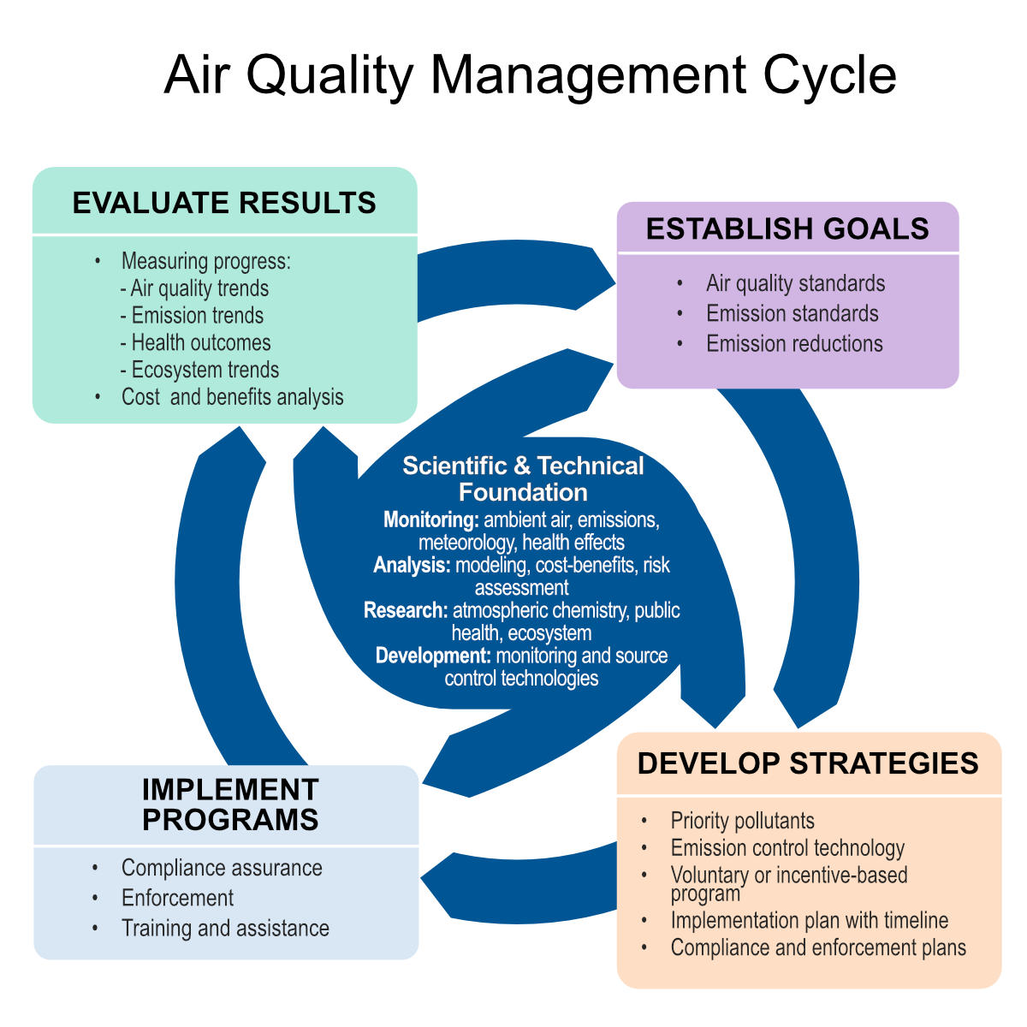
Air quality management process
AQ management is an iterative and dynamic process represented as a cycle of inter-related elements.
A government agency typically establishes goals related to air quality and determines emissions reductions needed to achieve the goals.
In developing control strategies, AQ managers consider how pollution prevention and emission control techniques can be applied to achieve the reductions.
In implementing the pollution control strategies, it is necessary to enforce the rules and regulations, provide training and assistance.
It is essential to continuously evaluate the effectiveness of the strategies and the progress towards meeting the air quality goals.
A key element in this cycle is the contributions of scientific research that provide AQ managers with fundamental knowledge to make informed decisions.
(Adapted from NRC, 2004 and Bachman, 2007)

Slide 5
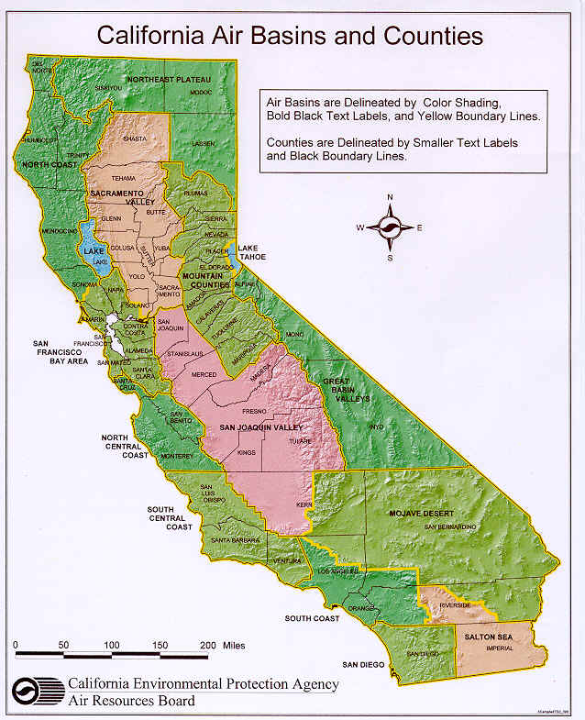
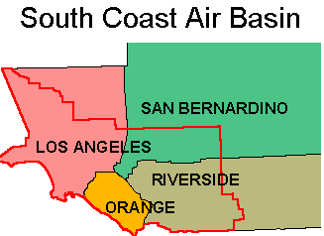
Los Angeles Metropolitan Area: Factors affecting the air quality
Population
Los Angeles Metropolitan Area (Los Angeles & Orange counties) ~13 million
South Coast Air Basin (SoCAB) ~18 million
Geography and meteorology confine air pollutants
SoCAB is bordered by Pacific Ocean on the west and mountains on the other three sides, which limit horizontal ventilation.
During the summer, the basin is under the influence of a large-scale subsidence inversion that traps a layer of cool marine air. Pollutants emitted from various sources are pushed inland during the day by an
on-shore sea breeze, where they undergo photochemical reactions and generate ozone and other products.
Urban sprawl
Major commercial, financial, and cultural institutions are geographically dispersed; vast network of interconnected freeways.
Transportation plays a major role in air quality problems and GHG emissions.
(L.T. Molina, Faraday Discussion, 2021)

Slide 6
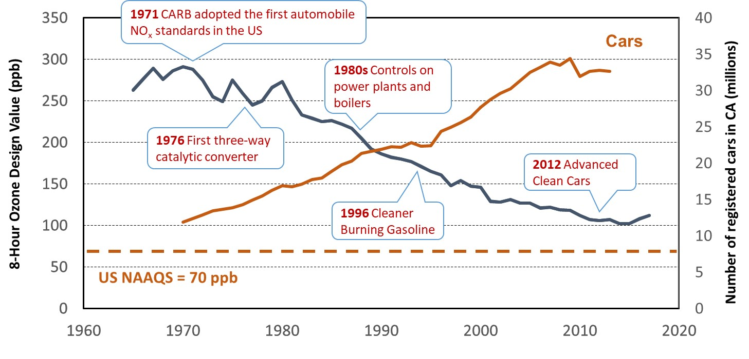
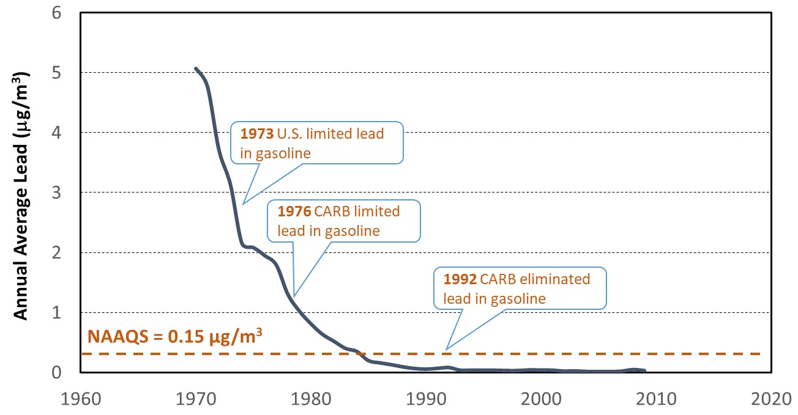
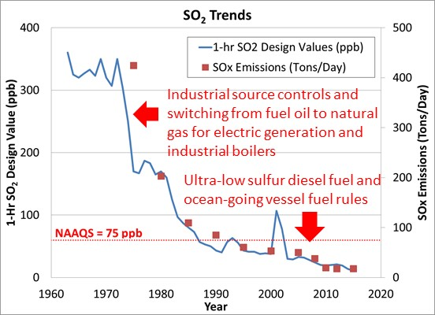
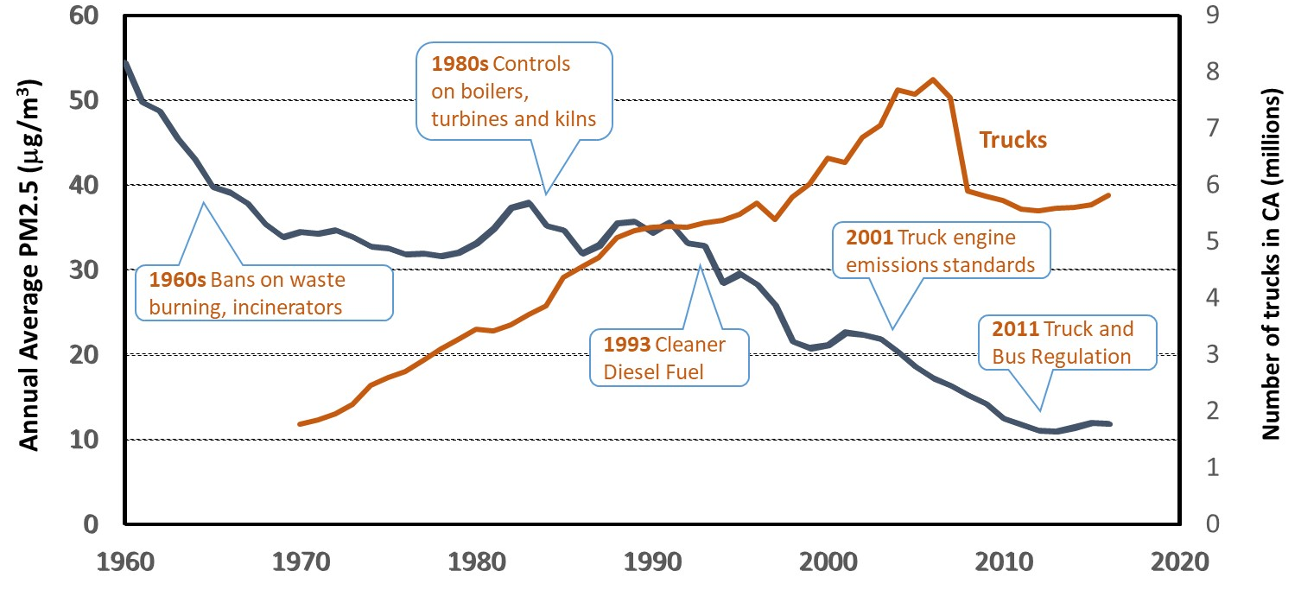
Air quality evolution in Los Angeles
(Credit: B. Croes)

Slide 7
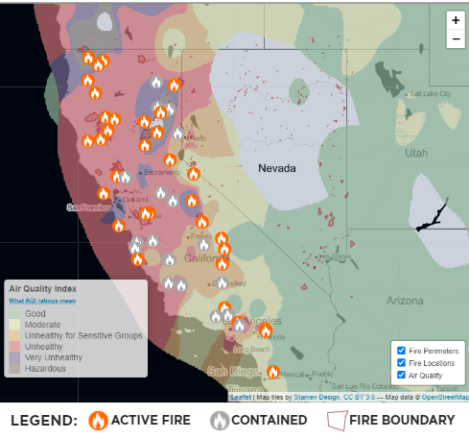
Los Angeles Basin Air Quality: On-going Challenges
Substantial fraction of O₃ in Southern California is transported into the region from outside its border which is not subject to local control. This includes O₃ transported from the Pacific, production from natural O₃ precursors from trees, lightning, wildfires, etc.
Transport-derived emissions of volatile organic compounds (VOCs) have decreased due to strict vehicular regulations, while emissions from volatile chemical products such as paints, cleaning agents, coatings and personal care products have increased.
Fire location and Air Quality (Sept 11, 2020)
While contributions of tailpipe emissions to particulate matter in the LA basin have reduced because of increasing stringent standards for exhaust emissions, those of non-tailpipe (brake and tire wear, road dust resuspension) emissions have increased, suggesting the need to regulate non-tailpipe emissions.
Wildfires in California have markedly increased, worsening air quality in much of the region. A warmer and drier climate is expected to lead to more frequent and more intense fires near or within the populated areas. Long-term monitoring and reevaluation of forest management strategies will be needed.
2020 - largest wildfire season recorded in California
(10,000 fires burned over 4.2 M acres)
(Sources: https://ww2.arb.ca.gov/; https://www.aqmd.gov/; L.T. Molina, 2021)

Slide 8
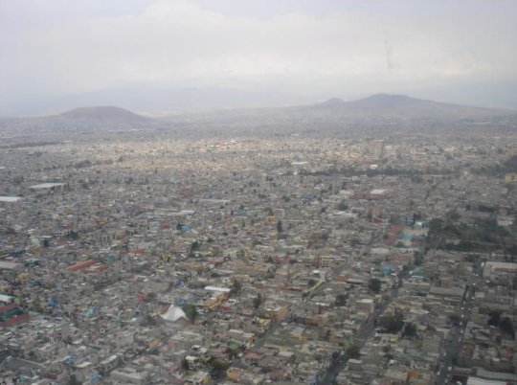
Mexico City Metropolitan Area: Factors affecting air quality
Topographical map showing urban expansion
Population growth
  > 21 M: 25-fold increase since 1900
  High population density
Urban sprawl
  CDMX: 1500 km², 10x increase since 1960
  Expansion to peripheral areas
  Geographic and topographical conditions
  High altitude (2240 m); Sub-tropical climate; Strong sun insolation
  Mountains on three sides - physical barrier for winds
  Temperature inversions in dry season
Increase in emissions sources
5.7M vehicles (81% private cars, 13% freight trucks, 6% public transport)
6 million households
High concentration of industrial and commercial activities
Regional transport of pollutants
Coordination with neighboring states with different jurisdictions
Population of the MCMA = 21.8 M
Mexico City (CDMX, national capital, 16 boroughs): 9.2 M
State of Mexico
(59 municipalities): 12.4 M
State of Hidalgo
(1 municipality): 170 K
(Source: SEDEMA, IE 2020)

Slide 9
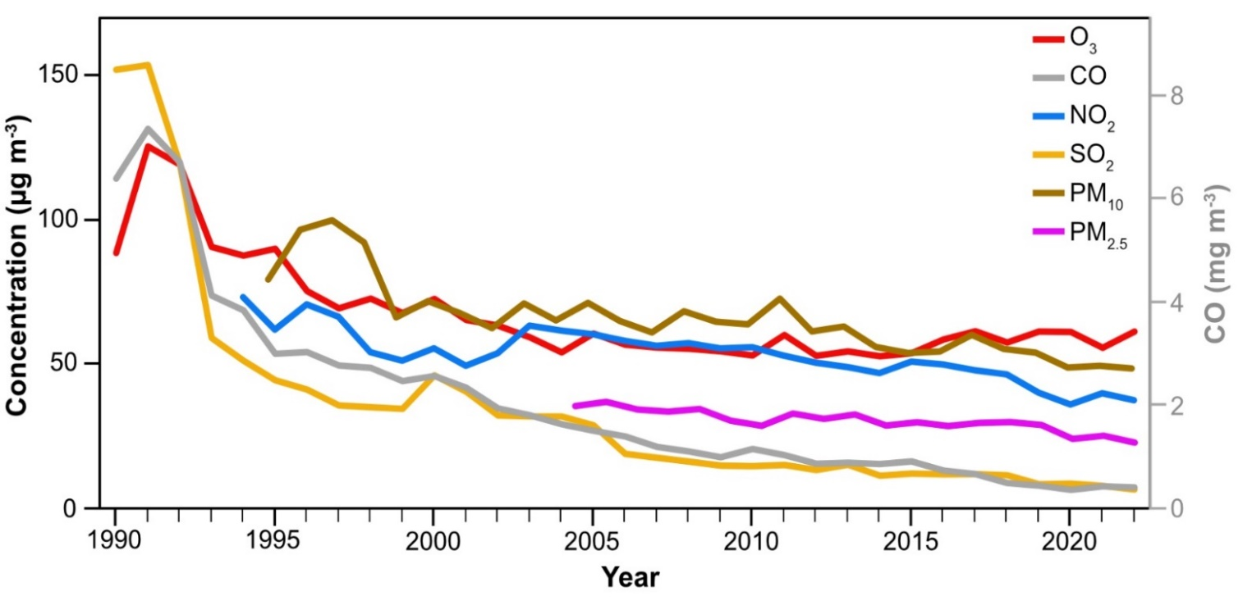
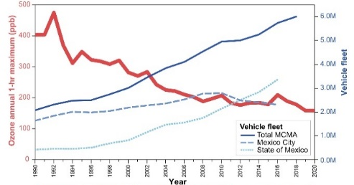
MCMA: Air Quality evolution and improvement actions
Late 1980s - early 1990s:
  All criteria pollutants frequently exceeded AQ Standards
  Actions taken starting in late 1990s Significant reduction in all criteria pollutants
  However, O₃ and PM still above AQ standards.
Transportation
Remove lead from gasoline
Mandatory use of catalytic converters in cars
Reduce sulfur content in diesel fuel
Strengthen vehicle inspection and surveillence
Promote cleaner and energy efficient vehicles (hybrid, electric)
Implement air pollution contingency program
Mandatory “no driving day” programs
Promote public transportation and bike sharing
Industrial and residential sectors
Substitute fuel oil in industry and power plants with natural gas
Reformulate LPG (cooking & water heating)
Promote solar water heating
Closing of oil refinery
Relocate high polluting industries
Air pollutants annual averages
(Source: SIMAT, SEDEMA)

Slide 10
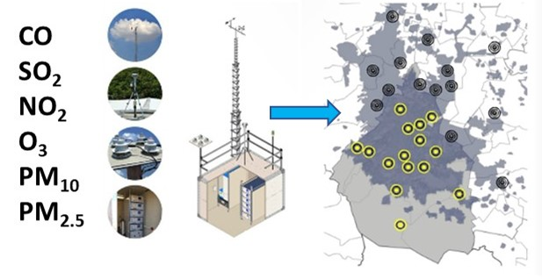
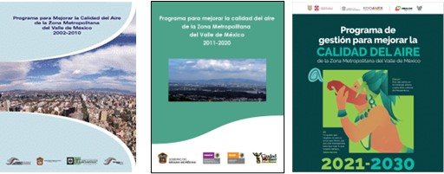
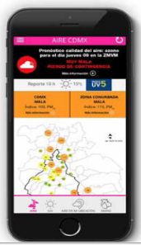
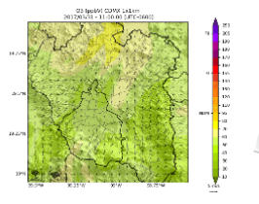
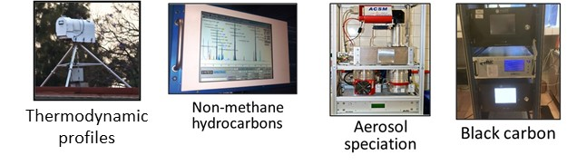
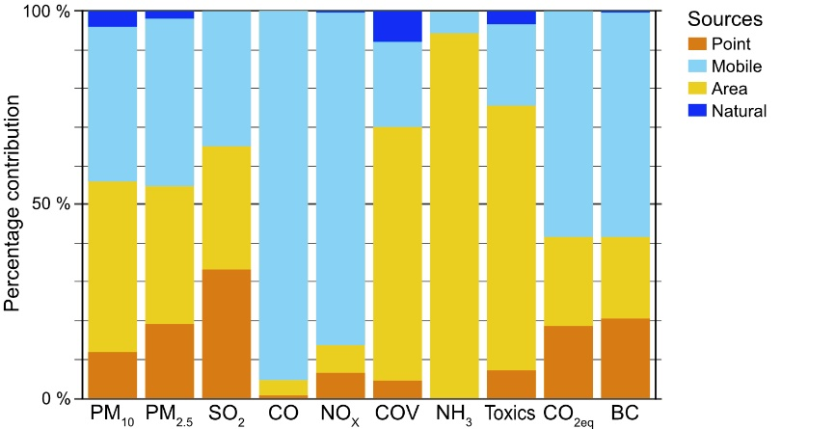
Air quality management tools in the MCMA
Air quality monitoring network
Air Quality Improvement Program (ProAire)
Updated every 10 years
Air quality forecasting
Hourly updated for the next 24 hours.
WRF-ARW + CMAQ
Air quality index, O₃, PM_{2.5}, NO₂, SO₂, CO, & met data
SIMAT Environmental Laboratory
Emissions inventory
Risk Index for Susceptible People (IRPS)
Collaborate with Health Sector in epidemiological and exposure assessment
Special studies
Collaborate with national and international researchers
updated
every 2 yrs
(Source: SEDEMA)

Slide 11
Science-based air quality management
  Intensive international collaborative field measurement campaigns
  1994: Mexico City Air Quality Research Initiative (MARI Project)
  1997: IMADA-AVER Boundary Layer Experiment in the Mexico City Area
  2000: Project for the design of an integrated strategy for the air quality management in the Valley of Mexico
  2001–2010 (Air Quality in the Mexico Megacity: An Integrated Assessment, 2002).
  2002-2003: MCMA-2002 and MCMA-2003 campaigns (Special issue in Atmos. Chem. Phys)
  2006: Megacity Initiative: Local and Global Research Observations (MILAGRO)
  (Special issue in Atmos. Chem. Phys)
  2013: Short-Lived Climate Forcers Field Measurement Campaign (SLCF)
  Field studies by Mexico City government (SEDEMA) and National University (UNAM)
  SEDEMA field studies: Aerosols (2015, 2016, 2018); Volatile organic compounds (2014 -2018)
  2019: Chemical Speciation of Atmospheric Aerosols (EQAA)
  2022: Chemical Speciation of Atmospheric Organic Aerosols (EQAOA)

Slide 12
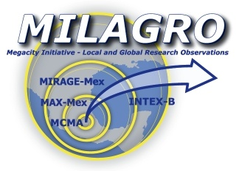
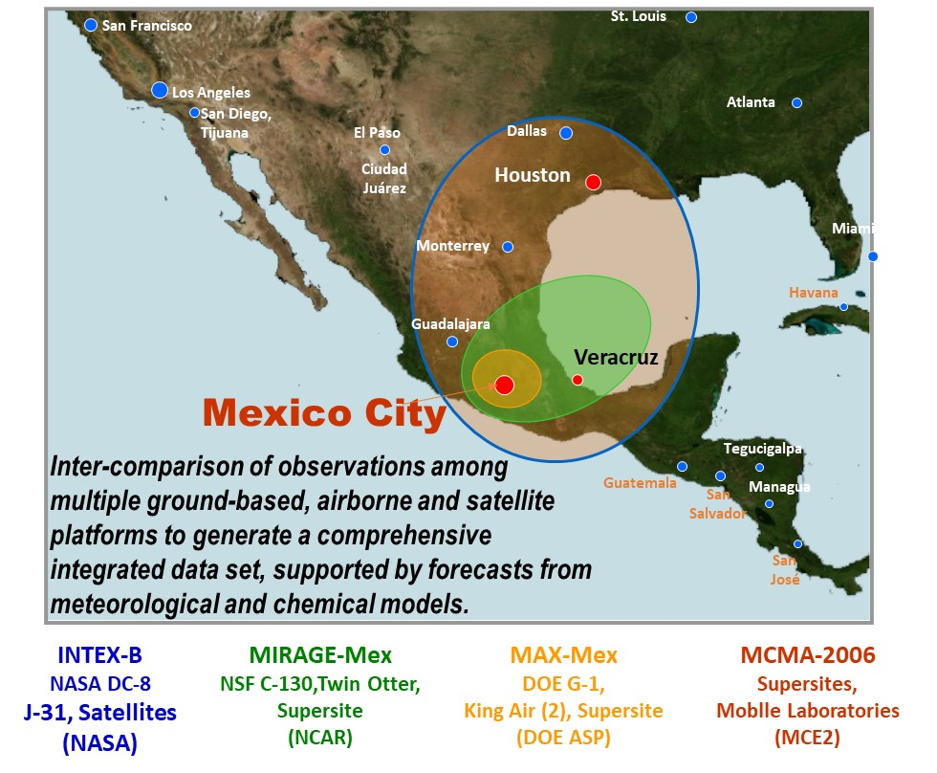
Megacity Initiative: Local And Global Research Observations
International collaborative scientific study
Objective: examine the behavior and the export of atmospheric emissions from a megacity
Four categories of results
Urban & regional meteorology, emissions, chemistry, radiation
Fundamental chemical and physical processes
Measurement techniques
Health impacts of air pollution
Capacity development
Participation of Mexican researchers and students
Guided tours for students and the public
Scientific findings and policy implications
Special Issue in Atmos. Chem. Phys (open access)
All data and results available to the scientific community.
Presentation to relevant Mexican officials and stakeholders
Incorporated in Mexico City’s Air Quality Improvement Program
Four coordinated components providing different geographic coverage
(Molina et al., Atmos. Chem. Phys., 2010)
Notes:
Four coordinated components
providing different geographic coverage

Slide 13
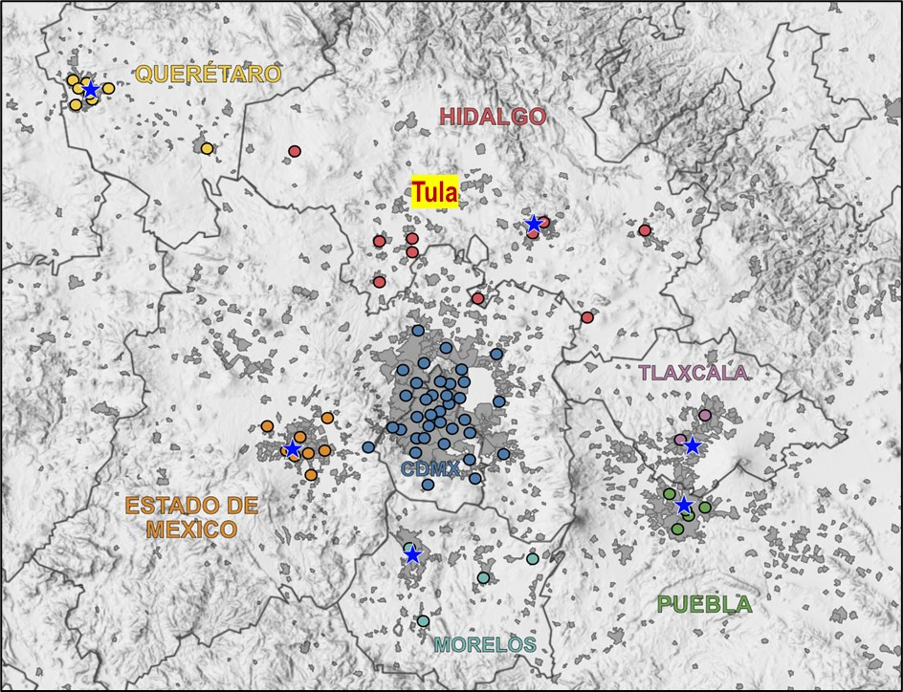
MCMA Air Quality: Ongoing challenges
Changes in atmospheric reactivity
A recent study on changes in O₃ production indicates changes in VOC profiles and the VOC-OH reactivity compared with corresponding estimates from MILAGRO.
Alkanes are still key contributors to VOC-OH reactivity, whereas the contribution from aromatic and alkene species has decreased, in agreement with reductions of VOC emissions from mobile sources.
Changes in O₃ production suggest that increases in the relative contributions from highly oxygenated volatile chemical products are responsible for sustained high O₃ levels in recent years.
(blue circles indicate AQ monitoring stations)
(Zavala et al., Atmos. Env., 2020)
Increased influence of regional air pollution
Expansion of MCMA has produced the “Megalopolis” with limited environmental policy coordination, increasing motorization and inadequate air quality monitoring.
Contribution of SO₂ from power plant and refinery in the north (Tula) higher than the local emission.
Agricultural and forest fires are frequent during dry season. Burning of regional biomass is a major contributor of fine particles and trace gases to the MCMA during particle pollution episodes.
Notes:
(Zavala et al., Atmos. Env., 2020)

Slide 14
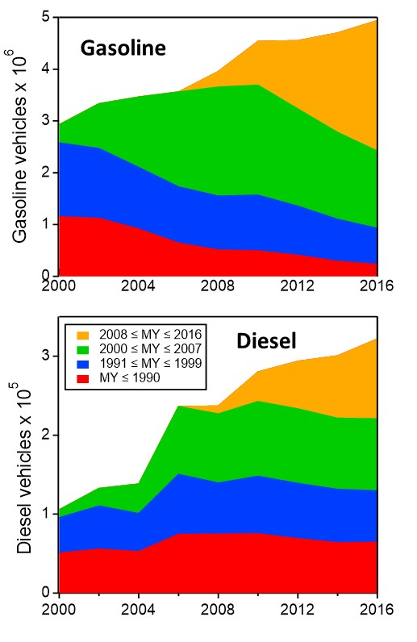
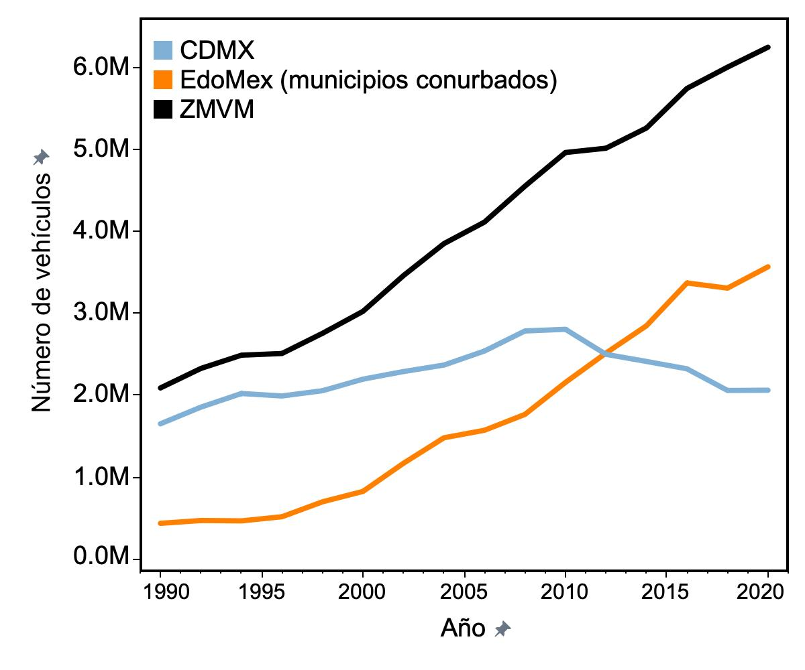

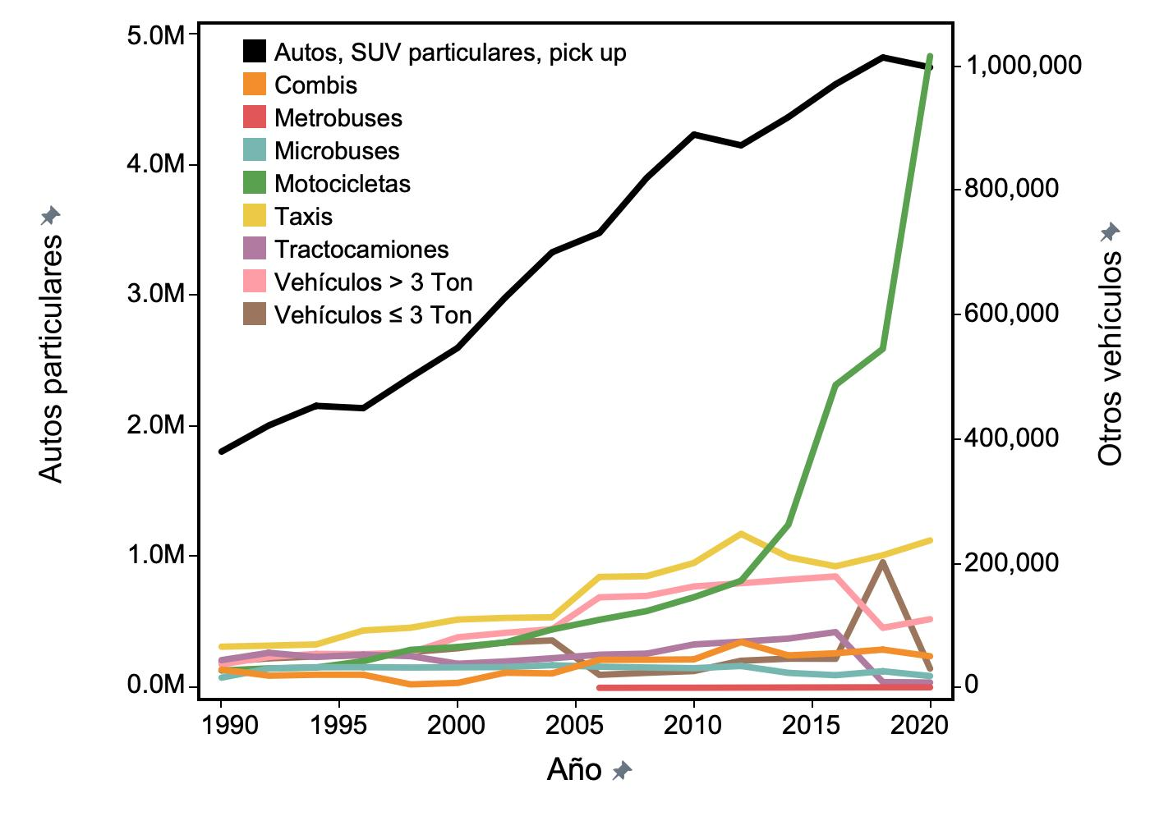
Changes in vehicle fleet composition
Evolution of vehicle fleet
Vehicle fleet continues to increase in the MCMA.
Motorcycle fleet increases exponentially.
Changes in vehicle technology, fuel reformulation, and fleet renewal have substantially reduced emissions.
Older gasoline vehicles still contribute disproportionally to vehicle emissions.
Diesel vehicles stay longer in the fleet: need to accelerate diesel fleet renewal.
(Data source: SEDEMA, 2020 Emissions Inventory)
(Zavala et al., Atmos. Env., 2020)

Slide 15
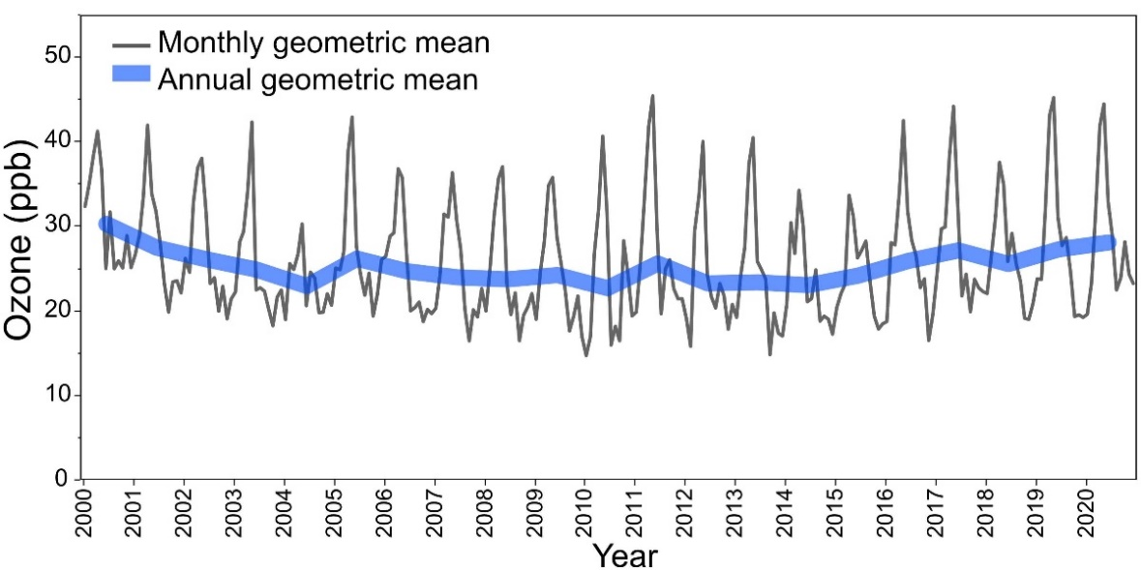
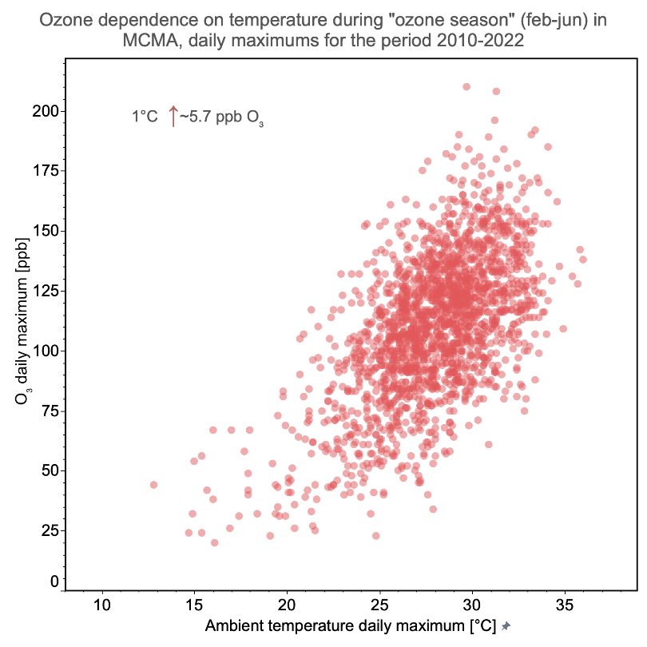
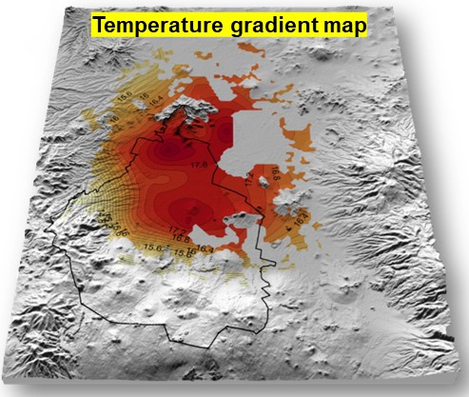
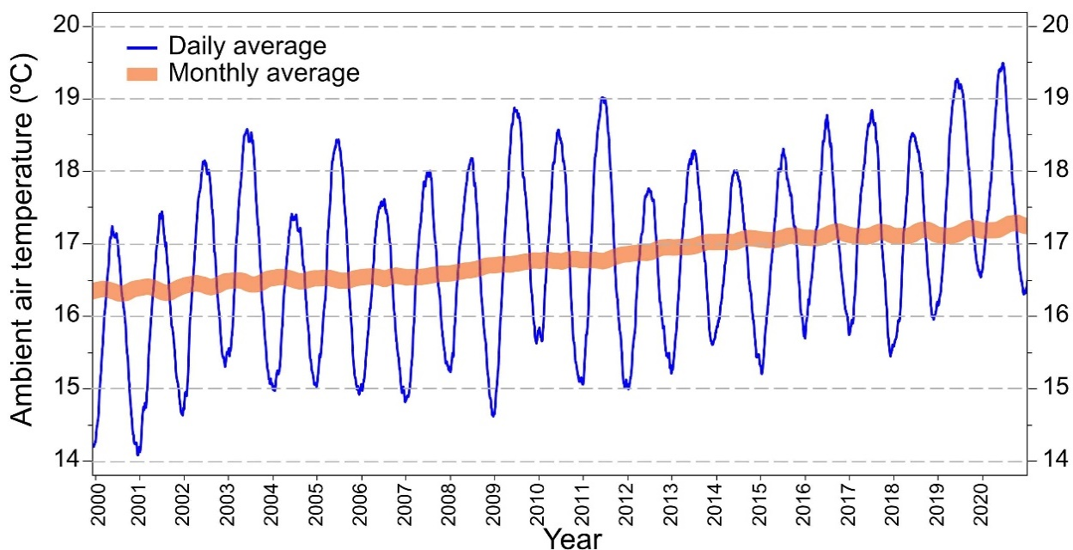
Temperature change, urban heat island and air quality in the MCMA
(Credit: A. Retama)
Concentrations of air pollutants have decreased
Reductions have been slow
But O₃ levels have increased in recent years
Rise in temperature could be offsetting emissions control measures
(Data source: Air Quality Monitoring System of Mexico City, SEDEMA)

Slide 16
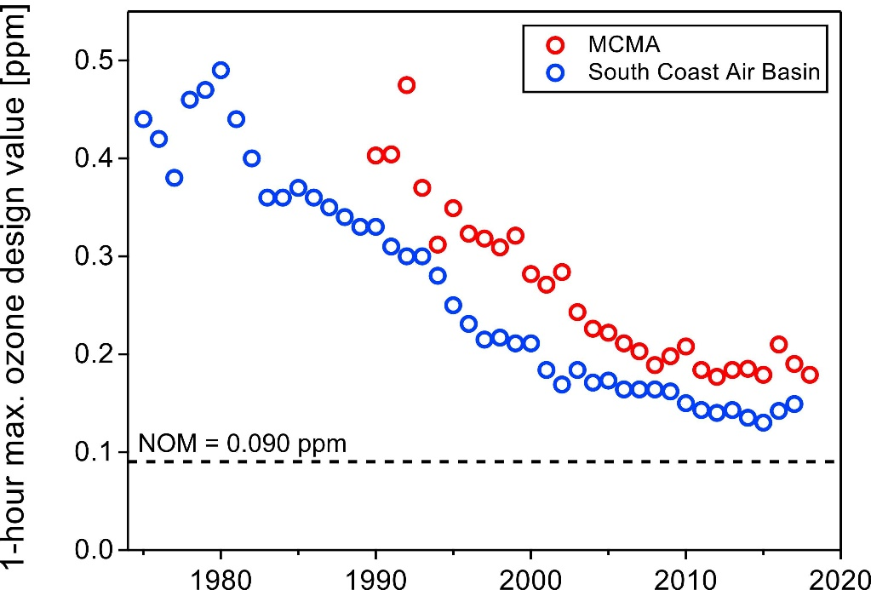
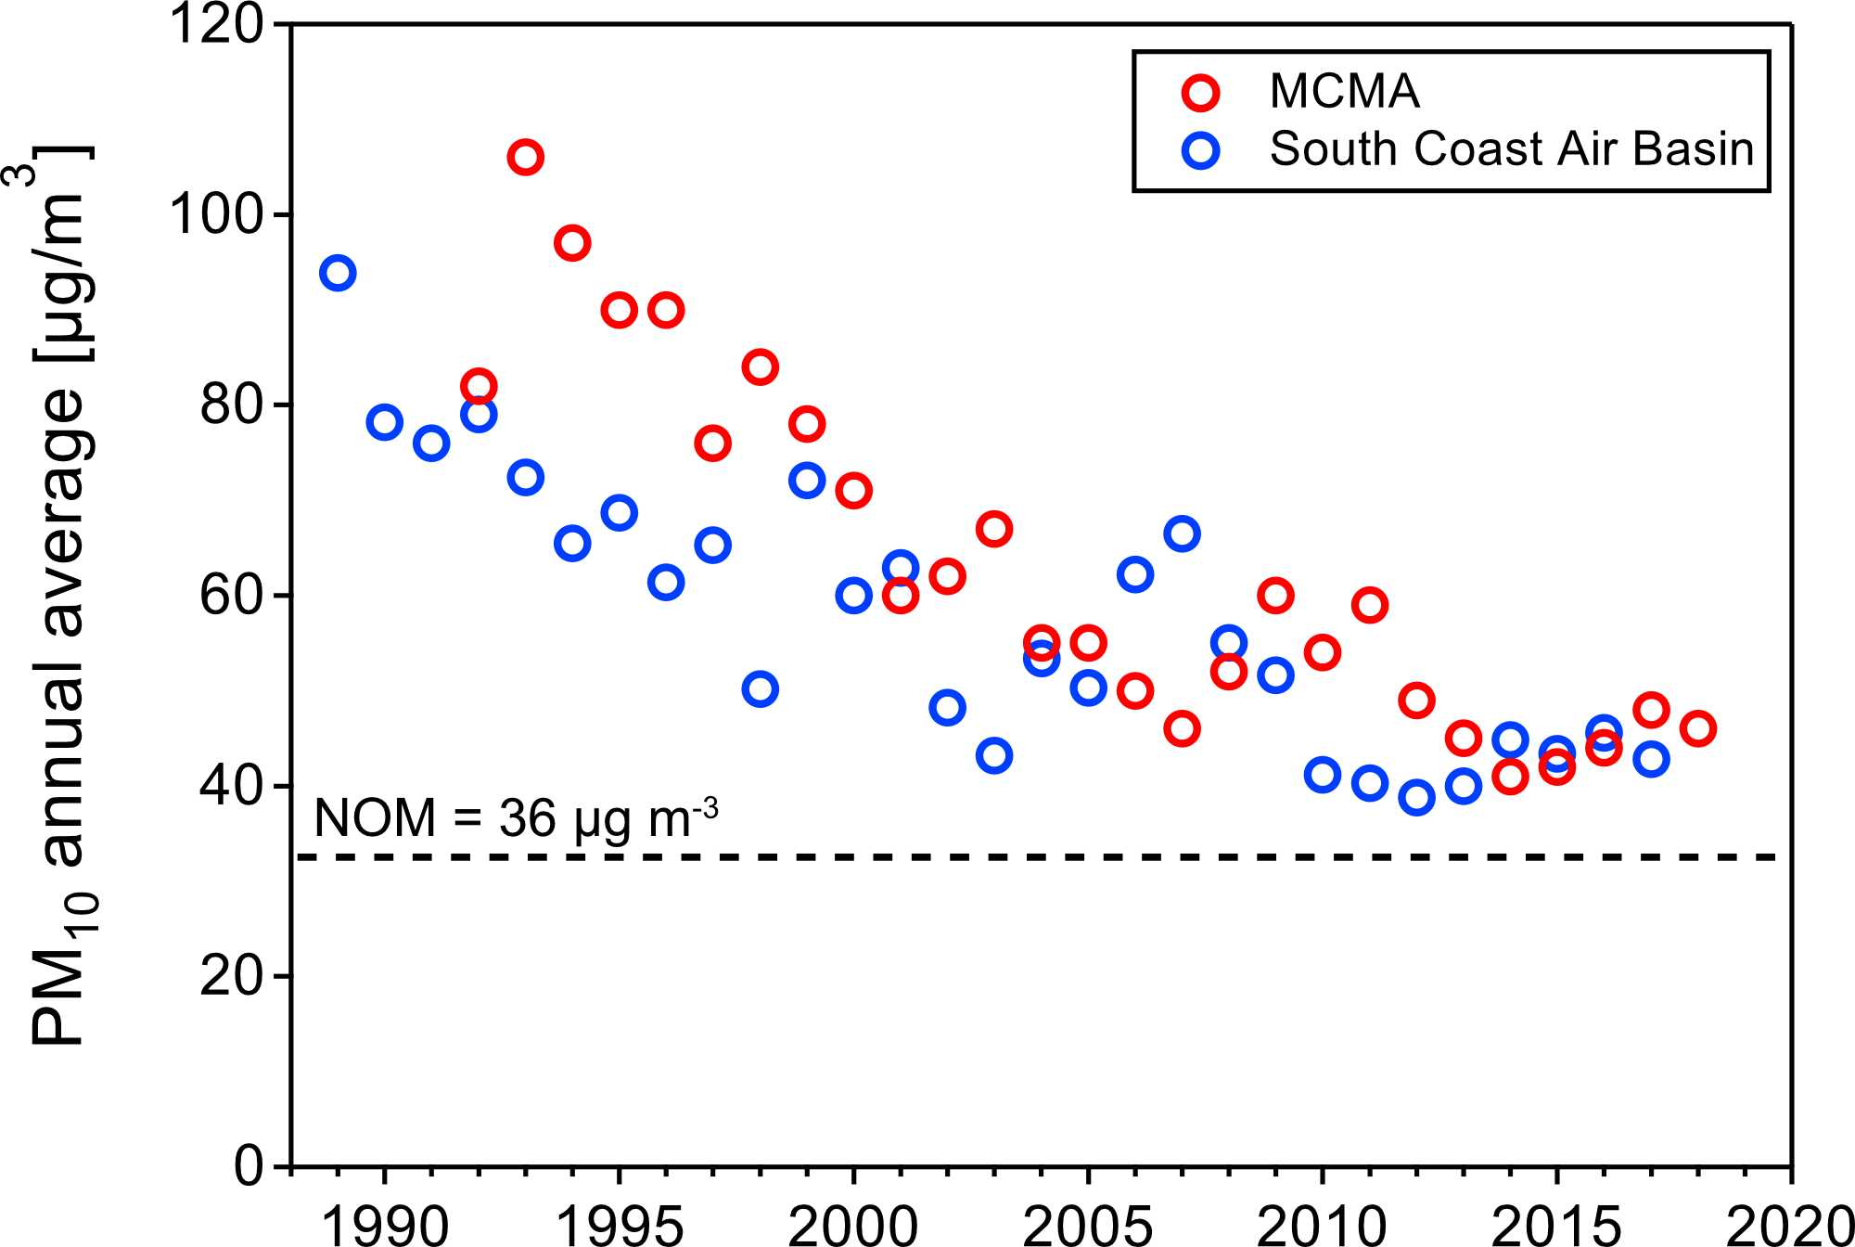
Mexico City is not the only city struggling to reduce O₃ & PM
AQ trends in the MCMA and Los Angeles
O₃ and PM₁₀ have decreased significantly in both air basins, despite large difference in the financial and human resources and institutional capacity.
Critical need: Continue scientific research to better understand changes in the complex atmospheric composition and processes
→ ensuring that the air quality models provide reliable information for proposed regulatory actions and services.
(Sources: http://www.aire.cdmx.gob.mx/;
http://www.aqmd.gov)

Slide 17

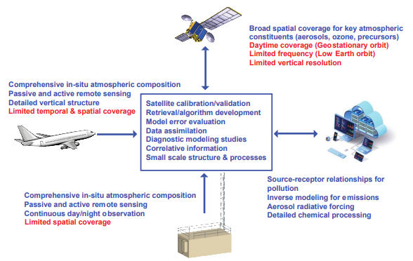
NASA Hemispheric Airborne Measurements of Air Quality
(HAMAQ) - North America
Goal: to advance the integrated observing system for air quality through targeted airborne observations over priority areas in coordination with the geostationary air quality satellite constellation and local monitoring to improve forecasting and inform policy.
Current plan consists of two deployments in 2028, including the Mexico City Megalopolis and another North American site yet to be selected.
(Source: https://science.larc.nasa.gov/wp-content/uploads/sites/147/2024/08/HAMAQ-White-Paper-20240827.pdf)

Slide 18
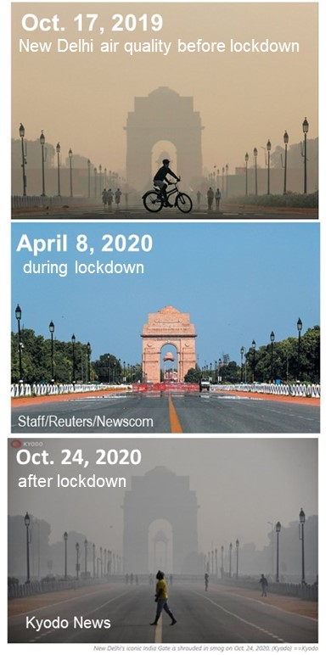
Urban air quality: Lessons learned from COVID-19 lockdown
The drastic measures implemented by governments around the world during COVID-19 pandemic led to significant reductions in the emissions of air pollutants, notably NO_{x} and CO₂ emissions from fossil fuel combustion.
  Many cities have seen remarkable improvement in air quality.
Delhi, one of the most polluted megacities, experienced the clearest skies in years as pollution dropped to its lowest level in three decades during the lockdown.
  As the restrictions were lifted and the recovery began, much of the air pollution has returned.
The unprecedented global pandemic demonstrates that it is possible to achieve better air quality by implementing emission reduction strategies that have been proven to be effective:
Comprehensive regulation of precursors gases from all possible emission sources must be considered for long-term improvement of air quality
Importance of meteorological factors when planning short-term emission controls
Enhanced public awareness about the benefits of cleaner air and call for government to take actions.
New Delhi air quality before lockdown
April 8, 2020
during lockdown
after lockdown

Slide 19
Conclusions
Comprehensive actions implemented by environmental authorities in Mexico City based on scientific, technical, social, political and economic considerations have achieved significant advances in air quality in the last three decades. However, episodes with high concentrations of O₃ and PM_{2.5} still occur.
Air quality challenges posed by growing urbanization, emergent emission sources, changes in emission profiles and atmospheric chemistry under a changing climate need to be better understood and incorporated in the design of air quality management programs.
Progress in understanding atmospheric composition and chemistry requires an observation strategy taking advantage of satellites, research aircraft, and ground measurements coupled to numerical modeling at local, regional, and global scales.
An important lesson learned is that addressing the multiple challenges of air pollution, climate change, biodiversity loss, and protection of human health effectively will require cutting-edge interdisciplinary research, evidence-based intersectoral policy and actions from the decision makers, and active involvement of stakeholders and the public.
Cities should work towards building robust infrastructure and air quality management tools and rely on scientific research to attain cleaner air. International collaboration will be needed, including strengthening local capacity in air quality monitoring and emissions inventory development, so that cities confronting severe air pollution challenges will learn from the experience of those cities that have successfully addressed them.

Slide 20
Take home message
Good science and well-chosen technologies can direct the way to corrective regulatory measures; but without strong commitment from the government and active participation from the civil society, no amount of science or technology can help to achieve clean air.
A successful result would be to arrive at harmonized control strategies
that are effectively implemented and adopted by society.

Slide 21
THANK YOU!

