Slide 1

Training Course on Seamless Prediction of Air Pollution in Africa, 12-25 September 2024
Air Quality Model Evaluation
Ensuring Reliable and Accurate
Air Quality Forecasts
Sara Basart (sbasart@wmo.int)
Scientific Officer, Science and Innovation Department

Slide 2

World Meteorological Organization (WMO)
UN specialized agency on weather, climate and water.
Supported by 193 Members and headquarters in Geneva (Switzerland).
Coordinates work of > 300,000 national experts from meteorological and hydrological services, academia and private sector.
Co-founder and host agency of IPCC.

Slide 3

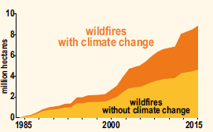
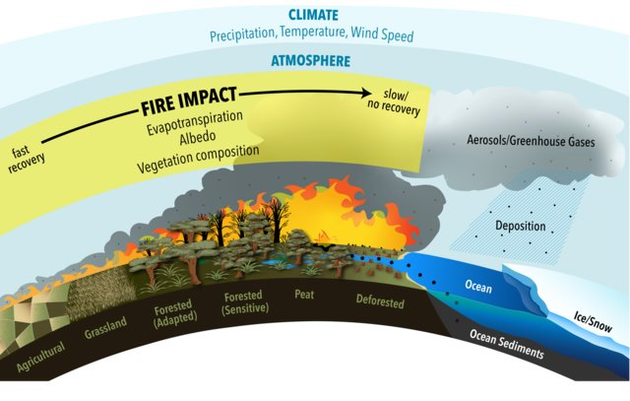
Atmospheric Composition
on the Global context: Wildfires
Lower emissions that would limit the global temperature increase to <2°C would reduce projected increases of global burned area to 30% to 35% and projected increases of fire frequency to ~20%.
(IPCC, 2021)
(Lasslop et al., 2019)

Slide 4
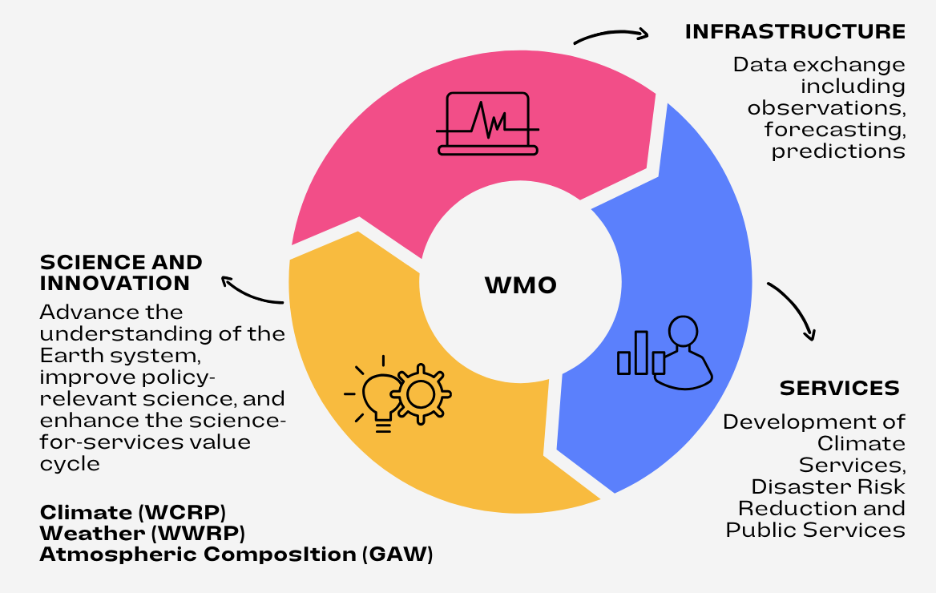
WMO Technical Departments
GCOS
G3W
WIPPS
EW4All
Including specific activities on SDS, wildfires and air quality forecasting

Slide 5

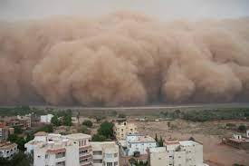
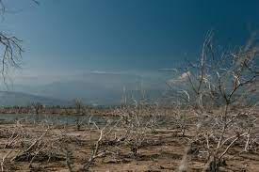
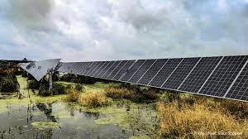
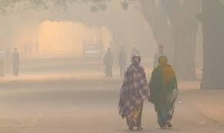
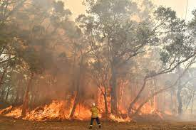
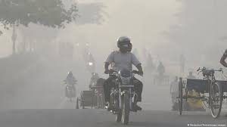
WMO Research - Global Atmosphere Watch (GAW)
Research Enabling Atmospheric Composition Services
Advance and enhance science, services and infrastructure related to atmospheric composition, and support policies for society through applied research aimed at improving the understanding of the roles of aerosols, reactive gases, stratospheric ozone and greenhouse gases and their interactions in the Earth System.
Drivers: Global societal needs
Notes:
The GAW programme is focused on research enabling atmospheric composition services through providing high quality observations and better representing these processes in Earth System Models.

Slide 6
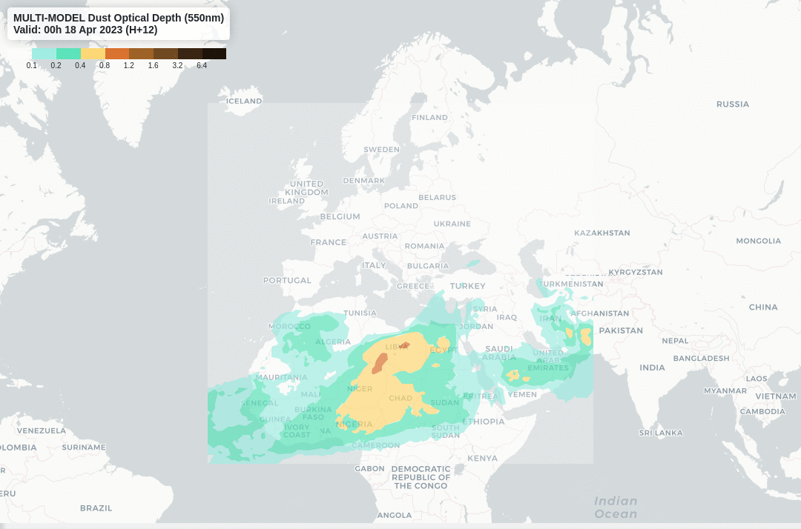
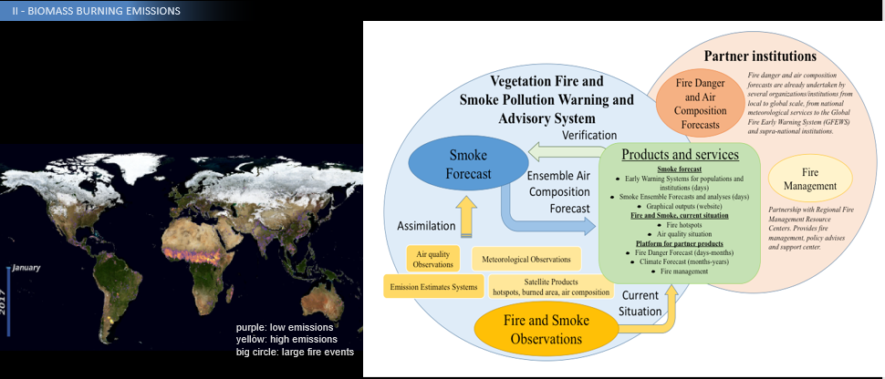
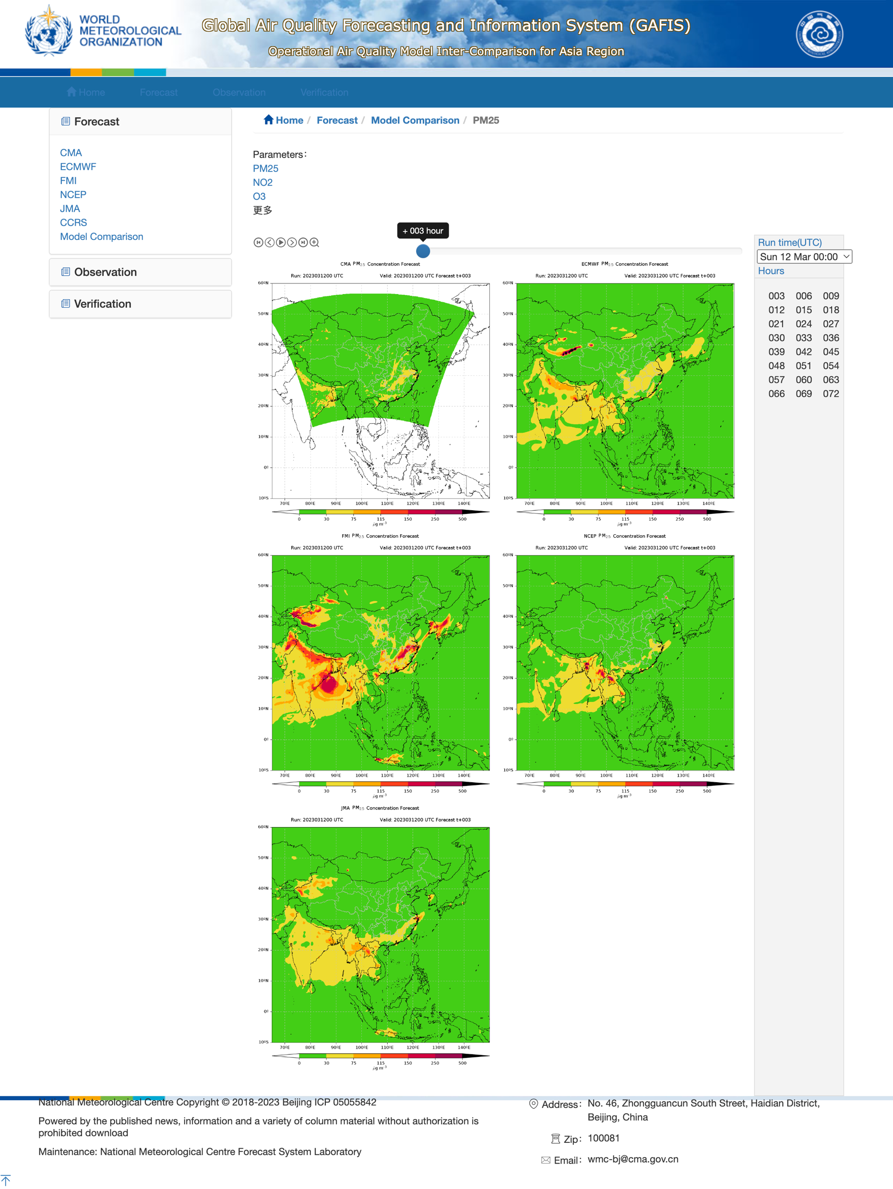
WMO Research - Science for Services
Advance the application of atmospheric composition information in support of policies and conventions, and expand societal services related to air quality, human and ecosystem health, climate change and food production.
Warnings and Forecasting Services
Model intercomparisons
Global Air Quality Forecasting and Information System (GAFIS)
Vegetation Fire and Smoke Pollution VFSP-WAS
Sand and Dust Storm SDS-WAS
Notes:
The GAW programme is focused on research enabling atmospheric composition services through providing high quality observations and better representing these processes in Earth System Models.

Slide 7
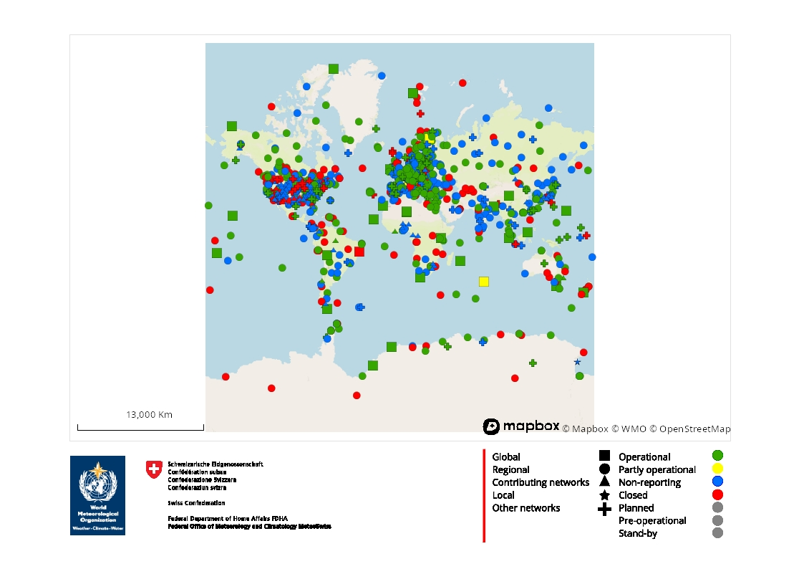
Research Infrasctructure for the provision of Services
Strengthen the atmospheric composition measurement and data infrastructure and contribute to understanding trends and variability and extremes.
Filling gaps:
LCS and satellites, but also National AQ networks
GAW Station Information System (GAWSIS, https://gawsis.meteoswiss.ch/GAWSIS/#/) part of WMO Integrated Global Observation Systems (WIGOS)
- More than 200 parameters
- Intercomparisons
- Measurement guidelines
- World Data Centers
  Open access with emphasis in QA and QC
Notes:
SO A with figure 5 observational infrastructure.
Activity SO-A1: Enable a fully traceable, world-scale observing system for atmospheric composition guided by requirements (GCOS, OSCAR).
Activity SO-A2: Strengthen coordination of atmospheric composition measurement and data infrastructure.
Activity SO-A3: Respond to emerging needs and emerging technologies.
Activity SO-A4: Strengthen policies that support the importance of atmospheric composition data.

Slide 8
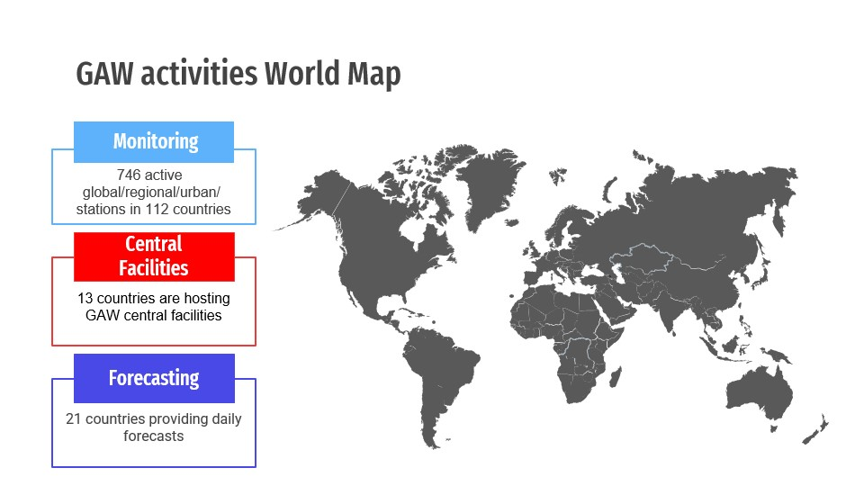
Research Infrasctructure for the provision of Services
Forecasting - Model Intercomparisons:
Sand and Dust Storms
Wildfires
Air Quality
GHG emission information systems – IG3S city projects
WMO INFRASTRUCTURE - WIPPS
Regional Specialized Meteorological Center with activity specialization

Slide 9

WMO Sand and Dust Storms Warning Advisory and Assessment System (SDS-WAS)
Godzilla, June 2020
International coordination of research for weather and climate
Identification and assessment of SDS impacts
Promoting the use of current available SDS products
Building capacity and facilitate access to the available services
Dissemination and awareness
https://community.wmo.int/en/activity-areas/gaw/science-for-services/sds-was

Slide 10
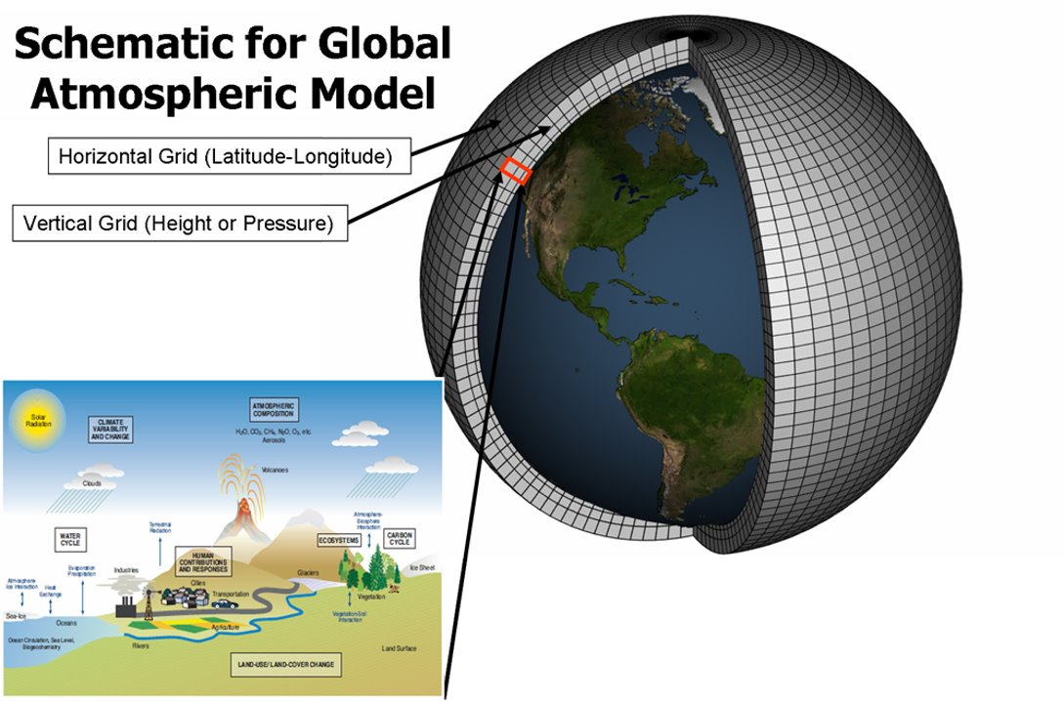
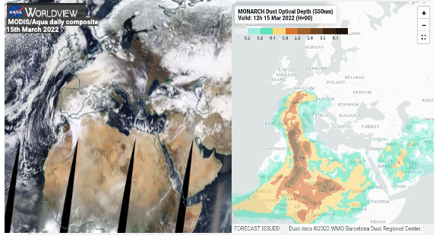
Modelling and Observations

Slide 11
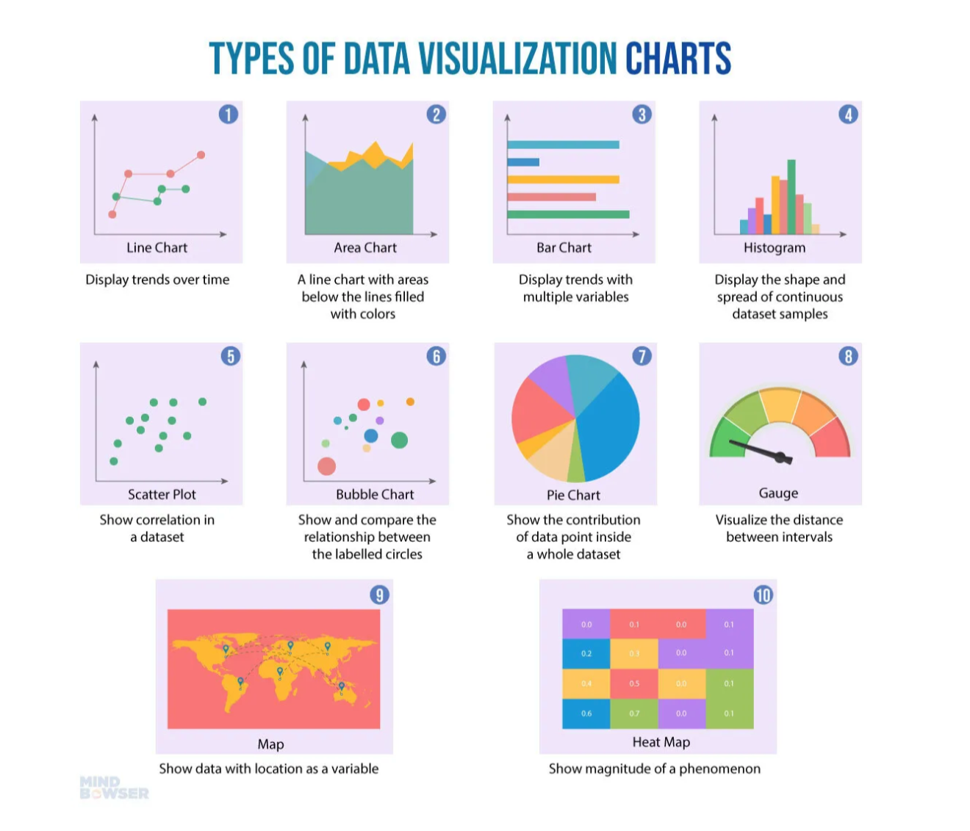
Why do we evaluate air quality models?
Accuracy & Reliability:
  Models need to predict pollutant concentrations with high accuracy.
Regulatory Compliance:
  Ensure models meet national and international air quality standards.
Key Steps in Model Evaluation
Comparison with Observations:
    Validate model output against measured air quality data (points: ground-based, gridded: satellite).
Statistical Performance Metrics:
    Categorical: Definition of categories by intensity
      Contingency tables
    Continuous
      Metrics like Mean Bias (MB), Root Mean Square Error (RMSE), and correlation coefficients.
VISUALISE THE RESULTS MATTERS!

Slide 12
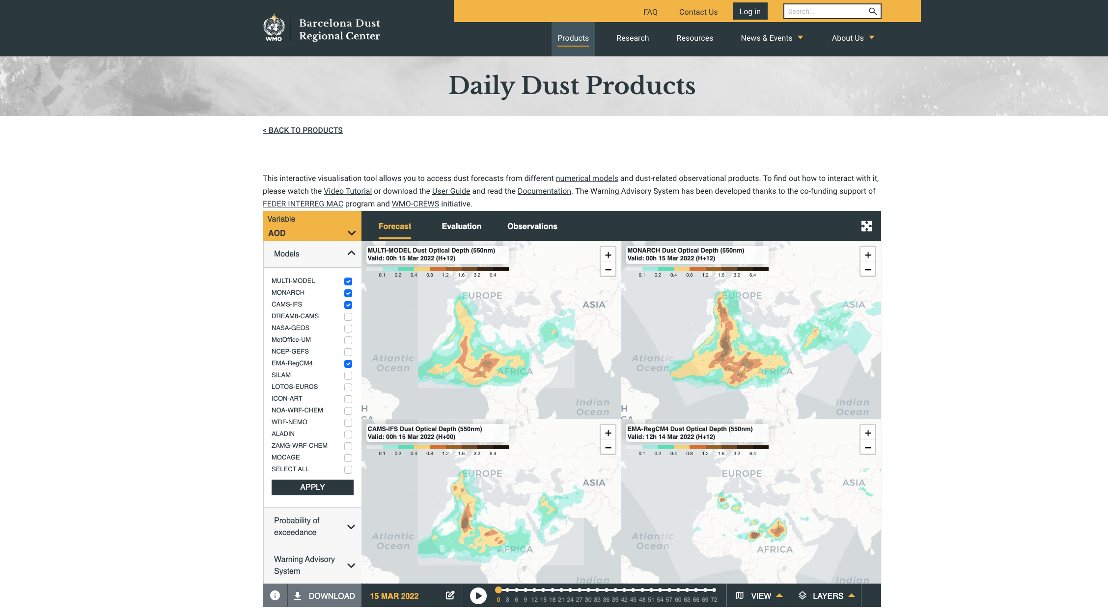
http://dust.aemet.es
@dust_barcelona
Model intercomparisons
1. Promoting best practices and guidelines to be used by the international community
2. Development of probabilistic forecasts
ONLY DUST

Slide 13
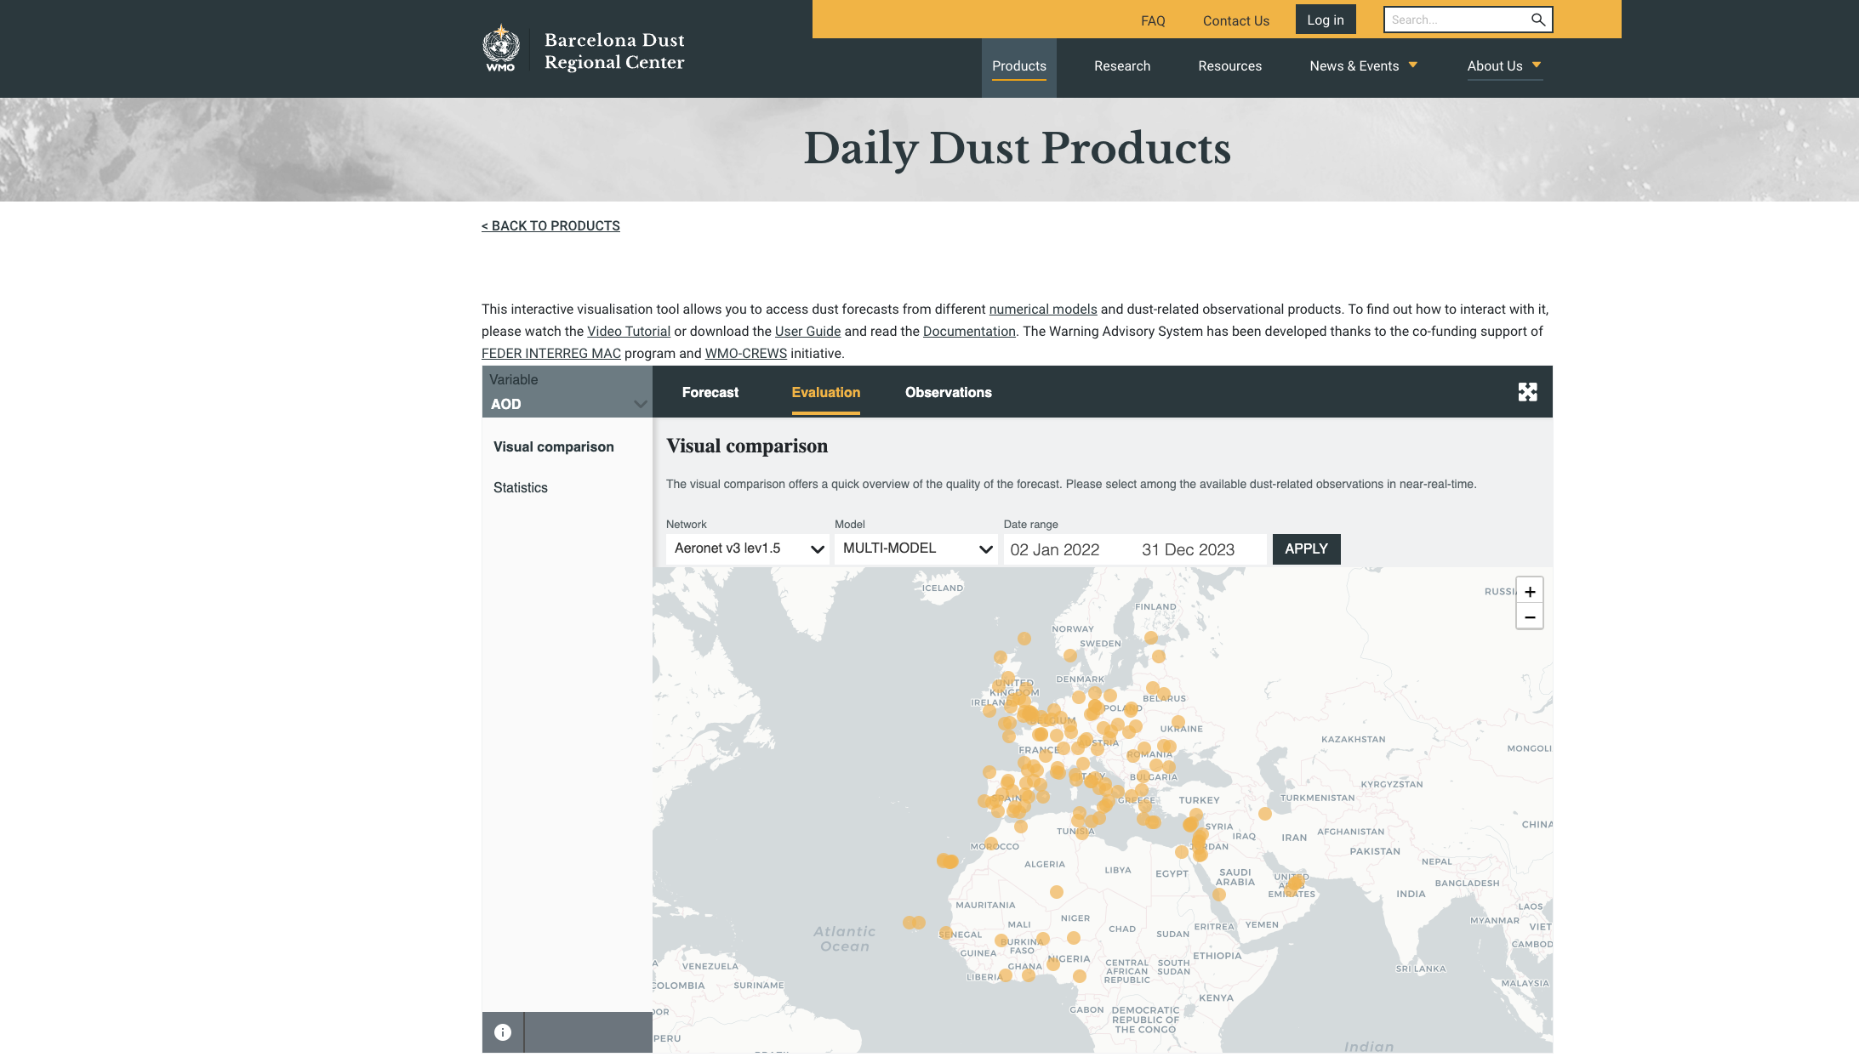

Slide 14
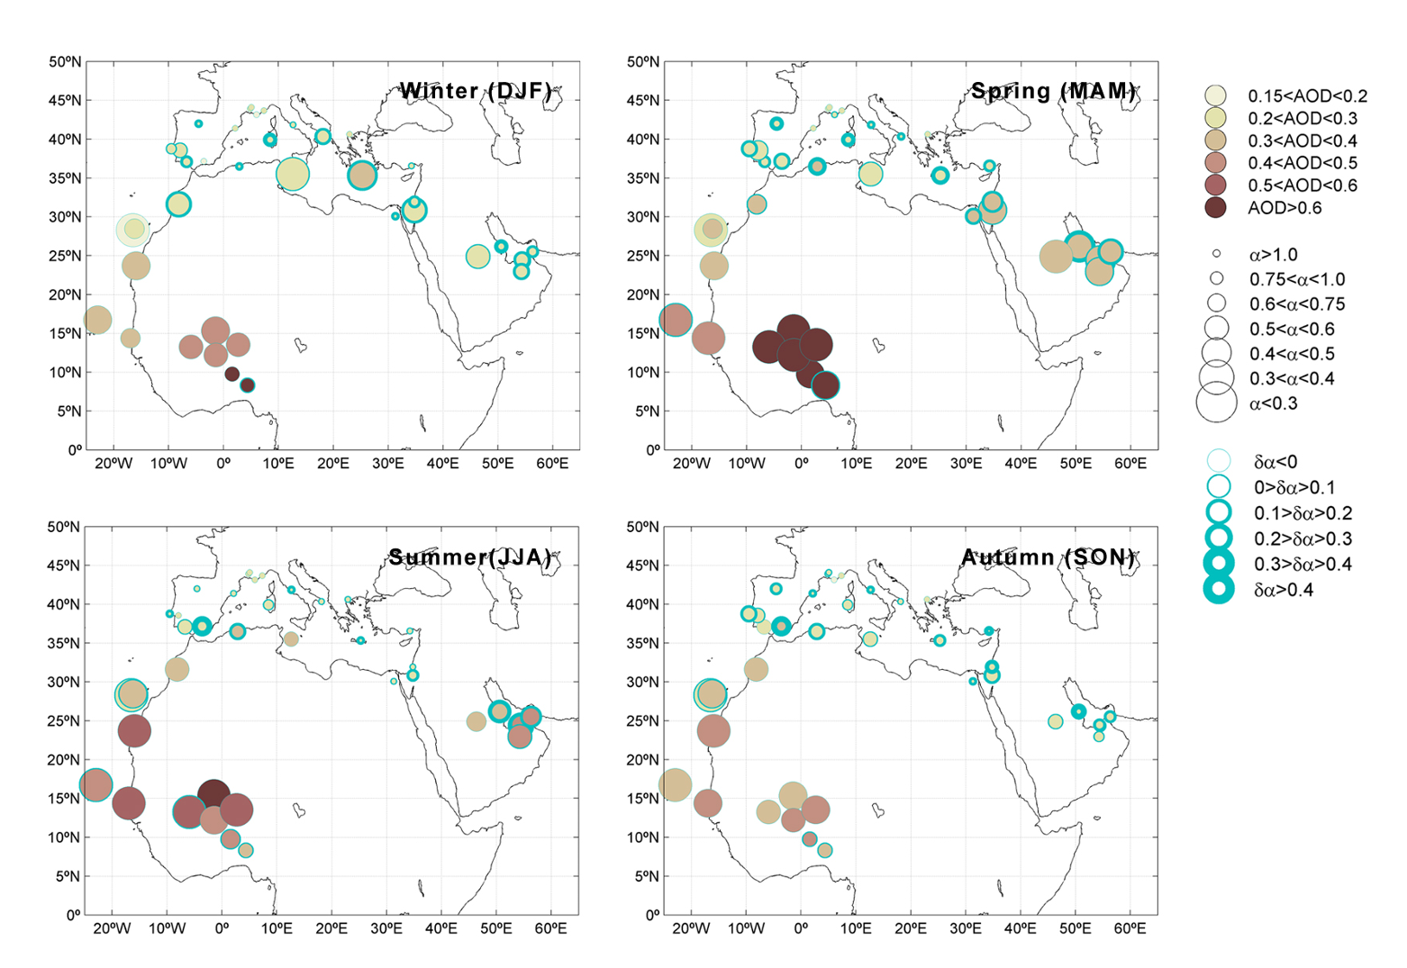
Understanding the observations
Aerosol typing – Example AERONET
Intensity
AOD 440 nm
Size
Angstrom Exponent
α(440,870 nm)
Mixture
Angstrom Exponent
Curvature
α(440,675nm)–α(675,870nm)
(Basart et al., 2012)

Slide 15
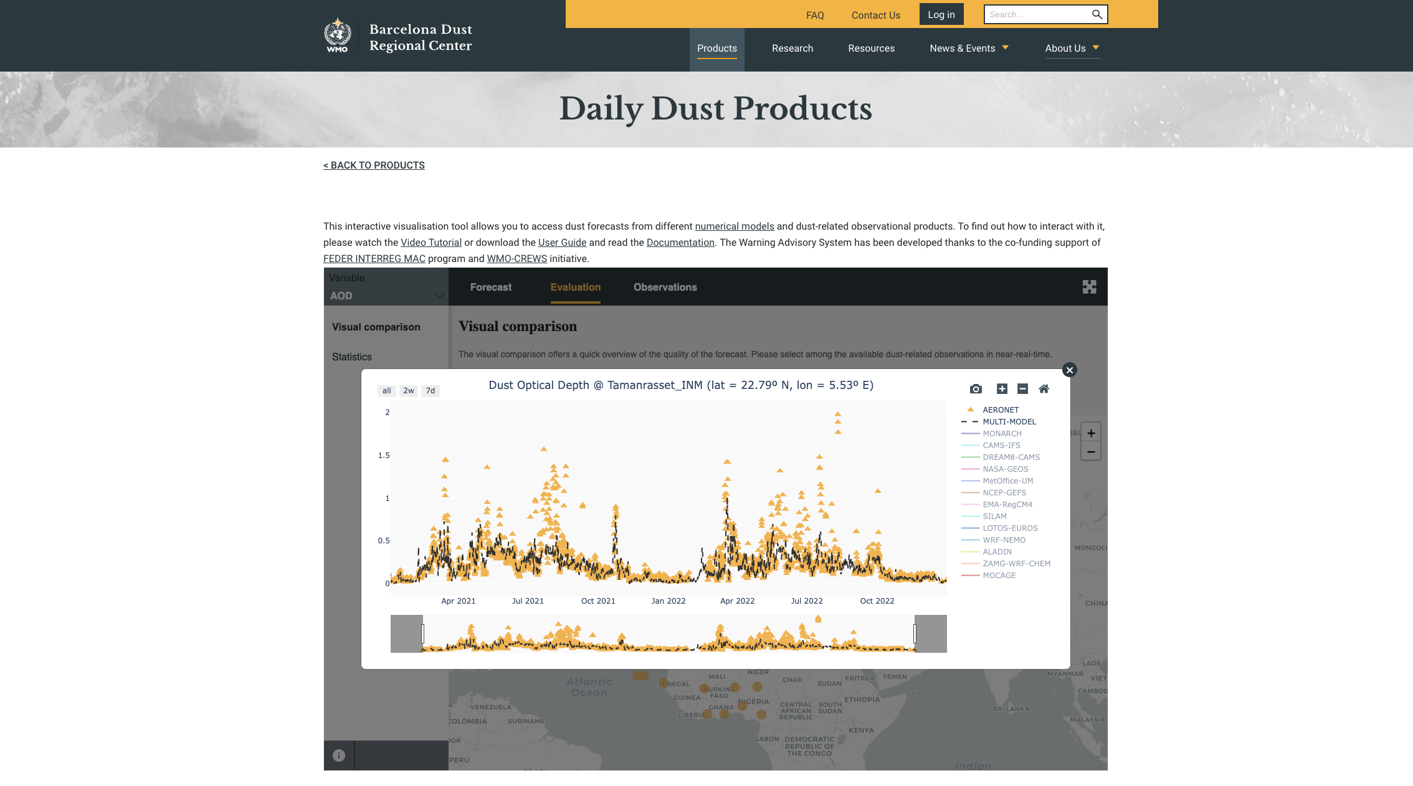
http://dust.aemet.es
@dust_barcelona
Systematic underestimations in summer in Tamanrasset (Algeria)
ONLY DUST

Slide 16
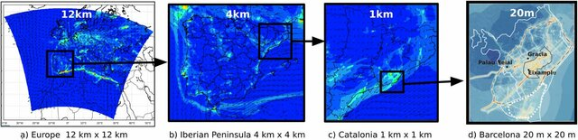
Understanding the forecast | Spatial resolution
Example of NO2
CALIOPE AQ forecasting system
Barcelona, Spain, ​9-25 November 2017
(Benavides et al., 2021)

Slide 17
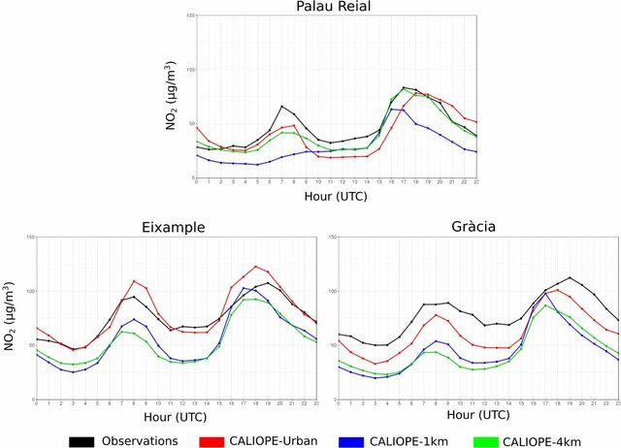
Understanding the forecast | Representativity
CALIOPE AQ forecasting system​
Barcelona, Spain, ​9-25 November 2017
(Benavides et al., 2021)

Slide 18
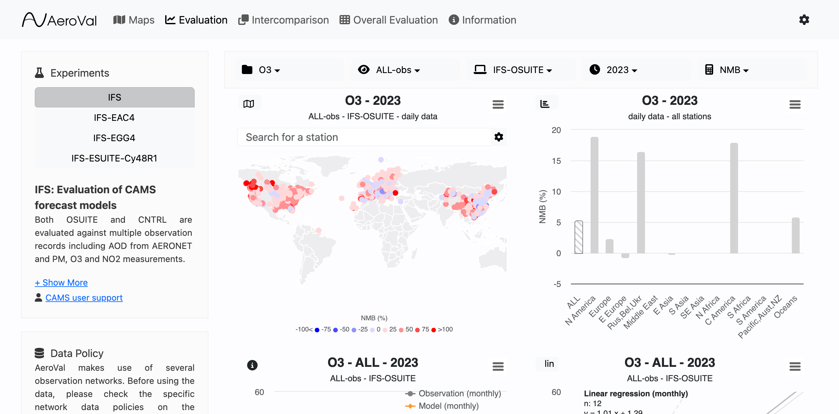

https://aeroval.met.no/pages/evaluation/?project=cams2-82

Slide 19
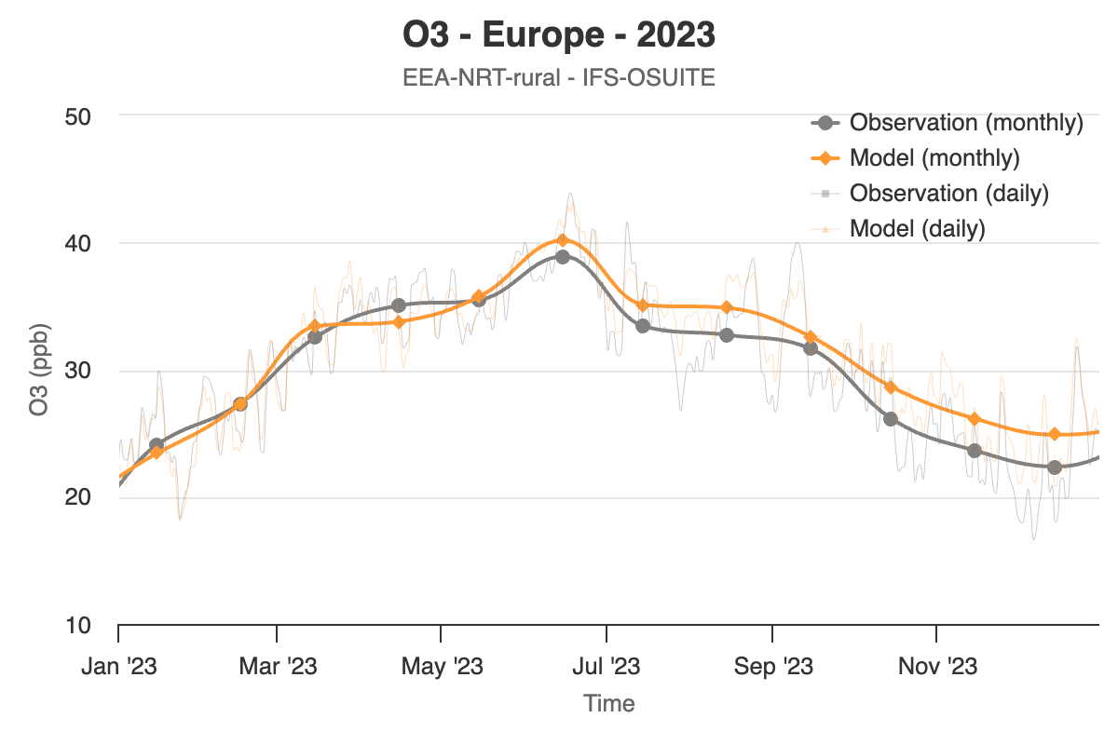
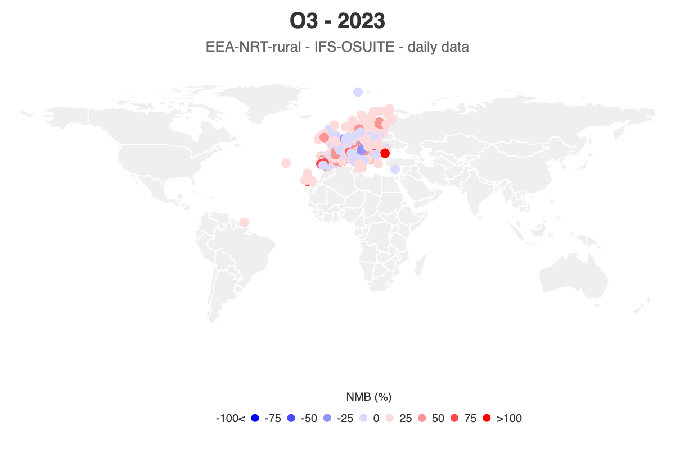
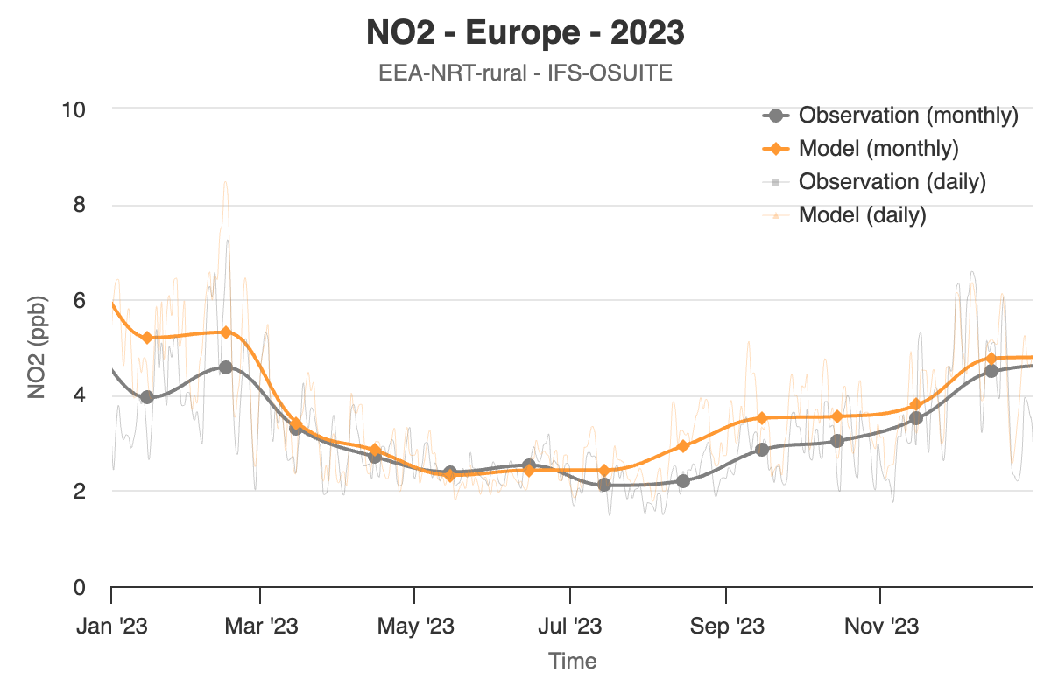
Understanding the processes
NO₂ is the precussor of O₃
https://aeroval.met.no/pages/evaluation/?project=cams2-82

Slide 20
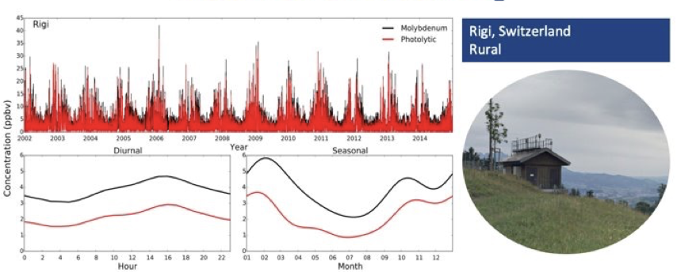
Understanding the observations
Measurement technique, NO₂ bias
There is a known bias associated to the chemilluminescence method used to mesured NO₂. When using an internal molybdenum converter, is essentially a fraction of NOx, overestimating NO₂.
Courtesy of Dene Bodwalo

Slide 21
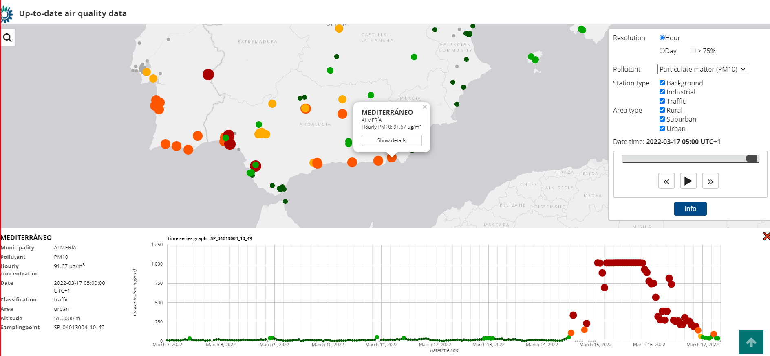
Understanding the observations
Measurement limitations
Limit of detection
The most impacted sites were “saturated” (i.e. recorded values lower than reals)

Slide 22
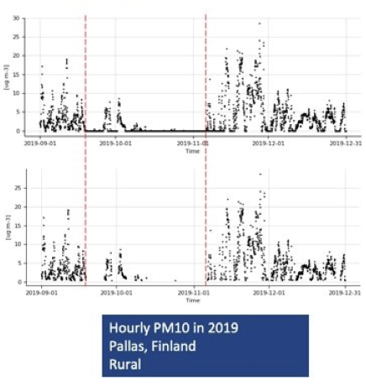
Understanding the observations
Should we take all data?
Each model evaluation will have sligthly different objectives, and how strict you wish to be in screening observations will depend upon these objectives
On a very simplistic level, deciding whether or not to keep zero measurements can vary between evaluations (i.e. statistics)
Courtesy of Dene Bodwalo

Slide 23
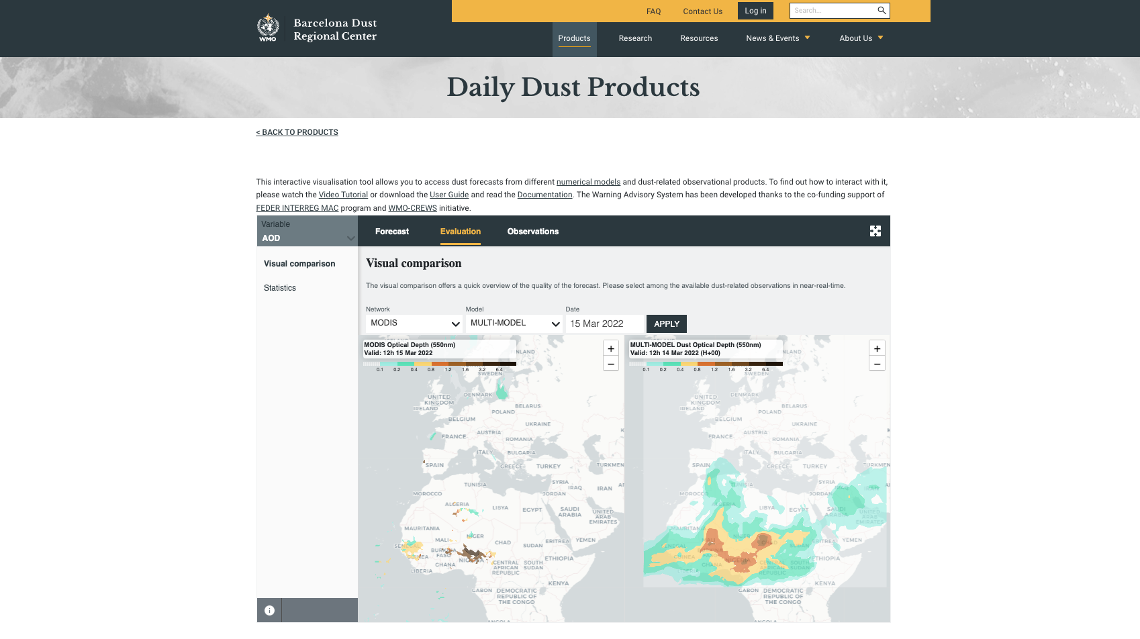
http://dust.aemet.es
@dust_barcelona
Fair comparison
MODIS is on board of a polar satellite.
This means two overpasses per day over the same region.
ONLY DUST

Slide 24
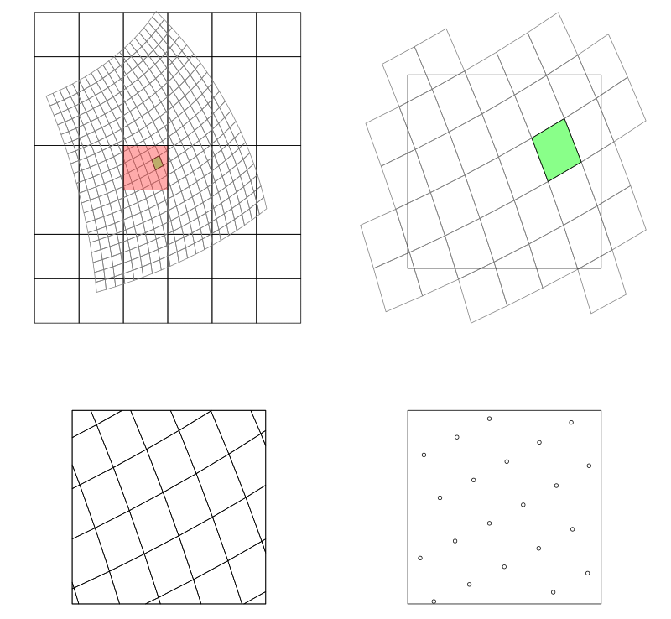
Understanding the forecast | Regridding and interpolations
Spatial regridding refers to the process of transforming model data from one grid resolution or structure to another.
There are different interpolation methods (nearest neighbor, bilinear interpolation, cubic spline, ...)
  Check artifacts! Ensure that regridding does not introduce unrealistic patterns or distortions in the data.
Tools CDO, EMSF, xEMSf

Slide 25

Key Messages
Design your evaluation for the purpose
  Continuous vs categorical
  Observations (point vs grid)
  Selection of your plot, graph, map...
Compare oranges with oranges
  Comparison of the same parameter
  Understand the spatial and temporal representativity of the stations or gridded datasets
Understand your model
  Be sure about the scales that you are considering in your configuration and the processes represented
OPEN DATA and OPEN SCIENCE, Clear Skies: Improving Air Quality for a Healthier Tomorrow!

Slide 26


Thank you.
https://community.wmo.int/en/activity-areas/gaw
Sara Basart (sbasart@wmo.int)
Special thanks to all researchers, providers and users contributing to the WMO initiatives

