Slide 1
Global Atmospheric Composition Forecasting at the
Copernicus
Atmosphere Monitoring Service (CAMS)
Johannes Flemming

Slide 2

WHAT ARE COPERNICUS AND CAMS?
CAMS is one of six thematic information services provided by
the Copernicus Earth Observation Programme of the European Union.
SENTINELS
Copernicus converts cutting-edge EO and the latest science into user-driven free and open data and information products.
It is not a project, but a long-term activity of the EU (5.4 B€ for 2021-2027 ; recently turned 25y).
EUROPE’S EYES ON EARTH

Slide 3
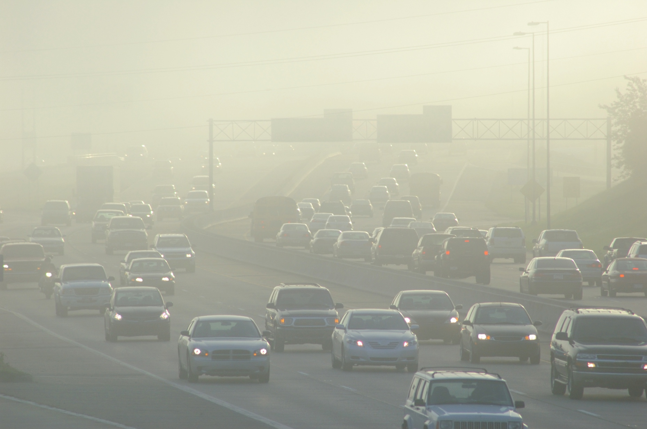





Copernicus Atmosphere Monitoring Service - themES
CAMS delivers consistent and quality-controlled information related to air pollution and health, solar energy, greenhouse gases and climate forcing, everywhere in the world.
Air quality
Policy tools
Solar energy
Ozone layer and UV radiation
Emissions and surface Fluxes
Climate forcing
Notes:
Check quality

Slide 4
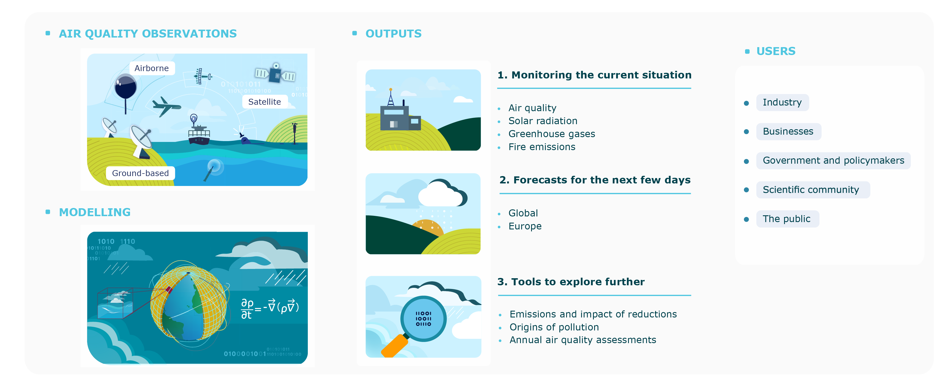
Copernicus Atmosphere Monitoring Service - Process
CAMS provides consistent and quality-controlled information related to air pollution and
health, solar energy, greenhouse gases and climate forcing, everywhere in the world.

Slide 5
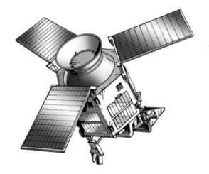
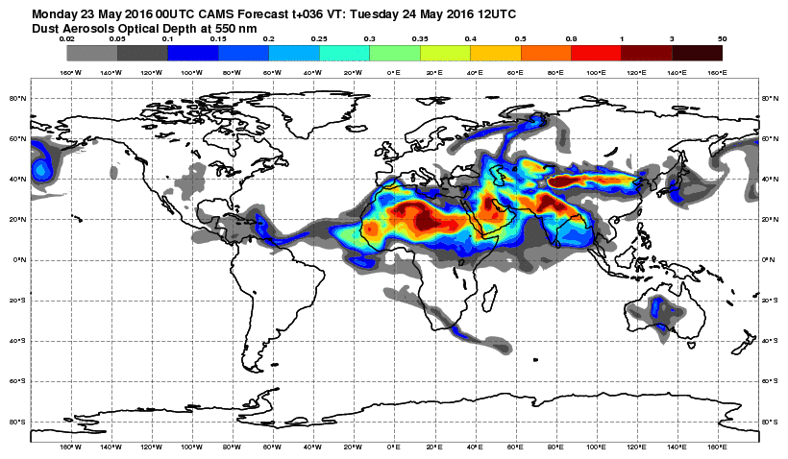
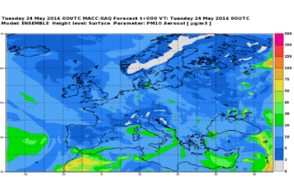
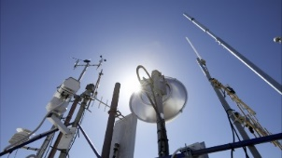
Global and Regional CAMS systems
CAMS SERVICE CHAIN
Data assimilation
ECMWF
IFS
global,
40x40 km
Global
CAMS Emissions
Satellite Observations
(AOD, O₃, CO, NO₂, SO₂)
GFAS
wildfire emissions
Boundary Conditions
11 regional CTMs over Europe,
10x10 km
Surface AQ observations
European CAMS
Emissions
Data assimilation
15

Slide 6
Atmospheric Composition Modelling in CAMS

Slide 7
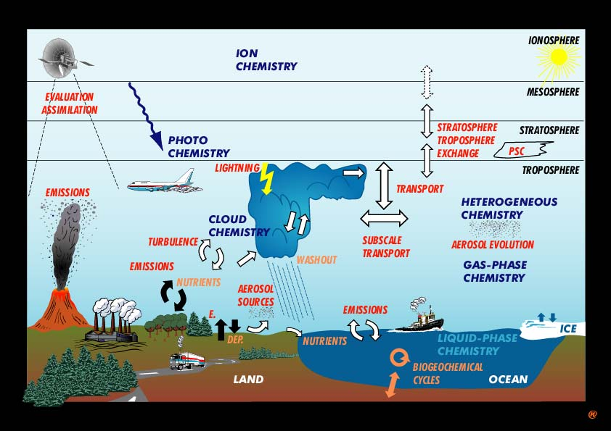
Atmospheric Composition

Slide 8
Processes Atmospheric Composition
Chemical
Reactions
Transport
Photolysis
Transport
catalytic
Cycles
Emissions
wet & dry
Deposition
Atmospheric
Reservoir
Dr. Martin Schultz - Max-Planck-Institut für Meteorologie, Hamburg

Slide 9
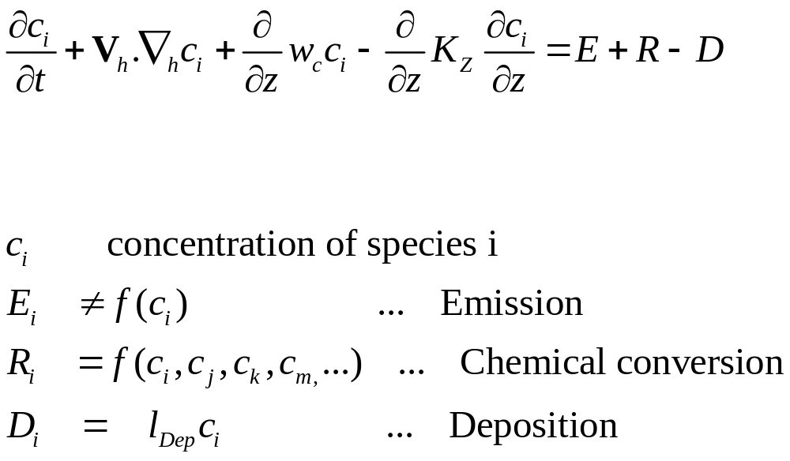
Modelling of Atmospheric Composition
Mass balance equation for chemical species ( up to 150 in state-of-the-art Chemical Transport Models)
Advection
Turbulent
Mixing
Source and Sinks

Slide 10
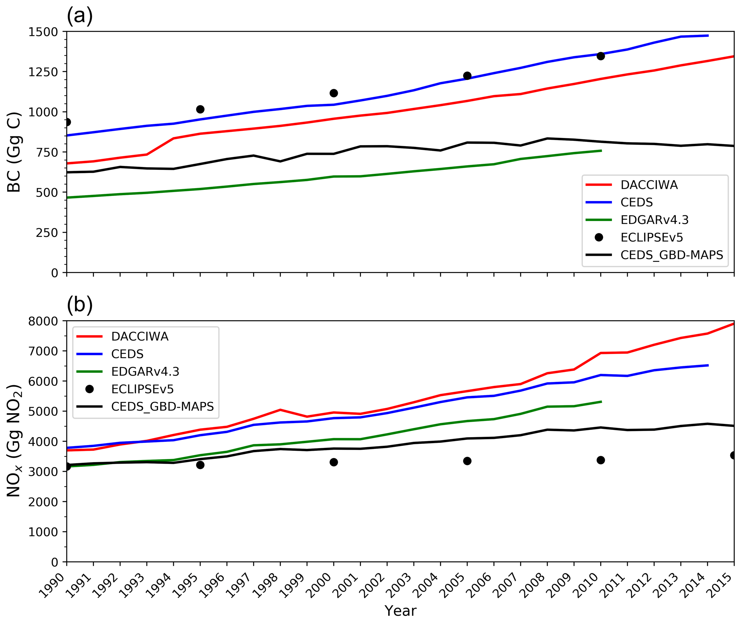
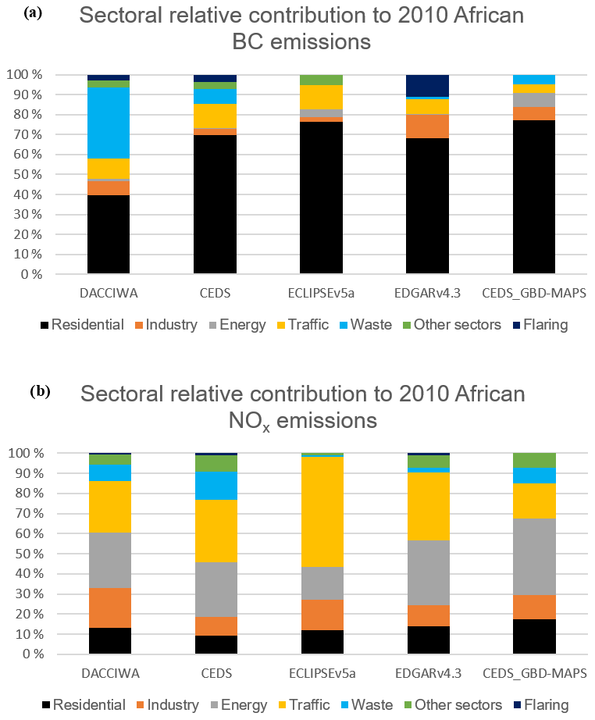
Africa Emissions (DACCIWA) vs other data
African Anthropogenic Emissions Inventory for gases and particles from 1990 to 2015
S. Keita, C. Liousse, E.-M. Assamoi, T. Doumbia, E. T. N'Datchoh, S. Gnamien, N. Elguindi, C. Granier, and V. Yoboué
https://doi.org/10.25326/56

Slide 11
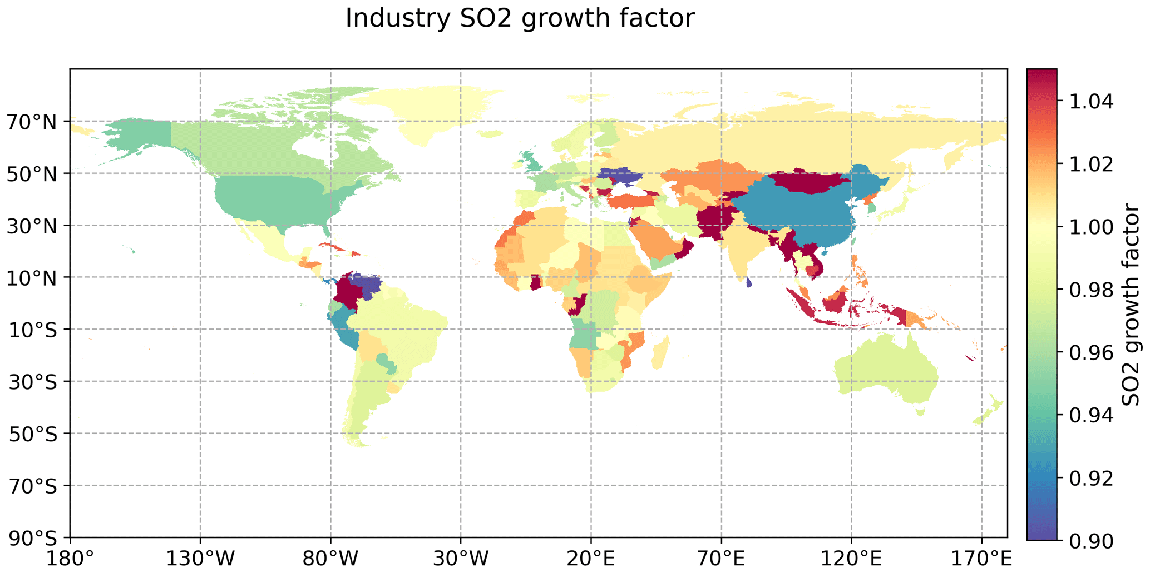
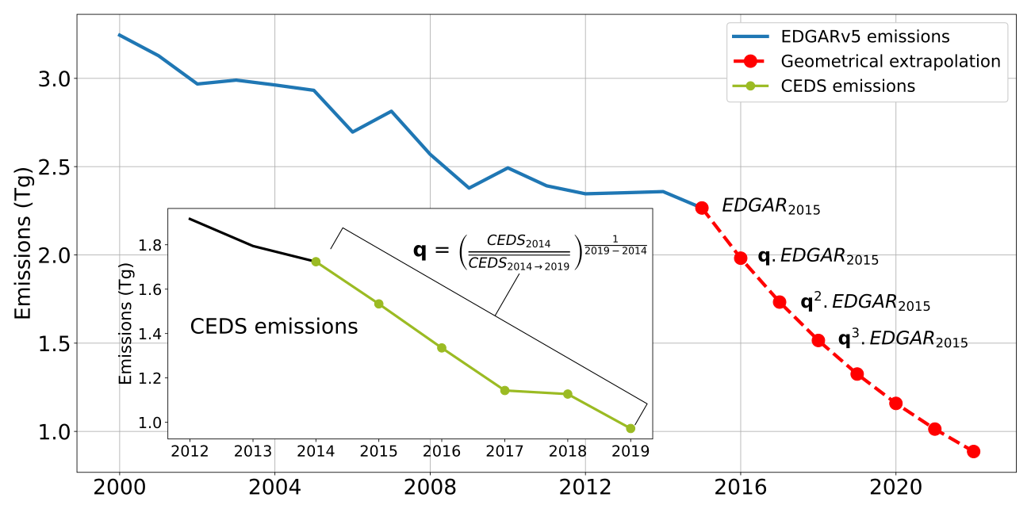
Projections of anthropogenic emissions
Inventory data are often not available for the year of the operational forecasting – they need to projected
Global anthropogenic emissions (CAMS-GLOB-ANT) for the Copernicus Atmosphere Monitoring Service simulations of air quality forecasts and reanalyses
Antonin Soulie, Claire Granier, Sabine Darras, Nicolas Zilbermann, Thierno Doumbia, Marc Guevara, Jukka-Pekka Jalkanen, Sekou Keita, Cathy Liousse, Monica Crippa, Diego Guizzardi, Rachel Hoesly, and Steven J. Smith

Slide 12
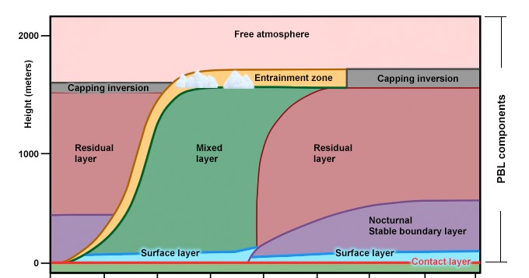
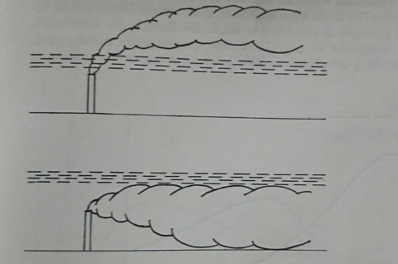


Transport - Mixing of Air Pollution
Plume transport injected below or above an inversion layer
Day
Night
Flemming G., Wald Wetter Klima, 1982
time

Slide 13

Deposition Processes
Note … on global average deposition matches the emissions
… deposition is always proportional to the concentration
In-cloud scavenging
(rainout)
C = Concentration
V_{DD =} = dry deposition velocity =
F (Diffusion, surface and canopy )
C_{res} = scavenging rate =
F (solubility, transfer to droplet)
F_{p} precipitation flux
F
Below-cloud scavenging
(wash-out)
Dry deposition
F_{DD} = V_{DD} * C
Evaporation
Wet deposition
F_{WD} = F_{P} * C _{res}

Slide 14
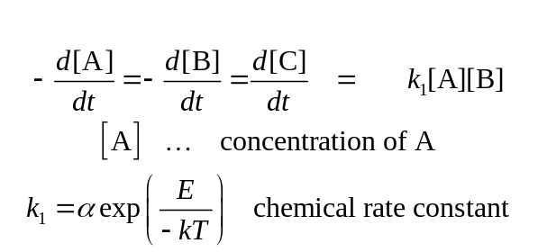
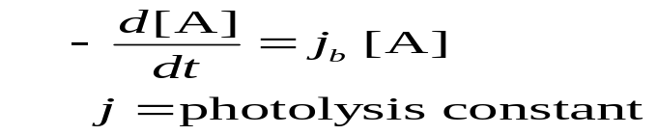
Chemical Kinetics
Reaction speed (= concentration change per time) is proportional to product of concentration of reacting species
Example: A + B → C
Example: Photolysis A + hν → B + C
Chemical Mechanism comprise of 50-150 chemical species and ca 200 chemical reactions are stiff systems of ordinary differential equations, which are solved with dedicated numerical solvers.

Slide 15
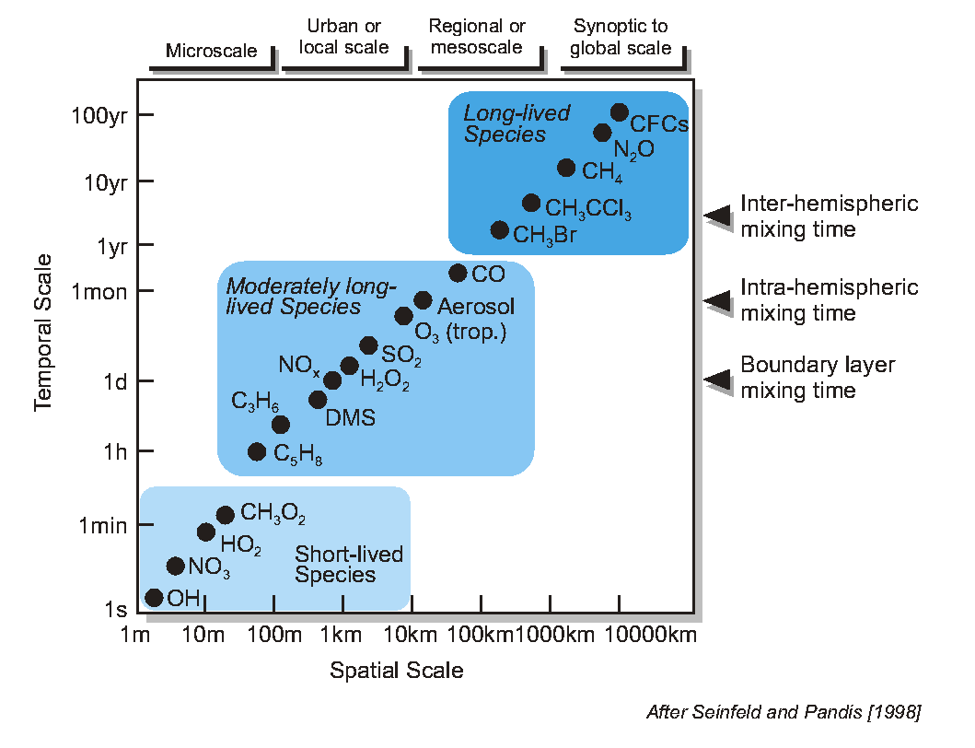
Chemical Lifetime vs. Transport Scale
◄ into stratosphere
No transport modelled

Slide 16
Data assimilation for atmospheric composition

Slide 17
Observations vs Model
Evaluation
(checking models with observations)
Scattered in space
(and time)
Continuous in space and time
Observation
“truth”
model
„theory“
Data Assimilation
(improving models with observations)

Slide 18
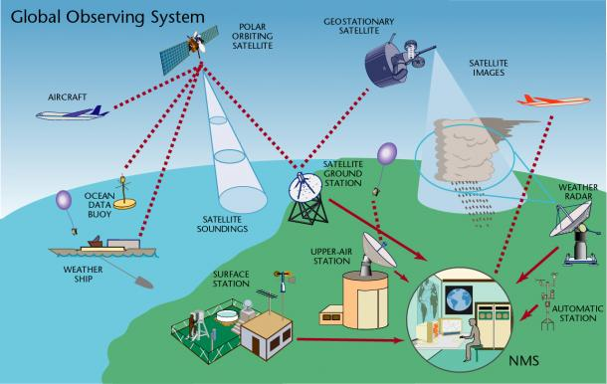

Global observing system
We want to provide information about near-surface air quality
WMO
CAMS assimilates satellite retrievals of atmospheric composition
CAMS uses in-situ data and satellite retrievals for validation

Slide 19
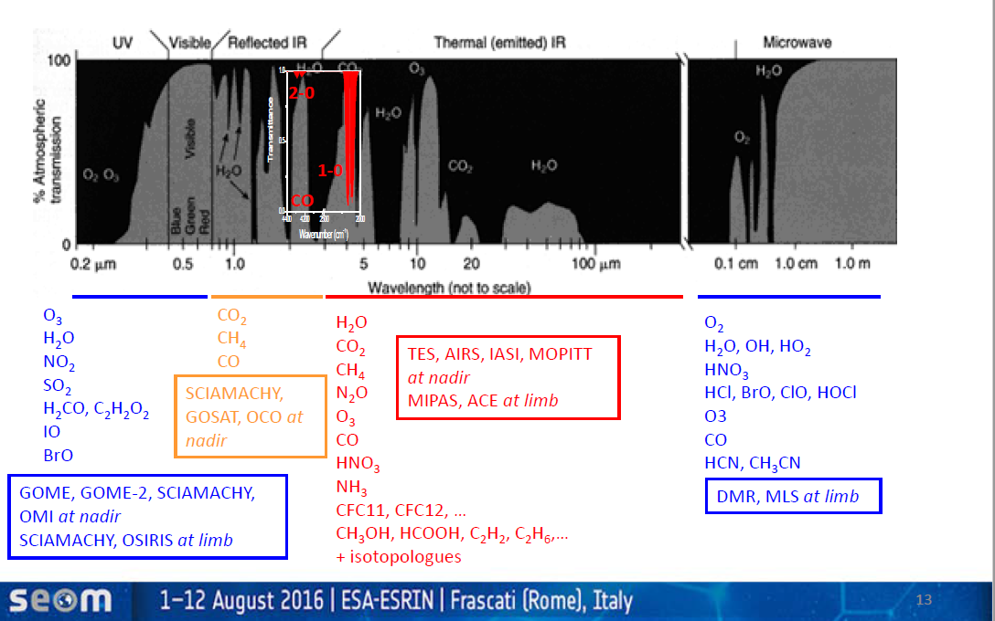
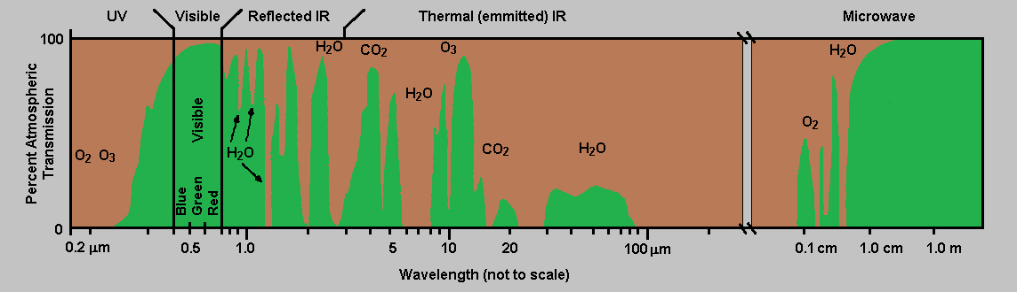
Spectral signature of trace gases
NIR, SWIR
Day-light only
TIR CO 4.7 µm
TROPOMI
AOD MODIS
SWIR CO 2.3 µm
TROPOMI
Credit: M. Van Roozendael

Slide 20
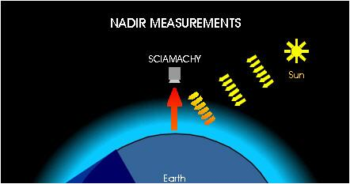
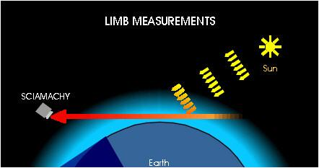
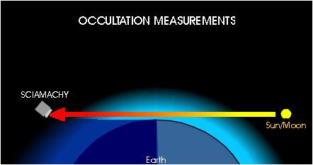
Measurement geometries
Nadir measurements (e.g. TROPOMI, IASI):
Observe atmospheric volume directly under the instrument.
High horizontal resolution, low vertical resolution.
Total columns, partial columns, limited sensitivity to PBL
Limb measurements (e.g. MLS):
Look at the edge of the atmosphere and perform scans at different tangent altitudes over a larger range in horizontal direction.
Low horizontal resolution, but higher vertical resolution.
No info about lower atmosphere.
Ideal for stratospheric composition
Occultation measurements (e.g. ACE-FTS):
Use limb geometry but point directly at sun/ moon/ stars. Atmospheric densities are obtained by comparing measurements of the transmitted solar or lunar radiation with the unattenuated source.
Limited geographical coverage (one sunrise/ sunset per orbit)
Self calibrating
www.iup.uni-bremen.de

Slide 21
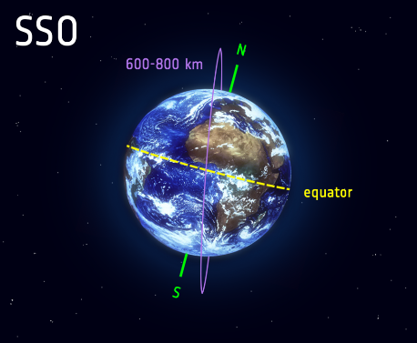
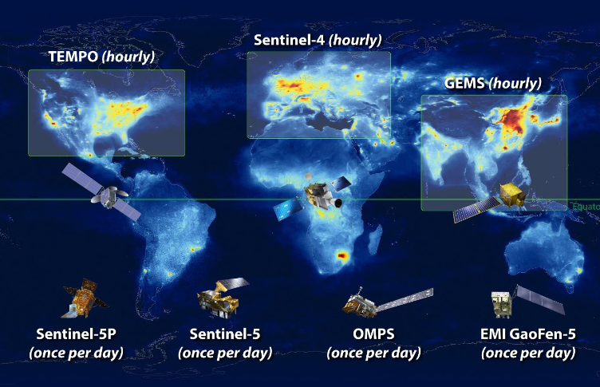
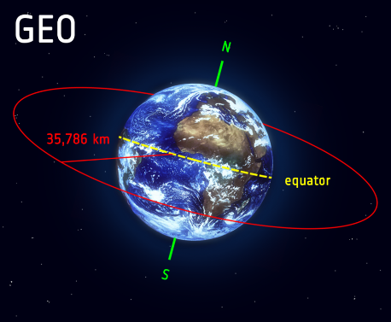
Satellite orbits
Polar Orbit:
Low earth orbit (LEO, 600-800 km)
Sun-synchronous orbit: overpass over given latitude always at the same local time, providing similar illumination
Global measurements possible, but fixed overpass time & no observation of diurnal cycle
Global coverage in a few days (in some cases better); often limited to cloud free conditions
Geostationary Orbit:
36000 km flight altitude, equatorial orbit
Fixed position relative to the Earth,
Limited area from low to middle latitudes,
No global measurements possible
Observations of diurnal cycle
AC constellation planned (GEMS, S4, TEMPO)
www.esa.int

Slide 22
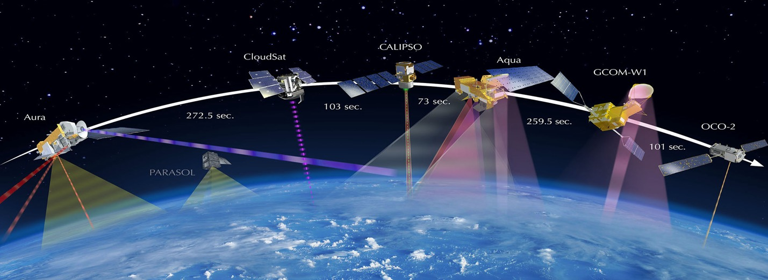
AC Observations used in CAMS global
Species | Instruments
CAMS NRT
O₃ | S5P, GOME-2, OMI, OMPS-NP, MLS, OMPS-LP, GEMS
CO | S5P, IASI, MOPITT
NO₂ | S5P, GOME-2, GEMS
Aerosol | MODIS, VIIRS, PMAp, S3
CO₂ | GOSAT, IASI, OCO-2
CH₄ | GOSAT, IASI, S5P
SO₂ (volcanic) | S5P, GOME-2, IASI
SO2 (anthropogenic) | S5P
HCHO | S5P
GFAS fire emissions | MODIS, VIIRS, GOES, S3
CAMS uses Earth Observation data from many satellites for atmospheric composition and weather.
---- Used
---- Undergoing testing

Slide 23
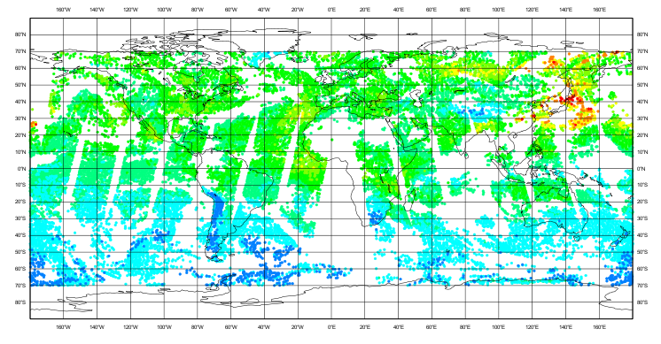
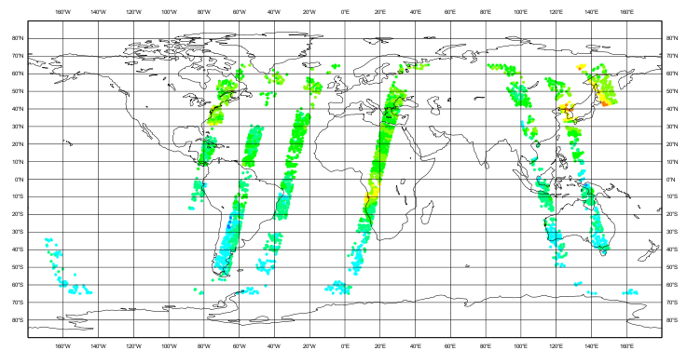
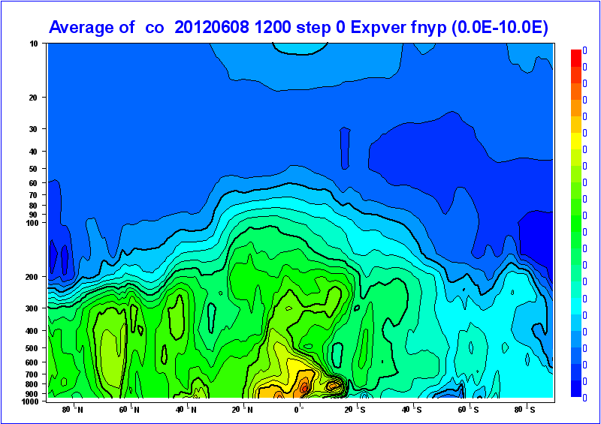
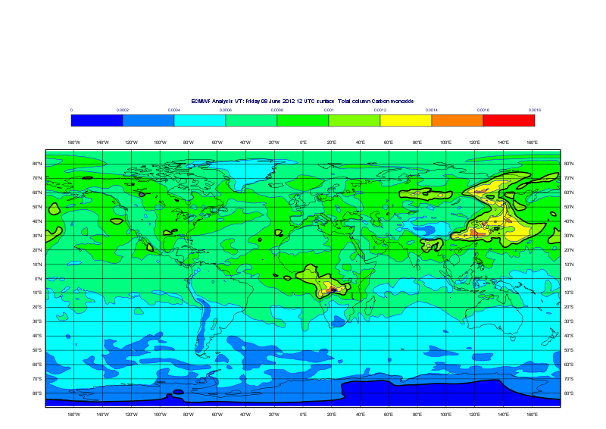
Assimilation of CO observations in a global model
MOPITT CO (NASA/NCAR)
IASI CO (LATMOS/ULB)
Data assimilation is combining multiple observations with a model in an optimal way based on error statistics

Slide 24
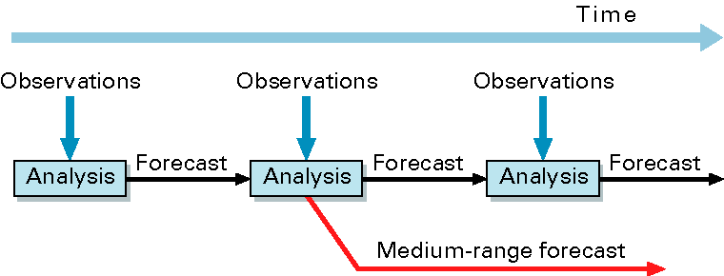
Variational Data assimilation
NWP definition: Combining data and model in an ‘optimal’ way to produce the best possible initial conditions for a numerical forecast
Optimal in a statistical sense: minimize error and/or maximize probability of the analysis being correct
CAMS uses ECMWF’s 4-dimensional variational data assimilation system or 4D-Var with a 12-h window
For AQ it might be of interest to
minimize other parameters too
(e.g. emissions)
model state
Model trajectory from corrected initial state
y
x_{a}
Model trajectory from first guess x_{b}
x_{b}
3
6
9
12
15
time
Assimilation window

Slide 25
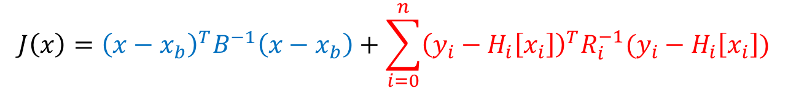
Cost function
Data assimilation for atmospheric composition is in principle no different from NWP data assimilation
Analysis: x that minimizes cost function
$$J\left(x\right)={\left(x−x_{b}\right)}^{T}B^{−1}\left(x−x_{b}\right)+\sum_{i=0}^{n}{{\left(y_{i}−H_{i}\left[x_{i}\right]\right)}^{T}R_{i}^{−1}(y_{i}−H_{i}\left[x_{i}\right])}$$
J_{b}
J_{o}
Cost function
Background term
Observation term
x: control vector
x_{b}: model background (short forecast)
B: Background error covariance matrix
y: Observations
H[x]: Model equivalent of observations
R: Observation error covariance matrix
Strong constraint 4D-Var assumes perfect model over assimilation period
Weak constraint 4D-Var includes a model error term – being developed for O3 and H2O as part of HE CAMEO project

Slide 26
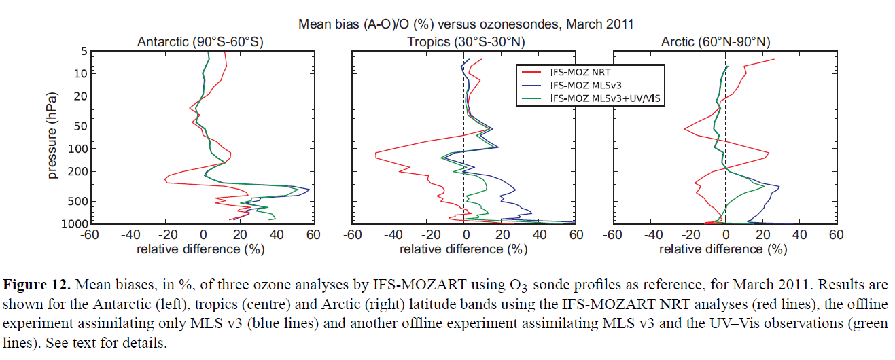
Combining observations in DA system
Lefever et al. (2015, doi:10.5194/acp-15-2269-2015)
Improved quality of ozone analysis if MLS and UV-VIS obs are assimilated together
Tropospheric ozone is improved compared to MLS-only assimilation and stratospheric O3 analysis is not degraded

Slide 27
16 CAMS aerosol tracers
Sea salt Bin 1
Sea salt Bin 2
Sea salt Bin 3
Nitrate from gas/particle portioning
fine
Desert Dust Bin 1
Desert Dust Bin 2
Desert Dust Bin 3
Nitrate from het. Reactions coarse
Organic matter hydrophobic
Organic matter hydrophilic
Black carbon hydrophobic
Black carbon
hydrophilic
Ammonium
Sulphate
SOA biogenic
SOA anthropogenic

Slide 28
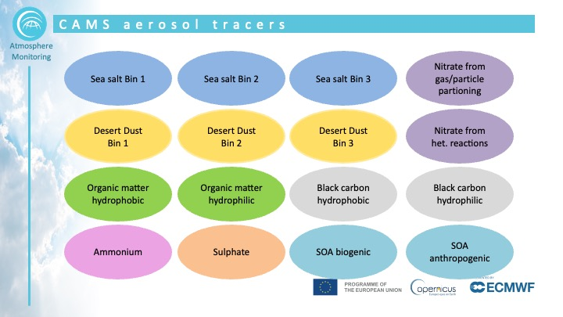
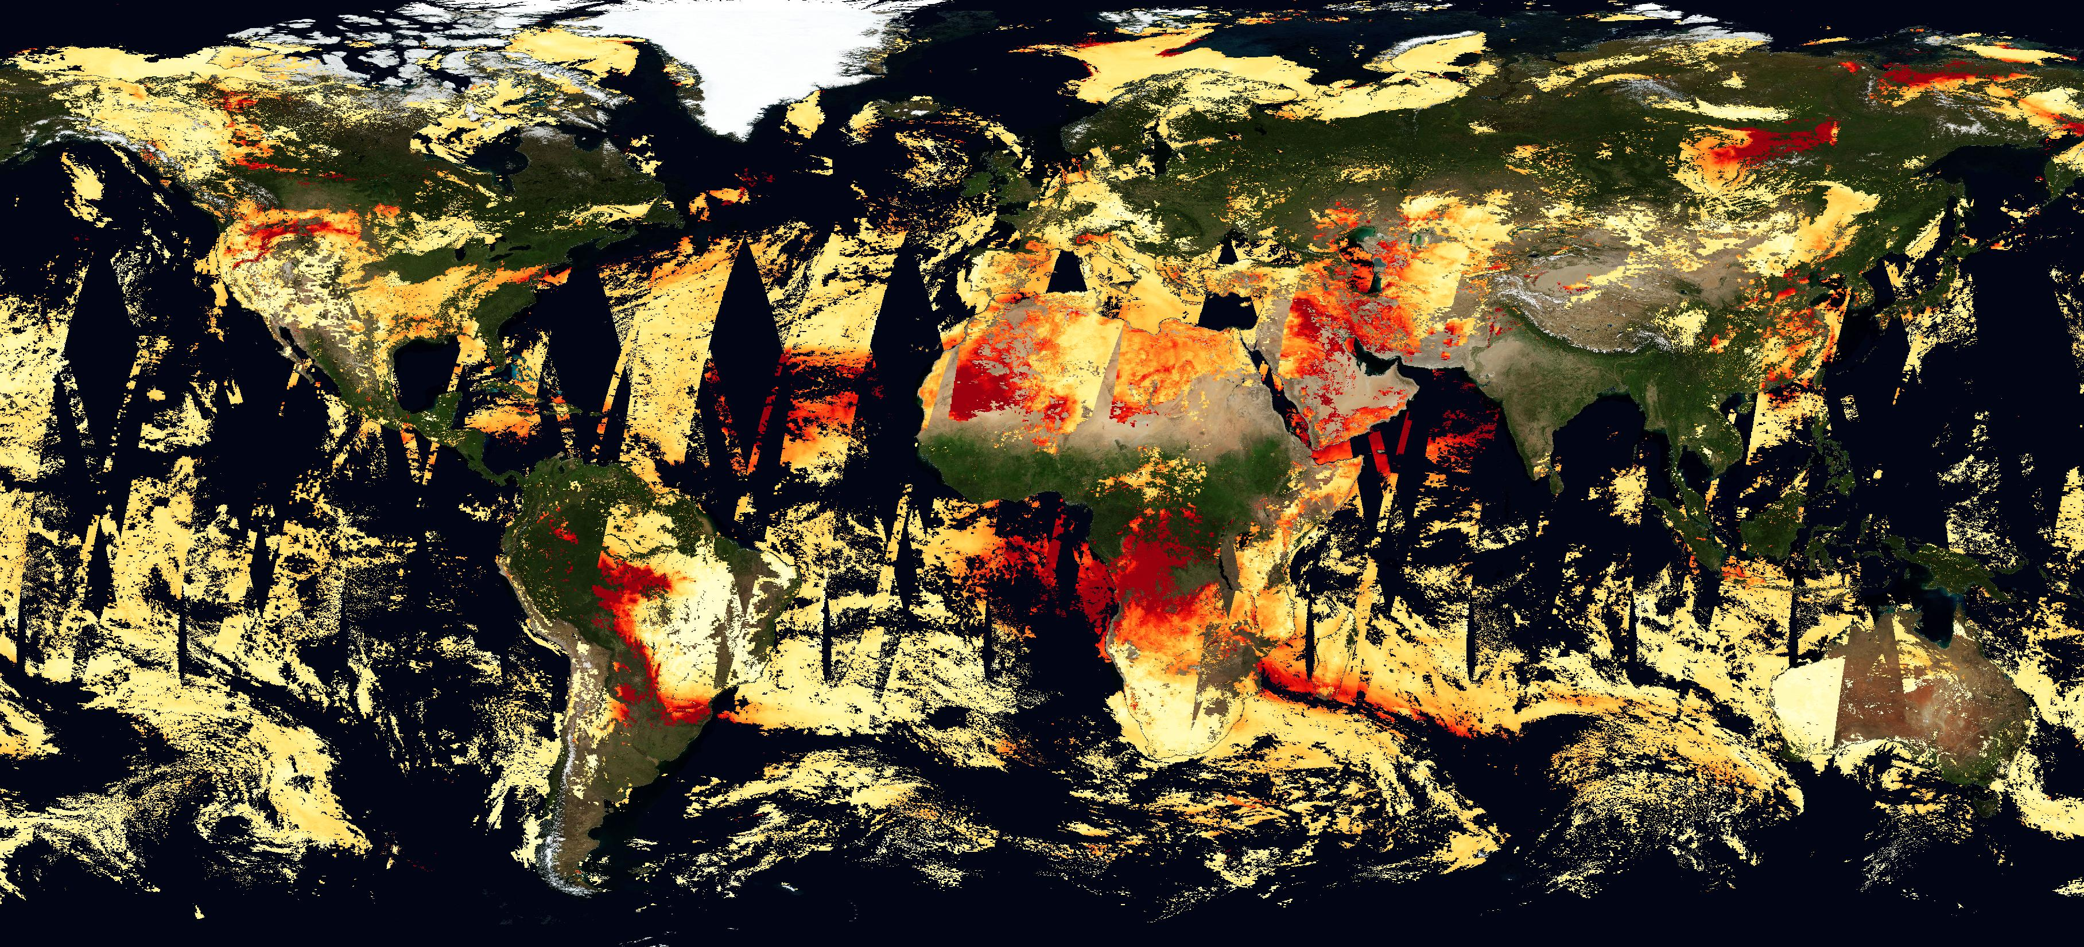

Forward AOD observation operator
Model fields are aerosol mixing ratios of 16 tracers
Assimilated data are total AOD at 550 nm (e.g. from MODIS, VIIRS, PMAp)
We need to transform aerosol mixing ratios into total AOD
MODIS AOD
Credit: Nasa Worldview
Forward AOD observation operator steps:
Control variable is total aerosol mixing ratio
Interpolate aerosol mass mixing ratios to obs location & time
Calculate model RH: it has impact on the optical properties of hygroscopic aerosol
Get mass extinction coef at waveleghth (e.g. 550 nm) from a look-up table
Multiply (3) * (1) to get single-species AODs
Total AOD is sum of single-species AOD
Straight forward
Notes:
The observation operator used to transform the aerosol mass mixing ratios into AOD consists of a lookup table (LUT) of aerosol optical properties which were computed assuming externally mixed aerosol species, spherical shape and a lognormal size distribution prescribed for each aerosol species. The relative humidity derived from the IFS meteorological variables is used to represent its impact on the optical properties of hygroscopic aerosol. The aerosol mass of each aerosol species is first interpolated at the location and time of the observation and then integrated vertically. AOD at 0.55 µm for each individual aerosol species is computed from the extinction coefficient stored in the LUT, and then the total AOD is calculated as the sum of the individual species AOD.
From Garrigues et al. (2023): https://doi.org/10.5194/acp-23-10473-2023, 2023.

Slide 29
Adjoint AOD observation operator
MODIS AOD
Credit: Nasa Worldview
Adjoint AOD observation operator steps:
AOD analysis increments transferred to total aerosol mixing ratio
Analysis increments are repartitioned into the 16 species according to their fractional contribution to the total aerosol mixing ratio of the background forecast
Largest contribution for dominant aerosol species
Can not ‘create’ a species if not present in background forecast
The repartitioning of the total aerosol mixing ratio increment into the different bins can lead to problems with the aerosol speciation
Not well constrained

Slide 30
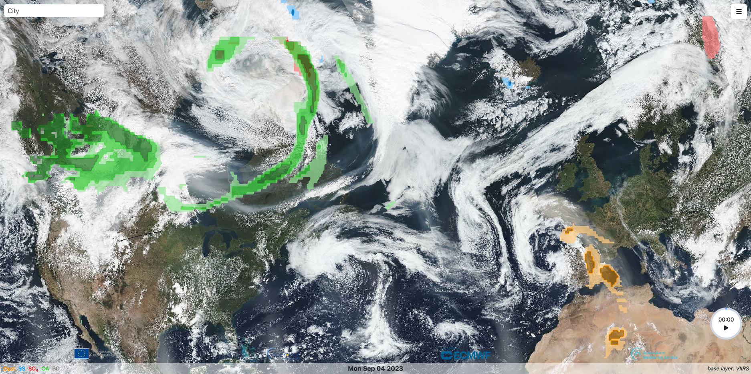
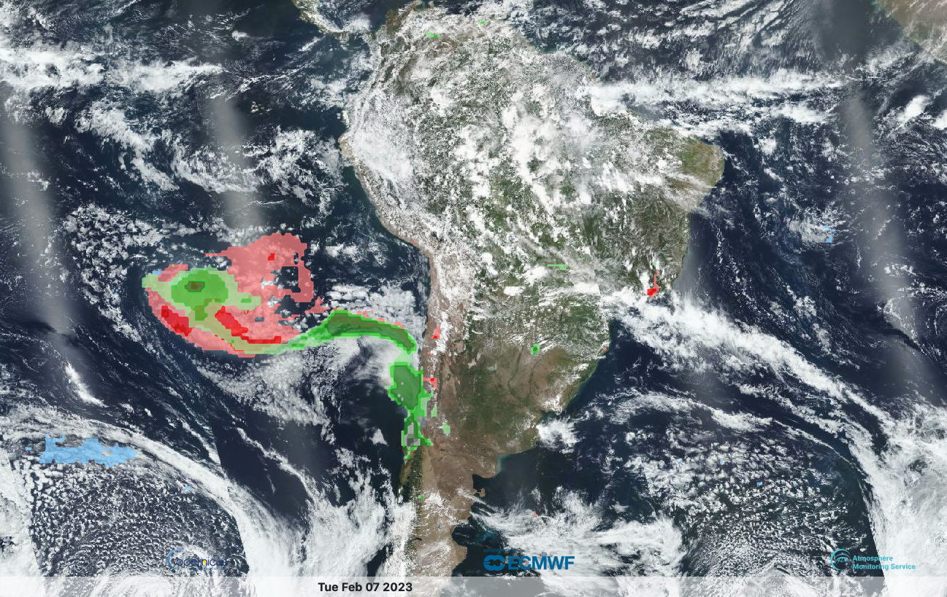
Examples of CAMS aerosol species
Good example
Not so good example
Organic matter, desert dust, sea salt, sulphate
Part of fire plume is attributed to sulphate which is the dominant species in background forecast
CAMS aerosol alerts:
https://aerosol-alerts.atmosphere.copernicus.eu/

Slide 31
Global CAMS production, products and evaluation

Slide 32
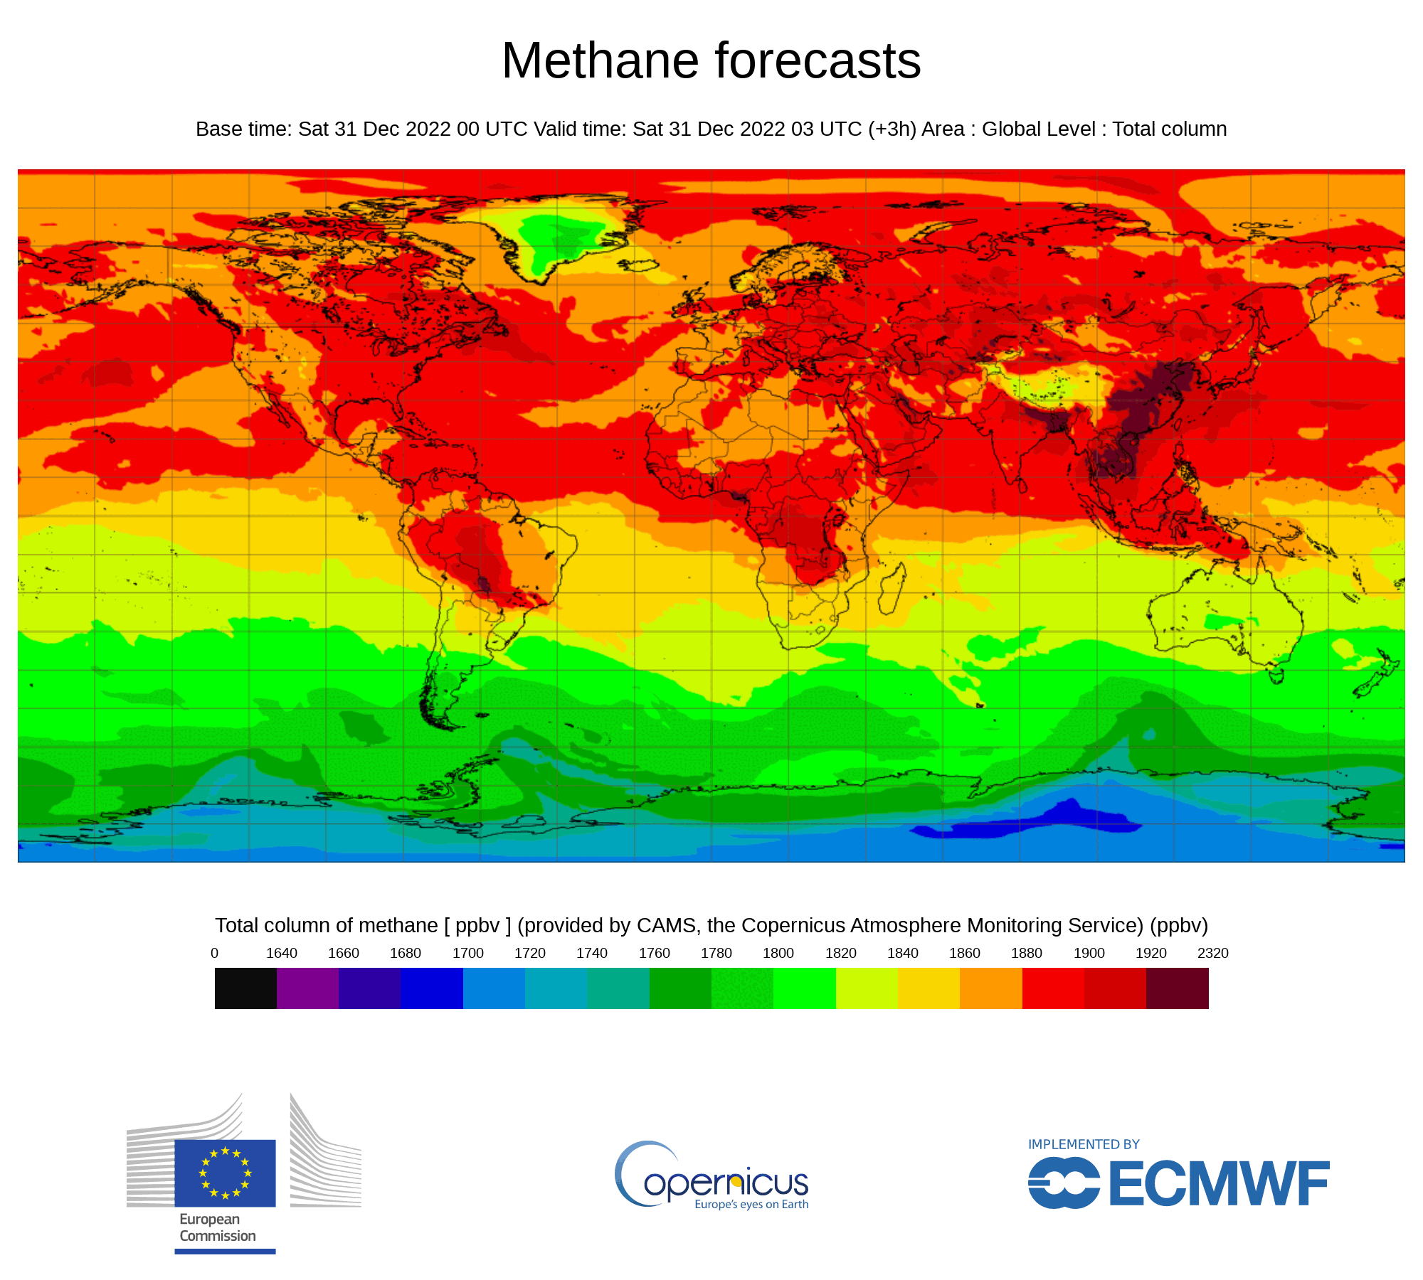
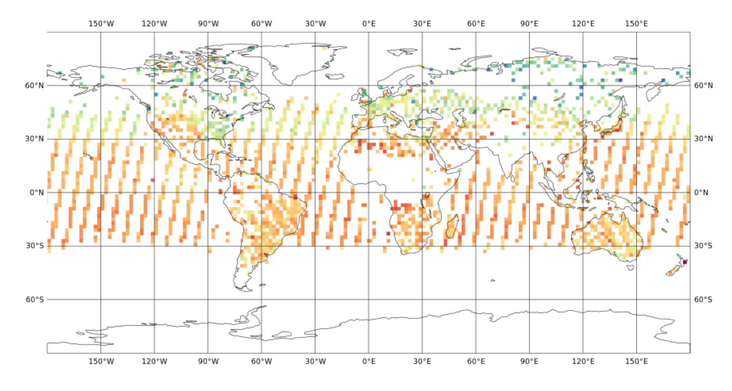
CAMS Global Forecasts – CO₂ as example
Satellite observations (GOSAT & IASI)
Medium-range forecast
Forecast
Analysis
Forecast
Analysis
Yesterday’s forecast is adjusted by today’s observations to produce the outlook for tomorrow. Every day.

Slide 33
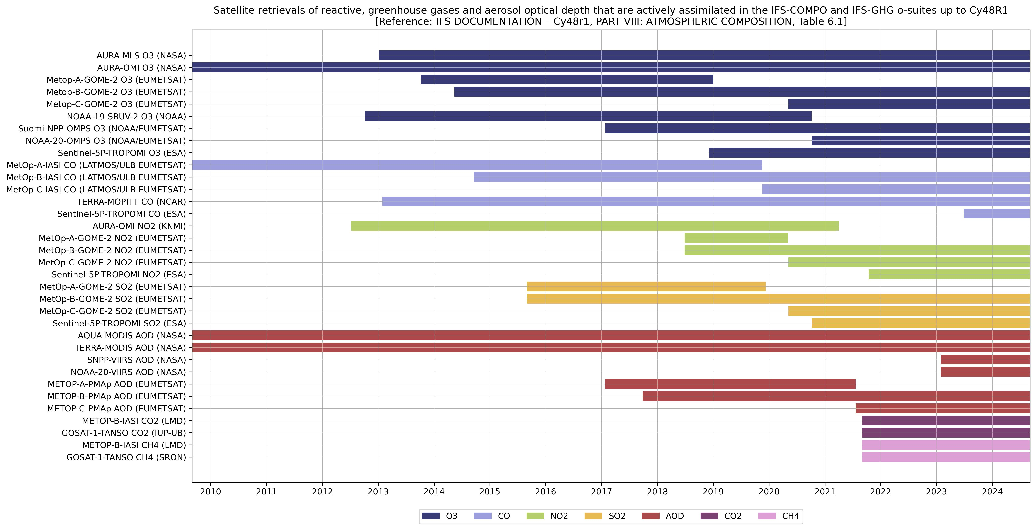
Satellite data usage in CAMS global forecast system
European
30

Slide 34







Observation data flow at ECMWF
EUMETCast
Ingestion & processing
(SAPP)
Analysis & forecast
(Atos supercomputer)
internet
Acquisition (ECPDS)
Data storage (DHS)
GTS

Slide 35
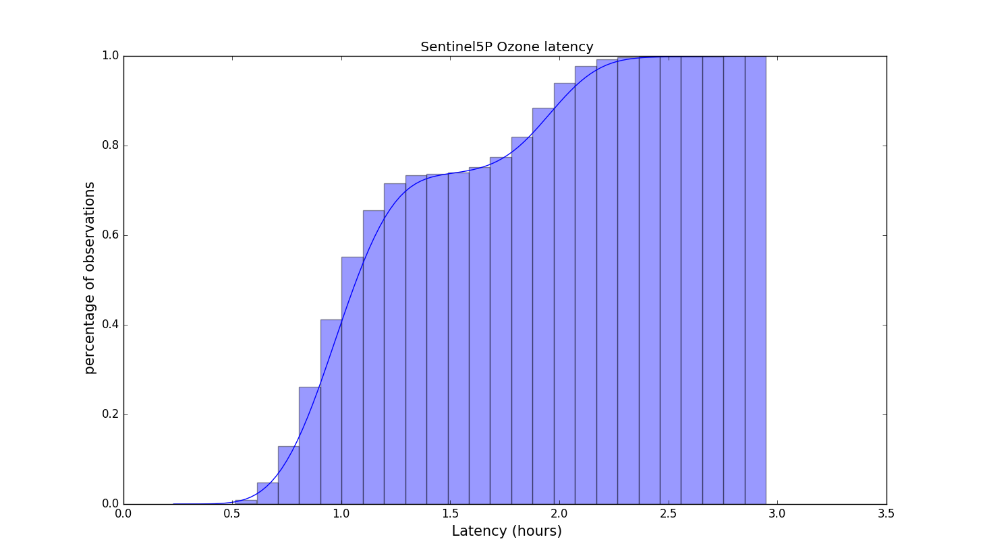
Timeliness of data(Example S5P O3)
00Z analysis window
Time
(UTC hours)
15
00
03
07
Observation cut-off
12Z analysis window
Time
(UTC hours)
03
12
15
19
2.5 hours
Observation cut-off
Timeliness of observations is important
Observations received within 4 hours of sensing time are guaranteed to be included in the 12-hour analysis window
Arrival time – sensing time

Slide 36
CAMS global products
Forecast of atmospheric composition and air quality for 5 days ahead started at 00 and 12 UTC
  Aerosols, PM2.5/10, reactive gases such Ozone, CO, NOx at the surface in the troposphere
  Stratospheric chemistry such as ozone hole and simple aerosol scheme.
  Data assimilation of AOD, O₃, NO₂, CO and SO₂ as well as CO₂ and CH₄ satellite retrievals to improve initial conditions of forecasts
  Globally at 40 km resolution
  CO₂ and CH₄ forecast a 9km resolution
Re-analysis of atmospheric composition in a consistent way from 2003 – present day (6 month delay)
  Data assimilation AOD, O₃, NO₂, CO and SO₂
  Globally at 80 km resolution, update at 40 km in progress (
Emissions
  Daily emissions from wildfires bases on FRP satellite observations (GFAS)
  Anthropogenic emissions inventory CAMS-GLOB-ANT 6.2 (based on EDGAR 7)
  Biogenic emission inventory CAMS-GLOB-BIO 3.1
Derived products
  solar energy radiation (clouds and CAMS aerosols)
  Aerosol alert service

Slide 37
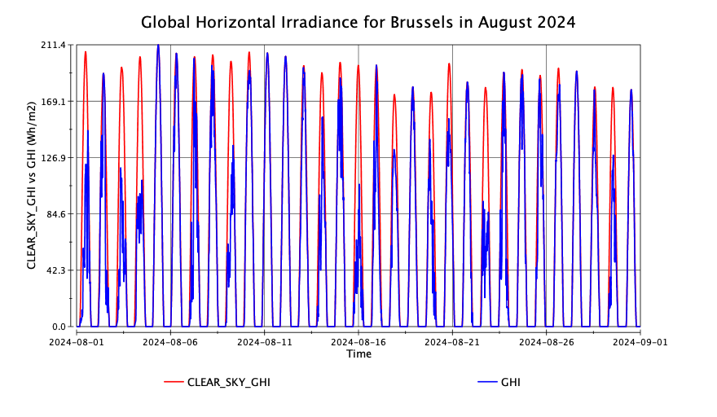
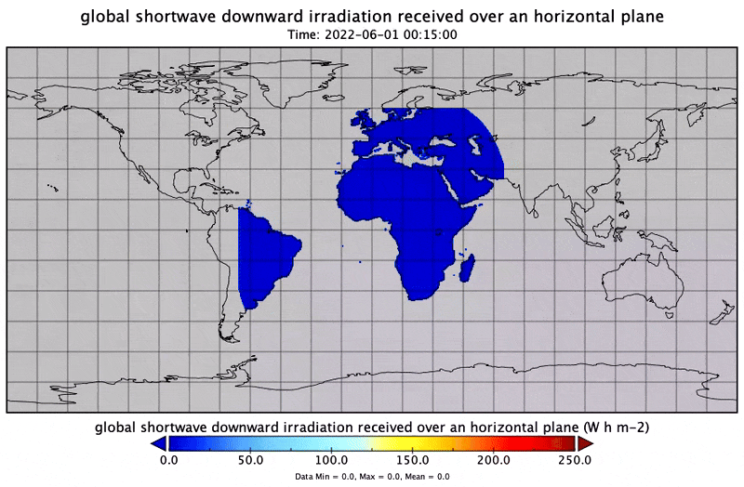
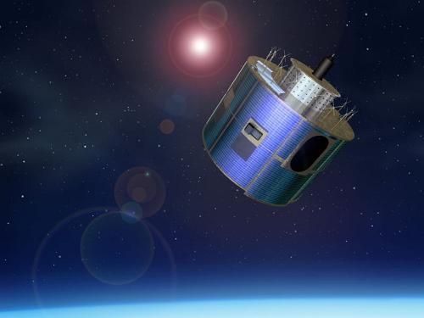
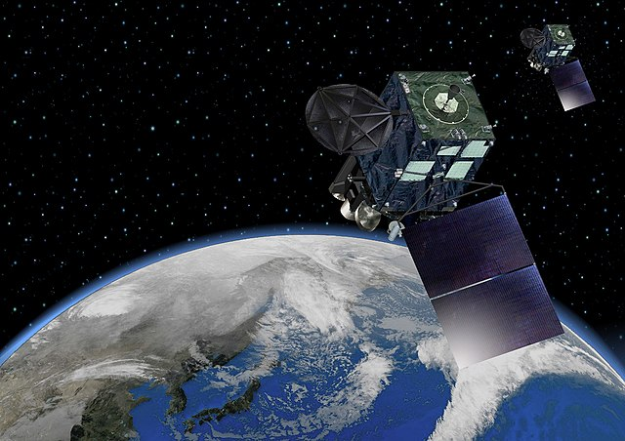
Solar energy
MSG
Himawari
Combining cloud information from geostationary satellites with ozone and aerosol information from CAMS global forecasting system.
By met.no, Attribution, https://commons.wikimedia.org/w/index.php?curid=17791231
By Japan Meteorological Agency, CC BY 4.0, https://commons.wikimedia.org/w/index.php?curid=107708221

Slide 38
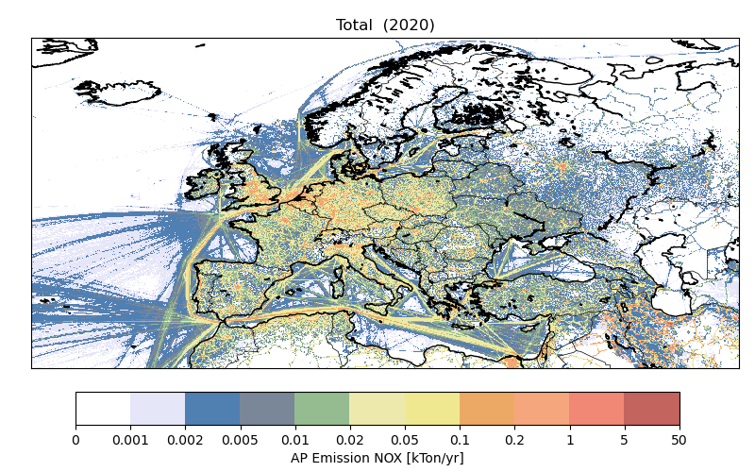
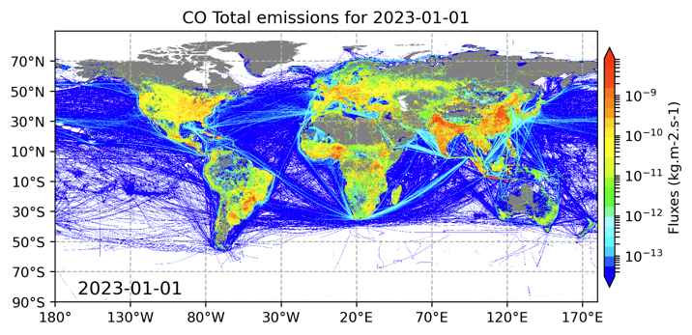
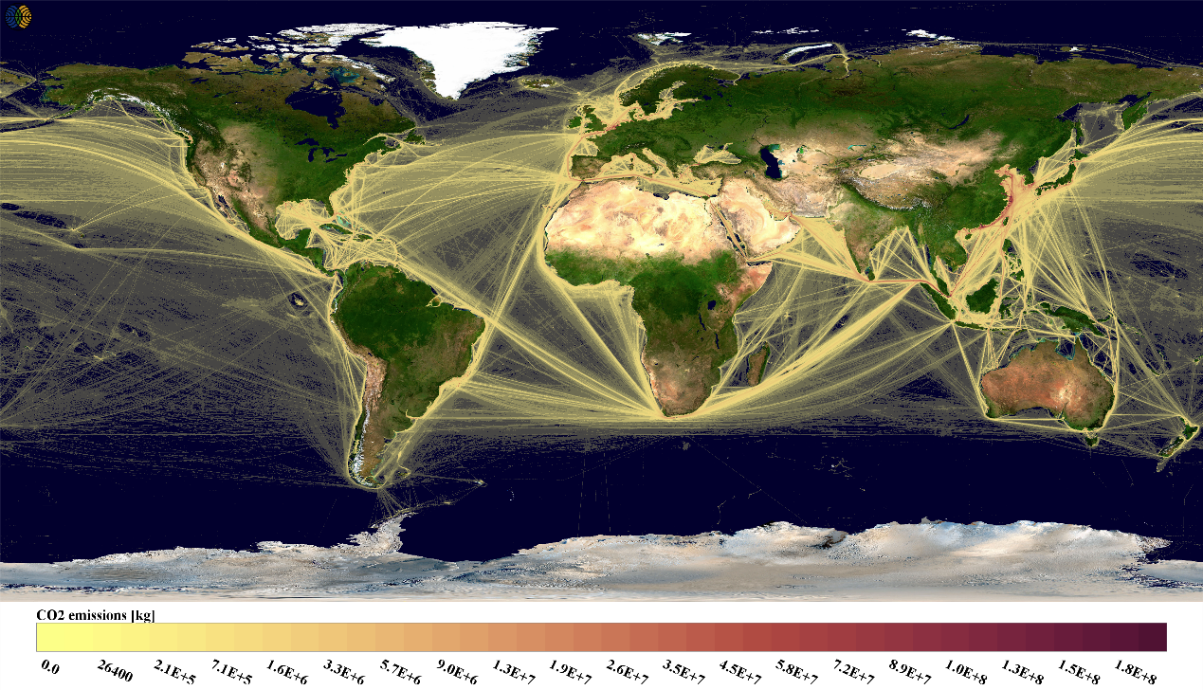
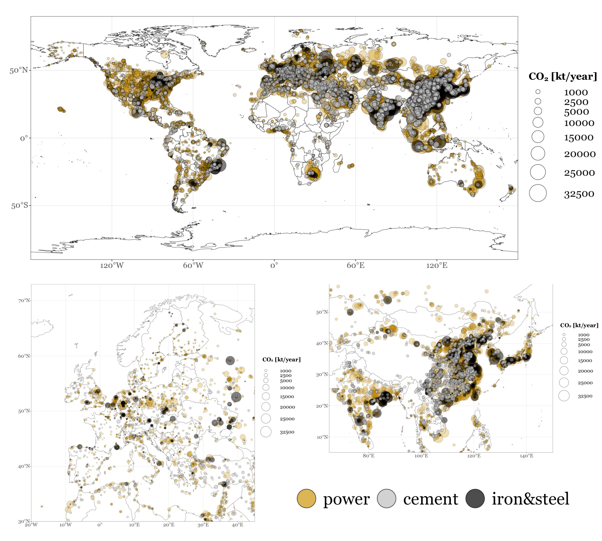




CAMS bottom-up emissions
Regional emission inventories for Europe, consistent with national reported emissions to EMEP/CEIP and UNFCCC | Global emission inventories based on EDGAR and CEDS with projection to current year | Shipping emissions based on STEAM model with inputs from EMSA
Point source data base | Temporal profiles | Daily fire emissions (GFAS)
Activity-based CO2 emissions (to be extended to other species) | Model-based vegetation fluxes (e.g., CO2 and isoprenes)
24

Slide 39


NEW: the Aerosol alert system
The new CAMS aerosol warning system allows users to see (or even receive or declare) warnings for anomalous aerosol events.
https://aerosol-alerts.atmosphere.copernicus.eu

Slide 40

Presenting Global CAMS Forecast
https://atmosphere.copernicus.eu/charts/packages/cams/

Slide 41

Presenting Global CAMS Forecast
Windy.com - select layer air pollution

Slide 42





Observations for Verification
AQ Airbase
AQ Airnow
AQ China
AOD Aeronet
Ozone Sondes

Slide 43



Slide 44


AOD verification JAS 2024 – Examples

Slide 45


Validation and Documentation (Routine)
All CAMS products are document and quality-controlled evaluated. EQC reports are regularly published

Slide 46



Atmosphere Data Store
https://ads-beta.atmosphere.copernicus.eu/
Documentation
Download
Overview of dataset

Slide 47


USER SUPPORT

