Slide 1
Model Types and Systems for AQ forecasting
M.Sofiev
with material of
A.Uppstu, R.Hanninen, R.Kouznetsov, SILAM team

Slide 2
Outline: add-ons to previous talks
AQ ensemble forecasting
AQ applications of SILAM model
  landscape fires system IS4FIRES
  dust forecasting in Africa
  source inversion via data assimilation

Slide 3
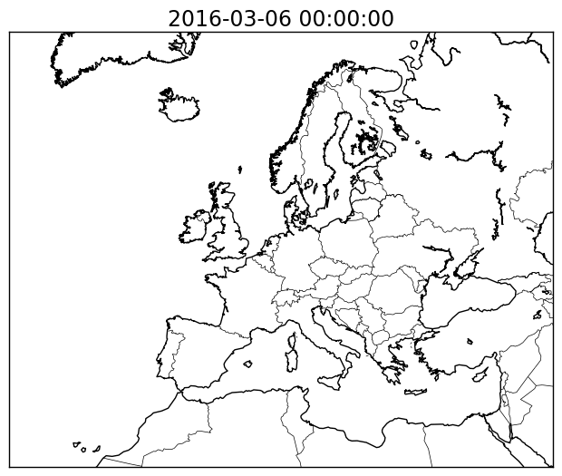
Ensemble AQ forecasting
All models have uncertainties, in most cases poorly quantified
AQ models have external source of uncertainties
  emission inventories
  meteorological fields
Random uncorrelated errors can be reduced by averaging
Idea: generate / take many predictions of the same
phenomenon and average
How to construct such ensemble?
Most-important choice to make: what variable(s) to vary?
  Variation should be meaningful
  System should be sensitive to the varying parameter
Two key approaches
  single-model ensemble: 80 plume predictions for an eruption, EnKF
  multi-model ensemble: EMEP-HM1996, COST-728,
  MarkoPolo-Panda, CAMS, PAPILA, …
EnKF ensemble, 80 members,
ash concentrations at ~FL250.
Red: > 0.2 mg/m³ in ≥ 50 % ensemble members.
Orange: > 0.2 mg/m³ in ≥ 2 % ensemble members
Fake eruption

Slide 4
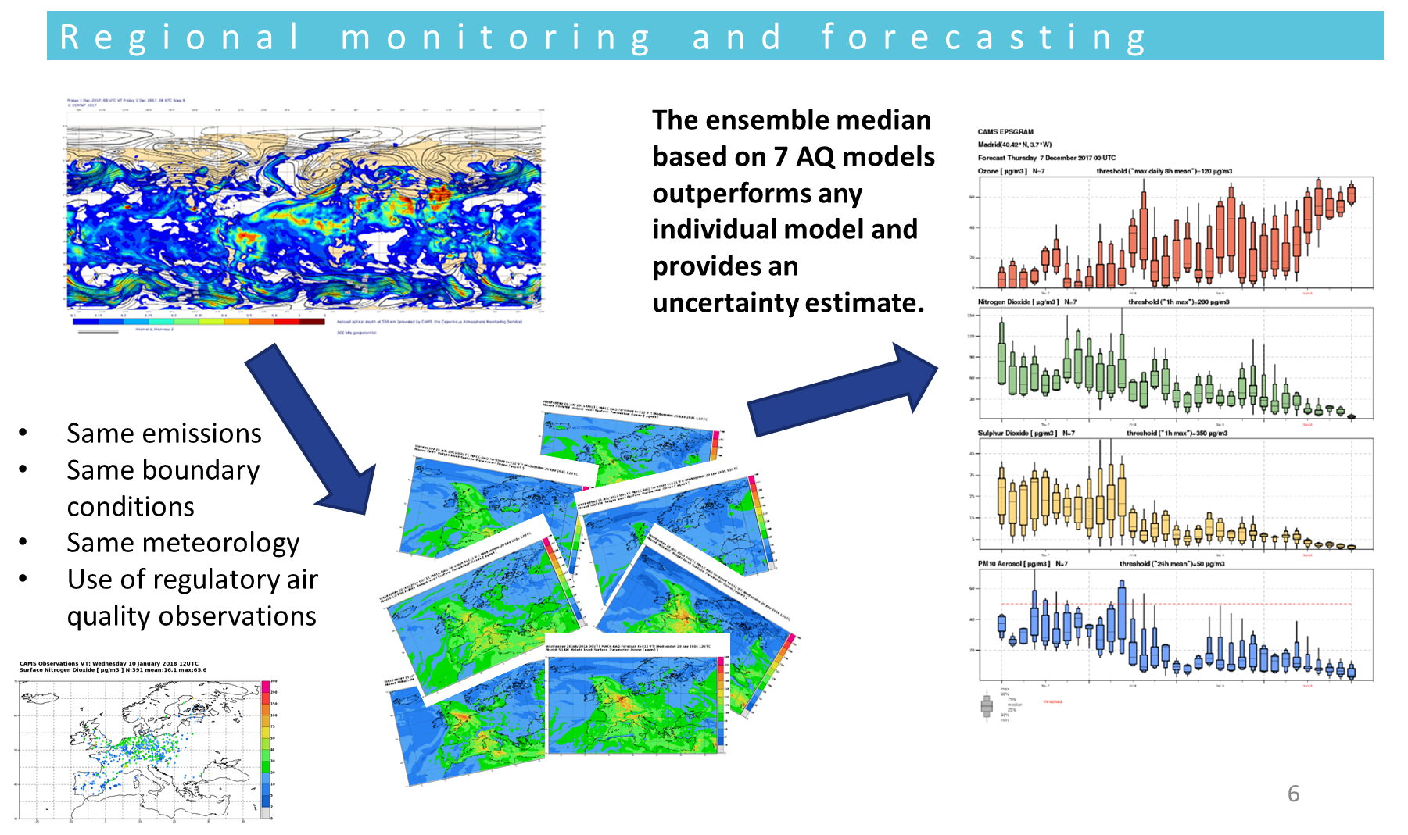

Multimodel ensemble AQ forecasting:
Copernicus Atmosphere Monitoring Service (CAMS)

Slide 5
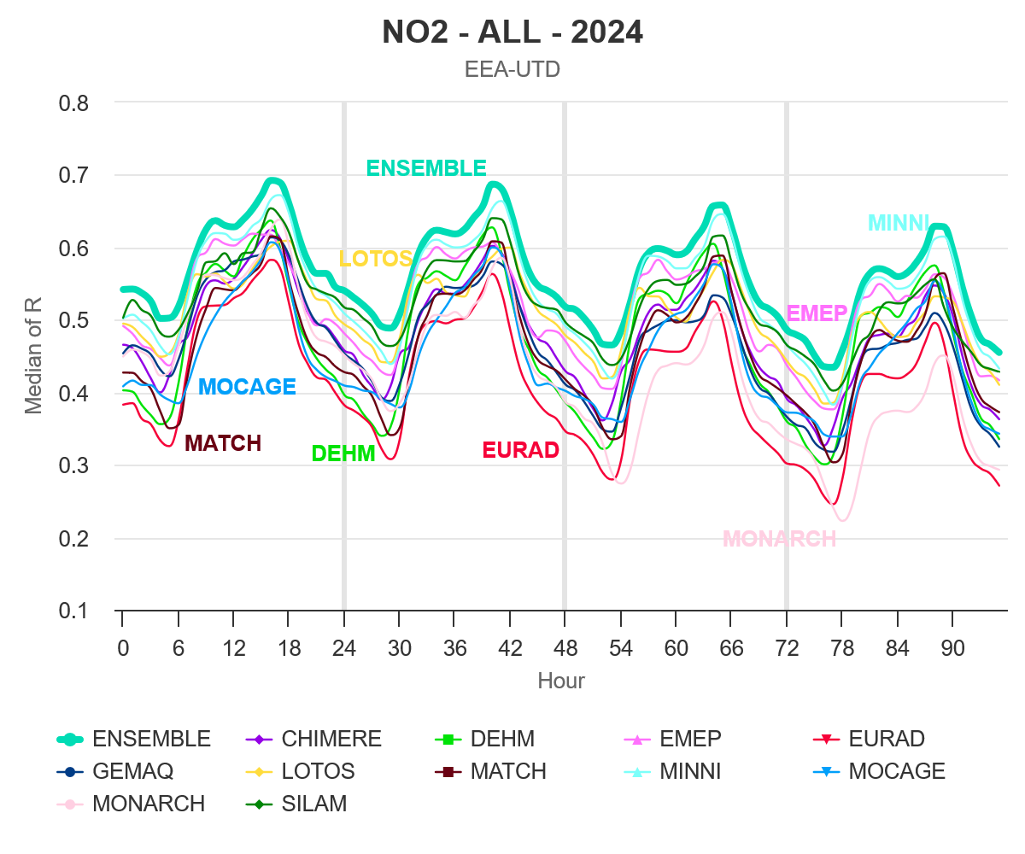
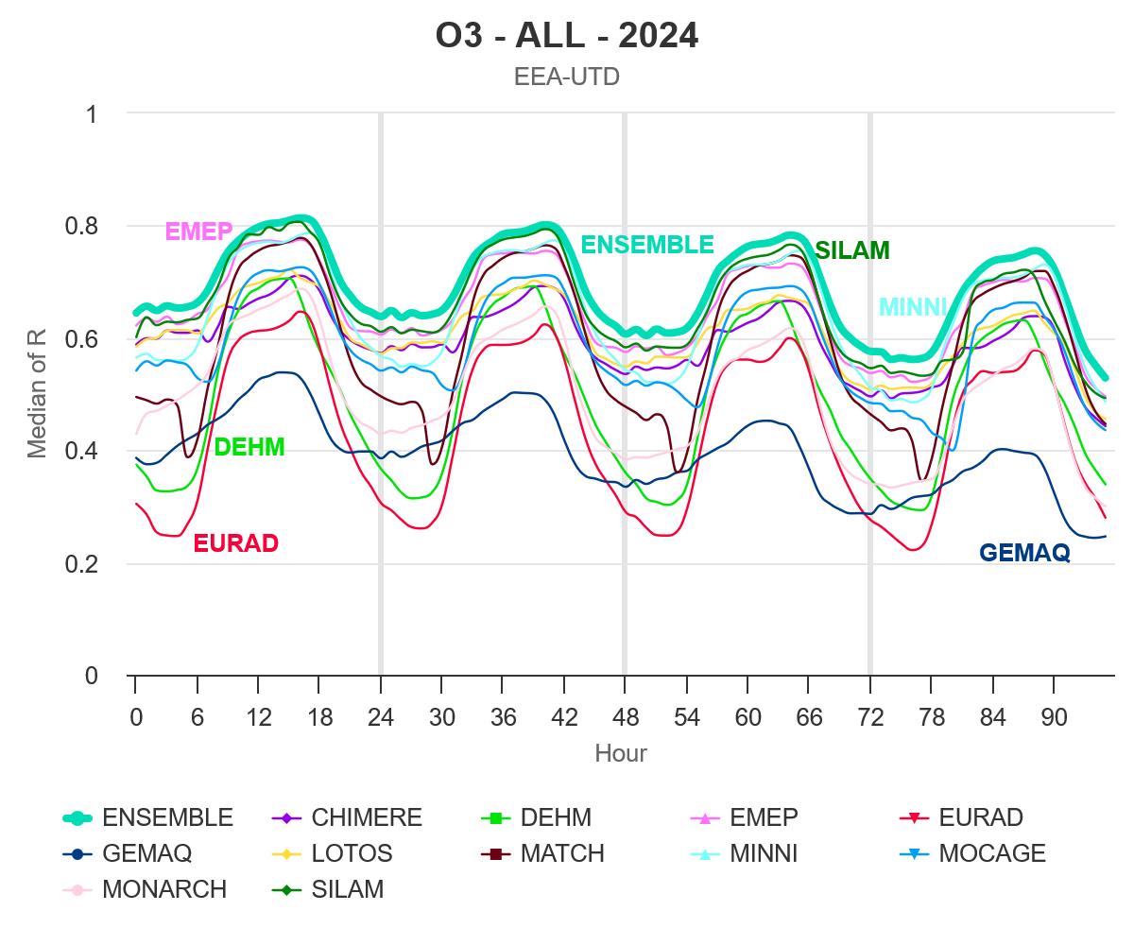
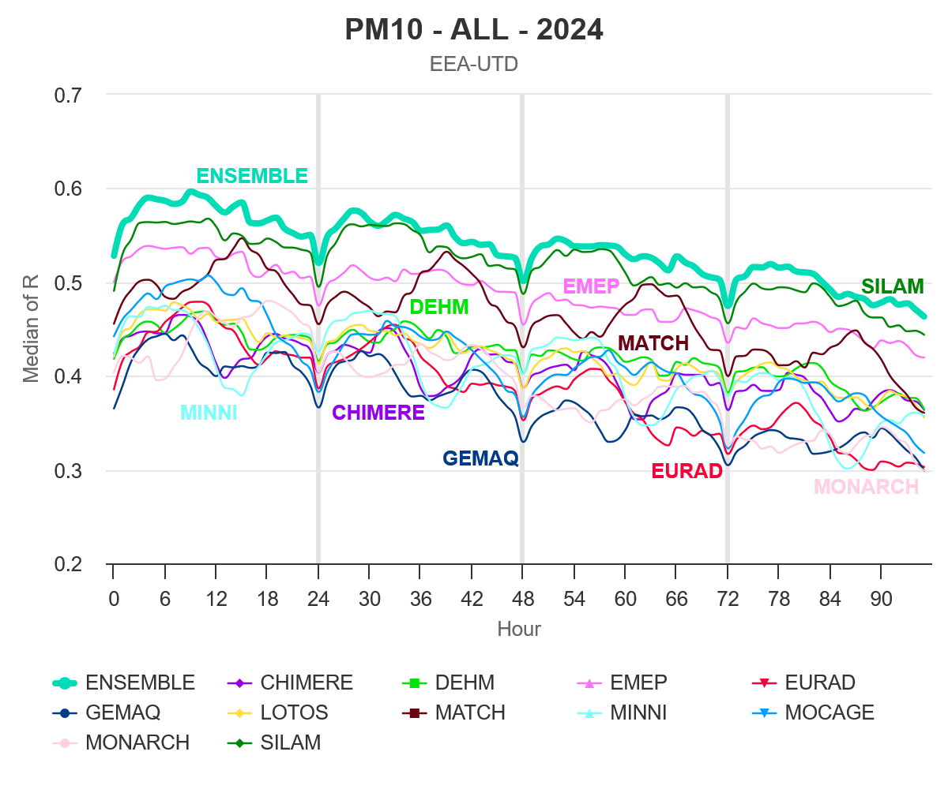
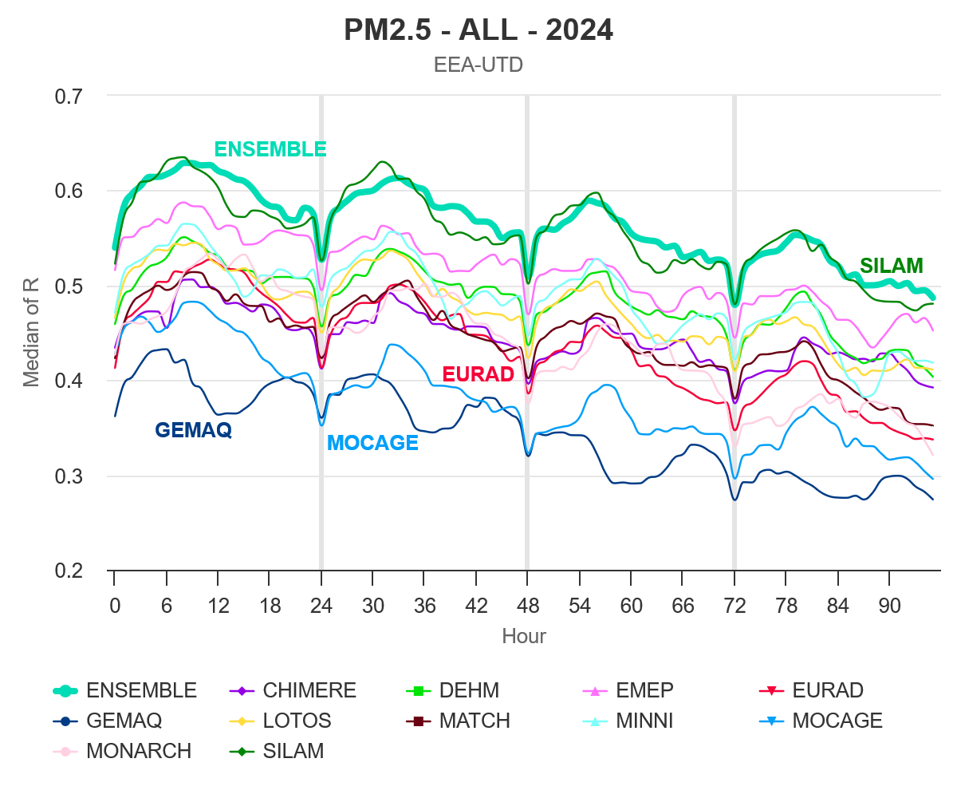
CAMS ensemble prediction skills: correlation

Slide 6
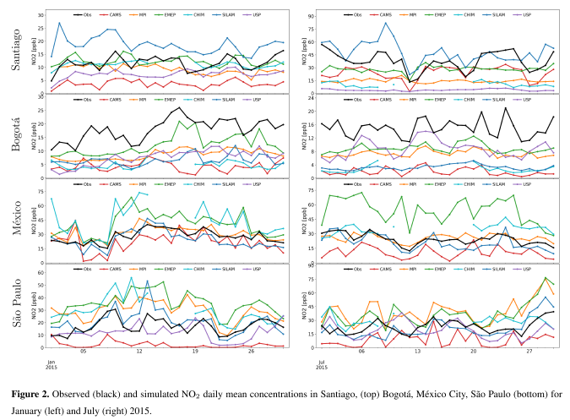
PAPILA ensemble for Latin America:
AQF over poorly known area

Slide 7
SILAM model
An offline chemistry-transport model
Global-to-local scales (up to 10 m resolution)
Spans over the troposphere and the stratosphere with the corresponding physical and chemical mechanisms
Eulerian and Lagrangian transport schemes (AQF is based on Eulerian framework)
Incorporates adjoint dispersion formalism, 3D- and 4D- variational and ensemble Kalman filter data assimilation
Developed for a wide variety of problems, from emergency decision support to air quality and atmospheric composition studies and operational activities
Open-code system, installed in 7 countries, modules used in >10 other models

Slide 8
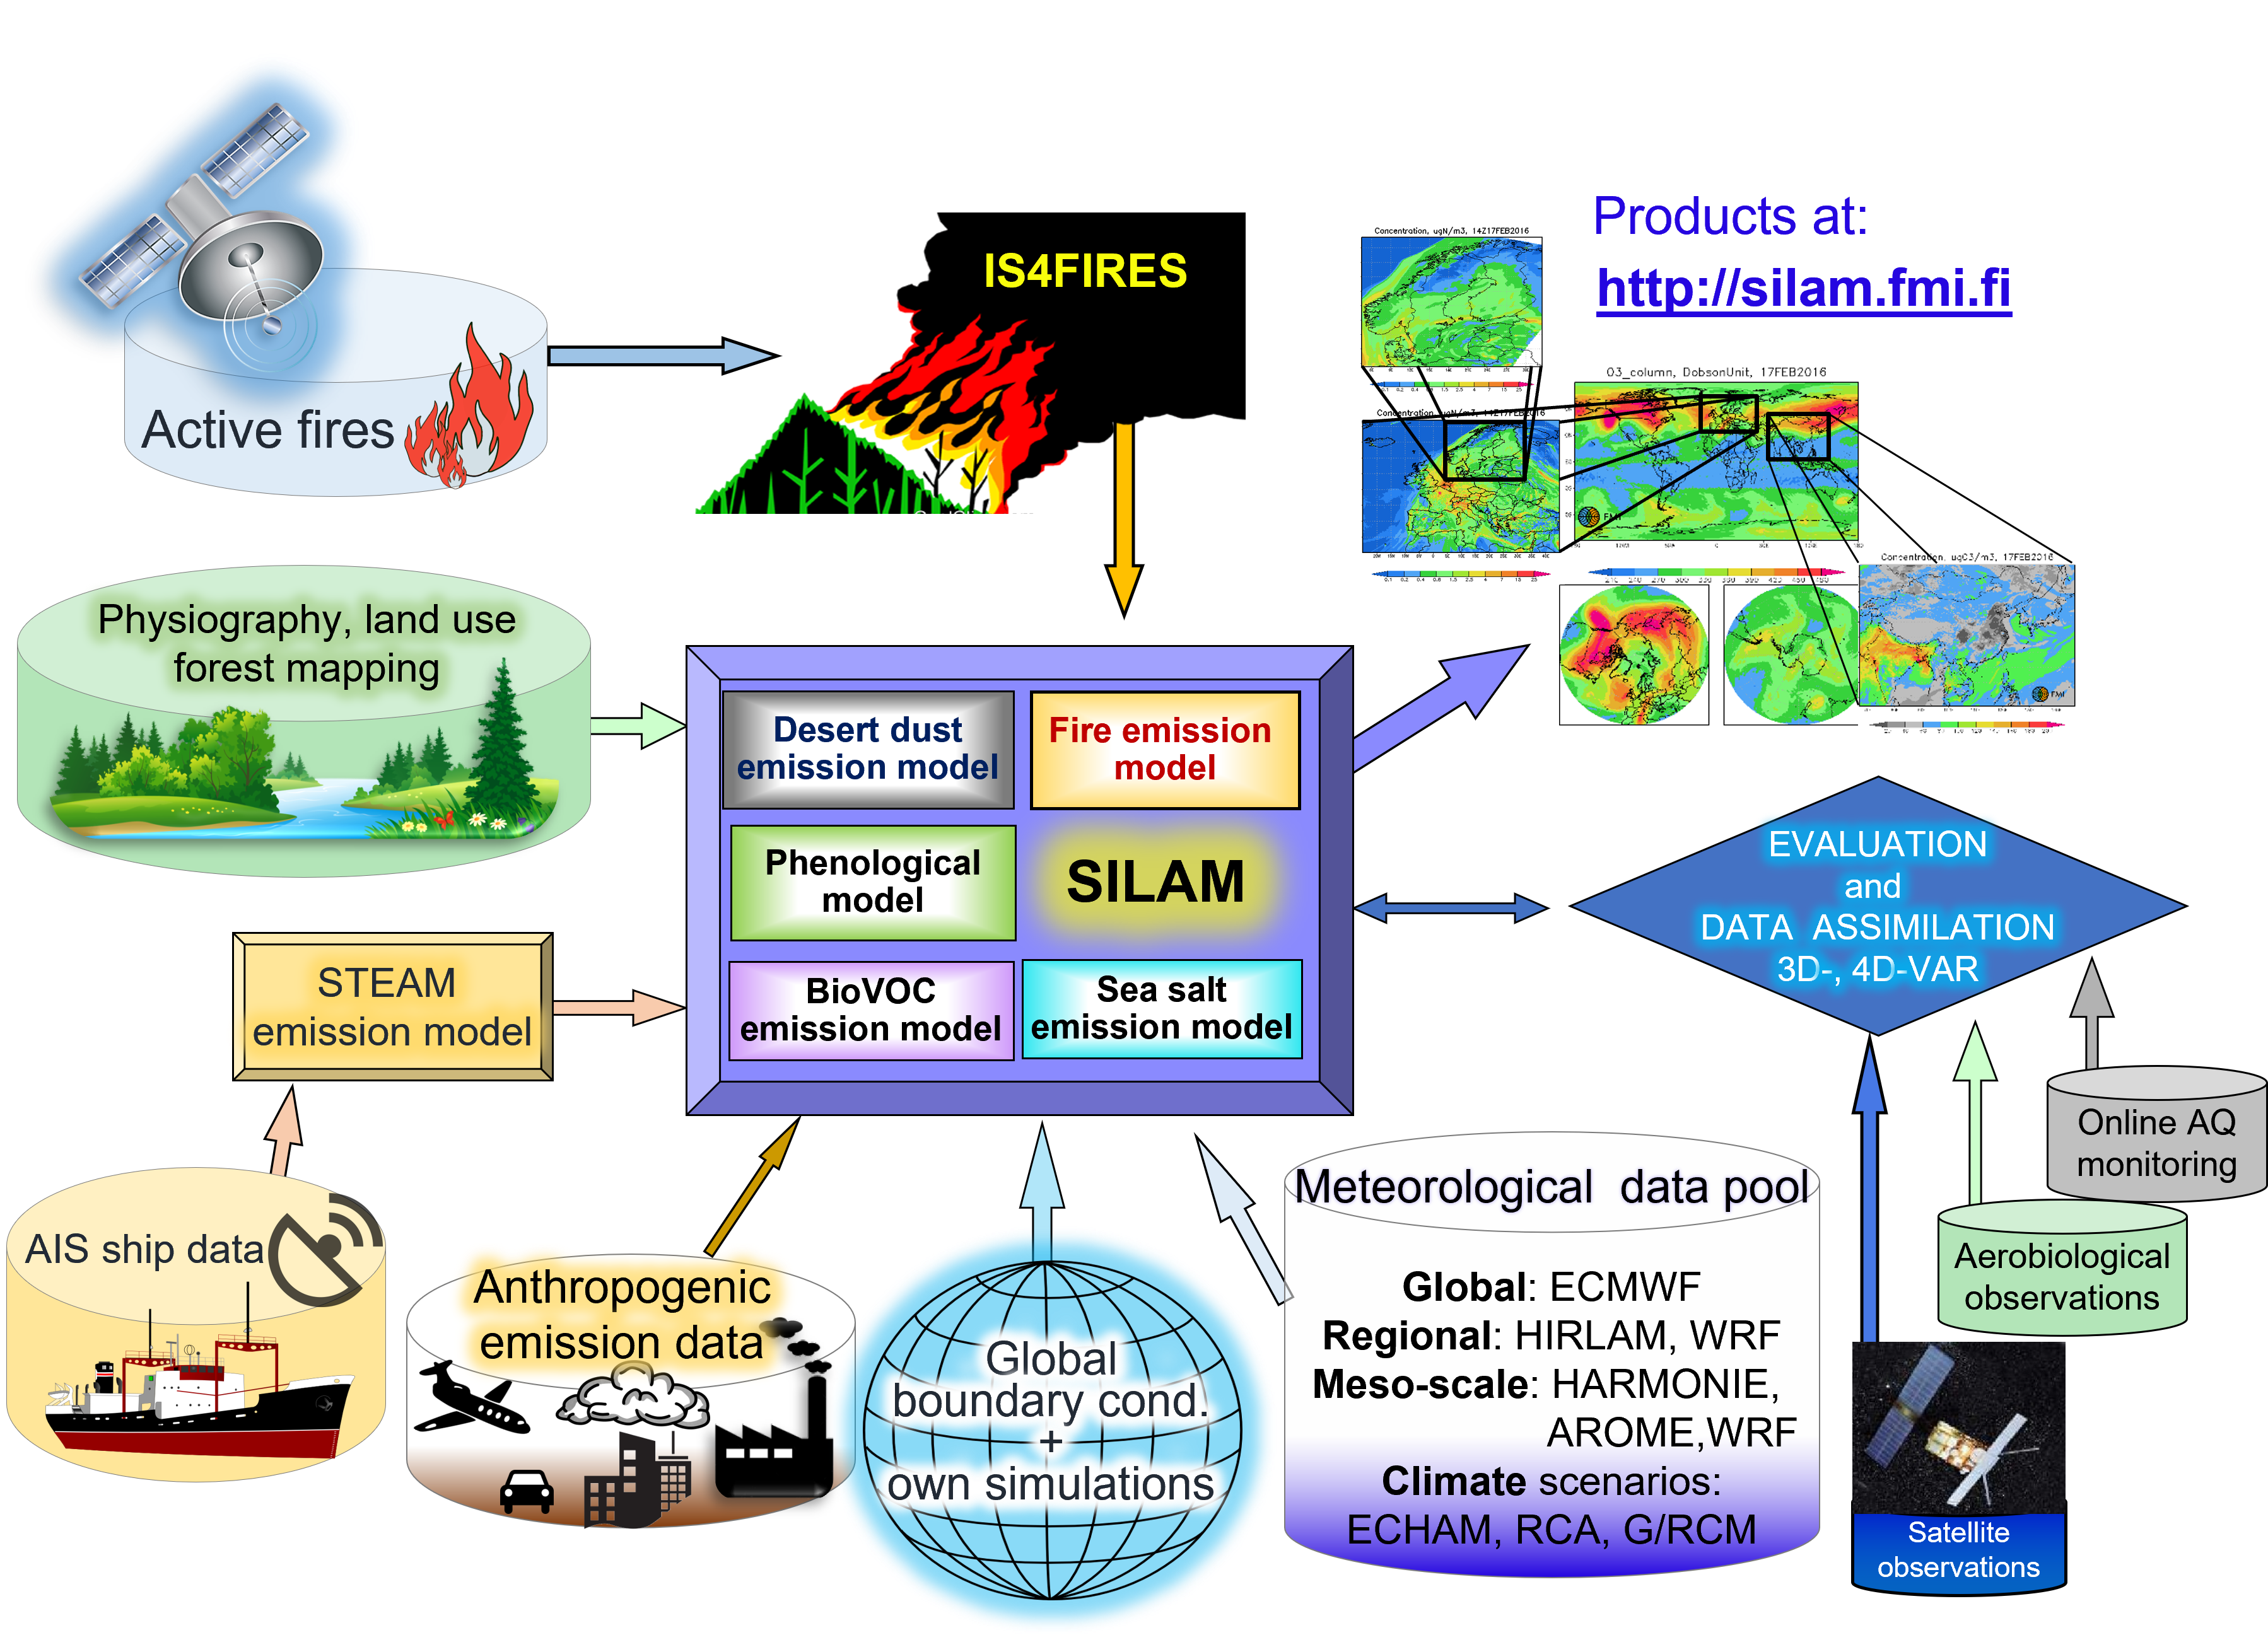
SILAM AQ assessment and forecasting platform

Slide 9
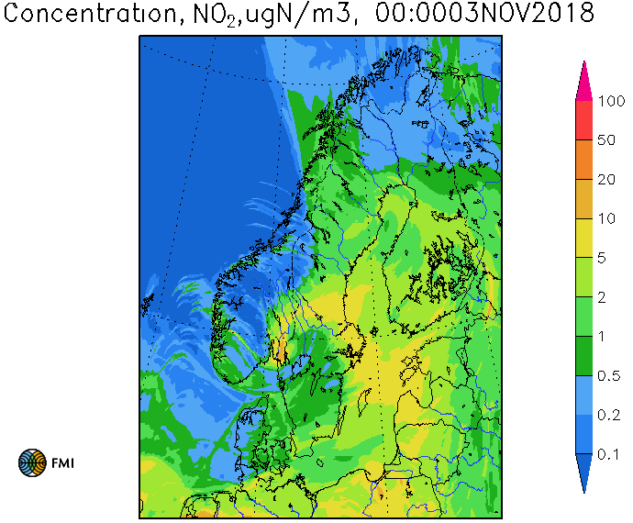
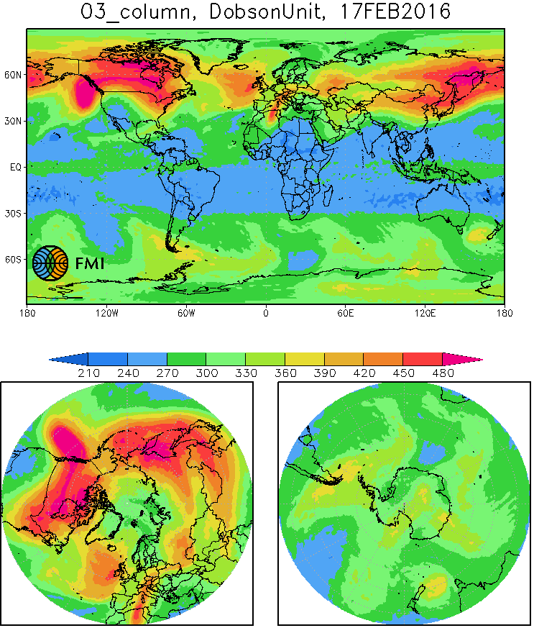
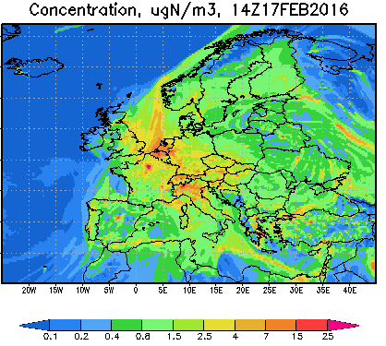
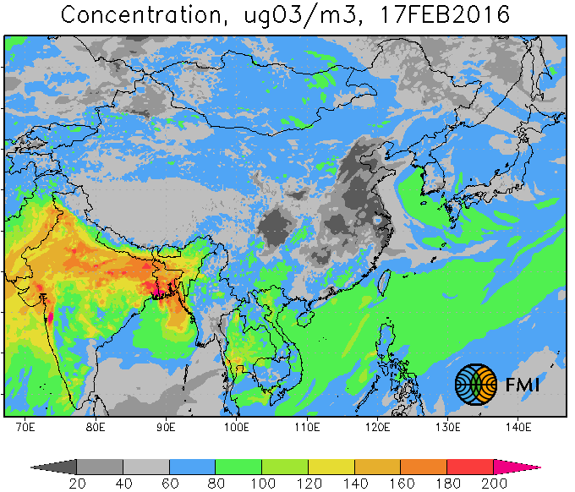
Operational AC/AQ-modelling at FMI
Global: 20km, SILAM v.5.8
troposphere+ stratosphere
All forecasts:
4 days with 1hr step,
SILAM v.5.x
http://silam.fmi.fi
Asia: 14km,
troposphere
SILAM v.5.5
Northern Europe:
2.5km, troposphere
Europe: SILAM v.5.8
10km, troposphere
boundaries: C-IFS
hindcast: 3D-Var

Slide 10
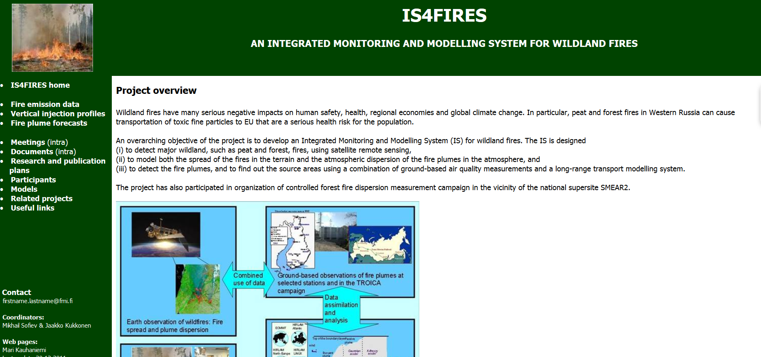
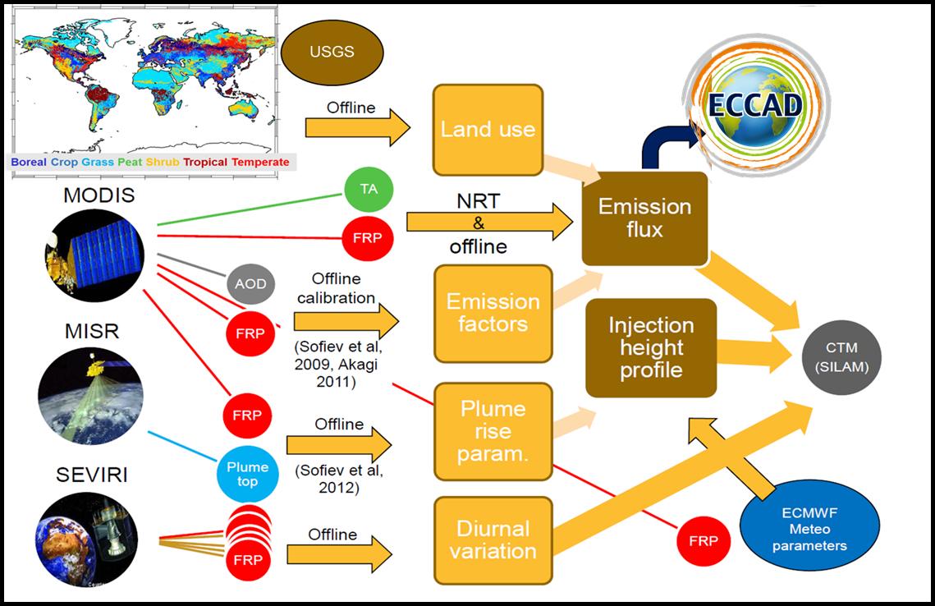
Fire data for emission: IS4FIRES
is4fires.fmi.fi

Slide 11
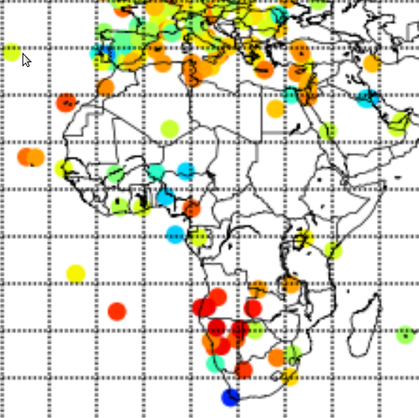
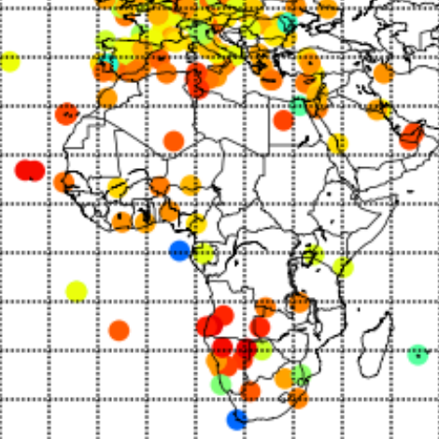
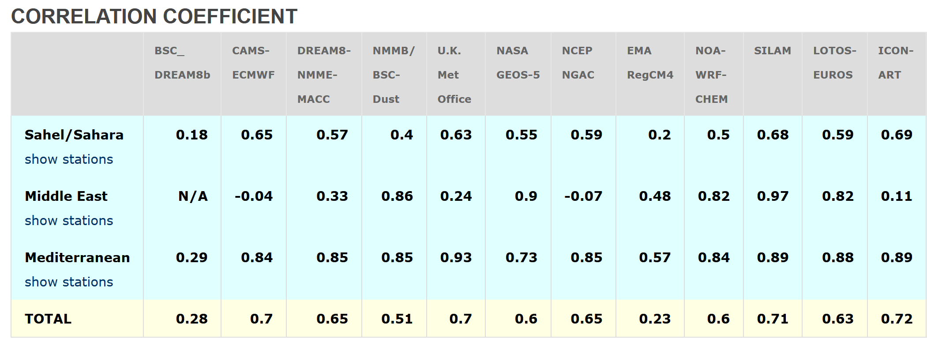
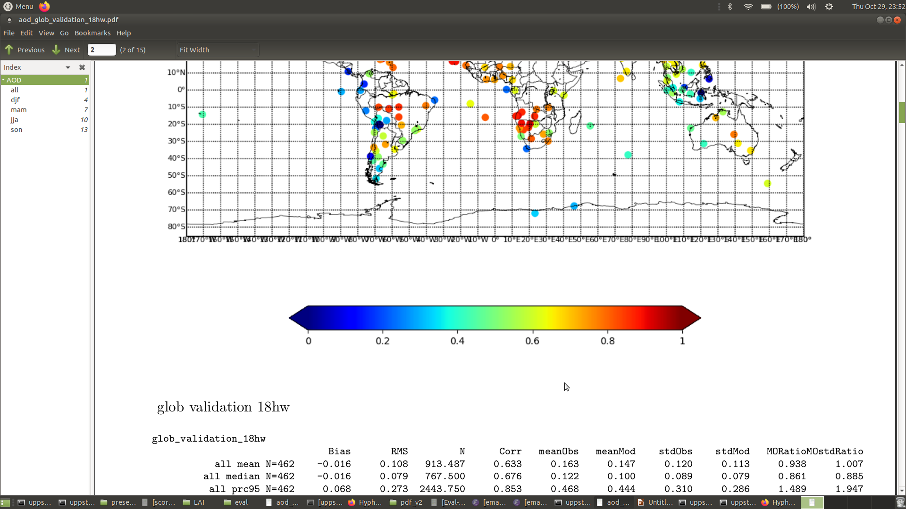
New dust emission model
The first dust source: ~2015
  based on theoretical considerations, revised consensus parameterizations
  problems related to data quality: sensitive to small variations of input parameters or data inaccuracies
New source is largely empirical, succeeds several features of the initial source
Dust emission ~ (v_{10m}– v₀)³ • bare_land_fraction / ln(roughness), v₀ = 4.1 m/s
Significantly improved correlation
with AERONET AOD
Soil moisture, leaf area index and snow
depth are used to turn off the emission
old model
new model
SDS-WAS evaluation, Oct 2021
Sand and Dust Storm Warning Advisory and Assessment System (SDS-WAS)

Slide 12
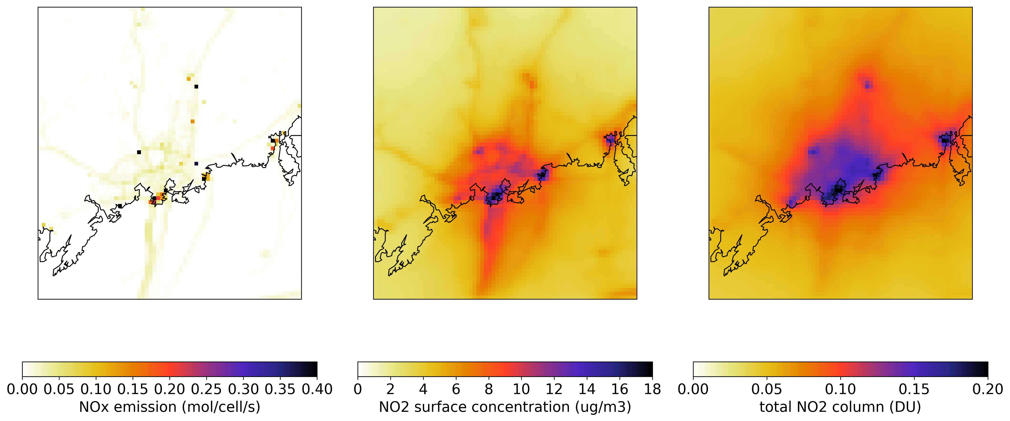
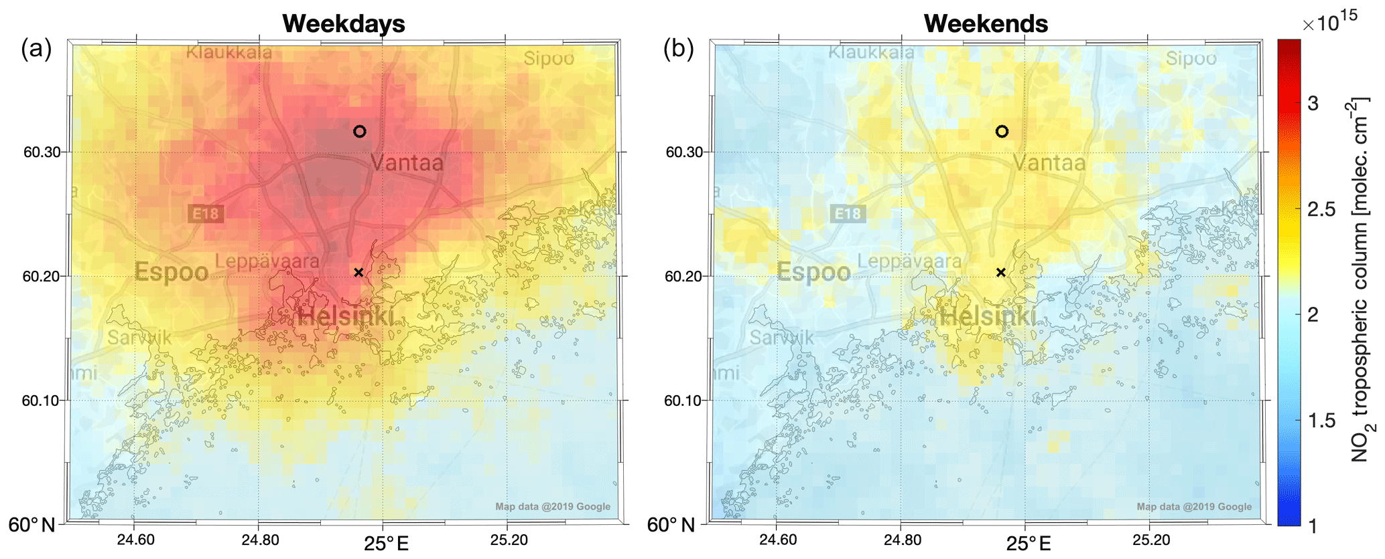
Use case:
Emission estimation for Helsinki
Background: Simulated and retrieved NO2
Combined NOX emission inventory from SYKE and STEAM, and simulated average surface and tropospheric NO2 concentration from the SILAM model for May to September 2015
TROPOMI retrieved NO2 columns for weekdays and weekends in the period April 15 to September 30, 2018, (Ialongo, et al., 2020)

Slide 13
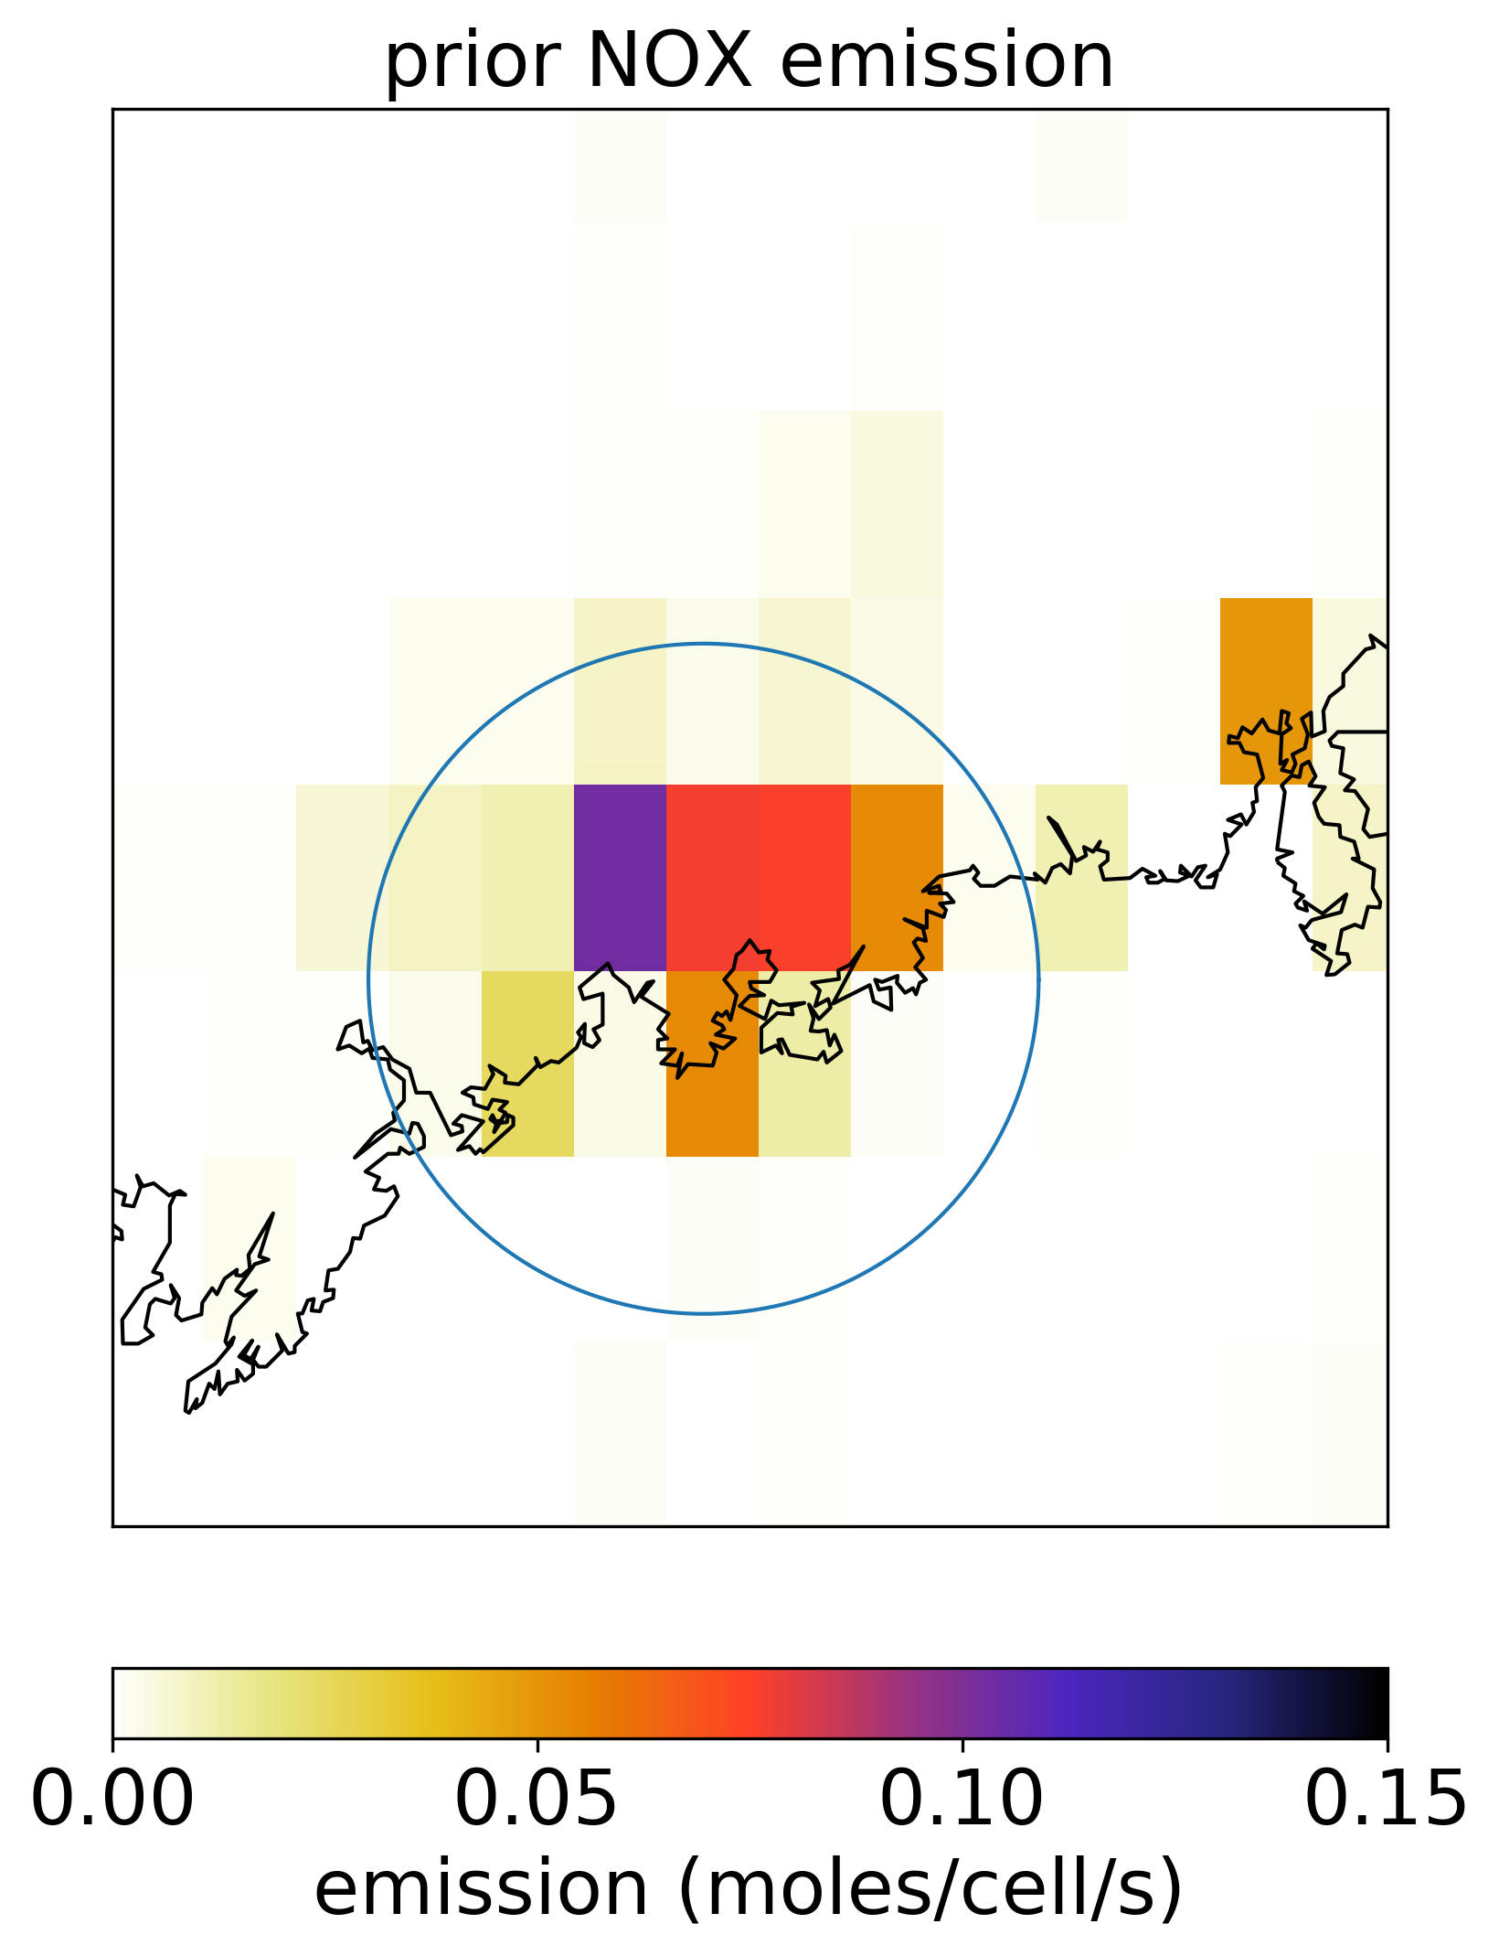
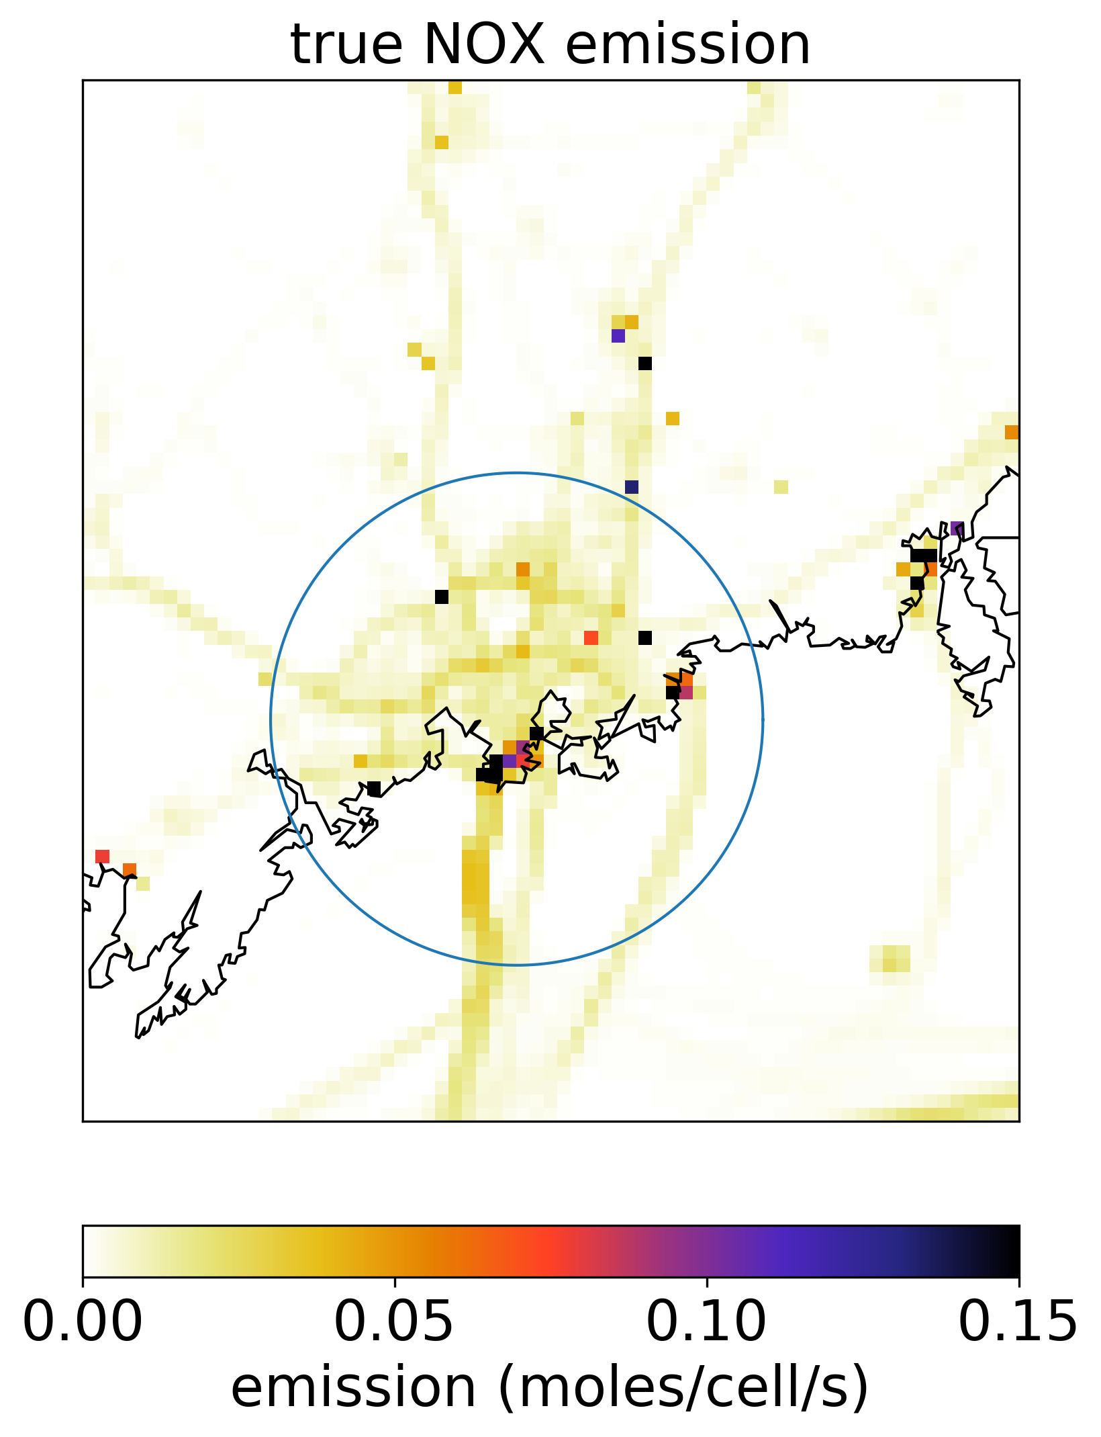
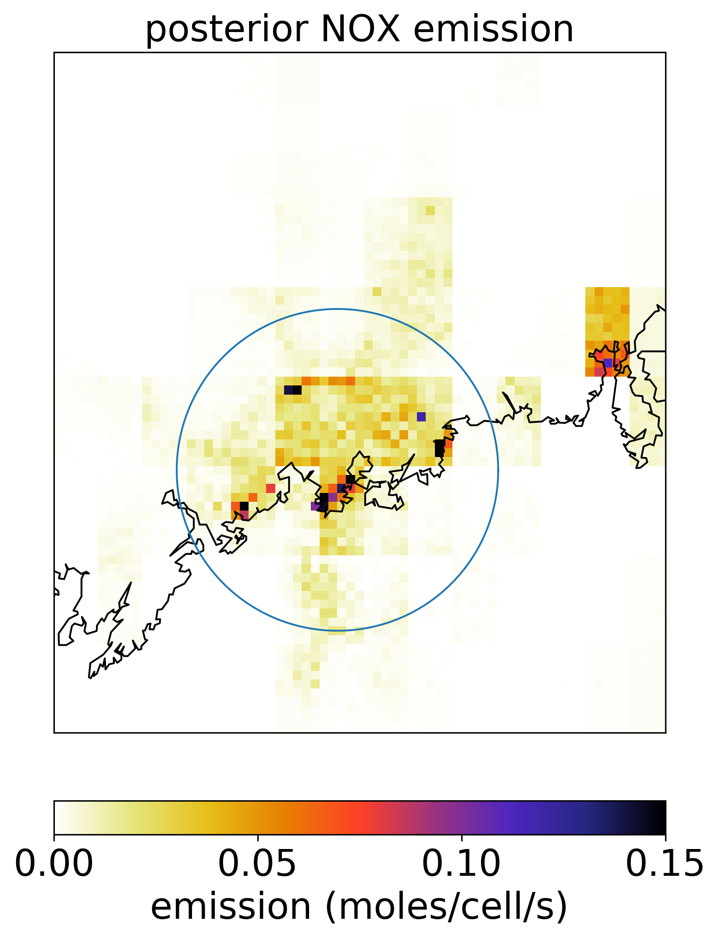
Prior and posterior emissions
The area for simulated observations is indicated by the circle

Slide 14
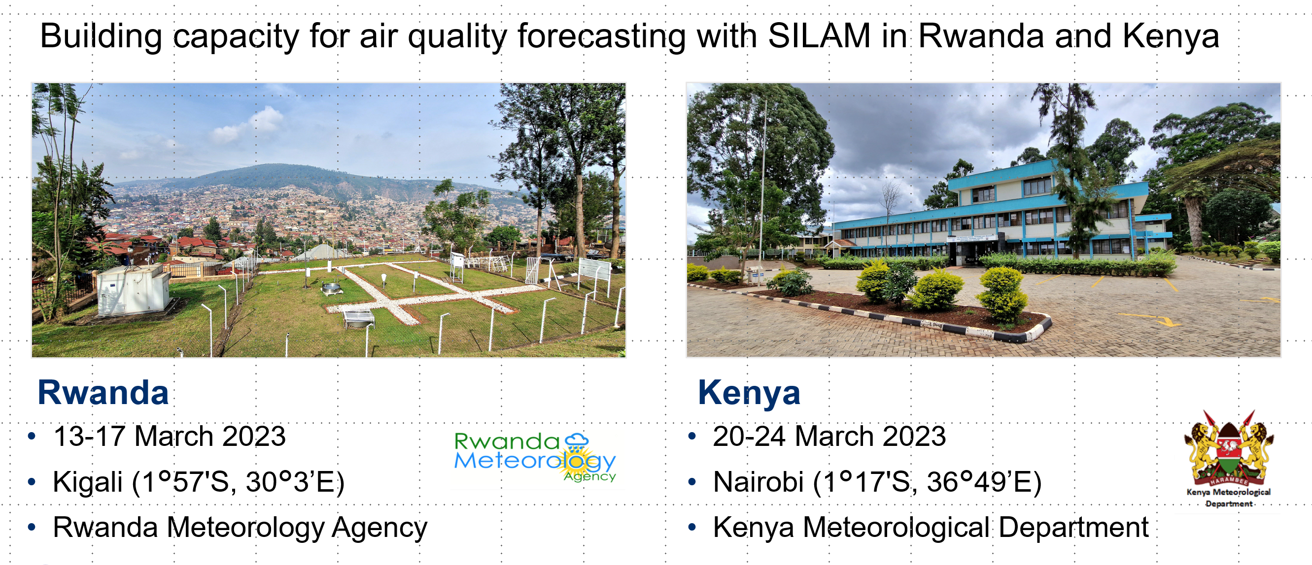
Summary
Ensemble AQ forecasting: a way to improve forecasts, under some conditions.
SILAM is an example of offline global-to-local atmospheric composition and AQ model

