Slide 1










Air Pollution in Africa: Overview of emission sources, impacts, and mitigation strategies
N’datchoh E. TOURE
Ndatchoh.toure01@ufhb.edu.ci
University Felix Houphouet-Boigny Abidjan-Cocody
Cote d’Ivoire

Slide 2
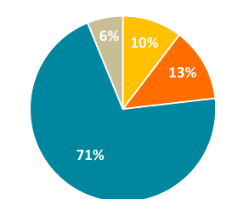
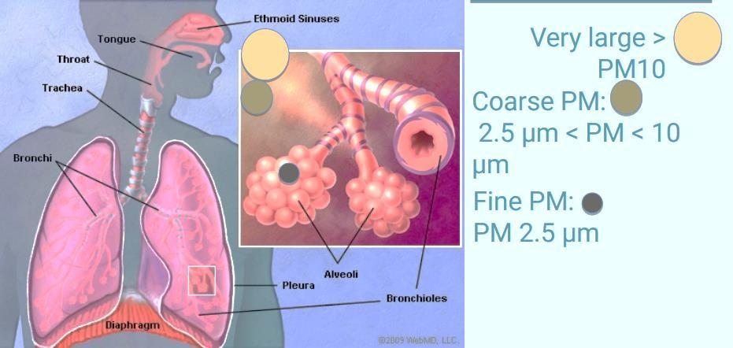
Background
Africa accounts for only 6% of global energy demand and about 3% of electricity demand.
The residential sector represents 65% of total energy consumption in sub-Saharan Africa (22% globally, <20% in developed countries)
Bioenergy is still the largest source of energy in Africa today (45% of primary energy demand and 50% of energy consumption)
GHGs and pollutants (gases and particles) emissions from several sectors including energy are growing fast and lack of policy control in many African countries.
In 2019, Air pollution from all sources was responsible for 1.1 million premature deaths in Africa (Fisher et al., 2021)
Still lack of in-situ measurements to better characterize and understand the air quality issues in Africa

Slide 3
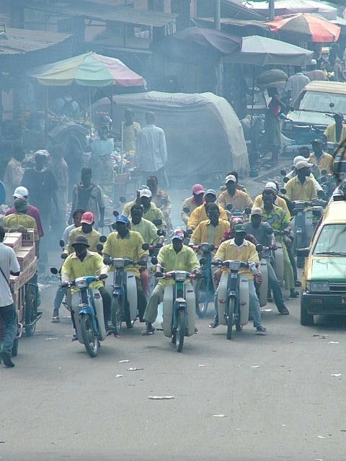
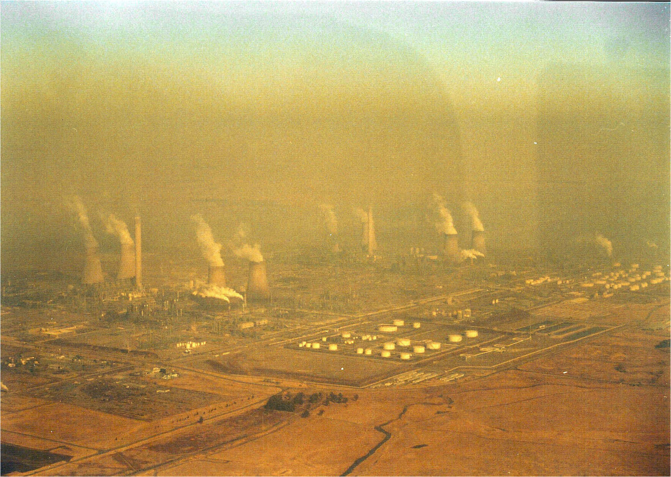

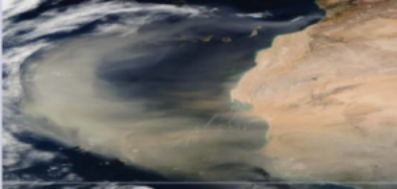
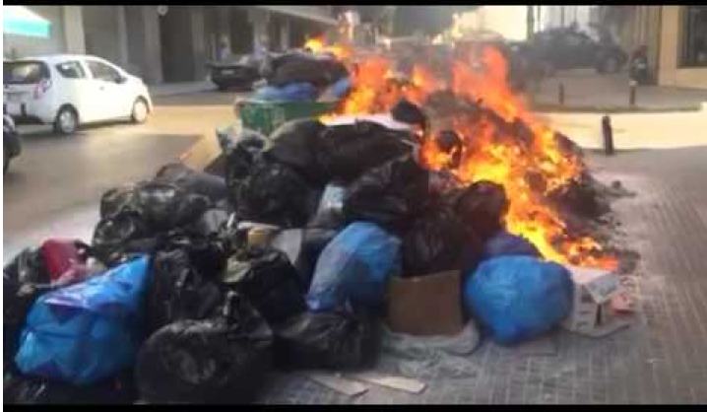
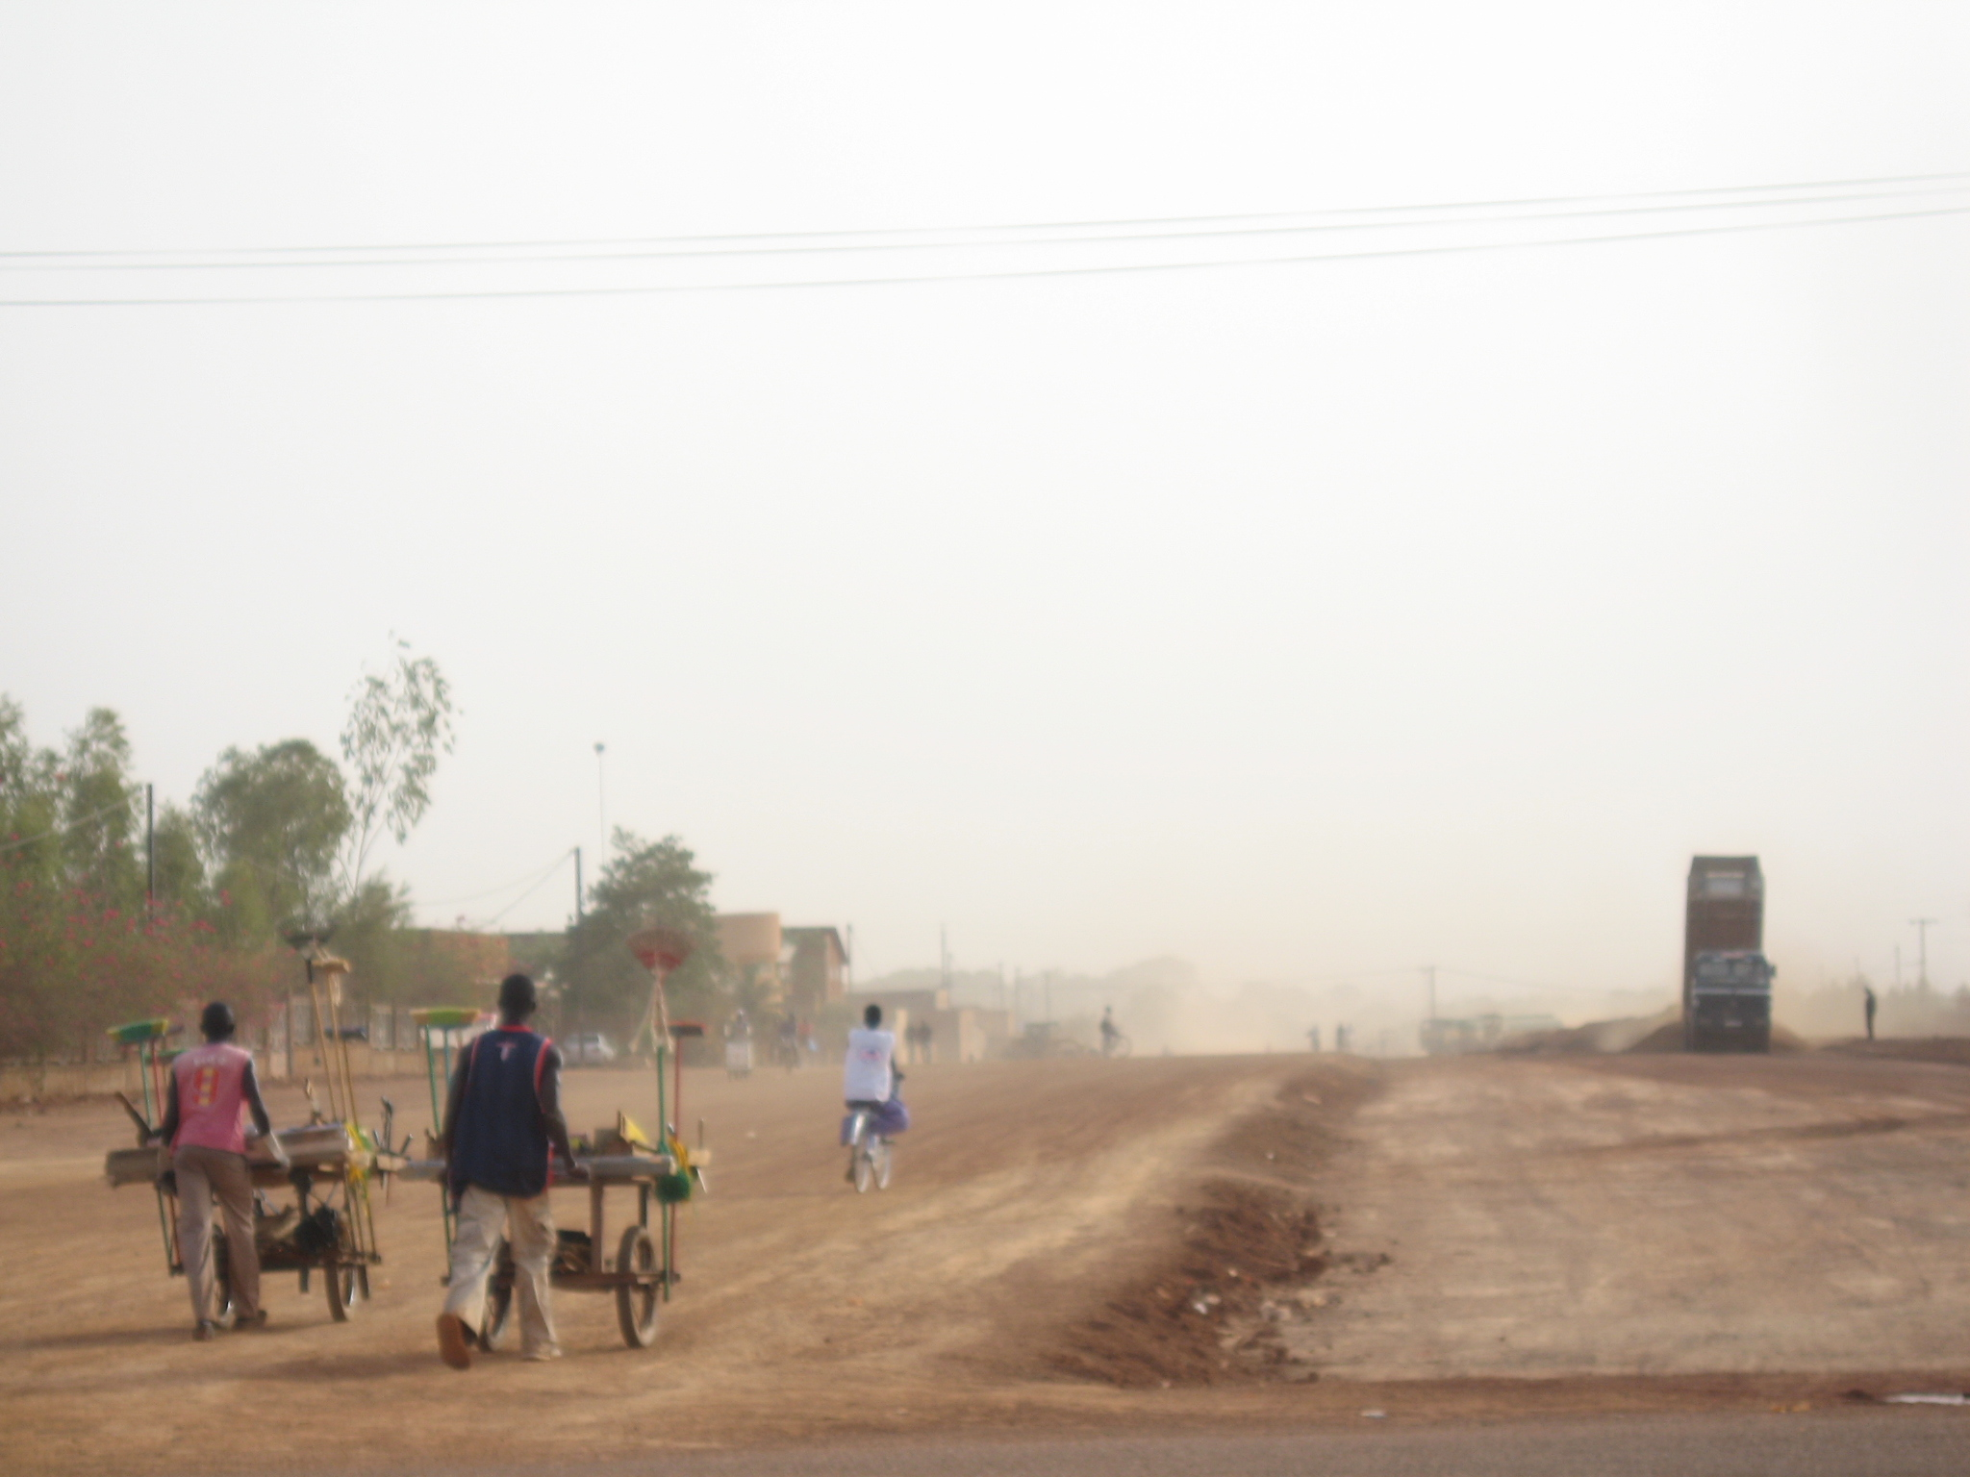

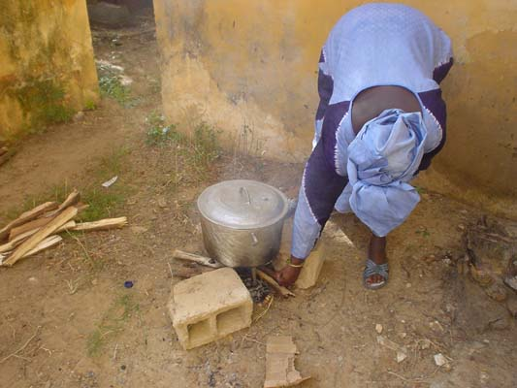
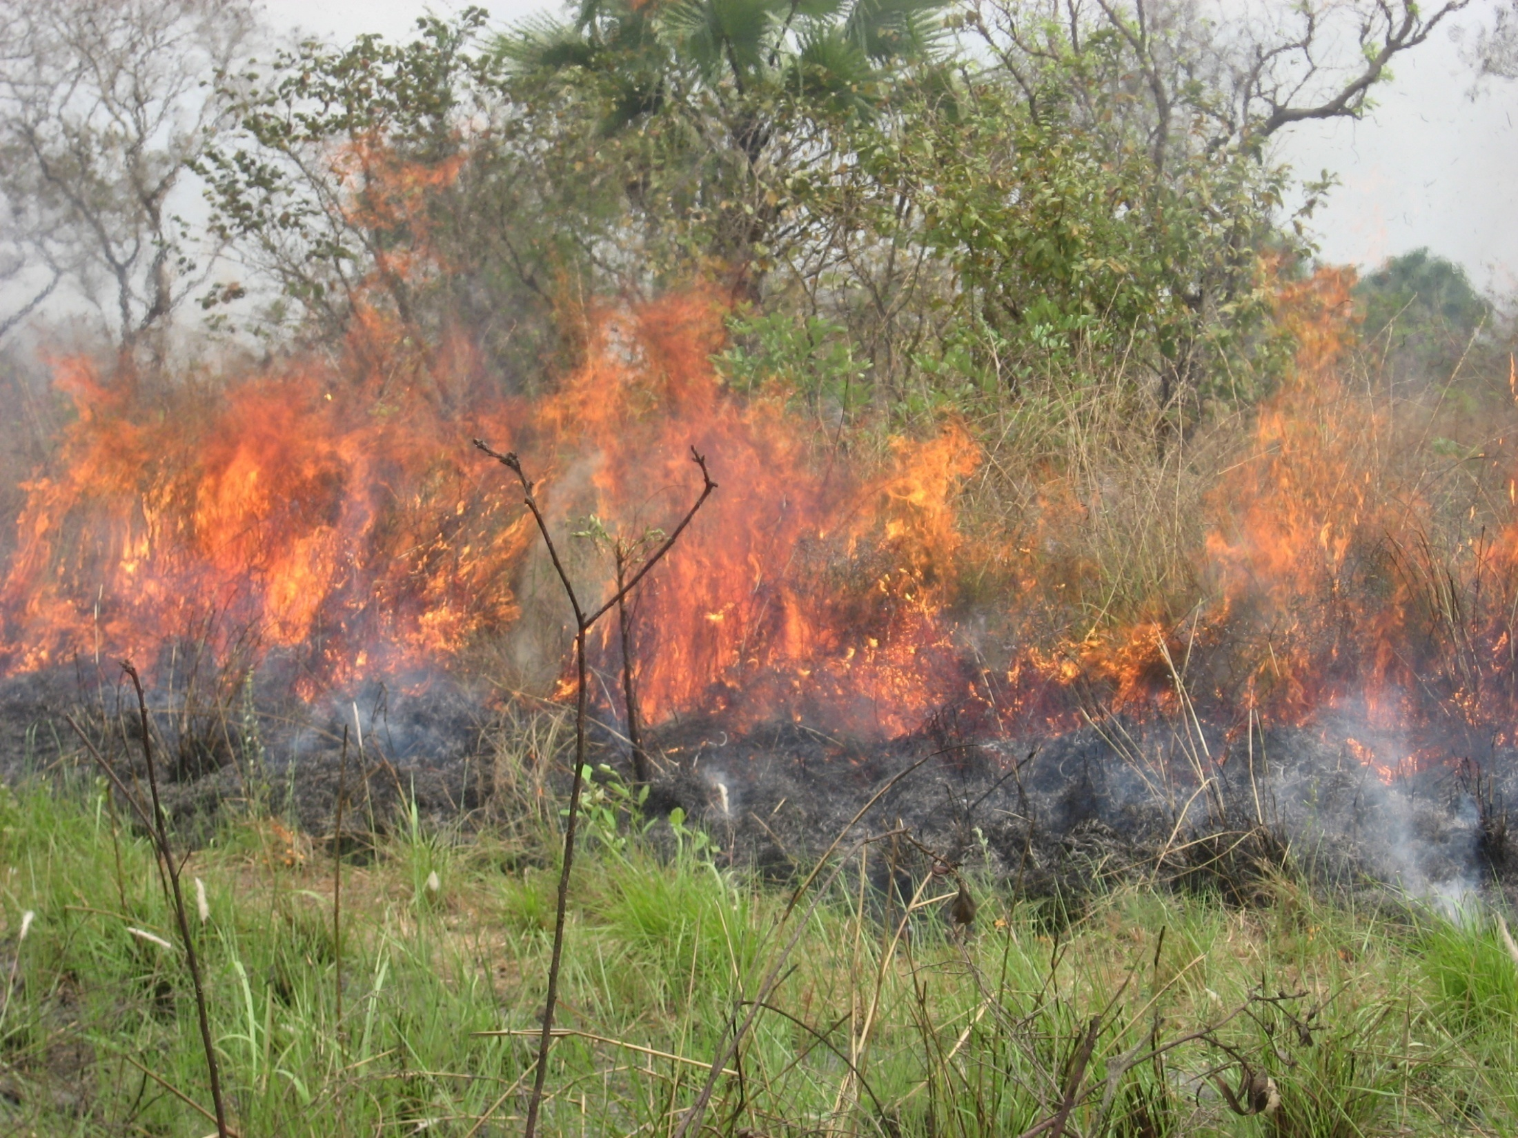
Several sources of air pollution in Africa
Antrhopogenic sources
Natural sources
Traffic
Industries
Waste burning
Sahel – Saharan dust
Sea salt
Domestic fires
Dust
Biomass burning
Aerosols from biogenic source

Slide 4
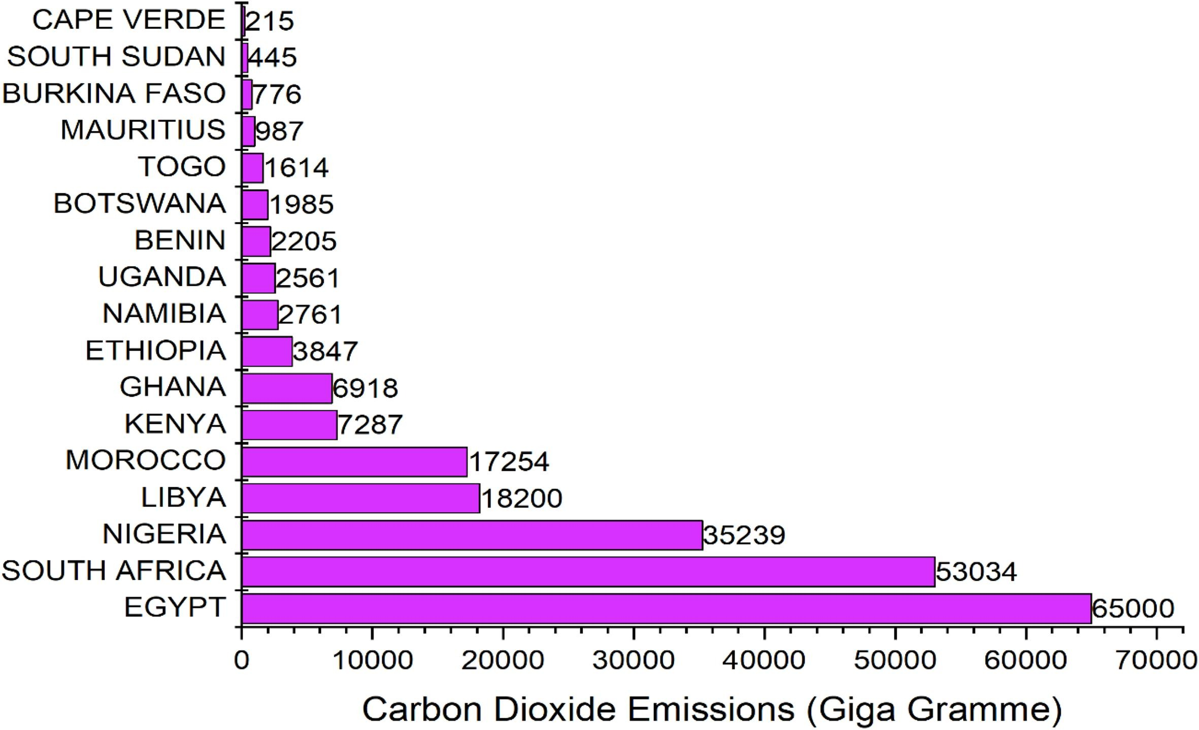
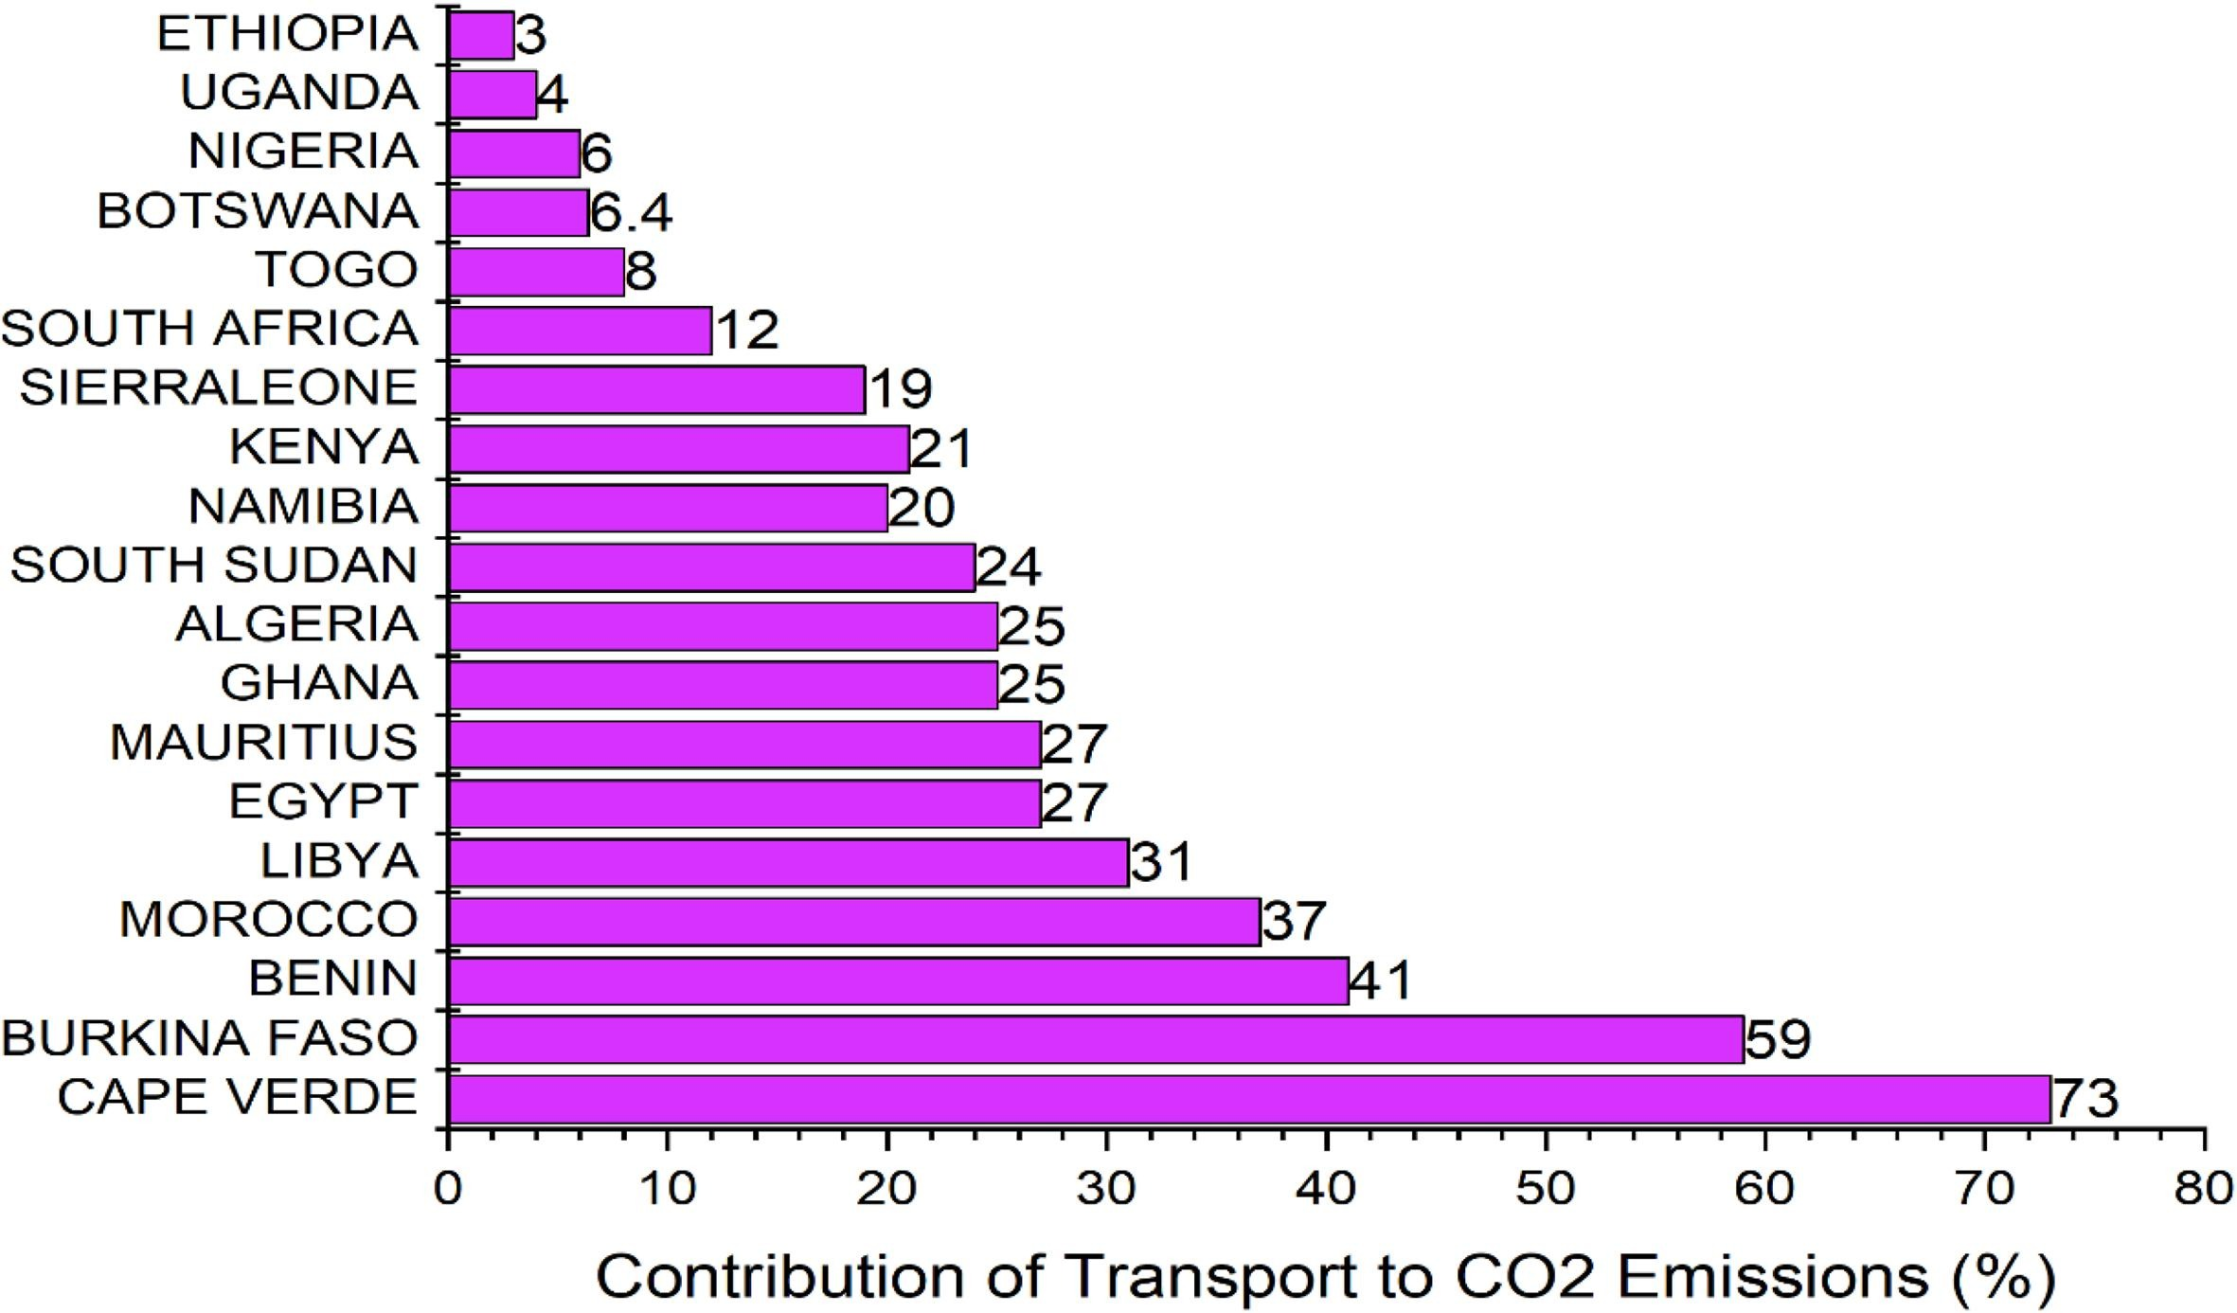
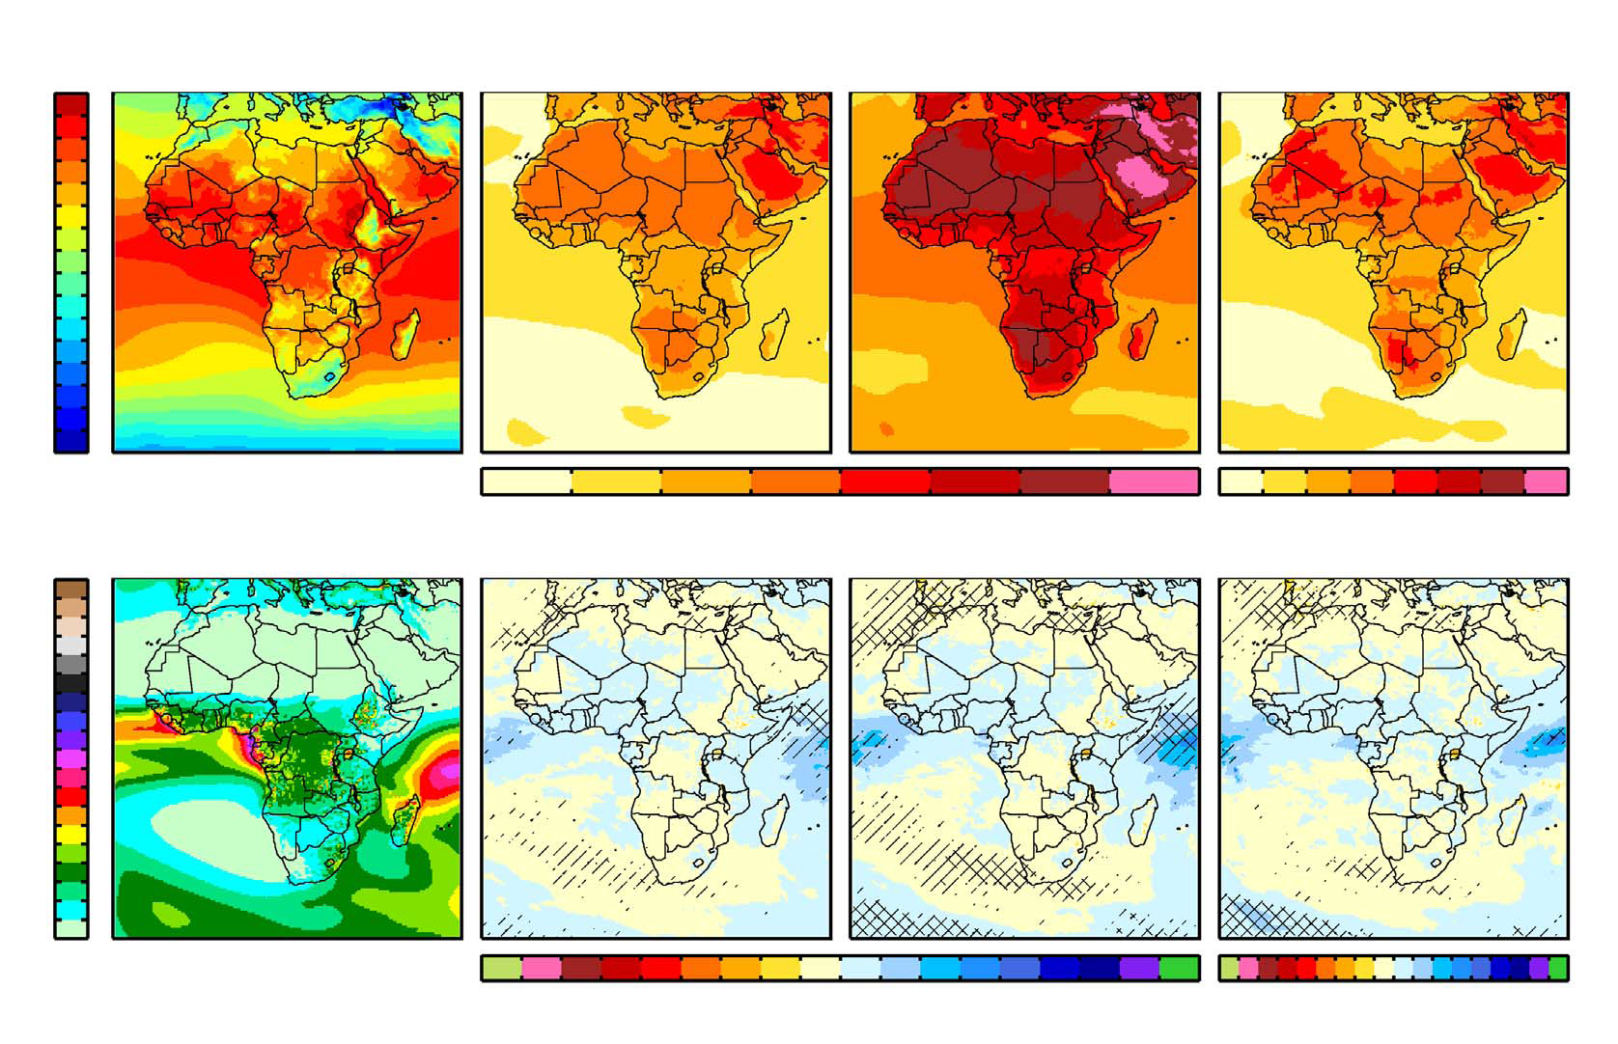
Emissions in Africa and their impacts on climate
Africa has been a minor contributor to global GHGs emissions
Road transportation remains the biggest contributor to GHGs emissions in Africa
These GHGs contribute to Global warming and impact the African climate and other sectors (Agriculture, energy, food security, …)
Many Africa’s ecosystems are already affected disproportionately by climate change
CO2 emissions from transport in 2015 (UNFCCCR) source Ayetor et al., 2021
Changes in temperature (first row) and precipitation (second row) over Africa under GWL 1.5 and 2ºC based on CORDEX-AFRICA Ensemble (Nikulin et al., 2018).

Slide 5
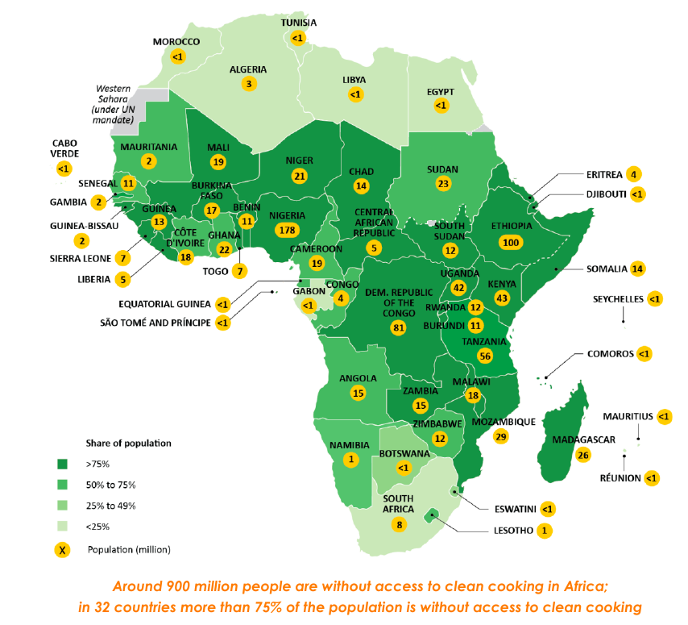
Emissions from Household and their impacts on Air quality
Household/residential
Solid-fuel (wood, charcoal, ...) combustion in Africa contribute to increase global ambient PM2.5 by 2%
84,000 premature deaths/yr in Africa (Gordon et al., 2021)
Emissions (gases and aerosols) from charcoal production estimated to increase PM2.5 (0.5–1.4 μg/m³) and ozone (0.4–0.7 ppbv) concentrations over densely populated cities in East and West Africa (Bockarie et al., 2020)
Residential emissions are estimated to contribute about ~38% to the present-day air pollution in Africa
Household air pollution from the lack of access to clean cooking facilities, affects mostly women and children
Source Africa Energy Outlook 2019

Slide 6
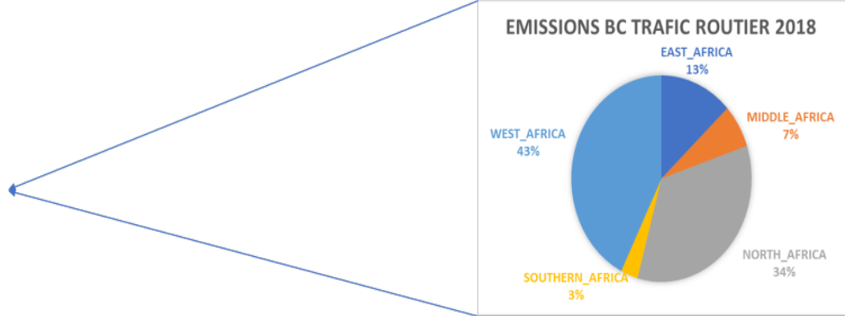
Emissions from traffic impacts on Air quality
Traffic
Road Traffic contribute to 9% of total BC emissions in Africa
West and North Africa lead BC emission from road trafic predominated by gasoline engine
Outdated vehicle technologies and local refineries with outdated technologies contributing to produce less cleaner fuels used in the transport sector
About 80% of private cars in sub-Saharan Africa are used cars (from Japan and Europe) no longer meeting emissions standards in their origin countries
BC emissions from traffic sources per region in Africa

Slide 7
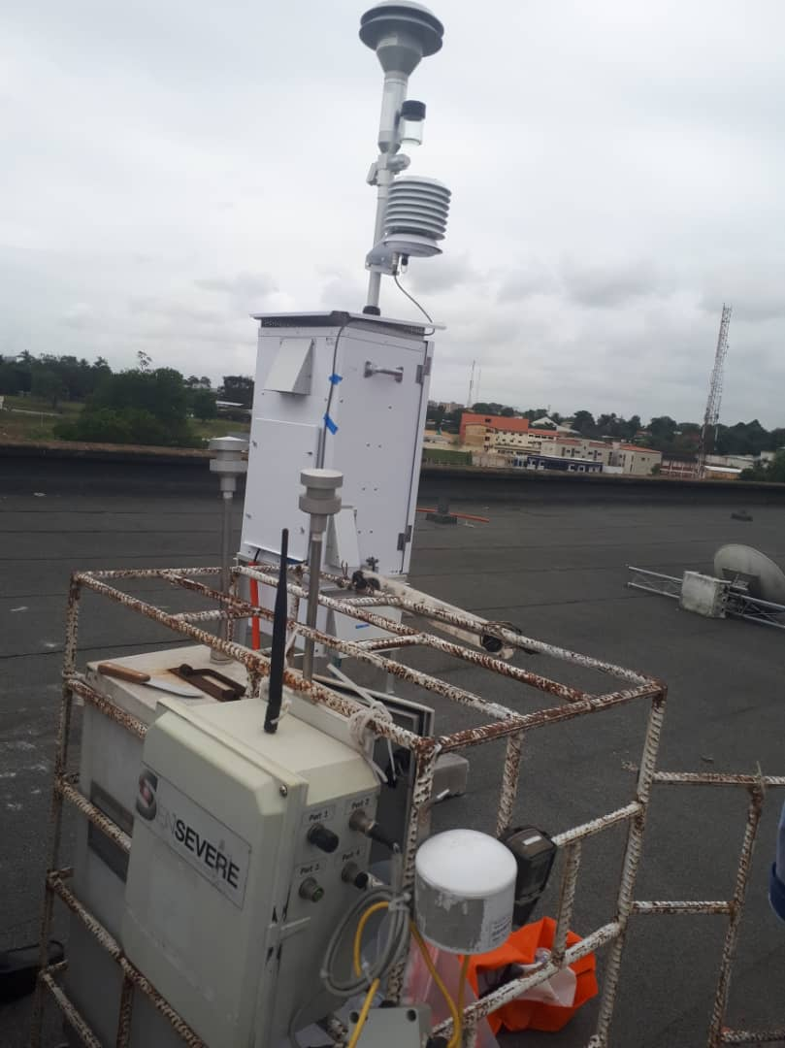
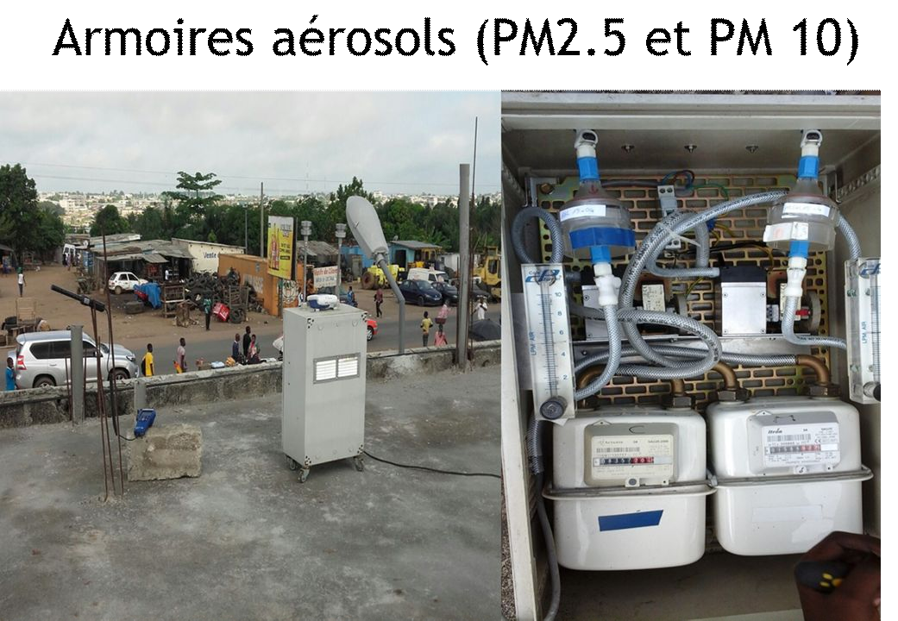
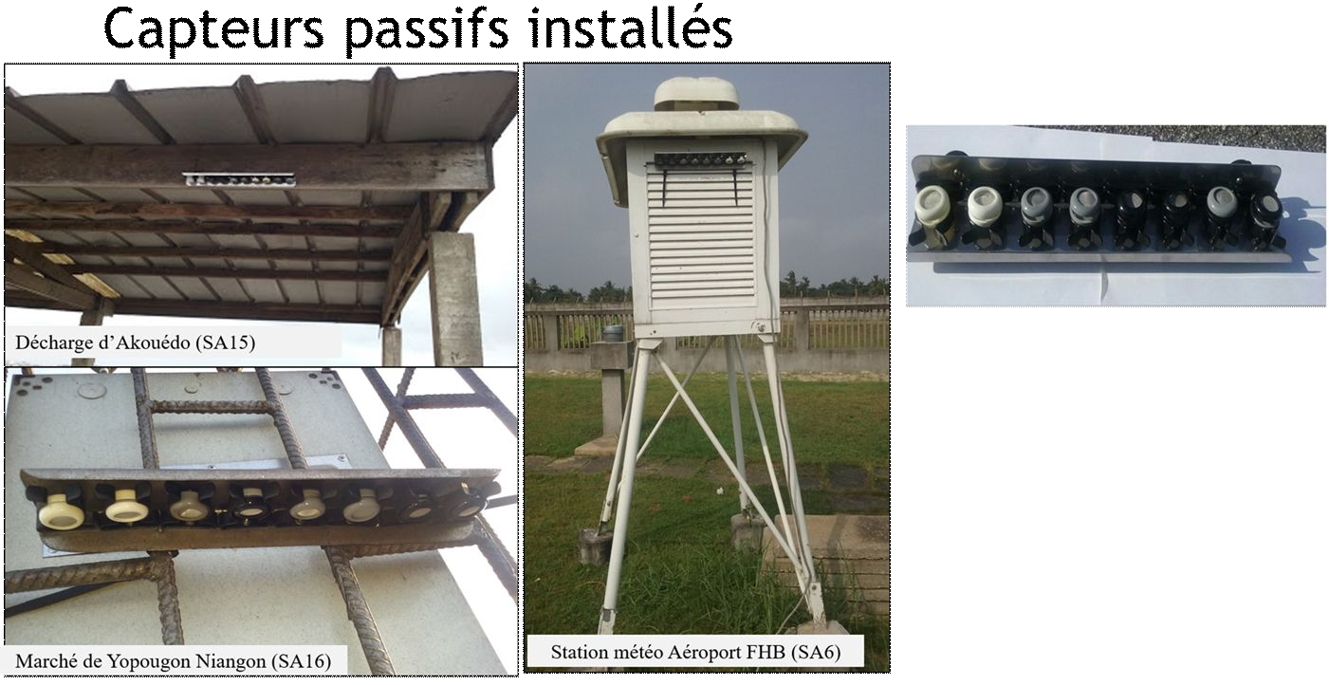
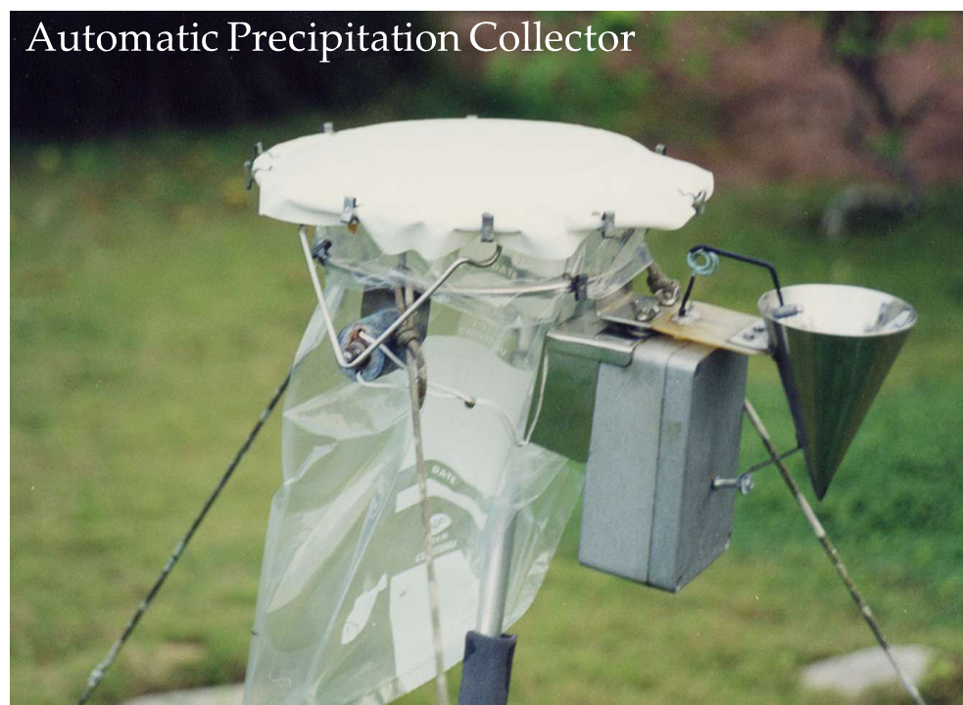
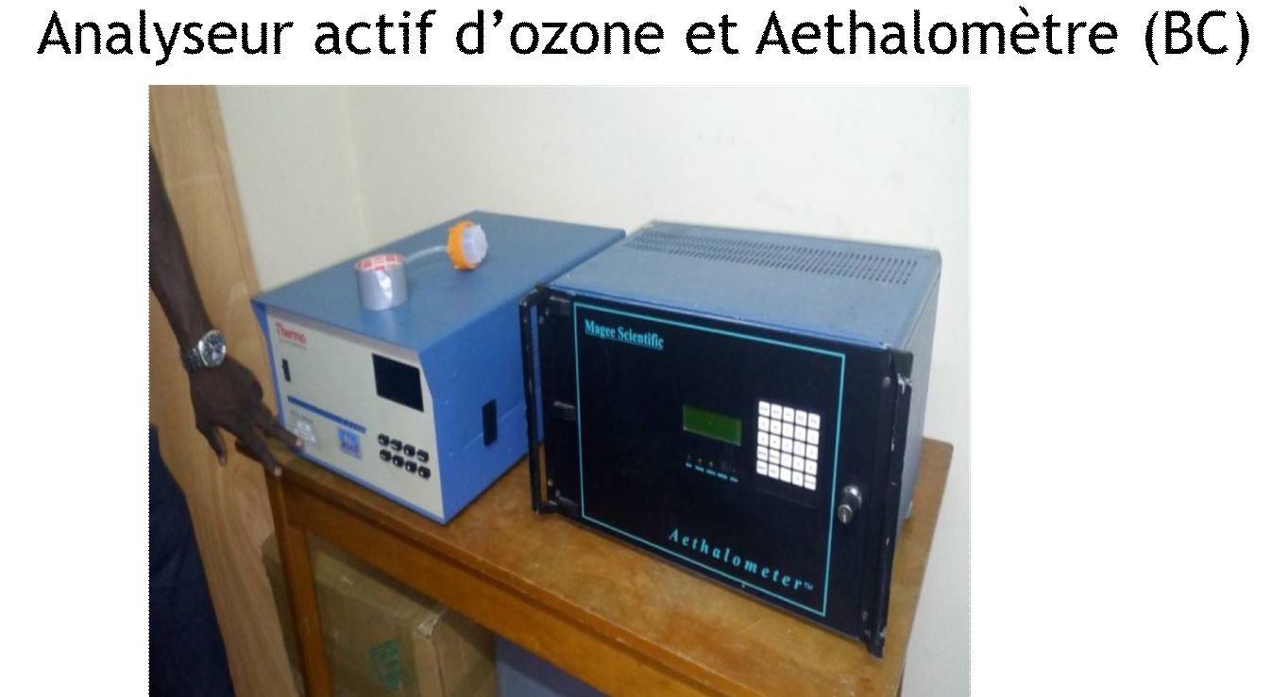
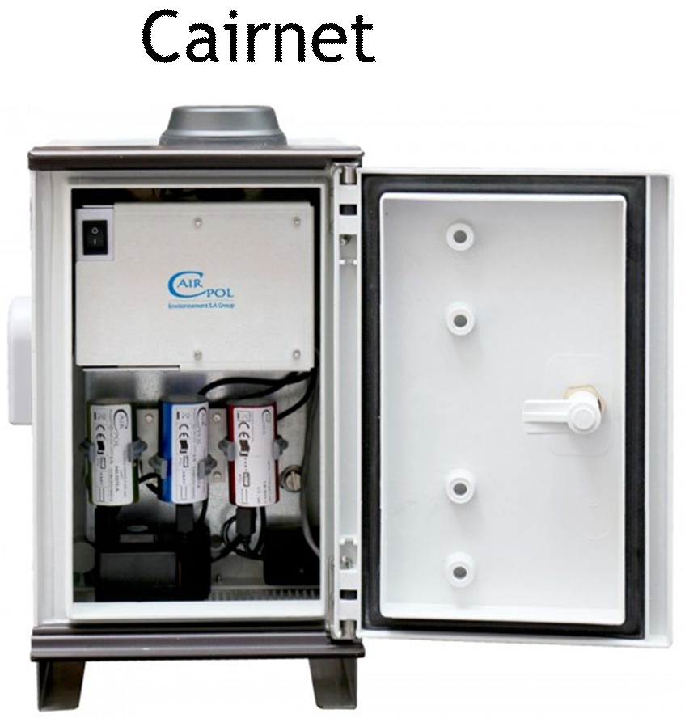
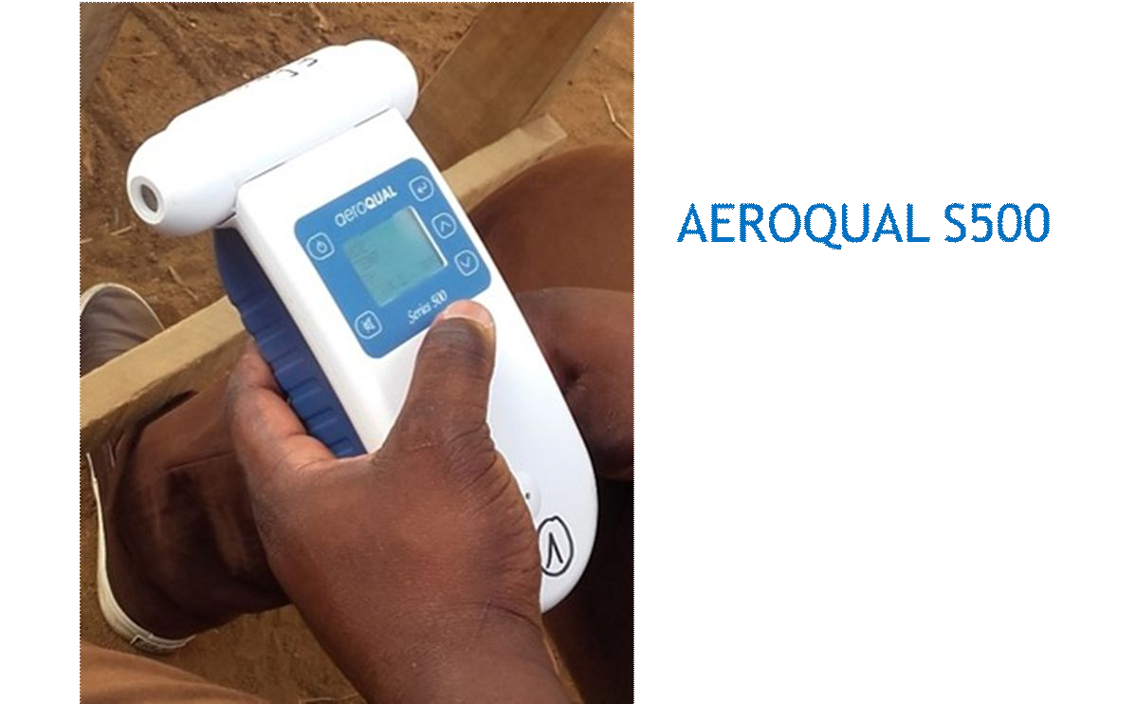
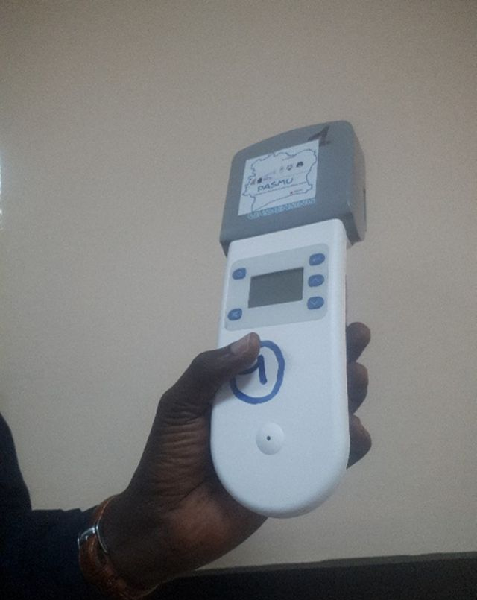
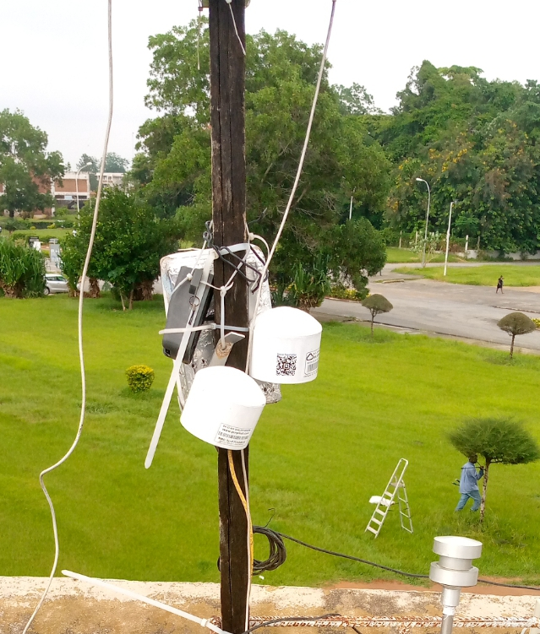
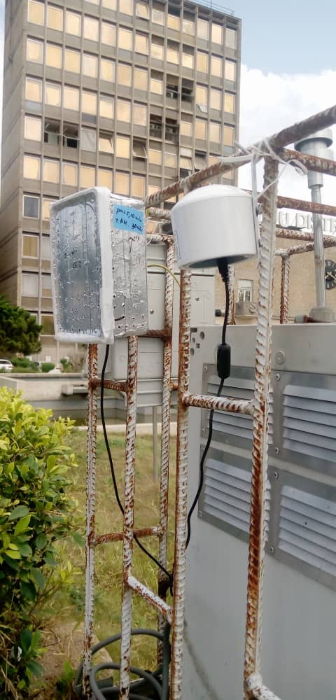
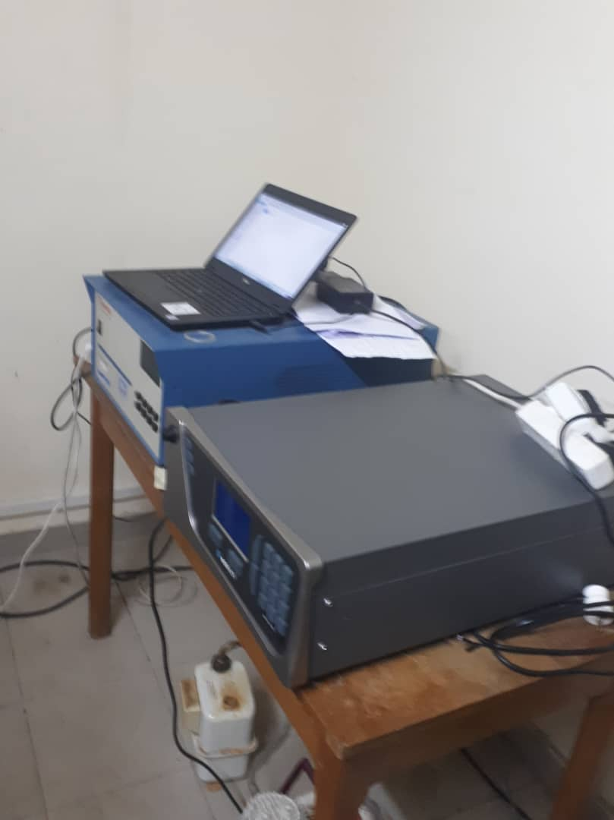
LASMES/UFHB contribution to AQ observations in Africa
Aerosol sampler
PM10, PM2.5
Rain sampler
BAM (Bêta Attenuation Monitor)
Passif sensor
NO2, SO2, O3, PM 2.5, PM10 Analyser
Low cost sensors
O3
BC
Nox Analyser ECOTECH
Aerosols (PM1, PM2.5, PM5 and PM10);
Gaseous pollutants (O3, NO2, HNO3, NH3, SO2 );
Rainfall composition monitoring (pH, cond, organic and inorganic ions)

Slide 8
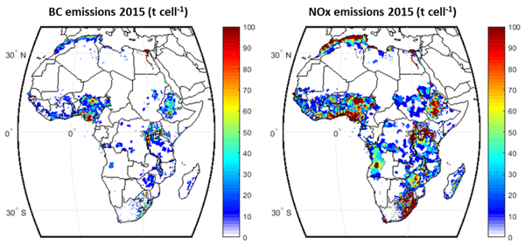
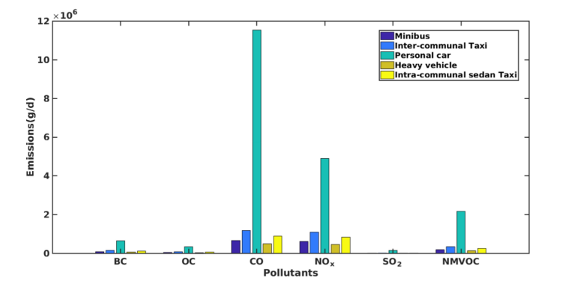
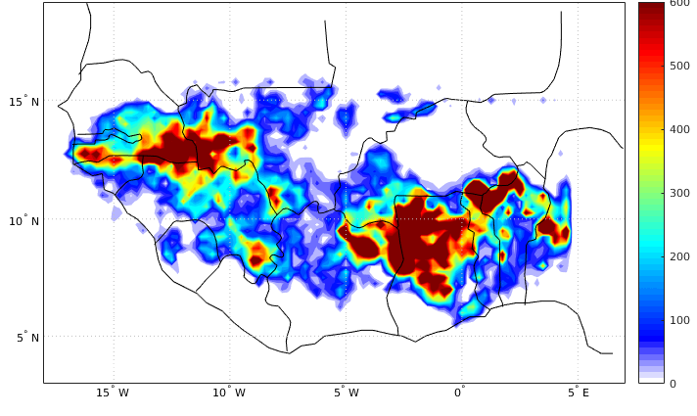
Building emission inventories
Regional and global emission inventories
local emission inventories
Development of EFs
Spatial distribution of Anthropogenic BC and NOX in Africa in 2015 (Keita et al., 2021)
Spatial distribution of Biomass burning mean BC over West Africa between 2001- 2012 (N’datchoh et al. In preparation)
Traffic emission contribution by vehicle types in Yopougon (Abidjan) in 2016 (Doumbia et al., 2021).

Slide 9
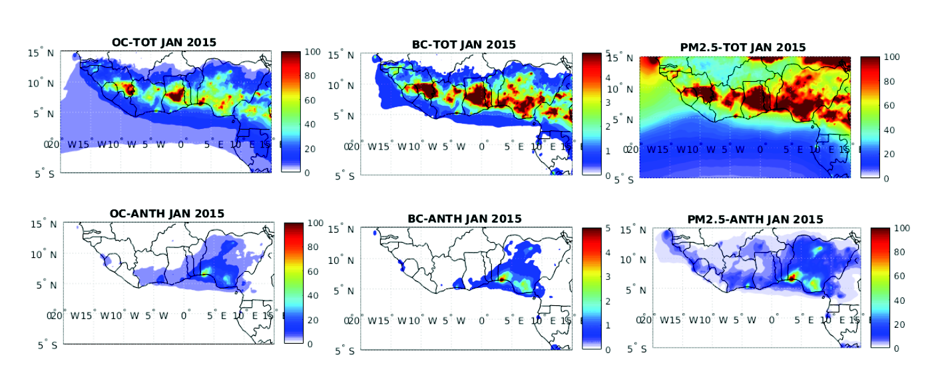
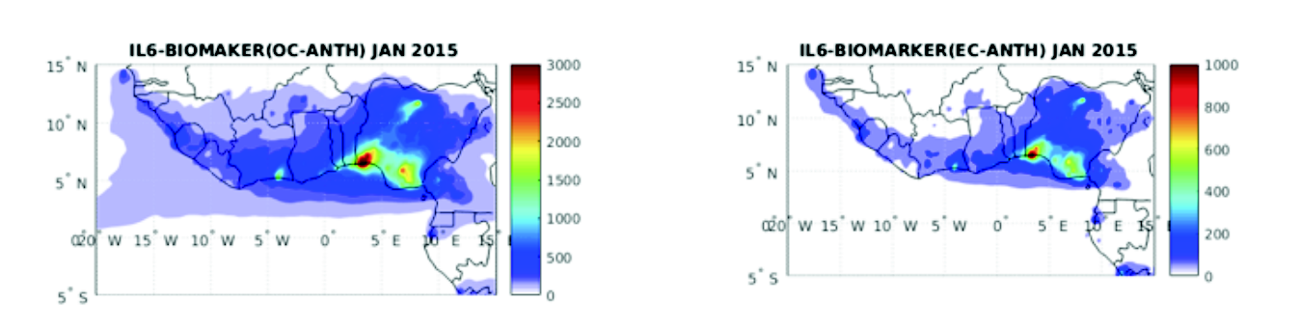
Modeling and AQ impacts (health and ecosystem)
Chemical composition of the atmosphere
Baseline and mitigation scenarios for climate, Human health and ecosystem impacts
Spatial distributions of OC, BC and PM2.5 (in μ g/m3 ) given by RegCM4 modelling in January 2015, for all sources (TOT) and for anthropogenic sources (ANTH).
Inflammatory risk regional maps due to OC particles (left) and to EC particles (right) for January 2015 and for anthropogenic sources over West Africa.

Slide 10
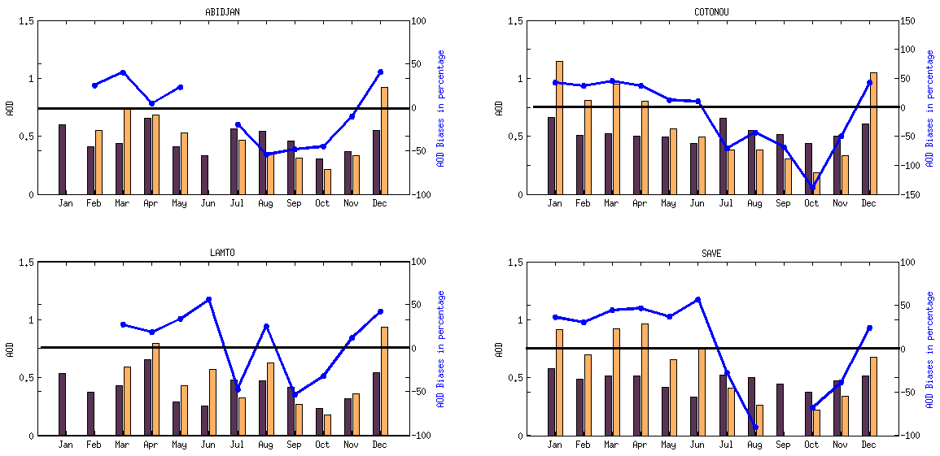
AOD in DACCIWA sites
Positive AOD biases observed during dry season (December to May) while negative AOD biases during wet season (July to November) in cities of Abidjan (Cote d’Ivoire) and Cotonou (Benin).
Positive AOD biases during dry season (January to June and December) and negative AOD biases during wet season (July to October except August) in Lamto (Cote d’Ivoire) and Save (Benin).
Different pattern between urban and rural AOD biases related to strong impact of BB in rural areas than urban areas strongly influenced by anthropogenic sources.
Project Meeting 24-27 October 2017
Presenter | Organisation
6

Slide 11
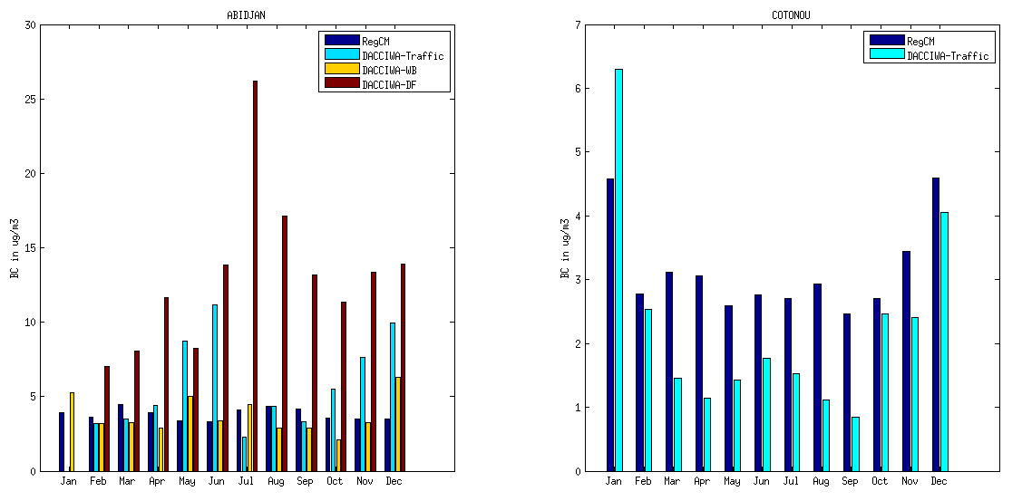
Carbonaceous particles (BC and OC)
Fig 7: Simulated BC comparison with DACCIWA WP2 measurements in Abidjan and Cotonou
Good agreement between simulated and measured BC concentration in Abidjan waste burning.
Underestimation of simulated BC concentration in Abidjan traffic site during May, June, November and December.
Good agreement between simulated and measured BC concentrations in Cotonou except from march to September (model underestimated).
Project Meeting 24-27 October 2017
Presenter | Organisation
6

Slide 12
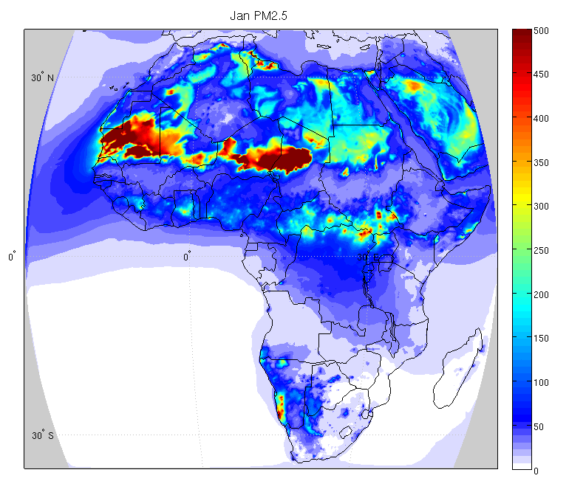
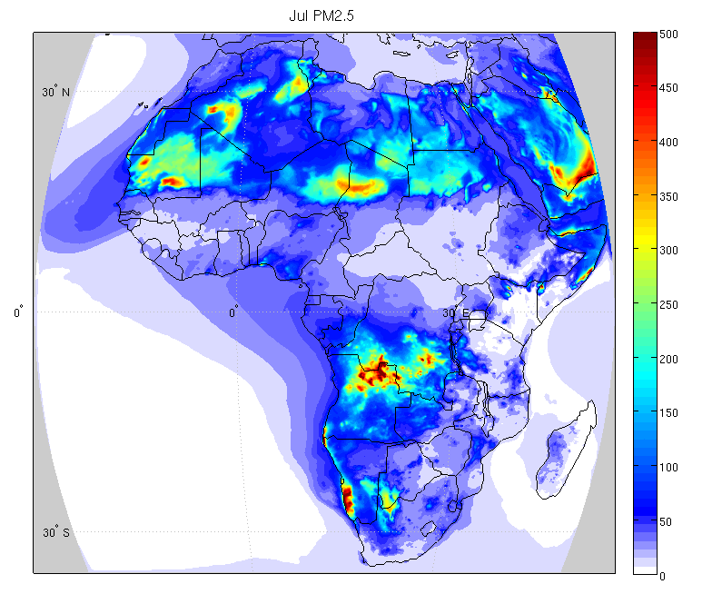
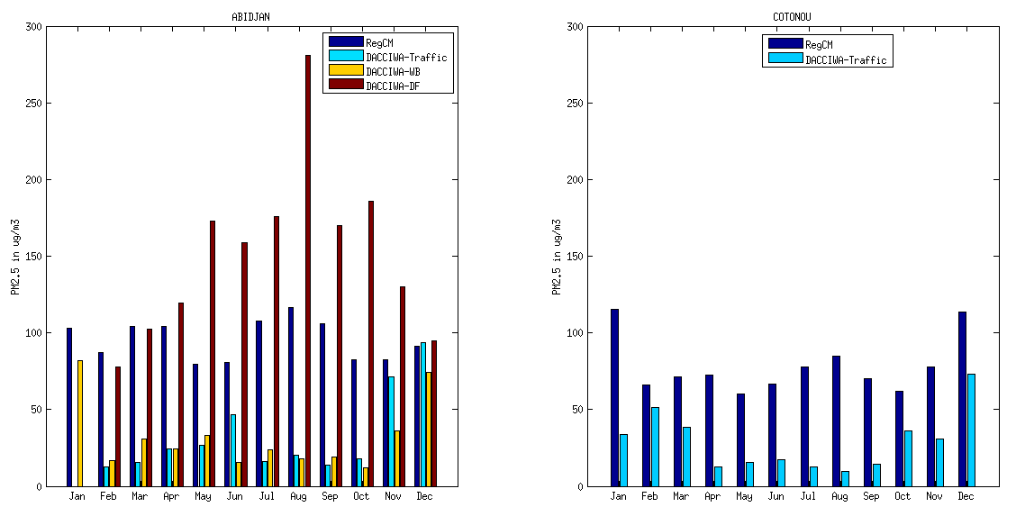
PM2.5
Dust: large part of PM2.5 in north hemisphere of Africa especially in Sahel.
Strong BB impact underlined in central and southern Africa.
Important anthropogenic sources contribution in the coastal zone especially in the cities along the Gulf of Guinea.
Same PM2.5 magnitude order for traffic and waste burning sites during the dry season.
Overestimation of PM2.5 during the wet season
Fig 9: Simulated PM2.5 surface concentration in (ug/m3) spatial distribution in Africa during January and July 2015
Fig 10: Simulated PM2.5 comparison with DACCIWA WP2 measurements in Abidjan and Cotonou.
Project Meeting 24-27 October 2017
Presenter | Organisation
6

Slide 13
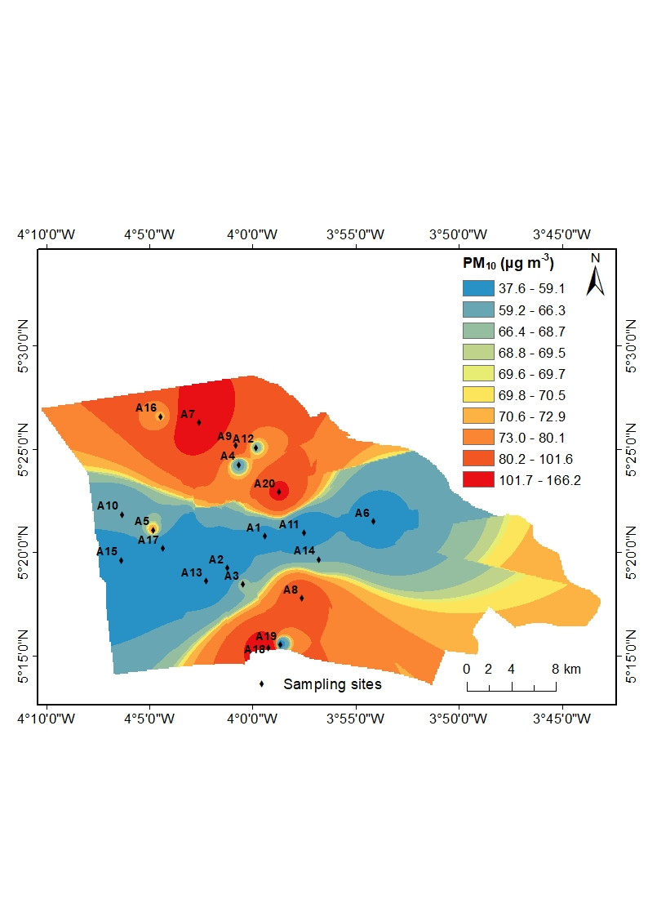
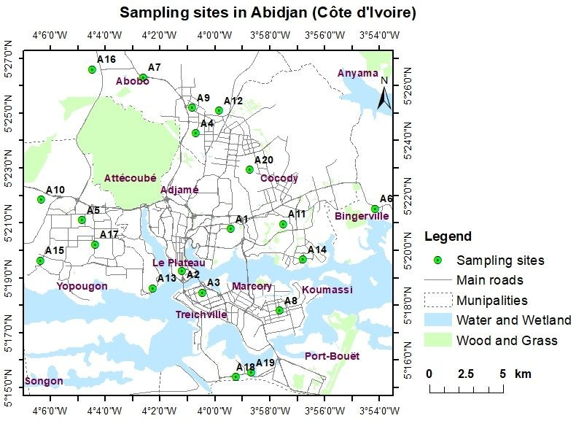
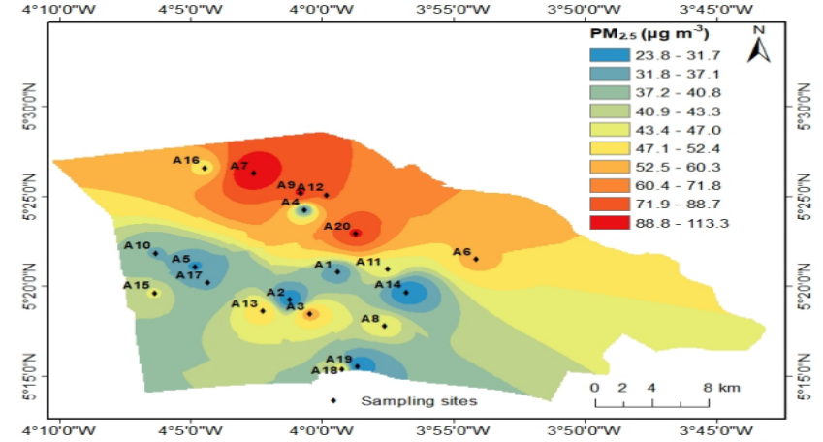
PM10 and PM2.5 modelling over Abidjan
20 sites in Abidjan to assess PM10 and PM2.5 spatial distribution in Abidjan
PM10
PM2.5
Gnamien et al., 2020
37.6μg/m³<PM10> 166.2μg/m³ (15 μg/m³ WHO 24 hour mean limit)
23.8 μg/m³ <PM2.5> 113.3 μg/m³ (5 μg/m³ WHO 24 hour mean limit)
High spatial variability of pollutant concentrations across Abidjan

Slide 14
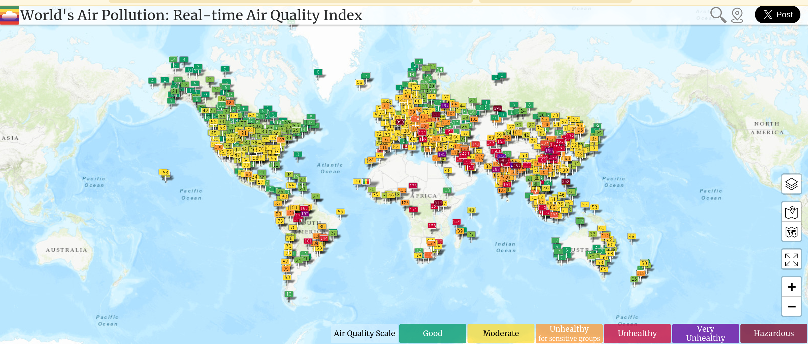
LCS an opportunity for AQ monitoring
World's Air Pollution: Real-time Air Quality Index (https://waqi.info/ )

Slide 15
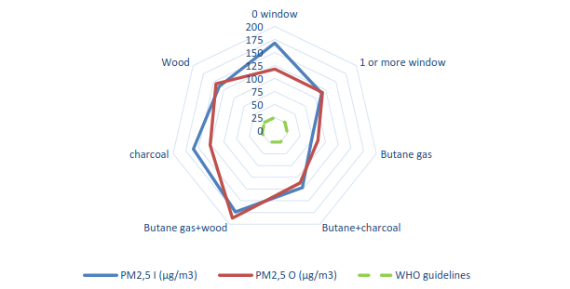
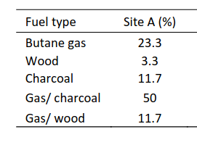
An example of Household pollution exposure
Average concentration of indoor PM 2.5 and outdoor PM 2.5 (25 μg/m3 Old WHO norms) in a low income area of Yopougon (Abidjan, Kouao et al., 2019)
Children under 5 years spend about 71% of the day in indoor

Slide 16
The “Integrated Assessment of Air pollution and Climate Change for Sustainable Development in Africa” :
An opportunity to accelerate Air Quality measures implementation in Africa

Slide 17
Assessment Objectives
The African Union’s Agenda 2063, describes a vision of the “the Africa we want”, but further guidance is required to assess how best to achieve that vision.
The Africa Assessment aims to examine the challenges, implications and trade-offs of a range of alternative development paths that might plausibly be taken to achieve the goals set out in Agenda 2063.
More specifically the assessment aims to:
examine how an ambitious development agenda for Africa can proceed at the same time as reducing air pollution, improving health and well being, limiting impacts on local ecosystems, and helping to avoid climate change impacts
provide appropriate and timely responses to inform planning by governments and other stakeholders
explore using modeling various options for enhanced synergies and avoided tradeoffs

Slide 18
The Assessment approach and features
Africa-wide model developed in LEAP with data for 54 African nations.
Time Period: Historical Period: 2000 – 2018, Projections: 2019-2063. Annual results but with particular focus on 2030 (SDG target year) and 2063.
Geography: Whole continent with national-scale resolution of key variables. Results can be shown for Africa as a whole, for individual countries or for various country groupings.
Sectors: Modeling of all energy consuming and producing sectors and key non-energy sectors (agriculture, Industrial Processes and Product Use (IPPU), solid waste, etc.)
Pollutants: All long-lived GHGs and short-lived climate pollutants (SLCPs), and all major local air pollutants.
Scenarios: One Baseline scenario (where Africa heading under current policies), plus two policy scenarios:
SLCP: Focused primarily on avoiding short-lived climate pollutants (CH4, BC, OC, etc.).
Agenda 2063: Builds on SLCP scenario by adding additional CO2 mitigation measures and addressing Africa’s Agenda 2063 development goals.
All scenarios share the same population (UN), GDP growth (DSSP2) and urbanization projections (UN).

Slide 19

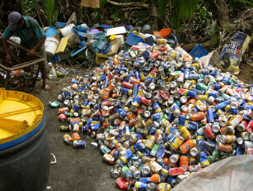
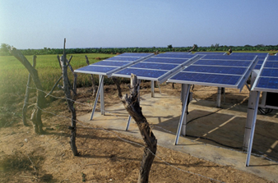
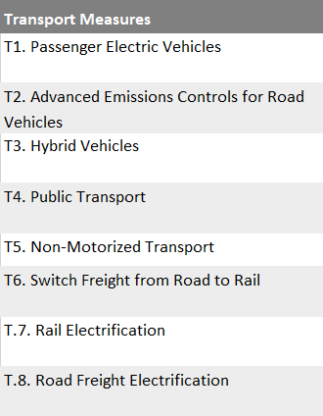
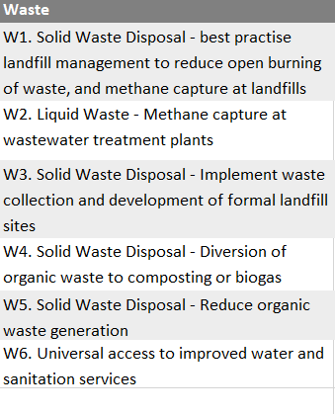
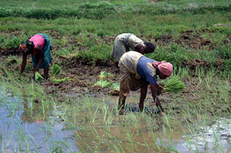
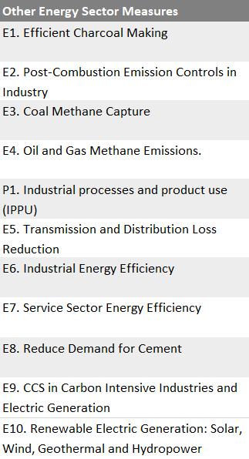
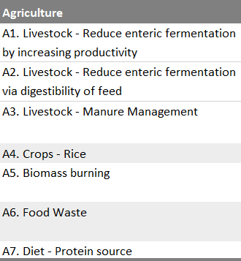
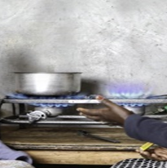
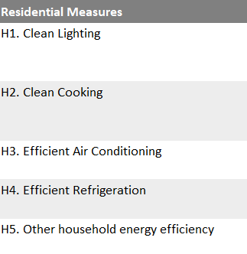
Measures Modelled
Measures common to National and Regional Action Planning on SLCPs, Agenda 2063, SDGs and NDCs in African

Slide 20

Estimation of emissions from baseline scenario of Assessment
Estimated emissions of GHGs, SLCPs and air pollutants in the baseline produced by the assessment

Slide 21

The assessment identified 5 action areas and 37 measures
Notes:
All 37 measures have co-benefits for a range of air pollutants, SLCPs and GHGs in 2030 and 2063 under the SLCP Mitigation and Agenda 2063 Scenarios developed for the Assessment compared to the baseline in 2018
25

Slide 22

Air quality health impacts Precipitation
Air Pollution
Baseline: Without policy intervention, outdoor air pollution will increase, leading to around 930,000 premature deaths per year in 2030 and 1.6 million per year in 2063.
Agenda 2063: By implementing the 24 energy sector measures and 13 non-energy sector measures, 180,000 premature deaths per year due to outdoor air pollution can be avoided in 2030 rising to 800,000 in 2063.
Agenda 2063: In addition, a further 20,000 premature deaths could be avoided from indoor air pollution through these same measures, rising to 80,000 avoided premature deaths by 2063.
Mean Precipitation Change in 2050-2060 vs. 2015-2025 (JJA)
Agenda 2063 Baseline (A2063-Baseline)
While the climate in Africa is largely governed by global emissions, the Assessment finds that policies in Africa can still have a considerable impact on local precipitation patterns, especially in the Sahel region (June –Aug) and southeast Africa (Jan-Mar), due to the change in radiative balance caused by aerosols and SLCPs.
Notes:
Agriculture: livestock enteric fermentation (blue) main reduction via productivity increases linked to increased feed digestibility, animal weights, fertility rates and reductions in age at calving
+ Shift in diets - no change modelled by 2030 but by 2063 if average red meat is > 23g per day, the minimum risk exposure level for red meat (GBD, 2019), then meat consumption was reduced to this amount
+ Food waste will be completely eliminated by 2063. With technological advancements and behavioural changes
25

Slide 23


Outdoor PM_{2.5} and Ozone Related Premature Mortality
Fine Particulate Matter - PM_{2.5}
Tropospheric Ozone – O₃

Slide 24

Outdoor PM_{2.5} Exposure Relative to WHO Guidelines
The exposure graphs also show the WHO Air Quality Guideline (5 μg m⁻³ annual average) and interim Target 1 (35 μg m⁻³ annual average)

Slide 25




Residential Clean Cooking
Premature Deaths from Indoor Air Pollution

Slide 26
Key Message
The Assessment shows that:
Air pollution and climate change are inextricably linked – the integrated package of measures can achieve synergies and avoid trade-offs
By investing in solutions to fight climate change and air pollution together, Africa has the opportunity of building on progress made in recent decades towards achieving multiple sustainable development objectives
If these measures widely implemented across Africa, they could generate substantial environmental, social, and economic benefits across gender, age and income groups related to health (air pollution and climate related benefits), crop yields and the mitigation and adaptation of climate change
Some of the recommended measures have already been successfully implemented in some parts of Africa
Projected growth across Africa can be achieved sustainably while maintaining current levels of emissions or even reducing them, despite huge increases in economic activity, urbanisation, and population

Slide 27

A synergy of atmospheric
scientist for Emission, Air Quality, Meteorology Climate variability, Climate Change and its impacts in Africa
https://igacproject.org/working-groups/anga
ANGA email: ANGA.Mailing@gmail.com
ANGA Twitter: @ANGA_AtmosSci

