Slide 1


Arab Republic of Egypt Ministry of Environment Environmental Affairs Agency
Environmental Policies to Improve Air Quality in Egypt

Slide 2


Slide 3
Air pollution is considered one of the major challenges that affect on the environmental.
The Ministry of Environment put some issues on the top of its priorities, and gave extraordinary attention to execute the strategies that face air pollution relatively with economic growth in addition to industrial, and other development processes such as the following :
1- Air Quality Management by monitoring air pollutants and Early warning system of air pollution.
2- Monitoring of burning points
3- Continuous updating of laws and legislation

Slide 4
4- Committees to improve air pollution and climate change.
5- Maximizing the economic value of waste by recycling and using it in fuel alternatives instead of open burning
6- Air Quality Improvement Projects
7- Awareness and information to reduce air pollution
8- Expanding the cultivation of green spaces
9- Establishing environmentally friendly urban communities to be compatible (green building)
10- Renewable energy

Slide 5
1-Air Quality Management by
Monitoring Air Pollutants and Early warning system of air pollution
The Ministry of Environment has developed a plan for development a national network for monitoring the following:
1- National Network for Monitoring Ambient Air Pollutants.
2-The national network for monitoring industrial emission .
3- Early warning system of air pollution .

Slide 6
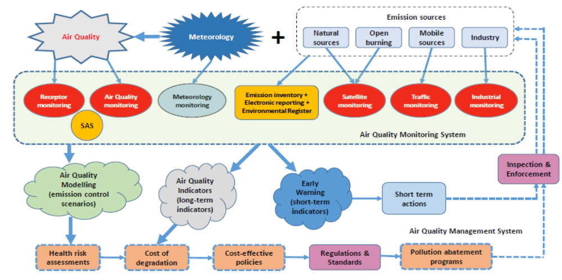
General Framework of the Environmental Monitoring System and Air Quality Management (Reality & Future)

Slide 7
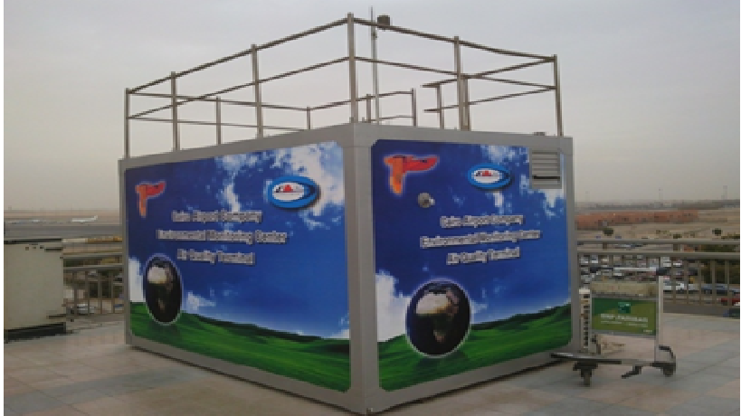
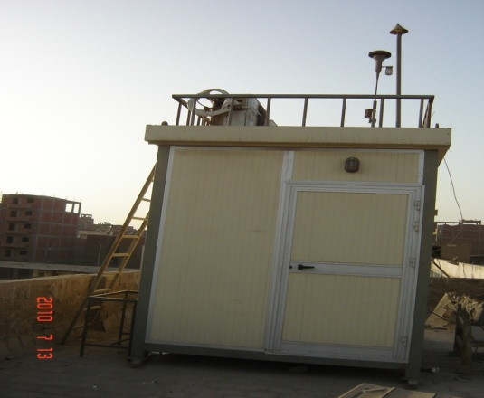
Ministry of Environment and its executive agency has started the establishment of a network to monitor air pollutants at 1998 in the context of its responsibility for the protection of the Egyptian environment and it aims to identify ambient air quality, A national monitoring network consists of 121 monitoring stations distributed all over the different regions of the Republic.
1- National Network for Monitoring Ambient Air Pollutants.

Slide 8
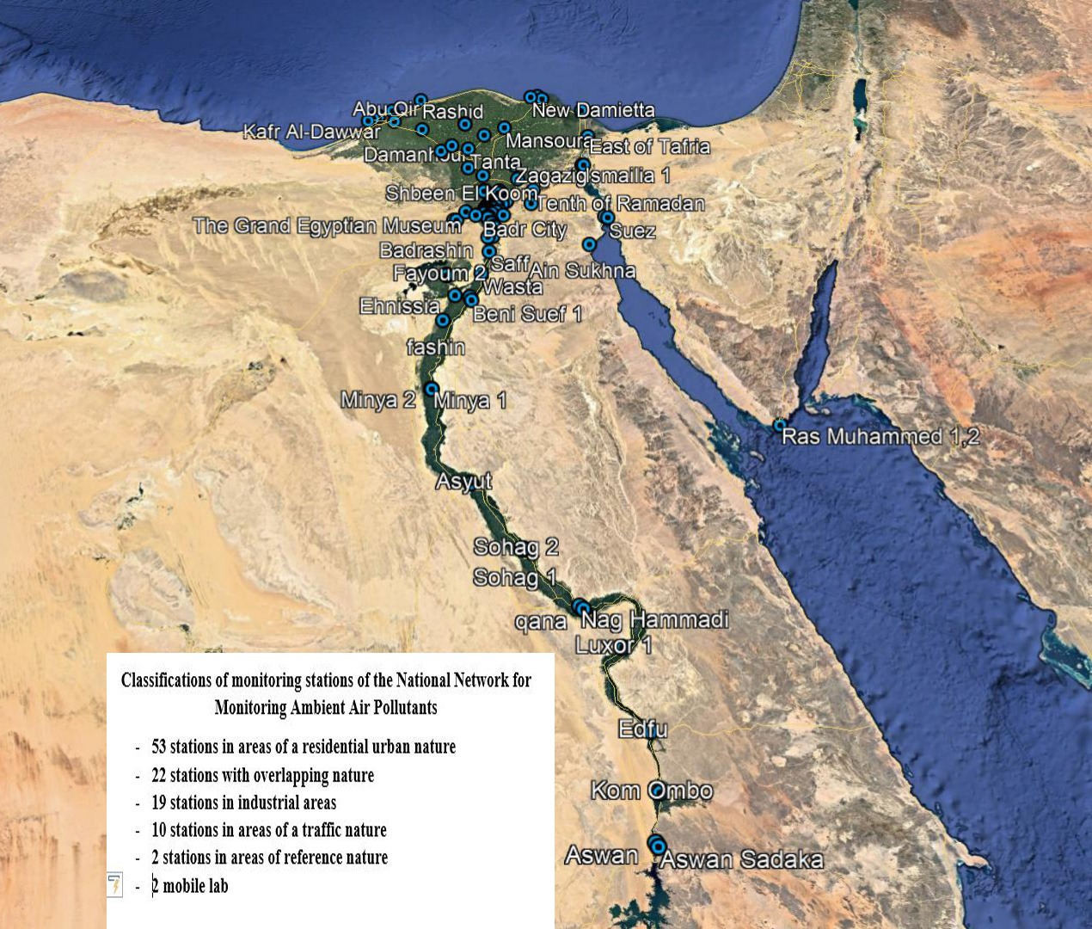
The methods of monitoring process in the national Network are as follows:
The first method: - through instantaneous automatic devices operated 24h/7day, where the data records and Statistical calculations done on hourly and daily basis. 63 )stations)
The second method: - carried out through semi-automatic sampling devices (collection on filters), later these samples are analyzed in specialized chemical laboratories to determine concentrations. ( 58 stations(
Air quality monitoring station locations

Slide 9
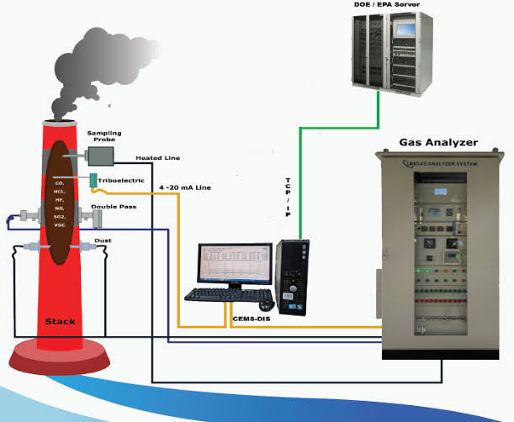
2-The national network for monitoring industrial emission
The Ministry of Environment establish the National Network online Monitoring Industrial Emissions System which cover all cement and big industrial companies (Continues Emission Monitoring System- CEMS)
That based on data's storage (in-site) and transfer through communication system to the central server in EEAA.

Slide 10

3- Early warning system
The results of Ambient Air Pollutants monitoring system and the industrial emission system with meteorological data through an early warning system that depends on the analysis of data on wind speed and direction .
The system predicts the weather factors affecting concentration levels of pollutants for the next three days for all regions of the Republic.

Slide 11
Early Warning System
Trj .25 Degree for HySplit
72 Hour Forecast
Air -Ampiant Database
WEB interface
GFS .25 Degree
72 Hour Forecast
Download
& encoding
Analyses& operation
EW Reports
Ambient Reports
Industry Reports
Fire Report
Aerosol Map
NoAA.com
GDAS .25 Degree
24 Hour
Download
& encoding
WRF Model
EWS Database
Analyses& operation
Metar
CSV 24 Hour
Download
Industrial Database
Fire Web site
CSV 24 Hour
Download
Analyses& operation
Title
Title
Title
Title
Title
Population database of Egypt
ground heights
Elements of weather conditions

Slide 12
Through the results, coordination is made with the rest of the agency’s departments to develop general policies on air quality by focusing inspection and follow-up campaigns on pollution sources and identifying the causes of problems to take the necessary measures to adjust the companies’ conditions and carry out maintenance with a more modern system that complies with the limits of the law.

Slide 13
4- Air Dispersion Model
An *Air Dispersion Model* is a mathematical simulation used to predict how pollutants disperse in the atmosphere. These models estimate the concentration of pollutants at various locations downwind of a source, such as a factory or vehicle emissions, based on inputs like emission rates, meteorological conditions (wind speed, direction, atmospheric stability), and terrain features.

Slide 14
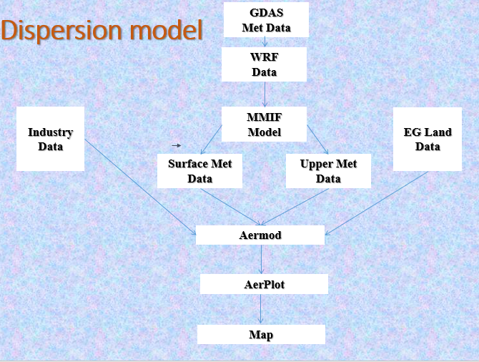

Slide 15

2- Monitoring of hot spots
Using satellite image to monitor different hot spots
NASA follow burning points through three satellites around the world, each passing through the Middle East once every 12 hours.
Early warning System downloads the data of the three satellites as CSV files to the database to identify the sites of hot spots.

Slide 16
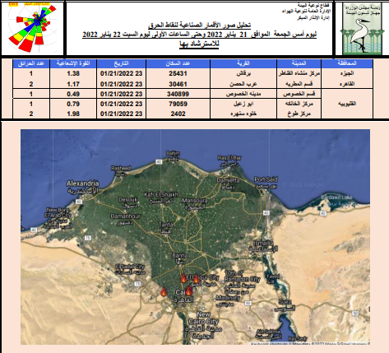
Action taken by EEAA to reduce burning points all over the governorates of the Arab Republic of Egypt.
Early Warning System was connected to all regional branches of EEAA through a link to access it and reach to the sites of burning points inside their governorate by Google maps.
Inspection and control axes are directed to these sites .
The Early Warning Department prepares a daily burning points report for all governorates of the Arab Republic of Egypt.
An example of the daily burning points report allover 24-hour at Greater Cairo governorates

Slide 17

3- Continuous updating of laws and legislation
Continuous updating of environmental laws and regulations that comply with European standards to oblige facilities to use technology that is more compatible with the environment.

Slide 18
For Egypt, this process involves several steps:
  Analyze existing laws and regulations to identify gaps, inefficiencies, or areas needing improvement.
  Compare Egypt's legislation with international best practices and standards.
  Consult with environmental scientists, legal experts, and policy advisors to gather input on necessary updates

Slide 19
  4- Draft amendments to address identified issues and incorporate new environmental standards.
  5- Propose changes to enhance the enforcement mechanisms, including penalties and compliance monitoring.

Slide 20
4- Committees to improve air quality and climate change
Coordination with the relevant ministries and establish a committees to reduce air pollution and put recommendations to each ministry to take actions to reduce air pollution, such as:
Ministry of Environment
Ministry of Local Development
Ministry of Interior
Ministry of Industry and Transport
National Authority for Media, etc .......

Slide 21
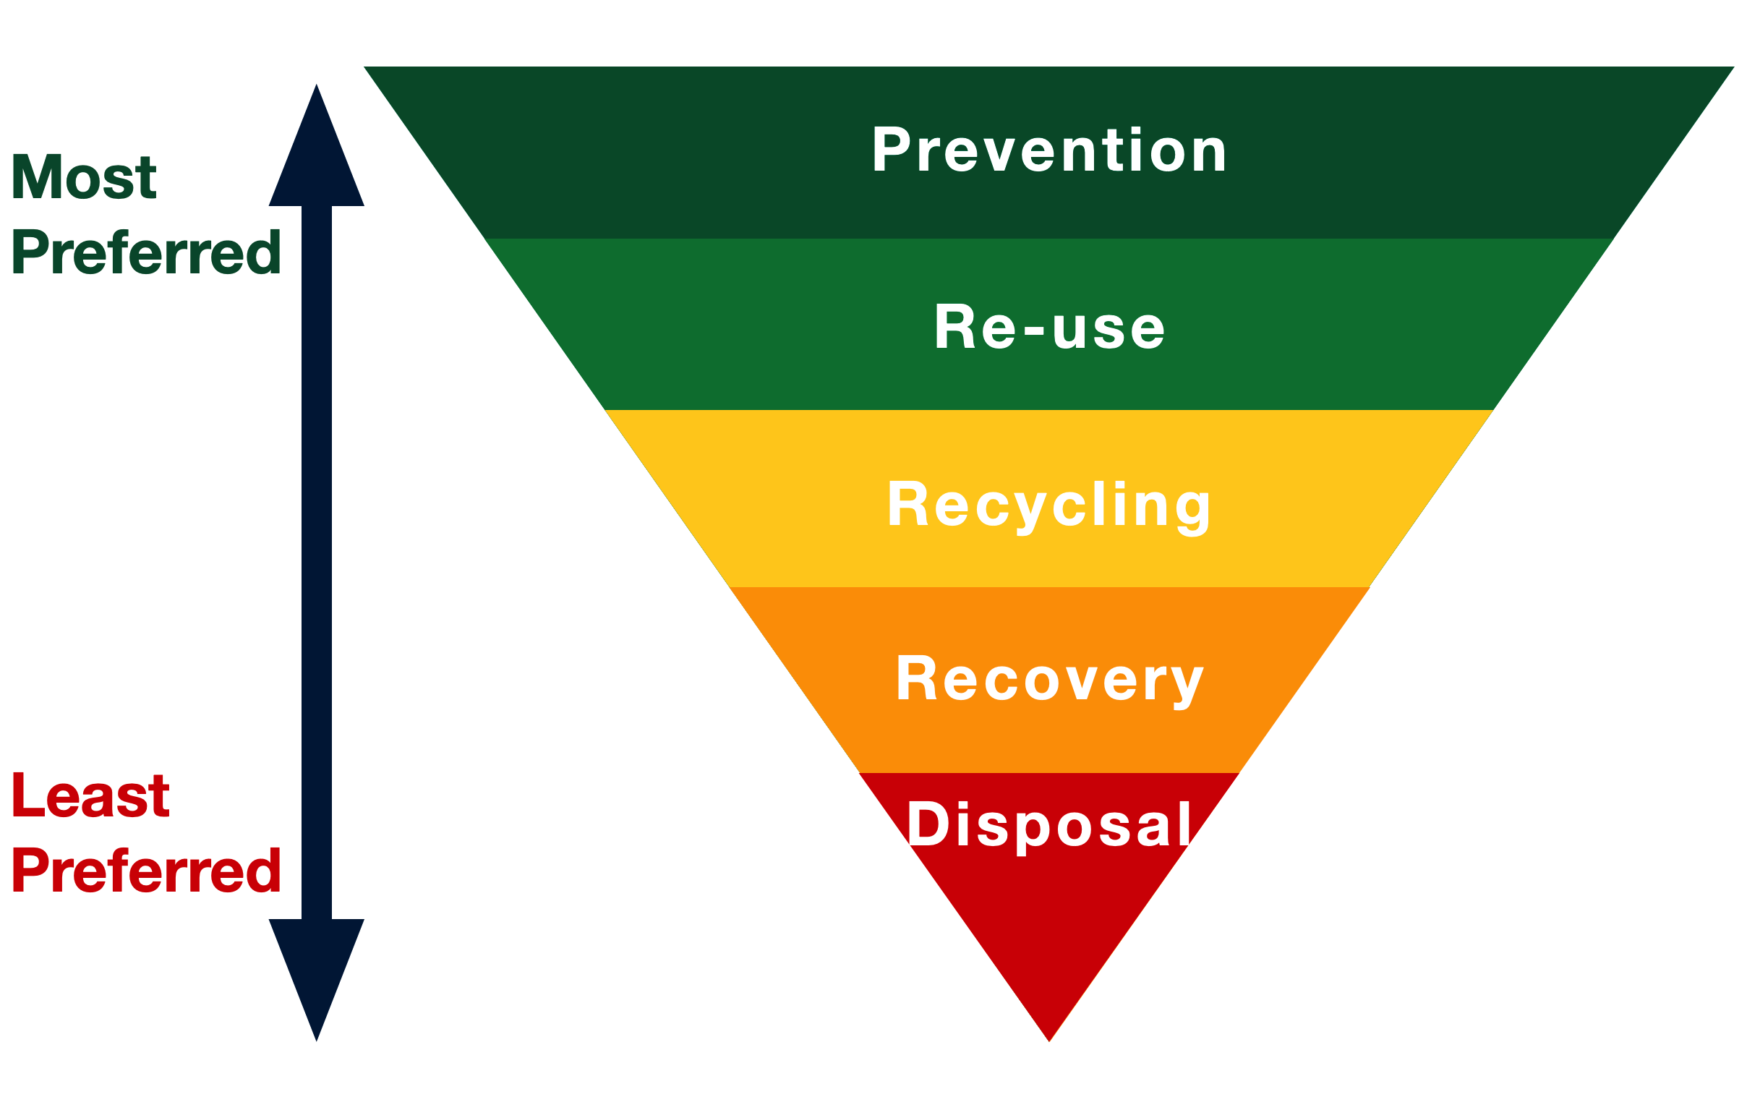
5- Maximizing the economic value of waste by recycling and using it in fuel alternatives instead of open burning

Slide 22
Maximizing the economic value of waste involves promoting recycling and repurposing waste materials to create fuel alternatives rather than resorting to open burning.

Slide 23
6- Air Quality Improvement Projects
Providing financing packages through Air Quality Improvement Projects by granting loans to industrial facilities to develop production units to comply with environmental requirements and standards or establishing environmental projects

Slide 24
These financing mechanisms offer industries the financial support needed to invest in clean technologies, reduce emissions, and adopt sustainable practices.

Slide 25
7- Awareness and information to reduce air pollution
Raising awareness and providing information to reduce air pollution are critical components.
Effective strategies include Public Education Campaigns, Informing communities about the causes and effects of air pollution.
This may involve promoting the use of public transport, reducing energy consumption, and encouraging recycling Industry .

Slide 26
Informing policymakers about the necessity of strict air quality regulations.
Utilizing websites, social media, and apps to share real-time air quality data and offer tips on reducing personal carbon footprints.

Slide 27
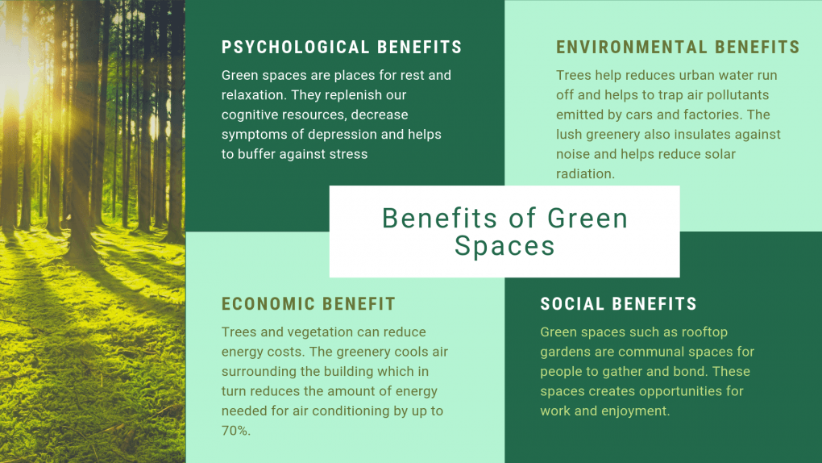
8- Expanding the cultivation of green spaces
Expanding the cultivation of green spaces to overcome the natural factors resulting from the geographical nature of the Arab Republic of Egypt as one of the mitigation methods to face climate change

Slide 28
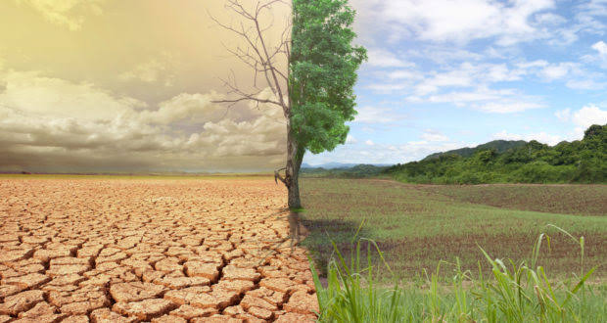
Expanding the cultivation of green spaces is a key strategy to mitigate the impact of natural factors
By increasing urban greenery, reforestation, and developing agricultural areas.
Properly designed green spaces represent one of the mitigation strategies to address climate change by promoting sustainability

Slide 29
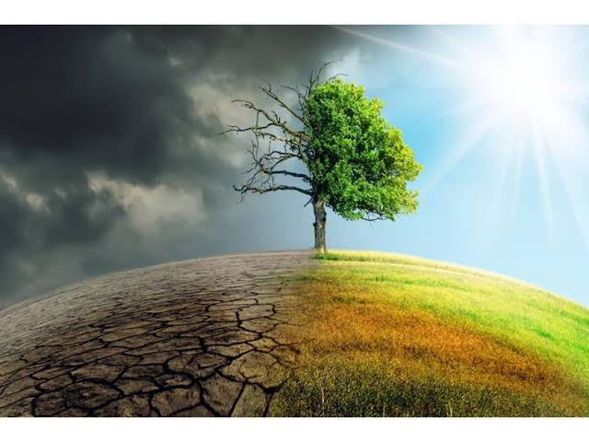
Egypt can help to overcome the negative effects of climate change as follow:
Expanding green spaces that stabilize soil, reduce dust storms
Plants act as natural air purifiers, absorbing carbon dioxide and releasing oxygen, which helps in reducing air pollution and greenhouse gas emissions.

Slide 30
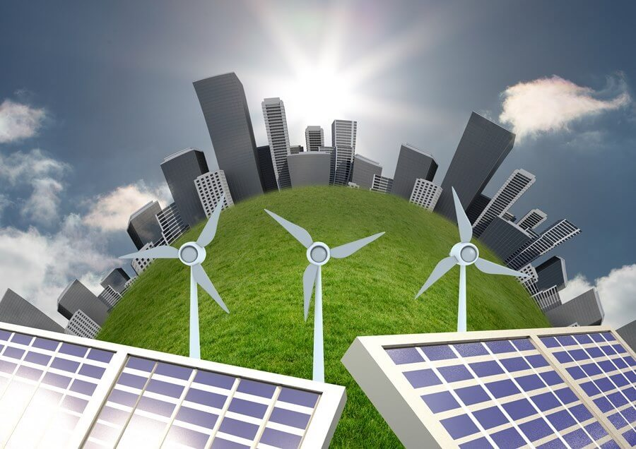
9- Establishing environmentally friendly urban communities to be compatible (green building)
Establishing environmentally friendly urban communities with a focus on green building aims to create sustainable living environments that minimize environmental impact and promote resource efficiency.

Slide 31
Buildings are designed to reduce energy consumption
Incorporating water-saving technologies such as rainwater harvesting, greywater recycling, and low-flow fixtures to reduce water consumption
Using environmentally friendly, non-toxic, and recyclable materials in construction.
Promoting recycling and composting within communities, and incorporating systems to handle waste in an environmentally responsible manner.

Slide 32
Integrating parks, gardens, and green roofs into the urban environment to promote biodiversity, improve air quality, and create healthier living conditions
Encouraging the use of public transport, walking, and cycling through well-planned infrastructure to reduce reliance on fossil fuels and cut down emissions.

Slide 33
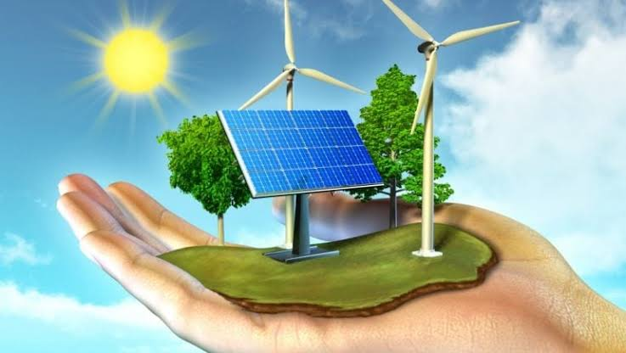
10- Renewable energy
Expanding the uses of renewable energy through the production of electrical energy from solar and air projects instead of relying on fossil fuels in the production of electricity.
Expanding the use renewable energy by producing electrical energy from solar and wind projects offers a sustainable alternative to relying on fossil fuels for electricity generation

Slide 34
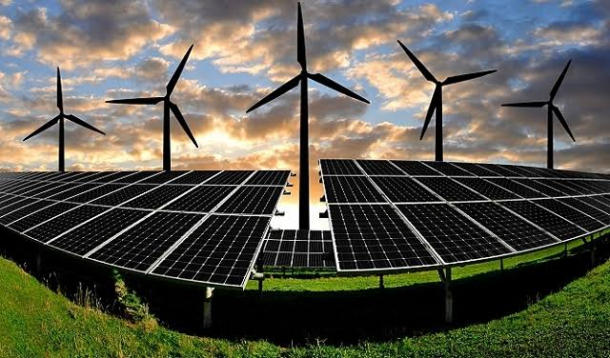
Reducing Greenhouse Gas Emissions: Transitioning to solar and wind energy significantly reduces carbon dioxide and other harmful emissions, helping to mitigate climate change.
Energy Security: Renewable energy sources like wind and solar are abundant and domestically available, reducing dependence on imported fossil fuels and enhancing energy independence.

Slide 35
3-Diversification of Energy Sources: Incorporating solar and wind energy into the national grid diversifies energy sources, making the power supply more resilient and reducing the risks associated with fluctuating fossil fuel prices.
4-Environmental Preservation: By shifting away from fossil fuels, there is a reduction in environmental degradation, including air and water pollution caused by the extraction and burning of fossil fuels.
By prioritizing solar and wind projects, nations can move toward clean energy production, supporting global sustainability goals while improving energy resilience and reducing environmental impact.

Slide 36
5-Reducing Traffic Congestion: Encouraging the use of mass transportation systems, such as buses, trains, and trams, can significantly decrease the number of private vehicles on the road, alleviating traffic congestion in urban areas.
6-Lowering Air Pollution: Mass transportation systems, especially those powered by electricity, produce far fewer emissions compared to individual cars, contributing to improved air quality and a reduction in greenhouse gases.
7-Promoting Electric Vehicles (EVs): Relying on electric-powered cars, buses, and trams helps reduce dependence on fossil fuels

Slide 37
Thanks

