Slide 1



Air quality monitoring andmanagement in the gambia
Bridging the Skills Gap
MoHERST 2024
Teeda Njie

Slide 2
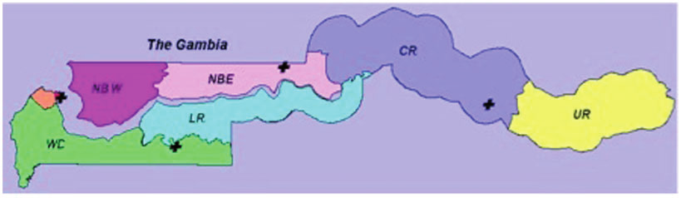
InTRODUCTION
Surrounded on the three sides by Senegal and on the Atlantic Ocean on the forth side
It has a population of 2.4 Million
The Gambia experience Sahelian climate, characterized by a long, dry season (November to May) and a short, wet season (June to October).
Average temperatures in Gambia range from 18°C to 30°C during the dry season and 23°C to 33°C during the wet season.

Slide 3
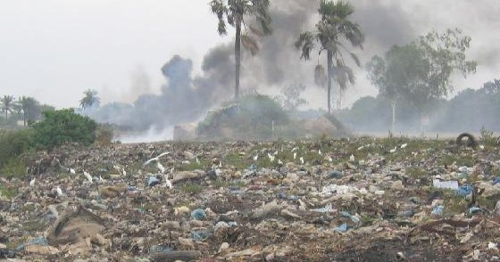
Air quality in The Gambia is influenced by a combination of natural and anthropogenic factors, with significant contributions from
Vehicle emissions
Urbanization
Industrial activities
Bush burning
and natural phenomena such as
The harmattan winds.
SOURCES OF AIR POLLUTion IN THE GAMBIA

Slide 4
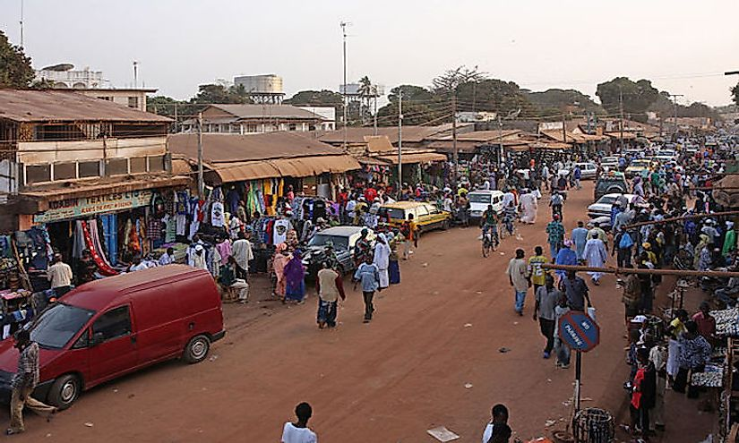
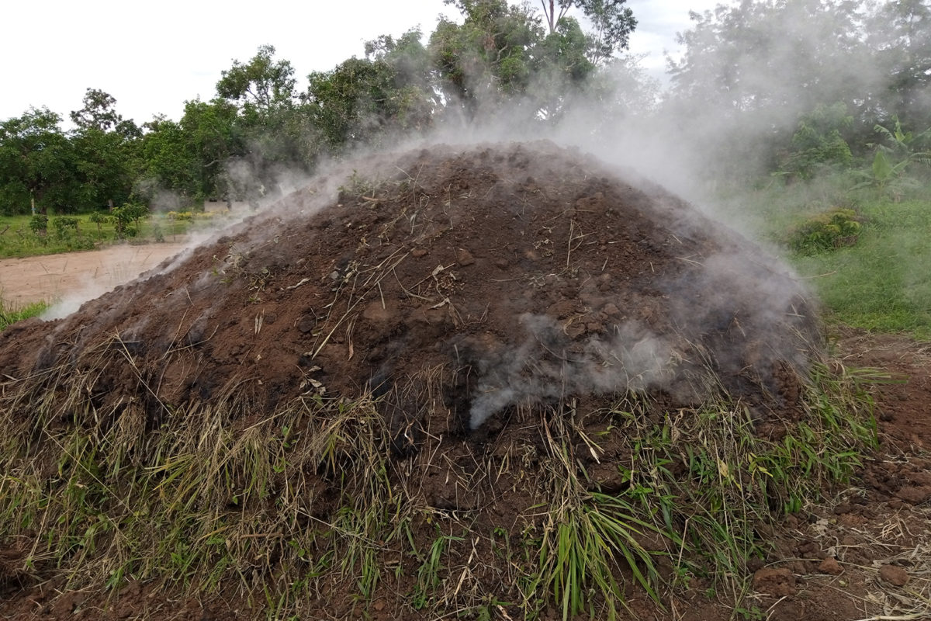
Urbanization
The concentration of population in urban centers leads to increased pollution due to high use of biomass for cooking and waste generation.

Slide 5
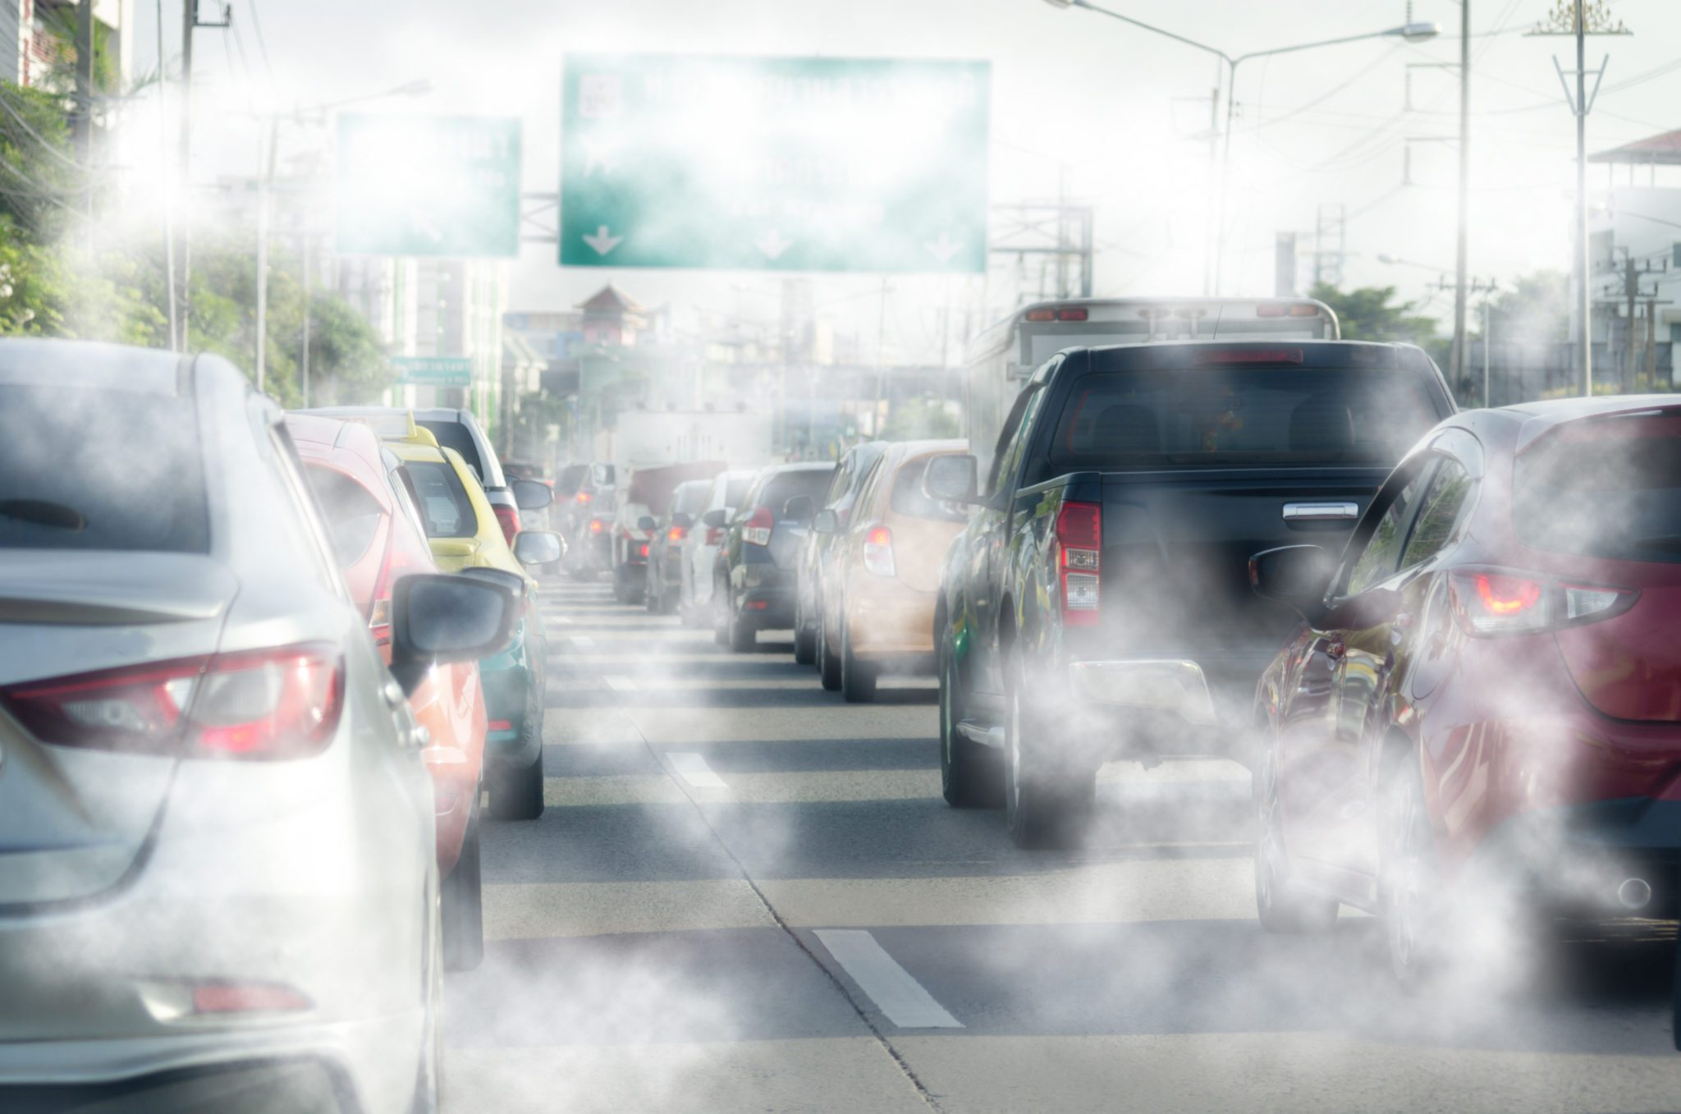
VEHICLE EMISSION
The fleet of vehicle in the country are characterized by older models that are less efficient and have higher emissions per mile traveled
poor fuel quality and inadequate maintenance practices
Traffic congestion further aggravates the situation, leading to increased idle times and higher emissions of carbon monoxide, nitrogen oxides, and particulate matter.

Slide 6
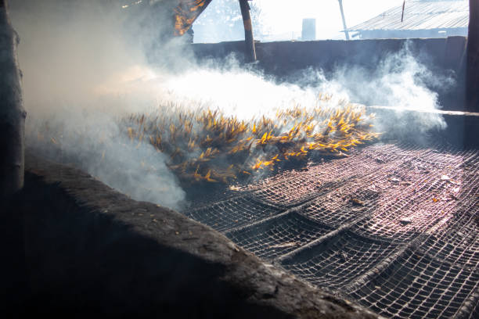
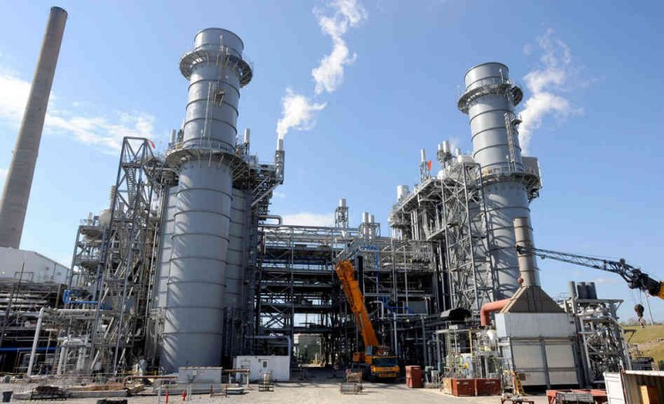
industrial activities
Fishing and fish smoking site
Energy generation using fossil fuels.

Slide 7
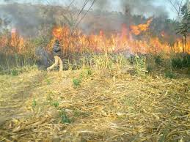
Bush Burning
Bush burnings commonly occur in rural and sub-urban areas, particularly during the dry season and pre-monsoon period when the vegetation is highly combustible and farmers are prepering lands for farming

Slide 8

Seasonality factors
The winds blown during the harmattan season carry fine dust particles, which significantly:
Increase the particulate matter concentration in the air.
Affects visibility and
contributes to respiratory problems among the population

Slide 9
IMPACTS OF AIR POLLUTION IN THE GAMBIA
Respiratory diseases
Cardiovascular problems
Effects on vulnerable populations
Impact on wildlife and biodiversity
Impact on vegetation and agricultural productivity

Slide 10
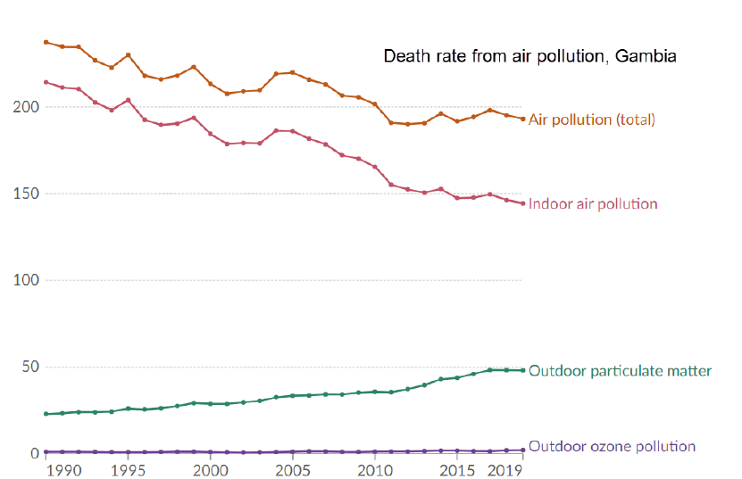
Figure 1: The annual trend of the death rate from air pollution in Gambia from 1990 to 2019, measured as the number of deaths per 100,000 people

Slide 11
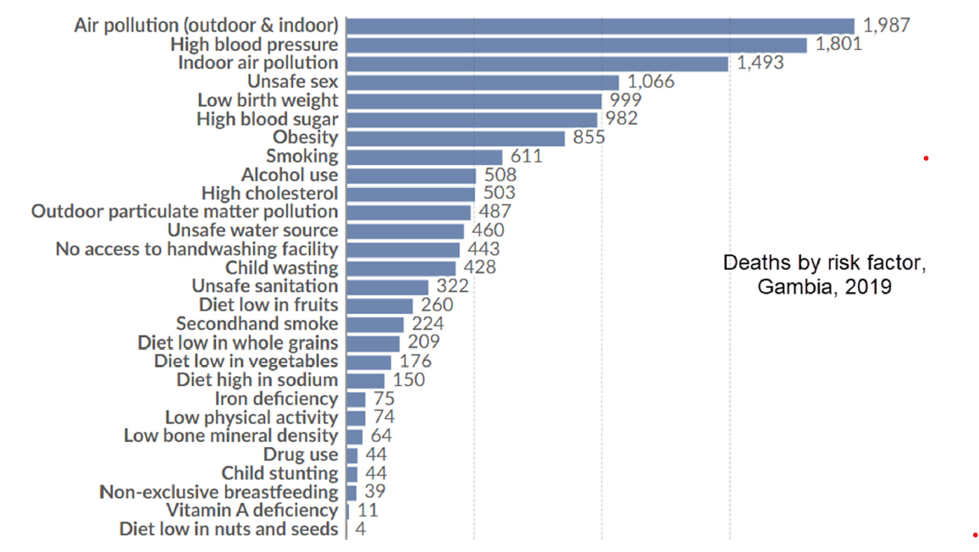
Figure 2: The estimated annual number of deaths attributed to each risk factor. Data source: IHME, Global Burden of Disease (2019)

Slide 12
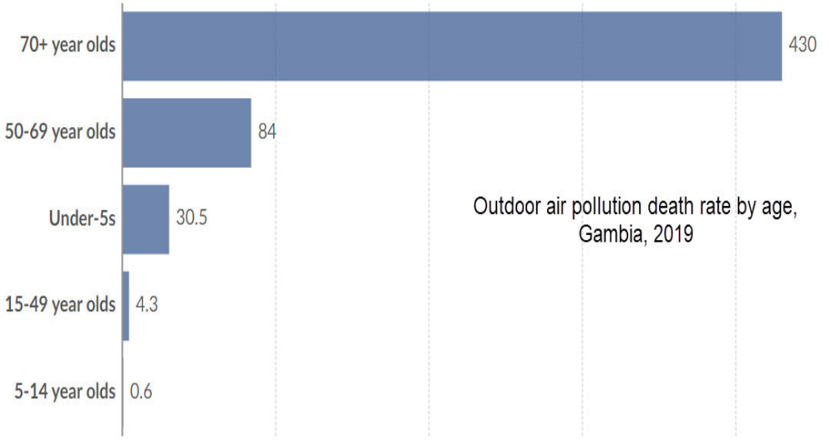
Figure 3: Outdoor air pollution death rate by age, Gambia, 2019. Death rates are measured as the number of premature deaths attributed to outdoor particulate matter air pollution per 100,000 individuals in each age group. Data source: IHME, Global Burden of Disease (2019).

Slide 13
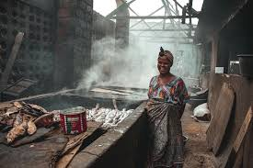
Major air pollutants
The atmospheric air quality in The Gambia is significantly impacted by various pollutants, including:
Particulate matter (PM10 and PM2.5)
Carbon monoxide (CO)
Nitrogen oxides (NOx),
volatile organic compounds (VOCs),
Carbon dioxide CO₂
Sulphur dioxide (SO2),

Slide 14
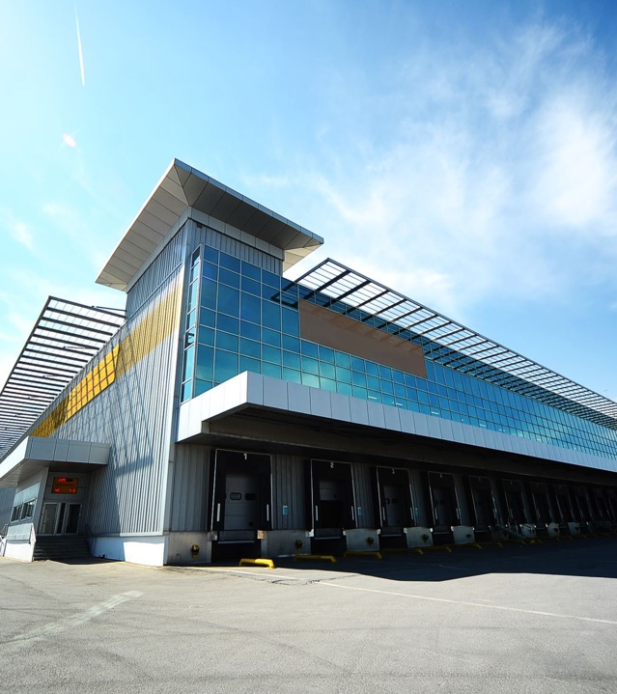
Air Quality Monitoring
The Gambia was lacking behind in terms of Air Quality monitoring until May 2023, when Permian Health's Clean Air Initiative received a prestigious grant from the EPIC Clean Air Program at the Energy Policy Institute at the University of Chicago (EPIC). The awards to help to scale fine particulate pollution (PM2.5) monitoring networks in areas that have traditionally lacked them.
This award greatly enhance to install air quality monitors (local sensors) nationwide and support the National Enviroment Agency and Ministry of Health to incorporate air pollution into national strategic planning and policy making.

Slide 15
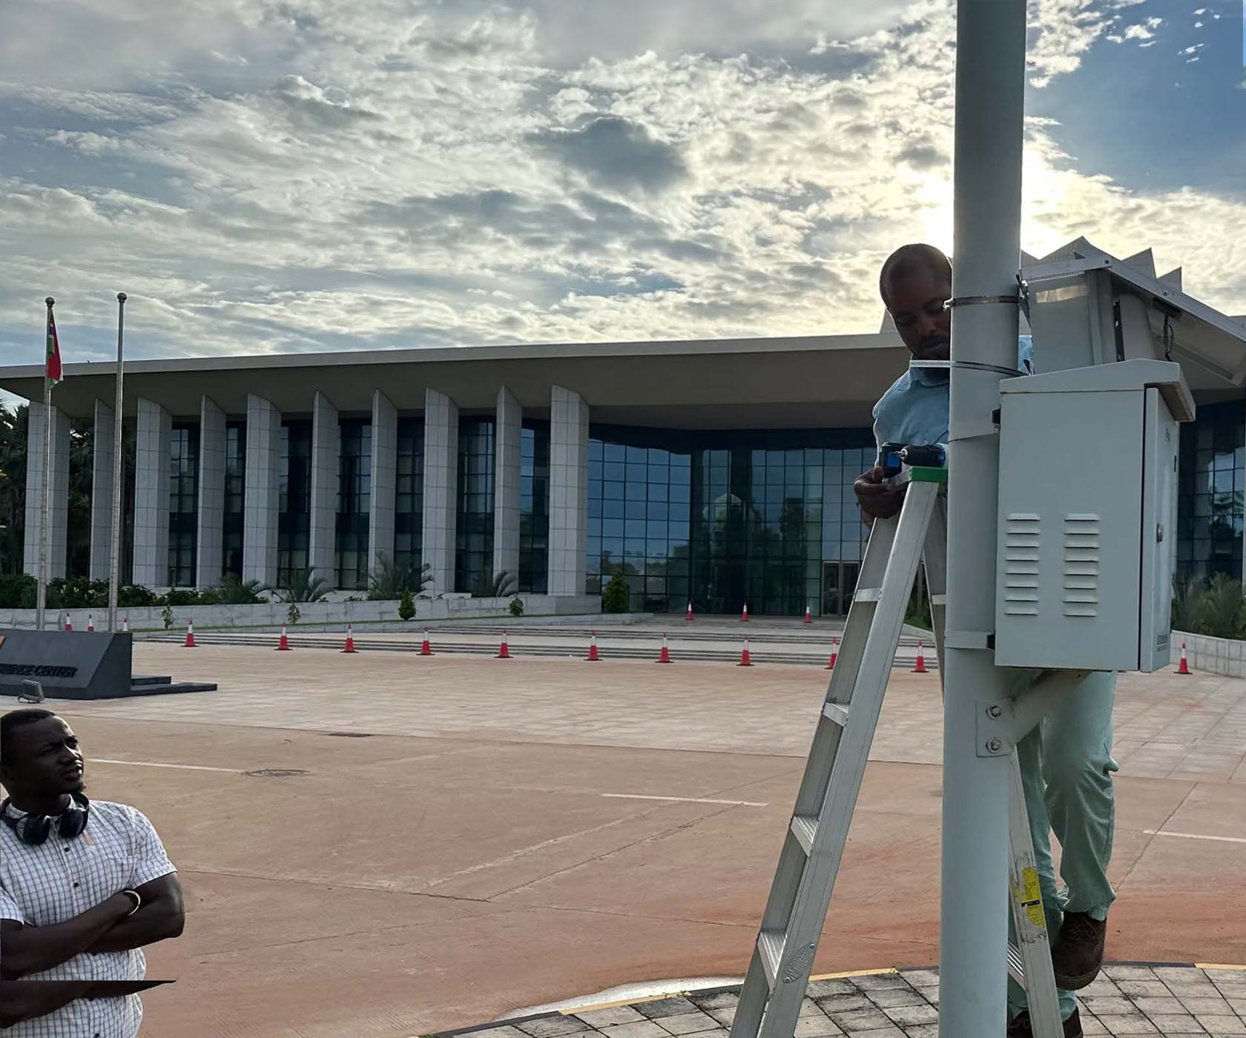
air quality monitoring TOOLS
The IQAir AirVisual Outdoor monitors
It monitor up to 8 environmental parameters including AQI, PM1, PM2.5, PM10, temperature, relative humidity, and pressure.

Slide 16
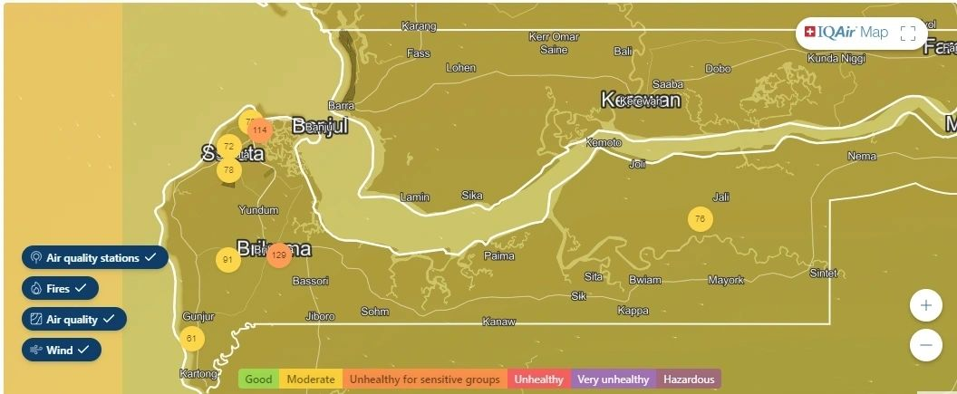
Network of Air quality monitors in the gambia

Slide 17
Air pollution Management in the gambia
Air pollution management in the Gambia comprises of:
Ministry of Environment, Climate Change, and Natural Resources
Ministry of Fisheries and Water Resources
Ministry of Health
The National Environment Agency (NEA)
Municipalities
Private sectors

Slide 18
Challenges of air quality in the gambia
Policy implementation and enforcement
Capacity gap (Human capacity)
Lack of air quality forcasting System and enough monitiring tools

Slide 19

Interventions
The government has employed several strategies in managing air pollution. Some of which are:
Policy interventions.
Community-based initiatives
Public health initiatives
Renewable energy

Slide 20

Policy interventions.
Policy interventions have been central to The Gambia's strategy to improve air quality.
These include implementing stricter emissions standards for vehicles and industries and developing urban planning policies that promote cleaner transportation options.

Slide 21
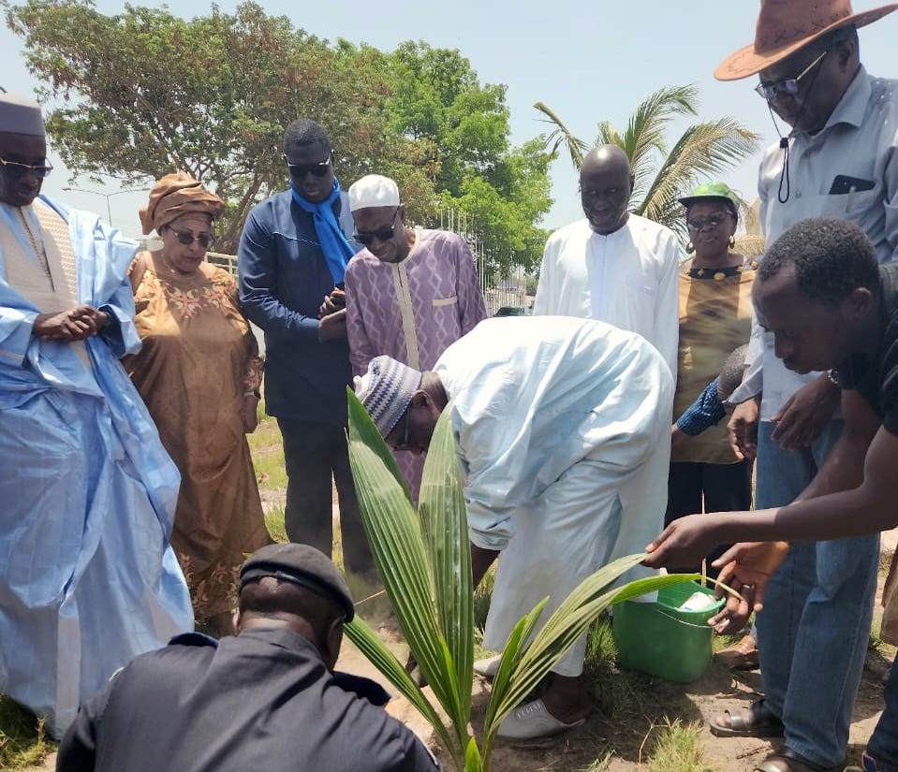

Community-based initiatives
Educating the public about the sources and dangers of air pollution and how to mitigate exposure.
Engaging local communities in tree-planting campaigns, waste reduction efforts, and educational workshops.
Empowering citizens to take action in their local environments.

Slide 22
Public health initiatives
Regular health monitoring and screenings for respiratory conditions in communities affected by poor air quality. For instance, programs that track the health impacts of air pollution on children in urban areas have been established, providing early diagnosis and treatment of respiratory issues, thereby significantly improving their quality of life.

Slide 23

Renewable energy
The government of The Gambia has commissioned a 23 MW solar plant in the country's western region including 8 MWh of battery for storage.
The GAMBIA River Basin Organization Project (OMVG) - a sub regional energy project for member states to gain 50% energy efficiency target by 2030 using hydroelectric Dam

Slide 24
Thank you
THANK YOU

