Slide 1



Air Quality Management Exchange (AQMx)
Training session
WMO Training course on seamless prediction of air pollution in Africa | September 18 2024

Slide 2


Overview
Background on AQMx
Introduction to structure and content of AQMx
Practical use cases for AQMx
Feedback from participants
Q&A
September 18 2024

Slide 3
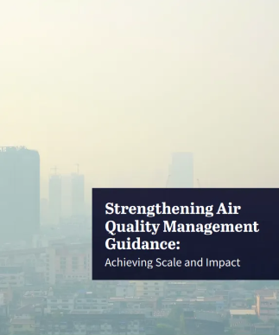
Background on AQMx: Needs assessment report
Strengthening Air Quality Management Guidance (Clean Air Fund, GHV, UNEP – 2023)
Key finding 1: Lack of capacity/technical or other knowledge to carry out work was identified as the 2nd biggest barrier faced by air quality managers (after lack of access to funding).
Key finding 2: Delivery of guidance needs to be harmonized, accessible, and facilitate cross-learning.
Key finding 3: Guidance needs to be expanded and strengthened to address critical gaps, and should be adapted to different contexts and capacities.
September 18 2024

Slide 4
Background on AQMx: Launch of the CCAC Clean Air Flagship
CCAC Clean Air Flagship approved at COP28 by CCAC Ministers
Objective 1: Amplify and strengthen regional and multi-level governance, cooperation and capacity on integrated climate and air quality management;
Objective 3: Elevate air quality agenda through advocacy, by highlighting readily available solutions, providing capacity support for data and implementation, and reinvigorating the BreatheLife Network
2024 Clean Air Flagship activities: Launch a knowledge platform for air quality managers and host national and sub-regional technical and advocacy workshops […]
September 18 2024

Slide 5
Background on AQMx: Adoption of UNEA-6 Resolution (March 2024)
"Promoting regional cooperation on air pollution to improve air quality globally"
This resolution encourages Member States to accelerate efforts to improve air quality globally, including by setting national ambient air quality standards.
… It requests UNEP to form and facilitate an air quality network and provide an updated global online platform for information sharing.
September 18 2024

Slide 6
Presentation of AQMx
September 18 2024

Slide 7
What is Comprehensive AQM Planning?
Air Quality Monitoring
Manual filter sampling (FRMs)
Continuous monitors (FEMs)
Low-cost sensors
Gas sensors
Remote sensing methods
Data validation
Data management systems
Public access
Source Attribution
Chemical speciation
Source apportionment
Dispersion models
Lagrangian (trajectory) models
Chemical transport models
Reduced complexity models
Airshed approaches
Emissions Inventory
Criteria pollutants
SLCPS/GHGs
Source sector identification
QA/QC – Cycle of continuous improvement
Policy effectiveness tracking/ accountability framework
UNFCCC reporting
AQ modeling input (emission modeling/ gridding)
Health Impact Assessment
Health incidence data (ICD-10)
CRFs
Burden of disease
Valuation methods
Government health spending
Developing public health messages
Sustainable Development Benefits Assessment
Ecosystem services
Waters
Biodiversity
Habitat
Fuel savings
Congestion mitigation
Crop Yields
Climate benefits
Tourism/aviation
Decision Support
Energy balance
Economic projections
Technology options/solutions/costs
Scenario analysis
Integrated Assessment Models
Cost-benefit
Cost-effectiveness
Macroeconomic impacts
Policy integration/prioritization
Public Engagement and Communication
Public awareness
Data accessibility
AQI, apps, website
Disseminating public messages
Stakeholder engagement
Buy-in to data, tools, assessment methodology
Communications materials
Legal Framework, Policy Design and Implementation
Ambient standards
Tech. performance standards
Permitting
Fiscal policy/incentives
Voluntary programs
Market trading
Clean technology adoption/ finance
Point of regulation
Staffing/budget
Agency mandates/accountability

Slide 8
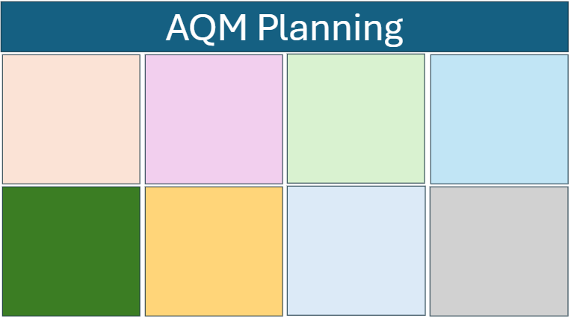
AQMx Structure – Content
Guidelines/Tools/Models
AQM Planning
AQM Planning
Data
Knowledge
NGO/DP Reports
Literature
Training resources

Slide 9
AQMx Structure – Engagement Stages
Stage 5
Stage 4
All Stages
Stage 3
Stage 2
Stage 1

Slide 10
AQMx Structure – Global Regions
Africa
Asia
Europe
LAC
North America
West Asia
Global

Slide 11
AQMx Structure – Multi-level Governance
Regional
Airshed
All Levels
National
Subnational

Slide 12
AQMx is comprised of two twin platforms
Resource Exchange Library: data, tools, reports, case studies that are shared by the community relevant to key aspects of AQM
Curated Guidance: basic "how to" instructions on key aspects of AQM developed and vetted by AQ experts, presented in stages

Slide 13
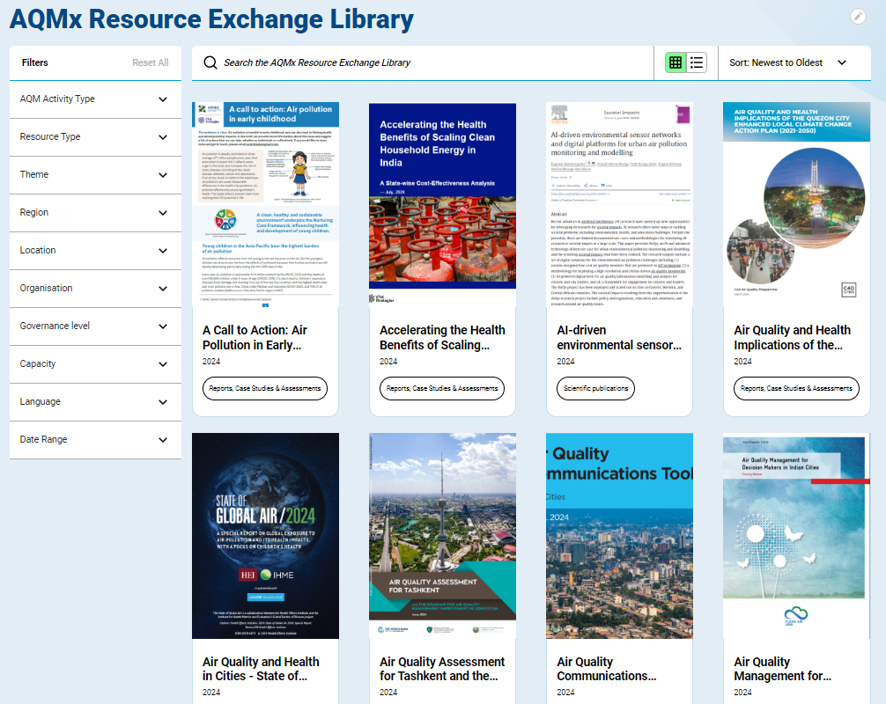
800 resources in the Resource Exchange Library, to be updated over time.
Suggestions for additional resources are welcome!
September 18 2024

Slide 14
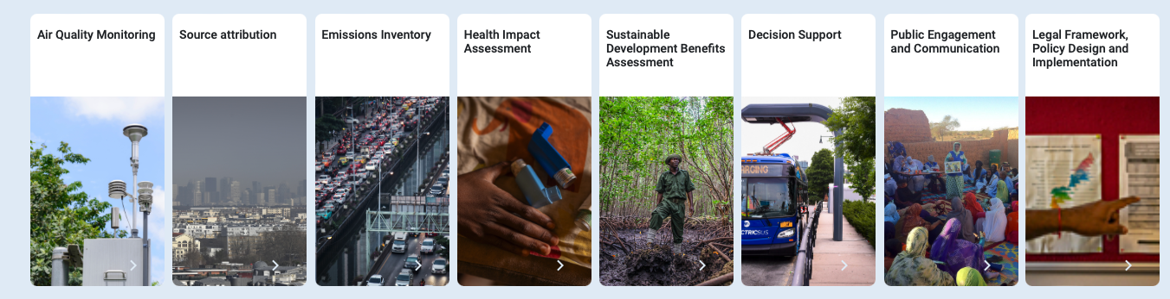
AQMx Curated Guidance
8 Stage 1 Curated Guidance Pages with 10 basic steps to get started with AQM.
Suggestions for refinements and Stage 2-5 guidance are welcome!
September 18 2024

Slide 15
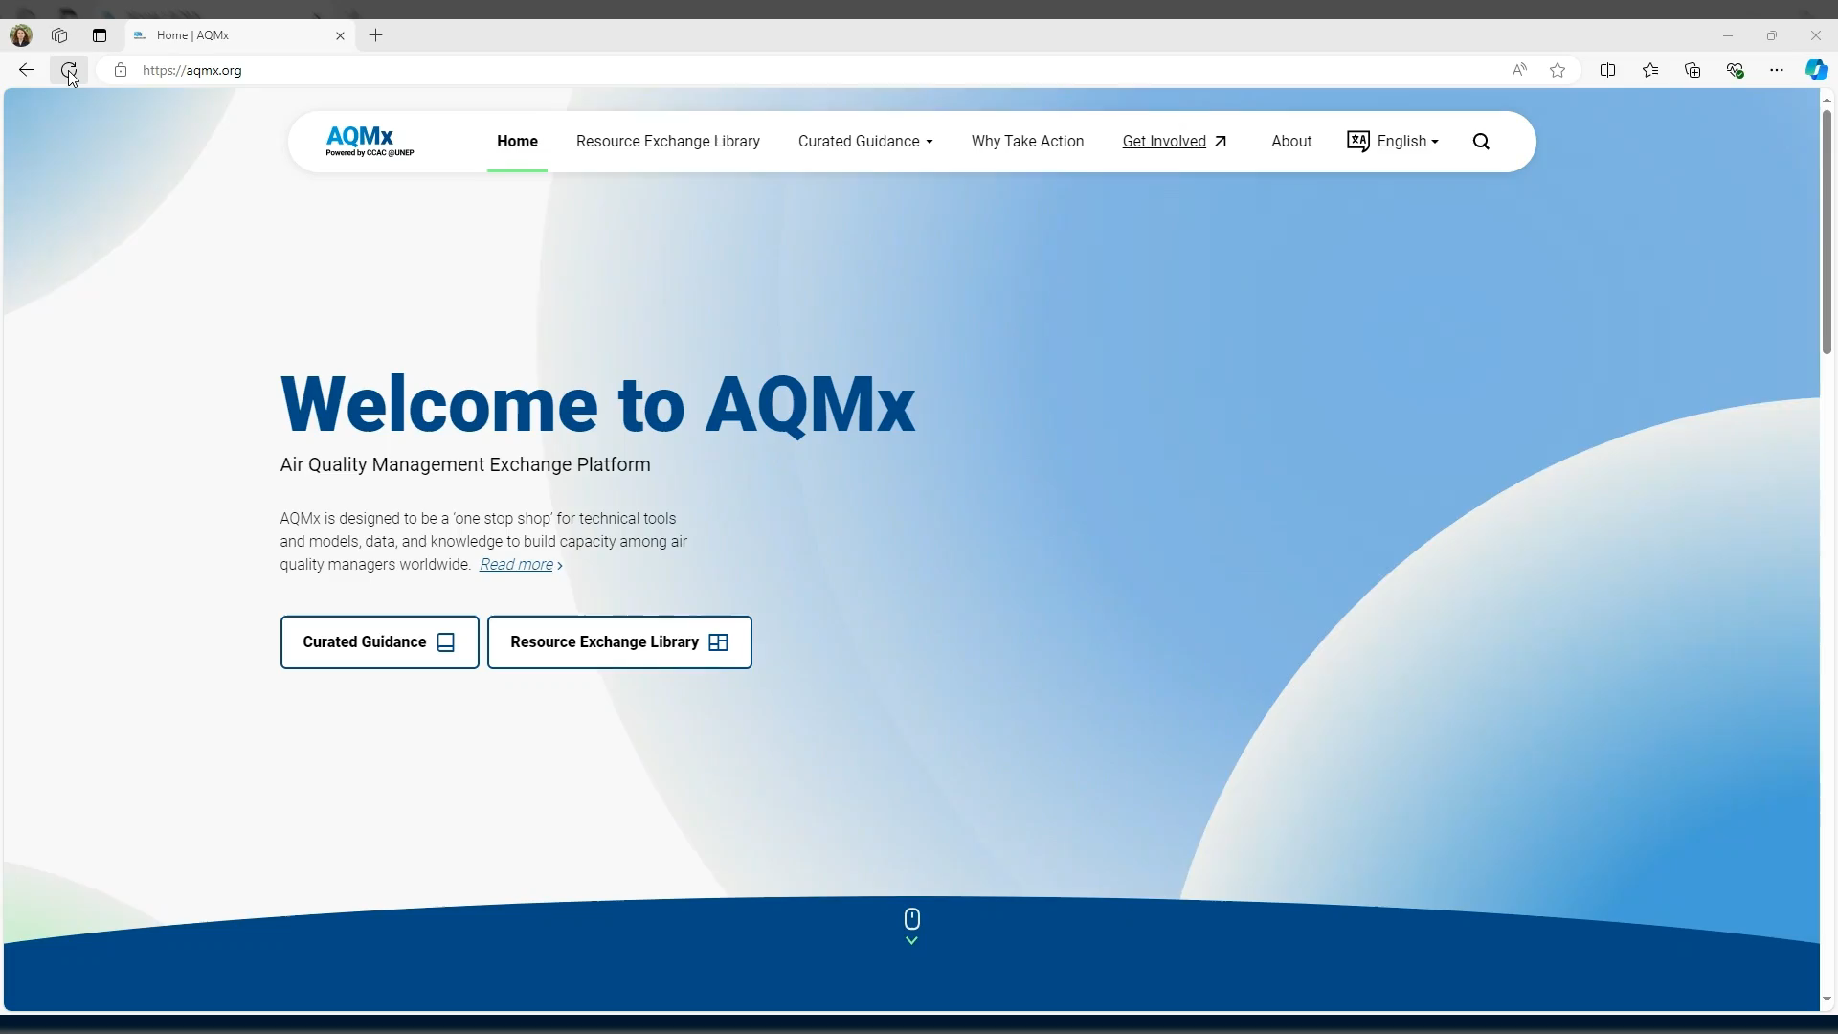
September 18 2024

Slide 16
Use cases: How can air quality managers use AQMx?
Siting a reference-grade monitor (x)
Accessing vehicle registration data (x)
Estimating the costs of a control program (x)
Engaging the health sector in raising awareness about air pollution (x)
September 18 2024

Slide 17

We would love to get your feedback and suggestions on AQMx!
https://forms.office.com/e/fX0JX11NYK
September 20 2024
Notes:
Also ask for immediate feedback from participants

Slide 18
Q&A
September 18 2024

Slide 19
Thank you for your attention!
September 18 2024

Slide 20
Key CCAC Secretariat contacts:
Juliette Laurent
Air Quality Specialist, CCAC
Juliette.laurent@un.org
Gary Kleiman
Principal, Orbis Air
Gary@orbisair.com
Sandra Cavalieri
Hub Manager, CCAC
Sandra.cavalieri@un.org
Marko Baloloy
Hub Focal Point for National Consultants, CCAC
Marko.baloloy@un.org
September 18 2024

Slide 21
Air Quality Monitoring
Africa
Source Attribution
Regional
Asia & the Pacific
Emissions Inventory
Airshed
Europe
AQMx
Health Impact Assessment
National
Sustain. Dev. Benefits Assessment
North America
Subnational
Decision Support
Latin America & the Caribbean
All levels
Public Engagement & Comms
West Asia
Legal Framework, Policy Design & Implementation
September 18 2024

