Slide 1

WMO Training Course on Seamless Prediction of Air Pollution in Africa
Health Risk Assessments of Air Pollution
Wednesday 18 September 2024 – virtual
Department of Environment, Climate Change and Health

Slide 2



Assessing health effects and impacts
Health effects refers to changes in health status caused by an exposure
  Short-term effects account for acute impact on health after an immediate exposure (time-series studies)
  Long-term effects involve chronic health effect after a cumulative exposure (cohort studies)
Health impact assessment evaluates potential health effects of proposed actions relative to an exposure, to provide advice for decision-making process that will protect health

Slide 3
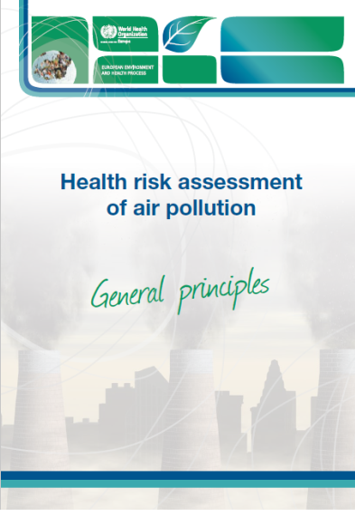
Health Risk Assessment of Air Pollution: a definition
« An Air Pollution Health Risk Assessment aims to estimate the risks of past, current or future exposure to air pollution and of changes in exposure that may result from planned policies or other modifications of air quality. »
(WHO, 2016)
https://www.who.int/europe/publications/i/item/9789289051316
Notes:
“As an analytical tool, an AP-HRA can be used as part of a comprehensive assessment of the health impacts of policies, programmes and projects that affect environmental conditions – a Health impact assessment
AP-HRA and HIA are different concepts, although the two terms are sometimes used interchangeably.
An HIA may be defined as follows : a combination of procedures, methods and tools by which a policy, programme or project may be judged as to its potential effects on the health of a population and the distribution of those effects within the population.
While an HRA tends to look into particular hazards and their effects on human health, an HIA takes a broader perspective. “

Slide 4
Two key questions of Health Risk Assessment
1. What is the health burden of a given exposure level?
2. What is (would be) the impact of the exposure change?
Incidence
2
1
Exposure
1
2

Slide 5

Estimation of health effects of exposure to air pollution in a population: Modes of Health Risk Assessment
Burden
  What is the size of the problem currently?
  How much inflated are current mortality rates?
  How much potential life years are we losing?
Impact
  If we apply policy X, what will be the (expected) burden change?
  What will be the pattern of mortality rate change?
  What will be the pattern of changes in total life years?
SDG 3.9.1 Mortality attributable to air pollution
Examples of policies : closing an industrial site, creating a low emission zone in a city center

Slide 6
Model of risk reduction
I(Ex) / I(Nex) = RR (relative risk in Exposed vs. Not-exposed)
Incidence
I(Ex)
I(Nex)
Not-exposed
Exposed
Exposure

Slide 7
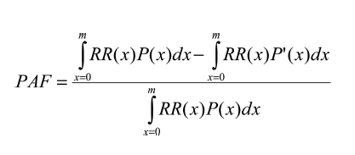
Measures of risk: Attributable risk
Population Attributable Risk (PAR): difference between the incidence of a disease in population with “real world” exposure and (often hypothetical) population not exposed; incidence attributable to the exposure.
PAR = I_{exposed} – I_{not exposed}
Population Attributable Fraction (PAF): fraction of the cases attributable to the exposure
RR - 1
PAF = (I_{exposed} – I_{not exposed}) / I_{exposed} =
RR
P(x): fraction of population exposed to x
P´(x) = 1- P(x)
PAR = PAF * I_{exposed}
Number of attributable cases = PAR * Nex Nex: number of people in exposed population

Slide 8
Main steps in health risk assessment of air pollution
Input information needed for HRA
1) Current exposure level (or exposure distribution) in the population of interest
Reference exposure level (counterfactual, cut-off)
2) Size of target population
3) Background incidence of health outcome
4) Concentration-response function
They produce the fraction of health effects attributed to the exposure
Air Pollution data
Population at risk
Exposure assessment
Concentration-Response Functions
Reference exposure level (cut-off)
Background health data
Estimates

Slide 9
Input information needed for HRA from the population of interest
Current exposure level (or exposure distribution) in the population (C)
Reference exposure level (counterfactual, cut-off) (C₀)
Concentration-response function (RR)
Background incidence of health outcome (I)
Size of target population (N)
PAF
Fraction of health effects attributed to the exposure
PAR
Incidence attributed to the exposure
N+
Number of attributable cases (= I * N)

Slide 10
Example of the main relevant challenges
Data availability
Concentration Response Function development
Sources of uncertainty affecting quantification of air pollution-related health impacts
Communicating Air Pollution and Health Risks

Slide 11
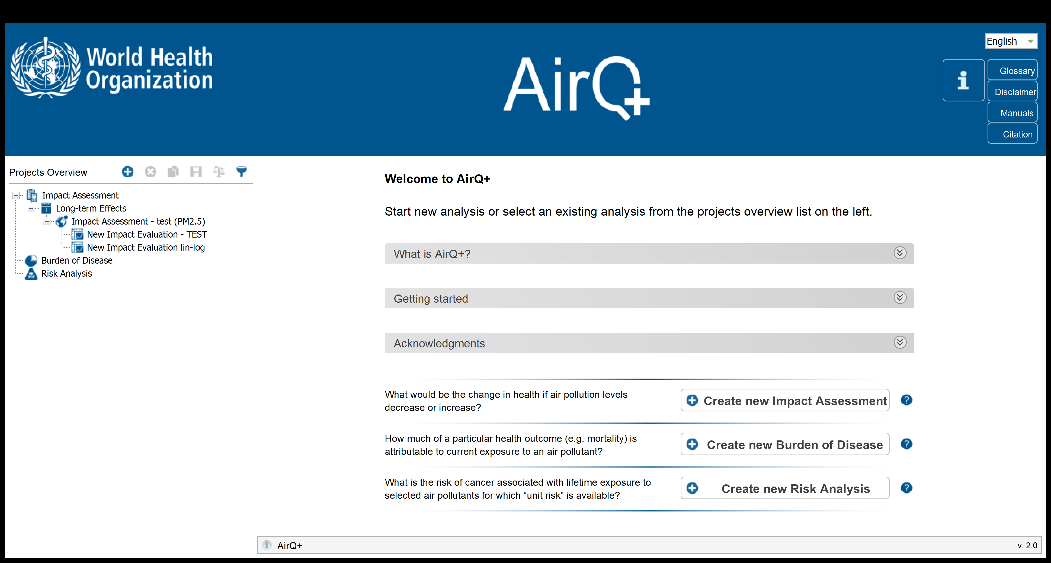

Tools for HRA of air pollution (examples)
WHO: AirQ+ 2.0
http://www.euro.who.int/en/health-topics/environment-and-health/air-quality/activities/airq-software-tool-for-health-risk-assessment-of-air-pollution
US EPA: BenMAP
https://www.epa.gov/benmap

Slide 12
What is AirQ+?
A user-friendly software
to estimate the magnitude
of the most important and best recognized
effects of air pollution in a given population

Slide 13
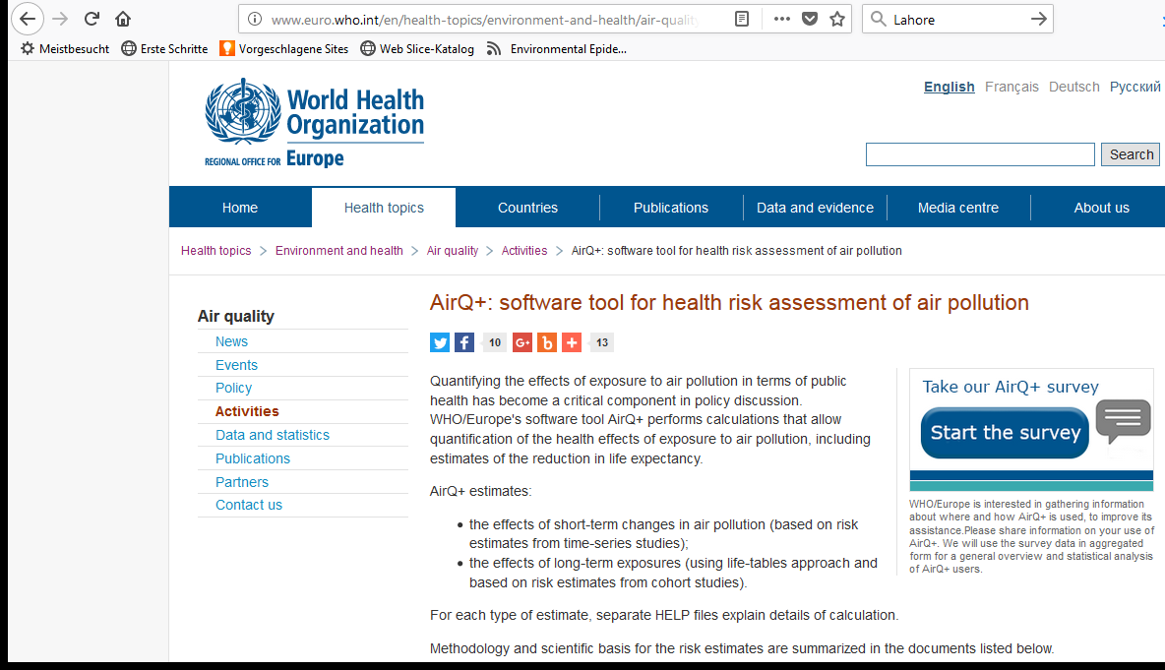
Downloading AirQ+ software
(Current version: AirQ+2.2, March 2023)
https://www.who.int/europe/tools-and-toolkits/airq---software-tool-for-health-risk-assessment-of-air-pollution
Notes:
New version of AirQ+ is expected by the end of 2024.

Slide 14
Input information needed for HRA
Current exposure level (or exposure distribution in the population) (C)
Reference exposure level (counterfactual) (C₀)
Concentration-response function (RR)
Background incidence of health outcome (I)
Size of target population
PAF
Fraction of health effects attributed to the exposure
PAR
Incidence attributed to the exposure
N+
Number of attributable cases

Slide 15
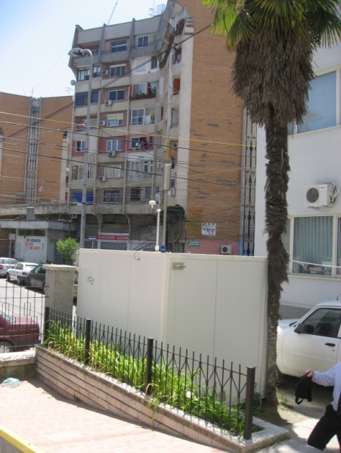
Minimum AQ data requirements for AirQ+ analysis
Concentration of:
Particulate Matter ≤ 2.5μm (PM2.5),
Particulate Matter ≤ 10μm (PM10) (essential if PM2.5 not available),
Ozone (O3),
Nitrogen Dioxide (NO2)
Monitoring stations:
Continuous monitoring, >18h/day, >75% days/year
Representative of population exposure
Not affected by local sources
Minimum data:
- For PM2.5, PM10, NO2: arithmetic mean of daily means (in µg/m³)
- For O3: SOMO35 – sum of O3 max daily 8-h means over 35 ppb (70 µg/m³) (in µg/m³)
Additional data:
- For PM2.5, PM10, NO2: daily means for each day of the year or frequency distribution of daily means (frequency of days with certain pollution level)
- For O3: max daily 8-h mean for each day of the year or frequency distribution of daily max 8-h means (frequency of days with certain pollution level)

Slide 16
Reference exposure level (counterfactual concentration)
Options for burden analysis:
The lowest observed concentration
Natural background level
WHO guideline levels
Options for impact analysis:
Concentration under various pollution reduction scenarios
  Elimination of a particular source of pollution;
  Reduction of pollution emissions;
  Achievement of certain legally binding concentration limits / norms.
risk
C₀
concentration

Slide 17
Input information needed for HRA
Current exposure level (or exposure distribution in the population) (C)
Reference exposure level (counterfactual) (C₀)
Concentration-response function (RR)
Background incidence of health outcome (I)
Size of target population
PAF
Fraction of health effects attributed to the exposure
PAR
Incidence attributed to the exposure
N+
Number of attributable cases

Slide 18
Baseline health data
For the outcome with available concentration – response function
(including age category, e.g. CV mortality age 30+)
Ideal: official / verified mortality / morbidity data for studied:
    population
    time period
    (for life tables analysis) by age (e.g. in 5yrs age groups)
2nd choice: data for:
- last available period
- region including studied population
- … national rates
- ……. External (international) rates
Important:
Document quality / potential uncertainty of input data
Make uncertainty (sensitivity) analysis

Slide 19
Baseline population data
Official / verified demographic data for studied:
    population (including age groups)
    time period
Important:
Document potential uncertainty of input data
Make uncertainty (sensitivity) analysis
    the same
    as health data

Slide 20
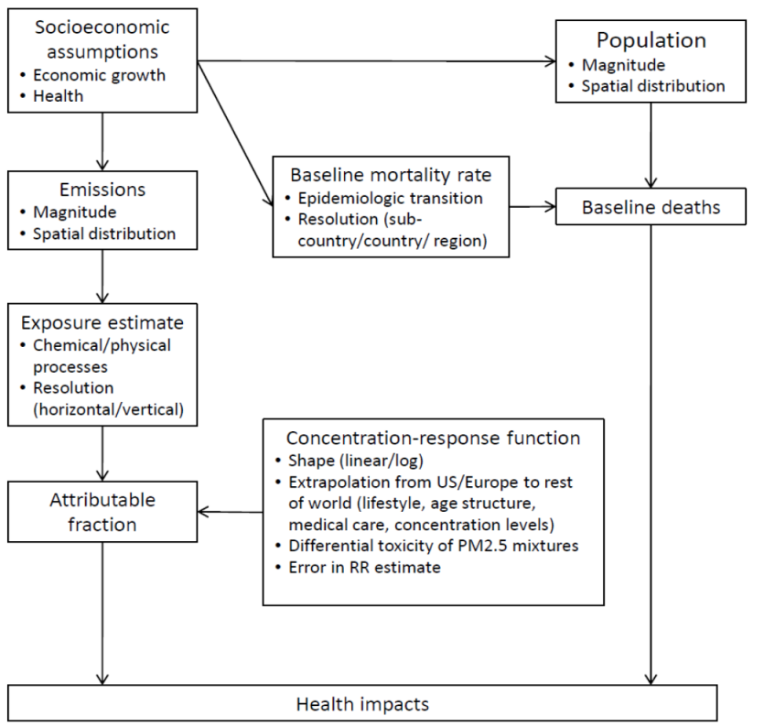
Sources of HRA uncertainty
CV
CV
WHO 2014

Slide 21
Elements of BoD analysis uncertainty assessment
Statistical uncertainty
  CRF (RR) estimates CI
  Exposure estimates
Selection of health outcomes associated with the exposure
Selection of CRF shape & counterfactual exposure level
Selection of pollutants considered, cumulating of effects
Exposure assessment / modelling
  Estimates of concentrations
  Estimates of population exposed
Uncertainties of input data to atmospheric models (emission data)

Slide 22
Presentation of BoD analysis results must include:
Definition of health outcomes and exposure matrix
Range of estimates resulting from uncertainty analysis (minimum: statistical uncertainty)
All assumptions made concerning:
      Exposure estimates
      Selected health outcomes and baseline health data
      CRFs, including counterfactual levels
      Accumulation of effects of various pollutants (if applicable)
Results of sensitivity analysis indicating main factors influencing BoD estimates
If relevant – discussion of possible differences with other estimates concerning the same population

Slide 23
Knowledge needs
Set priorities for policy-relevant scientific questions: how, why and for whom do the health effects of air pollution exist?
Undertake research into a broader range of health end-points, as the list of organ systems and conditions possibly affected by air pollution is steadily increasing.
Improve the methodology in exposure assessment, study design and evidence synthesis and evaluation.
Undertake research into mechanisms of health effects.
Improve assessment of the effectiveness of interventions (accountability research)
Continue to develop burden and health impact assessment.
Source: WHO (2021) Air Quality Guidelines

Slide 24
Continue to develop burden and health impact assessment
Improve methods and input data for health risk assessments, which play a key role in identifying the overall and relative importance of air pollution and its sources for population health. They provide the foundation for identifying priorities and tracking the effectiveness of solutions.
Improve the apportionment of population exposure to specific sources or source categories to enable source-specific health risk assessment at the local, national and regional levels.
Establish solid mechanisms for the regular review of evidence related to the quantification of CRFs and health burden assessments, including the integrated assessment of burdens from complex mixtures.
Integrate air-pollution-related health risk assessment into a comprehensive health impact assessment of actions focused on other determinants of health (such as physical activity, diet and climate).

Slide 25
Conclusions
Health Risk Assessment provides an important process to understand the impacts of air pollution
Estimating health impacts of policies are important to orient decision-making
  The health sector is empowered with tools that allow collaboration with other sectors
  WHO provides tools for the health risk assessment of air pollution, for example AirQ+ that is a tool that is simple to use to estimates adverse health risks and impacts of air pollution

Slide 26

Thank you !
Authors:
European Center for Environmental Health, WHO Bonn
Pierpaolo Mudu & Michal Krzyzanowski

