Slide 1





Air Quality Sensors
Overview and Applications
Training Course on Seamless Prediction of Air Pollution in Africa
17th Sep 2024
Sebastian Diez
Researcher - Centro de Investigación en Tecnologías para la Sociedad,
Universidad del Desarrollo, Chile
Visiting researcher - Wolfson Atmospheric Chemistry Laboratories,
University of York, UK
Co-Chair Allin-Wayra (IGAC)

Slide 2
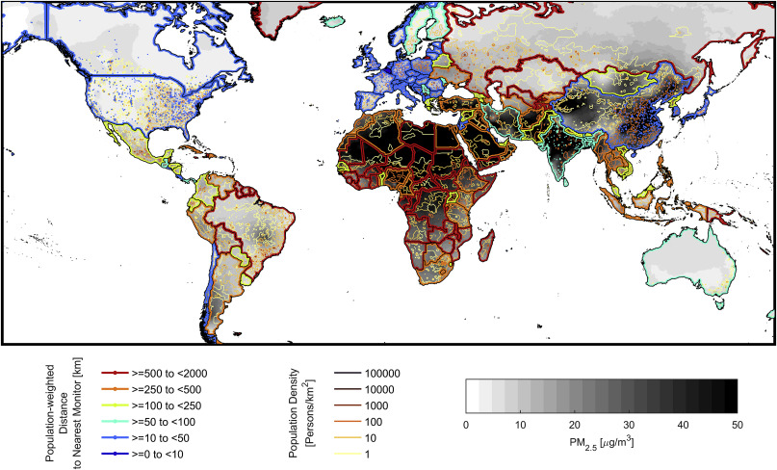
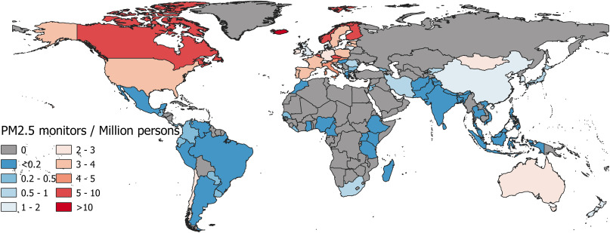
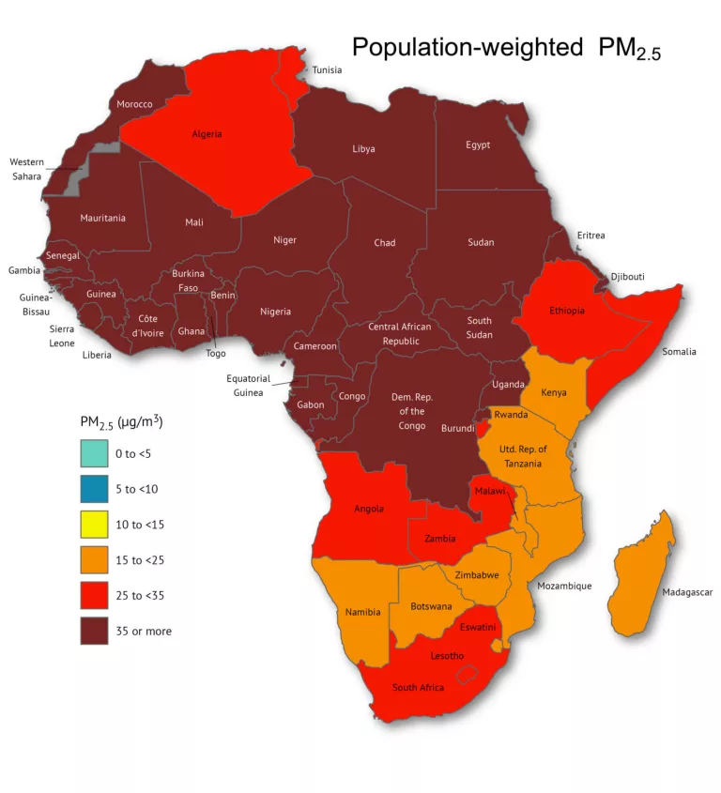
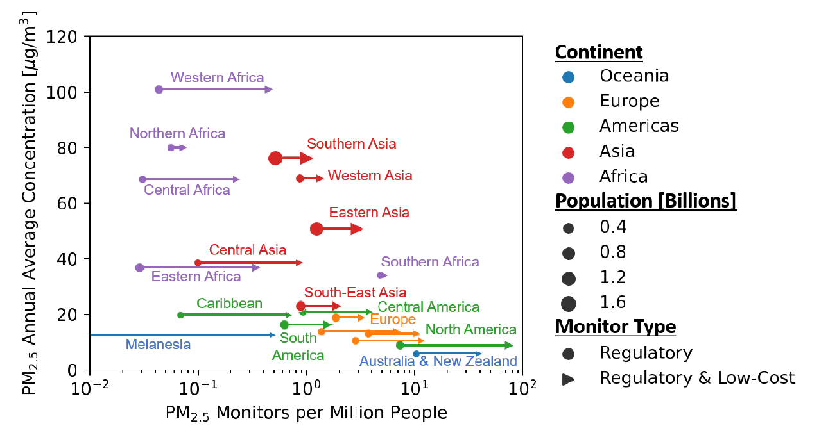
Whe need for more (and better?) observations…
Number of PM2.5 monitors per million inhabitants by country (2010–2016). Martin et al., 2019 (https://www.sciencedirect.com/science/article/pii/S2590162119300437)
Country-mean pop-weighted distance to nearest PM2.5 monitor. Greyscale indicates global estimates of PM2.5 conc. Martin et al., 2019 (https://www.sciencedirect.com/science/article/pii/S2590162119300437)
GAW Report No. 293
(https://wmo.int/media/news/low-cost-sensors-can-improve-air-quality-monitoring-and-peoples-health)
Population-weighted annual average PM2.5 exposures in countries across Africa (https://airqoon.com/resources/global-inequality-air-pollution-in-africa/)

Slide 3
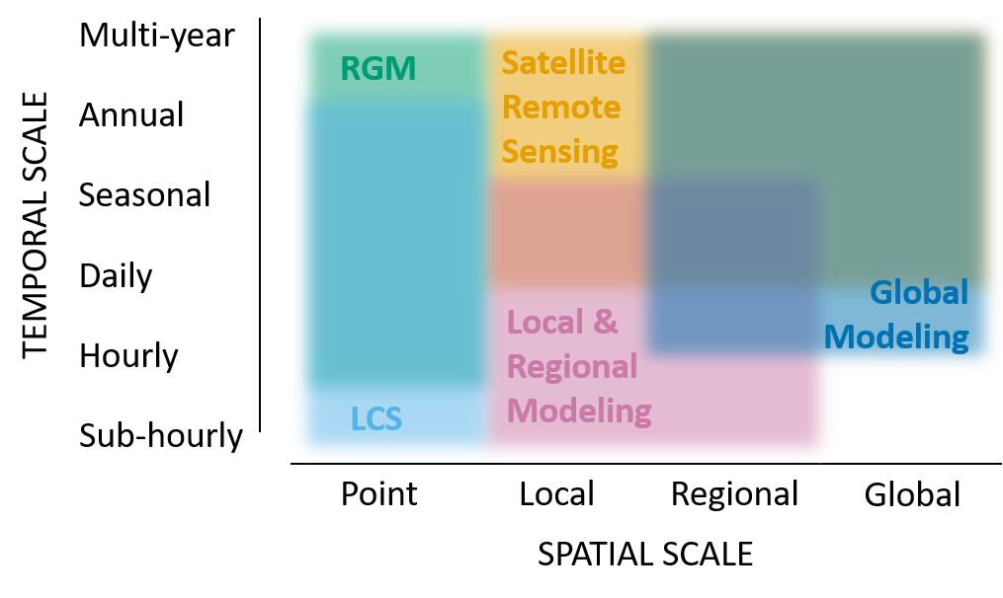
Can sensors help fill the gaps?
GAW Report No. 293
(https://wmo.int/media/news/low-cost-sensors-can-improve-air-quality-monitoring-and-peoples-health)
Satellites cover large areas, providing valuable data where ground sensors are sparse. However, they offer total column concentration (opposite to a surface AQ measurements) and may struggle with precision at local levels and in complex environments like cities.
RGMs are the “gold standard” for AQ measurements, key for validating and calibrating both sensor and model outputs..
Observations
Sensors can potentially provide highly localized, real-time data on air quality, helping to bridge gaps in areas with limited or no monitoring infrastructure. While they are cost-effective, their data quality can be lower, requiring careful calibration and integration with other data sources.
Local & regional models can capture local air quality dynamics influenced by nearby pollution sources and meteorological factors.
Global models offer insights into long-term air quality trends, filling in gaps over wide geographic areas but may lack the fine spatial resolution needed for local decision-making.
By combining modelling (different techniques) with RGMs, satellite data and sensors, we can forecast pollution trends in areas lacking extensive monitoring networks, improving accuracy over larger regions.
Mathematical construct
Notes:
Sensors can fill the gap?
This figure illustrates how various technologies contribute to a comprehensive air quality monitoring system by combining local sensor data with modeling and satellite data to provide a global perspective.

Slide 4
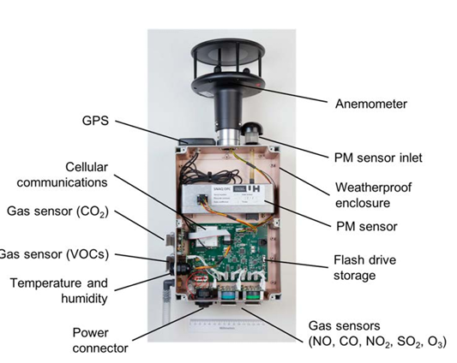
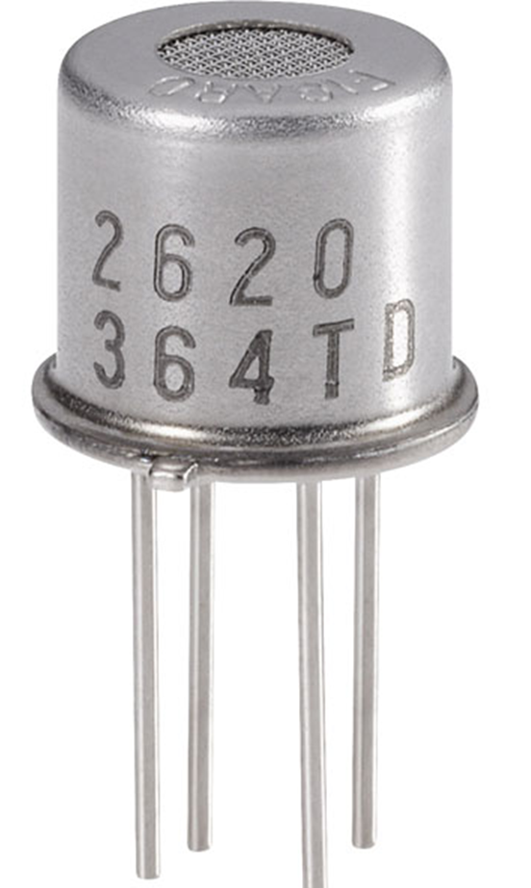
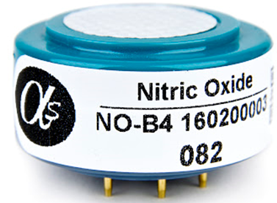
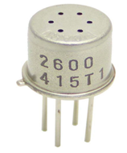
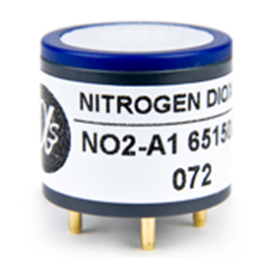
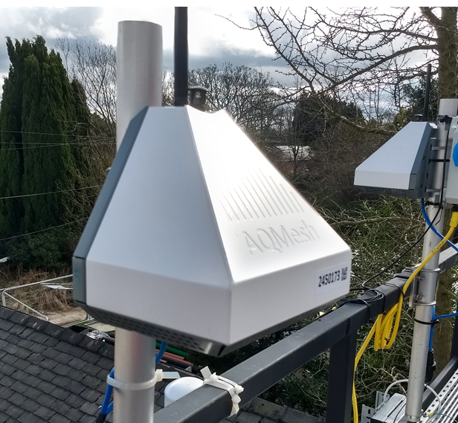
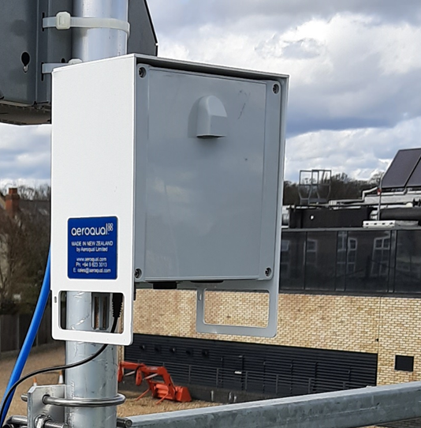
AQ Sensors and sensor systems (aka, Low-Cost Sensors)
Sensors
Also called “sensing elements”, “detectors” or “OEM” (original equipment manufacturer)
Sensor Systems
Diez et al., 2024 (https://amt.copernicus.org/articles/17/3809/2024/)
It is the basic sub-component technology that actually makes the analytical measurement of a greenhouse gas or an air pollutant.
The presence of a relevant gas or particle is typically converted into an electrical signal where the relative magnitude of that signal is related to the atmospheric concentration.
Examples include capacitive sensors, electrochemical sensors, metal oxide sensors, optical sensors including UV, nondispersive infrared sensor (NDIR) or optical light scattering sensors.
Alternative names: “sensor devices”, “sensor nodes”, “sensor units” or “pods”.
Core components are the sensing element for detection and components that acquire, process, and output data as:
sampling (e.g. pump),
power (e.g. batteries),
signal processing,
data transmission capability (e.g. WiFi, 4G),
housing and weatherproofing
WMO report, 2020. https://library.wmo.int/idurl/4/37465
Notes:
The term “sensor systems” refers to sensors housed within a protective case, which includes a sampling and power system, electronic hardware and software for data acquisition, analogue-to-digital conversion, data processing, and their transfer (Karagulian et al., 2019).

Slide 5
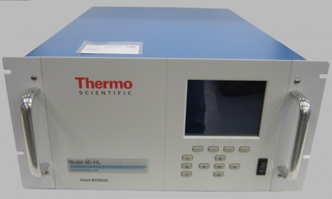

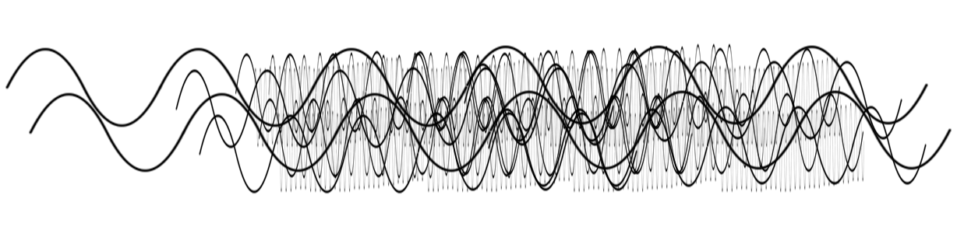
Low-Cost Sensors?
High data quality
Low measurements density
RGM
USD10,000 – USD100,000
Lower data quality
Sensing element (*)
USD10 – USD150
High data density
(*) This does not include the cost of the complete system, nor even QA/QC procedures + maintenance

Slide 6
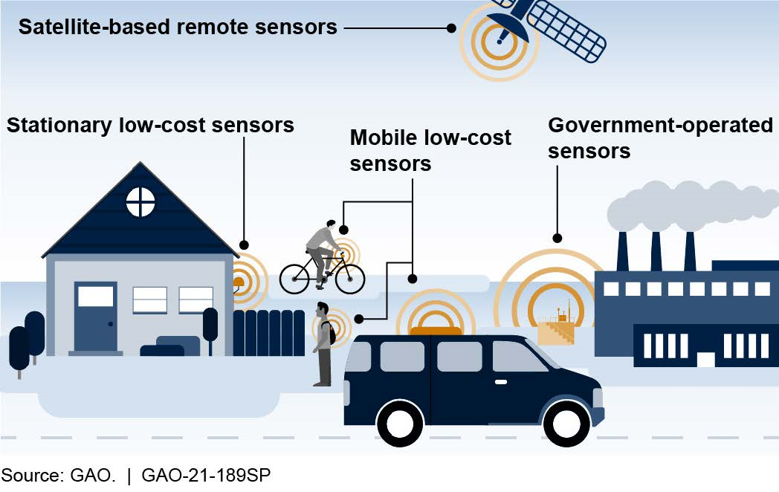
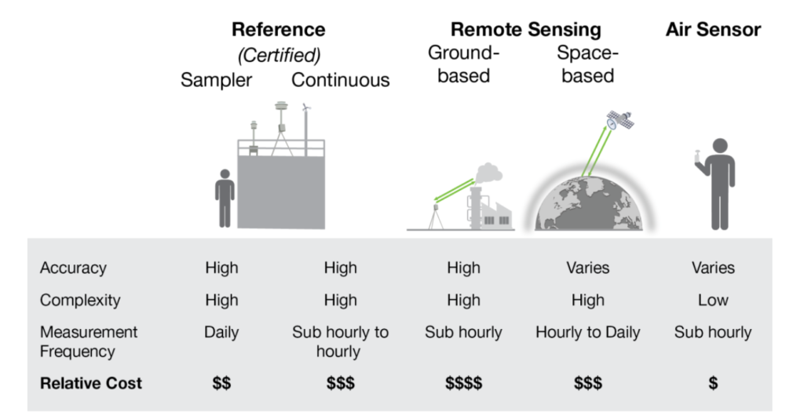
Low-Cost Sensors?
In this context, "low-cost" refers to the initial purchase price of a sensor system, typically 1-2 orders of magnitude cheaper than reference instruments measuring the same atmospheric parameters. This term doesn't include installation, operational, or network costs, which vary (WMO Report No. 1215, 2018).
Technical trade-offs which enable this lower cost usually also limit data quality, selectivity, sensitivity to low concentrations, robustness, and/or operational lifetime compared to ref monitors. These properties also vary across LCS technologies and measured pollutants, i.e. gases or particles (GAW Report No. 293, 2024). and/or
The Enhanced Air Sensor Guidebook, EPA., 2022 (https://cfpub.epa.gov/si/si_public_record_report.cfm?Lab=CEMM&dirEntryId=356426)
The necessary calibration and data quality control processes needed to establish confidence in LCS data, together with the infrastructure and personnel needed to support networks with multiple LCS in a region, can significantly add to their initial costs (GAW Report No. 293, 2024).
*Definitions of "low-cost" vary across communities and agencies

Slide 7
Sensor types
Type | Principle of operation | Pollutant | Examples
Electrochemical | Measures gas concentration through chemical reactions producing electrical signals. | NO₂, NO, O₃, CO, SO₂, H₂S | Alphasense A4 Series, CityTech 4OxLL
NDIR | Measures gas absorption of specific wavelengths of infrared light. | CO₂, CH₄, specific VOCs | Senseair S8, Amphenol T6713, Sensirion SCD30
Photo-ionisation detector | Uses UV light to ionize gas molecules, then measures the resulting current. | Total VOCs | Ion Science Falco Series, PID Analyzers PIDs
Metal Oxides | Detects gases through resistance changes when they interact with metal oxide surfaces. | NO₂, NO, O₃, CO, SO₂, H₂S, VOCs | SGX Sensortech MICS Series, Bosch BME680
Pellistors | Measures heat changes from gas combustion over a catalytic surface. | CH₄, Hydrocarbons | Figaro TGS2611, Figaro TGS6810
Optical Particle Counter (OPC) | Counts and sizes individual particles by detecting light scattered from each one. | PM₁₀, PM₂₅, PM₁ | Alphasense OPC-N3, Grimm EDM 180, TSI DustTrak II
Nephelometer | Measures scattered light intensity to estimate particle concentration in the air. | PM₁₀, PM₂₅, PM₁ | Plantower PMS5003, Plantower PMS7003, Sensirion SPS30
Note: This table provides examples of commonly used devices, but it is not an exhaustive list of all available sensor types, technologies or models.

Slide 8
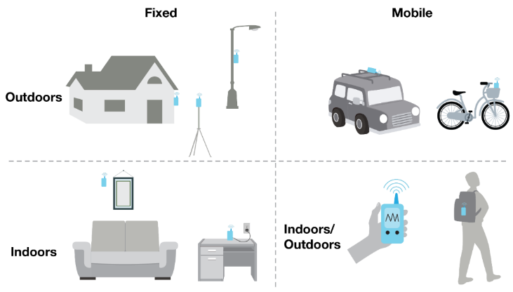
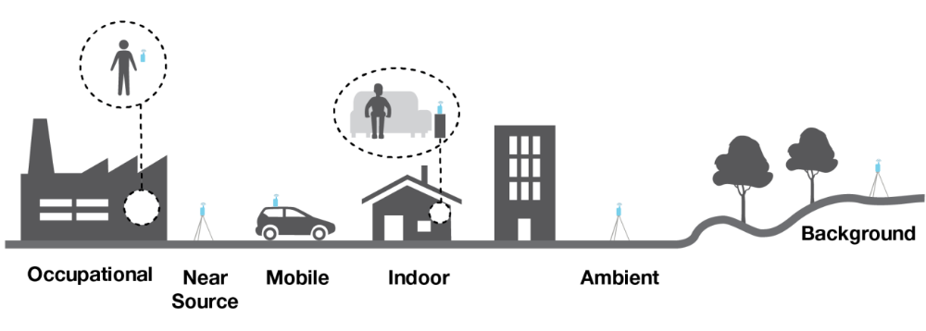
AQ Sensor common deployments
The Enhanced Air Sensor Guidebook, EPA., 2022 (https://cfpub.epa.gov/si/si_public_record_report.cfm?Lab=CEMM&dirEntryId=356426)
Fixed outdoor sensors: installed in permanent locations outdoors, such as on homes, streetlights, or tripods. They continuously monitor environmental conditions like air quality in a specific area.
Fixed indoor sensors: placed in static indoor settings, such as on a wall or a desk. They measure indoor air quality in homes, offices, or other enclosed spaces.
Mobile outdoor sensors: attached to vehicles, bicycles, or carried by individuals. They capture air quality data as they move through different outdoor locations, providing more dynamic and geographically diverse measurements.
Indoor/outdoor mobile sensors: portable sensors can be carried by hand or worn by individuals in backpacks, allowing for air quality monitoring both indoors and outdoors as the user moves through different environments.
Occupational: placed in workplaces, particularly in industrial settings, where employees might be exposed to high concentrations of pollutants.
Near source/fenceline: positioned close to pollution sources, such as factories or industrial plants, to monitor emissions directly from the source.
Background: placed far from major pollution sources, in rural or natural environments, to capture baseline air quality data, unaffected by direct anthropogenic emissions. This helps to understand background pollution levels.
Notes:
citizens use sensors to monitor pollution levels while on the move, sending real-time data to central systems for analysis. This participatory method leverages mobile and fixed devices, enabling localized monitoring and creating larger datasets. The involvement of ordinary citizens enhances spatial coverage, making air quality data more comprehensive and actionable.

Slide 9
Current challenges
Single systems-wise…
Sensor networks-wise…
Accuracy, precision and uncertainty
Sensitivity/specificity
Interferences
Calibration
Performance evaluation
Measurement independency
Sensor lifetime and sensor drift
Hardware failure
Data processing transparency
Dara traceability
Data ownership
Scalability
(Big) Data management
Technical capacity
And probably more…

Slide 10
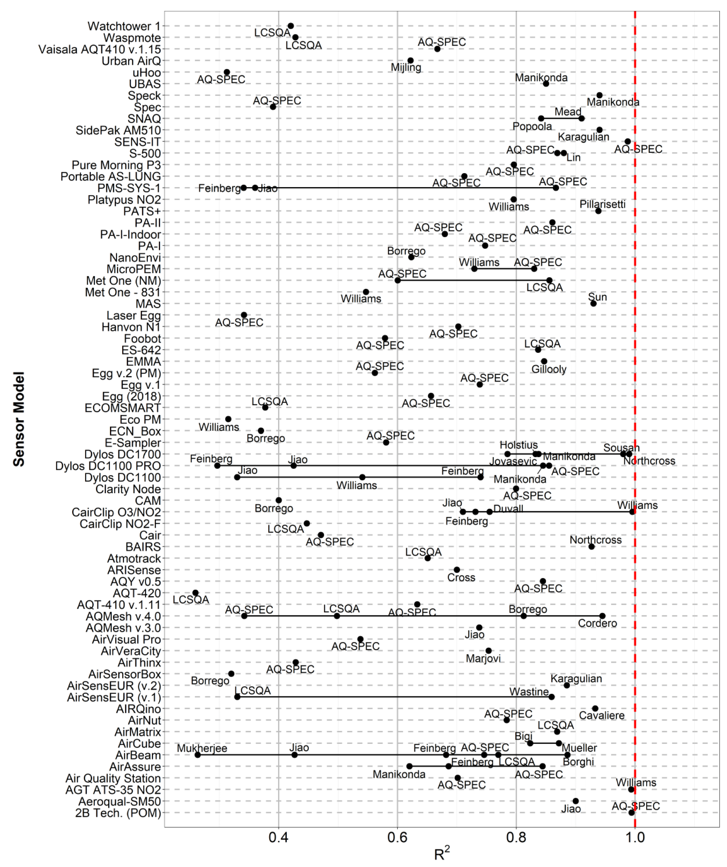
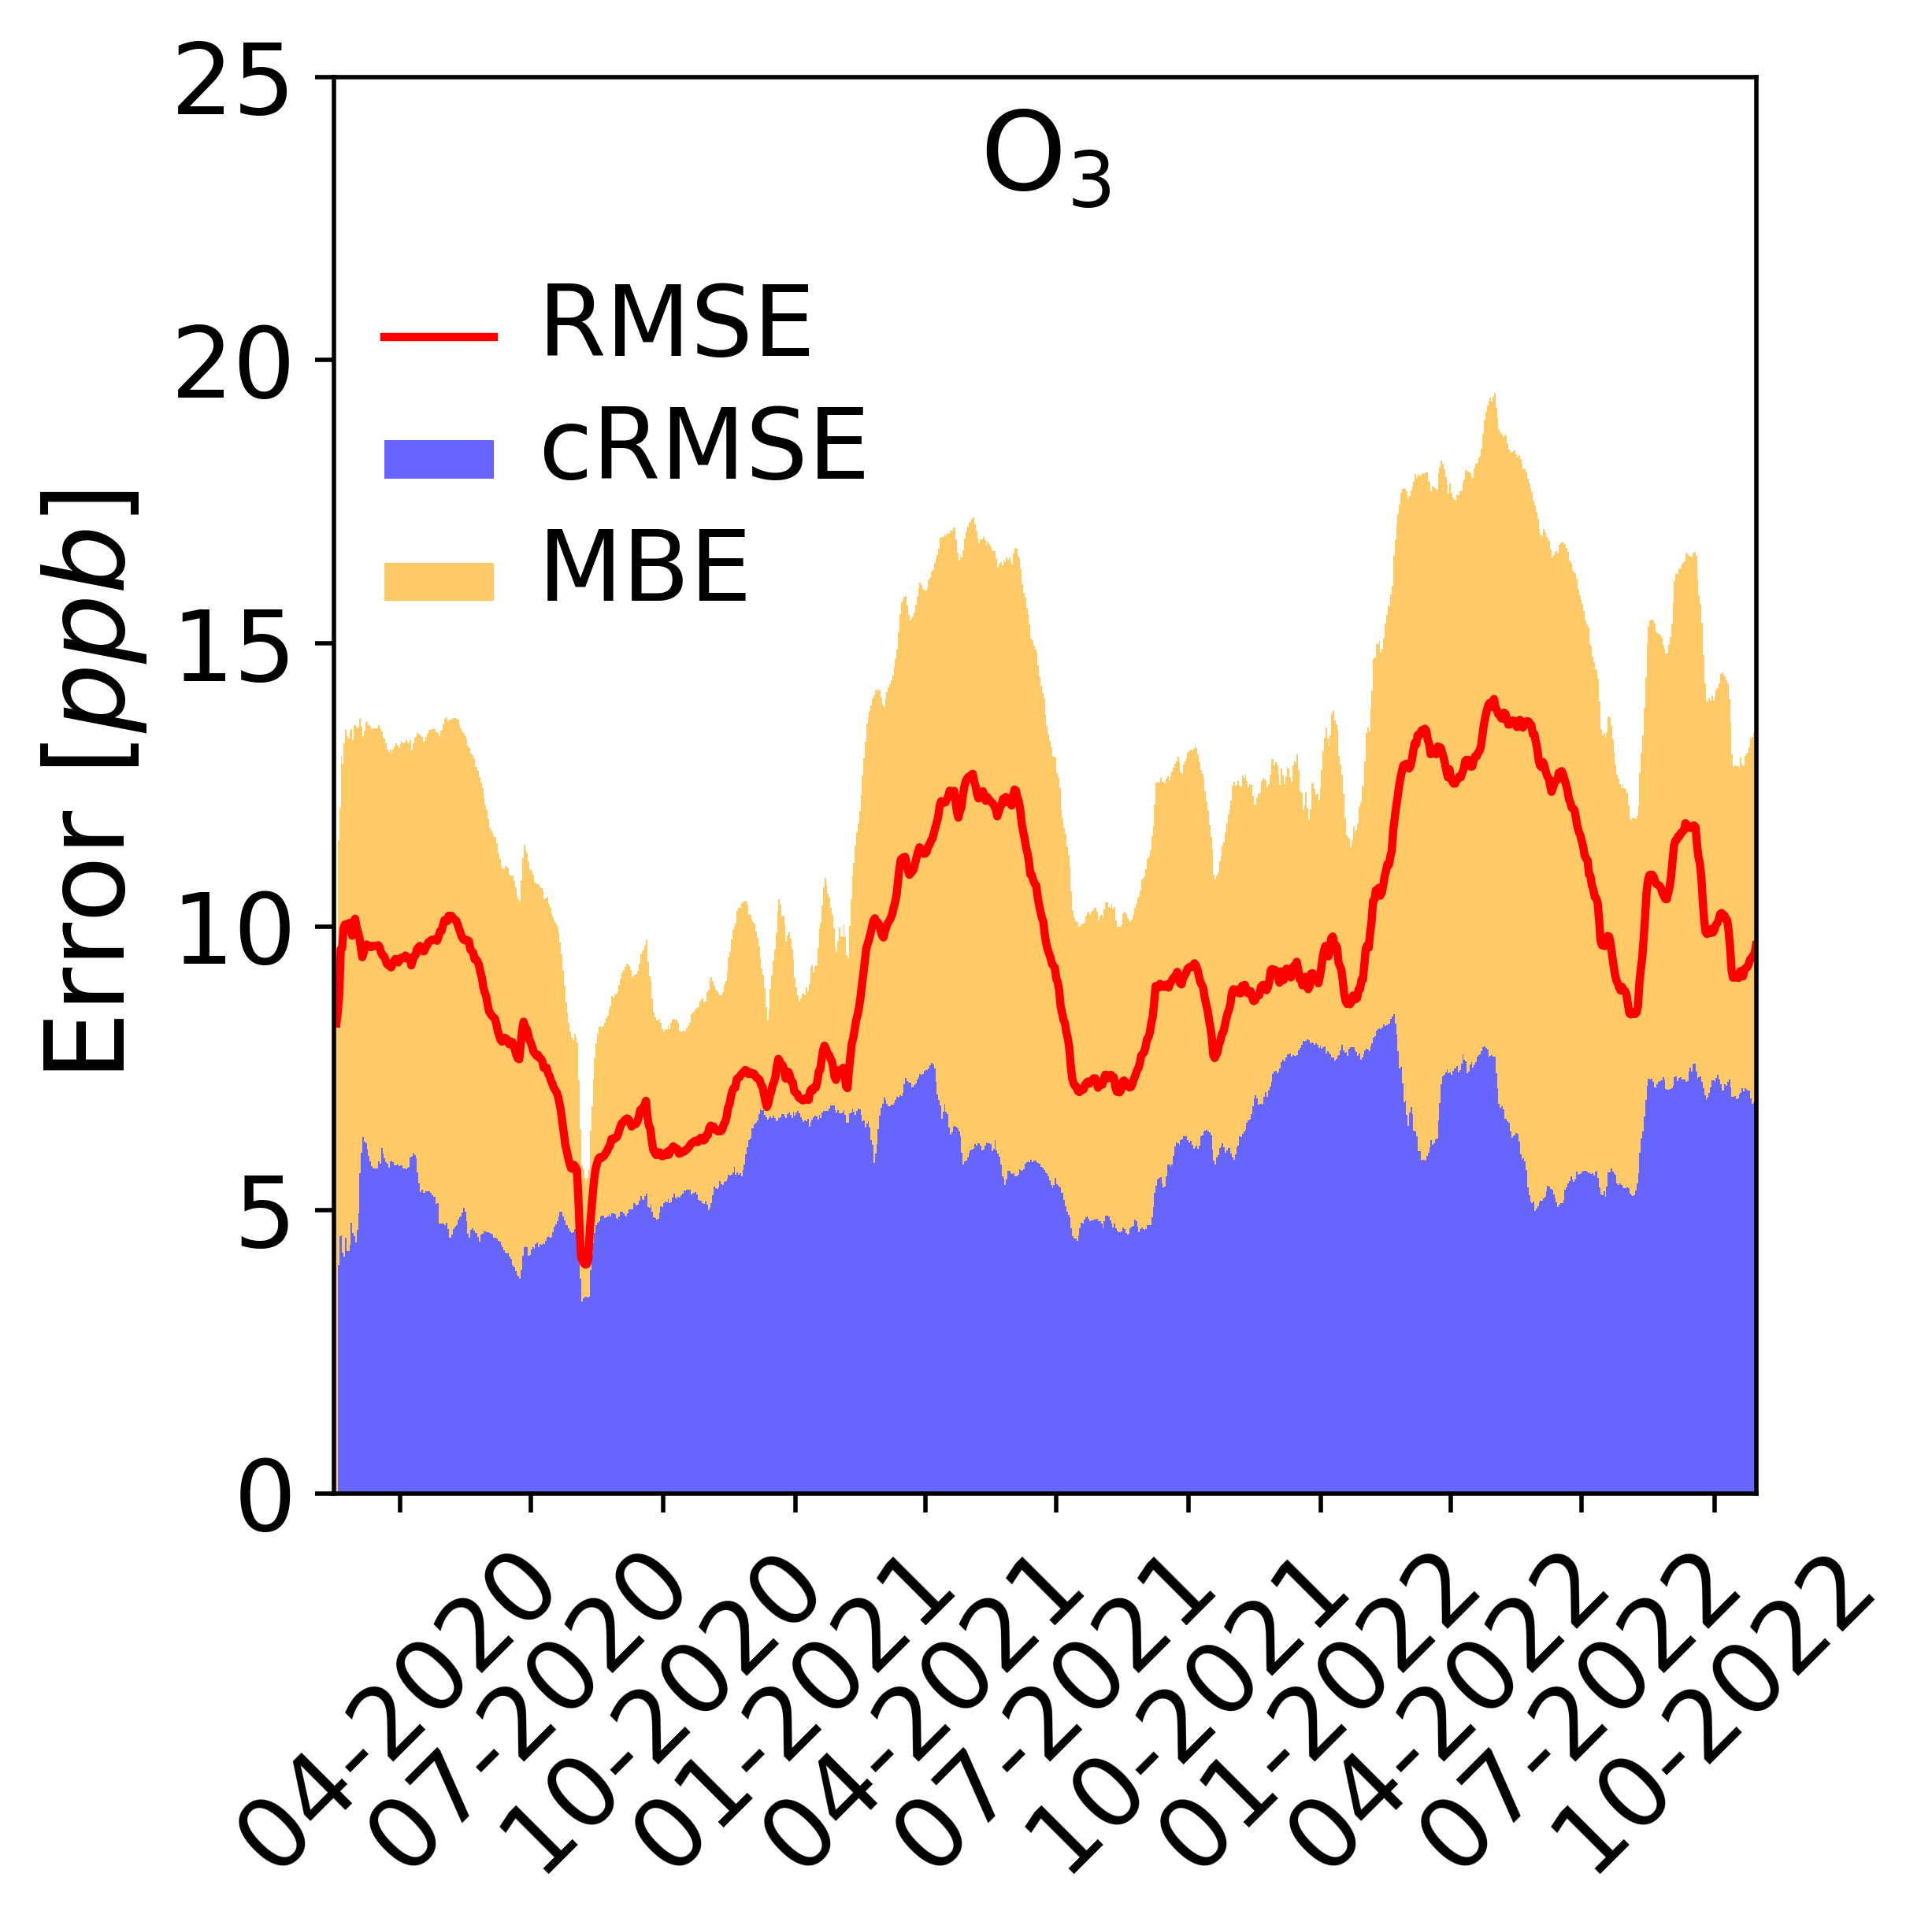
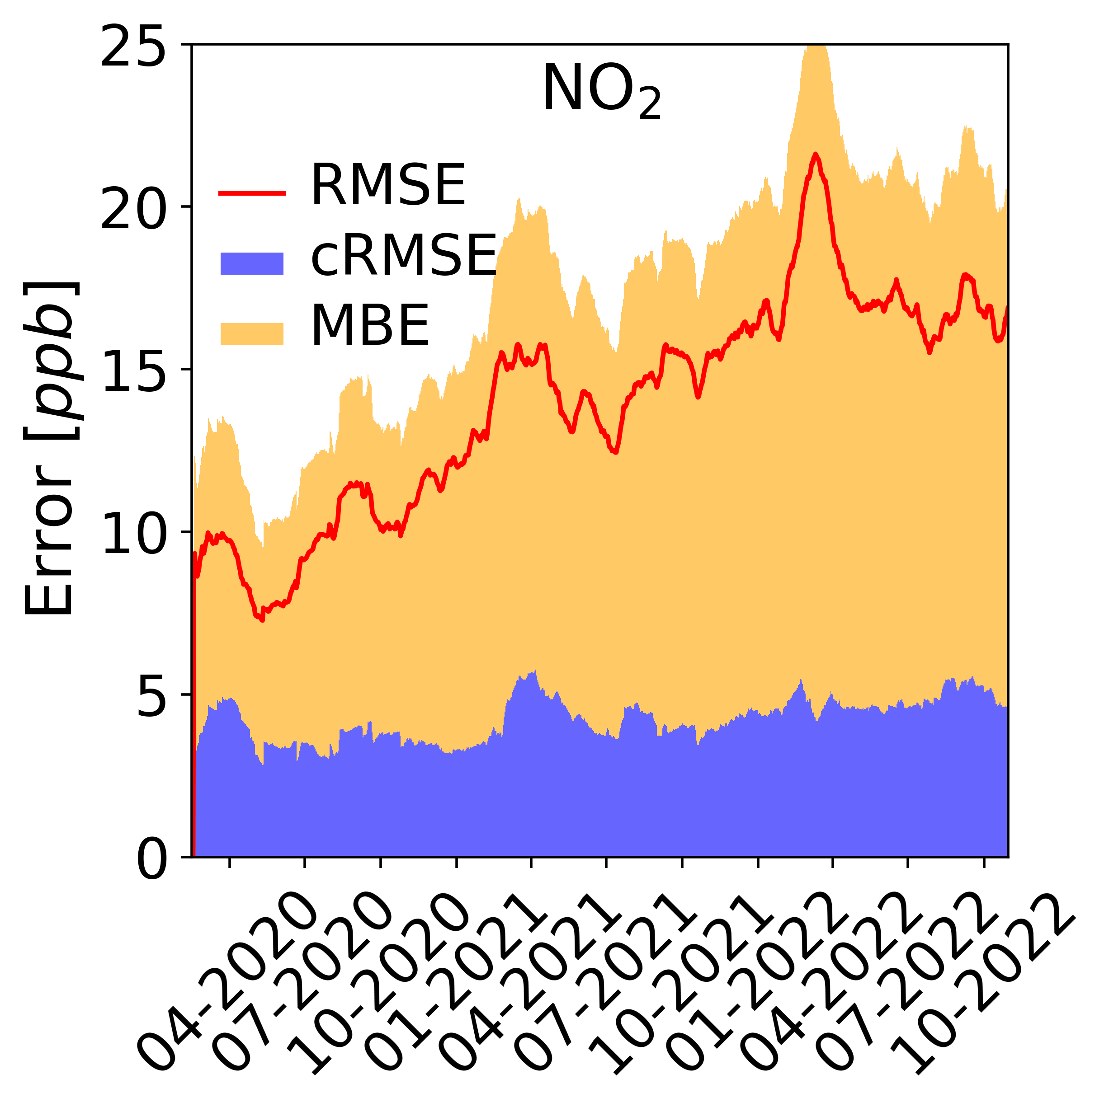
Accuracy
a)
b)
Diez et al., 2024
(https://amt.copernicus.org/articles/17/3809/2024/)
Karagulian et al., 2019 (https://doi.org/10.3390/atmos10090506)

Slide 11
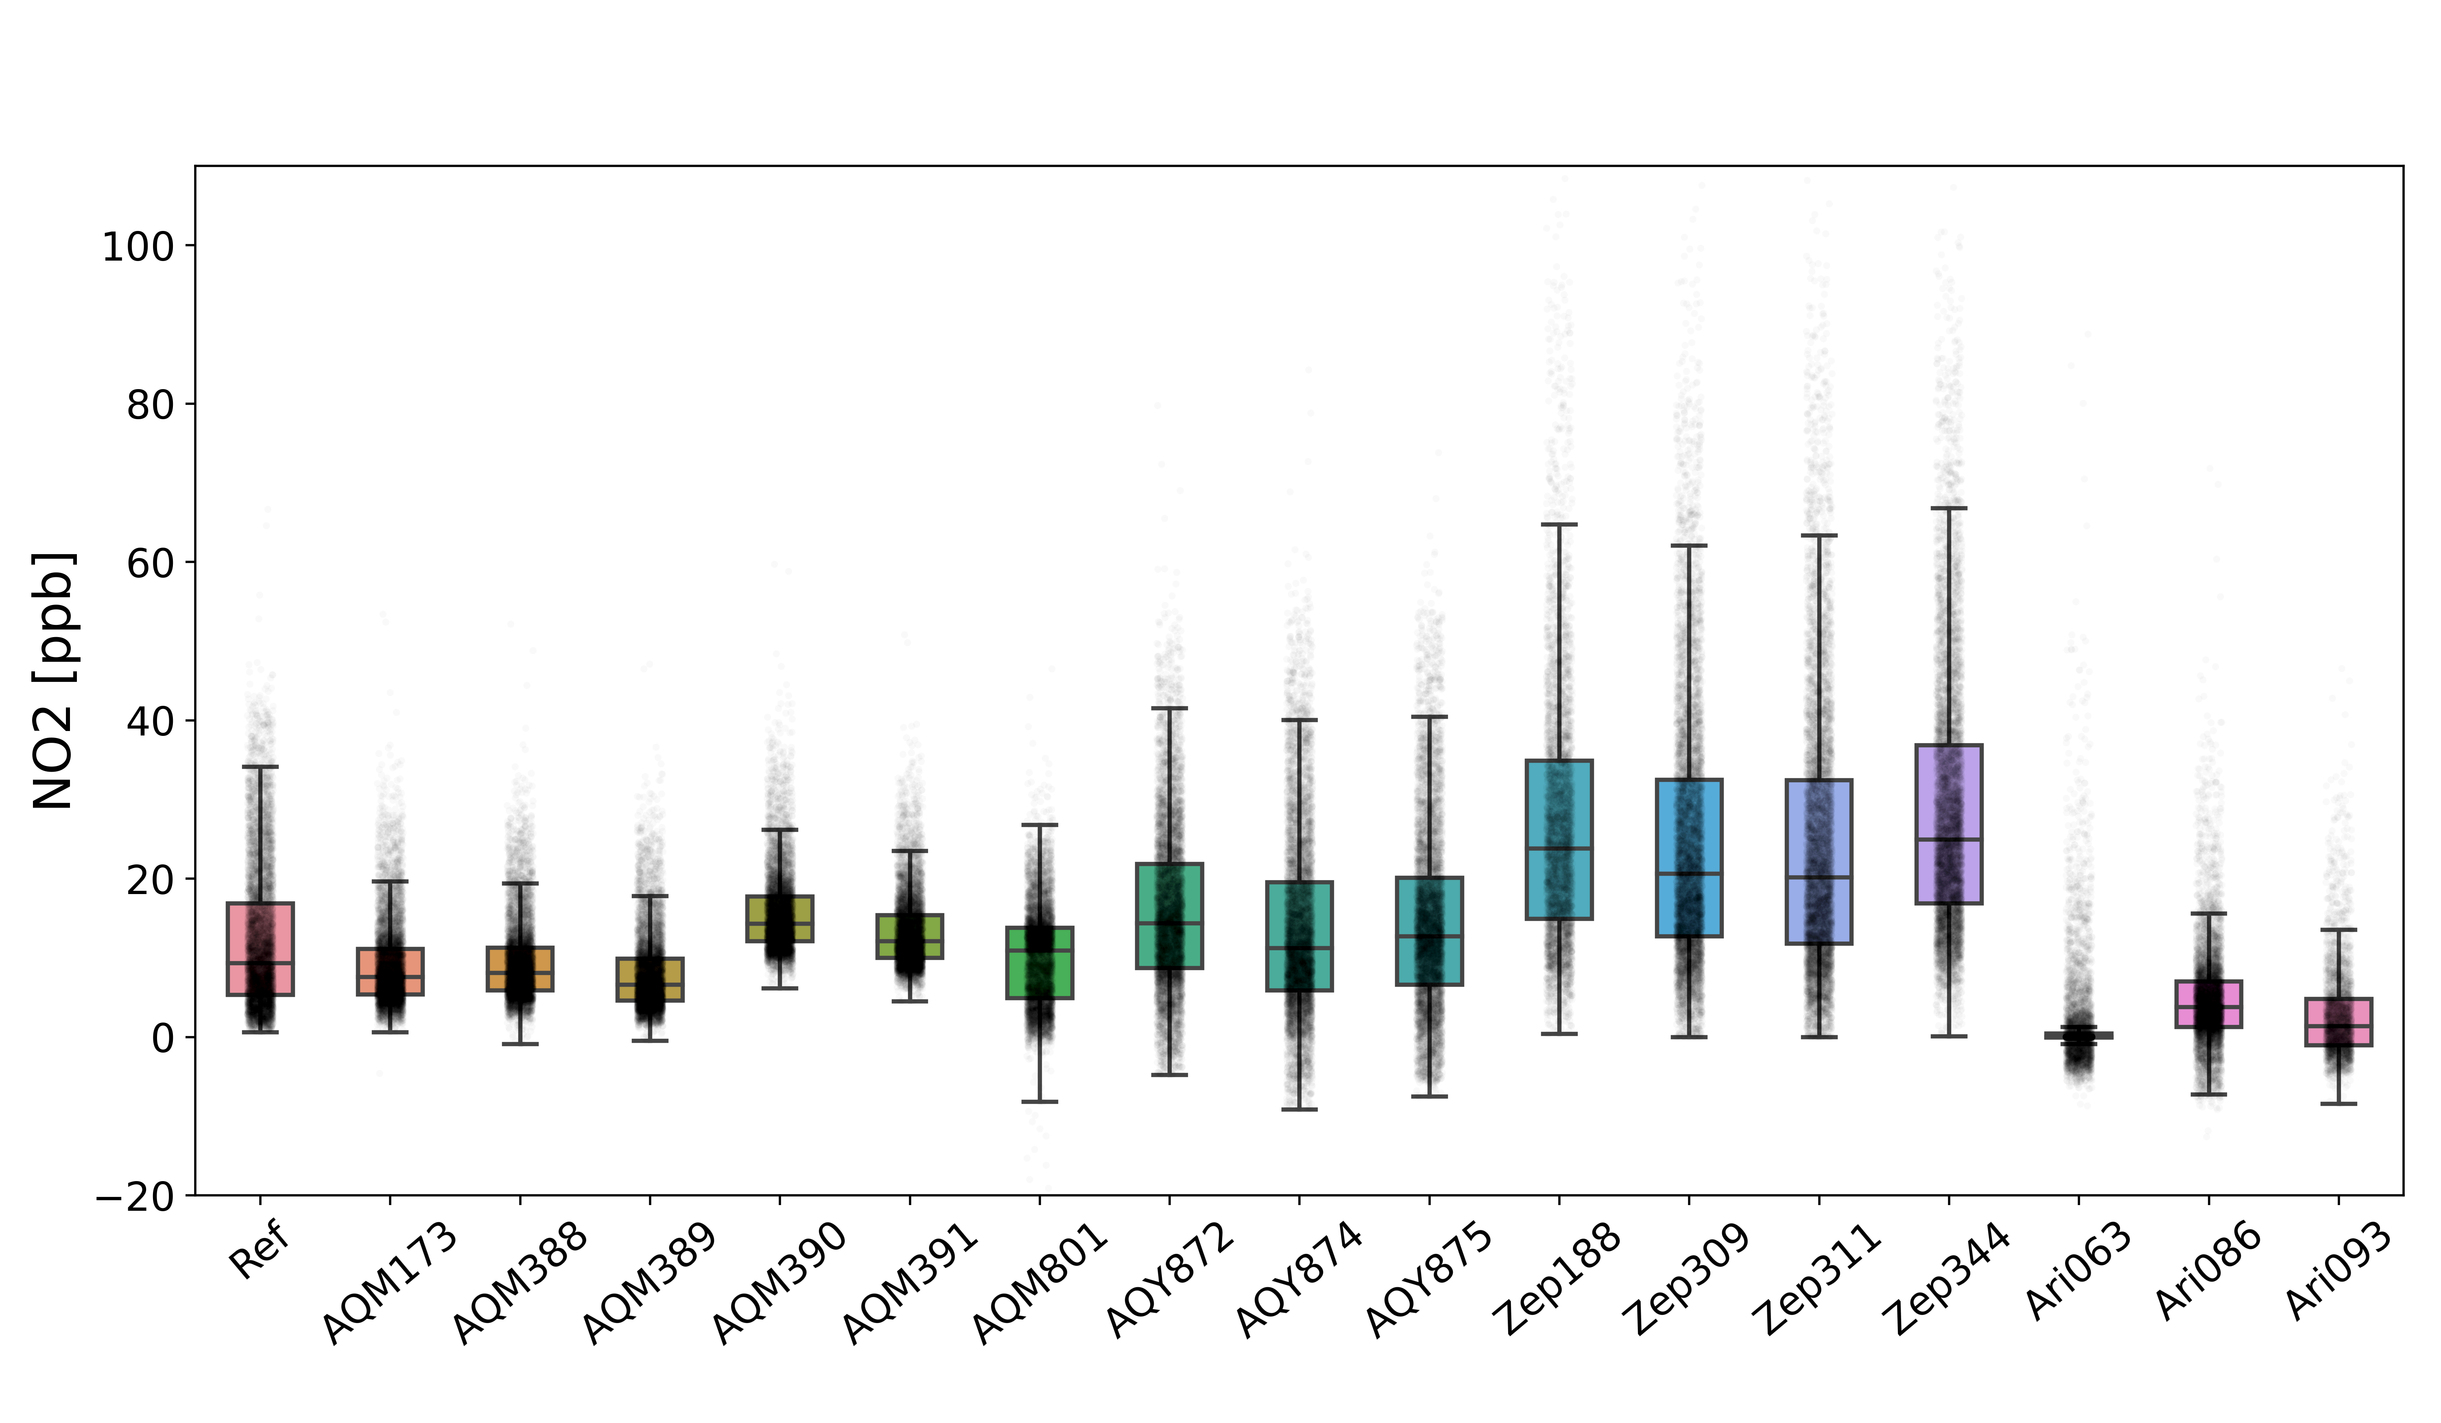
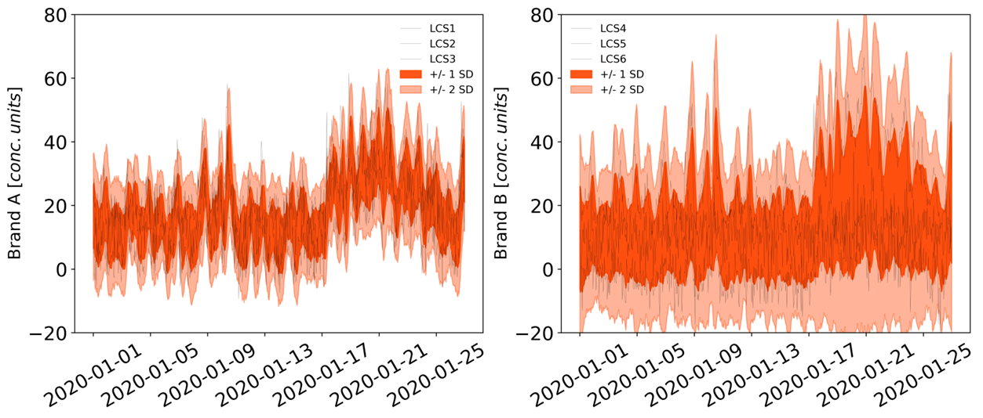
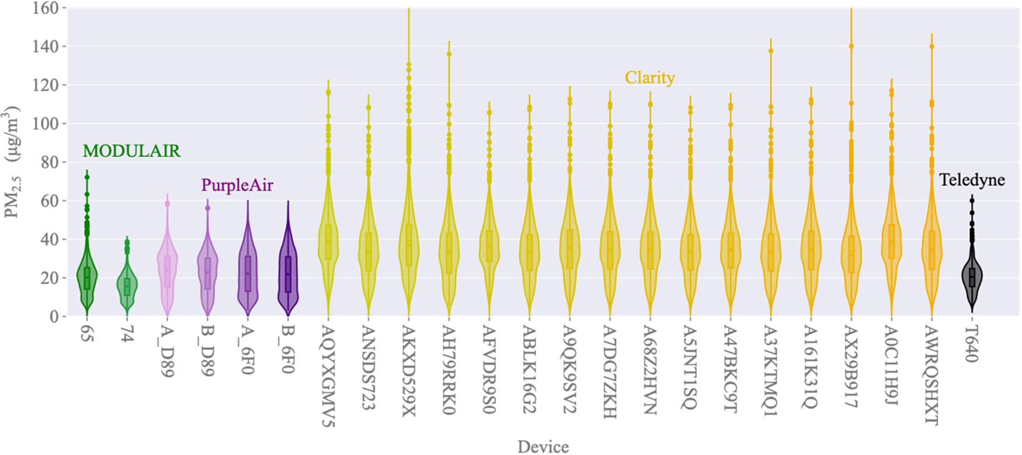
Precision
Diez et al., 2024 (https://amt.copernicus.org/articles/17/3809/2024/)
Raheja et al., 2023 (https://pubs.acs.org/doi/10.1021/acs.est.2c09264)

Slide 12
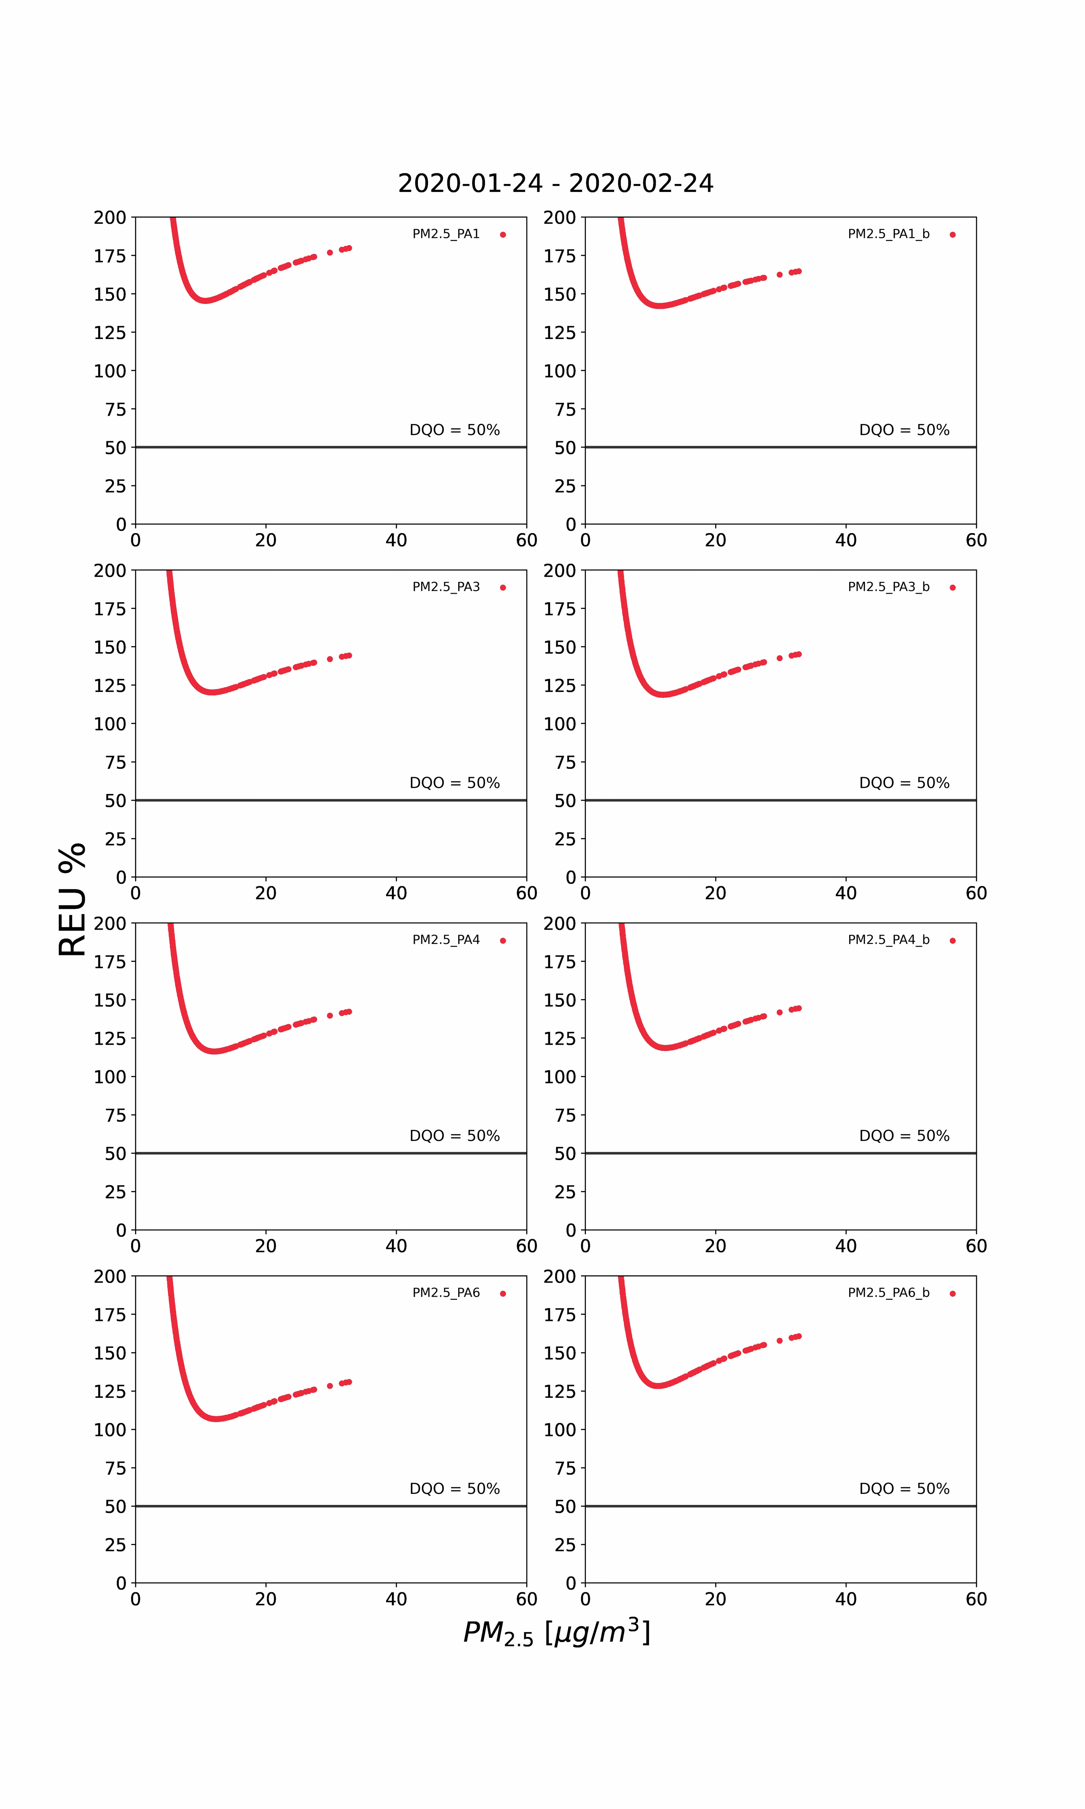
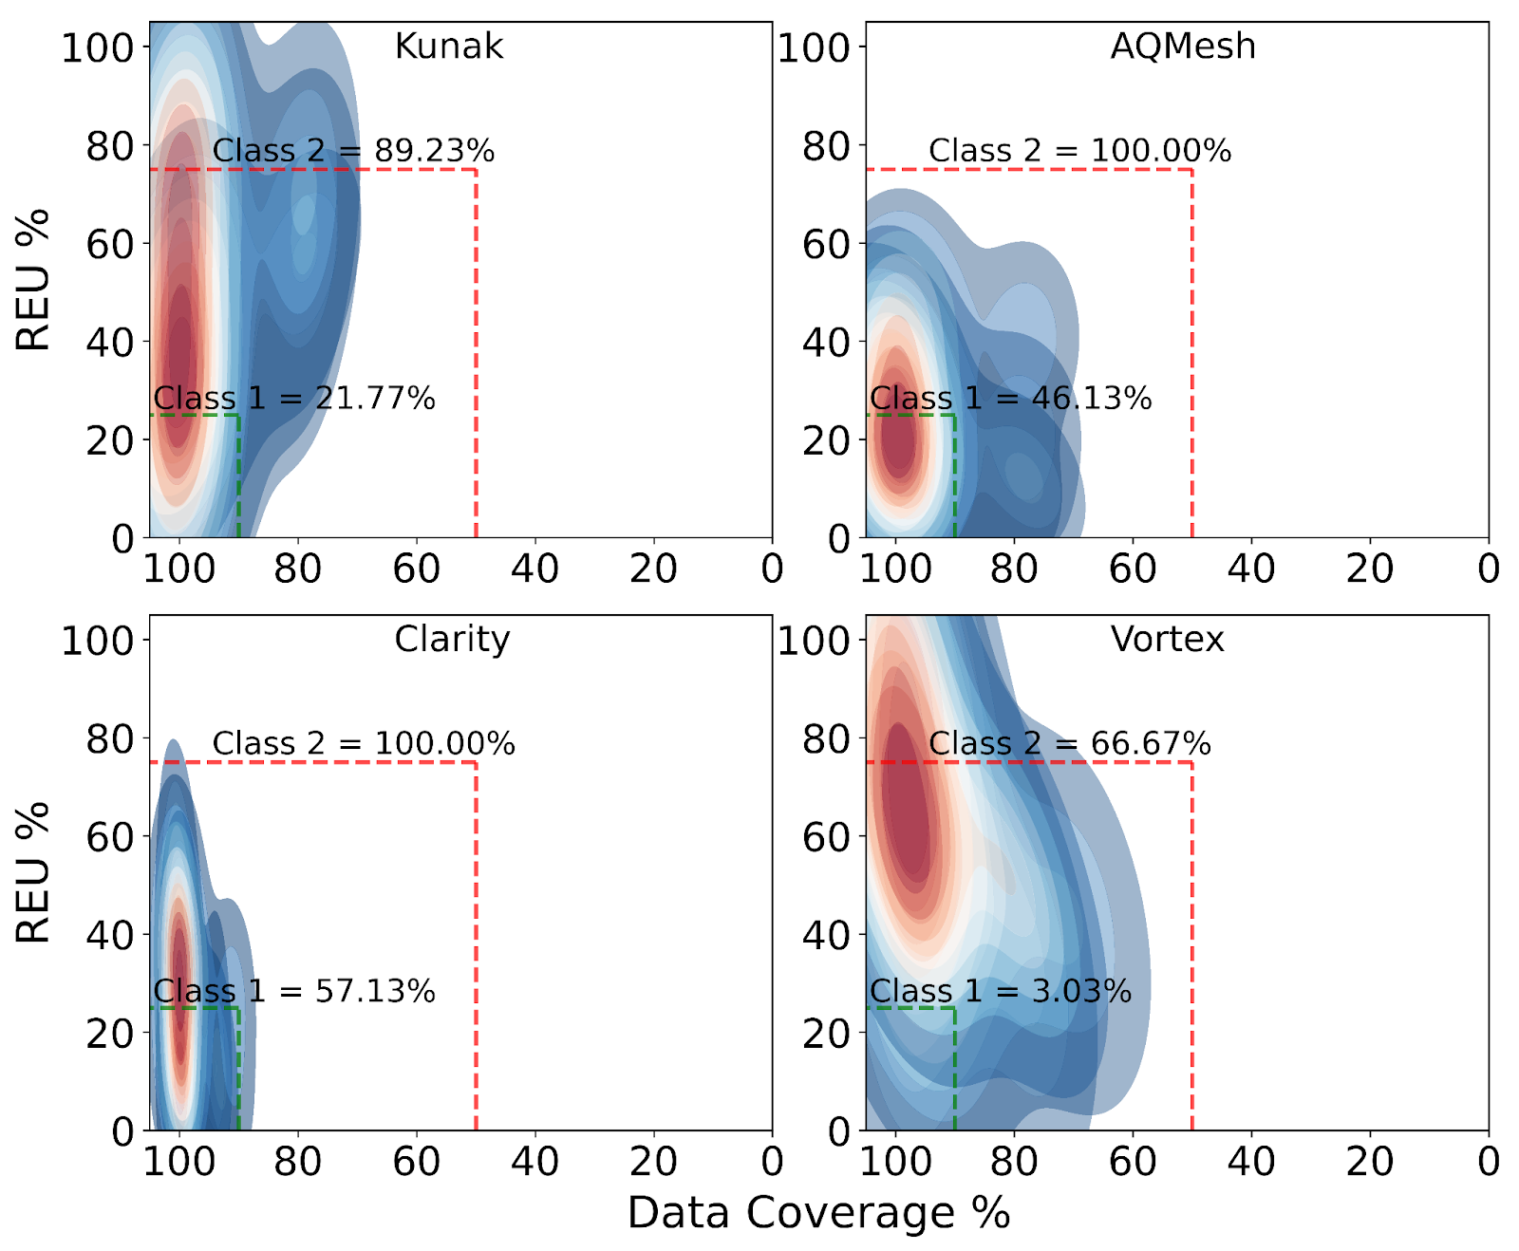
Uncertainty
Diez et al., 2024
(https://amt.copernicus.org/articles/17/3809/2024/)
Diez et al., 2022
(https://amt.copernicus.org/articles/15/4091/2022/)

Slide 13
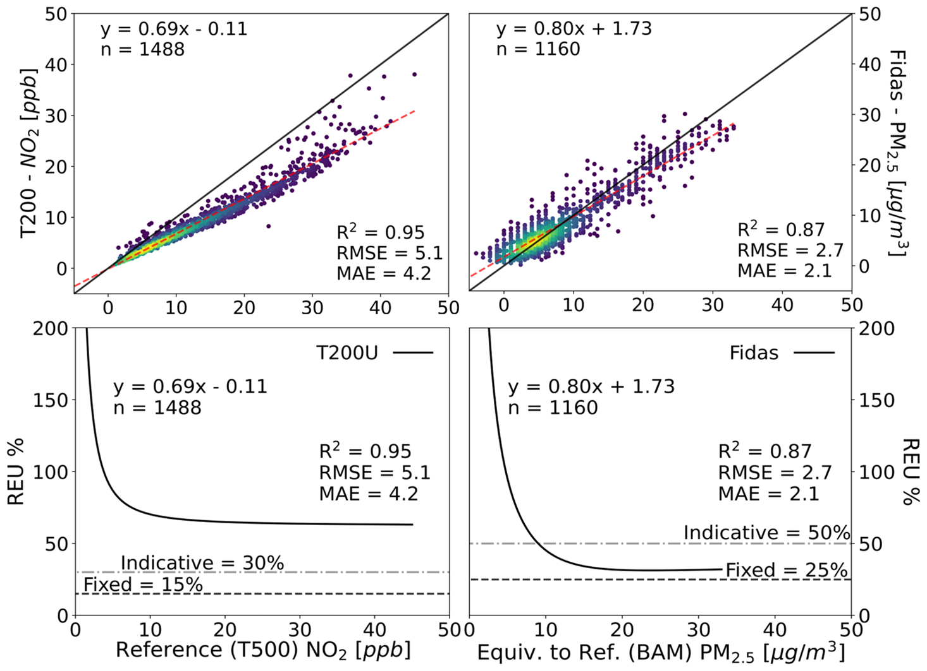
RGMs are key!
Diez et al., 2024
(https://amt.copernicus.org/articles/17/3809/2024/)

Slide 14
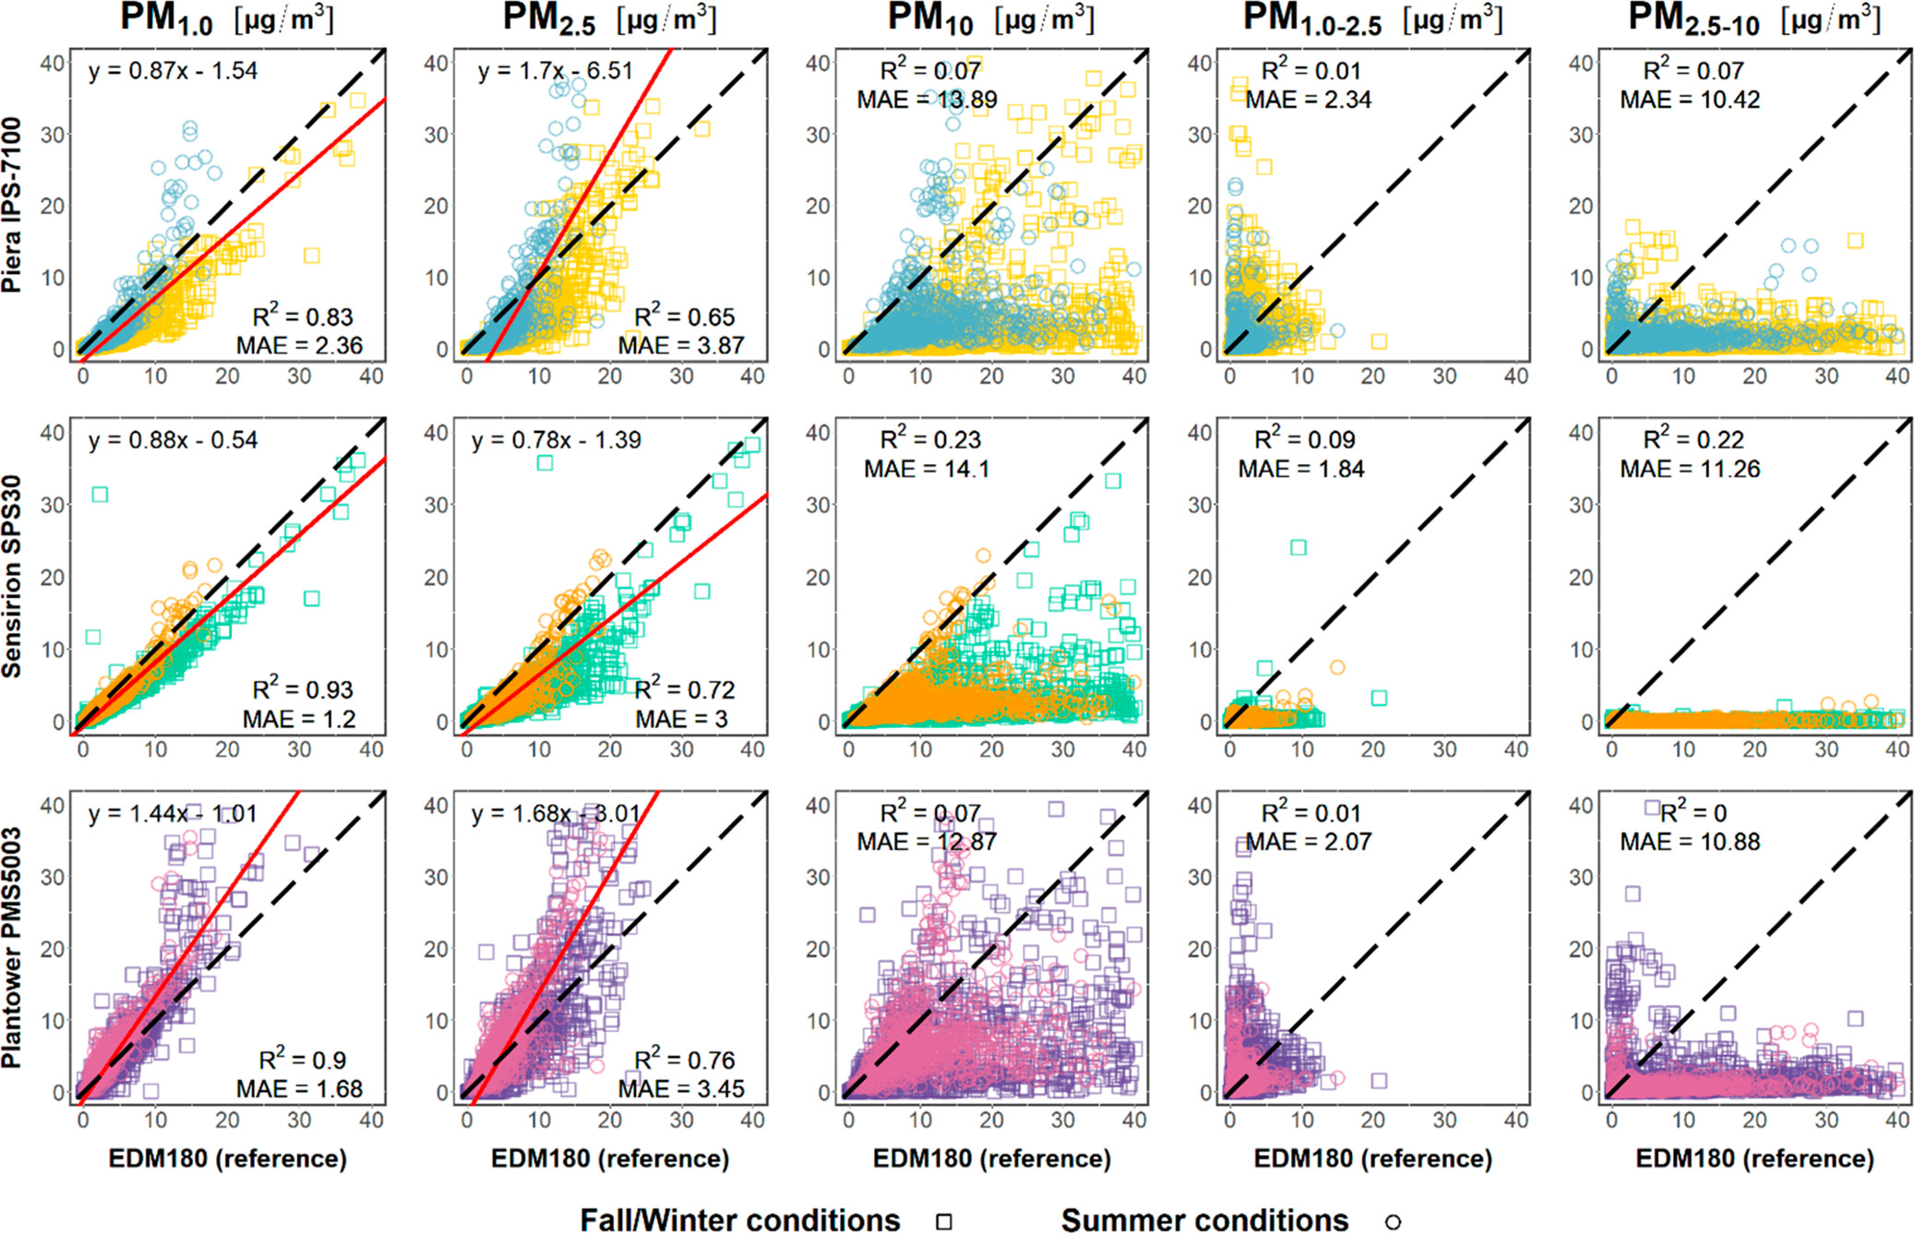
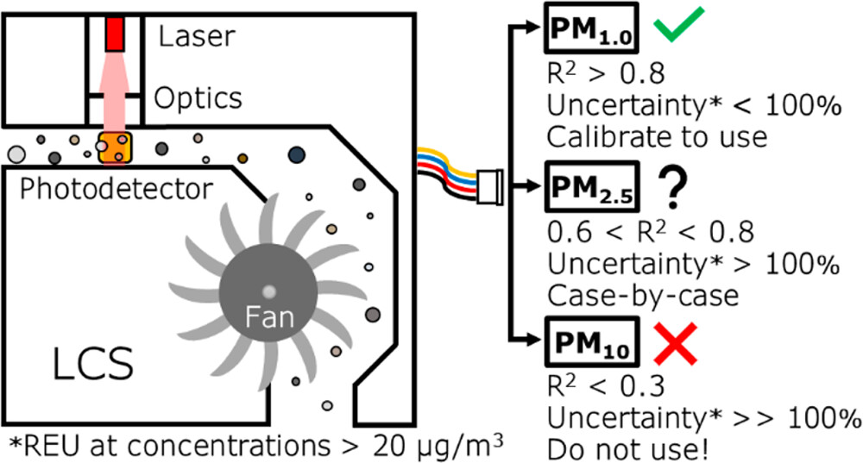
Sensitivity/specificity
PM1.0: Sensors showed strong accuracy, with low bias and high corr with ref monitors.
PM2.5: Slightly worse agreement; bias doubled and correlation decreased.
PM10 estimates are unreliable: sensors show high scatter and large bias, with no meaningful signal for PM10, which should be disregarded.
Sensors fail to accurately detect particles in the 1.0–2.5 μm and 2.5–10 μm ranges. These errors are mostly random and noisy.
Sensor accuracy may be artificially high when particle sizes match manufacturer calibration conditions, but performance may deteriorate in real-world environments.
Effective sensor use depends on calibration tailored to aerosol properties and environmental conditions.
Regression plots of low-cost sensor PM estimates versus the EDM180 reference measurements (site: Colorado State University, Fort Collins, USA). Rueda et al., 2023 (https://pubs.acs.org/doi/10.1021/acs.estlett.3c00030)

Slide 15
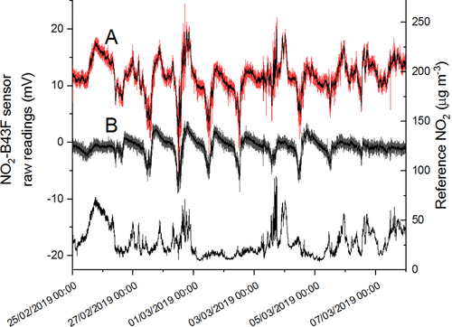
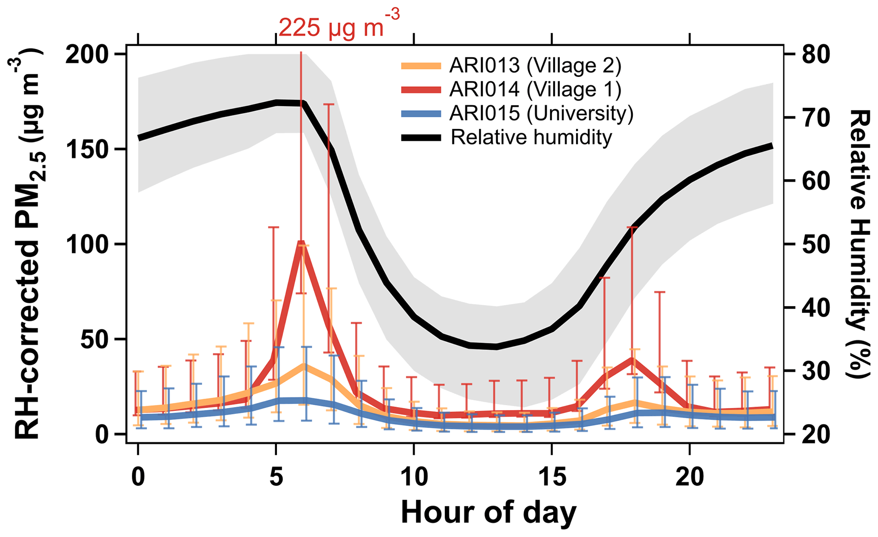
Interferences
Ouyang et al., 2020 (https://amt.copernicus.org/articles/15/3353/2022/)
Bittner et al., 2023 (https://amt.copernicus.org/articles/15/3353/2022/)

Slide 16
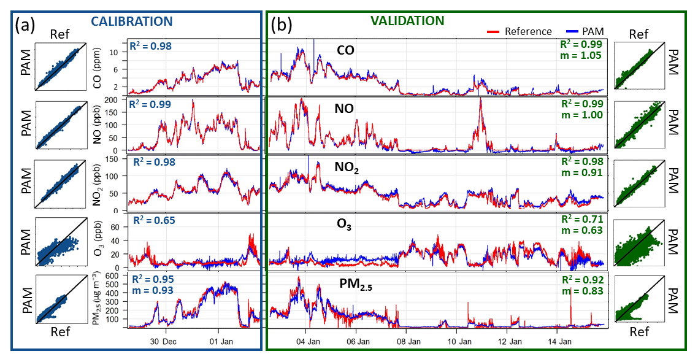
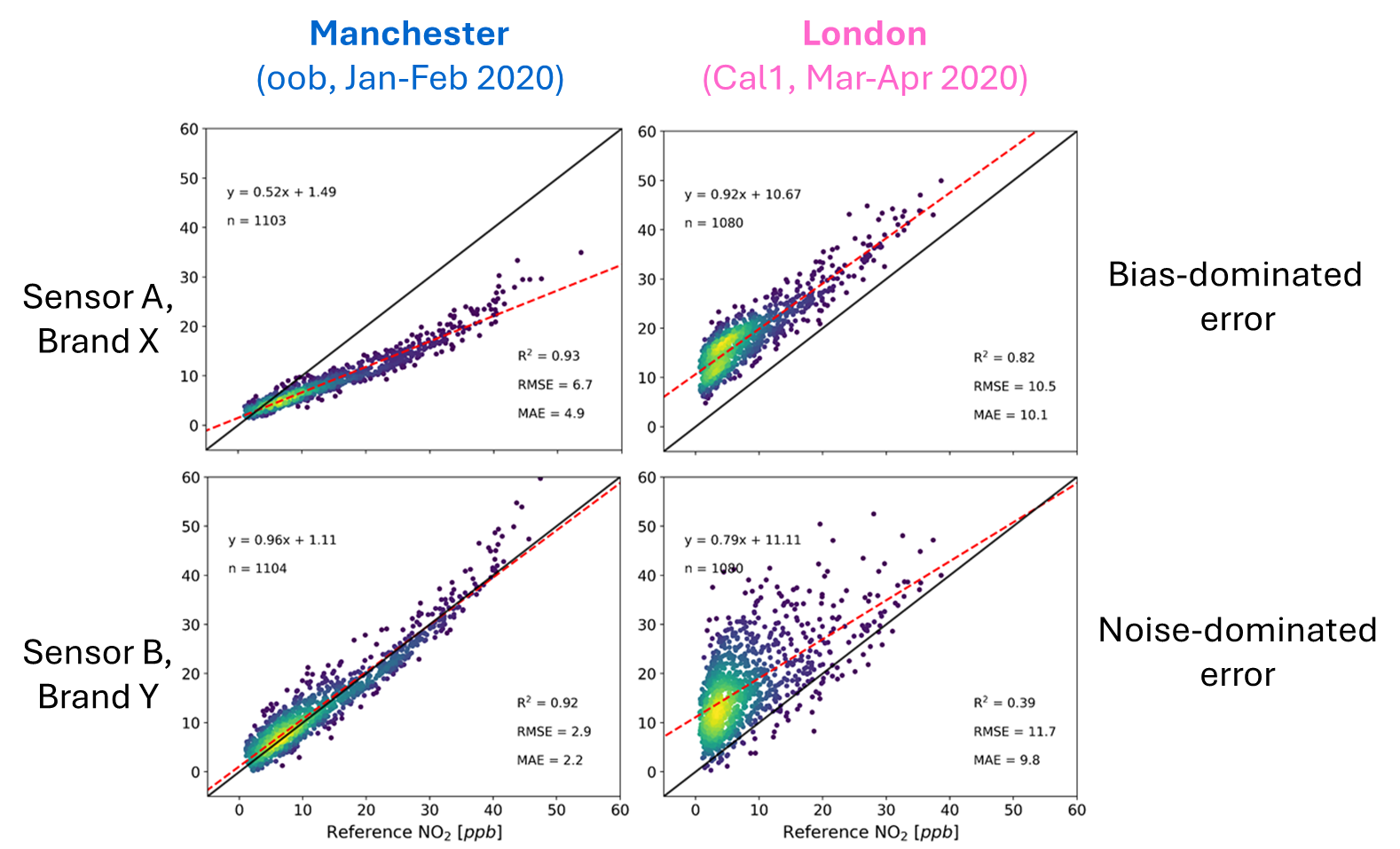
The importance of calibrations
Chatzidiakou et al., 2019
(https://amt.copernicus.org/articles/12/4643/2019/)
Diez et al., 2024
(https://amt.copernicus.org/articles/17/3809/2024/)
Notes:
-El sensor fue movido de Man a Lon
-Fue calibrado con datos en Manc
Sensor B, Brand Y: overfited model?

Slide 17
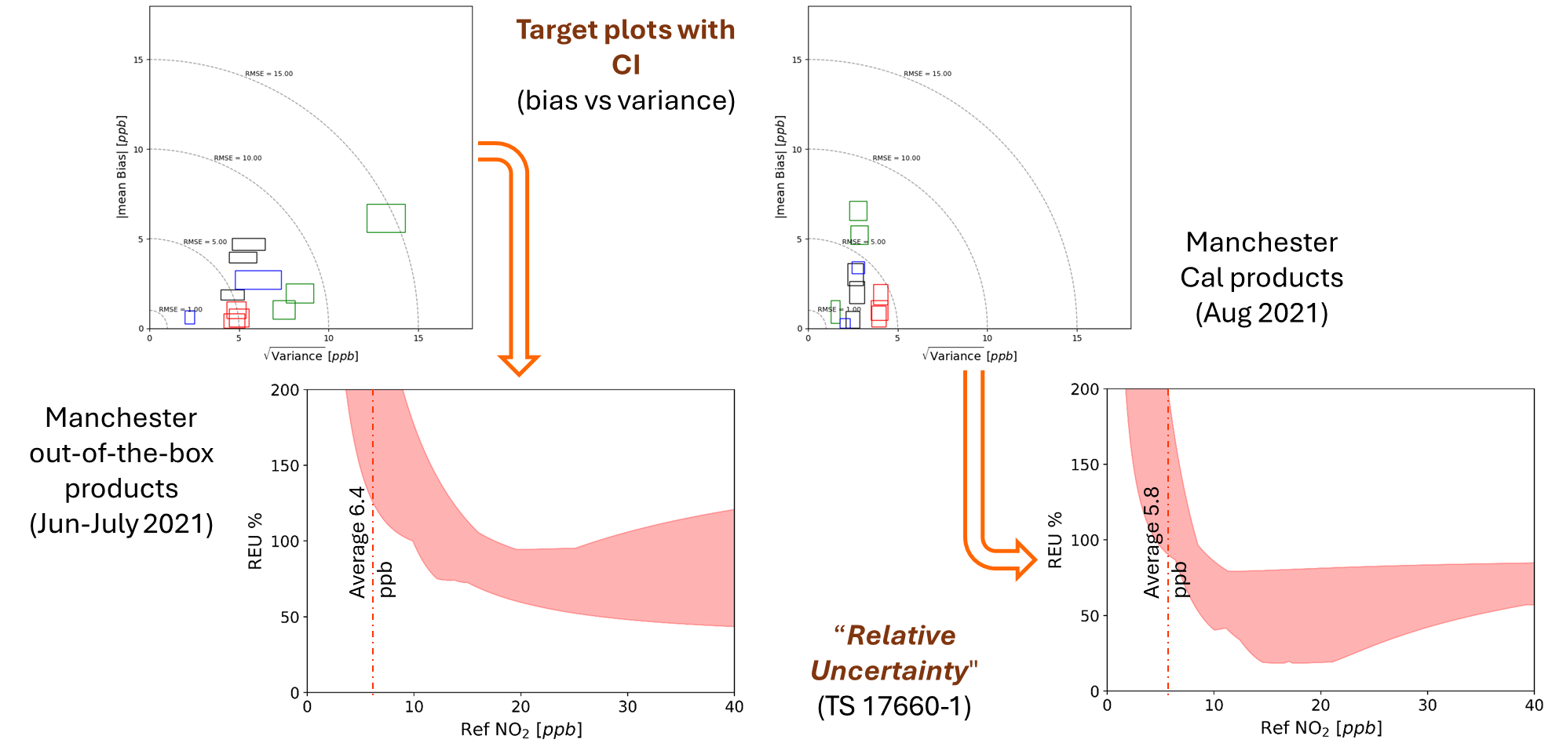
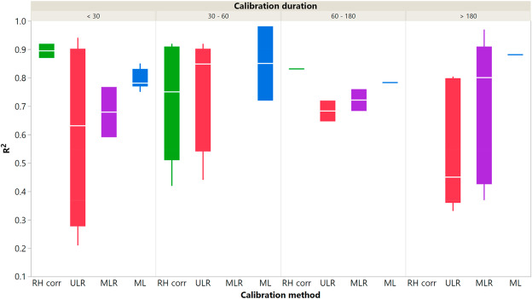
The importance of calibrations
Diez et al., 2024
(https://amt.copernicus.org/articles/17/3809/2024/)
Liang, 2021 (https://www.sciencedirect.com/science/article/pii/S0013935121004576)
Notes:
WPS

Slide 18
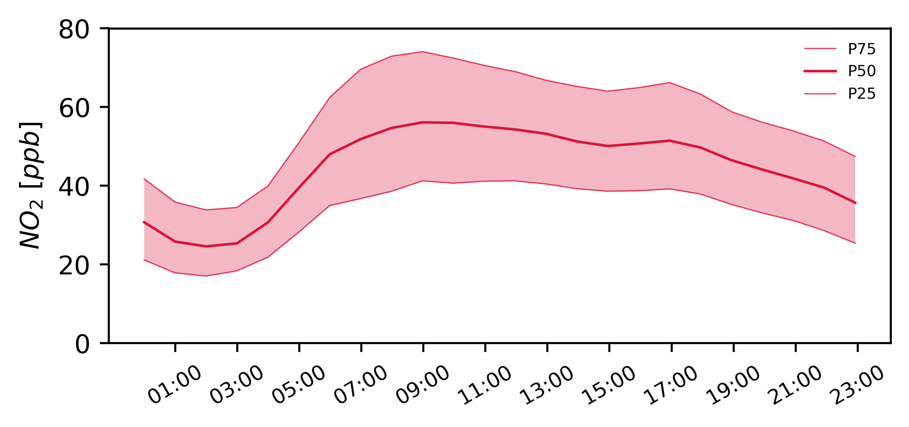
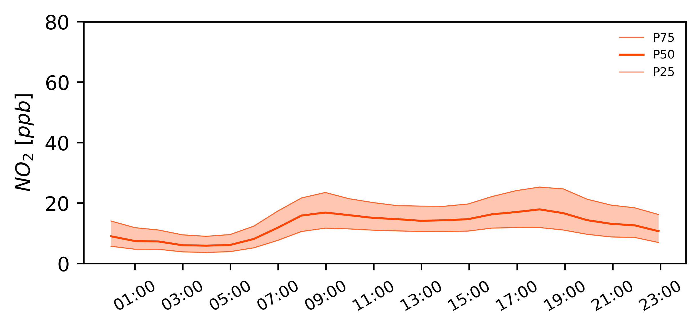
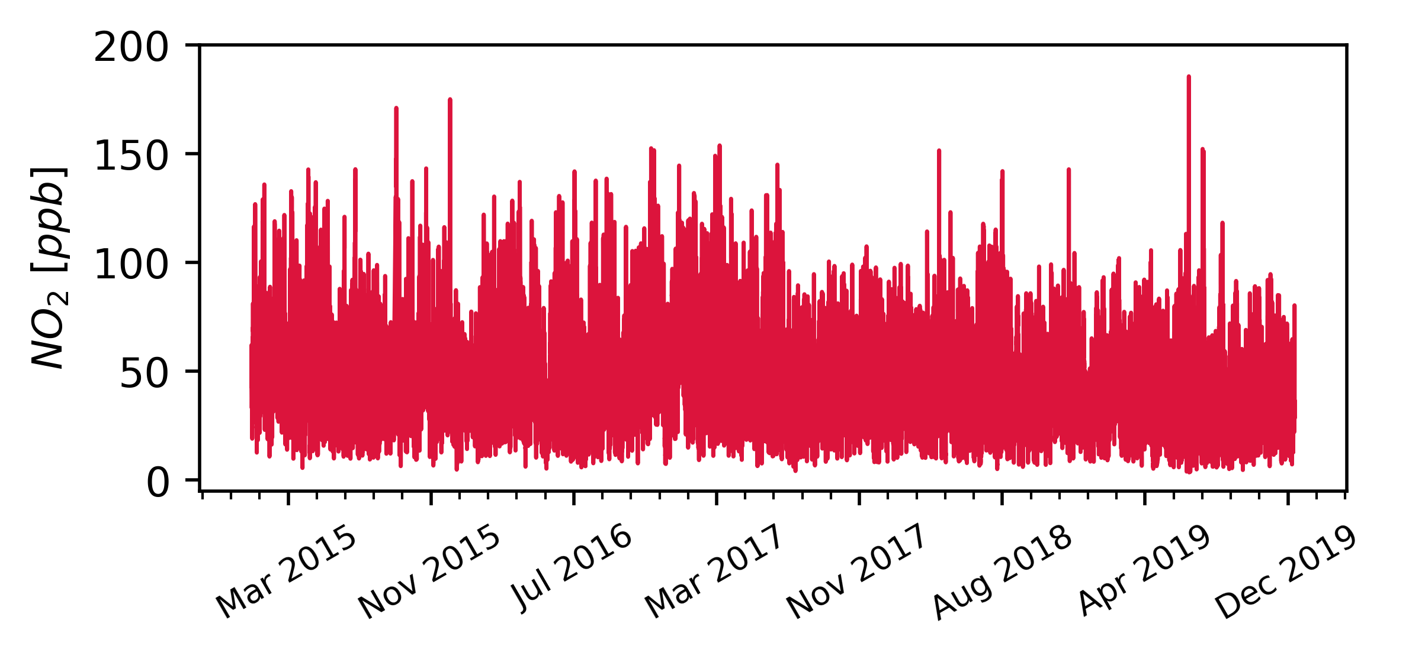
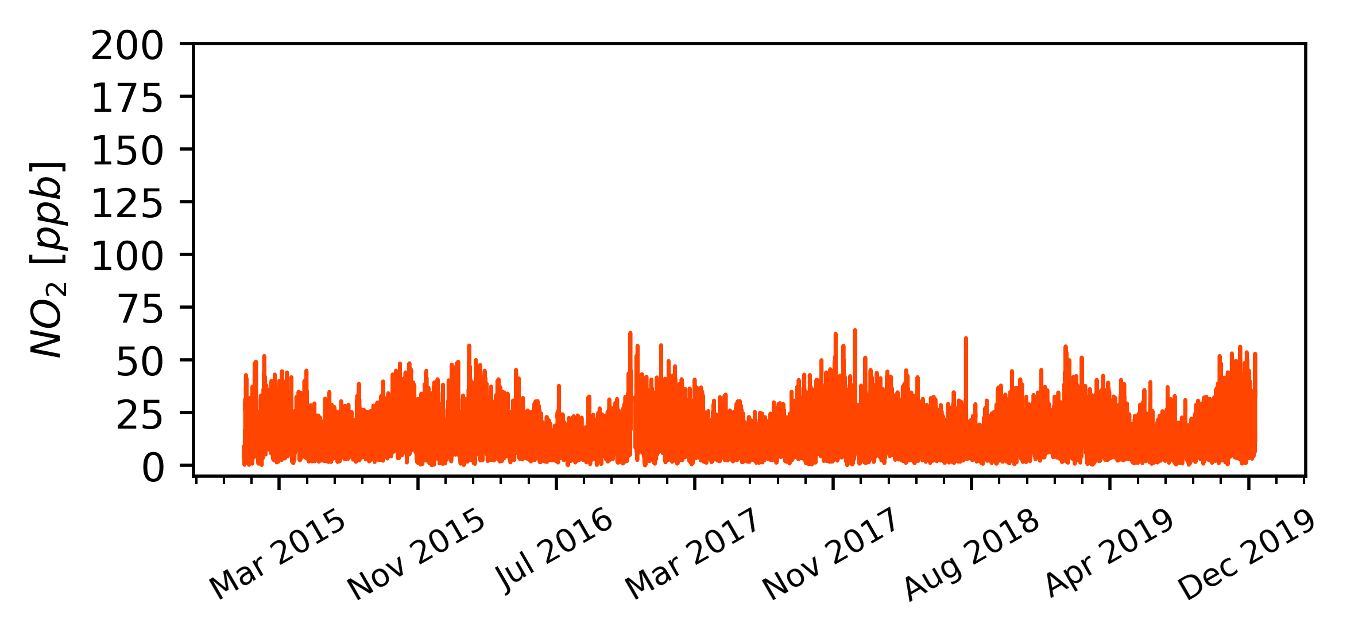
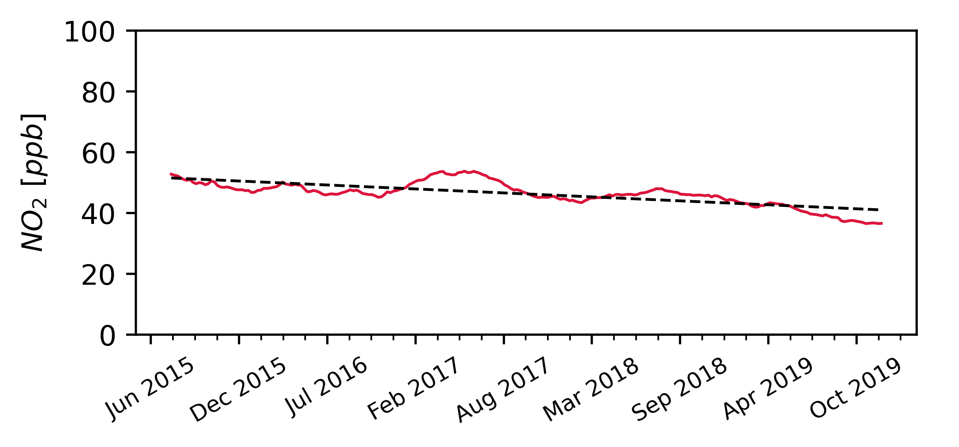
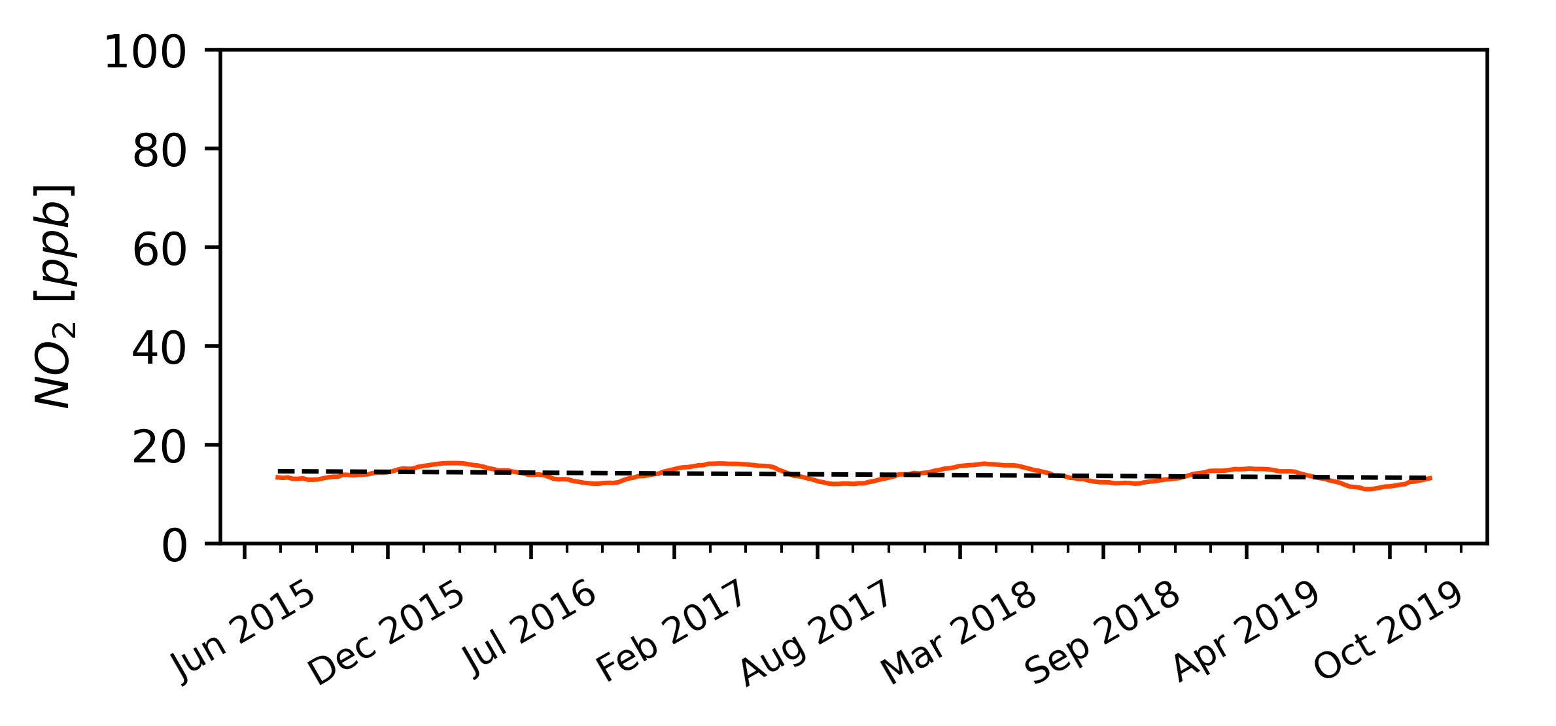

2 Sites’ fingerprint
(5yr, 1hr data)
Site 1
Site 2
Instrument 1
R² = 0.95
RMSE = 4.5
Time res.: 1hr
Instrument 8
R² = 0.90
RMSE = 4.0
Time res.: 15min
Instrument 2
R² = 0.90
RMSE = 5.0
Time res.: 24hs
Potential instruments
to do the job
Instrument 7
R² = 0.85
RMSE = 3.5
Time res.: 30min
Instrument 3
R² = 0.85
RMSE = 5.5
Time res.: 30min
Instrument 6
R² = 0.80
RMSE = 4.0
Time res.: 24hs
Instrument 5
R² = 0.75
RMSE = 4.5
Time res.: 1hr
Instrument 4
R² = 0.80
RMSE = 5.0
Time res.: 15min
Notes:
Sometimes user have some a priori information about the sensor tipe/brand
How do we now which instrument would perform best for a particular task?
How the performance indices were obtained? In which period?
More importantly, are they comparable?

Slide 19
Performance evaluation: single value metrics
How do we now which sensor will perform best for a particular task?
How do the performance indices were obtained? Period? Site?
Are they comparable?
Is it possible to use them as a measure of prognosis uncertainty?
Instrument 1
R² = 0.95
RMSE = 4.5
Time res.: 1hr
Instrument 8
R² = 0.90
RMSE = 4.0
Time res.: 15min
Instrument 2
R² = 0.90
RMSE = 5.0
Time res.: 24hs
Potential instruments
to do the job
Instrument 7
R² = 0.85
RMSE = 3.5
Time res.: 30min
Instrument 3
R² = 0.85
RMSE = 5.5
Time res.: 30min
Instrument 6
R² = 0.80
RMSE = 4.0
Time res.: 24hs
Instrument 5
R² = 0.75
RMSE = 4.5
Time res.: 1hr
Instrument 4
R² = 0.80
RMSE = 5.0
Time res.: 15min

Slide 20
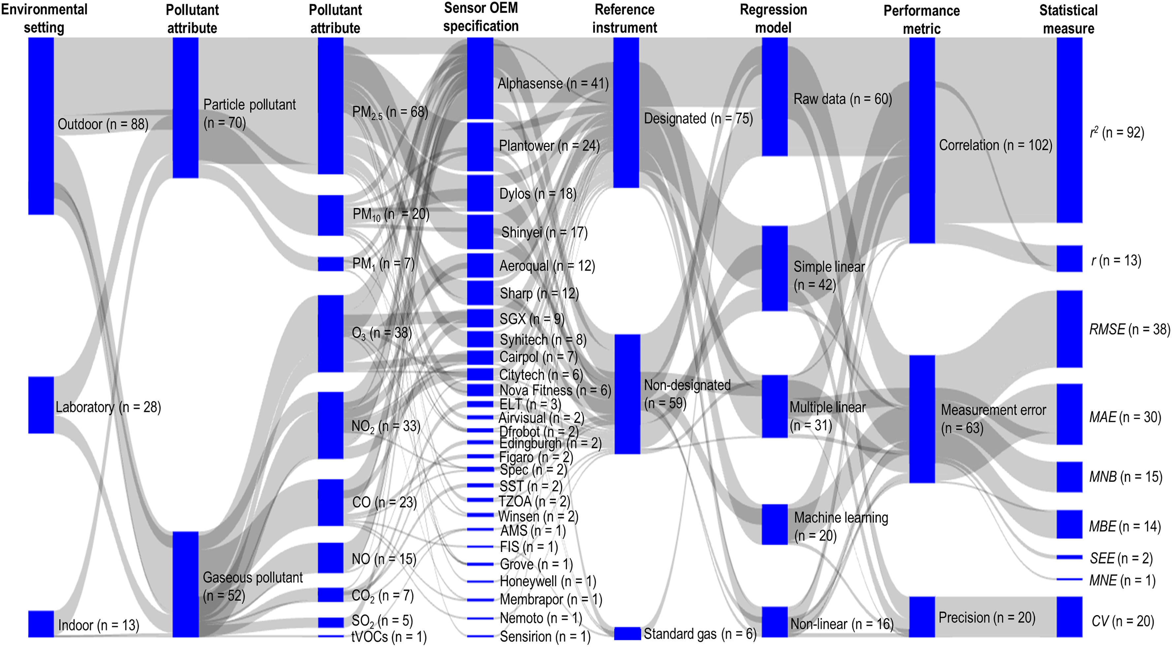
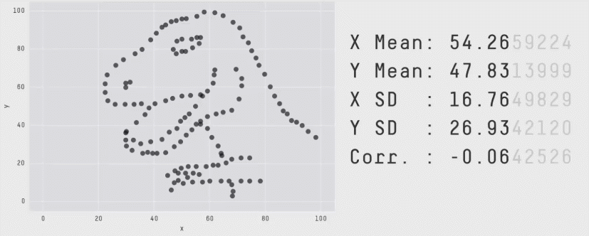
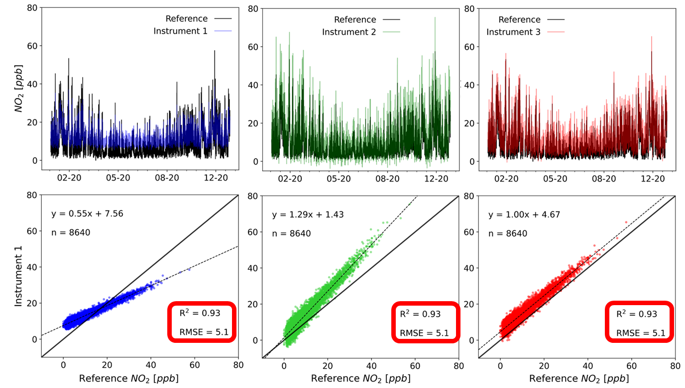
Performance evaluation: single value metrics
Matejka & Fitzmaurice, 2017
Kang et al., 2022 (https://www.sciencedirect.com/science/article/pii/S0048969721068455)
Diez et al., 2022 (https://amt.copernicus.org/articles/15/4091/2022/)
Notes:
This really didactic animation known as the Datasaurus Dozen taken from Matejka & Fitzmaurice.
Perhaps you all knew this. In my case it was just two weeks ago that I get to meet these fantastic plots. Thanks Peer for sharing this paper!
As you may have noticed, the figure shows the progression between different shapes, constructed by the same number of data points, with the particularity that each new figure has the same summary statistics, as well as all of the intermediate frames.

Slide 21
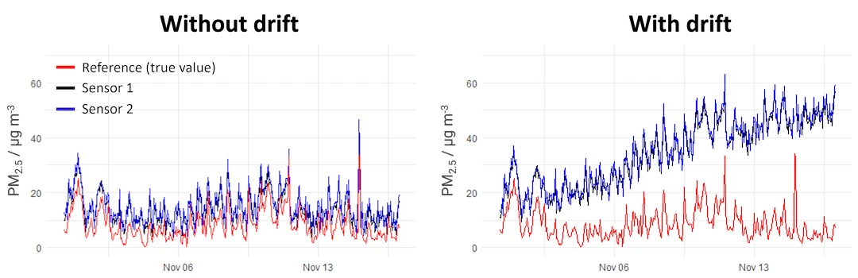
Sensor drift
As sensors age, they may experience drift, where measurements deviate from the true values over time. This is illustrated in the image where Sensor 1 and Sensor 2 increasingly diverge from the reference (true value) as time progresses. Regular recalibration is essential to maintain sensor accuracy and extend its useful lifetime.
https://www.airgradient.com/blog/sensor-performance-precision-reproducibility-accuracy/

Slide 22
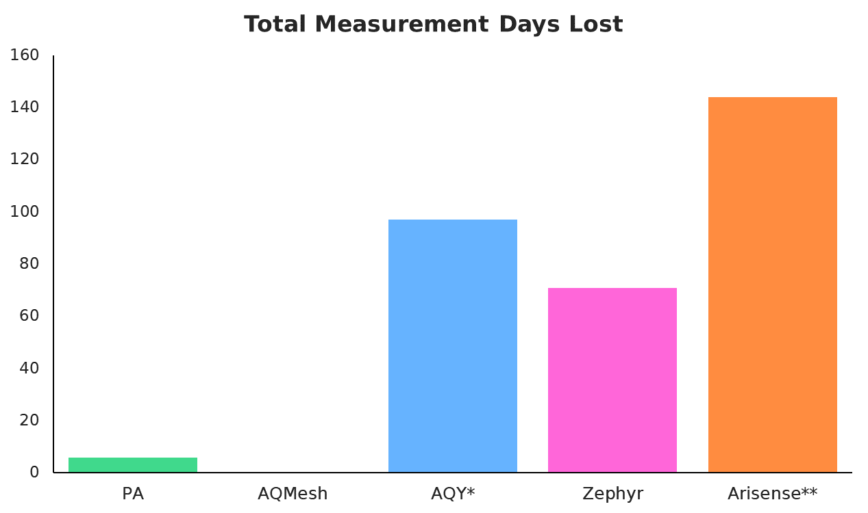
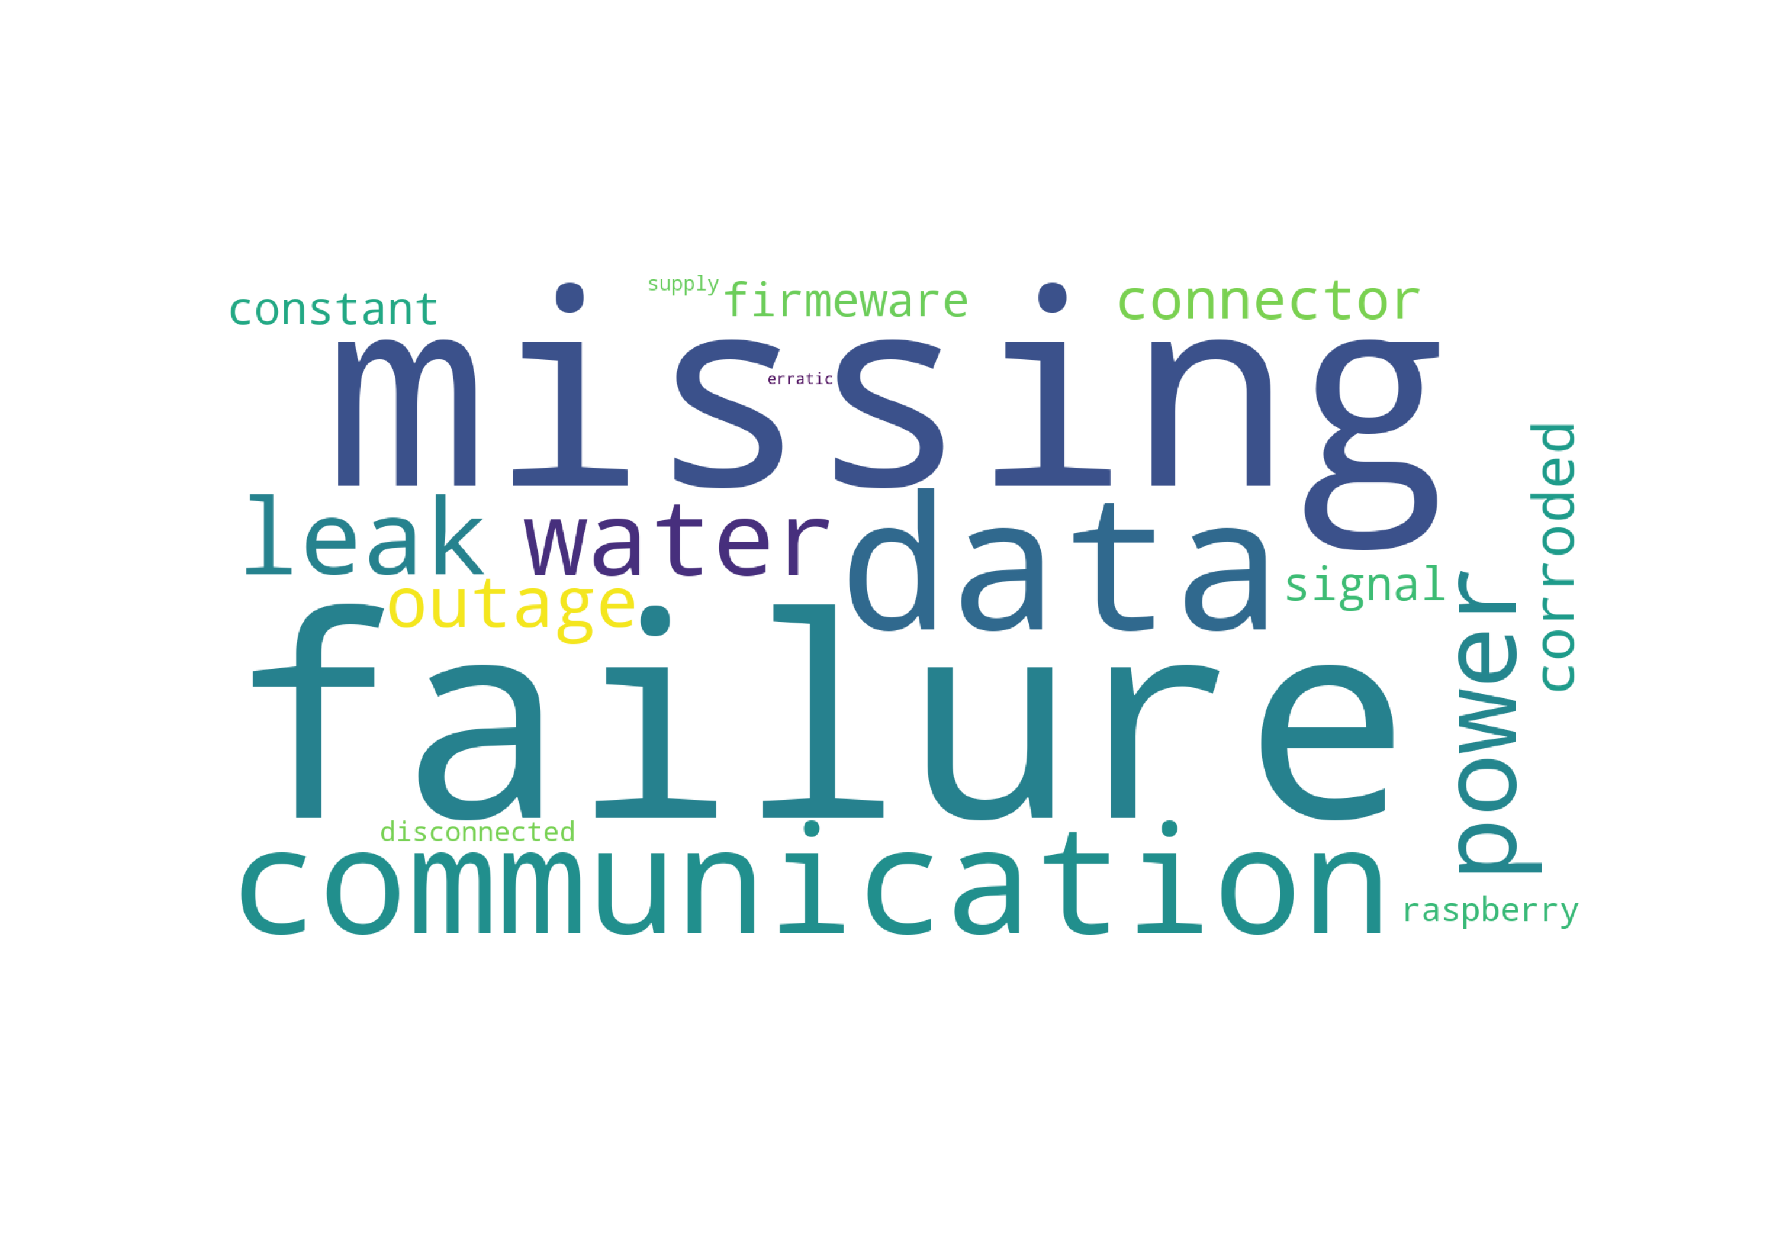
Hardware failure
Main causes:
SIM card (67 d)
Water leak (110 d)
Power supply (48 d)
X Y Z

Slide 23
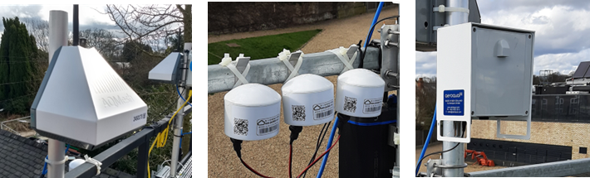
Measurement independency
Measurement performance = f(Hardware, Software)
Reference/Research instrument
Low-Cost Sensor system
Software
Software
Different levels of:
Corrections
Post-procesing
Traceability
Transparency
Performance
Apparent Performance
Hardware
Hardware

Slide 24
Future Also current challenges
Data privacy and security: as sensor networks expand and gather vast amounts of data, there are growing concerns about how personal is being collected, shared, and used. Without clear regulations, the risk of data breaches/misuse of sensitive information may increase significantly.
Dependence on cloud infrastructure: many regions may not have the technical capacity or funding to maintain reliable cloud infrastructure for sensor networks. These issues exacerbate the digital divide.
Unregulated expansion of sensor networks: the rapid deployment of sensor networks without proper regulation or standards can lead to inconsistent data quality and challenges in maintaining long-term reliability and accuracy.
Over-reliance on sensor for decision making: relying solely on sensor data without integrating other sources of information (e.g., regulatory monitors, expert knowledge) may result in incomplete/inaccurate decisions, particularly in public health situations.

Slide 25
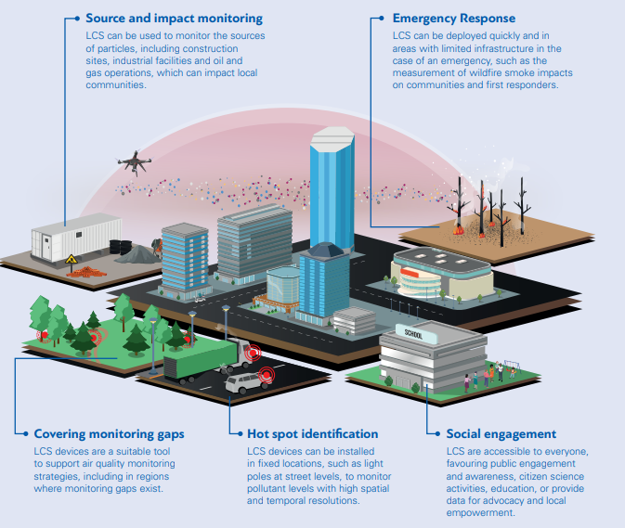
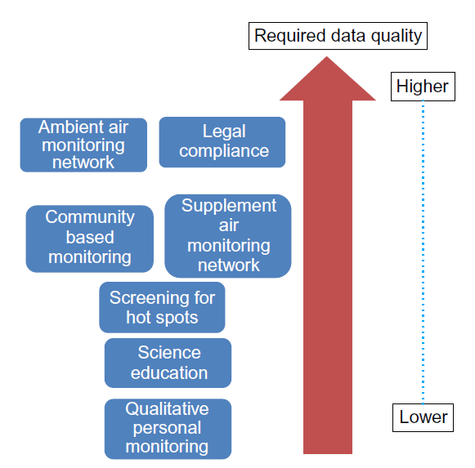
AQ Sensor applications
Penza, 2018 (https://doi.org/10.1016/B978-0-12-814827-3.00012-8)
https://wmo.int/news/media-centre/low-cost-sensors-can-improve-air-quality-monitoring-and-peoples-health

Slide 26



AQ Sensor applications: Outdoor/Indoor AQ monitoring
https://www.clarity.io/
https://www.clarity.io/
Pantelic, 2022 (https://www.frontiersin.org/journals/built-environment/articles/10.3389/fbuil.2022.971523/full)
Afroz, 2023 (https://pubs.rsc.org/en/content/articlelanding/2023/ea/d2ea00149g)

Slide 27


AQ Sensor applications: Emissions estimations
Alzahrani et al., 2024 (https://acp.copernicus.org/articles/24/9045/2024/)
Jayaratne et al., 2020 (https://aaqr.org/articles/aaqr-20-06-oa-0280)
Notes:
citizens use sensors to monitor pollution levels while on the move, sending real-time data to central systems for analysis. This participatory method leverages mobile and fixed devices, enabling localized monitoring and creating larger datasets. The involvement of ordinary citizens enhances spatial coverage, making air quality data more comprehensive and actionable.

Slide 28





AQ Sensor applications: Citizen science and educational purposes
Overall architecture of the mobile sensing-based participatory paradigm systems. Singla et al., 2018 (https://link.springer.com/article/10.1007/s10661-018-6940-8?fromPaywallRec=false)
https://ingenieria.udd.cl/enviro/proyectos/
Notes:
citizens use sensors to monitor pollution levels while on the move, sending real-time data to central systems for analysis. This participatory method leverages mobile and fixed devices, enabling localized monitoring and creating larger datasets. The involvement of ordinary citizens enhances spatial coverage, making air quality data more comprehensive and actionable.

Slide 29


AQ Sensor applications: Personal exposure
Chatzidiakou et al., 2020 (https://link.springer.com/article/10.1038/s41370-020-0259-6)
Lee et al., 2020 (https://www.nature.com/articles/s41598-020-73205-x)
Notes:
citizens use sensors to monitor pollution levels while on the move, sending real-time data to central systems for analysis. This participatory method leverages mobile and fixed devices, enabling localized monitoring and creating larger datasets. The involvement of ordinary citizens enhances spatial coverage, making air quality data more comprehensive and actionable.

Slide 30




AQ Sensor applications: Source attribution
https://aaqr.org/articles/aaqr-20-10-oa-0598
Hofman et al., 2022
(https://www.mdpi.com/2073-4433/13/6/944)
https://amt.copernicus.org/articles/15/4047/2022/

Slide 31


AQ Sensor applications: AQ reconstruction
Spatiotemporal distribution of NO2 in Tangshan (China) during a severe pollution episode in November 2018. Fu et al., 2023 (https://doi.org/10.1016/j.atmosenv.2023.119756)

Slide 32

AQ Sensor applications: forecasting
Deterministic models: based on physical and chemical equations that simulate atmospheric processes like transport, transformation, and deposition of pollutants (e.g., WRF-Chem, CMAQ, GEOS-Chem).
Statistical models: based on historical data to identify patterns and relationships between meteorological conditions and pollutant concentrations (e.g., LR, ARIMA, Neural Nets, Random Forests, etc.).
Complementary/hybrid techniques:
  Data Fusion: integrates multiple data sources (e.g., satellite, ground-based sensors, model outputs) to improve accuracy and reduce uncertainty.
  Data Assimilation: incorporates real-time observational data into models (usually deterministic) to correct predictions and improve forecasting.
GAW Report No 293 (https://library.wmo.int/idurl/4/68924)

Slide 33

AQ Sensor applications: forecasting
Some examples of the potential role of sensors:
Deterministic models:
  Adjust local emissions not well represented in inventories.
Statistical models:
  enhances model training (sensor can capture local patterns and continuous high-res time-series).
Complementary techniques:
  In Data Fusion, sensors improve the accuracy of fused data products by complementing other sources (satellite, ground stations, land cover, models, etc.).
  In Data Assimilation, sensors provide real-time data to correct model predictions, especially for localized events.
Malings et al., 2024
(ppt presentation)
*in all cases sensors can potentially improve
spatial and temporal resolution validation

Slide 34

AQ Sensor applications: forecasting
48 hour predictions of air quality (NO2) Central London and a running route that changes shape to minimise air pollution.
The Alan Turing Institute (https://www.turing.ac.uk/research/research-projects/london-air-quality)

Slide 35
AQ Sensor applications: forecasting
Considerations/recommendations:
Ensure proper calibration (and recalibration!) of sensors to avoid introducing biases to your model (noise in sensor’s data is unavoidable!).
Take into account the local environment (urban vs. rural, topography, met…) as sensors might respond differently to varying pollution sources/microclimates.
Perform regular maintenance, especially in varying environmental conditions (e.g., temp, humidity, rain, snow, dust…) that can impact sensor performance.
Implement robust QA/QC procedures to filter out outliers or faulty data.
Sensors placed near pollution sources (e.g., traffic, industry) should be carefully validated for proximity effects. Many sensors publicly available are actually deployed indoors!!!
Best practices involve model outputs cross-validation methods (for both RGMs and sensors). If you use a set of sensors as input to your model, don’t use it again for validation!
Conduct sensitivity analyses to assess how much sensor accuracy impacts model performance.
If you are only using the data, ensure to carefully review all available information and metadata provided by the data source. If the origin or quality of the data is uncertain, it may be better to avoid using it!

Slide 36

AQ Sensor applications: forecasting
Schneider,et al., 2017
(https://doi.org/10.1016/j.envint.2017.05.005)

Slide 37
AQ Sensor applications: forecasting
In Oslo, Norway, a study (Schneider et al., 2017; Castell et al., 2017) deployed 24 sensor systems (for CO, NO, NO₂, O₃, PM₂₅ and PM₁₀). These sensors were co-located with an RGM for calibration and collected data over six months. The sensor data was combined with a 3D dispersion model (EPISODE) for urban and regional air quality forecasting. By applying Data Fusion (sensor data + model outputs), they predicted spatial and temporal pollution trends.
In Tangshan, China, a machine learning model was used to integrate data from LCS, regulatory monitors, and the TROPOMI satellite. This produced a high-resolution (1 km) NO2 forecast, demonstrating that LCS can be combined with satellite data to improve prediction accuracy, especially between satellite overpasses and in capturing fine-scale pollution gradients (Fu et al., 2023).
In Medellin, Colombia, LCS data was assimilated into the LOTOS-EUROS model to improve PM2.5 forecasting. The results showed that integrating LCS data improved air quality forecast performance from one to three days in advance. Interestingly, this approach provided a comparable benefit to using a smaller number of more accurate reference-grade monitors (RGM), indicating the potential of LCS to fill gaps in forecasting networks​ (Restrepo et al., 2021)
The Warning Advisory System (WAS) for airborne dust, deployed in West African countries, used LCS data to validate dust forecasts. The LCS, which measured PM10, PM2.5, and aerosol optical depth (AOD), were critical in a region with limited field measurements. The validation of WAS forecasts across seven countries would have been very challenging without these LCS​ (Terradellas et al., 2018).
Most of these examples are found in the GAW Report No 293 (https://library.wmo.int/idurl/4/68924)

Slide 38


Relevant guidelines, standards and reports
https://standardsdevelopment.bsigroup.com/projects/2022-00710
https://cfpub.epa.gov/si/si_public_record_Report.cfm?dirEntryId=350784&Lab=CEMM

Slide 39


Relevant guidelines, standards and reports
https://www.astm.org/d8406-22.html
https://standardsdevelopment.bsigroup.com/projects/2019-02999#/section

Slide 40


Relevant guidelines, standards and reports
WMO, WHO, UNEP, IGAC and EMEP (2020)
https://library.wmo.int/idurl/4/37465
GAW Report No 293:
https://library.wmo.int/idurl/4/68924

Slide 41
A few take-home messages
Sensors can help fill gaps in areas lacking traditional monitoring networks but require proper calibration and validation against reference-grade monitors.
End users need to clearly identify the data requirements. What is the question you want to ask to sensors? How can sensors help/complement your task?
Maintenance, calibration, and long-term costs must be considered to ensure the reliability of sensor over time.
Regular recalibration is necessary to maintain accuracy due to sensor drift and environmental interferences.
As error sources can change significantly for different sites/seasons, the sensors should ideally be tested in relevant environments
Single-value metrics convey very useful information…but take proper care as they can be misleading
Transparency in sensor data and its limitations is crucial to gain public trust, especially when the data is used for informing public health decisions.
Notes:
End users need to clearly identify the data requirements. What is the question to be asked to the data?
Measurement uncertainty is of critical consideration, as this determines the information content of the data, and how it can be used.
The use of global performance single-metrics (R², RMSE, MAE, etc.) sometimes obscures much of the information content of Colocation Studies.
The ability of B-A and REU plots to assess device performance across an observed concentration range, enables the user to make informed decisions about the capabilities of a device in that range.
Useful information can be obtained using colocation studies if the primary measurement has a well characterized uncertainty. Such colocation study should ideally be carried out in an environment as similar as possible to the application environment.
The presence of post processing algorithms further complicates things. This additional uncertainty is most likely to bias performance prediction if the user is unaware of the scale of the corrections, and their applicability to the target environmental conditions.

Slide 42



Allin-Wayra
small sensors for atmospheric science
This IGAC Activity is aimed at fostering a global community of practice around small sensors, with a particular focus on regions that lack air quality measurements.
Sign up for our mailing list here
Allin-Wayra, can be interpreted as “good air” or “winds of change” in Quechua a pre-colonial South American native tongue, is the name of the new IGAC Activity on small sensors.
allin.wayra@igacproject.org
Notes:
El titulo es muy largo
Pragmatismo del quantum mechanics

Slide 43




Gracias!!!
Sebastian Diez
sebastian.diez@udd.cl

