Slide 1

Training Course on Seamless Prediction of Air Pollution in Africa
Webinars 12-25 Sep 2024
Air Quality Management in Morocco: Significant Advancements and Innovations
Dr. Mounia TAHRI, Dr. Abdelfettah BENCHRIF​
National Centre for Nuclear Energy, Science and Technology (CNESTEN), Morocco

Slide 2
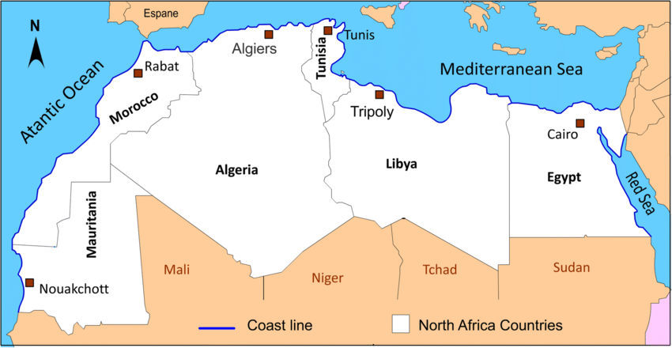


Introduction
Over the past 20 years, Morocco has undergone rapid urbanization and industrial production growth, which have negatively impacted air quality.
According to a study by the World Bank in 2014, the degradation of air quality was estimated at 9.7 billion dirhams equivalent to 1.05% of GDP (Gross Domestic Product), recording a notable increase compared to the year 2000.
The public authorities have decided to make the fight against air quality degradation a priority of its national policy to protect the environment and people's health.
Various laws and legislations have been implemented in Morocco to improve air quality.

Slide 3
Objectives
This presentation aims to:
Provide a state of the art of air quality and its impact in Morocco,
Highlight significant advancements in air quality management,
Showcase innovative technologies and practices,
Discuss future directions for improvement.

Slide 4
State of the Art of Air Quality in Morocco

Slide 5
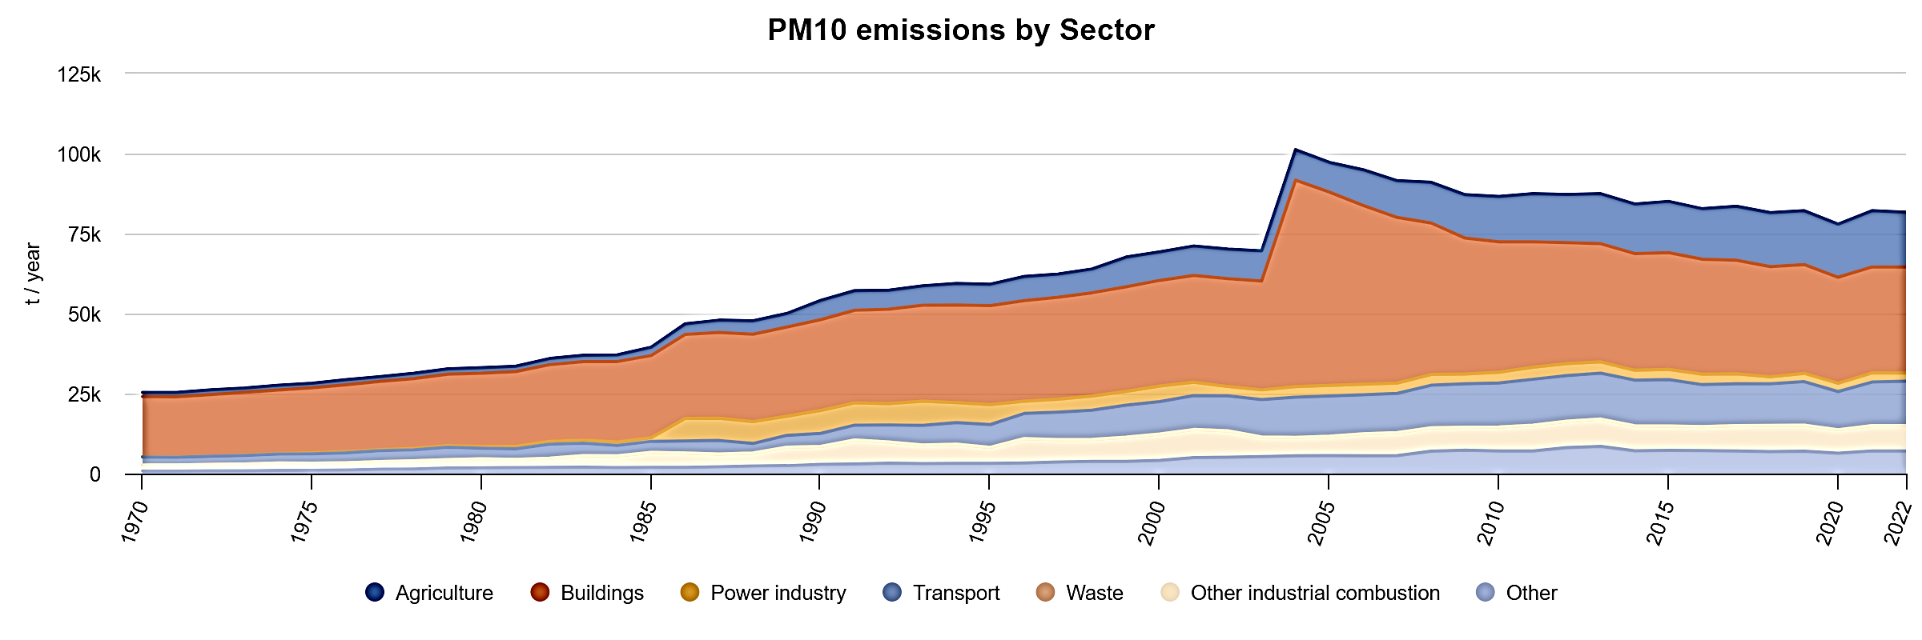
Particulate Matter Emissions (PM)

Slide 6
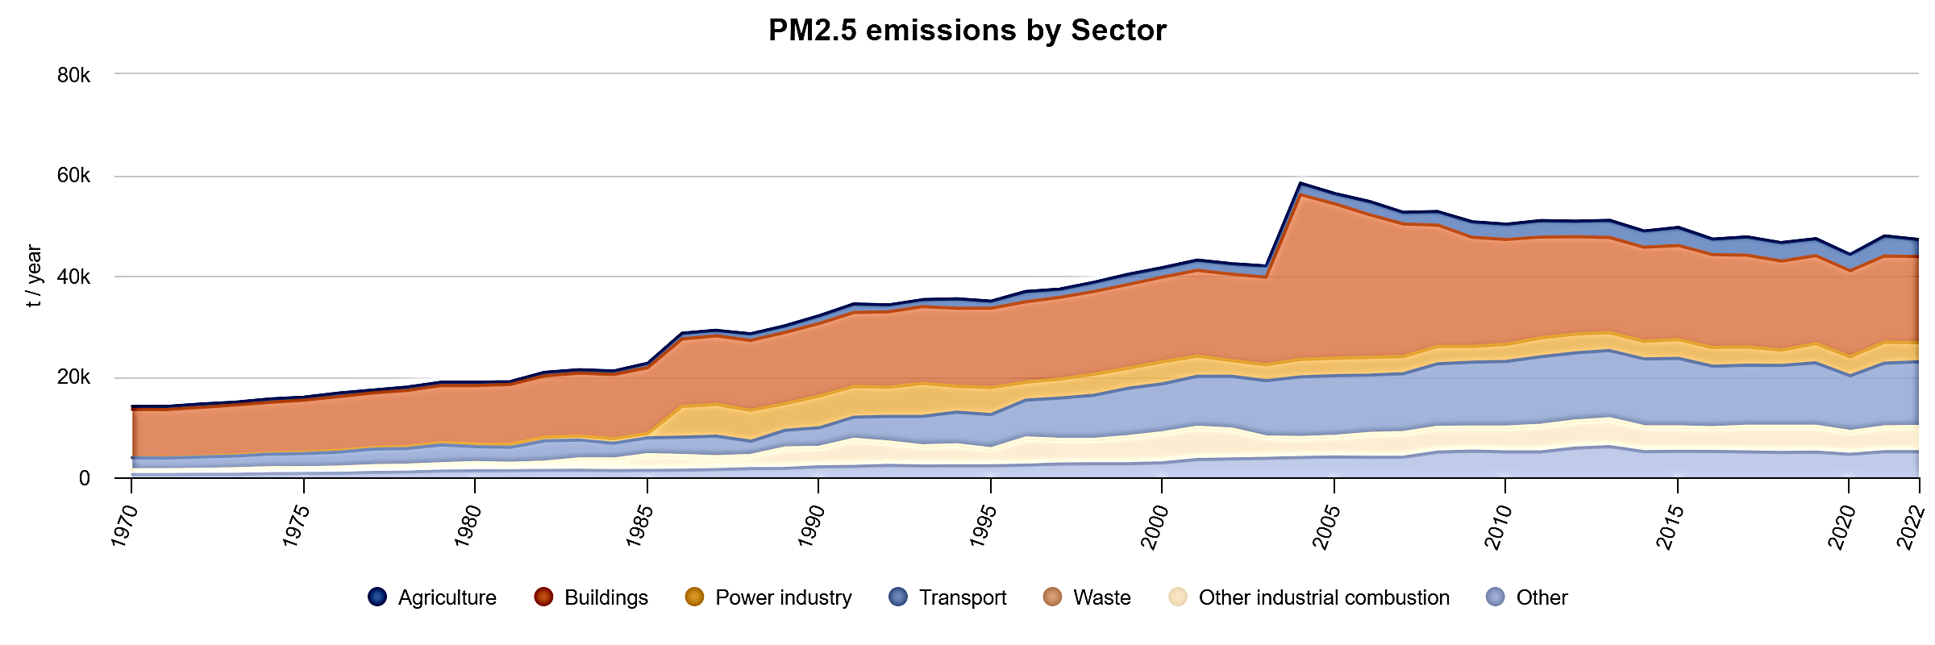

Slide 7
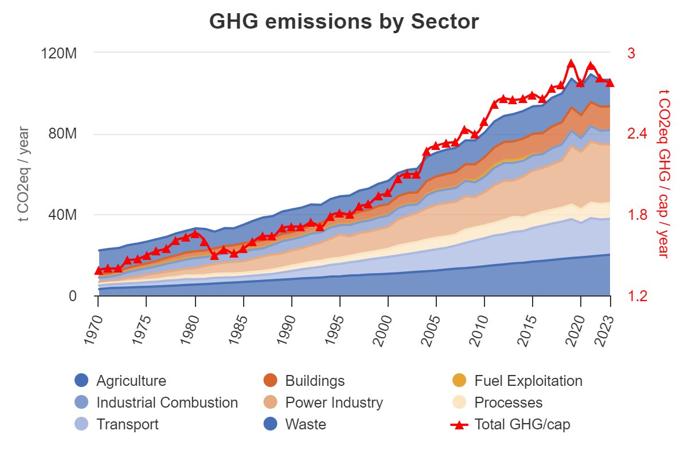
Green Gas Emission Emissions (GHG)

Slide 8
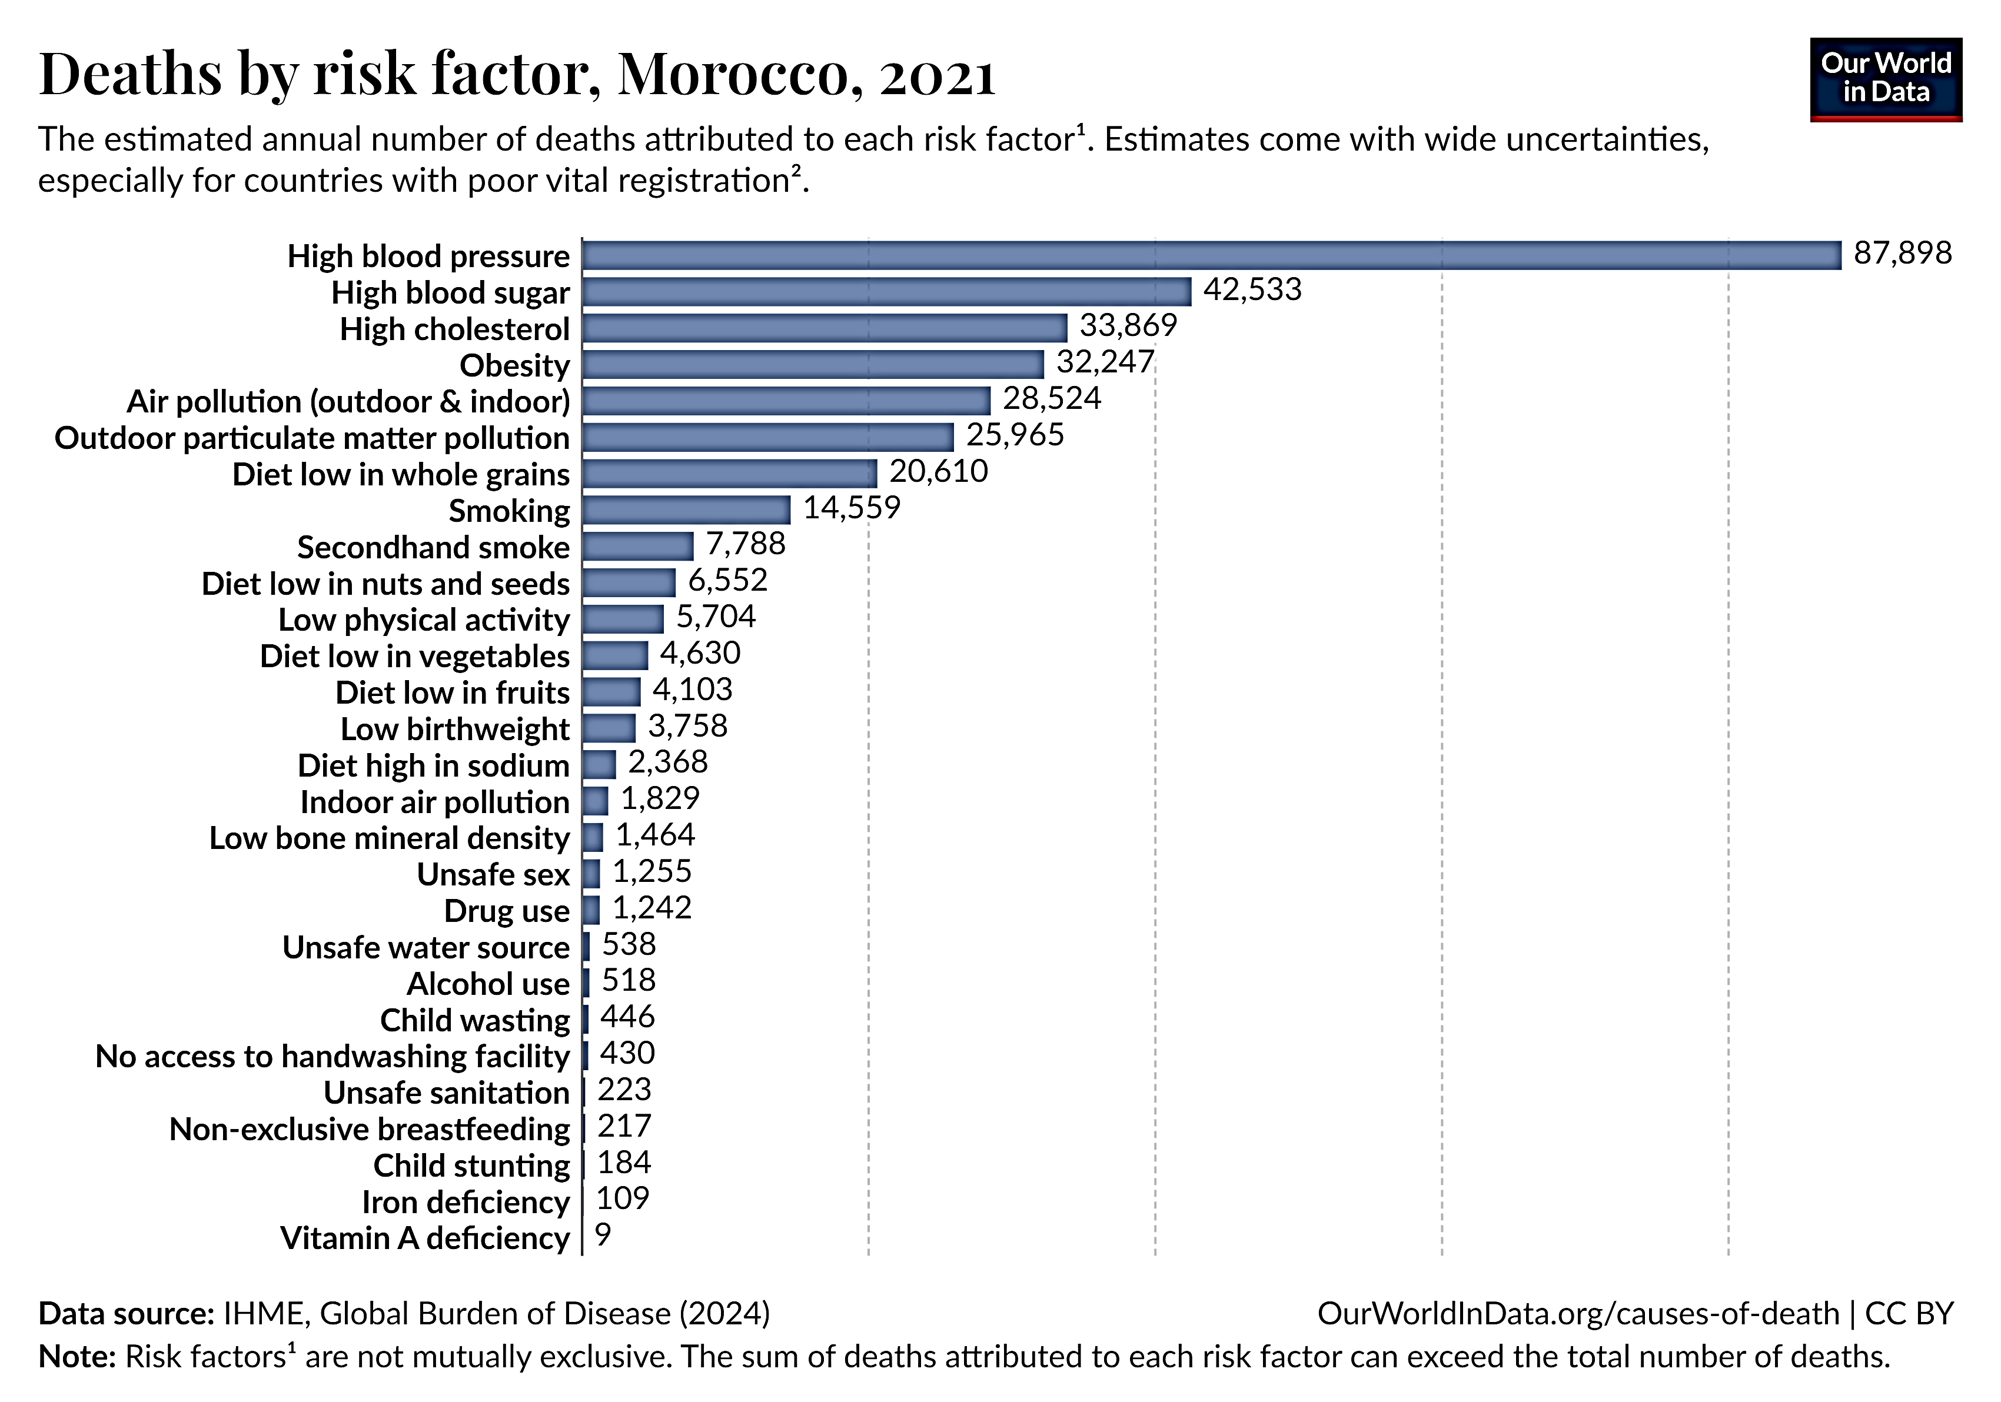
Risk Factor of Air Pollution

Slide 9
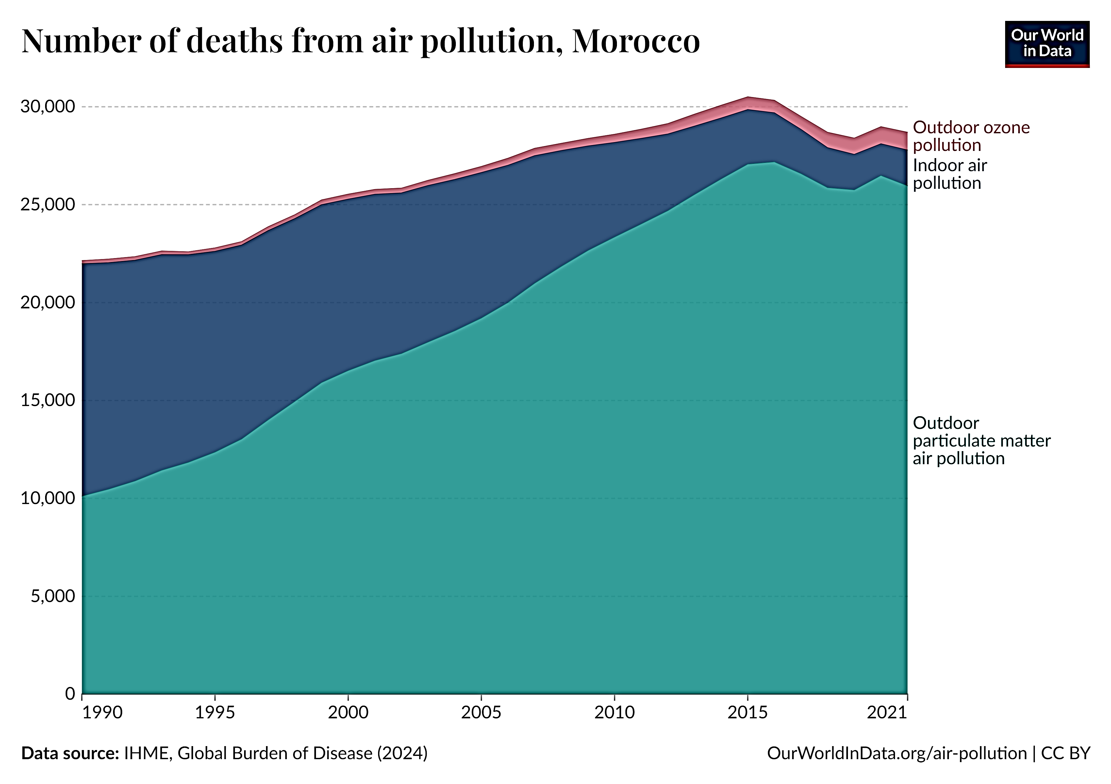

Slide 10
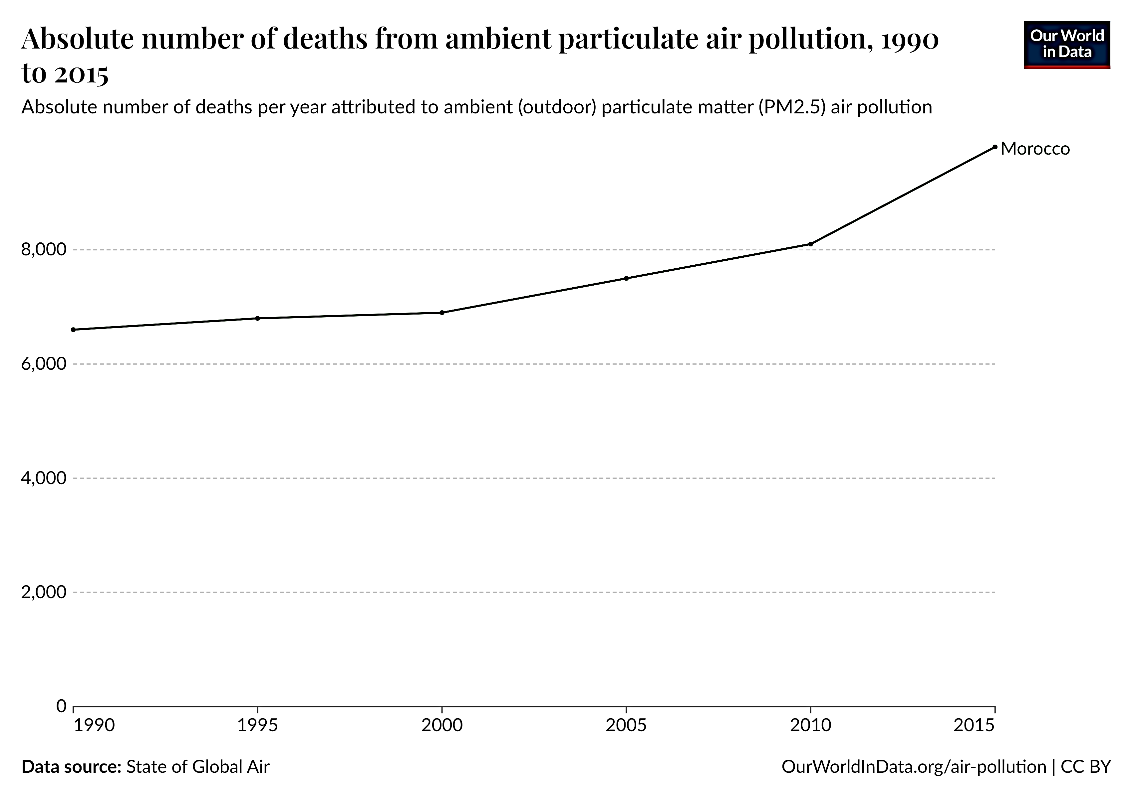

Slide 11
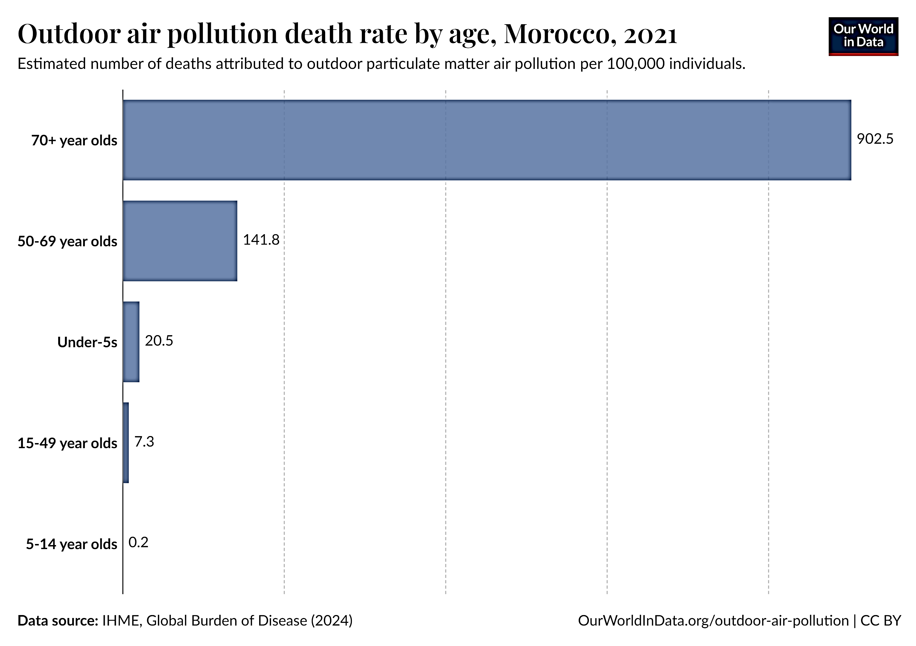

Slide 12
Regulatory Framework

Slide 13
Morocco has made significant strides in air quality management, including:
Establishment of Air Quality Monitoring Networks: The country has developed a network of monitoring stations to assess air quality across various regions.
Implementation of National Air Quality Standards: Morocco has set national standards for key air pollutants to ensure compliance and protect public health.
Public Awareness Campaigns: Initiatives aimed at educating the public about air quality issues and encouraging sustainable practices have been launched.
13

Slide 14
National Policies and Regulations
To strengthen the legal framework relating to the fight against air pollution, the public authorities have promulgated a series of legislative and regulatory texts. These include:
Framework law 99-12 establishing the national charter for the environment and sustainable development which strengthens the legal protection of resources and ecosystems by listing the measures that the State intends to take with the aim of fighting against all form's pollution and nuisance. | Law 13-09 relating to renewable energies. Adopted in March 2010, the law provides in its preamble that the development of renewable energy sources is a priority of national energy policy and one of the essential pillars of "the promotion of renewable energies to strengthen the competitiveness of the productive sectors of the country and preserve the environment through the use of clean energy technologies in order to limit GHG emissions and reduce the significant pressure exerted on the forest cover.
Law 11-03 relating to the fight against air pollution and its implementing texts which set air quality standards and limit values for emissions from industrial units. | Law 47-09 relating to energy efficiency. Adopted in September 2011, the law sets the objective of "increasing energy efficiency in the use of energy sources, avoiding waste, alleviating the burden of energy costs on the national economy and contribute to sustainable development”.
Law 12-03 relating to environmental impact studies and the law relating to waste management also provide rules limiting air pollution. | Law 77-15 on plastic bags. Adopted in December 2015, the law prohibits the manufacture, import, export, marketing and use of plastic bags.
Law 13-03 relating to the fight against air pollution. Adopted in June 2003, the law defines emission standards as “emission limits which must not be exceeded and are determined according to the latest relevant scientific data; the state of the receiving environment; the self-purification capacities of water, air and soil; and the requirements of sustainable national economic and social development. | Decree No. 2-09-631 of July 6, 2010 setting the limit values for vehicle exhaust gases.

Slide 15
Limit values ​​in the ambient air for different pollutants
Pollutants | Nature of the threshold | Limit Values
Sulphur Dioxide (SO2) µg/m³ | Limit values for health protection | 75th percentile 99.2 of daily averages.
 | Limit value for the protection of ecosystems | 20 annual mean
Nitrogen Dioxide (NO2) µg/m³ | Limit values for health protection | 200 centiles 98 of hourly mean / 50 annual mean
 | Limit values for health protection | 30 annual mean
Carbone Monoxide (CO) mg/m³ | Limit values for health protection | 7 daily mean
Ozone (O3) µg/m³ | Limit values for health protection | 110 average over 8 hours
 | Limit values for health protection | Average daily limit of 65 not to be exceeded for more than 3 consecutive days.
Suspended particles (PM10) µg/m³ | Limit values for health protection | 50 percentiles 90.4 of daily mean / 40 annual mean
Suspended particles (PM2.5) µg/m³ | Limit values for health protection | 45 daily mean / 35 annual mean
Lead (Pb) µg/m³ | Limit values for health protection | 1 annual mean
Cadmium (Cd) ng/m³ | Limit values for health protection | 5 annual mean
Benzene (C₆H₆) µg/m³ | Limit values for health protection | 10 annual mean

Slide 16
Advancement in Air Quality Management in Morocco

Slide 17
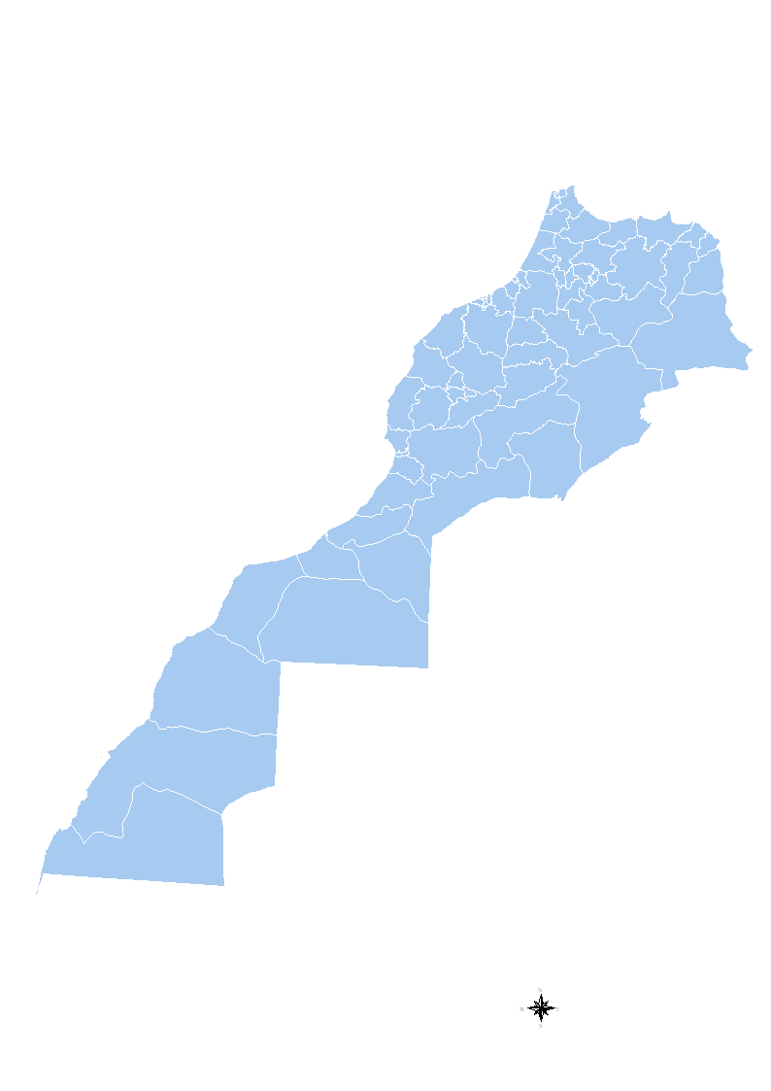
National Air Quality Monitoring Network
Tanger
Kenitra
The Moroccan air quality monitoring network consists of approximately 36 stationary stations located in 15 cities.
In 2020, the management of this network was transferred from the DGM (General Directorate of Meteorology) to LNESP (National Laboratory for Pollution Studies and Monitoring).
These stations are strategically located in urban areas, industrial zones, and locations with high traffic density to monitor air pollution levels effectively.
The monitored pollutants are:
Particulate matter (PM10 and PM2.5), nitrogen dioxide (NO2), sulfur dioxide (SO2), carbone monoxide (CO), ozone (O3), Total hydrocarbons and non methane hydrocarbons;
Meteorological parameters: temperature, wind speed and direction, relative humidity.
The current number of stations does not allow for the undertaking of a comprehensive survey of the air quality situation in the country, so it is expected to raise the number of stations from 36 to 140 by 2030.
Salé
Rabat
Fès
Casablanca
Benslimane
ELjadida
Settat
Khouribga
Safi
Marrakech
Essaouira
Agadir
36 stationary stations
4 mobile stations
15 cities

Slide 18
National Strategy for Sustainable Development
Morocco's National Strategy for Sustainable Development emphasizes the importance of environmental protection, including air quality improvement. The strategy outlines specific goals and actions to reduce emissions from various sectors, including transportation, industry, and agriculture.
Promotion of Public Transportation
To reduce vehicular emissions, the Moroccan government has invested in expanding and modernizing public transportation systems. Initiatives include:
Development of bus rapid transit (BRT): these systems are being developed in various cities across Morocco, including Marrakesh, Greater Agadir, and Tangiers. In Marrakesh, the BRT utilizes electric buses that operate in dedicated lanes for efficient public transportation.
Promotion of electric and hybrid vehicles by implementing incentives such as exemptions from the annual circulation tax for owners of these vehicles since 2017.

Slide 19
Regulation of Industrial Emissions
The government has implemented stricter regulations on industrial emissions to control air pollution from factories and manufacturing plants. This includes setting emission limits for various pollutants and requiring industries to adopt cleaner technologies and practices.
Low Emission Zones
Some Moroccan cities have introduced low-emission zones (LEZs) where access is restricted for high-polluting vehicles. These zones aim to improve air quality in densely populated urban areas by encouraging the use of cleaner vehicles and reducing traffic congestion.
Awareness and Education Campaigns
The Moroccan government has launched public awareness campaigns to educate citizens about the health impacts of air pollution and the importance of sustainable practices. These campaigns promote behaviors such as reducing vehicle use, adopting energy-efficient appliances, and participating in tree-planting initiatives.

Slide 20
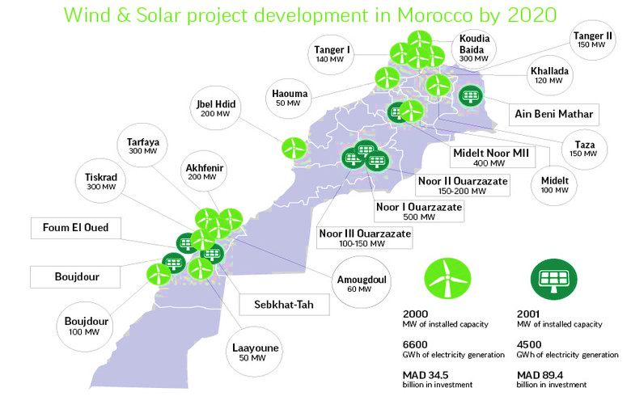
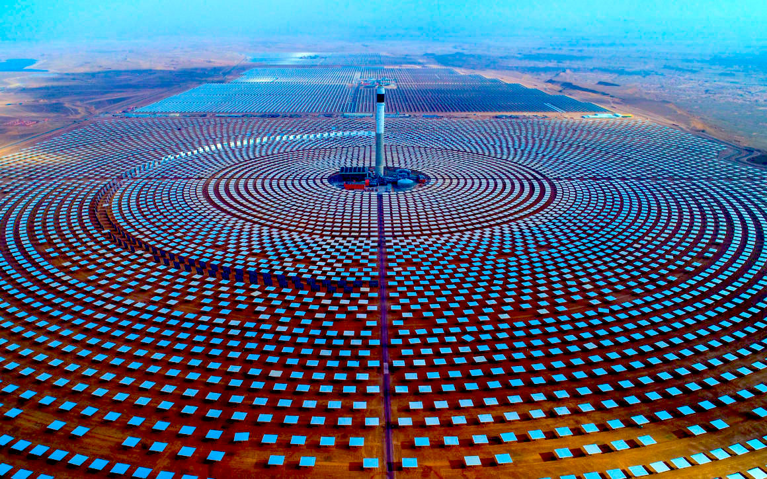
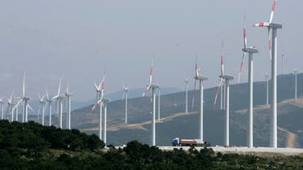
Renewable Energy Initiatives
Morocco has made significant investments in renewable energy projects, particularly solar and wind energy. By transitioning to cleaner energy sources, the government aims to reduce reliance on fossil fuels, which are a major contributor to air pollution.

Slide 21
Collaboration with International Organizations
The Moroccan government collaborates with international organizations and non-governmental organizations (NGOs) to enhance its capacity to address air quality issues. Some examples of these collaborations include:
UN Environment Program (UNEP);
World Bank;
Global Environment Facility (GEF);
World Health Organization (WHO);
United Nations Framework Convention on Climate Change (UNFCCC);
Bilateral Collaborations.

Slide 22
Innovations in Air Quality Monitoring
Innovative technologies have been adopted to enhance air quality monitoring, such as:
Satellite Technology: Remote sensing technologies are used to assess air quality on a larger scale, providing valuable data for policymakers.
Low-Cost Air Quality Sensors: The deployment of affordable sensors allows for widespread monitoring and community engagement in air quality assessment.
Data Analytics and AI: The integration of data analytics and artificial intelligence enables real-time monitoring and predictive modeling of air quality trends.

Slide 23
Future
Directions

Slide 24
To enhance air quality management in Morocco, it is expected to:
Raise the number of stations from 36 to 140 by 2030, a fund has been dedicated to the acquisition of new stations necessary for the measurement of air quality,
Acquire new equipment for the maintenance of measuring instruments, data transmission, and data analysis,
Purchase computer equipment for data processing.

Slide 25
This will allow the Department of Sustainable Development to start strengthening the monitoring network at the regional level by:
Updating the status of air pollution, distribution, and origins of air pollutants,
Updating studies of the cadastral emissions registry at the regional level according to the new administrative structure,
Centralizing the database in the LNESP.

Slide 26
THANK YOU FOR YOUR ATTENTION

