Slide 1


Air quality Forecasting in Morocco: Illustrative Cases
CNESTEN
Dr. Benchrif Abdelfettah, Dr. Tahri Mounia
Researcher Scientist
Geochemistry and Chemical Pollution Unit
National Centre for Nuclear Energy, Science and Technology (CNESTEN)
Training Course on Seamless Prediction of Air Pollution in Africa
Online session 12 September 2024

Slide 2
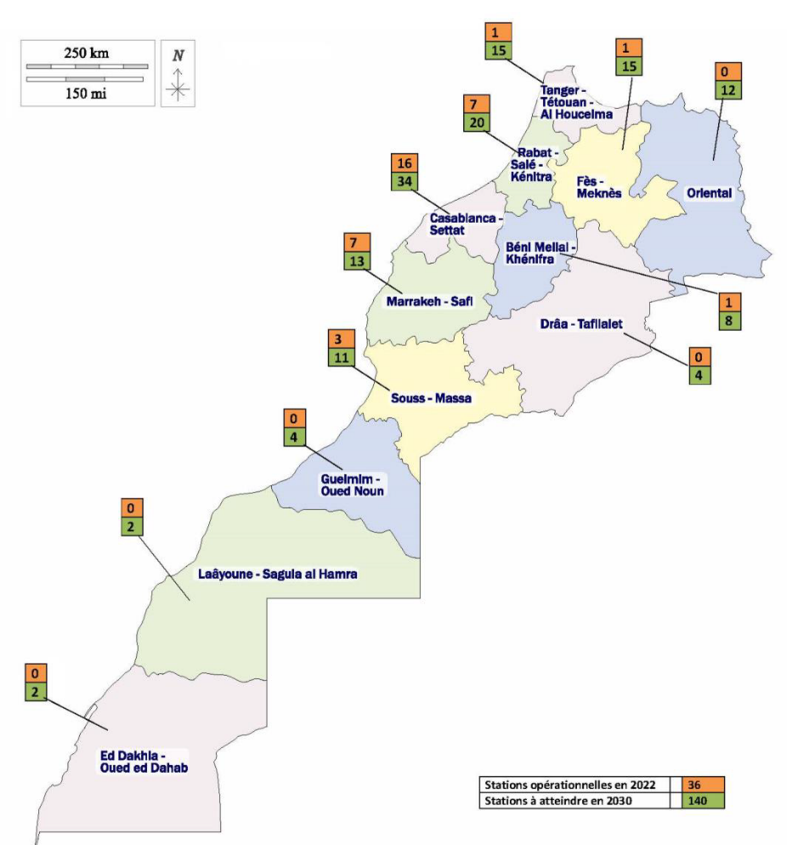
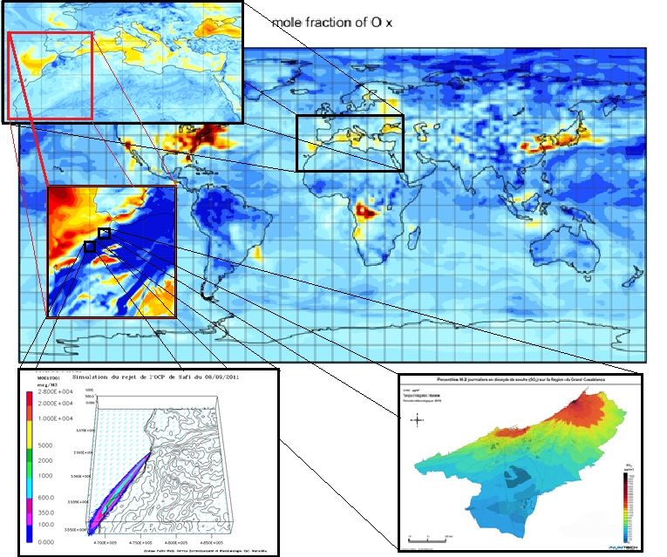
Air quality modeling (multi-scales)
No Available National Air Quality Forecasting Capability
MOCAGE : multi-scale chemistry and transport model
ADMS: advanced dispersion model + used for safety and emergency planning
ARIA RISK for the evaluation of industrial risks
General Directorate of Meteorology
Webinar on air quality monitoring in Africa, 20 April 2023

Slide 3
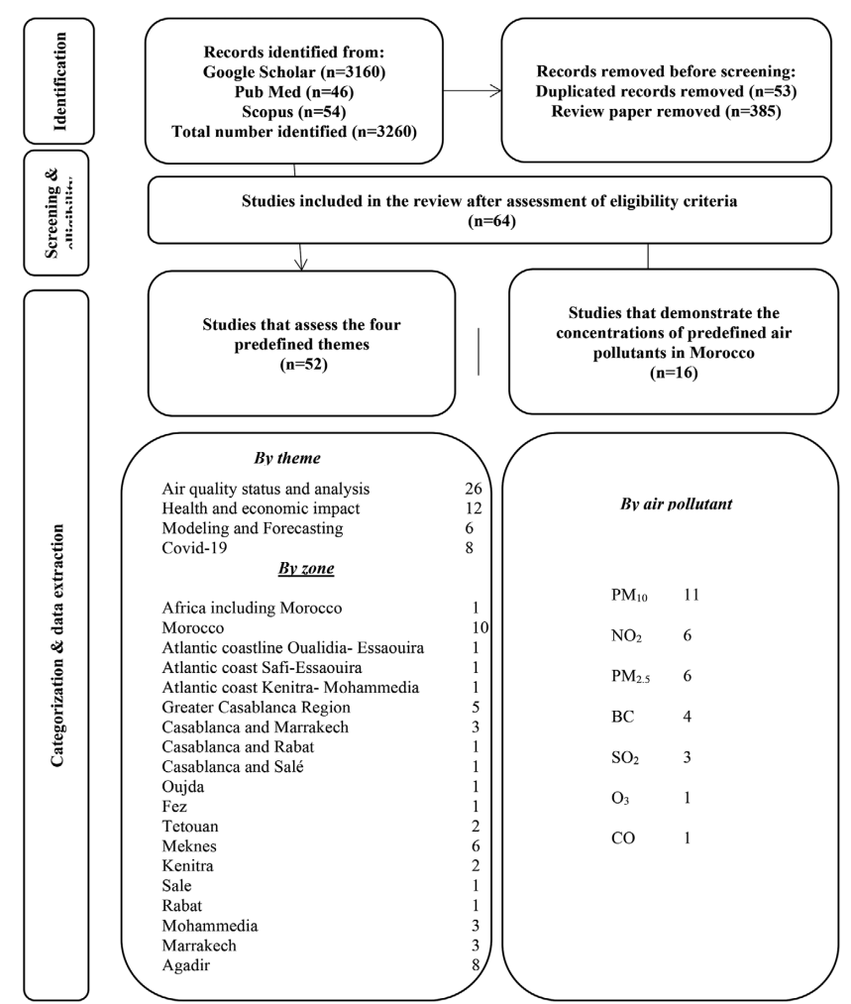
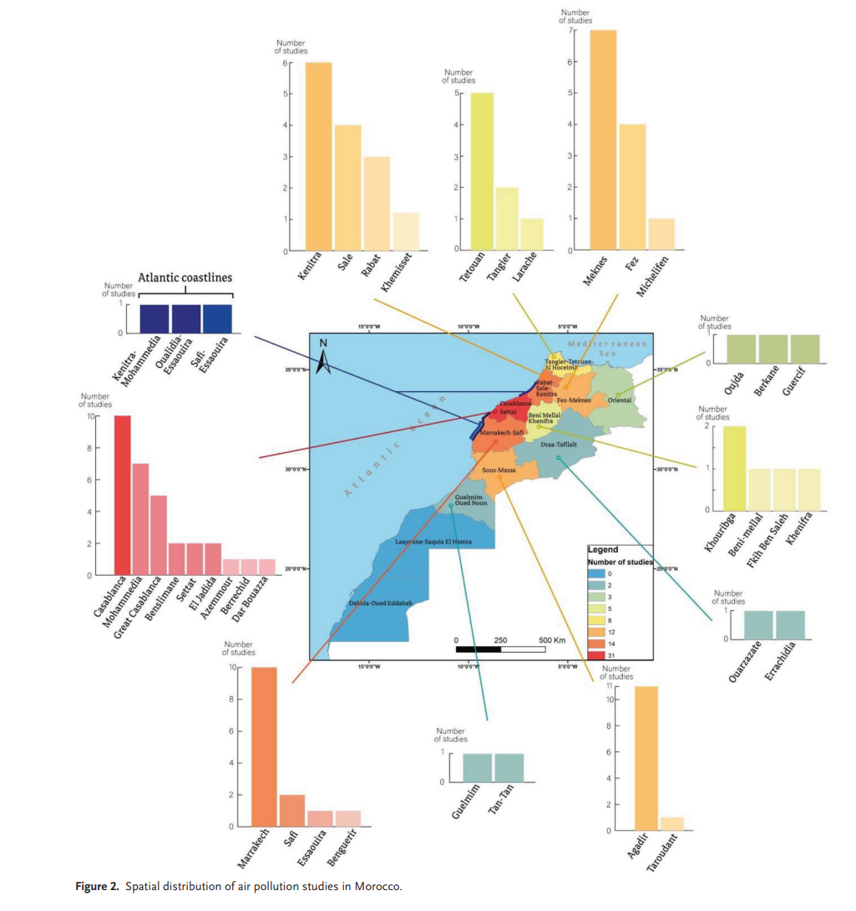
Keyword for PubMed and Scopus: “air pollution,” “air quality,” and “Morocco”.
Keyword for the Google scholar : “air pollution,” “air quality,” “Status and analysis,” “health and economic impacts,” “Modelling and forecasting,” “COVID-19,” “Morocco”.
Sekmoudi et al., 2024
Adv. Sustainable Syst.

Slide 4
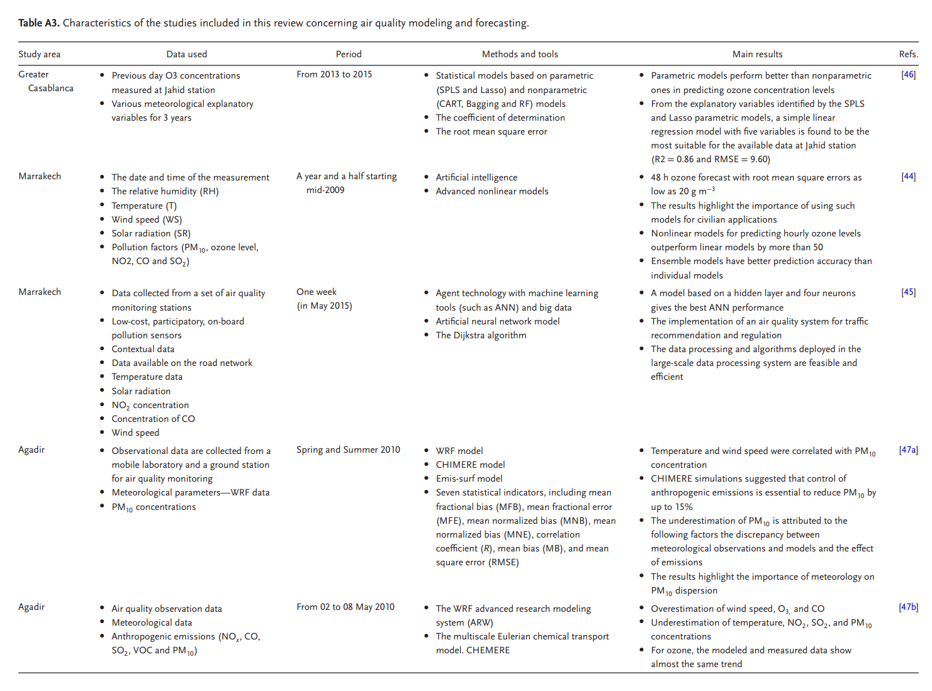
Sekmoudi et al., 2024

Slide 5
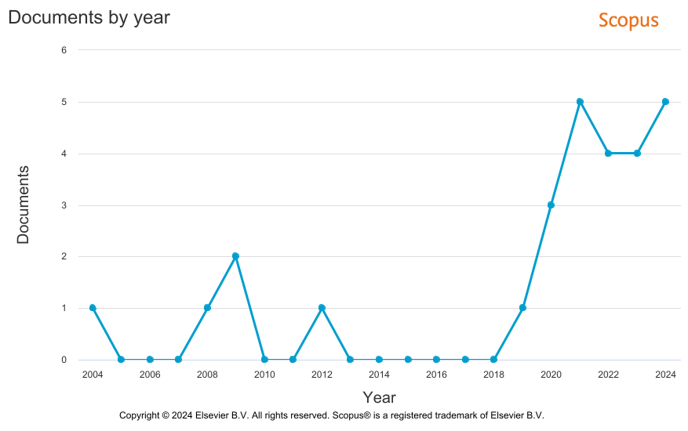
Number of Studies: Air Quality Modelling and Forecasting
TITLE-ABS-KEY ( Morocco AND forecasting OR prediction AND atmospheric OR air AND quality OR pollution ) ==˃ 25 documents
TITLE-ABS-KEY ( Morocco AND atmospheric OR air AND quality OR pollution ) ==˃ 349 documents
N° papers, Conference Paper, Book chapter | 16
Predictand pollutant | O3, PM10, CO
Predictor variable | Meteorological parameters

Slide 6
Are there any alternative sources to air quality observation data?
Are they reliable and representative in the Moroccan context?

Slide 7
Alternative sources to air quality observation data
Satellite Remote Sensing:
Model-Based Systems:
Reanalysis Datasets:
MERRA-2 (Modern-Era Retrospective analysis for Research and Applications, Version 2): re-analyzed data that include surface PM2.5 concentrations, useful for long-term studies and trend analysis.
ERA-Interim/ERA5: Reanalysis datasets from the European Centre for Medium-Range Weather Forecasts (ECMWF) that include atmospheric composition and pollutants.
MODIS (Moderate Resolution Imaging Spectroradiometer): Provides data on aerosol optical depth (AOD), which can be used to estimate particulate matter (PM) concentrations.
OMI (Ozone Monitoring Instrument): Measures atmospheric ozone and other pollutants like NO2, SO2, and aerosols.
TROPOMI (Tropospheric Monitoring Instrument): Offers high-resolution measurements of pollutants like NO2, CO, and CH4.
CHIMERE, MOCAGE, WRF-Chem (Weather Research and Forecasting Model with Chemistry): A regional model that includes chemical processes and is used for air quality forecasting.
CAMS (Copernicus Atmosphere Monitoring Service): Provides near-real-time air quality data and forecasts using a combination of satellite observations, ground-based data, and atmospheric models.
NASA Earth Science Data Program: Giovanni Web interface.
Monitoring and Scientific networks:
Emission Inventories (e.g., EDGAR, TNO); Crowdsourced and IoT Sensors; Proxy Data from Meteorological Models; …

Slide 8
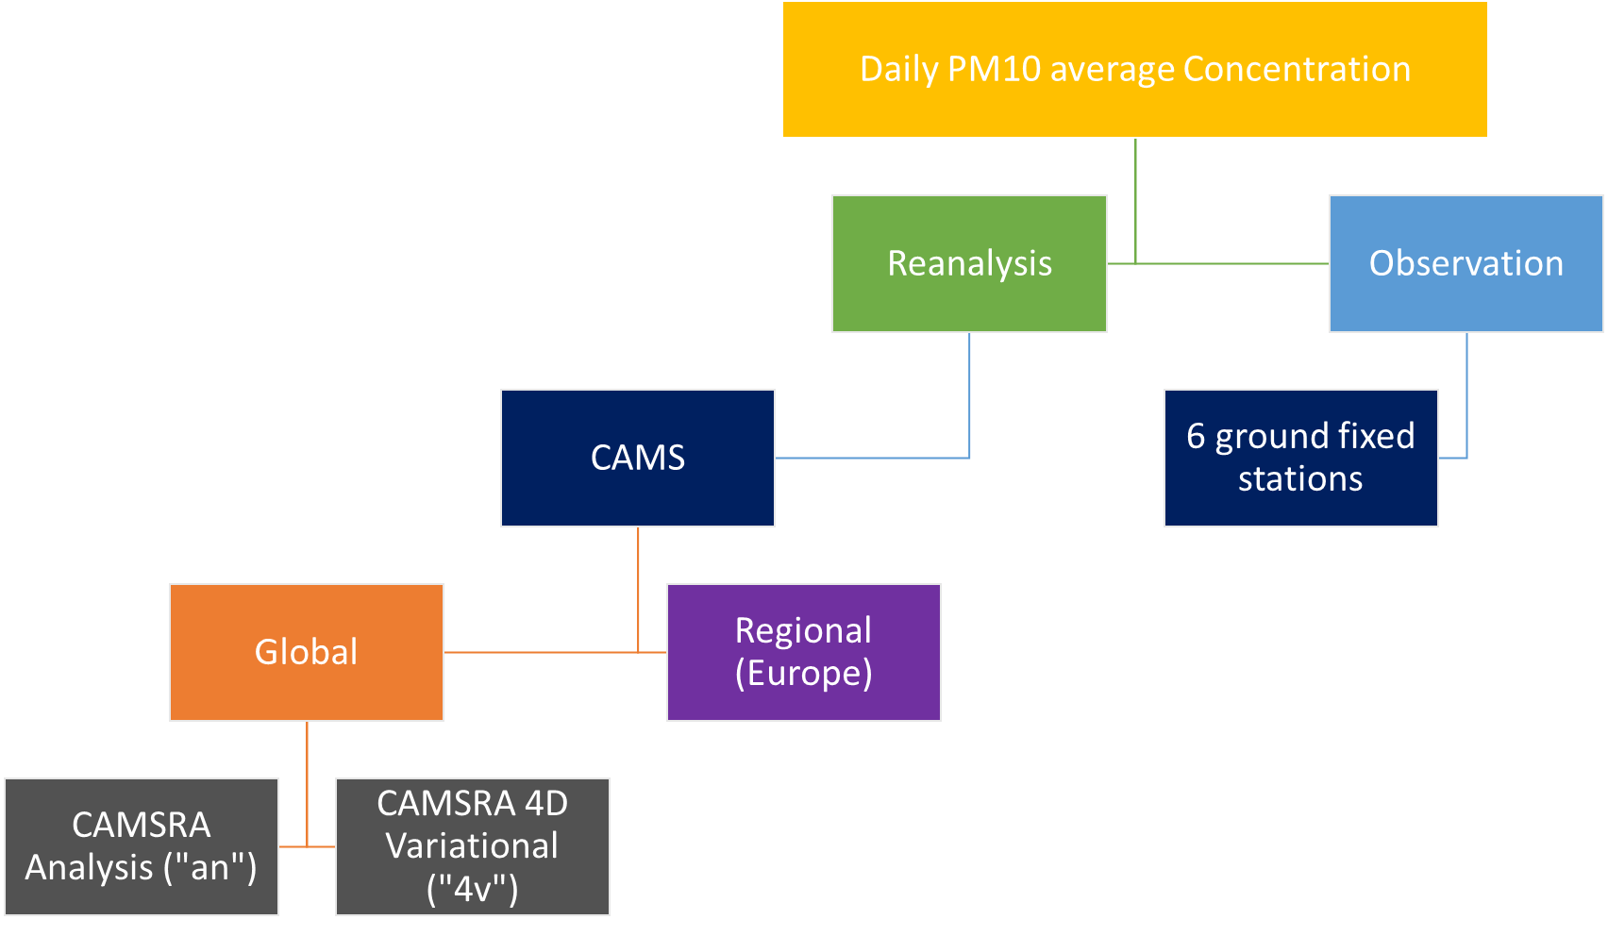
Data Type | Frequency | Spatial Resolution | Temporal Coverage | Notes
Global CAMS RA Analysis ("an") | 3-hourly | ~80 km | 2003-2018, extended annually | Full chemistry, broad application in climatology.
Global CAMS RA 4D Variational ("4v") | Twice daily | ~80 km | 2003-2018, extended annually | Optimization across 4D space-time domain.
Regional CAMS RA | Hourly | ~10-20 km | 2012-2016 | High resolution, used in European ensemble models.
CAMS RA data vs. observed data at 6 Moroccan measurement stations
Copernicus Atmosphere Monitoring Service Reanalysis (CAMS RA)
Accessibility
High Resolution
Adapted from
Sekmoudi et al., 2021, Environ Sci Pollut Res

Slide 9
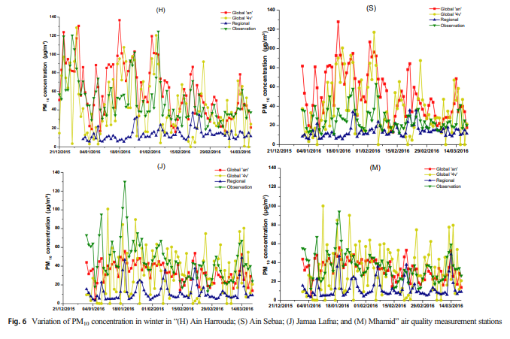
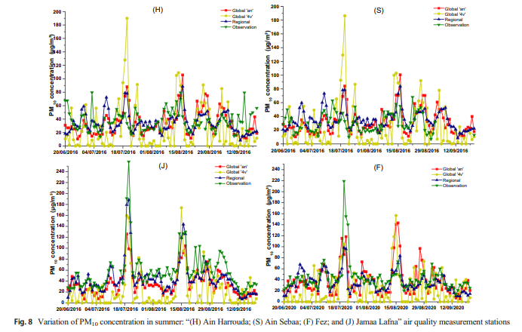
Accuracy of CAMS RA data by analyzing seasonal patterns, extreme events, and annual averages
winter
summer
Sekmoudi et al., 2021

Slide 10
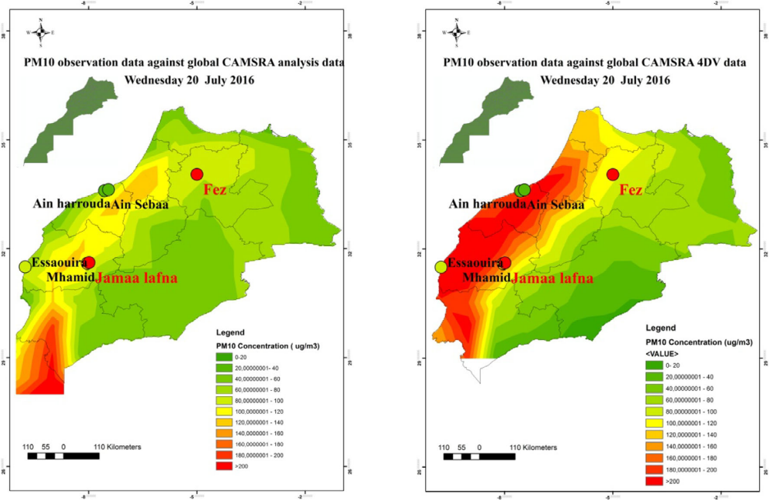
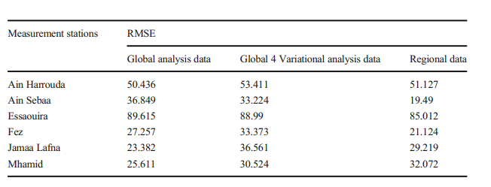
Accuracy of CAMS RA data by analyzing seasonal patterns, extreme events, and annual averages
RMSE of the three types of data sources
PM10 observation data against global CAMSRA data (Wednesday 20 July 2016)
Sekmoudi et al., 2021

Slide 11
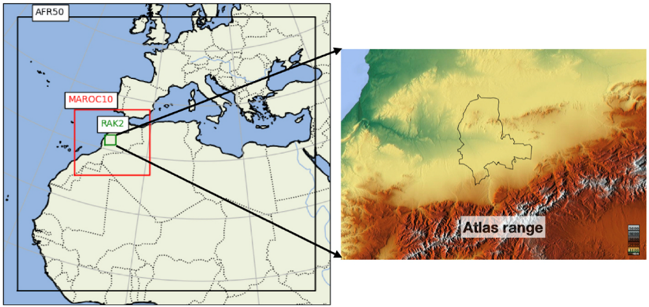
Air Quality at Local and Regional Scale: CAMS & Satellite Products
Air quality modelling in the city of Marrakech, Morocco using a local anthropogenic emission inventory
1- Compare simulated PM10, NO2 and O3 concentrations against in-situ measurements (AERONET)
2- Quantify the added value of the local inventory compared to the state-of-the-art global anthropogenic emission inventory (CAMS-GLOB_ANT)
LOCAL/ON: Detailed local inventory with aerosol radiative feedback mechanisms and high vertical resolution ;
CAMS/ON: Global inventory ;
LOCAL/OFF: Local inventory without feedback.
Local anthropogenic emission inventory provided by the Moroccan Ministry of Environment (MEMSD) for the city of Marrakech.
The inventory contains annual fluxes for the reference year 2013 of seven air pollutants for ten SNAP anthropogenic emission sectors: NOx, SO2, NMVOC, NH3, CO, PM10, PM2.5 and the greenhouse gas CH4
Spatial and temporal downscaling of the anthropogenic emission inventory to a 2km x 2km grid of the CHIMERE simulation using local traffic, population density, industrial locations, etc.
The three-level nesting with grid ratio of five
Adapted from Saidi et al., 2023, Atmospheric Environment

Slide 12
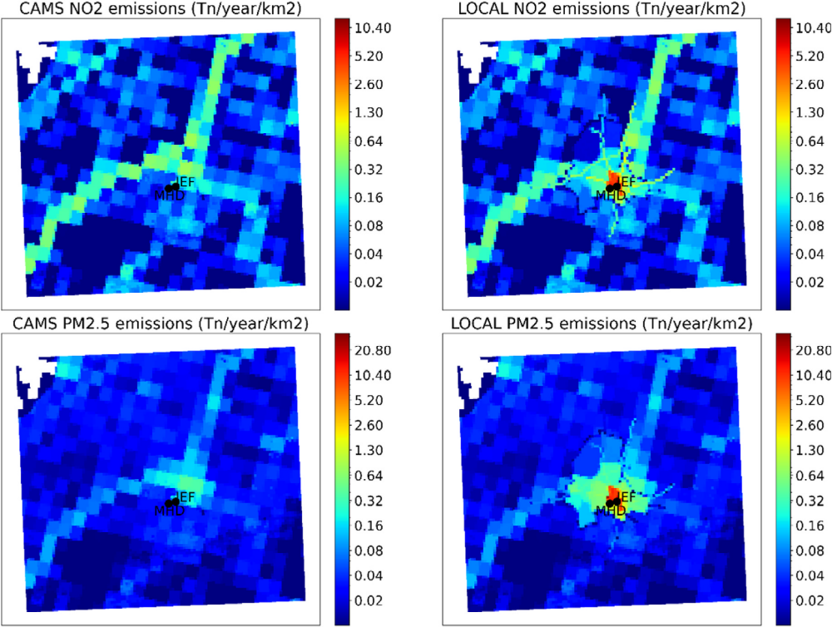
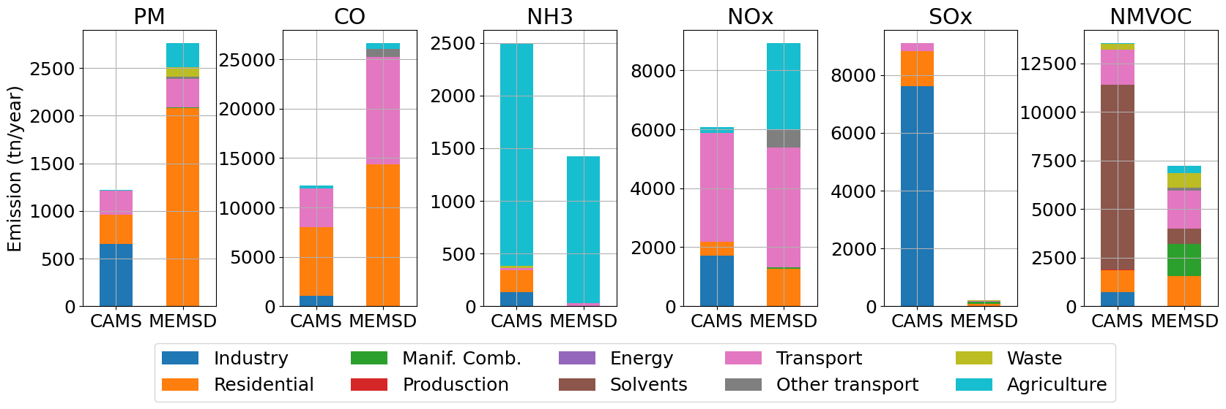
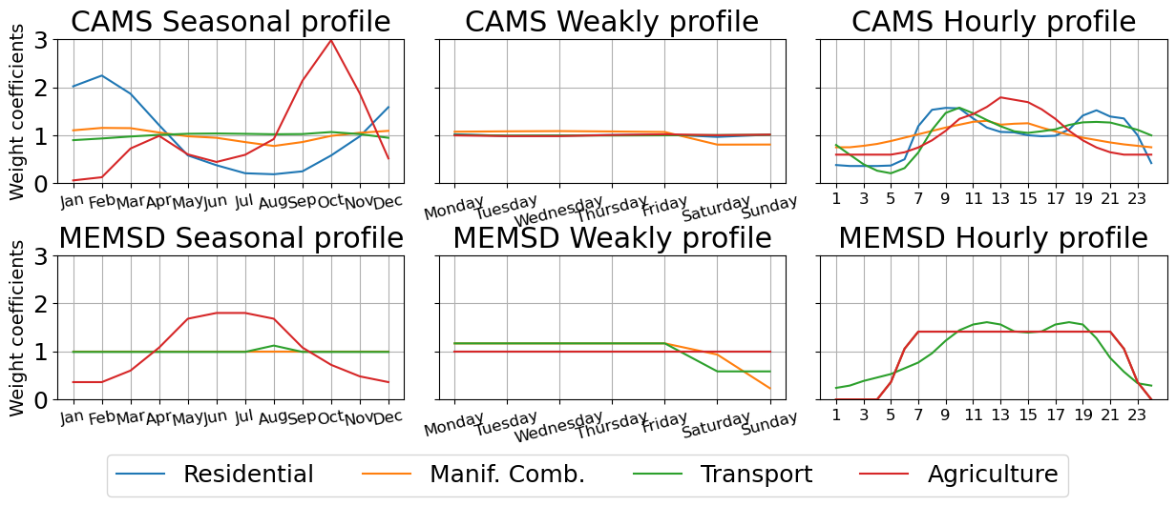
Annual emissions of the different inventory pollutants with the contribution of each activity sector according the global CAMS anthropogenic inventory and the local MEMSD inventory.
(Left) Annual emission fluxes (2013) of the global anthropogenic CAMS inventory downscaled to the 2 km × 2 km resolution CHIMERE simulation mesh. (Right) Combination of the CAMS and local inventories to compose the emission fluxes.
Sector-dependent, monthly (left), weekly (middle) and daily (right) profiles used for the temporal allocation of the annual anthropogenic emission fluxes of the MEMSD (local) and CAMS emission inventories to hourly fluxes
Saidi et al., 2023

Slide 13
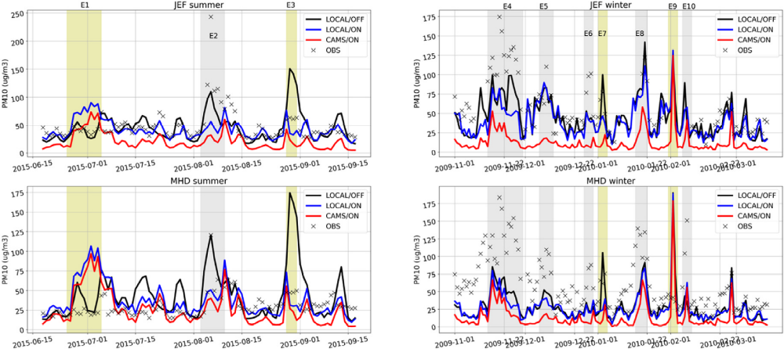
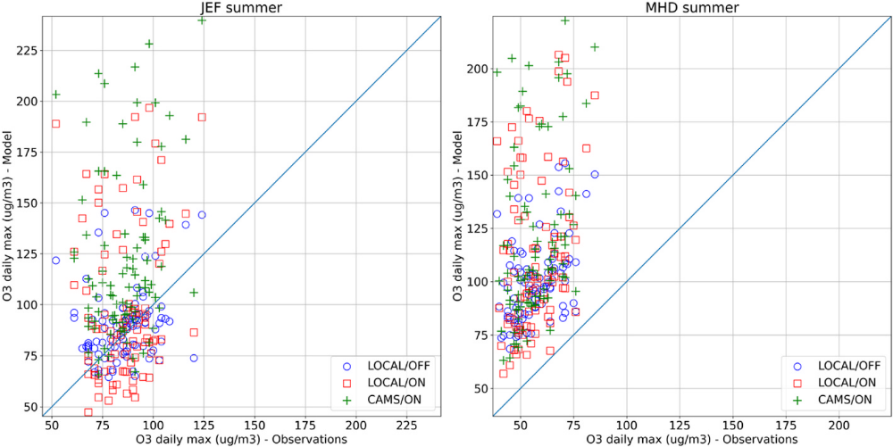
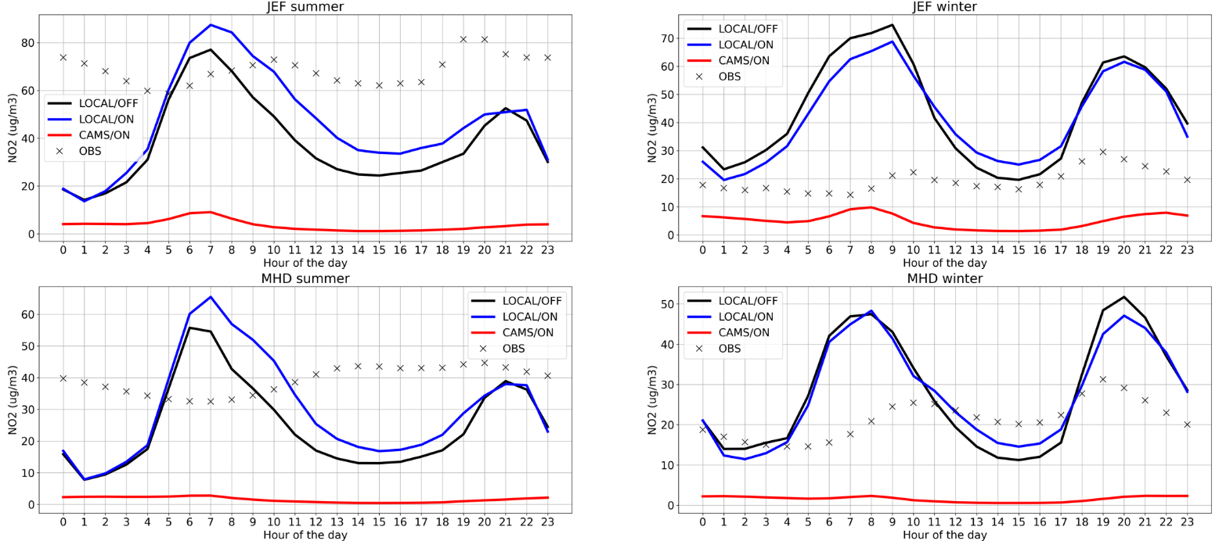
Modelled and observed diurnal cycles of PM10 (top), NO2 (bottom) and O3 (right) concentrations over the urban (JEF) and rural (MHD) monitor sites for the summer and winter simulation periods.
Saidi et al., 2023

Slide 14
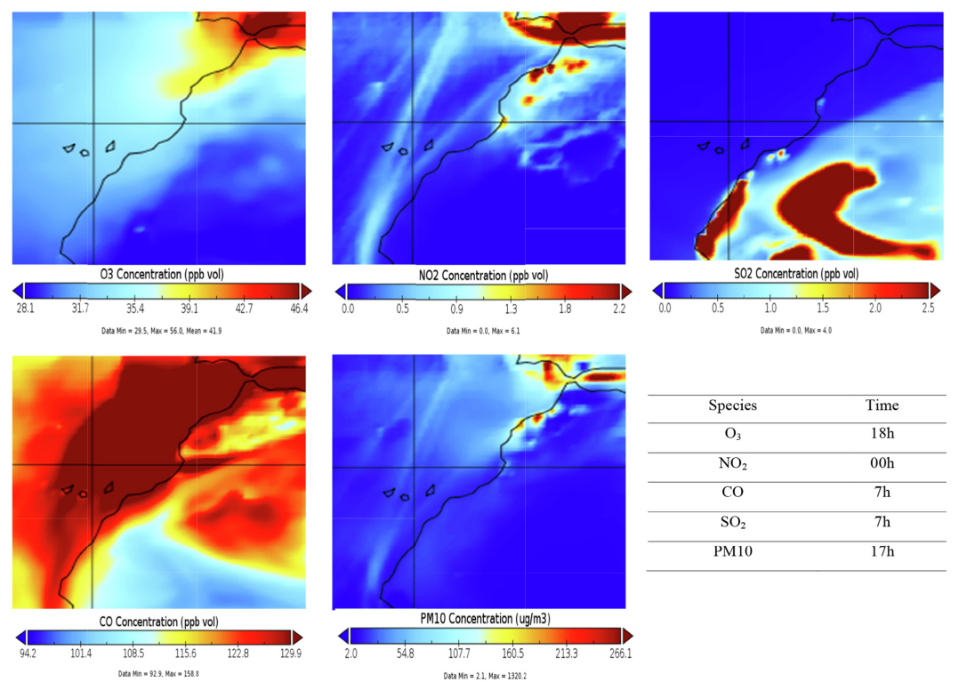
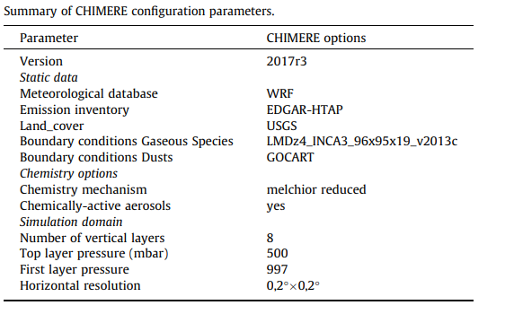
Towards air quality modeling in Agadir City (Morocco)
Ajdour et al., 2019,
Materials Today
Maps representing the spatial distribution of average concentrations of different modelled pollutants

Slide 15
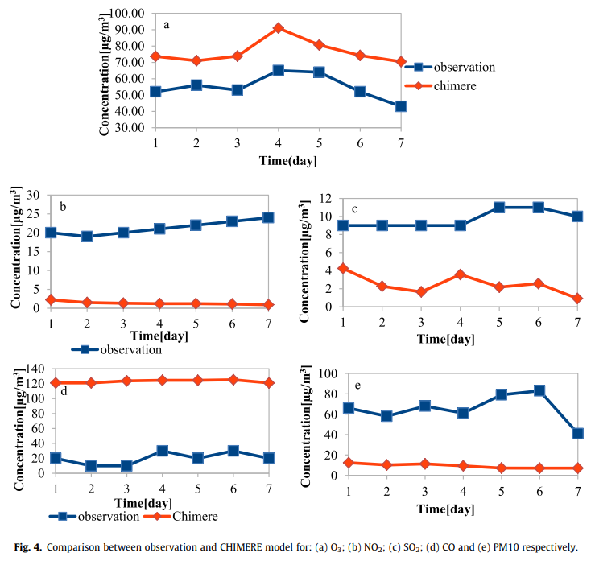
Towards air quality modelling in Agadir City (Morocco)
O3
Observed deviations:
Complex topography of Agadir City,
Potential sensitivity of the model to the resulting horizontal resolution,
Lack of a high resolution emission inventory for the Agadir region.
NO2
SO2
CO
PM10
Ajdour et al., 2019

Slide 16
Statistical post-processing methods
Post-processing methods for forecast CAMS data involve refining predictions using techniques based on historical patterns (analog-based), AI technologies (AI-based), and statistical methods (SL-based).
Post-processing of datasets produced by CAMS to provide near-real-time forecasts data and analyses of air pollution and its effect at the global to regional and local scales.
New CAMS European air quality forecasts optimised at observation sites using a statistical post-processing method called Model Output Statistics (MOS). The MOS method uses machine learning with predictive variables including background air quality observation datasets, ECMWF meteorological forecasts, and the "raw" CAMS European air quality ensemble median forecast.
The CAMS-MOS product proposes new and complementary type of information available at sites where in-situ measurements are routinely made. This new CAMS product is based on an innovative machine learning post-processing algorithm, that combines the forecasts from the CAMS regional ensemble with air quality observations and meteorological forecasts.

Slide 17
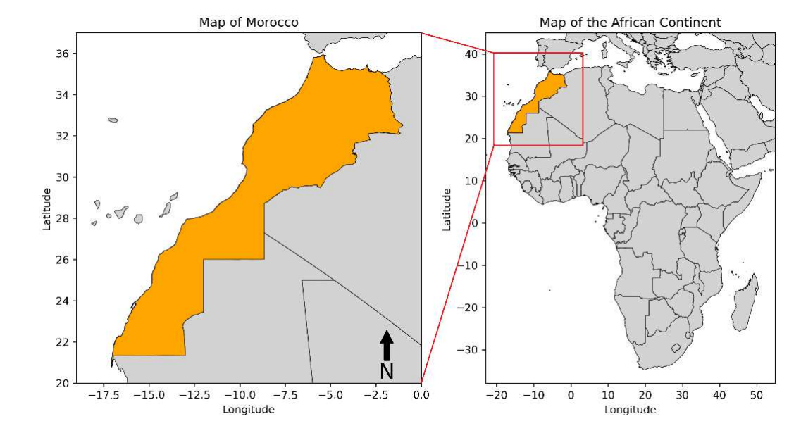
Predicting PM10 Levels in Morocco: A 5-Day Forecast Using the Analog Ensemble Method.
Objective:
Data Source:
Method:
Goal:
Comparison:
To improve PM10 forecast accuracy over Morocco using the SL-based methods (Analog Ensemble (AnEn) and Bias Correction (AnEnBc)).
Copernicus Atmosphere Monitoring Service (CAMS) predictions and reanalyzed data.
Post-processing CAMS predictions using AnEn.
Reduce prediction errors and enhance reliability of PM10 forecasts, especially in dust-storm regions.
Compare forecasted data with reanalyzed data to identify discrepancies and improve accuracy.
PM10 Observations:
Source: CAMS global reanalysis dataset (EAC4)
Temporal resolution: 3-hourly
Spatial resolution: 0.75°x0.75°
PM10 Forecasts:
Source: CAMS global atmospheric composition forecasts
Temporal resolution: 1 hour
Spatial resolution: 0.4°x0.4°
Forecast duration: up to 5 days (120 lead time hours)
Coverage: Entire region of Morocco
Houdou et al., 2024
Environmental Monitoring and Assessment.

Slide 18
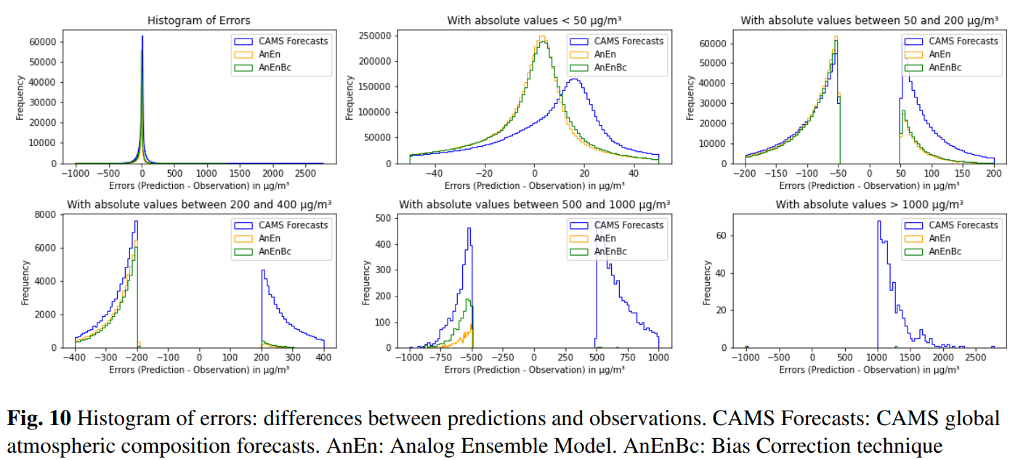
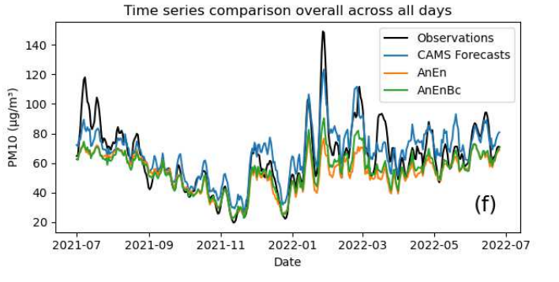
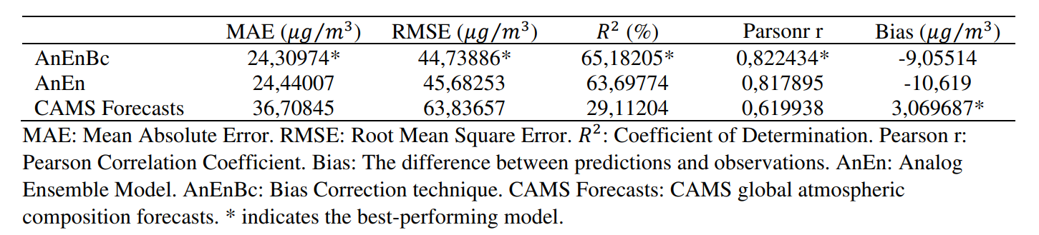
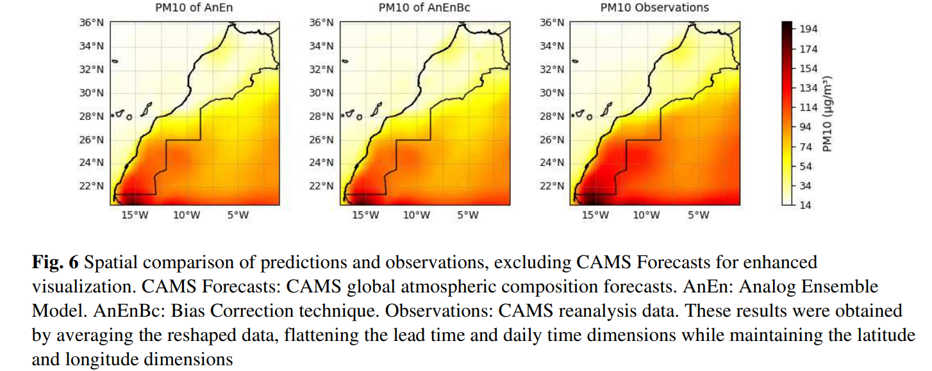
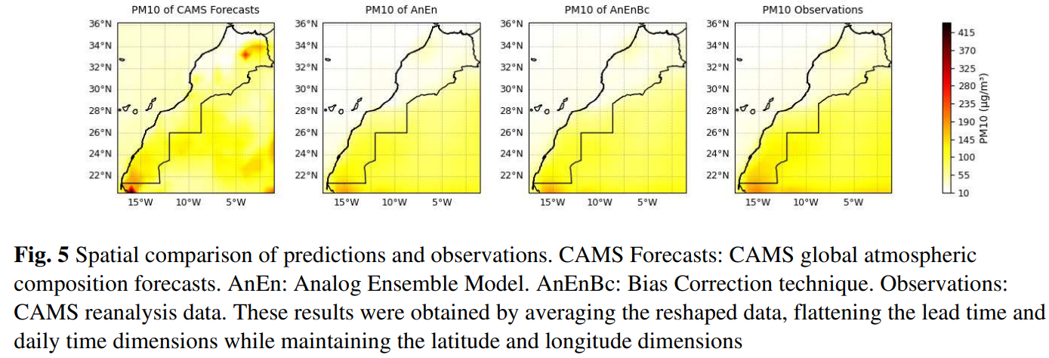
Predicting PM10 Levels in Morocco: A 5-Day Forecast Using the Analog Ensemble Method.
Houdou et al., 2024

Slide 19
Key Messages
The importance of using fine scale and local information on anthropogenic emissions to assess air-quality in Morocco, particularly in regions with limited monitor networks.
CHIMERE and WRF models emerged as the most frequently used tools for air quality simulation and modelling in Morocco.
Implementing a detailed local inventory significantly enhances the accuracy of urban scale air quality modelling.
The global CAMS reanalysis data are best option as complementary data that can be used to assess study trends, evaluate models, compare other reanalysis data, or serve as boundary conditions for regional models for historical periods.

Slide 20
Thank you for your Attention
Questions?

