Slide 1






Training Course on Seamless Prediction of Air Pollution in Africa
An Introduction
Ranjeet S Sokhi* and Luisa Molina+
*Centre for Climate Change Research (C3R)
University of Hertfordshire, UK
+Molina Center for Energy and the Environment, USA

Slide 2
Organised by:
World Meteorological Organization (WMO)
WMO Education and Training Office (ETR)
WMO World Climate Research Programme (WCRP),
WMO Global Atmospheric Watch (GAW) programme, GAW’s initiatives on:
Prediction and Forecasting Improvement for Africa (PREFIA)
Global Air Quality Forecasting and Information System (GAFIS)
In collaboration with:
Egyptian Meteorological Authority (EMA)
University of Hertfordshire, UK
University of Pretoria, South Africa,
Northeastern University, USA
Copernicus Atmosphere Monitoring Service (CAMS)
European Organisation for the Exploitation of Meteorological Satellites (EUMETSAT)

Slide 3
Online training sessions – what to expect
Date | Time Egypt | Time UTC | Topic | Speakers
2024-09-12 | 15:00 | 12:00 | Introduction to air quality – its importance, prediction and forecasting | Ranjeet Sokhi (UK) and Luisa Molina, (USA)
 | 16:30 | 13:30 | African experiences: Experiences from Morocco and Nigeria | Luisa Molina (USA), Zeibnab Salah (EMA, Egypt), Abdelfettah Benchrif (Morocco), Mounia Tahri (Morocco), Olumide Olaniyan (Nigeria)
2024-09-16 | 15:00 | 12:00 | Atmospheric chemistry and processes | Yang Zhang (USA), Greg Carmichael (USA)
 | 16:30 | 13:30 | Aerosols formation and interactions with climate. This session includes a presentation about the Future Earth Africa Hub. | Robert MBiaké (Cameroon), Faten Attig-Bahar (Tunisia)
2024-09-17 | 15:00 | 12:00 | Satellite products | Federico Fierlii (Germany)
 | 16:30 | 13:30 | Surface observations | Africa Barreto (Spain), Sebastian Diez (UK)
2024-09-18 | 15:00 | 12:00 | Health impact assessments | Sophie Gumy (WHO, Switzerland), Aurelio Tobias (Spain), Massimo Stafoggia (Italy)
 | 16:30 | 13:30 | AQMx tool | Gary Kleiman (USA), Juliette Laurent (France)
2024-09-19 | 15:00 | 12:00 | Air Quality management and interventions | Luisa Molina (USA), Zeibnab Salah (EMA, Egypt)
 | 16:30 | 13:30 | African experiences: Experiences from Egypt and Gambia | Hayam Saber (Egypt), Ibrahim A. Hassan (Egypt), Teeda Njie (Gambia)
2024-09-23 | 15:00 | 12:00 | Fundamentals of AQF - connecting regional and urban scales | Greg Carmichael (USA), Yang Zhang (USA)
 | 16:30 | 13:30 | Model Types and Systems for AQF. This session includes WRF-Chem testbeds specifics for the hands-on sessions. | Yang Zhang (USA), Alexander Baklanov (Denmark), Mikhail Sofiev (Finland),
2024-09-24 | 15:00 | 12:00 | Emission inventories and data for AQF models (GEIA African experiences) | Evely Toure (Côte d'Ivoire), Keita Sekou (Côte d'Ivoire)
 | 16:30 | 13:30 | Pre-processing data and configuration of a model. This session includes WRF-Chem testbeds specifics for the hands-on sessions. | Yang Zhang (USA), Daniel Schuch (USA)
2024-09-25 | 15:00 | 12:00 | Meteorological modelling and data assimilation: CAMS global forecasts | Johannes Fleming (Germany)
 | 16:30 | 13:30 | Model evaluation approaches. This session includes WRF-Chem testbeds specifics for the hands-on sessions. | Sara Basart (WMO, Switzerland), Yang Zhang (USA), Kahnh Do (USA)

Slide 4
What we will cover in this
this session
This lecture
Introduction to atmospheric physics and meteorology – with examples from WRF ARW model and CMIP6 data (Ranjeet S Sokhi) ~ 30 min
Introduction to air quality and management (Luisa Molina) ~ 30 min
Q&A ~ 30min

Slide 5
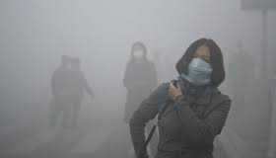
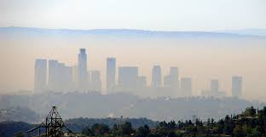

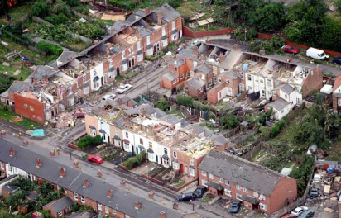
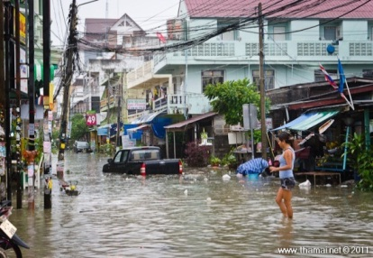
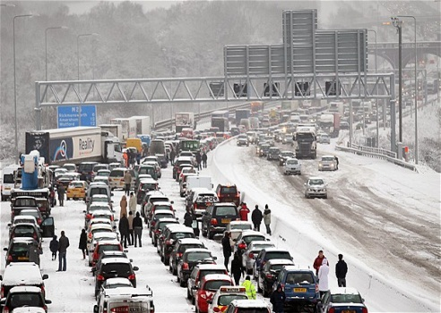
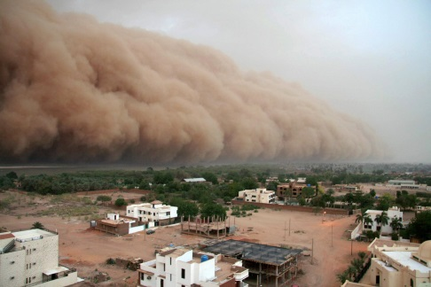
Multi-Hazards affecting Africa - I
Air quality - Long-term poor air quality and air pollution episodes
Weather extreme – heat waves, cold spells, drought days, flooding, high winds
Wild fires, sand and dust storms
Health impacts – air pollution, weather stress
Climate and cities - major CO₂ and non-CO₂ GHG emission sources, changes in urban meteorology and atmospheric composition, sea-level rise for coastal cities,
MALAO@pictzz.blogspot.com
© Adrian Pearman/Caters
© www.thamai.net
© Tommy Hindley/ Professional Sport

Slide 6
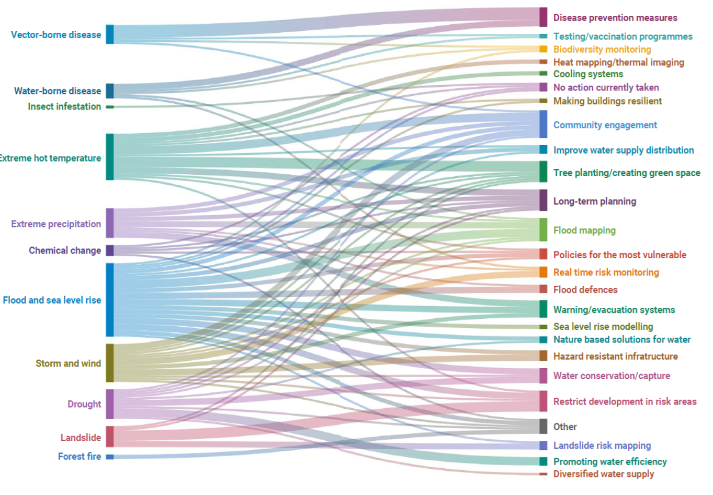
Multi-Hazards affecting Africa - II
Source:
CDP AFRICA REPORT
Benchmarking progress towards
Climate safe cities, states, and regions, 2020

Slide 7
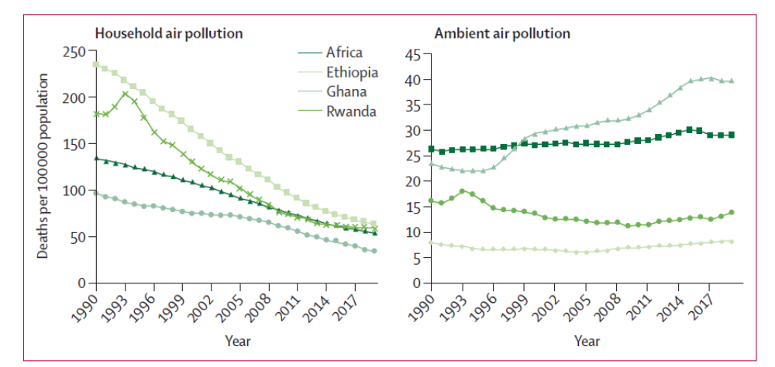
Indoor and outdoor air pollution over the past three decades
Source: Fisher et al, Lancet Planet Health 2021; 5: e681–88

Slide 8
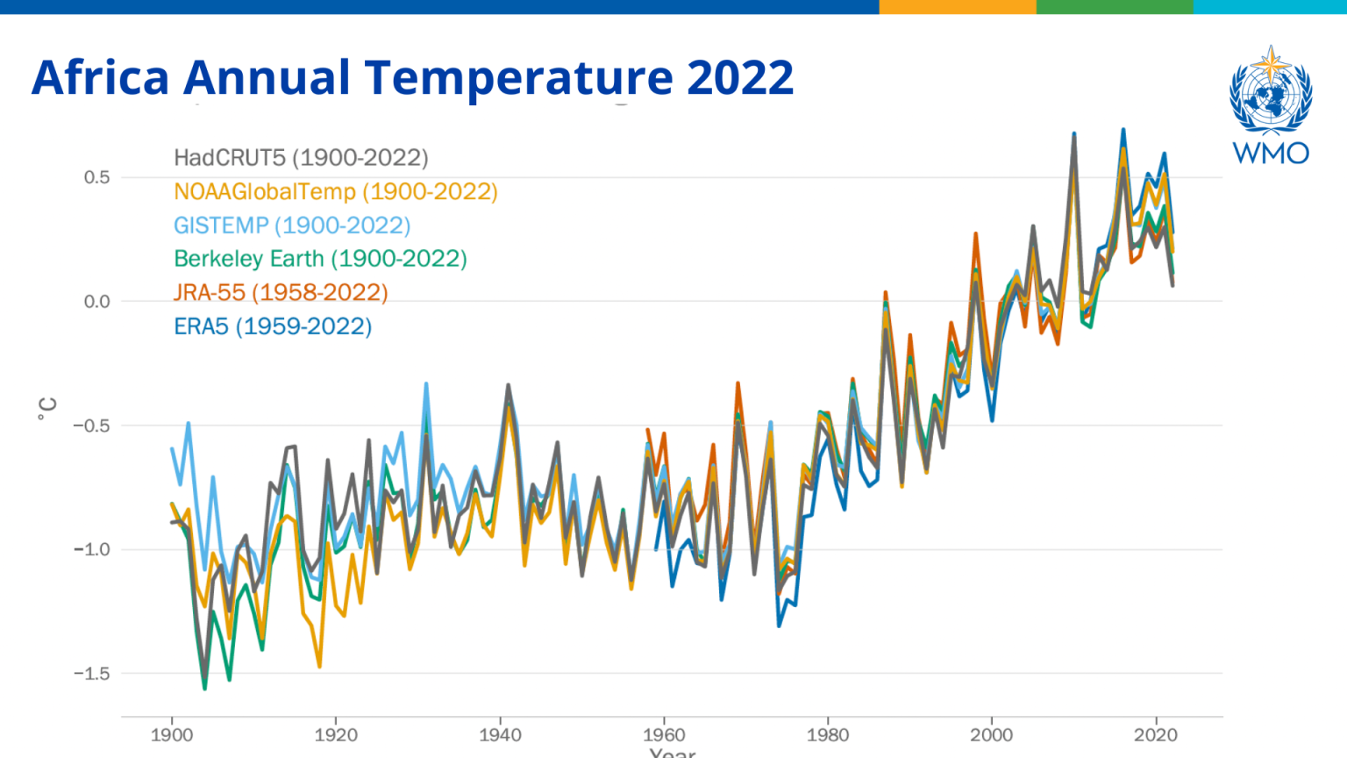
Contributions to GHG is low globally but risks from climate change and air pollution are high
Temperature difference in °C with respect to the 1991–2020 climatological period for Africa (WMO Regional Association I) from 1900 to 2022, based on six datasets
Source: State of the Climate in Africa 2022 report
Multiple hazards: air pollution, wildfires, heatwaves, heavy rains, floods, tropical cyclones, and prolonged droughts

Slide 9
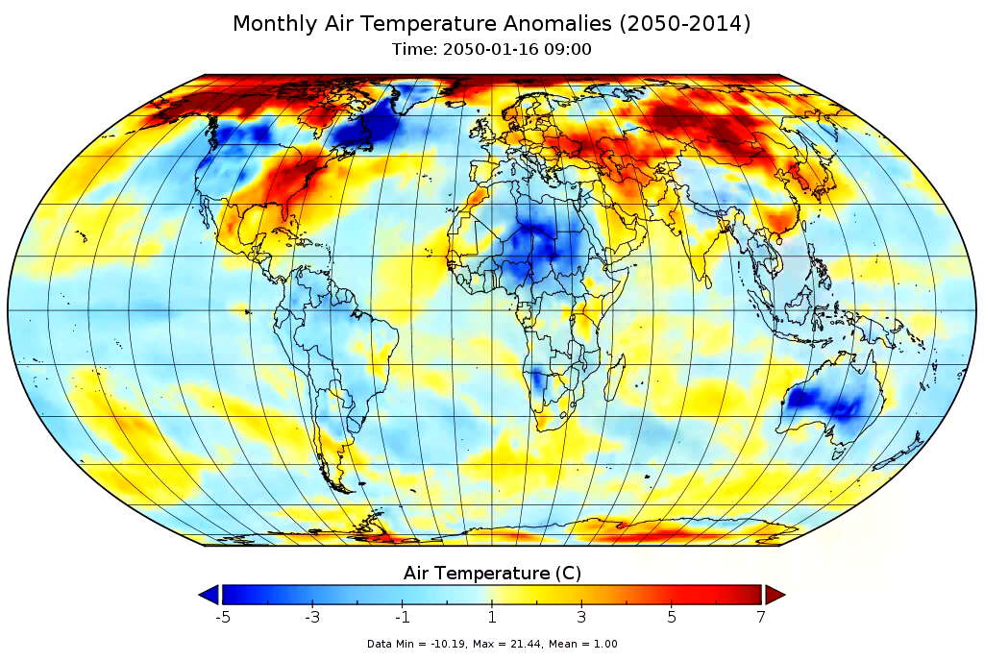
Data from CMIP6
Spatial and temporal variations determined by many factors
Need for higher resolution modelling

Slide 10
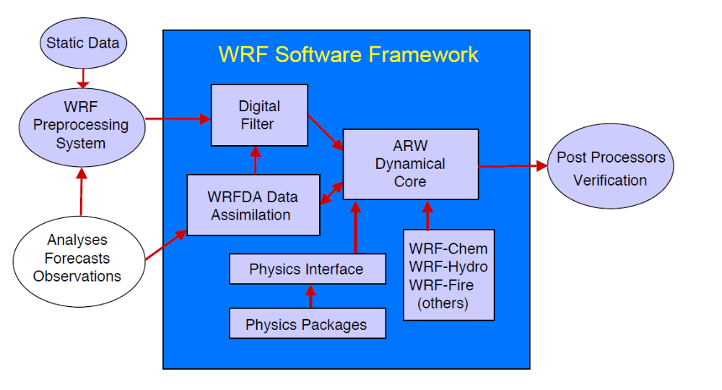
Example of the structure of the Weather Research and Forecast model (WRF)
Source: WRF ARW V4 Description 2021

Slide 11
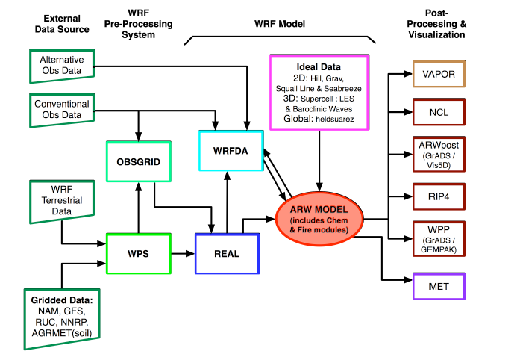
Example of the structure of the Weather Research and Forecast model (WRF)
Source: WRF User manual

Slide 12
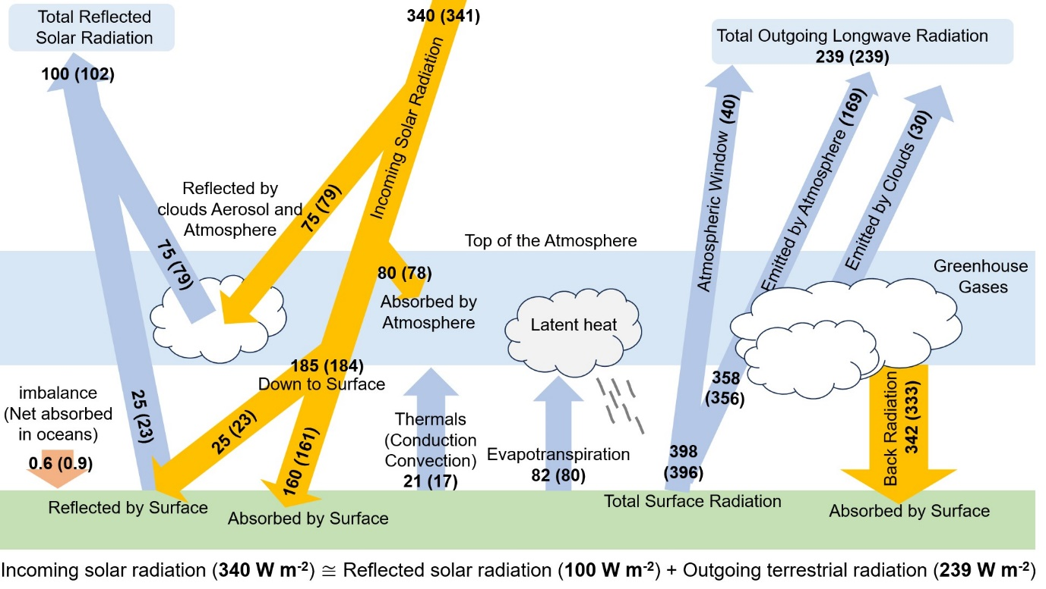
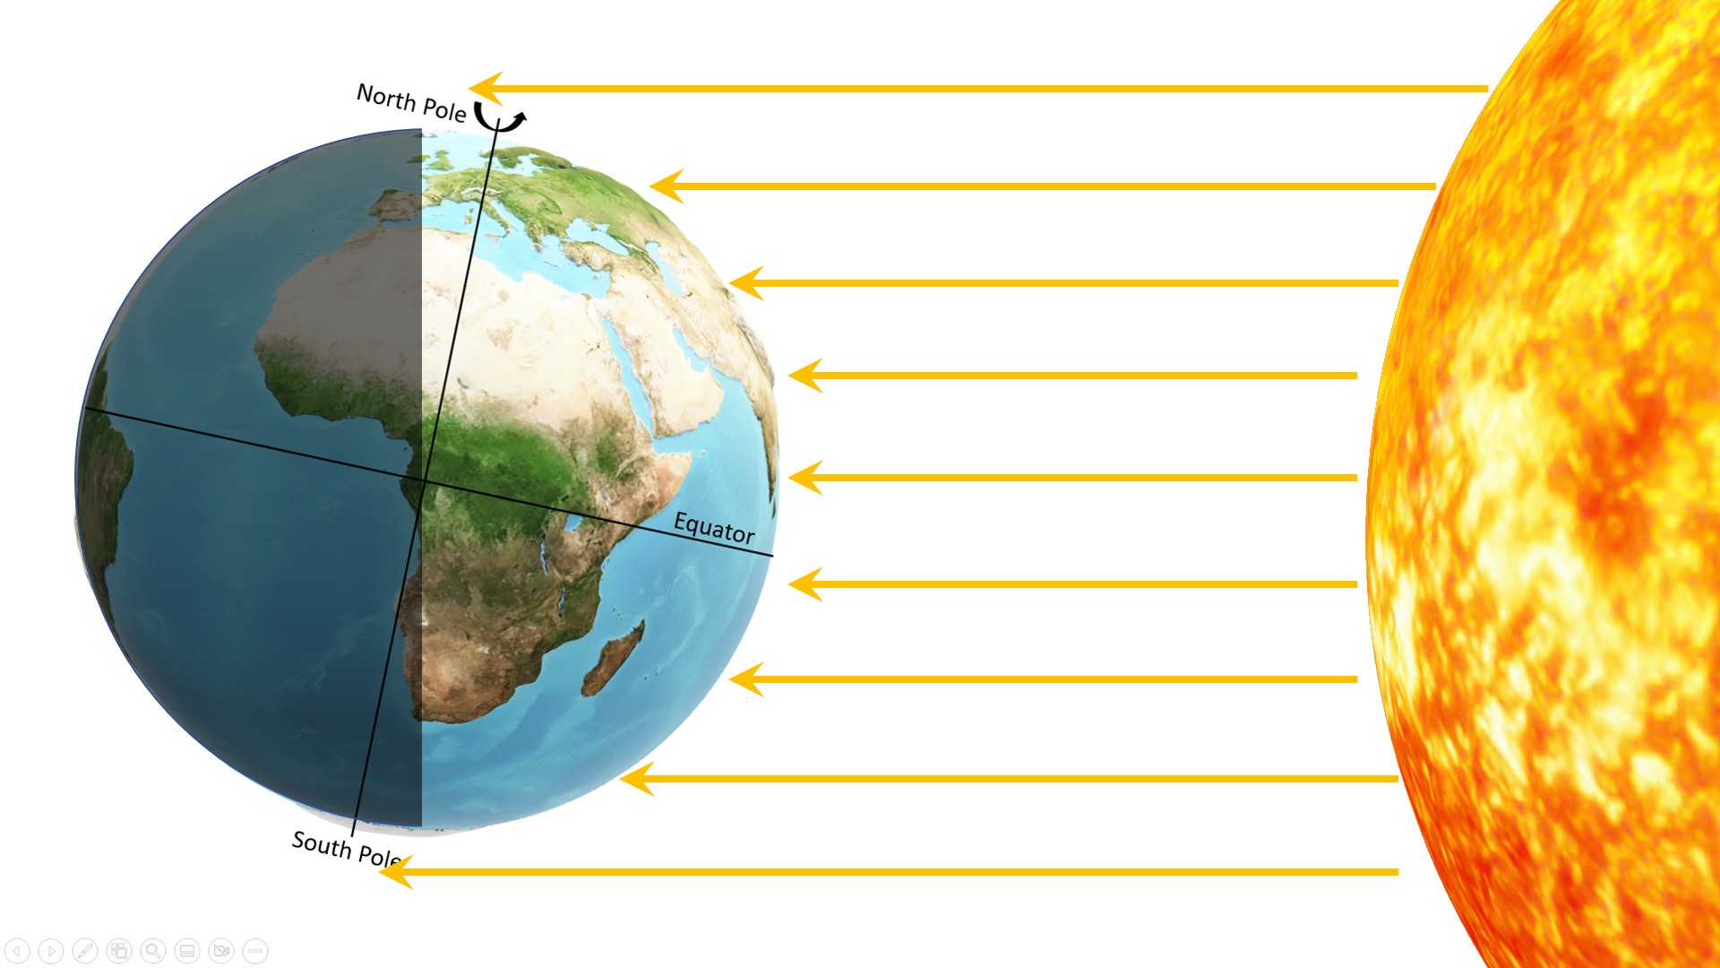
The Earth’s annual global mean energy budget (in W m⁻²) for the present-day climate conditions at the beginning of the twenty-first century and for comparison, values given in parenthesise for the period from March 2000 to May 2004. Incoming radiation is depicted in saffron, while outgoing radiation is represented in blue. The residual heat flux (top of the atmosphere energy imbalance) is estimated as 0.6 (~0.9) W m⁻² and is mostly absorbed by the oceans. Adapted from Trenberth et al., 2009 and (adapted from Wild et al., 2015
Sokhi et al., 2024, Pub: Elsevier
Not to be copied without permission

Slide 13
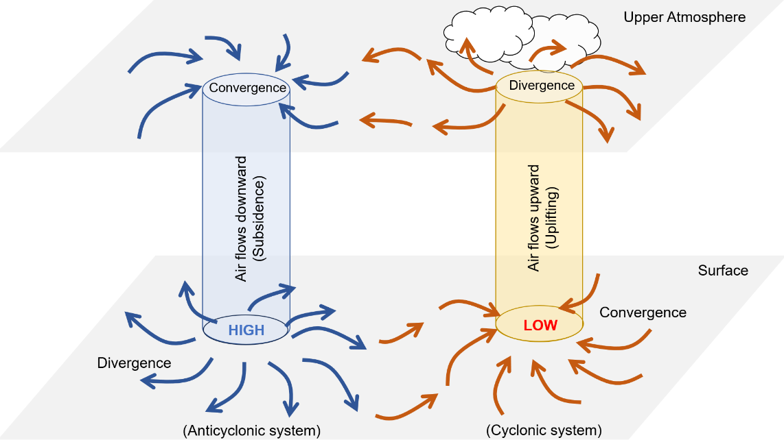
Low-pressure centres are called cyclones, and their cyclonic flows rotate counterclockwise in the Northern Hemisphere and clockwise in the Southern Hemisphere.
converging surface winds and rising air with uplift of moisture causing cloudy conditions
brings wet and windy conditions to a region. In such a case, the storms may wash air pollutants or transport them horizontally to other areas
High-pressure centres are called anticyclones, and the flow around them is called anticyclonic which rotate clockwise in the Northern Hemisphere and counterclockwise in the Southern hemisphere
diverging surface winds, and descending dryer air leading to clear skies, calm weather in Summer and clear and cold days in Winter.
descending air may cause temperature inversions which limits dispersion of air, and air pollutants may get trapped close to the ground layer
Relationship between converging and diverging air in cyclones and anticyclones and vertical air motion.
Sokhi et al., 2024, Pub: Elsevier
Not to be copied without permission

Slide 14
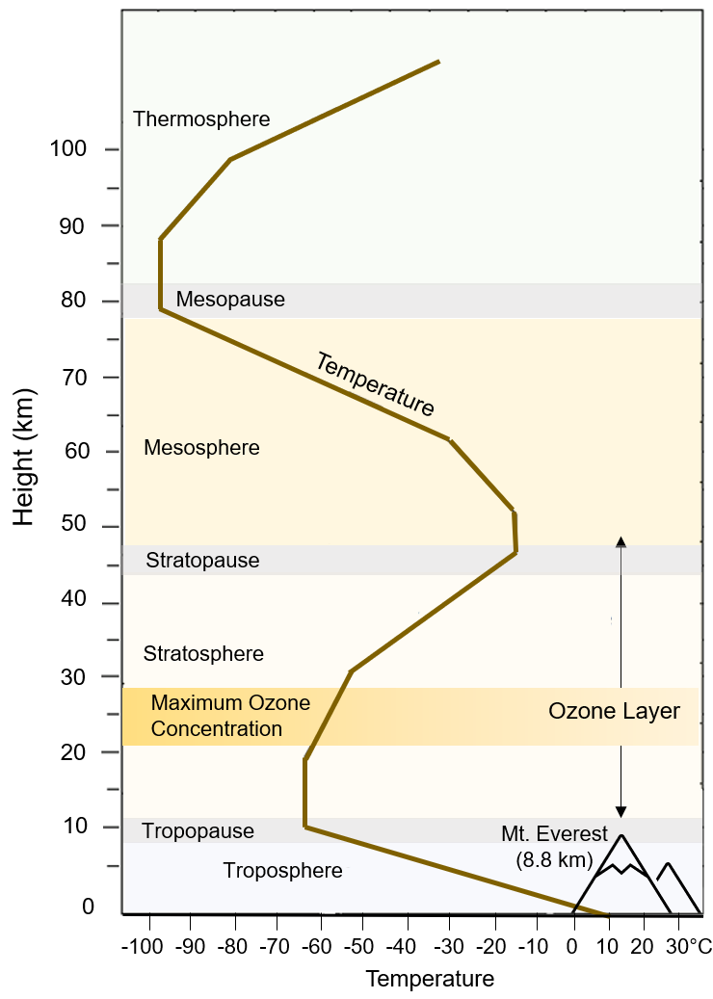
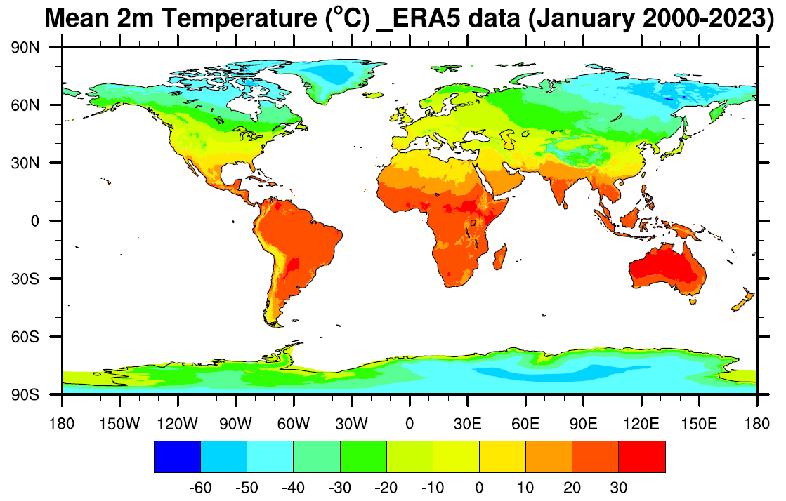
Global average temperature distribution for January over 2000-2023 (mapped with the observation assimilated model data from Hersbach et al, 2023).
The vertical distribution of atmospheric layers according to temperature in a standard atmosphere
Sokhi et al., 2024, Pub: Elsevier
Not to be copied without permission

Slide 15
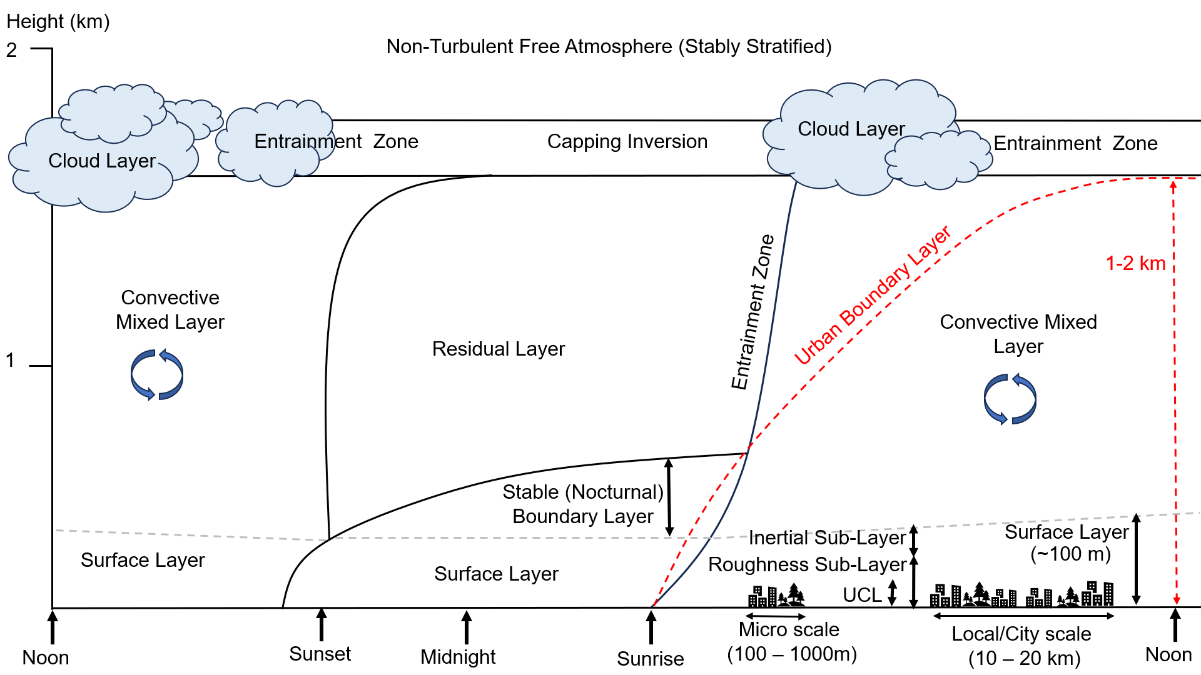
    Lower atmospheric boundary layer
Free atmosphere - layer above the PBL where the influence of the Earth’s surface is negligible
Turbulence - irregular motions of the air caused by surface forcings
Stable boundary layer (usually at nighttime i.e., nocturnal or early morning)
Mixed layer – convective, warm air driven turbulence
Residual layer – remaining air at sunset as turbulence/mixing reduced
The evolution of atmospheric boundary layer height through a diurnal cycle and daytime evolution of urban boundary layer (adapted from Stull, 1988 and Barlow, 2014). Red dashed line shows the top of the urban boundary layer. The Urban Canopy Layer (UCL) is usually taken to represents the mean height up to the roof tops and the Roughness Sub-Layer (RSL) height is typically 2 to 5 times the mean rooftop height (UCL height).
Sokhi et al., 2024, Pub: Elsevier
Not to be copied without permission

Slide 16
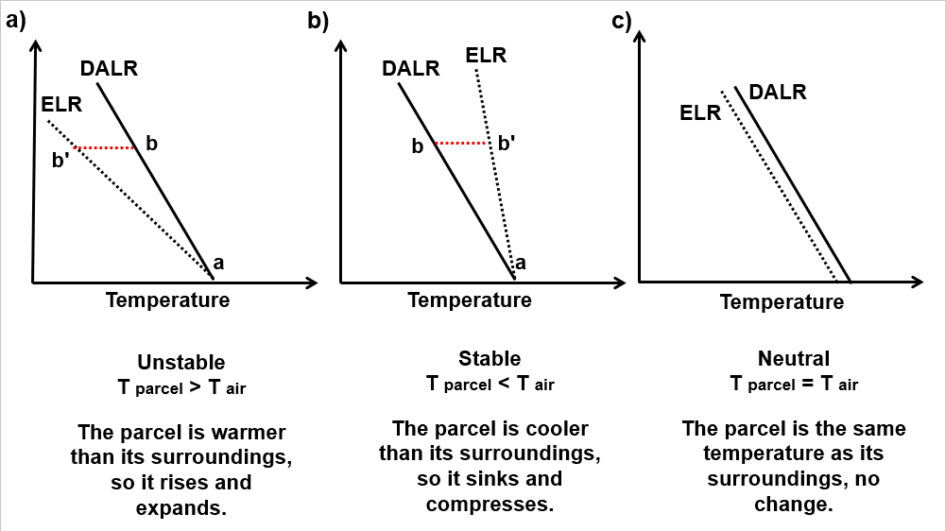
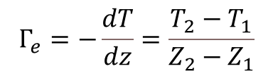
Superadiabatic conditions
Subadiabatic conditions
adiabatic air parcel - no exchange heat with its surroundings
lapse rate - the rate of change of air temperature with height
environmental lapse rate (ELR) - temperature variation of the air that surrounds air parcels
$$Γ_{e}=−\frac{dT}{dz}=\frac{T_{2}−T_{1}}{Z_{2}−Z_{1}}$$
Stable conditions, inversions – critical for air pollution events
Synoptic scales – anticyclonic conditions
Comparing the temperature profiles of an ideal air parcel (DALR) to that of the surrounding environment (ELR) in unstable, stable and neutral atmospheres
Dry adiabatic lapse rate (DALR) - rate at which temperature of dry air (e.g., a dry air parcel) will change as it moves up and down without exchanging heat with the surrounding air (- 9.8 °C/km)
Wet adiabatic lapse rate, or moist adiabatic lapse rate, is used when the water content is available in the adiabatic air parcel (3.6-5.5 °C/km)
Sokhi et al., 2024, Pub: Elsevier
Not to be copied without permission

Slide 17
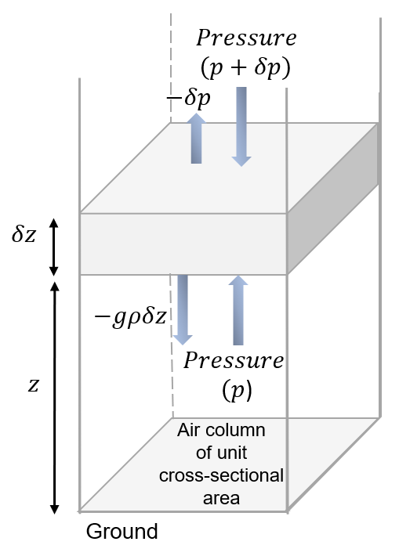

Hydrostatic balance of the atmosphere
When the upward and downward forces are equal, that is that there is no vertical acceleration (or negligible compared to acceleration due to gravity), the atmosphere is in hydrostatic equilibrium. On average and in the absence of atmospheric motion, the downward gravitational and the upwards pressure gradient forces are usually almost in balance in the atmosphere.
Hydrostatic equation:
$$\frac{∂p}{∂z}= −g ρ$$
Incompressible layer of thickness δz
p = air pressure
ρ = air density
That is, assume that there is local balance between the gravitational and the vertical pressure gradient forces
Justified assumption for meso, synoptic, and global-scale circulations - not for local scales, deep convection, complex terrain, vertical entrainment – positive vertical acceleration
Forces acting on an idealised layer within an air column
See e.g. Yang, Q., L. R. Leung, J. Lu, Y.-L. Lin, S. Hagos, K. Sakaguchi, and Y. Gao (2017), Exploring the effects of a nonhydrostatic dynamical core in high-resolution aquaplanet simulations, J. Geophys. Res. Atmos., 122, 32
Sokhi et al., 2024, Pub: Elsevier
Not to be copied without permission

Slide 18
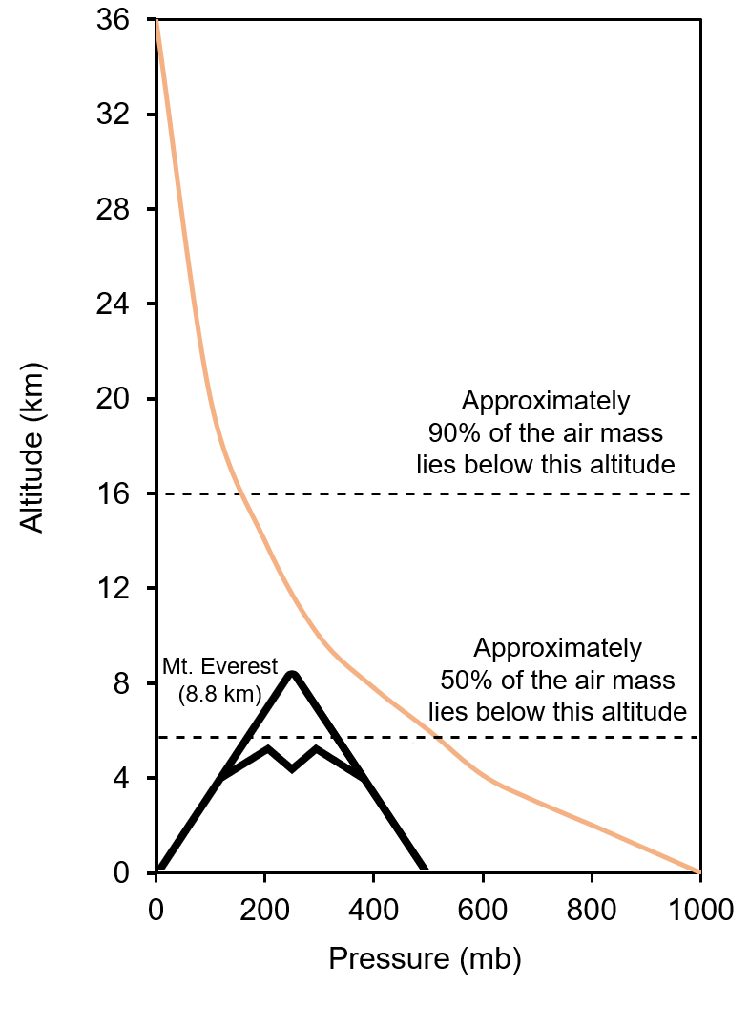
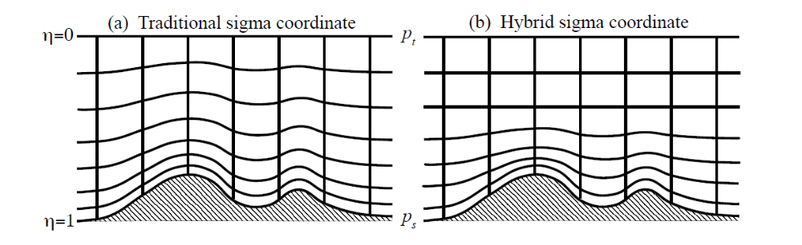
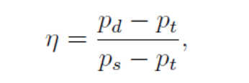
Terrain following coordinate systems
Friction effect reduces as altitude increases and eventually becomes negligible above a few kilometres.
Traditional terrain following Sigma
Coord. system used in hydrostatic models
Newer models e.g. WRF ARW v4 Hybrid Sigma coordinate system
Generalised system where it smoothly transitions from the Sigma coord system near the surface to a pressure coord system at upper levels
p_{d} = Air pressure of dry air at a specific height
p_{s} = Air pressure at the surface
p_{t} = Air pressure at the top of the atmosphere
Pressure variation (orange line) in the atmosphere with altitude.
Source: WRF ARW V4 Description 2021
Sokhi et al., 2024, Pub: Elsevier
Not to be copied without permission

Slide 19
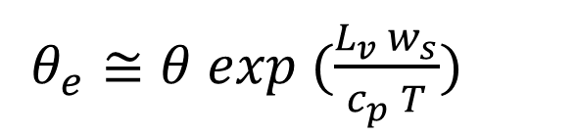

    Potential temperature and atmospheric stability
Profile of potential temperature followed by an air parcel as it moves vertically can be used to ascertaining the stability of the atmosphere
If potential temperature of the air parcel increases with height, the atmosphere can be described to be generally stable, and
If it decreases with height, the atmosphere is generally unstable
The atmosphere is neutral when the potential temperature remains constant
Potential temperature is conserved during an adiabatic process. The potential temperature has, therefore, a constant vertical profile if the atmosphere behaves adiabatically
For moist air - latent heat of condensation is released as the air parcel rises
$θ_{e}≅θ exp (\frac{L_{v} w_{s}}{c_{p} T})$
θ_{e} = equivalent potential temperature for saturated air
= potential temperature of moist unsaturated air
L_{v} is the latent heat of vaporization or evaporation
w_{s} = saturation mixing ratio
c_{p} = specific heat of air at constant pressure (p)
T = temperature of the air parcel.
$\frac{1}{θ} \frac{∂θ}{∂z} =\frac{1}{T} (Γ_{d}− Γ)$
Θ = potential temperature
z = height above ground level
T – air temperature
Γ_{d} = dry adiabatic lapse rate, Γ = actual lapse rate
Potential temperature, θ, is then defined as the temperature that an air parcel would have if it were brought from a pressure (p) to a standard pressure (p_{o}) through adiabatic expansion or compression

Slide 20
Atmospheric stability metrics
Condition of the atmosphere | Lapse rate | Potential temperature variation with height
Stable | Γ < Γ_{d} | ∂θ/∂z is increasing, > 0
Unstable | Γ > Γ_{d} | ∂θ/∂z is decreasing, < 0
Neutral | Γ = Γ_{d} | ∂θ/∂z is constant, = 0
Characterisation of the stability of unsaturated atmosphere according to lapse rate and potential temperature

Slide 21
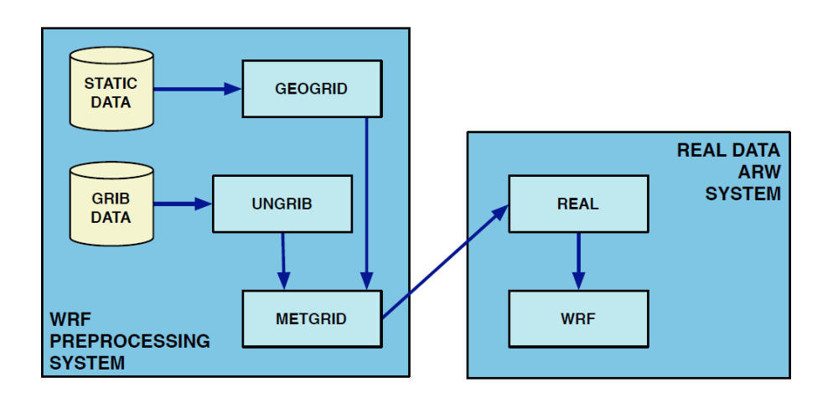
Describing the atmosphere
WRF Preprocessing system (WPS)
Data flow and program components in WPS
GRIB format: General Regularly-distributed Information in Binary form
GEOGRID: defines the model domain and creates static files of terrestrial data
UNGRIB: reformats GRIB-formatted data
METGRID: interpolates meteorological data to the model domain
Source: WRF User manual and Technical note, v4
Prepares a 3D description of the atmosphere
REAL: real data simulations via real.exe and vertically interpolates meteorological fields to WRF vertical levels
WRF: executes the final simulations (wrf.exe)

Slide 22
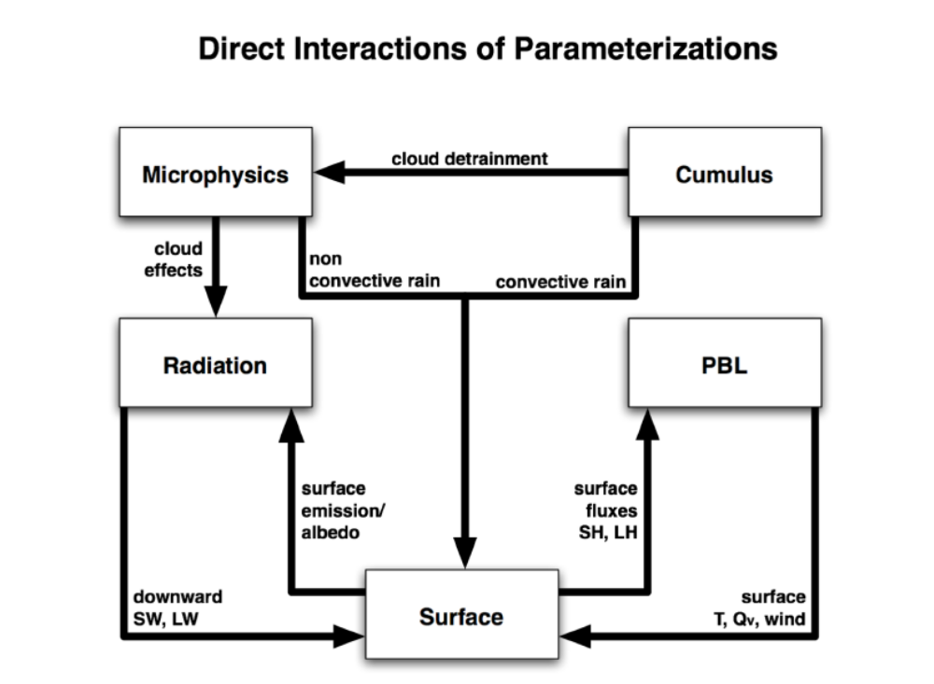
Interactions between physics components in WRF ARM
WRF is modularised but there are many interactions via model state variables that get passed from one module to another (potential
temperature, moisture, wind, etc
Typical sequence
Radiation scheme is called first as radiative fluxes are input to the
land-surface scheme
Land-surface model (LSM) requires rainfall from the microphysics and cumulus schemes )at different timesteps
Boundary-layer scheme is after the land-surface scheme as it requires the heat and moisture fluxes
Source: WRF User manual and Technical note, v4

Slide 23
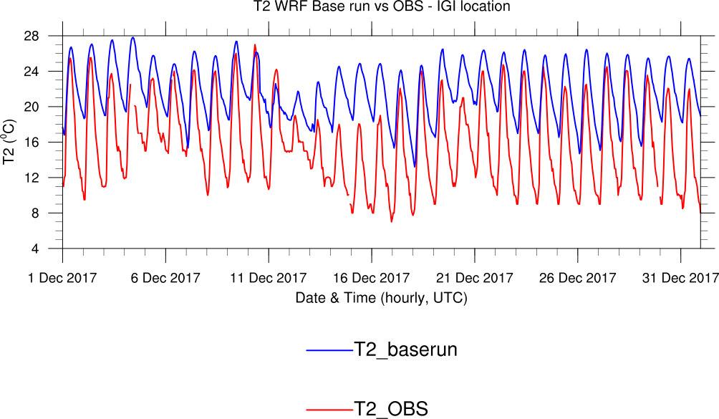
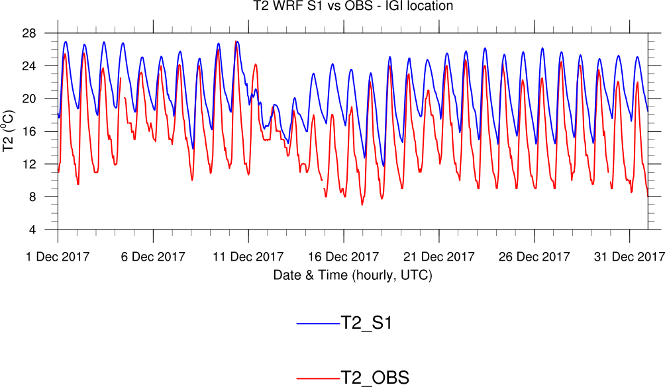
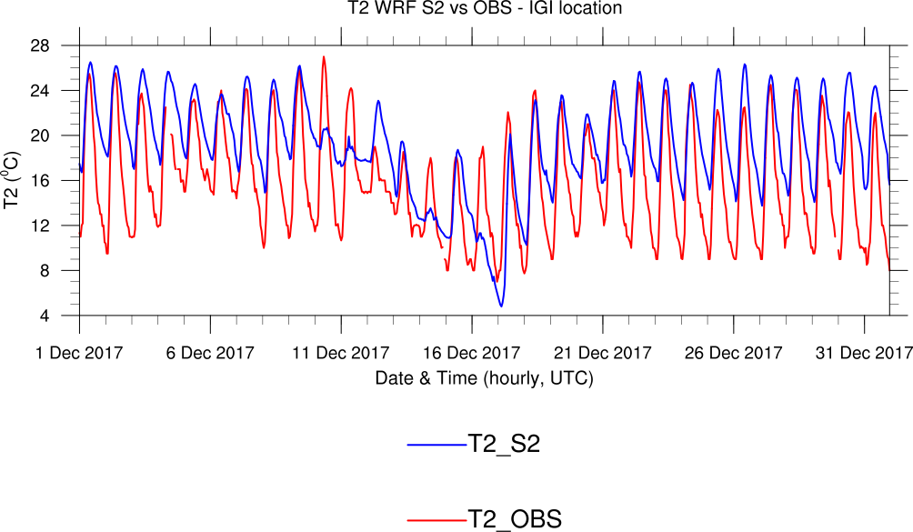
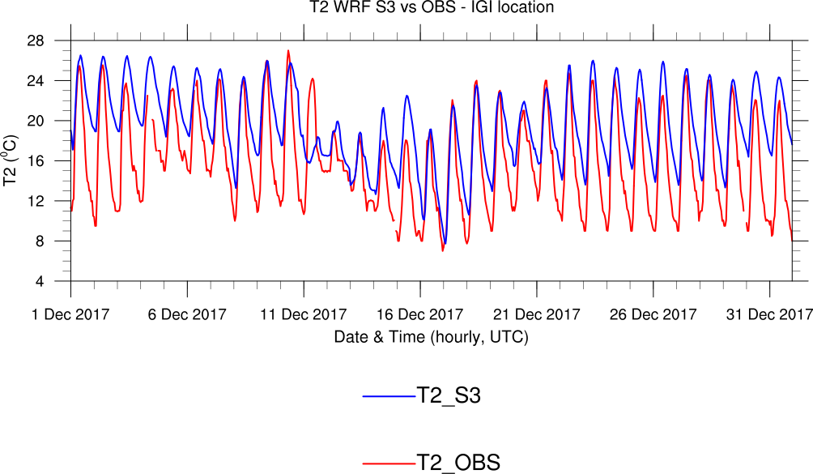
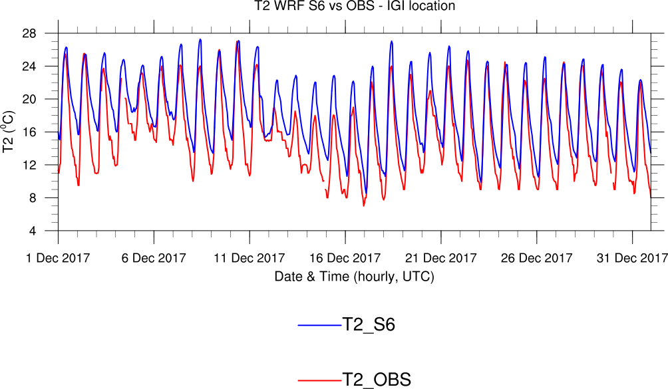
D04 – 1.67 km
WRF Example of sensitivity to physics schemes – Delhi, T2m
Comparison with ground-based observations

Slide 24
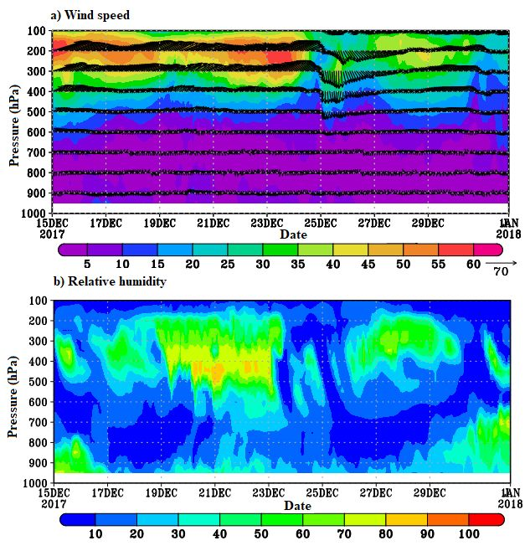
Vertical structure of the boundary layer – Example of Delhi
Important for:
Determining mixing
Air pollution from upper levels e.g. LRT
Trapping of air pollution e.g. inversions
Uplift of air pollutants

Slide 25
Key messages - I
Prediction and forecasting relies on sound physics, meteorology and chemistry representation in models
Verification of models with observations is critical for confidence in their outputs
Sensitivity analysis can play a useful and an important tool to adapt models to specific application, e.g. for Africa
Model output interpretation should be in the context of key processes to gain a robust understanding of the variations and trends
Often, 2D distributions are not sufficient and a 3D representation is required e.g. to understand long range contributions
Understanding model predictions, requires understanding of their assumptions, applicability and their limitations (uncertainties)
Challenges from multiple hazards with regional variations – Tools need to be developed for Africa

Slide 26
Urban Air Quality
Urban air quality is strongly influenced by several factors, including geographical location, demography, meteorology, atmospheric processes and the level of industrialization and socioeconomic development.
Since the 1952 London killer fog episode and the recognition of Los Angeles photochemical smog in late 1940s, important progress has been made in the last few decades in understanding the sources and atmospheric processing of emissions and how best to control them.
Exposure to smoke from burning of sulfur-rich coal were correlated with sickness and death during weather-induced pollution episodes in London.
  While coal-related air pollution has improved in some cities by using cleaner coal with low-sulfur content and emission control technologies, coal-burning power plants remain one of the largest contributors of SO₂ and co-emitted pollutants (NO_{x}, PM and CO₂) in some regions of the world, especially in emerging economies in Asia and South Africa.
On the other hand, despite the large amount of research that has been conducted, the sources and processing of emissions generated in urban centers leading to high concentrations of O₃ and PM are still not well understood.

Slide 27
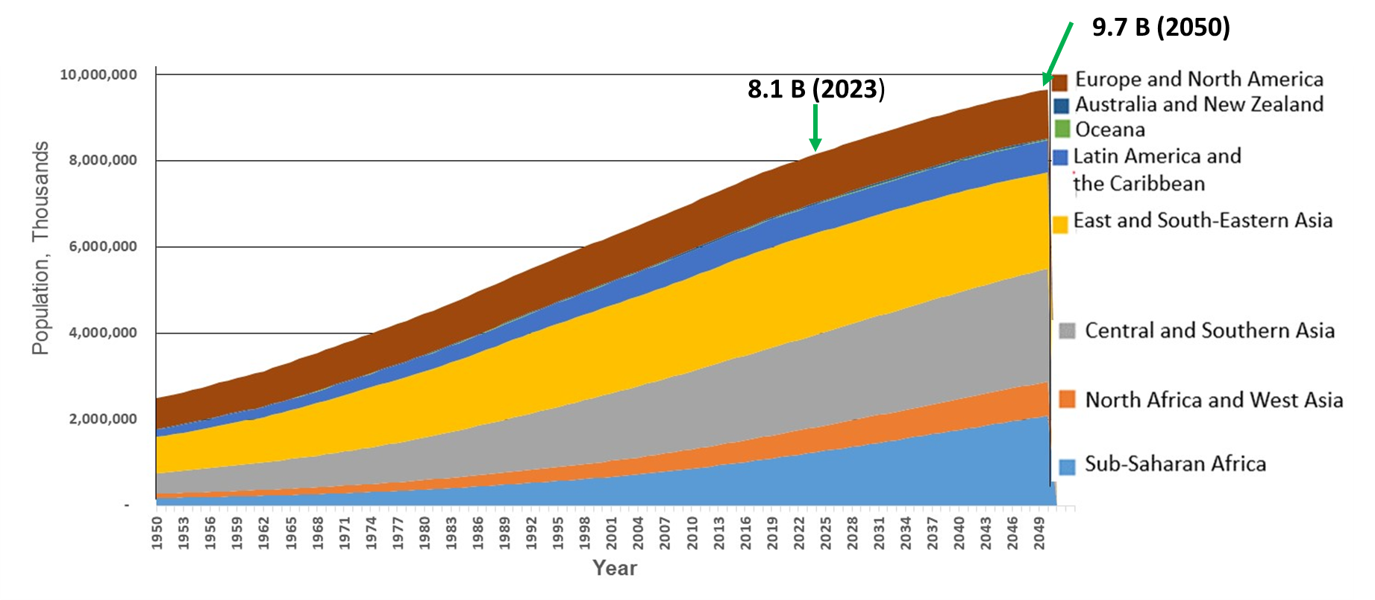
World population estimates (2023) and projections
(classified by UN SDG regions)
The latest projections by UN suggest that the global population could grow to around 9.7 billion in 2050.
The largest growth will occur in sub-Sahara Africa, Central and Southern Asia and the Eastern and South-Eastern Asia. Many of the countries in these regions are also classified by World Bank as low-to-middle income countries and they are projected to double in population between 2023 and 2050, posing challenges to the achievement of the Sustainable Development Goals.
(Data source: United Nations, World Population Prospects 2024. Note: Population data as of July1 of the year.)

Slide 28


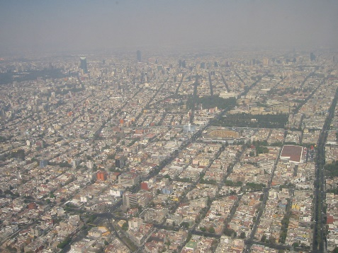
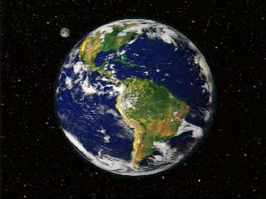
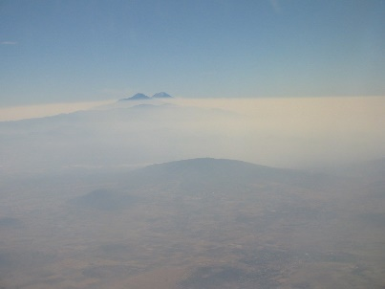
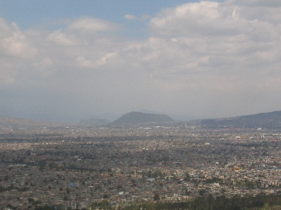
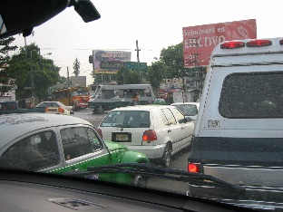
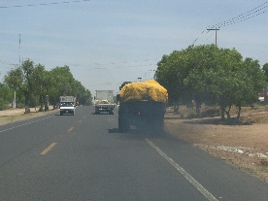
Local, regional, and global impacts of human activities
Regional
Urban
Global
Increased energy usage in urban areas including motor vehicles and industrial activities leads to high levels of gases and aerosols.
Urban air quality
degradation;
both chronic and acute
health effects;
visibility reduction.
Pollutants emitted from urban areas can react in sunlight to form other products downwind of the cities.
acid deposition;
ecosystem degradation;
- changes in regional climate.
Global Impacts
- trace gases and aerosols can lead to weather modification and global climate change.

Slide 29
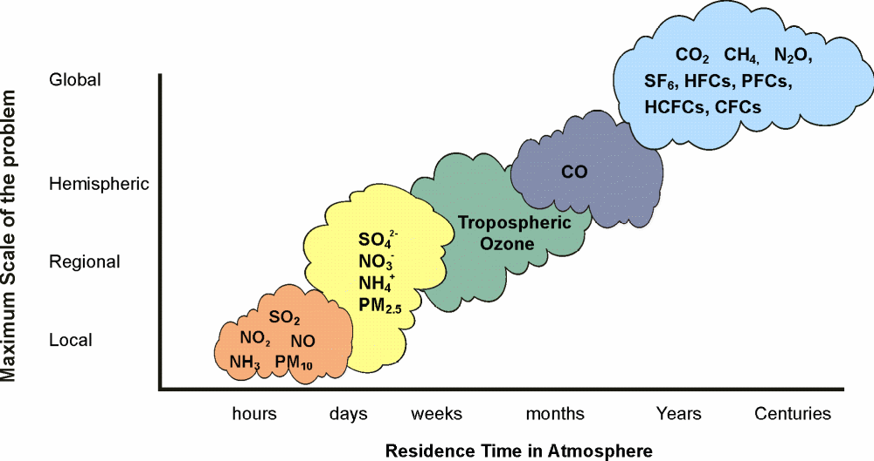
Selected pollutants, their average residence times in the atmosphere and maximum extent of their impact
(Source: GEO-4, 2007)

Slide 30
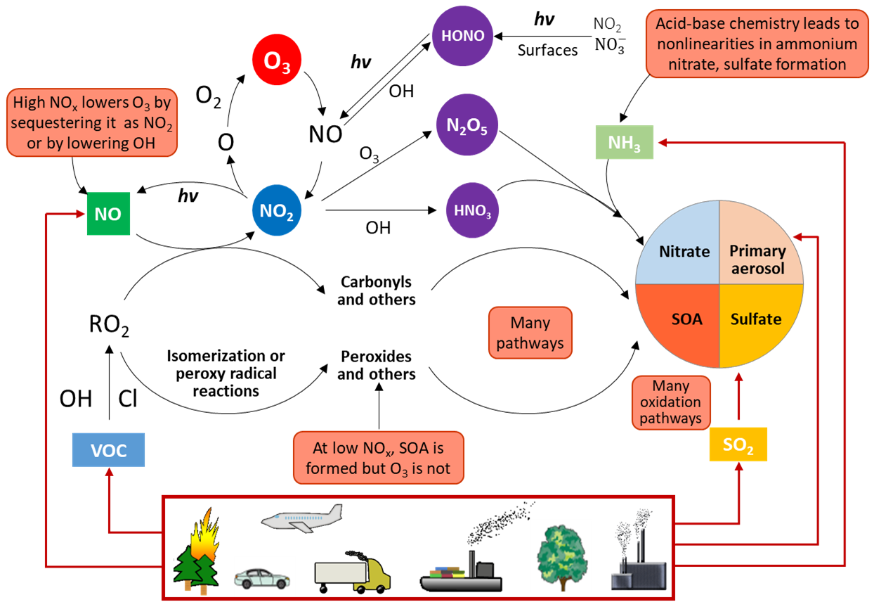
Atmospheric Physicochemical Processes
Atmospheric reactions of pollutants from anthropogenic and biogenic emission sources have significant impacts on human health and the environment.
NO_{x} , CO and VOCs, mostly emitted by the transportation sector, are transformed in the presence of sunlight to produce O₃, and other oxidants in a complex series of chemical reactions. These reactions also generate secondary organic aerosols, nitrate and sulfate.
  Relation between NO_{x}, VOCs, and O₃ is driven by complex nonlinear photochemistry.
  Formation and growth of PM also involves complex physical and chemical processes.
(Figure adapted from Kroll et al., 2020)
Application and validation of air quality models require spatially and temporarily resolved emissions data and meteorology. In addition to criteria pollutants, individual VOCs and PM chemical compositions are needed; however, this detailed information is seldom available in some cities.
(Source: L.T. Molina, Faraday Discuss., 2020)

Slide 31
Particulate Matter
The abundance and chemical constituents of PM_{2.5} vary in urban cities, depending on the complex interplay between meteorology, emissions, and chemical processes.
Substantial fraction of urban PM₁ is organic aerosol (OA), composed of primary OA (POA) emitted directly and SOA formed from chemical reactions of precursor gases. SOA is typically 2 to 3 times higher than POA for these locations.
UFP (Ultrafine particles with diameter 0.1 μm or less), produced predominantly from combustion processes with major contribution from vehicular exhaust in cities, have become increasing important for public health studies. It is important to monitor both PM_{2.5} and UFP for exposure risk assessment.
Non-refractory submicron PM1 (typically comprises most of PM_{2.5}) composition measured in urban and urban outflow regions from field measurements (data provided by J. Jimenez)
(Source: L.T. Molina, Faraday Discuss., 2020)

Slide 32
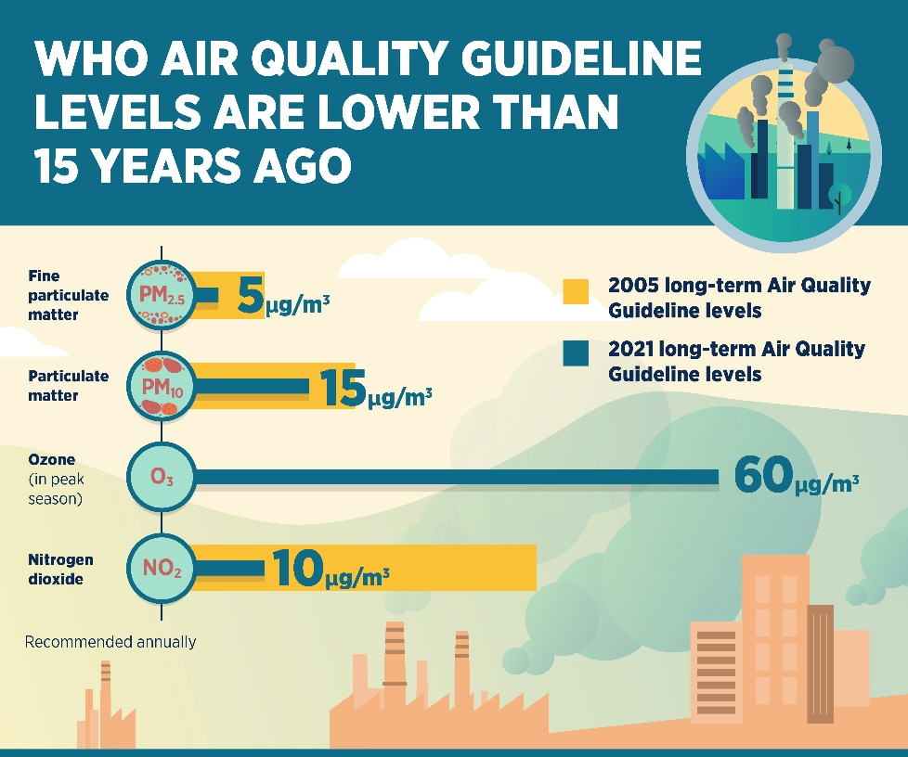
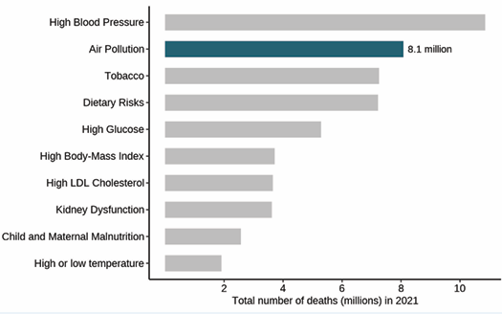
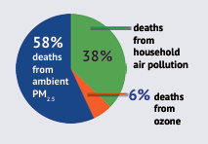
Health Impacts of Air Pollution
Emissions and ambient concentrations of pollutants in urban centers can have widespread adverse effects on human health.
While many countries have established AQ standards for criteria pollutants or follow WHO guidelines, there is an ongoing debate as to the maximum permissible limit of a particular pollutant concentration. WHO tightened its AQ guidelines on September 22, 2021, for the first time since 2005.
Mortality due to air pollution and other causes (2021)
(Sources: WHO Air Quality Guidelines, 2021;State of Global Air 2024, HEI-IHME-GBD Project)

Slide 33
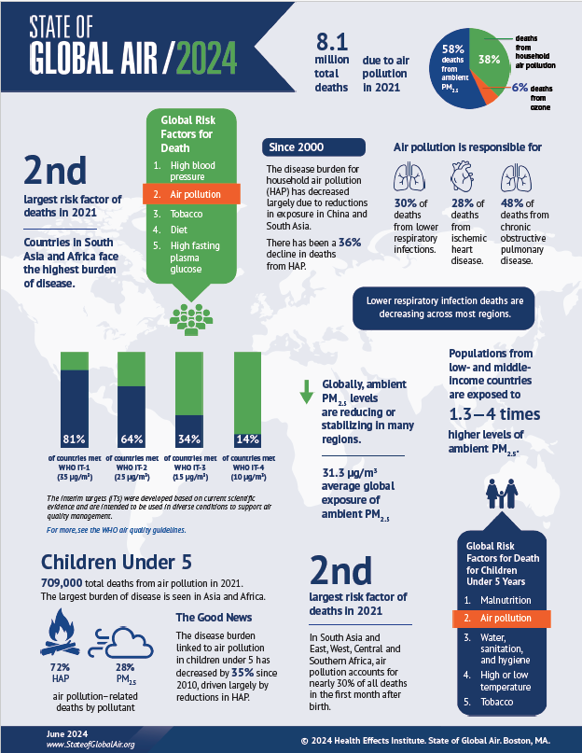
State of Global Air in 2021
Air pollution accounts for more than 1 in 8 deaths globally.
Air pollution contributed to 8.1 million deaths in 2021
  second leading risk factor for early death, including for children under five years.
  countries in South Asia and Africa face the highest burden of disease.
Of the total deaths, noncommunicable diseases including heart disease, stroke, diabetes, lung cancer, and chronic obstructive pulmonary disease (COPD) account for nearly 90% of the disease burden from air pollution.
More than 700,000 deaths in children under five yrs were linked to exposure to air pollution, about 15% of all global deaths in children under five (72% from HAP, 28% from PM_{2.5} emissions from power plants, transportation, industries, waste combustion). The heaviest burden is seen in poorer regions, particularly South Asia and East, West, Central, and Southern Africa.
State of Global Air 2024, Health Effects Institute, 2024.
https://www.stateofglobalair.org/resources/report/state-global-air-report-2024

Slide 34
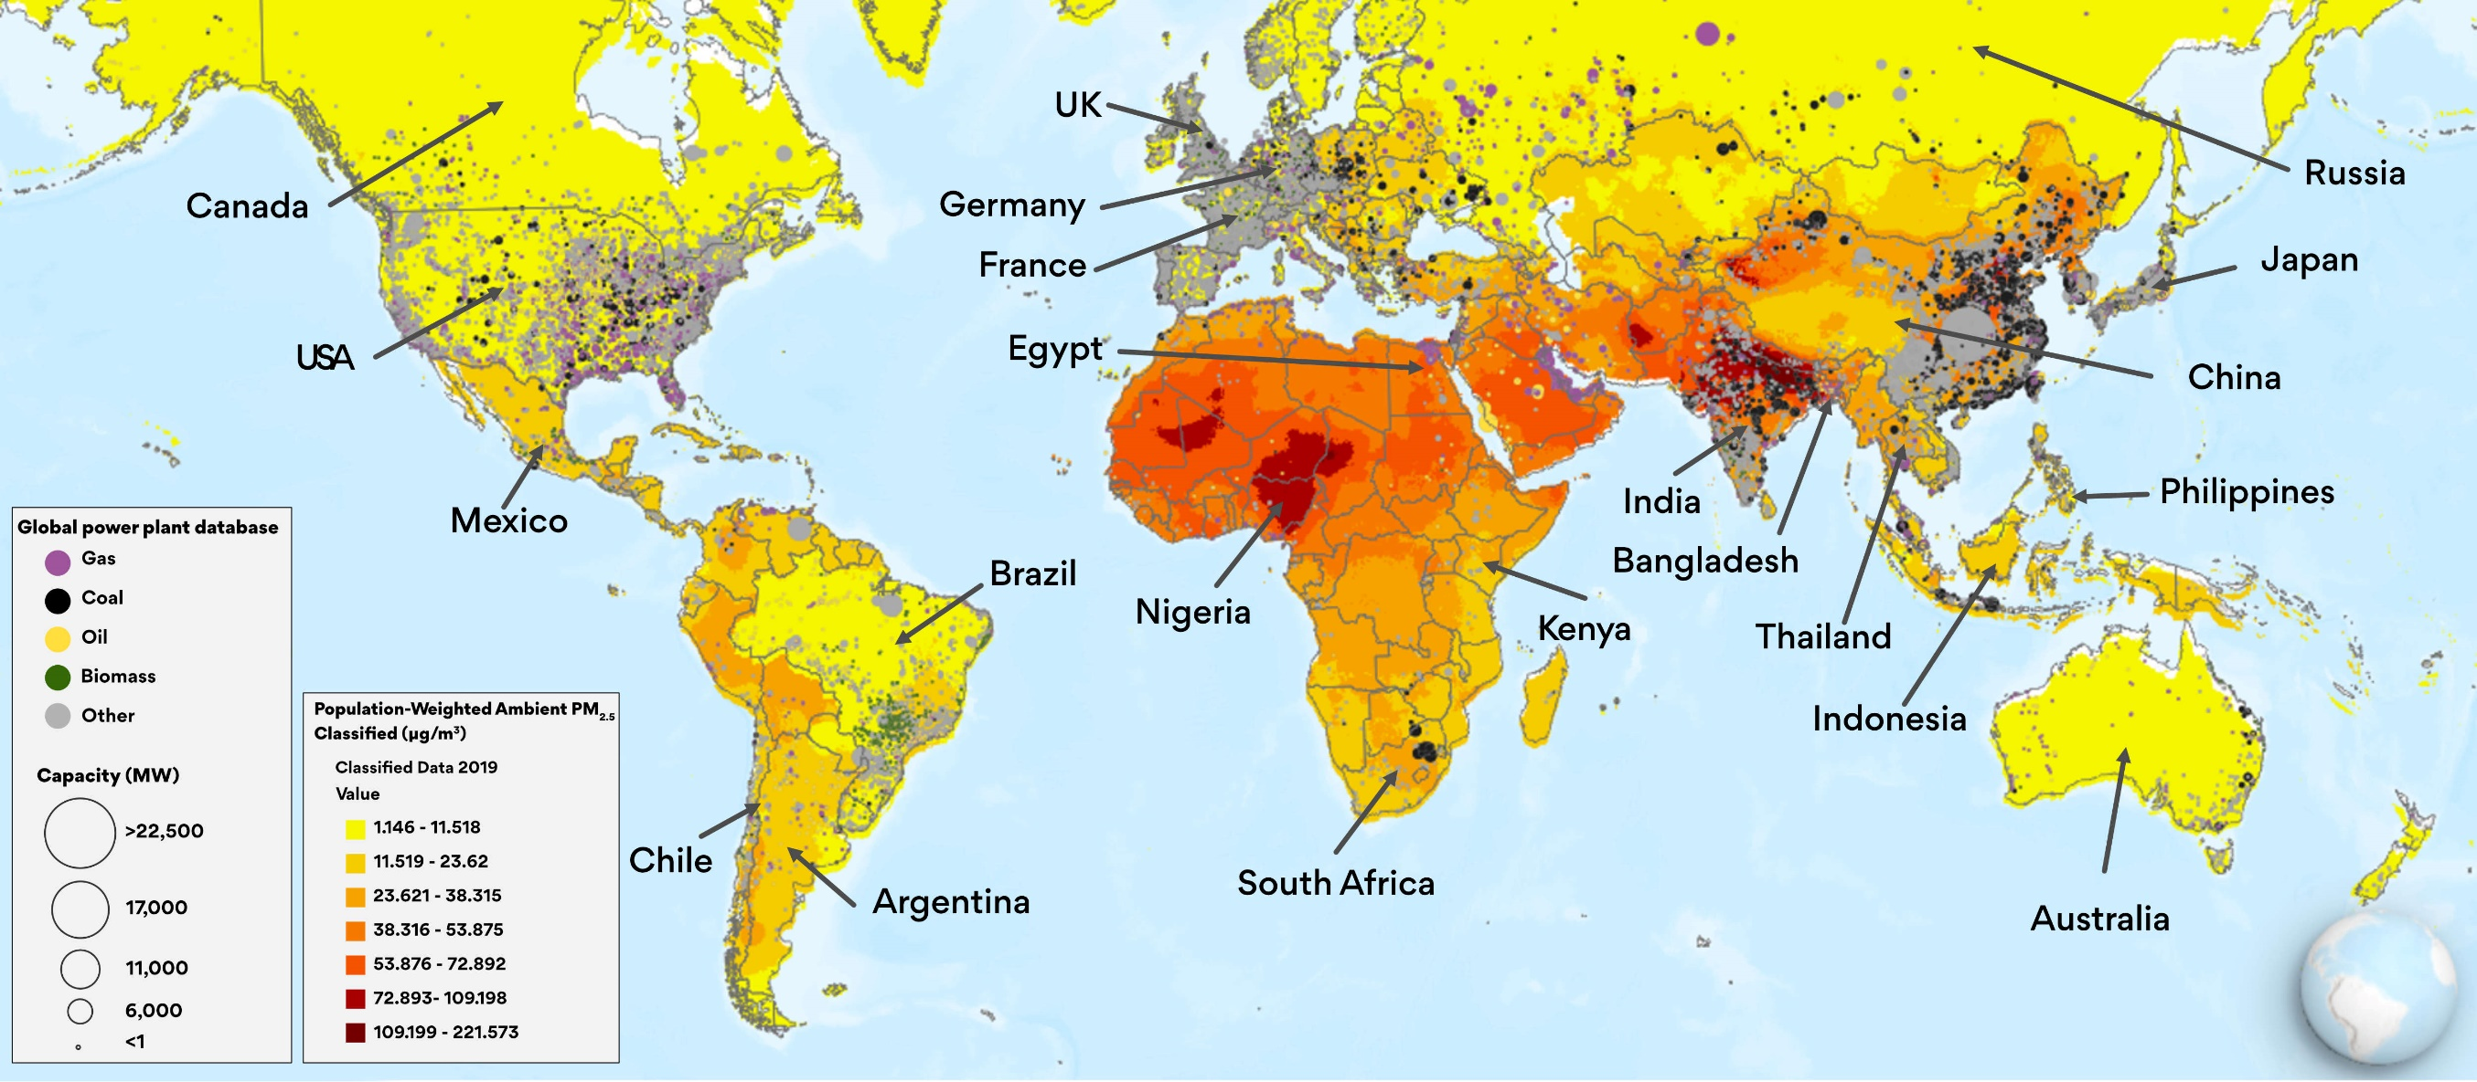
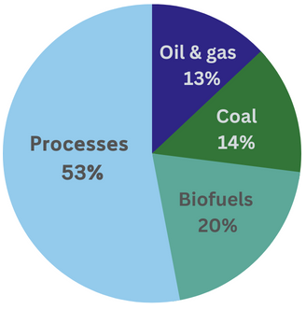
Air pollution and health:
Global impacts of fossil fuel and biofuel combustion
Source: Air Pollution and Health: The Global Impacts of Fossil Fuels, State of Global Air, November 7, 2023
https://www.stateofglobalair.org/resources/storymap/air-pollution-and-health
Contribution of different fuels to ambient PM_{2.5} levels

Slide 35
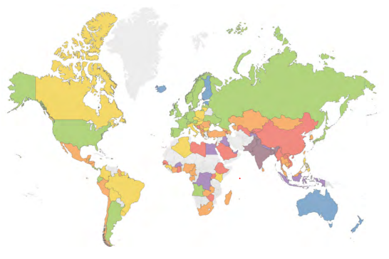
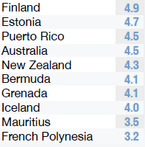


2023 Global map color coded by annual average PM_{2.5} concentration
Population weighted average PM_{2.5} (μg/m³)
Of 134 countries and regions surveyed, only 10 countries, territories, and regions met the WHO annual PM_{2.5} guideline.
The countries in Africa and Central and South Asia had the highest annual average PM_{2.5} concentrations weighted by population.
Finland
Iceland
Regional capital city ranking Population weighted average PM_{2.5} (μg/m³):
New Zealand
Australia
WHO annual PM_{2.5} guideline value = 5 μg/m³
(Source: IQAir, 2023 Global Air Quality Report)

Slide 36



Potential gains in life expectancy from reducing PM_{2.5} levels
Selected major global threats to life expectancy in 2022
Reducing PM_{2.5} to 5 μg/m³ in 2022 would add 1.9 yrs onto average life expectancy
Global and select regional annual average PM2.5 concentrations, 1998-2022
Pollution levels globally have fallen slightly from 2013 to 2022 due to China’s progress in combating air pollution.
While pollution declined in the South and Southeast Asia, pollution levels increased across the Middle East and African continent.
People living in highly polluted countries in the world would gain the most years onto their lives in 2022.
WHO AQG = 5 μg/m³ (2021)
(Source: M. Greenstone et al., Air Quality Life Index report, 2024)

Slide 37

Indicators of Global Climate Change 2022
  Increased greenhouse gas concentrations combined with reductions in aerosol pollution have led to rapid increases in human-induced effective radiative forcing, which has in turn led to atmosphere, land, cryosphere and ocean warming.
  This in turn has led to an intensification of many weather and climate extremes, particularly more frequent and more intense hot extremes, and heavy precipitation across most regions of the world
  Air pollution and climate change are interrelated as all major pollutants share common sources, atmospheric processes, and human and environmental impacts. Integration of air quality and climate stabilization goals in environmental policy design would be highly beneficial.
(Source: Forster, P. M. et al., Earth Syst. Sci. Data, 15, 2295–2327, 2023)

Slide 38


Short-Lived Climate Forcers
Relatively short-lived in the atmosphere
  Black carbon (BC) ~ 3 to 8 days
  Tropospheric ozone (O₃ ) ~ 1 week to a month
  Methane (CH₄) ~ 12 years
  Some hydrofluorocarbons (HFCs) - average of mix: 15 yrs
  Global assessment of SLCFs highlighted opportunities for reduction of SLCFs using existing measures and would allow gaining some time for widespread implementation of CO₂ mitigation measures, in addition to multiple benefits.
Link solutions to climate change, air pollution, and O₃ depletion
    Reduce one of the most important greenhouse gases – methane
Reduce air pollution - protect health and crops
Find alternatives to HFCs - avoid build-up of new powerful GHG
Allow more time for vulnerable communities to adapt to climate change
It is important to emphasize that despite these near-term benefits, reducing warming in the longer term will also require action now to reduce current and future CO₂ emissions.
(WMO-UNEP, 2011; UNEP 2011; Shindell et al., 2017)

Slide 39

Role of science in air quality management
Air quality management is an iterative and dynamic process represented as a cycle of inter-related elements.
A key element in this process is the important contributions of science and technology in the application of various assessment tools, including emission inventories, air quality monitoring and modeling, to provide the air quality managers with fundamental knowledge to make informed decisions.
To achieve the required reductions goals, it is necessary to implement the proposed programs, enforce the rules and regulations, maintain an ongoing evaluation of the effectiveness of the strategies, and measure the progress towards meeting the air quality goals.
It is essential to communicate the air quality status to the public throughout the process.
(Adapted from NRC, 2004 and Bachman, 2007)

Slide 40

Air quality monitoring and environmental justice
Although more countries are monitoring their air quality and more cities are now included in the air quality database, there are still many cities that do not have ambient monitoring where pollution levels may be high.
In February of 2020, UNEP, UN-Habitat and IQAir launched the world’s largest air quality platform that addresses the global air quality information gap by providing an interactive map that shows real-time estimates for PM_{2.5} from thousands of governments, researchers, and citizen contributors.
Low-cost monitors: In some low- and middle-income countries, concentrations of criteria pollutants are not routinely monitored because of lack of technical and financial resources. Use of low-cost monitors will expand the capability of current networks if they are calibrated against regulatory-grade monitors at regular intervals. The data obtained can help in detecting local hot spots and improving information for air quality management.
Various satellite instruments are currently in orbit providing useful data for air quality study, especially for cities with limited monitoring capacity. The recent availability of geosynchronous orbit satellites has made it possible to obtain data with unprecedented spatial and temporal resolutions. Several geosynchronous satellites are available and will be launched soon in Asia, North America and Europe.
IQAir 2023 Data source: aggregated from global distribution of more than 30,000 regulatory AQ monitoring stations and low-cost sensors operated by governments, educational and research institutions, NGOs, private companies, and citizen scientists.
The map reveals significant disparities in real-time air quality data accessibility for the public.
Only 24 out of 54 countries in Africa had sufficient data available to be included in 2023’s report.

Slide 41




Air pollution network of PM using the AirQo low-cost monitors
Many African cities lack actionable data and evidence on the scale and magnitude of air pollution in order to tackle air pollution, a major urban environmental health challenge.
AirQo network exemplifies an African-led solution to the measurement data gap across Africa, empowering communities with accurate, hyperlocal, and timely air quality data to drive air pollution mitigation actions.
AirQo was founded in 2015 at Makerere University in Kampala, Uganda; it is deployed across 8 African countries.
  The low-cost air quality monitors are designed, manufactured, and calibrated to measure PM₁₀ and PM_{2.5} and optimized to suit the African infrastructure, providing locally-led solutions to African air pollution challenges.
Mobile monitoring
AQ monitoring sites in Uganda
https://airqo.mak.ac.ug/about-us; Sserunjogi et al., Seeing the air in detail: Hyperlocal air quality dataset collected from spatially distributed AirQo network, Data in Brief, 44, 2022, 108512, https://doi.org/10.1016/j.dib.2022.108512.

Slide 42

Sources of emissions and inventory
Major sources of emissions:
mobile sources: on-road vehicles such as passenger cars, commercial buses and trucks, motorcycles; non-road vehicles such as aircraft, marine vessels, construction and agricultural equipment, etc.
stationary sources such as factories, refineries, boilers and power plants, etc.
area sources: small-scale industrial and commercial operations; municipal solid waste; wastewater treatment plants; consumer products; residential heating/cooling systems; agricultural (livestock) activities, etc.
Natural sources: vegetation, windblown dust, volcanoes, lightning, forest and grassland fires, etc.
Emission inventory is essential for air quality model input and for evaluating progress of emission-control strategies and planning future actions.
As emission sources change due to changes in technology and regulations,
it is necessary to continue updating the inventory (activity data and emissions
factors) to reduce the uncertainty as improved methodology becomes available.
Need to better understand the sources and seasonal variabilities of
pollutants (VOCs, PM, etc.) compositions through continuous measurements.
Example: 2018 Emission inventory
for Mexico City Metropolitan Area
http://www.aire.cdmx.gob.mx.

Slide 43

Global sources of fine particles
(Source: https://www.unep.org/interactives/air-pollution-note/)

Slide 44
Sources and drivers of air pollution in Africa
Africa’s population is projected to nearly double to 2.5 billion by 2050, this will lead to increased energy demand, waste generation and transport vehicles — all of which are sources of air pollution.
Owing to distinctly different socioeconomic conditions among countries and cities, air pollution across Africa varies greatly and has distinct regional pollution patterns and sources.
Although household air pollution is still the predominant in Africa, outdoor air pollution is increasing because of increased energy demand, motorized transport, large-scale construction and industrialization, thus resulting to a mixture of pollutants from the various sources.
Biomass burning (forest fires, burning of crop residue, municipal solid waste, residential wood burning for cooking) releases a variety of gases (including CO₂, CH₄, NO_{x}), particulate matter (black carbon, organic carbon, polycyclic aromatic hydrocarbons, etc.)
  Traditional biomass dominates residential energy in sub-Saharan Africa, with over 80% of the population relying on it and is also an important source of air pollution across Africa.
Vehicles are important pollution source across Africa due to increasing mobility demand, rising imports of pre-owned, old and reconditioned vehicles with low emission standards from Europe, North America and Asia.
Crude oil exploitation in Nigeria induces black carbon emissions and particulate matter pollution.
Coal mining and power generation results in high emissions of greenhouse gases, NO₂ and SO₂ in South Africa.
(Source: Mead, M.I. et al. Spotlight on air pollution in Africa. Nat. Geosci. 16, 930–931, 2023)

Slide 45
Air quality strategies implemented in Africa (Technology)
G. Okello and an international multidisciplinary team undertook a scoping review of strategies developed and/or implemented in Africa. The review includes 3 main types of strategies, policy (20%), technology (75%), and education/awareness (5%) assessed for effectiveness in improving air quality and/or health outcomes, co-benefits and unintended consequences of the strategies.
Clean cooking technologies
Improved cookstoves (ICS) for solid biomass (81%), biogas (7%), LPG (7%) and electric mitads/stove (2%).
Some interventions combined technology with financial innovation.
Household and community renewable energy technologies
promotion of solar home systems, solar wind hybrid lights, solar water heating systems, solar park and streetlights.
Interventions related to hydropower and mini-hydro plants for electricity.
Low-cost air quality sensors
measure near real-time state of air quality with localities (Ghana, South Africa)
Transport technology
substitution of petrol/diesel by compressed natural gas (CNG) in transportation.
(e.g., in Algeria, ten buses were acquired and dedicated to CNG, and 125 light vehicles were converted to be powered by CNG).
Source: Okello, G. et al., Air quality management strategies in Africa: A scoping review of the content, context, co-benefits and unintended consequences. Environ. Intl., 171, 107709 (2023)

Slide 46
Air quality strategies implemented in Africa (Policy)
Motor vehicle regulations
total ban on “used” vehicles, restriction on the importation of used vehicles, strengthen emission standards;
incremental tax/additional excise duty on old cars;
introduction of a carbon tax on vehicles to promote hybrid cars (Mauritius)
restriction of vehicles on streets on Sundays (Rwanda)
Household energy policies
promotion of renewable energy technologies including biogas, briquettes, solar, and hydroelectricity;
master plan to increase LPG use in households;
regulating the collection and sale of biomass fuel wood;
improved access to modern energy services/electricity.
Tobacco control policies
increased tax on tobacco, restrictions on the sale of tobacco products;
restriction of public smoking to reduce indoor air pollution.
Air quality management plans
develop comprehensive plans to address air quality;
build capacity to develop and support development of air quality management.
Source: Okello, G. et al., Air quality management strategies in Africa: A scoping review of the content, context, co-benefits and unintended consequences. Environ. Intl., 171, 107709 (2023)

Slide 47
Five target areas for actions in Africa
As many regions across the globe have made progress with air pollution control, Africa can leverage existing knowledge, technology and strategies for effective capacity building via international collaboration. Regionally specific and multifaceted approaches are key to tackling different patterns of air pollution across Africa.
Continuous air monitoring.
  Wider installation of continuous air-quality monitoring networks to measure pollution levels and understand spatial and temporal variations of different pollutants
  Invest in air monitoring infrastructure and enhance local technical capacity
Investment in clean energy.
    Promote transition to clean energy (such as solar, hydropower and wind), while shifting away from dirtier energy sources.
Improved solid waste management.
  Reduce open waste dumping and burning.
  Provide appropriate incentives to promote waste reuse, recycling and recovery
  Develop and invest cleaner technologies to reduce waste generation
Investment in environmentally friendly technologies
Set standards to regulate imported technologies and only promote clean and environmentally friendly ones
Infrastructure improvements in the transportation sector
Improve public transportation and adopt higher emission standard for both fuels and imported vehicles
  Improve Infrastructure for nonmotorized transport, such as walking and cycling
Promote transition to electric mobility
(Source: Mead, M.I. et al. Spotlight on air pollution in Africa. Nat. Geosci. 16, 930–931, 2023)

Slide 48

Municipal Solid Waste (MSW)
UN General Assembly (Dec 14, 2022) proclaimed 30 March as International Day of Zero Waste to be observed annually
MSW is the third largest source of global anthropogenic CH₄ emissions and a significant source of black carbon and CO₂.
Many cities have recycling and waste separation program,
some are converting organic waste into compost; ban single-use plastic bags (but reappeared recently due to COVID-19).
Landfilling is the most widespread technology for final waste disposal, followed by capturing landfill gas for power generation → integrated waste management program.
Promote sustainable production and consumption practices
- reduce input of materials and energy, minimize amount of waste for treatment and disposal, and reuse or dispose the wastes produced without harming the environment.
Challenges
Many cities are host to some of the world’s largest landfills, the amount of solid waste generated will continue to increase with urban population growth, which will pose major challenge for MSW management.
Open garbage burning is common in many areas around the world, especially in cities without adequate solid waste disposal facilities such as landfills or incinerators. Pollutants produced by trash burning include air toxics, PAH, dioxins, furans, mercury; they are released primarily into the air and close to ground level where they are easily inhaled.
Zero Waste International Alliance - promote positive alternatives to landfill & incineration and to raise community awareness.
(Source: https://zwia.org/zwh/)

Slide 49

Examples of innovative solutions addressing solid waste in Africa
Algeria
Algerian National Strategy for the Integrated Management and Recovery of Waste by 2035 (SNGID 2035) seeks to reduce household waste by 10% by 2035, recover 47% of household and special waste, and recycle 60% of inert waste
July 2024, Algeria launched MyGeocycle platform to digitize waste management that helps track the collection, transport, and treatment of solid waste in Algeria.
  It is the first of its kind in the African region developed by Geocycle (French waste management company), enables businesses to monitor and manage their waste remotely and digitally, enhancing operational efficiency, reducing costs, and minimizing environmental impact.
Integrated Waste Management and Local Energy Production in Algeria (AIM-WELL): two wilayas will recycle about 500,000 tonnes of organic waste each year as fertilizer and energy,
  reduce greenhouse gas emissions (CH₄ and CO₂), improve access to electricity from renewable sources, improve sustainable agriculture, create added value for waste, and generate new jobs
South Africa
Cartoon Network raises awareness of e-waste management during holidays
The African branch of the Cartoon Network television channel has teamed up with the South African Electronic Waste Recycling Authority (ERA) to use its characters and stories to raise children’s awareness of the sustainable management of electronic waste, during the holiday period.
https://www.afrik21.africa/en/south-africa-cartoon-network-raises-awareness-of-e-waste-management-during-holidays/ (published 8/14/24)
https://www.sustainabilitymea.com/algeria-launches-initiative-to-digitize-waste-management/
https://www.afrik21.africa/en/algeria-the-mygeocycle-platform-is-launched-to-digitise-waste-management/

Slide 50



African oceans: the green revolution against the plastic tide
Plastic production has risen exponentially in the last decades and now amounts to ~ 400 M tonnes per year. A global treaty was adopted in March 2022 to address the full life cycle of plastic pollution and to have the treaty in place by 2025.
About 8 million tonnes of plastic waste end up in the oceans, much of this waste reaches African coasts and ingested by marine life, destroying natural habitats and contaminating the food chain. Several local and regional initiatives have been launched to combat plastic pollution:
South Africa: Operation Clean Sweep aims to prevent industrial plastic granules from entering the marine environment. Sasol chemicals and South African Plastics Recycling Organisation have committed to prevent plastic granules from being spilled during transport or production.
South Africa: Plastics SA has developed a technology for automatically sorting plastics to increase recycling efficiency. In 2021, plastics recycling rate reached 43%, one of the highest in Africa.
Ivory Coast: Plastic Waste Management Program project run by Conceptos Plasticos (NGO)
- uses plastic waste to build schools.
Kenya: Gjenge Makers transforms plastic waste into durable paving stones for construction.
Kenya: Flipflopi (Closing the Loop on Waste Plastics through Heritage Boat Building):
built a boat from recycled plastic to raise awareness of the importance of recycling; the boat has sailed along Kenyan coast, organizing clean-up campaigns and educational workshops;
  created a community-led network and recycling center to construct traditional sailing vessels and other local products including artisanal furniture from plastic waste.
Sources: https://www.unep.org/news-and-stories/press-release/un-declares-war-ocean-plastic-0; https://www.unep.org/inc-plastic-pollution;
https://www.theflipflopi.com/closing-the-loop-lamu/; https://www.afrik21.africa/en/african-oceans-the-green-revolution-against-the-plastic-tide/

Slide 51



Agricultural waste burning
Open burning of crop residues
Pest and weed control and preparing land for planting
Emits PM₁₀, PM_{2.5}, NO₂, CO and organic compounds
Air pollution, impaired visibility
  Mitigation strategies:
  Restrict open burning while promoting economically viable alternatives:
  Encourage mechanization of sugar cane harvesting
Farmers sell crop residues for construction material and livestock feed
Fueling industries with biomass pellets made from crop residues
Gasify biomass waste to supply electricity to rural villages
Cairo black cloud
(UN, www.unmultimedia.org)
Recurring annual phenomenon from illegal burning of rice straw following the harvest, creating black cloud across Nile Delta and Cairo in Oct and Nov.
No-tillage: Seeding crops into untilled soil without removing stubble by opening a narrow slot or trench of sufficient width and depth to obtain proper seed coverage.
A farmer sprayed bio-decomposer to convert agricultural waste into compost in New Delhi (Source: Reuters, Oct. 13, 2020) .
(Source: FAO, 2001; Derpsch, 2014)
(Note: Prof. Ibrahim A. Hassan will present impact of agricultural waste on Sep 19th)

Slide 52

Strengthening air quality knowledge and management

Slide 53
Key messages - II
Air pollution science has advanced substantially in the last few decades because of the improvement in scientific and technical knowledge to measure pollutants in the laboratory and in the field and the development of sophisticated air quality models.
  Much remains to be understood about the complex atmospheric physicochemical processes, the influence of emerging emissions sources, and the changing climate on air quality and health.
While more countries are taking action to improve the air quality, air pollution levels remain dangerously high in many regions of the world, particularly in the low- and middle-income nations.
  International collaboration and cooperation will be needed, including strengthening local capacity in air quality monitoring and emissions inventory development, so that cities confronting severe air pollution challenges will learn from the experience of those cities that have successfully addressed them.
Air pollution and climate change are interrelated with respect to sources, atmospheric processes, and human and environmental impacts.
  Addressing the multiple challenges of air pollution, climate change, biodiversity loss, and protection of human health will require innovative solutions from multidisciplinary teams of atmospheric, health and social scientists working collaboratively, evidence-based intersectoral policy and actions from the decision makers, and active involvement of stakeholders and the public to phase out unsustainable activities and reduce the resource intensity of energy, food, mobility, and housing.

