Slide 1
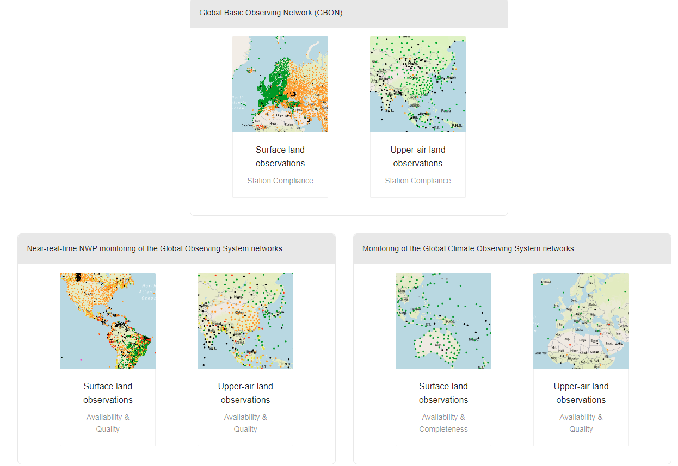
POSSIBLE ISSUES IN WDQMS-OSCAR/SURFACE
AND IMS RWC SOLUTIONS
TURKISH STATE METEOROLOGICAL SERVICE
MAY 2024
ANKARA
Özden TÜTEN

Slide 2
OUTLINE
EXAMPLE - 1 : WIGOS IDENTIFIER ISSUE (Surface Land Observation)
EXAMPLE – 2 : DATA QUALITY ISSUE (Surface Land Observation)
EXAMPLE - 3 : AVAILABILITY ISSUE (Surface Land Observation)
EXAMPLE - 4 : AVAILABILITY ISSUE (Surface Land Observation)
EXAMPLE - 5 : AVAILABILITY ISSUE (Surface Land Observation)
EXAMPLE - 6 : UPPER-AIR LAND OBSERVATİONS AVAILABILITY ISSUE
EXAMPLE - 7 : UPPER-AIR LAND OBSERVATİONS AVAILABILITY ISSUE

Slide 3
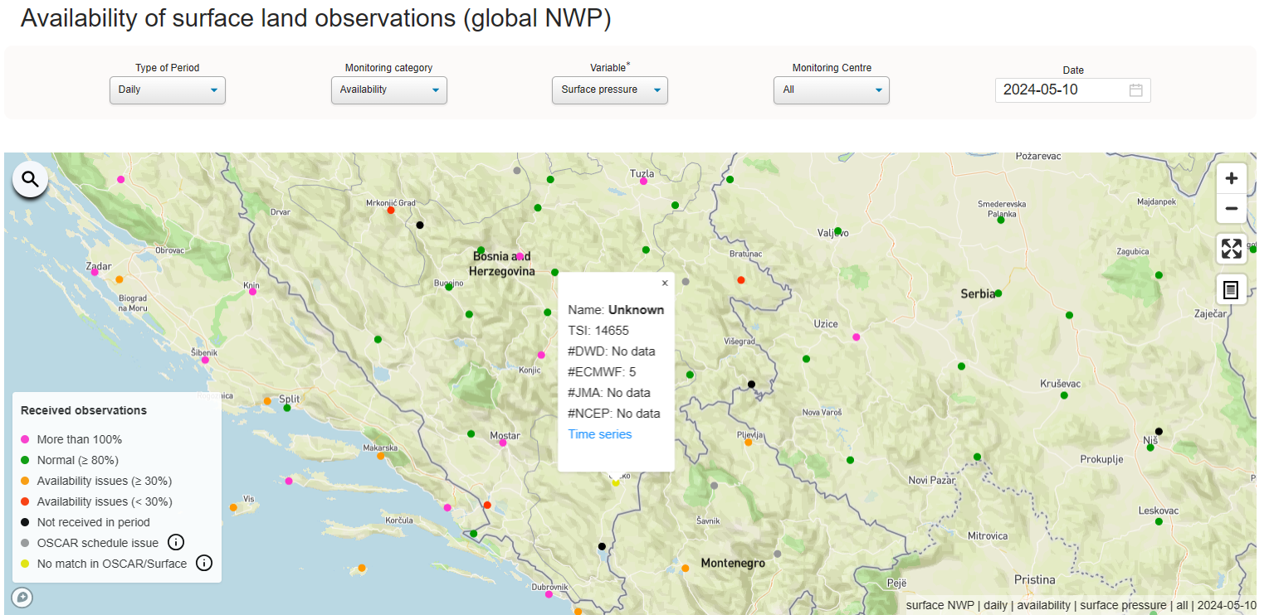
EXAMPLE – 1-1 : WIGOS IDENTIFIER ISSUE
WIGOS
IDENTIFIER ISSUE
NO match in OSCAR/Surface

Slide 4
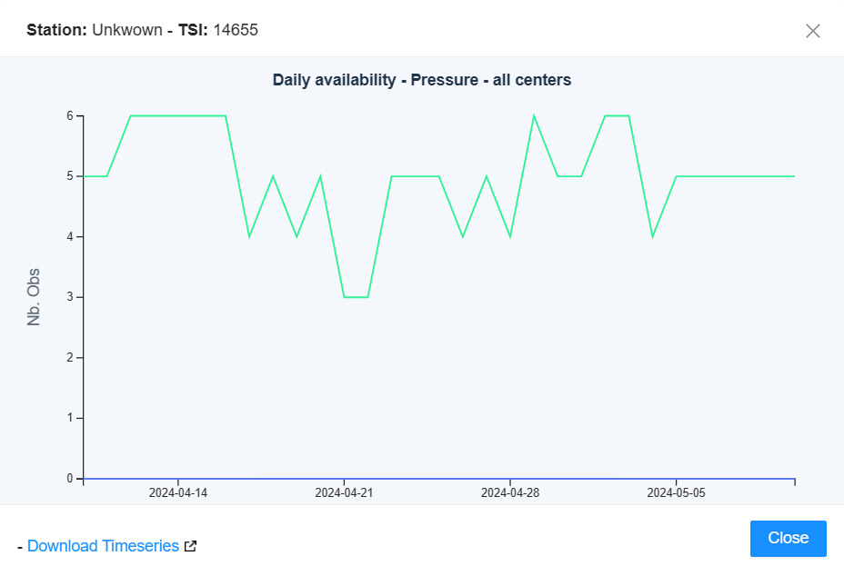
EXAMPLE – 1-2 : WIGOS IDENTIFIER ISSUE
EXPECTED:?
RECEIVED 4, 5, 6 etc

Slide 5
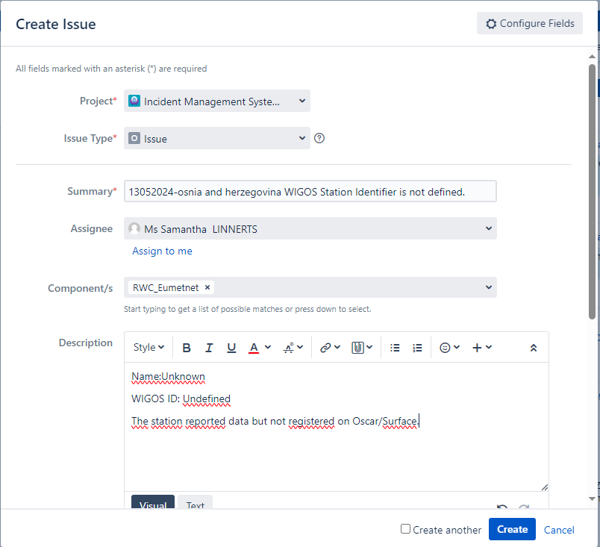
IMS PLATFORM
Project: Incident Management System for RWC (by default)
Issue type: “Issue” (by default);
Summary: The issue may be given in a specific format, below is an example of the format and its explanation.:
ddmmyyyy-country-station/location-issue,
“ddmmyyyy”: day, month and year when ticket is created
country: country where the station is located
station/location: station name
issue: keyword of the issue
Assignee: NFP:WDQMS
Component(s): The responsible RWC of the station where the issue(s) occurred can be selected from this list.
Description: Text that contains detailed explanations, including possible causes of the issue(s) and suggestions on how to solve it, if possible.

Slide 6
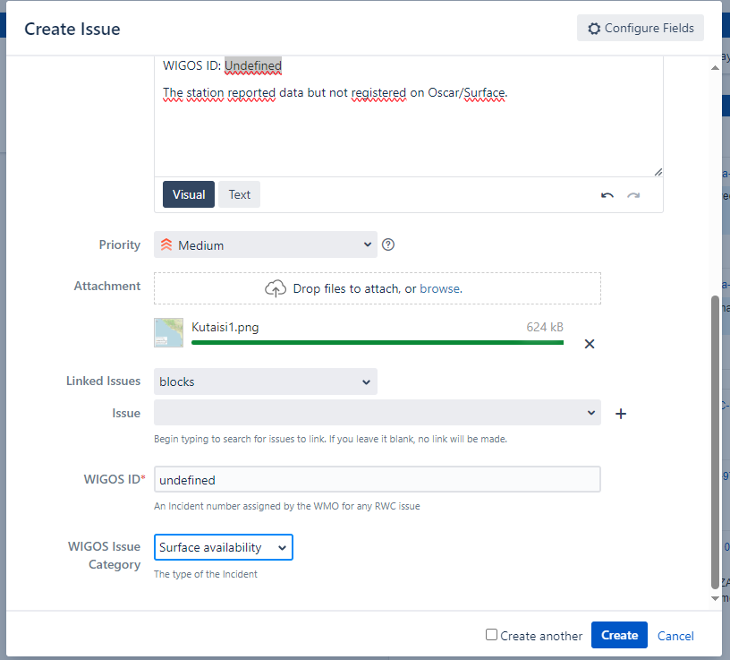
IMS PLATFORM
Priority: The priority level specified in the Regional WIGOS Centers Technical Guidelines for the WIGOS Data Quality Monitoring System. The appropriate value can be selected from the list.
Linked issues: If the issue is related to a previously recorded problem, it can be selected from this section.
WIGOS ID: WIGOS Station Identifier (WSI) as registered in OSCAR/surface.
WIGOS issue category: Depending on the type of issue, surface land observation availability, upper air land observations availabilty will be selected.

Slide 7
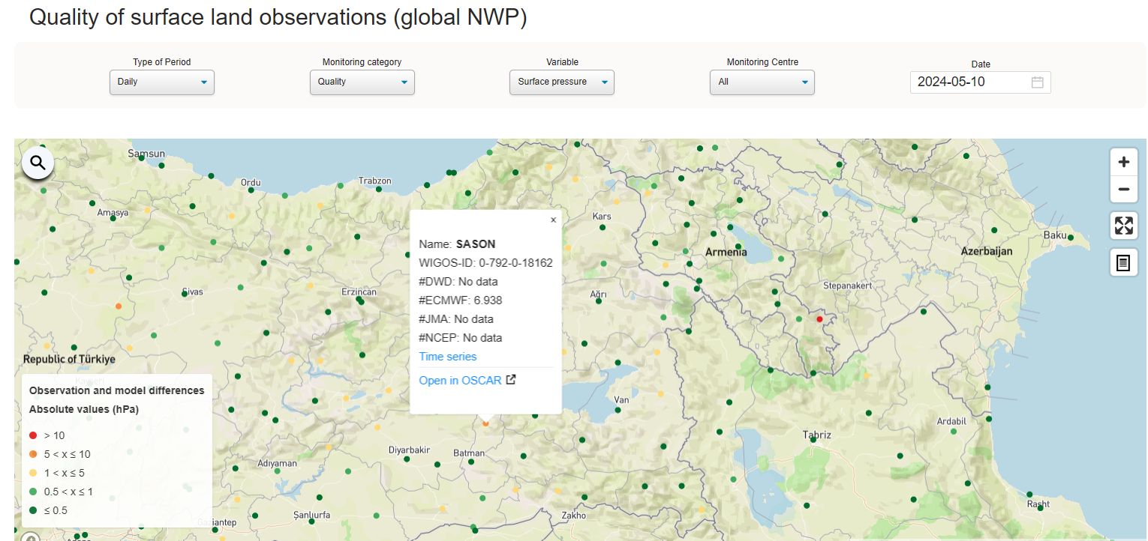
EXAMPLE – 2-1 : DATA QUALITY ISSUE
Observation and Model Differences
5< X ≤10

Slide 8
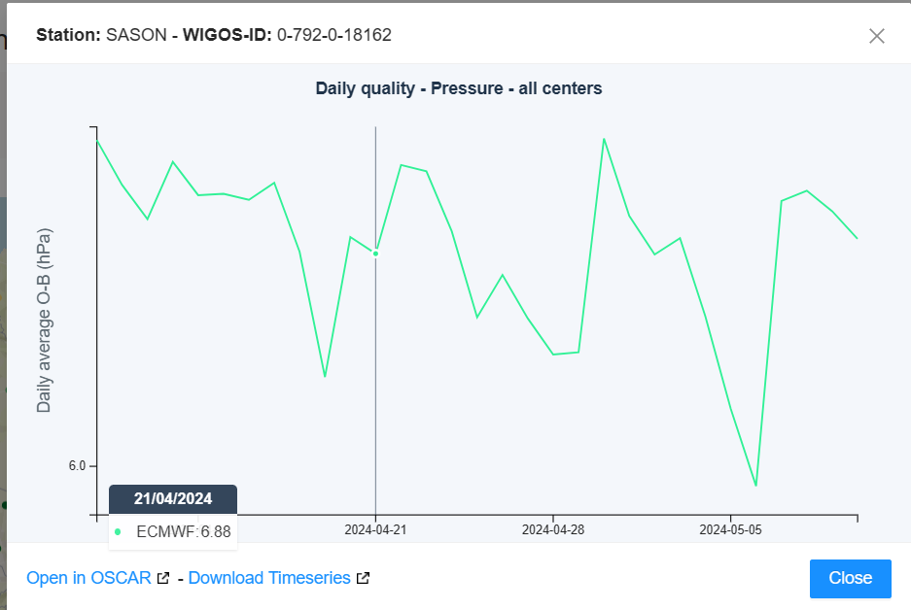
EXAMPLE – 2-2 : DATA QUALITY ISSUE
<7
<7
Minimum
Differences
≥6

Slide 9
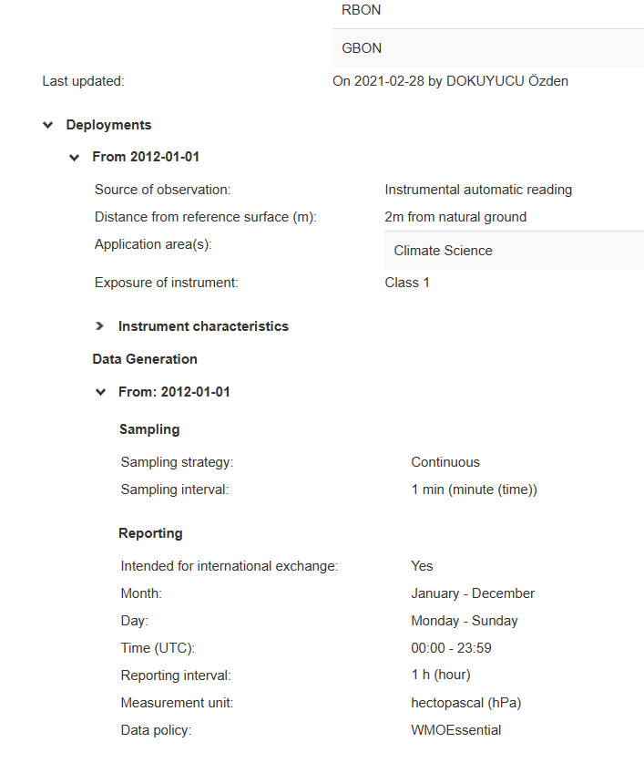
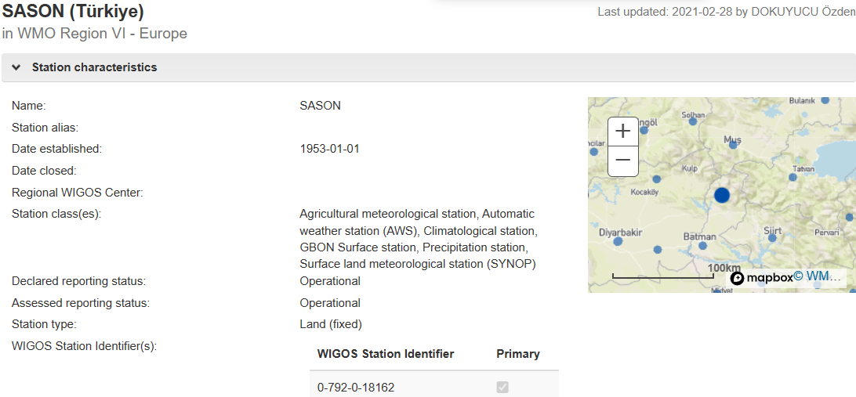
EXAMPLE – 2-3 : DATA QUALITY ISSUE
NO FAULT

Slide 10
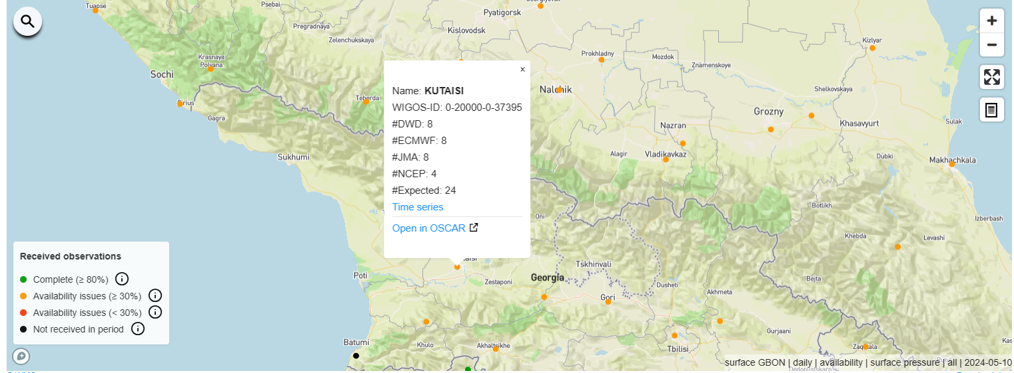
EXAMPLE – 3-1 : AVAILABILITY ISSUE
EXPECTED:24
RECEIVED:8

Slide 11
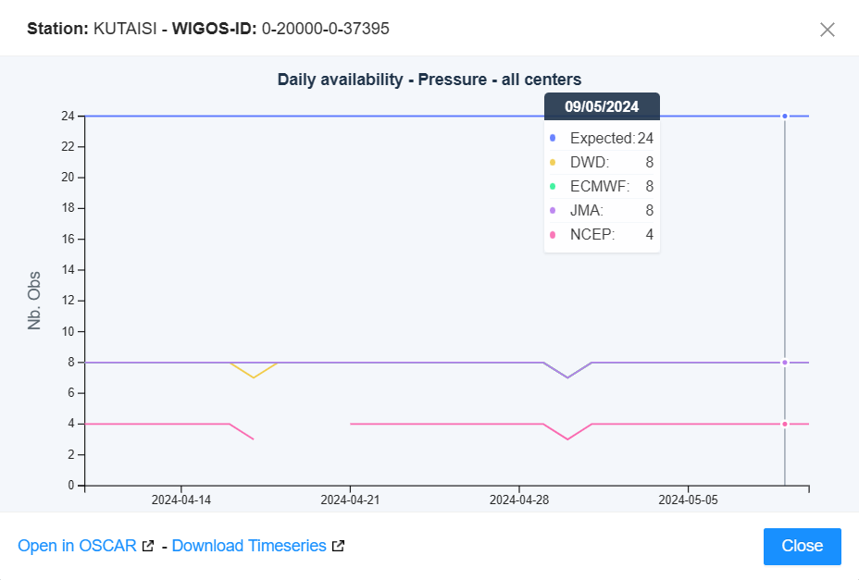
EXAMPLE – 3-2 : AVAILABILITY ISSUE

Slide 12
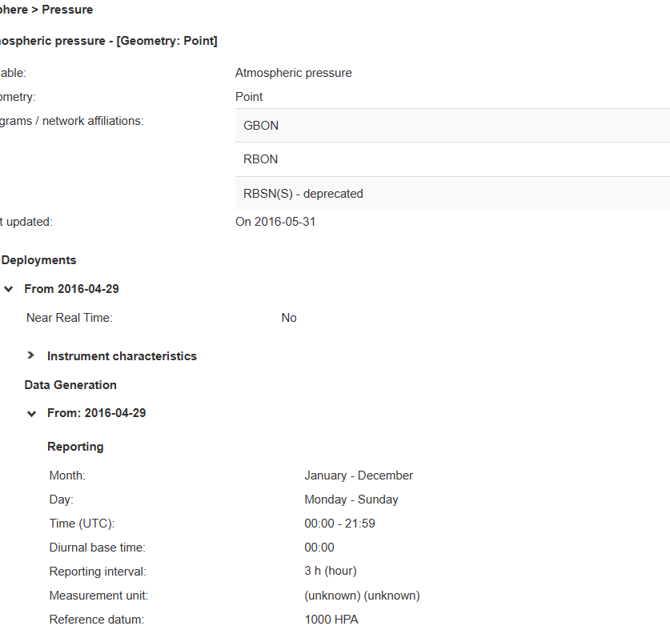
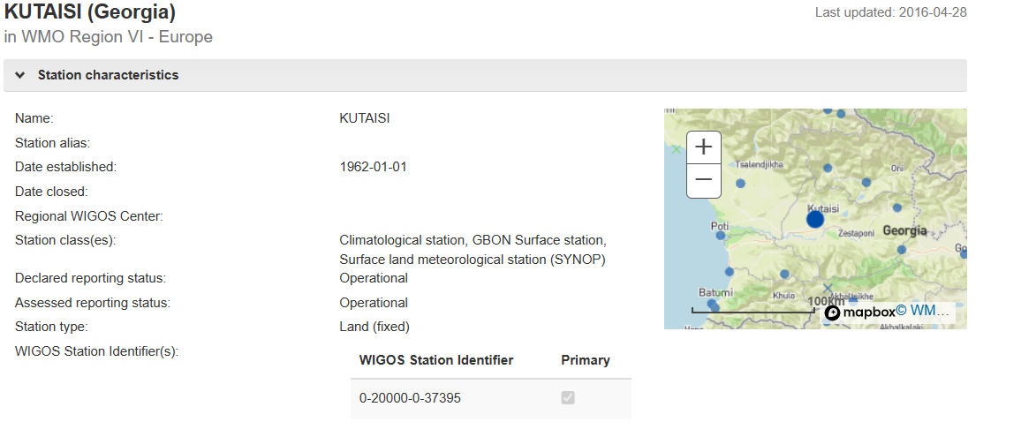
EXAMPLE – 3-3 : AVAILABILITY ISSUE
Intended for international exchange: ???

Slide 13
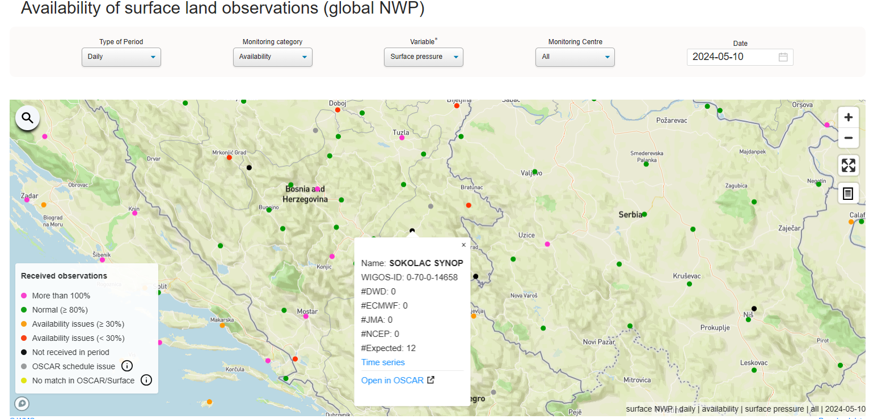
EXAMPLE – 4-1 : AVAILABILITY ISSUE
EXPECTED:12
RECEIVED:0

Slide 14
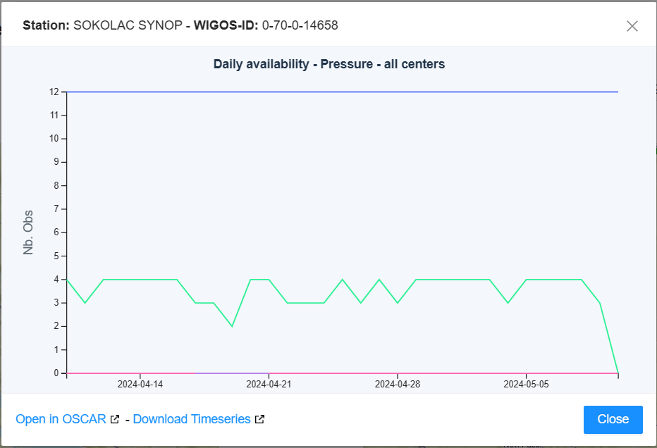
EXAMPLE – 4-2 : AVAILABILITY ISSUE
RECEIVED 2-4
LAST TIME: 0

Slide 15
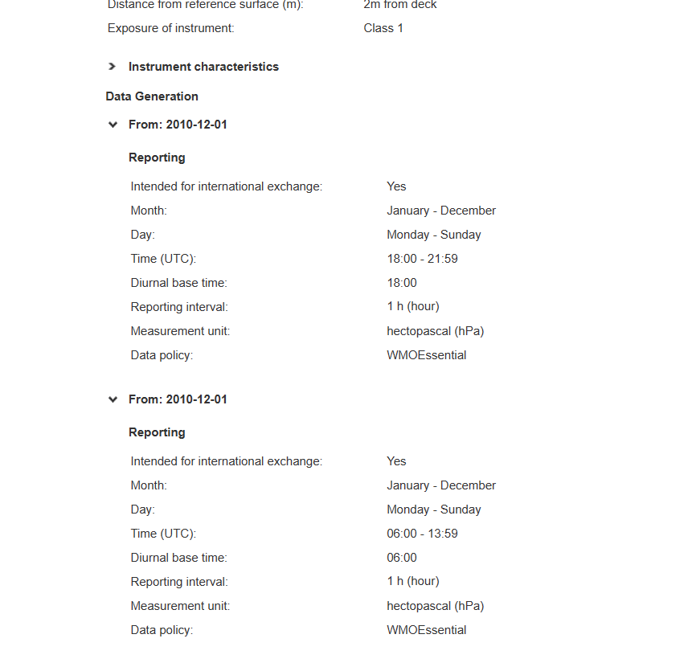
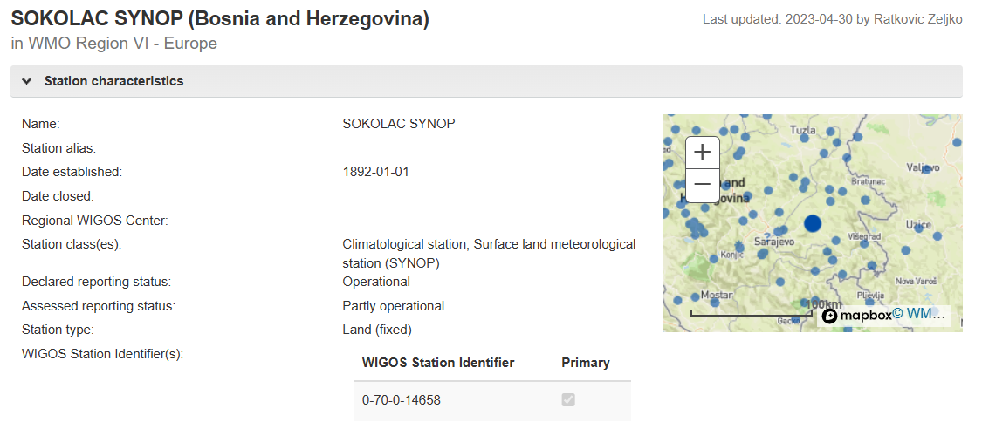
EXAMPLE – 4-3 : AVAILABILITY ISSUE
NO FAULT

Slide 16
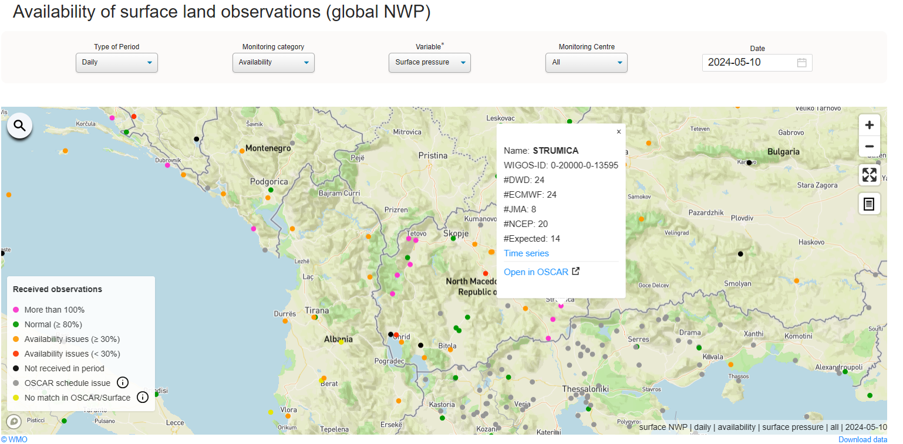
EXAMPLE – 5-1 : AVAILABILITY ISSUE
EXPECTED:14
RECEIVED:24

Slide 17
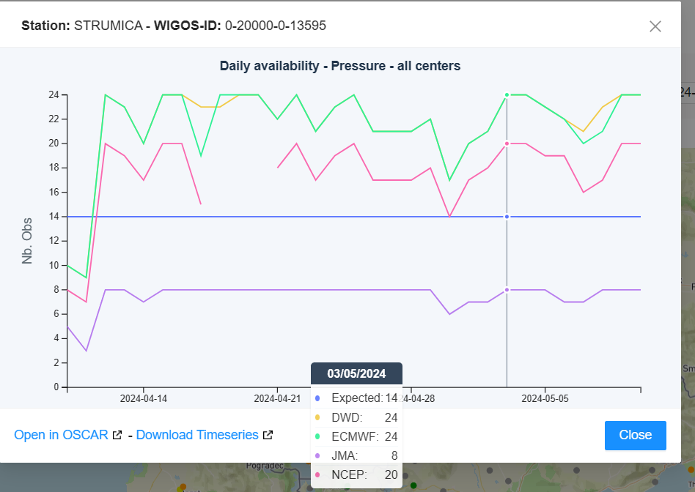
EXAMPLE – 5-2 : AVAILABILITY ISSUE

Slide 18
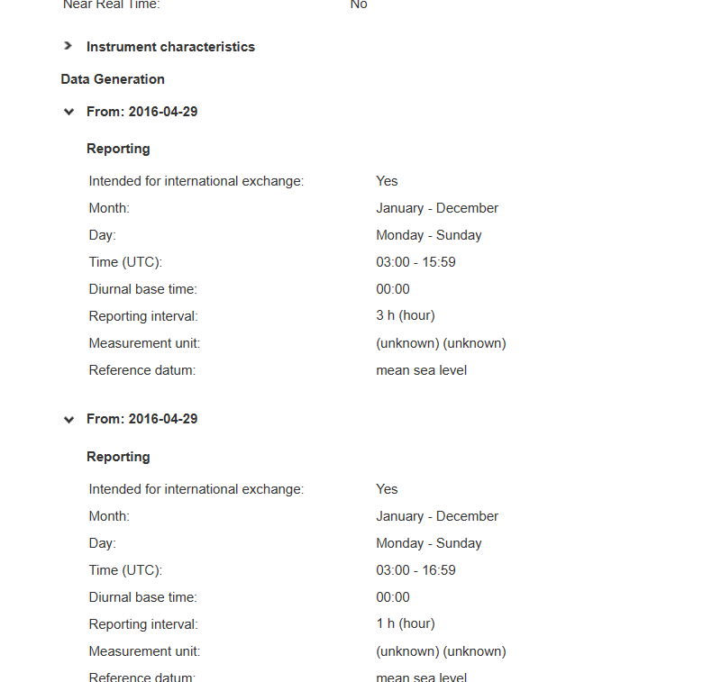
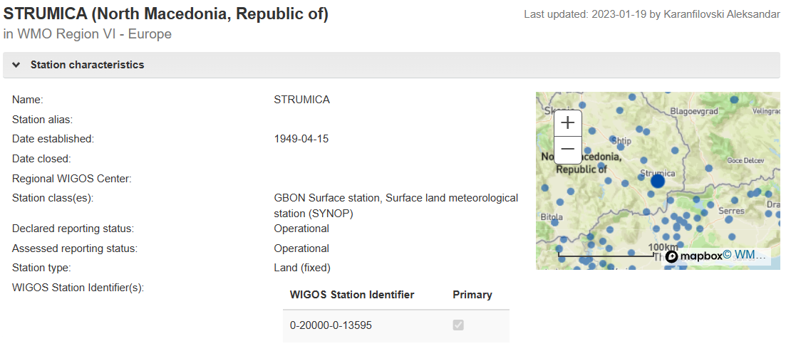
EXAMPLE – 5-3 : AVAILABILITY ISSUE
Data Availabilty Issue
SAME DATA GENERATION

Slide 19
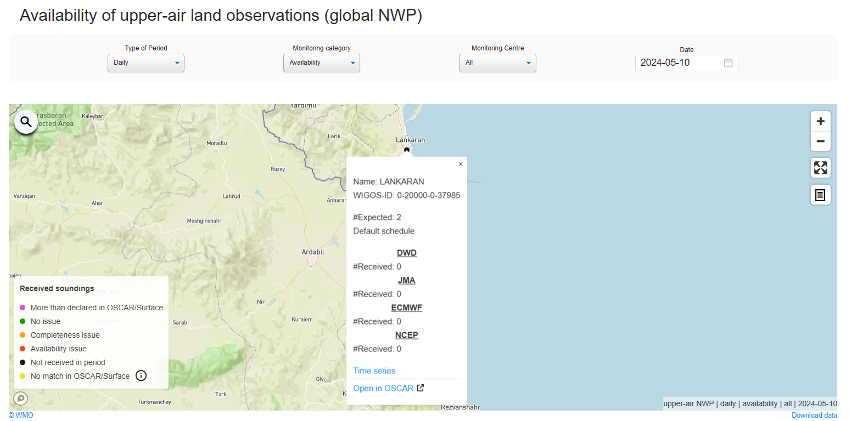
EXAMPLE – 6-1 : UPPER AIR AVAILABILITY ISSUE
EXPECTED: 2
RECEIVED: 0

Slide 20
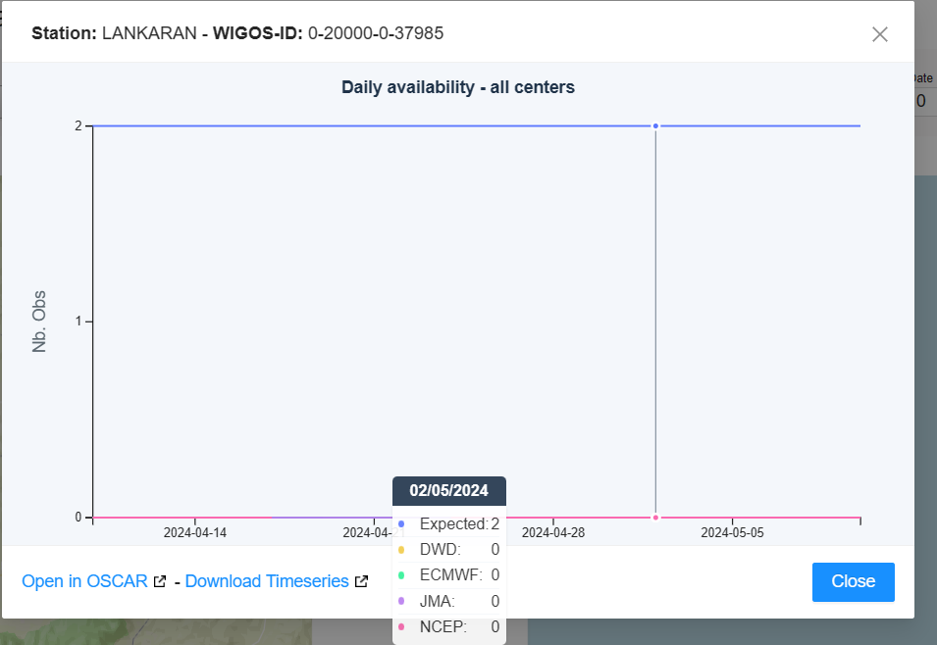
EXAMPLE – 6-2 : UPPER AIR AVAILABILITY ISSUE

Slide 21
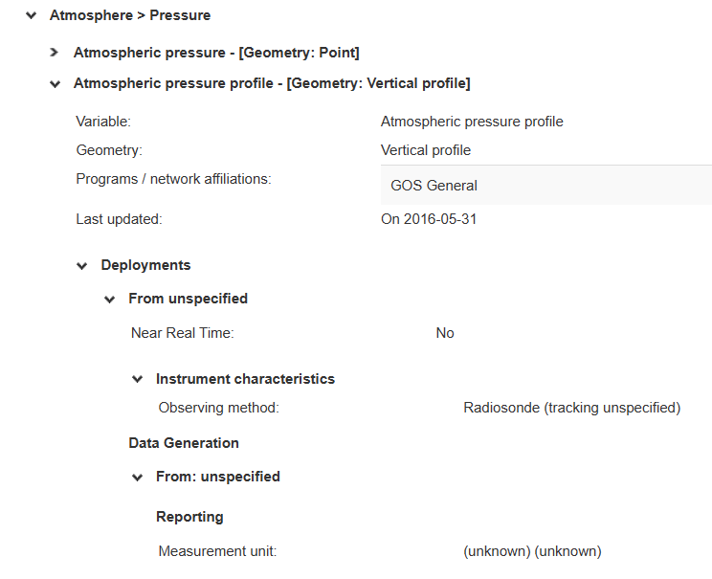
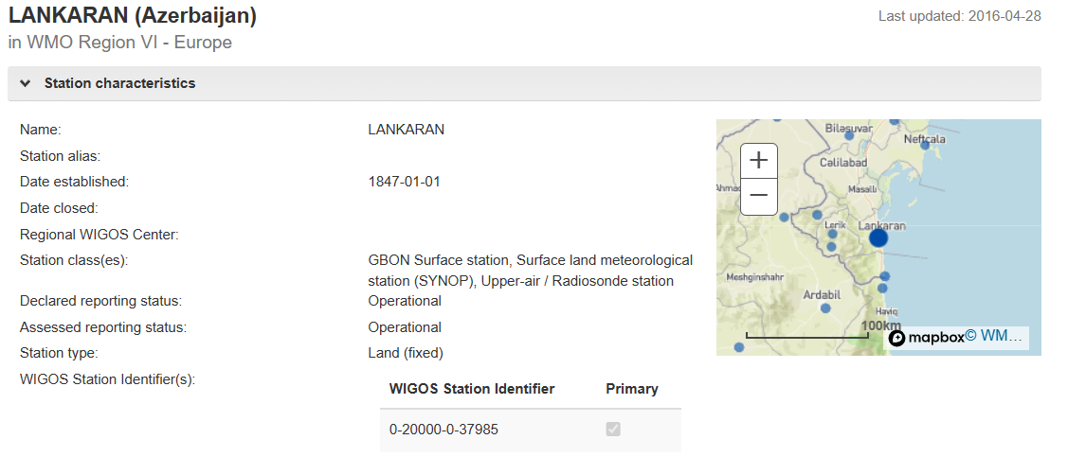
EXAMPLE – 6-3 : UPPER AIR AVAILABILITY ISSUE
Intended for international exchange: ???

Slide 22
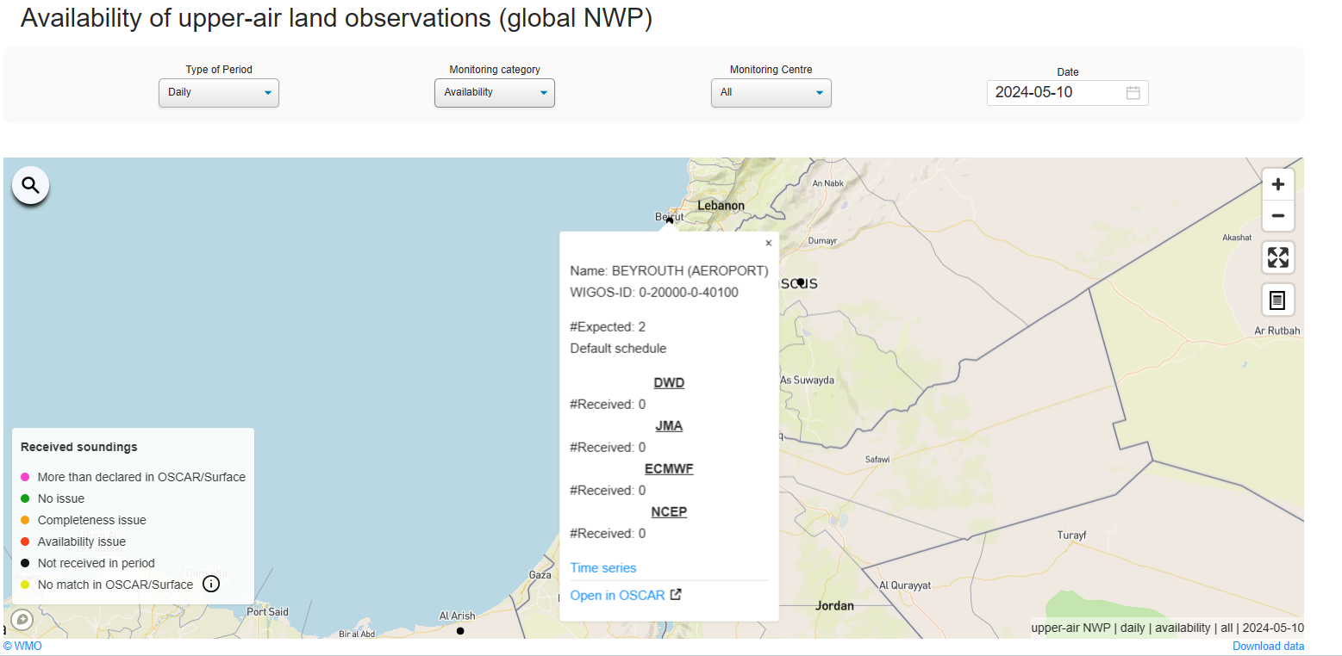
EXAMPLE – 7-1 : UPPER AIR AVAILABILITY ISSUE
EXPECTED: 2
RECEIVED: 0

Slide 23
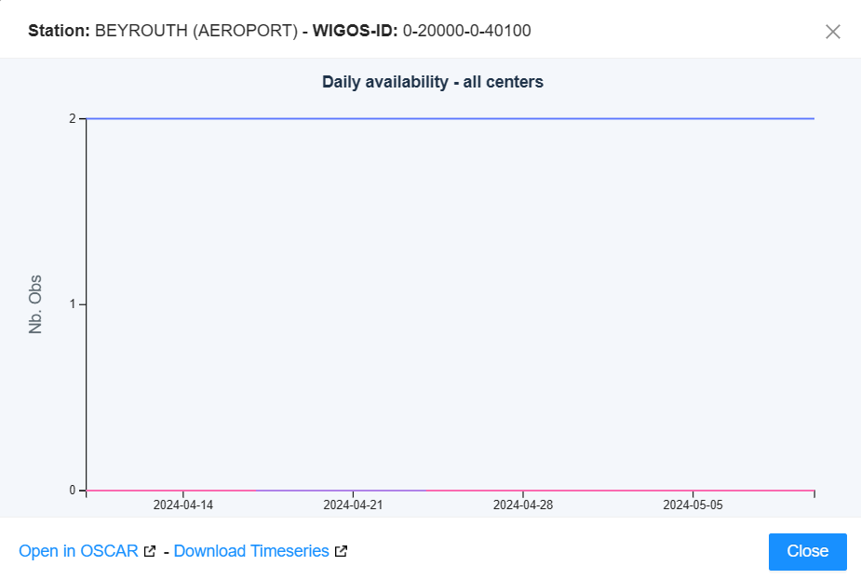
EXAMPLE – 7-2 : UPPER AIR AVAILABILITY ISSUE

Slide 24
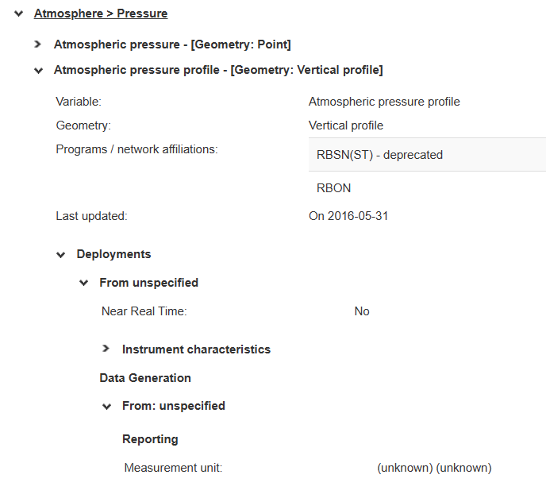
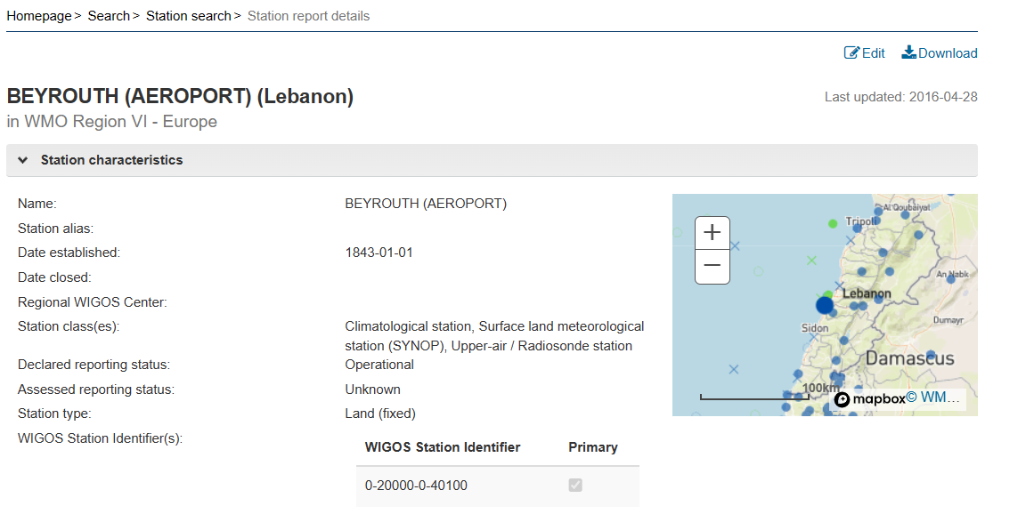
EXAMPLE – 7-3 : UPPER AIR AVAILABILITY ISSUE
Intended for international exchange: ???

Slide 25

For Your Attention.

