Slide 1


Priority activities
TCC-2
22 April 2024

Slide 2

Background
At TCC-1 (17-19 October 2023) SERCOM, INFCOM and RB presented an initial tentative list of priority activities (Doc. 3.2), over the short-, medium- and long-term
TCC-1 requested to finalize a consolidated list of priority activities for the work programmes, to be eventually adopted at their next sessions.
TCC-1 also requested to integrate the priority activities of technical commissions, regional associations and Research Board in the EW4All implementation plan
Definitions:
“short-term” → end of 2024
“mid-term” → to 2025 (Cg-Ext(2025))
“long-term” → to 2027 (final deadline of EW4All)

Slide 3
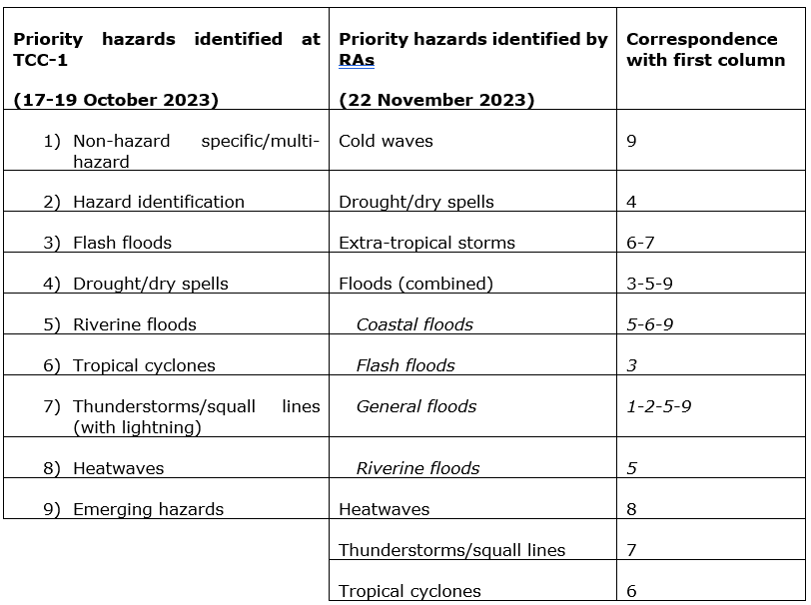
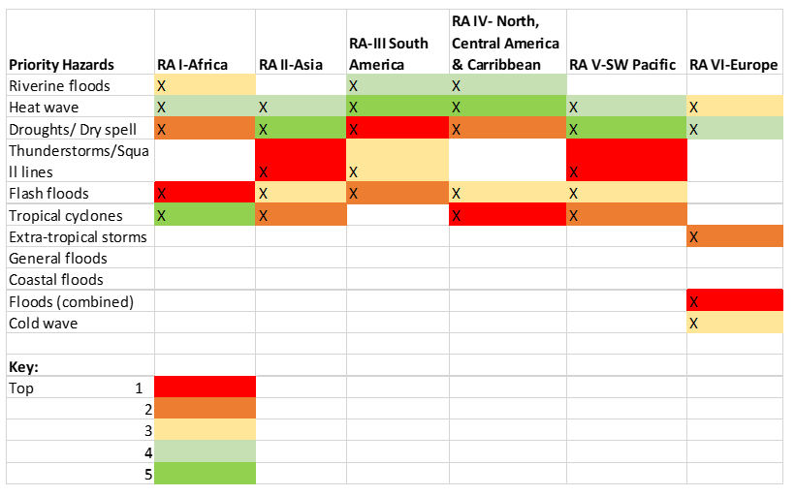
Methodology - Priority Hazards
Consolidated list of activities compiled against the 9 priority hazards (based on the survey carried out in 30 countries during Cg-19) presented in October 2023 at TCC-1
Refined list presented to TCC on 22 November, together with the prioritization of hazards by the six RAs.

Slide 4
Methodology – Activities along the value cycle
Different iterations with relevant focal points of the subsidiary bodies of the technical commissions and the Research Board to collect information on activities potentially contributing to the EW4All
Collected in 10 categories (further scaled down to 6) representing the different elements of the value cycle
a. | global observation of variables | Data and observation
b. | international exchange of data (both observation and products)
c. | global numerical weather prediction (NWP) | NWP
d. | limited area NWP (particularly of interest for hydrological hazards)
e. | other activities (research focused) | Research
f. | nowcasting | Forecaster added value
g. | local data processing, forecast, guidance products (requiring human intervention)
h. | impact- and risk-based forecasts and warnings | Dissemination and communication
i. | warning dissemination
j. | support to decision making | Decision support

Slide 5
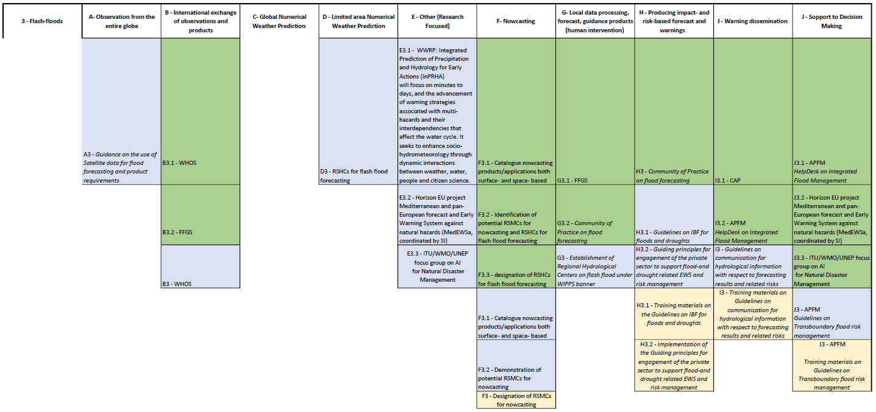

Slide 6













Research
FLASH FLOODS
WWRP: Integrated Prediction of Precipitation and Hydrology for Early Actions (InPRHA) will focus on minutes to days, and the advancement of warning strategies associated with multi-hazards and their interdependencies that affect the water cycle.
Data & Observations
Guidance on the use of Satellite data for flood forecasting and product requirements
WHOS
ITU/WMO/UNEP focus group on AI for Natural Disaster Management
FFGS
Horizon EU project Mediterranean and pan-European forecast and Early Warning System against natural hazards (MedEWSa, coordinated by SI)
Decision Support
APFM HelpDesk on Integrated Flood Management
ITU/WMO/UNEP focus group on AI for Natural Disaster Management
Horizon EU project Mediterranean and pan-European forecast and Early Warning System against natural hazards (MedEWSa, coordinated by SI)
Numerical Weather Prediction
RSHCs for flash flood forecasting
APFM: Guidelines on Transboundary flood risk management
APFM: Training materials on Guidelines on Transboundary flood risk management
Dissemination & Communication
Forecaster added value
Community of Practice on flood forecasting
Guidelines on IBF for floods and droughts
Community of Practice on flood forecasting
Identification of potential RSMCs for nowcasting and RSHCs for flash flood forecasting
APFM HelpDesk on Integrated Flood Management
Guidelines on communication for hydrological information with respect to forecasting results and related risks
Designation of RSHCs for flash flood forecasting
Catalogue nowcasting products/ applications both surface- and space- based
CAP
Short-Term
Medium-Term
Long-Term
Guiding principles for engagement of the private sector to support flood-and drought related EWS and risk management
Implementation of the Guiding principles for engagement of the private sector to support flood-and drought related EWS and risk management
FFGS
Establishment of Regional Hydrological Centers on flash flood under WIPPS banner
Training materials on Guidelines on communication for hydrological information with respect to forecasting results and related risks
Training materials on the Guidelines on IBF for floods and droughts
Demonstration of potential RSMCs for nowcasting
Designation of RSMCs for nowcasting

Slide 7
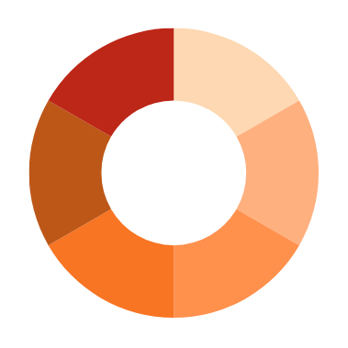

DROUGHT
Research
WWRP: Sub-seasonal to seasonal Applications for Agriculture and Environment (SAGE)
Horizon EU project Mediterranean and pan-European forecast and Early Warning System against natural hazards (MedEWSa, coordinated by SI)
Data & Observations
ITU/WMO/UNEP focus group on AI
for Natural Disaster Management
Standard GBON observations
HydroSOS
Decision Support
Horizon EU project Mediterranean and pan-European forecast and Early Warning System against natural hazards (MedEWSa, coordinated by SI)
IDMP: HelpDesk on Integrated Drought Management
Numerical Weather Prediction
HydroSOS
Identification and designation of RSHCs for snow cover prediction
Identification of impact-related indices (e.g. SPI, SPEI)
IDMP Guidance for water use, allocation and accounting in the Water Energy Food Ecosystems nexus
Training materials on Guidance for water use, allocation and accounting in the Water Energy Food Ecosystems nexus
Regional Climate Centers
RSHCs for snow cover prediction
Provision of impact-related indices (e.g. SPI)
Dissemination & Communication
IDMP HelpDesk on Integrated Drought Management
Training Members on developing National Drought Plans and Policies
Forecaster added value
Identification of potential RSMCs drought monitoring
HydroSOS
HydroSOS, VAMIS, CAP
Climate and hydrological prediction services
Guiding principles for engagement of the private sector to support flood-and drought related EWS and risk management
Dynamic Water resources Assessment Tool (DWAT)
Training Members on National Drought EWS
Framework for the evaluation of gaps and needs with respect to national drought forecasting and early warning systems
Short-Term
Medium-Term
Long-Term
Possible establishment of Global/Regional Centres on Drought Monitoring
Establishment of Regional Hydrological Centers on seasonal to sub-seasonal forecasting under WIPPS banner
Guidelines on Communicating Drought Information
Guidelines on communication for hydrological information with respect to forecasting results and related risks
Guidance on Flash drought
Possible establishment of Global/Regional Centres on Drought Monitoring
Training materials on Guidelines on communication for hydrological information with respect to forecasting results and related risks
Implementation of the Framework for the evaluation of gaps and needs with respect to national drought forecasting and early warning systems
Implementation of the Guiding principles for engagement of the private sector to support flood-and drought related EWS and risk management

Slide 8
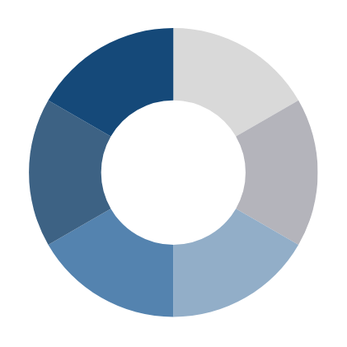

RIVERINE FLOODS
Research
Horizon EU project Mediterranean and pan-European forecast and Early Warning System against natural hazards (MedEWSa, coordinated by SI)
ITU/WMO/UNEP focus group on AI for Natural Disaster Management
Data & Observations
WHYCOS, WHOS, HydroSOS
Guidance on the use of Satellite data for flood forecasting and product requirements
Guidance on observation network density requirements for flood forecasting
Decision Support
Horizon EU project Mediterranean and pan-European forecast and Early Warning System against natural hazards (MedEWSa, coordinated by SI)
APFM Guidelines on Transboundary flood risk management
Numerical Weather Prediction
Catalogue global flood modelling capabilities, pilot the function as WIPPS centre
RSHCs for global riverine flood prediction
APFM Training materials on Guidelines on Transboundary flood risk management
APFM HelpDesk on Integrated Flood Management
Establishment of a new WIPPS activity for global riverine flood prediction and designation of RSHCs
Dissemination & Communication
Community of Practice on flood forecasting
CAP, CIFI
Forecaster added value
Guiding principles for engagement of the private sector to support flood-and drought related EWS and risk management
Guidelines on communication for hydrological information with respect to forecasting results and related risks
Community of Practice on flood forecasting
Inventory of models and platforms for flood forecasting
Short-Term
Medium-Term
Long-Term
Catalogue nowcasting products/applications both surface- and space- based
Implementation of the Guiding principles for engagement of the private sector to support flood-and drought related EWS and risk management
Training materials on Guidelines on communication for hydrological information with respect to forecasting results and related risks

Slide 9


TROPICAL CYCLONES
Research
Data & Observations
Sowing Seeds of Innovation: workshop in Central America/Caribbean focused on hurricanes to be held in Feb 2024 and workshop in southern Africa on TCs to be held in late 2024
WWRP with SERCOM and INFCOM: Tropical Cyclone - Probabilistic Forecast Products (TC-PFP) using the vale-cycle approach to probabilistic tropical cyclone forecasts of TC formation, position, structure, rainfall and storm surge
Coordination to ensure continual access to satellite data/products, radar images, AWS data, buoys
Region-specific TC Operational Plans/ Manuals
Operational Plans are updated regularly during the tropical cyclone regional bodies sessions
Numerical Weather Prediction
Tropical Cyclone Programme (TCP), Severe Weather Forecasting Programme (SWPF), Coastal Inundation Forecasting Initiative (CIFI)
Decision Support
More Members to establish national coordination procedures / mechanisms, e.g. National Crisis and Emergency Management Council/Committee, legislative frameworks, etc
Definition of tropical low/cyclone vortices variables
MCs and cascading by TC RSMCs, ensemble forecasting, etc.
Forecaster added value
Three 6-hourly updating by TC RSMCs and NMCs, up to 5 days for each region
TC RSMCs for regional advisory products and NMCs for national forecasting and warnings, both with human intervention in formulating products and information
Dissemination & Communication
Common Alerting Protocol
Coordinated standard operating procedures at regional and national levels through operational plans
TC Forecaster competency framework (Compendium of WMO Competency Frameworks (WMO nr 1209)
Short-Term
Medium-Term
Long-Term
TC RSMCs are leading to developing IBF products with risk information, including impacting areas, utilities and communities for actions
Marine Services course - progress rollout across regions and languages; The application of the Competency Assessment Implementation (Toolkit) - progress; IMO Mariner model courses - updates to meteorological training

Slide 10
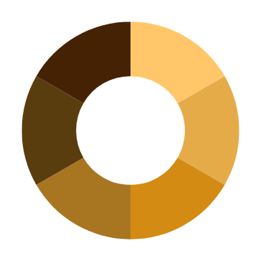

THUNDERSTORMS-SQUALL LINE
Research
Data & Observations
WWRP: WISER – EWSA (Weather and Climate Information Service - Early Warnings for Southern Africa) to improve early warnings of storms through the co-production of satellite-based nowcasting and NWP services
WWRP in coordination with SC-AVI, AvRDP Phase 2 research project to enhance early warnings for aviation forecasting of significant convection and associated hazards
Support to RSMC's for Numerical Ocean Prediction and Numerical Wave Prediction (establishment and evaluation)
Denser network of conventional and non-conventional observations, and application of new technology for rapid processing of observed and processed data.
SWFP subprogrammes
Numerical Weather Prediction
WWRP: WISER – EWSA (Weather and Climate Information Service - Early Warnings for Southern Africa) to improve early warnings of storms through the co-production of satellite-based nowcasting and NWP services available on APPs, website and capacity development done through 2 testbeds in Zambia and Mozambique
WMCs and RSMCs NWC and cascading by RSMCs SWF and regional SWF centres
SWFP coordinated regional and supporting to run fine LAM models resolving thunderstorms.
WMCs and RSMCs for SWF cascading.
RSMCs and Regional SWF Centre under SWFP
Decision Support
Forecaster added value
Marine Emergency Response Guide
SWFP to support National – subnational decision making in DRR response
SWFP regional subprogrammes
2 RSMCs SWFP develop udpdatedimproved guidance products with support from satellite operating centres (e.g. EUMETSAT, CMA, IMD, JMA etc.) and RSMCs for nowcasting
NMHSs of 30 Members have access to improved guidance products
Identification of potential RSMCs for nowcasting
SWFP regional subpogrammes
4 RSMCs SWFP develop improved guidance products for the neighbouring NMHSs with support from satellite operating centres (e.g. EUMETSAT, CMA, IMD, JMA etc.) and RSMCs for nowcasting
NMHSs of 60 Members have access to improved guidance products
Dissemination & Communication
Tailored guidance products developed
Implementation of Iridium SafetyCast across all METAREAS
Short-Term
Medium-Term
Long-Term
CAP
Catalogue nowcasting products/applications both surface- and space- based
IBF and risk information included in the forecasting products
Regional Specialized Meteorological Centers on marine meteorology and severe weather forecasting
Designation of RSMCs for nowcasting
Demonstration of potential RSMCs for nowcasting
NMHSs of 80 Members have access to improved guidance products
RSMCs SWFP develop improved guidance products for the neighbouring NMHSs with support from satellite operating centres (e.g. EUMETSAT, CMA, IMD, JMA etc.) and RSMCs for nowcasting

Slide 11
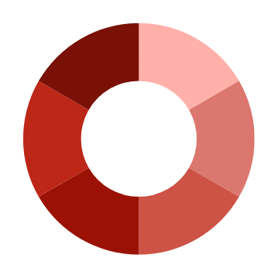

Research
HEATWAVES
Data & Observations
Improved resolution of humidity and wind fields for thermal indices
ITU/WMO/UNEP focus group on AI for Natural Disaster Management
Nationally integrated observing network to be sufficient to monitor and forecast severe weather
Maximum and minimum temperatures for indicator data and heatwave-intensity index. Temperature coupled with wind speed, humidity, radiation and pressure for thermal indices
WWRP :Urban Prediction project starting in 2025 with the purpose to developing applications (such as heat stress) and evaluating sub-kilometre modelling techniques for vulnerable urban communities and advancing the concept of digital cities as a companion to initiatives like Digital Earth and Digital Twins
30 year heatwave hazard climatology for a. temperature, b. thermal indices and c. heatwave-intensity indice
Horizon EU project Mediterranean and pan-European forecast and Early Warning System against natural hazards (MedEWSa, coordinated by SI)
Denser network of conventional and non-conventional observations, and application of new technology for rapid processing of observed and processed data.
Decision Support
Numerical Weather Prediction
Global Heat-Health Information Network (GHHIN/WMO), National Integrated Heat Health Information System support (NIHHIS/NOAA)
Horizon EU project Mediterranean and pan-European forecast and Early Warning System against natural hazards (MedEWSa, coordinated by SI)
Denser network of conventional and non-conventional observations, and application of new technology for rapid processing of observed and processed data
Improved resolution of humidity and wind fields for thermal indices
MMO/CLI revision of WMO No. 1131 Climate Data Management System Spcifications
ITU/WMO/UNEP focus group on AI for Natural Disaster Management
GHHIN, NIHHIS, GEO
Provision of impact-related indices (e.g. Heatwave- Intensity index, Thermal Indices and Temperature indicators via the Extreme Heat Services Roadmap)
Joint GEO/WMO (GHHIN) Global Heat Resilience Service: Integrating remote and local data at city scale for urban planners and managers
Dissemination & Communication
Training Members on good practices for the health sector
30 year heatwave hazard climatology for a. temperature, b. thermal indices and c. heatwave-intensity indice required for development impact-based forecast and warning codesign projects
Training in multi-hazard linkages between drought, dust, heatwave, fire, smoke and flash flood.
Training in CAP for temperature, thermal and heatwave-intensity extreme heat warnings.
MMO/CLI revision of WMO No. 1131 Climate Data Management System Specifications
Provision of impact-related indices (e.g. Heatwave Index)
Forecaster added value
Identification of potential RSMCs for heatwaves centres of excellence in product support, and train the trainer for extreme heat product suite
Training Members on Heat-Early Warning System Guidance
Training on heatwave-intensity principles
Training on interpretation and use of new Handbook on Extreme Heat Indicators and Indices
SWFP regional subprogrammes
RSMCs SWF cascade WMCs’s heat related products and indices to NMHSs as/when available
RSMCs SWFP develop specific guidance products in addition to the current hazards
Short-Term
Medium-Term
Long-Term
Relevant national arrangements support heatwave management
Finalize heat health guidance material
CAP
Guidelines on communicating severity classes for warnings. Co-designed hazard/impact studies guide development of heat action plans
Possible establishment of Global/Regional Centres on Heatwaves
Training Members on Heat-Early Warning System Guidance, Extreme Heat Services and Handbook on Extreme Heat Indicators and Indices
Training Members on good practices for the health and all essential services sectors
Training Members on Heat-Early Warning System Guidance

Slide 12
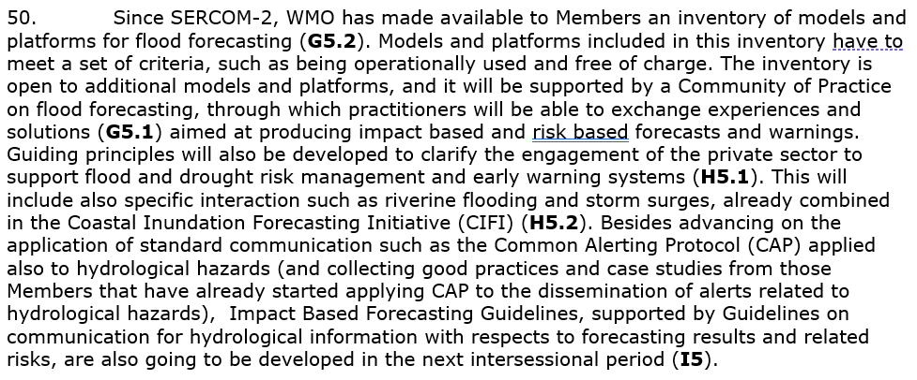
Consolidated list of activities – narrative for Members
Currently provided as Annex to Doc 3.1 (EC-78)
Provides in a narrative form a description of the different proposed activities, and how they fit along the DRR value chain (linking to the activities listed in the table)
Example:

Slide 13
Consolidated list of activities – feedback on priorities
The narrative list was circulated in late January 2024 to Members for their feedback on the prioritization of activities
Deadline coincided with the beginning of SERCOM-3 (4 March 2024) to be able to reflect the list of priority activities in the work programme of SERCOM
Only 39 Members provided feedback by 4 March.
SERCOM-3 considered all its workplan as a contribution to EW4All, and committed to follow the Implementation Plan (now Roadmap for implementation) to prioritize its activities
INFCOM-3 similarly committed, but identifying a subset of activities from its work programme as its contribution to EW4All
All feedback on priorities (from Members, SERCOM and INFCOM) has been included in the Roadmap for Implementation

Slide 14
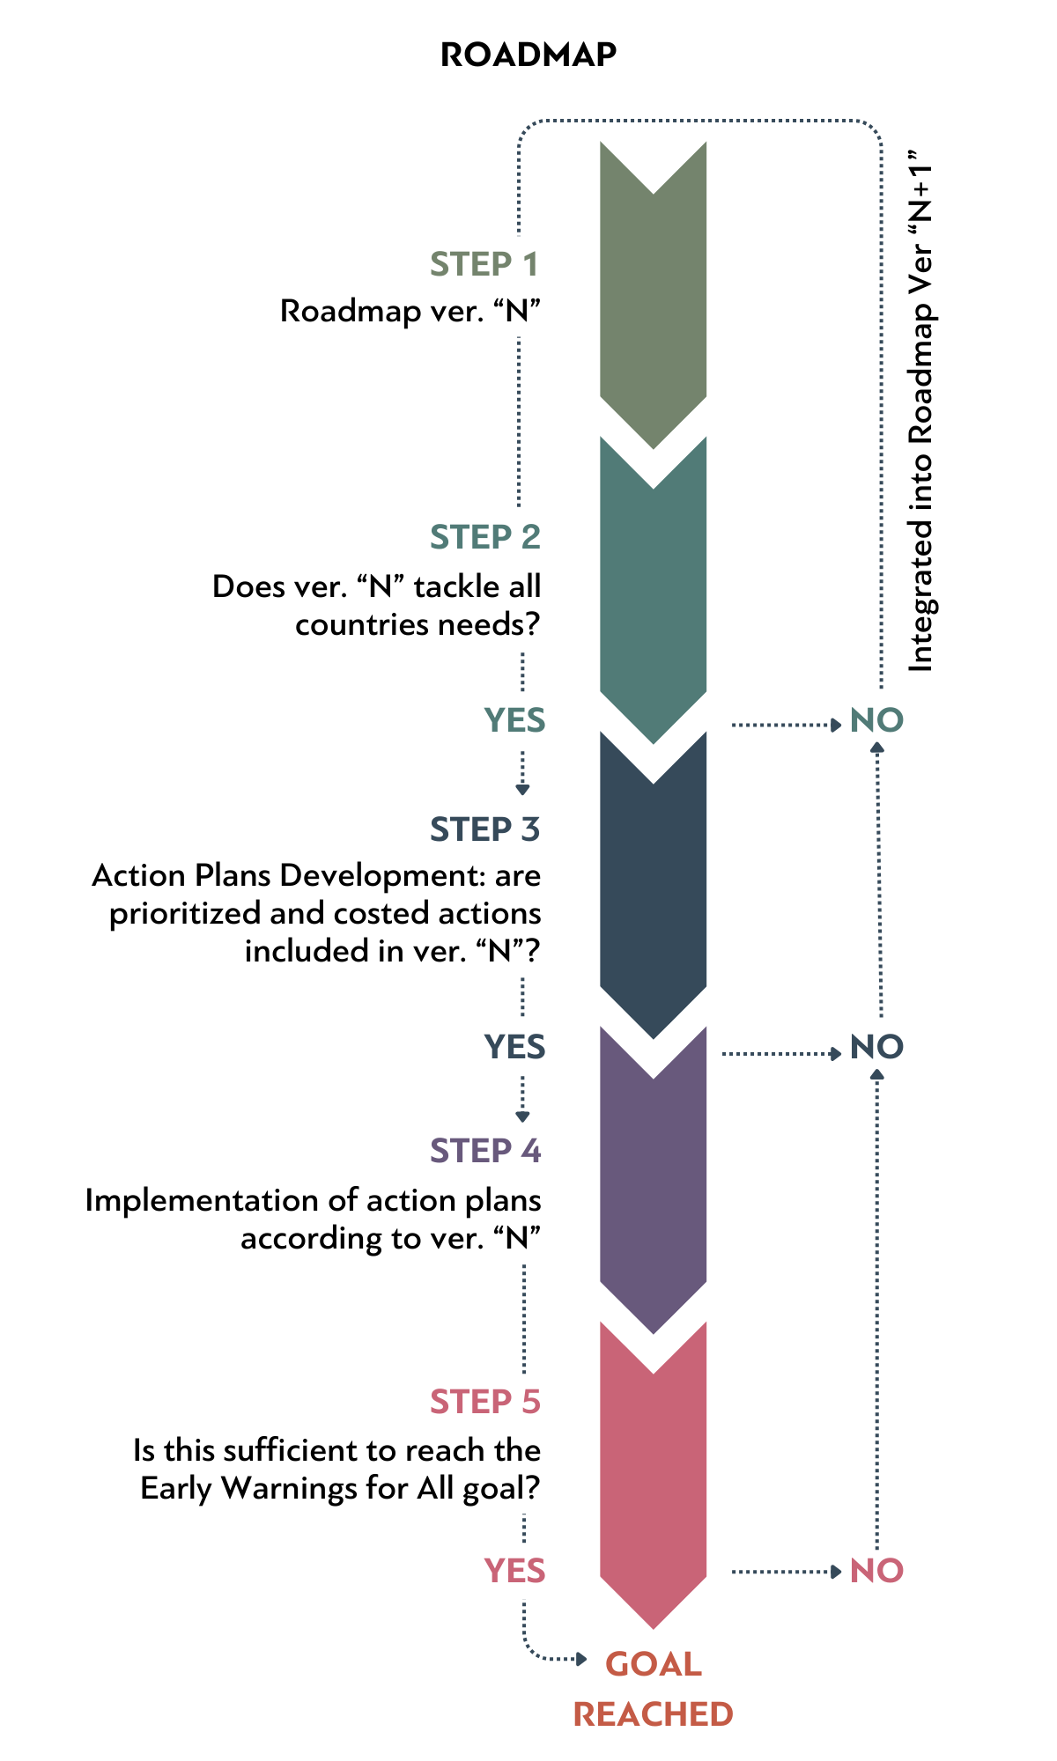
Consolidated list of activities – Next Steps
Following EC-78:
  second iteration of consultations with Members, based on the revised list of priority hazards by Members
  Inclusion of identified updated priority activities into the Roadmap (being a “living document”)
By EC-79 (and following EC sessions):
  Report on the status of implementation of the EW4All initiative and updates to the Roadmap
By 2026 (SERCOM-4 and INFCOM-4):
  Based on the updates to the Roadmap for implementation, technical commissions to update their workplans to prioritize activities identified by Members

Slide 15

Thank you.
^{wmo.int}

