Slide 1

INF 3.1(2)
Early Warnings for All:
A Rapid Assessment of Country Monitoring and
Forecasting Capacity
TCC-PAC-1 (2024)
23-24 April 2024

Slide 2

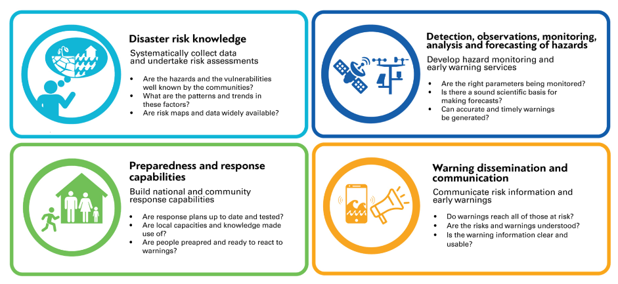
Purpose | Pillar 2 Rapid Assessment
  Inform the planning stage of the Early Warnings for All Initiative
    Quick baseline data, more granular data
  Identify capacity gaps
    Guide technical assistance and investments
  Develop a tool for monitoring country capacity
    Maturity Index
Notes:
2

Slide 3
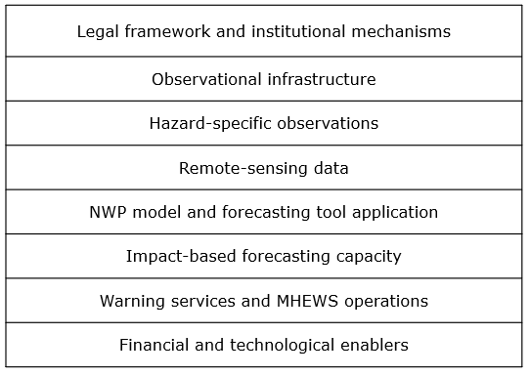
Methodology | Pillar 2 Rapid Assessment
  Scope:
  8 elements of hydrometeorological value chain
  70+ data points
  Quantitative and qualitative data
  5 priority hazards
  (based on WMO Catalogue of Hazardous Events )
  Approach:
  Structured interviews
  Response weighting
  Analysis of qualitative information
  Maturity levels on a scale of 1-5
  Based on:
    Country Hydromet Diagnostics
    MHEWS Checklist
Notes:
3

Slide 4
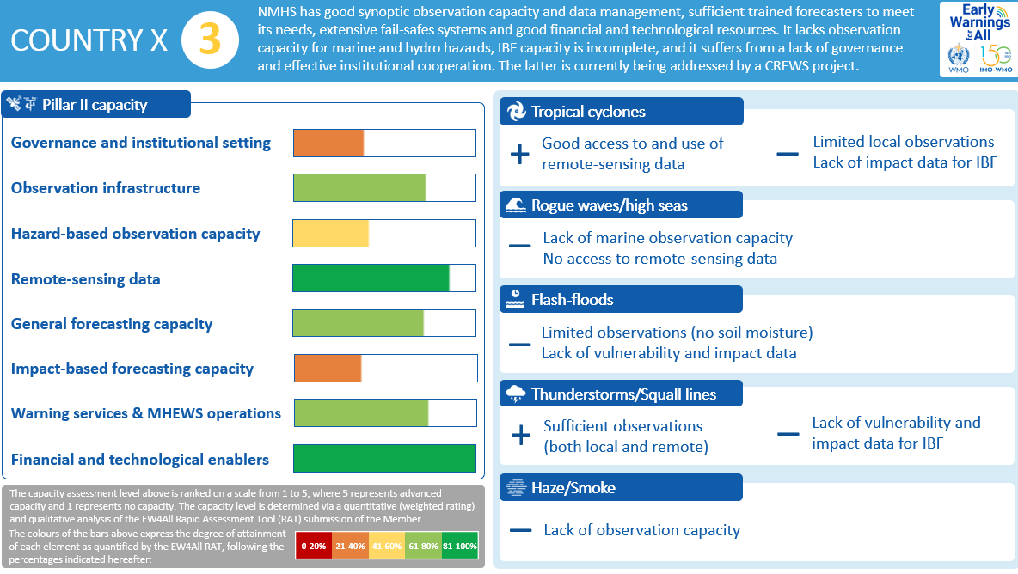
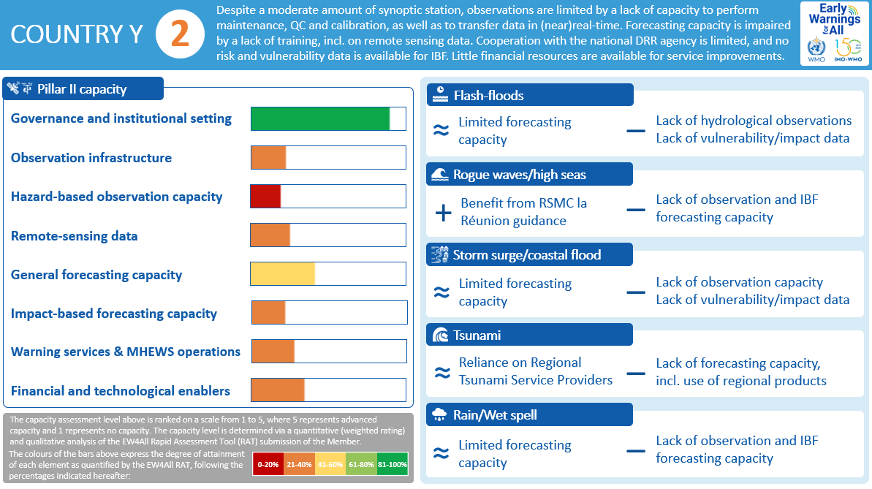
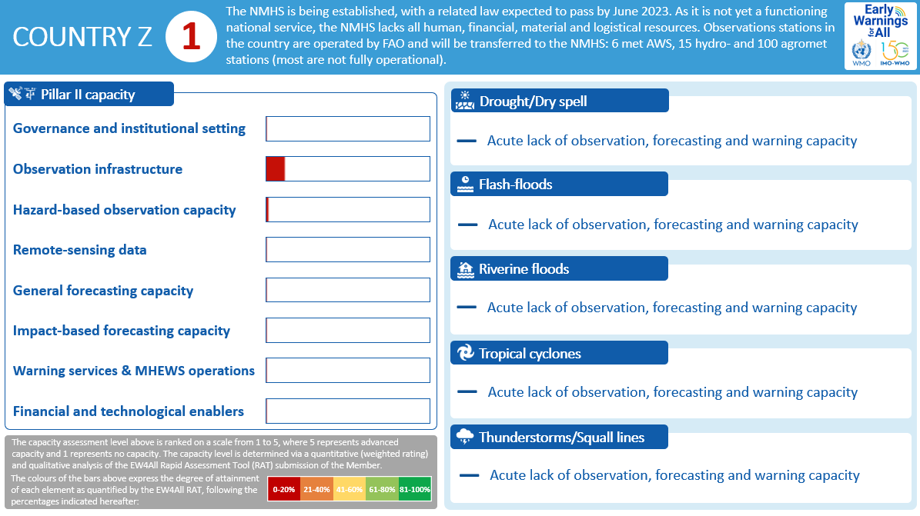
Country Scorecards | Pillar 2 Rapid Assessment

Slide 5

Data Quality Assurance | Pillar 2 Rapid Assessment
Notes:
5

Slide 6
Aggregate Results | Pillar 2 Rapid Assessment
Half of the 30 NMHS operate with basic monitoring and forecasting capacity;
a quarter with less-than-basic capacity
EW4All Pillar 2 capacity levels of 30 selected countries (data collected by WMO, 2023)

Slide 7
Implementation | Pillar 2 Rapid Assessment
  Since June 2023 applied to:
    41 Members, including
      30 initial EW4All focus countries
      8 RA VI Members (based on a request from the Management Group)
      3 other LDCs and SIDS
    Analysis is ongoing on:
        8 Members
Notes:
7

Slide 8
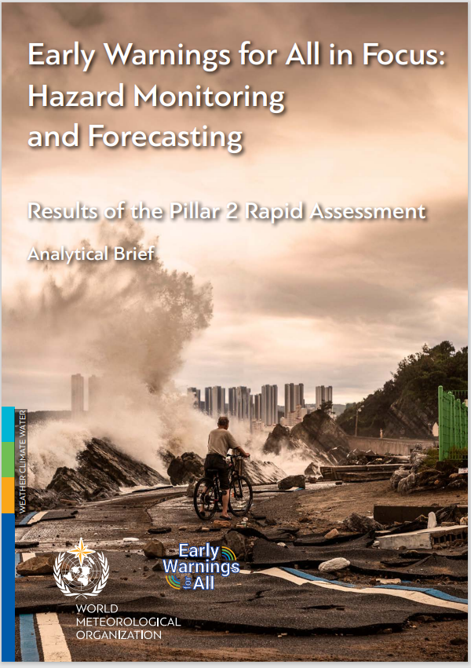

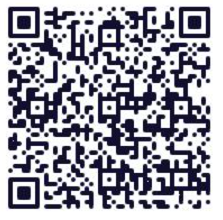
Early Warnings for All in Focus:
A Rapid Assessment of Country Monitoring and Forecasting Capacity

Slide 9
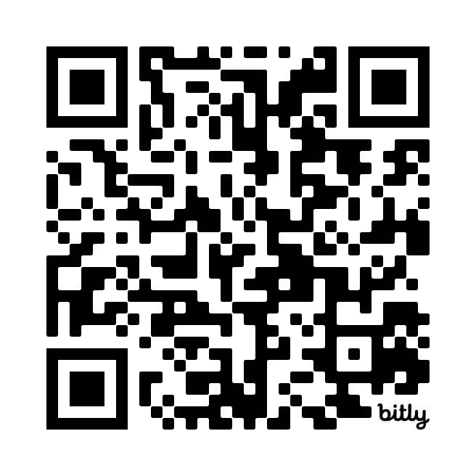
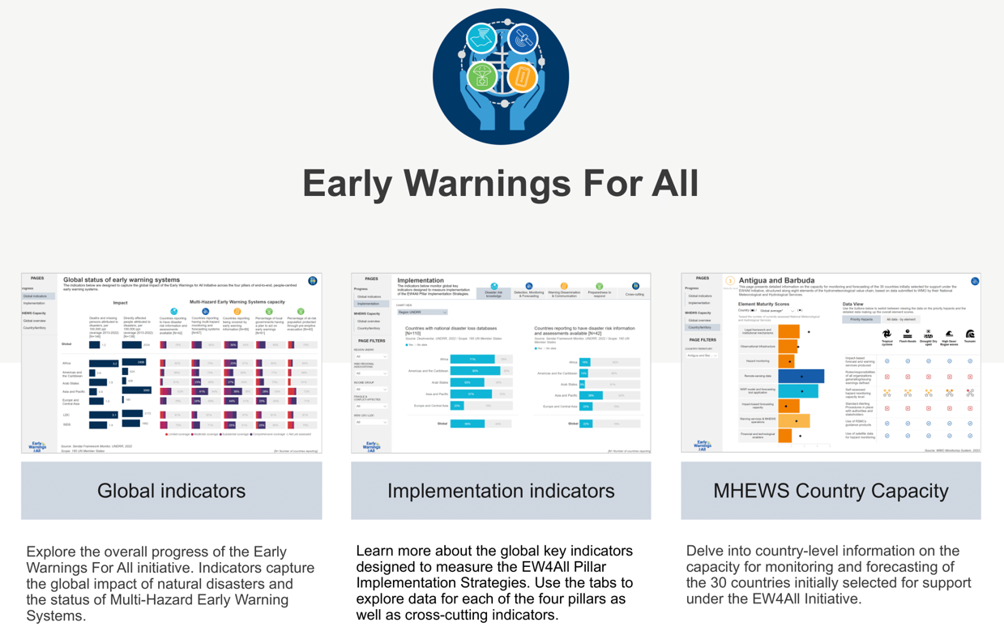

  Dashboard

Slide 10
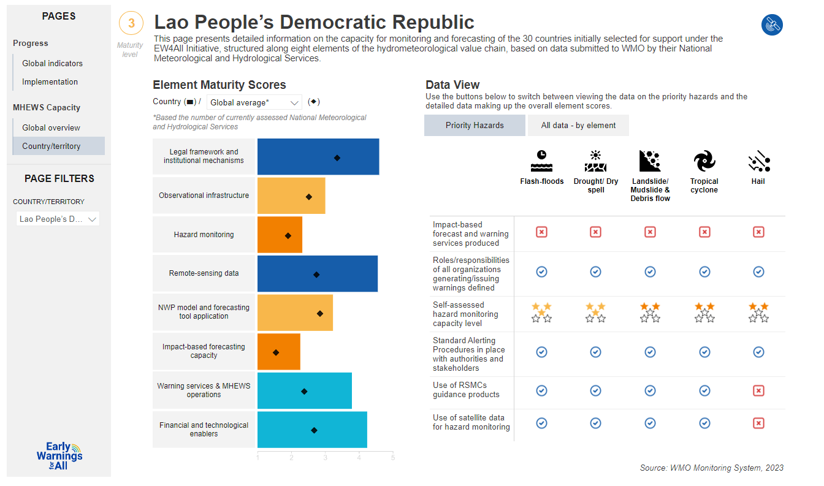

Slide 11
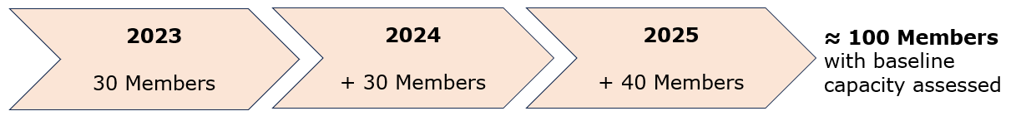
Next Steps | Rapid Assessment
Transfer of know-how to the Regional Offices
Scale up to more Members
Mechanisms :
    demand-driven (e.g. Members, Regional Associations)
    through the SOFF Readiness Phase, CREWS Multi-Stakeholder Accelerator
Expand beyond Pillar 2
  UNDRR testing on Pillar 1
  Use in the development of EWS Maturity Index
  EW4All Monitoring & Evaluation Working Group (co-chaired by WMO and UNDRR)
Notes:
11

Slide 12

Thank you
Monitoring, Evaluation, Risk and Planning Office
^{merp@wmo.int}
^{wmo.int}

