Slide 1


Training Workshop on Incident Management System
for RWCs in RA IV, 18 September 2023, virtual
Introduction to WIGOS Data Quality Monitoring System (WDQMS) concept and functions
Luís NUNES
WIGOS Branch, Observing Networks and Measurement Division
Acknowledgements: Tanja Kleinert, Ercan Buyukbas

Slide 2
Outline
Why?
  Value Chain and Quality of Weather Observations
What?
  WDQMS concept and functions
The link to/from OSCAR/Surface
Data availability and data quality issues
 | 2

Slide 3
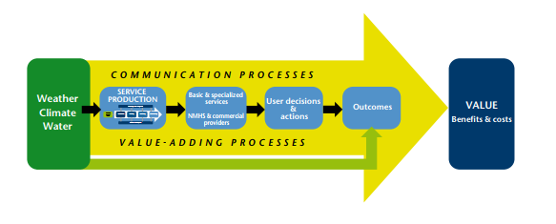
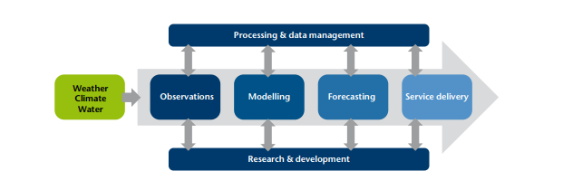

Observations in Value Chain
 | 3

Slide 4
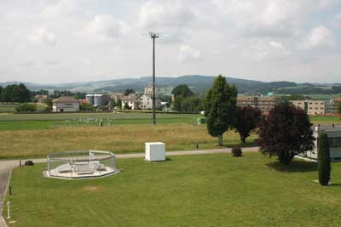
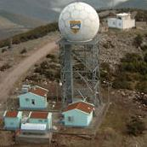


Observations data and their quality
    The overall purpose of taking weather and climate observations (and others) is to provide information in sufficient detail to meet the users requirements, to ultimately contribute to safety and well being of the people and goods.
    To ensure that, efforts are made to acquire, transmit, and archive observations with the greatest precision and consistency possible.
    However, observed data can be subject to failures and/or errors (e.g. due to human intervention, equipment failures, issues in the data processing, coding, or transmission).
    Various means are used to assure data "quality" and availability.
 | 4

Slide 5
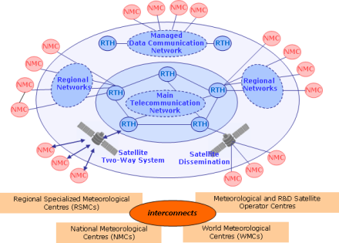



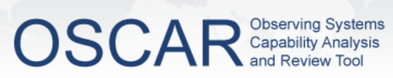

Observations data and their quality
National observing stations
!
Data transmission from site to NMHS Data Centre or Headquarter (HQ) Office
WDQMS starts here
NMHS HQ
GTS/WIS
International users
e.g. global NWP centres
International exchange
to be indicated in

Slide 6
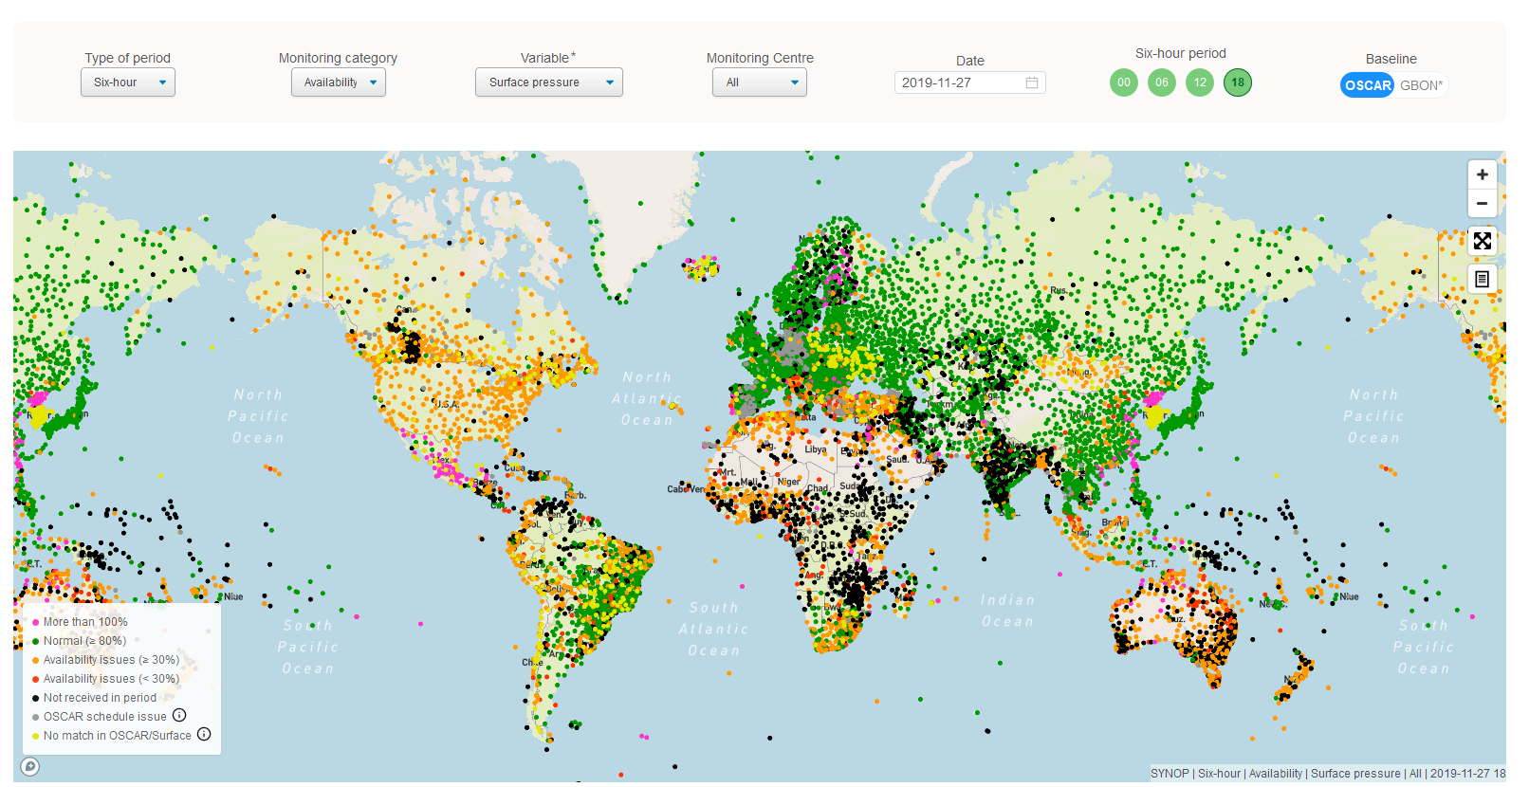
The WDQMS Webtool
    A web based tool for near-real time monitoring the availability and quality of observations exchanged internationally
      Land surface and upper air observations (near-real-time NWP)
      Surface and upper air observations of GCOS
      Surface and upper air GBON observations
    One of the WIGOS Tools, critical for WIGOS implementation/operations
    Operational since March 2020
    Under evolution based on requirements and expansion of the observing systems/observations to be monitored
    Several new releases expected per year
    Current release 1.4.2
    https://wdqms.wmo.int
 | 6

Slide 7
The WDQMS Webtool
Surface land observ. (availability & quality)
Surface pressure /geopotential height
Air temperature (2m)
Relative humidity (2m)
Wind (10m)
Upper air observations (availability & quality)
Air temperature
Relative humidity
Wind
Completeness of surface land observations (GCOS)
Pressure
Temperature
Max and min temperature
Water vapor
Precipitation
Sunshine duration
Quality of upper air land observations (GCOS)
Pressure
Temperature
Humidity
GBON stations monitor. (surface availability)
Surface pressure /geopotential height
Air temperature (2m)
Relative humidity (2m)
Wind (10m)
GBON stations monitoring (upper air)
Complete soundings
 | 7

Slide 8
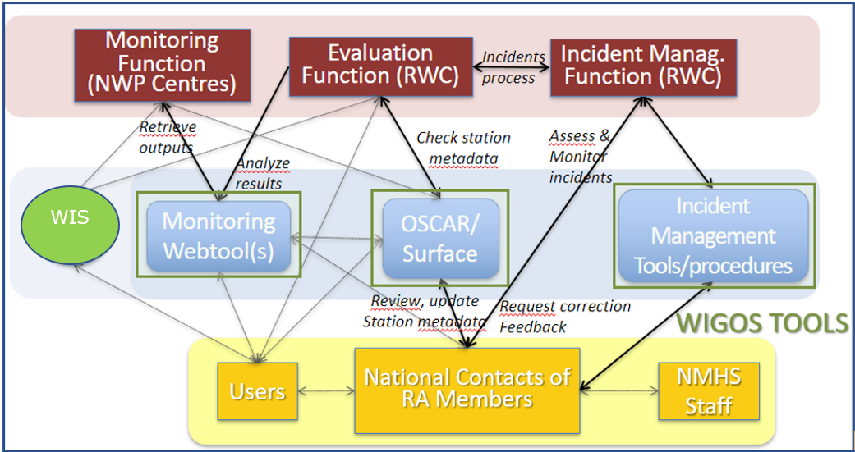
The WDQMS Process
 | 8

Slide 9
The WDQMS Webtool
    The WIGOS monitoring function - WIGOS Monitoring Centres (Global NWP Centres: ECMWF, NCEP, JMA, DWD):
      provide daily monitoring reports (availability/quality/completeness)
      provide input to the WIGOS evaluation function
    The WIGOS evaluation function generates routine performance reports on the basis of the relevant information
      From the daily monitoring reports
      From metadata about the observing stations, from the Observing Systems Capability Analysis and Review (OSCAR)/Surface tool,
      From the WMO Information System (WIS)
    The WIGOS incident management function
      takes up the issues that the evaluation function raise as incidents, and follows up actions with the data supplier to resolve the incident
 | 9

Slide 10
WDQMS outputs as part of the WIGOS monitoring and evaluation functions (examples for surface pressure)
    The webtool displays maps of monitoring outputs from Monitoring Centres allowing to evaluate the stations performances within a RWC´s responsibility
    It serves as part of the WIGOS evaluation function by aggregating the performances on a daily basis or in time series
Data availability
More than 100%
Normal (≥ 80%)
Availability issues (≥30%)
Availability issues (<30%)
Not received in period
OSCAR Schedule issue
No match in OSCAR/Surface
Data quality
Very high O-B
High O-B
Moderate O-B
Small O-B
Very small O-B
 | 10

Slide 11

Thank you
Merci
Gracias
^{wmo.int}

