Slide 1


RA IV Training Webinar on Incident Management System (IMS)
Online, 18 September 2023
RWCs functions and roles and responsibilities of relevant NFPs

Slide 2
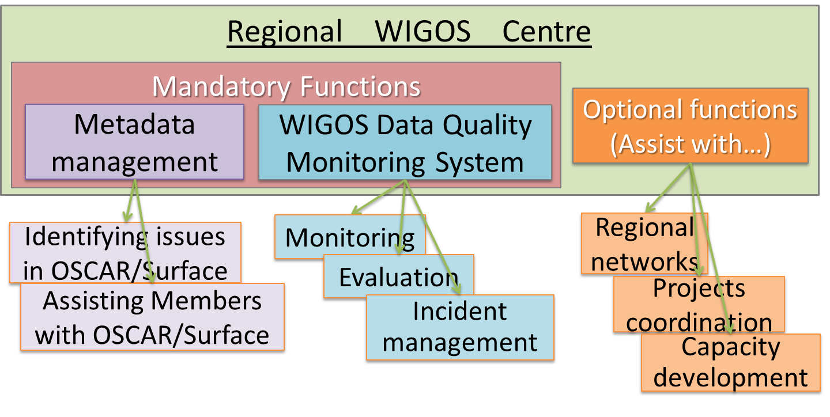
A diagram of the RWCs Functions
(
)

Slide 3
There are three NFPs related to WIGOS
National Focal Point for WIGOS
National Focal Point for OSCAR/Surface
  OSCAR/Surface is the Observing Capabilities Analysis and Review (OSCAR) tool for surface-based observations
    Intented to register all the observational metadata related to all surface stations (non-space-based)
National Focal Point for WDQMS
  WDQMS is the WIGOS Data Quality Monitoring System
    Provides monitoring results (maps and graphics) in near-real time on the
performance of surface stations (data availability and quality)
    It relates closely with the work of Regional WIGOS Centres (RWC)

Slide 4


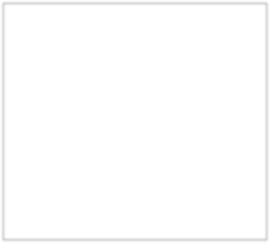
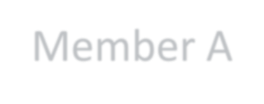


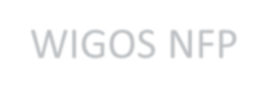











National level
WIGOS NFP = leads Member’s communications on WIGOS, with WMO; Monitors and reports on national status of WIGOS implementation and issues in the country; Identify and follow-up on WIGOS-related training and capacity development needs;
Member A
OSCAR/Surface NFP = Coordinates national activities related to WIGOS metadata towards their availability in OSCAR/Surf; Coordinates its user accounts at national level; Promulgates WMO relevant regulatory, guidance and training materials; Ensures that all accredited users are trained to edit metadata in OSCAR/Surf, including the use of automatic insertion/updates to OSCAR/Surf; Works closely with the relevant RWC; Reports on the status of national WIGOS metadata in OSCAR/Surf; Takes actions to correct erroneous and/or missing metadata in OSCAR/Surface.
WIGOS NFP
WDQMS NFP
OSCAR/Surface NFP
. . . .
WDQMS NFP = Provides timely answers to all queries and tickets sent by the RWC
related to issues with observations from the country; Initiates and coordinates actions to solve those issues as quickly as possible; Liaises with OSCAR/Surface NFP in relation to stations that exchange data internationally; Promulgates nationally the WDQMS related practices and procedures; Liaises with other relevant WMO Regional Centres, e.g. RICs, RTCs, to find sustainable solutions for issues identified by the WDQMS.

Slide 5
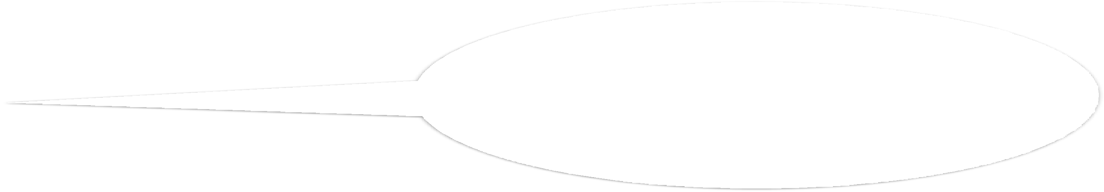


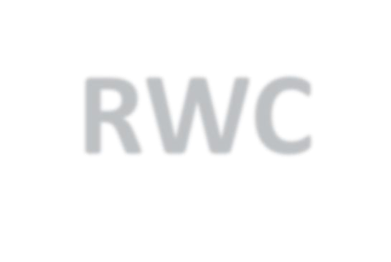
















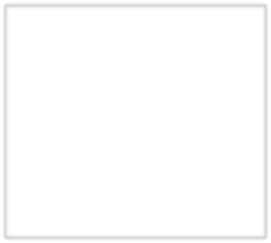
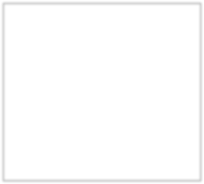
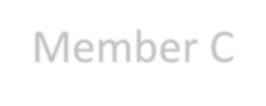
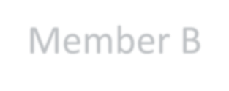
















Regional level
RWC staff:
- identify performance issues with
observations provided by Members
- use an incident management system to raise tickets, and to follow- up on them, using RWC account credits to manage the tickets;
- also provide support and assistance to Members and Region for their WIGOS implementation efforts.
Member A
National level
RWC
WIGOS NFP
WDQMS NFP
OSCAR/Surface NFP
. . . .
Member C
National level
Member B
National level
WIGOS NFP
WIGOS NFP
WDQMS NFP
OSCAR/Surface NFP
WDQMS NFP
OSCAR/Surface NFP
. . . .
. . . .

Slide 6
Support to RWCs related activities
Tools and material available to support the RWCs:
Guide to WIGOS (WMO-No.1165)
Technical Guidelines for RWCs on WDQMS (WMO-No.1124)
OSCAR/Surface User’s Manual
WIGOS Learning portal - WMO Moodle platform – contains videos, presentations, documents, links, etc
OSCAR/Surface, hosted by MeteoSwiss, operational since May.2016
WDQMS Webtool, hosted by ECMWF, operational since Mar.2020
A prototype of an Incident Management System as an online tool available to all RWCs, to register and follow-up on incident tickets
6

Slide 7























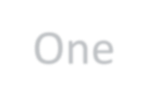

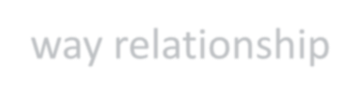
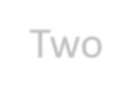

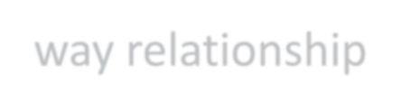
Role and Responsibility of WIGOS related NFPs in relation to RWC functions
Member
OSCAR/Surface
WIGOS NFP
RWC
OSCAR/Surface NFP
WDQMS Webtool
WIGOS
Monitoring Centres
WDQMS NFP
IMS
One-way relationship Two-way relationship
7

Slide 8

Thank you
For further information:
https://community.wmo.int/activity-areas/wigos

