Slide 1

Webinars on the process for the designation of GBON Stations
(5 and 6 January 2023)
The GBON Stations designation process
Etienne Charpentier
(Secretariat, Head, Observing Networks and Measurement Division)

Slide 2
Webinar Programme
Timing | Items | Presenter
3 min | Webinar modus operandi, incl. recording and sharing | Etienne Charpentier
7 min | WMO process for GBON implementation | Pascal Waniha, Chair TT-GBON
15 min | GBON requirements National contribution plan and gap analysis Exemption per Article 9 of MWO Convention Status of nominations & deadline,; the GBON webtool | Etienne Charpentier
30 min | The use of OSCAR/Surface to designate GBON stations, including GBON template GBON Compliance monitoring & WDQMS Webtool | Luis Nunes
15 min | The reporting of GBON data to WIS | Hassan Haddouch
10 min | Available material (GBON Guide and release schedule, GBON Website, WIGOS Learning Portal) | Zulkarnain
45 min | Questions and Answers | All participants

Slide 3
GBON requirements summary
(mandatory in bold)
 | HR | VR | Obs cycle | Variables | Other requirements
Surface land stations | 200km 100km¹ | n/a | 1h | SLP, T, U, Wind, precip. (hourly cumul), snow depth | Exchanged in real time through WIS2
Upper air stations operated from land | 500km 200km¹ | 100m | 2/24h | T, U, wind | Up to 30 hPa, exchanged in real time through WIS-2
Subset of upper air stations up to 10hPa | 1000km² | 100m | 24h | T, U, wind | Up to 10hPa, Exchanged in real time through WIS2
Surface marine stations in EEZs | 500km | n/a | 1h | SLP, SST | Exchanged in real time through WIS2
Upper air stations operated in EEZs | 1000km | 100m | 2/24h | T, U, wind | Up to 30 hPa, exchanged in real time through WIS2
Aircraft data | 100km at flight level | 300m for profiles | 1h | T, U, wind | Data exchange per licensing agreement
Remote sensing profiler observations | Where available | 100m | 1h | T, U, wind | n/a
1: High density requirement is mandatory for data exchange where capability exists
2: Requirement is mandatory for data exchange where capability exists

Slide 4
Process for the designation of GBON stations for the Initial Composition of GBON
2022/07
2023/01
2023/03
2023/05
Initial Composition of GBON (2022-2023):
Initial seeding based on OSCAR/Surface & WDQMS
Global Gap Analysis
Members setting national targets & gap analysis
Members defining their contribution plan
OSCAR/Surface NFPs designating stations in OSCAR/Surface
Review of conditional designations by INFCOM
Secretariat drafting INFCOM Recommendation
P/INFCOM to decide on draft Recommendation on behalf of INFCOM
Consultation of INFCOM in writing (3-month notice) – draft composition available in webtool
Cg-19 deciding on initial composition of GBON based on information in webtool

Slide 5
Circular to Members on Implementation of GBON –
Initial Composition of GBON
(Ref: 8876/2022/I/WIGOS/ONM/GBON dated 15 August 2022)
Asking Members to take steps to prepare for their contribution to GBON
GBON Guidance material referred in the letter
On 8 September “Green and Orange” stations were automatically assigned to GBON in OSCAR/Surface in “Pending Approval” status according to the proposed initial seeding of GBON
NFPs for OSCAR/Surface can remove automatic designation before 15 November 2022 (no action = concurrence)

Slide 6
Circular to Members on Implementation of GBON
Letter has 4 annexes (1: Reference to useful material, 2: Required actions by Members for initial composition of GBON, 3: Criterial for initial seeding of GBON, 4: Global gap analysis for the Country
Members invited to
  Conduct national gap analysis using TT-GBON guidance and template
  Set national targets and develop national contribution plan per TT-GBON guidance
  Nominate NFP for OSCAR/Surface
  Consider proposals of the Secretariat on initial seeding of GBON stations
    Confirm (do nothing) or object (un-assign designation to GBON)
  Designate additional GBON stations using OSCAR/Surface
See also website with above guidance

Slide 7
Global GBON Gap Analysis
Based on 1 January 2022 baseline & status of actively reporting stations (green or orange in WDQMS)
  Reports > 30% of required obs. for more than 60% of the days
Computed against GBON requirements
Gives estimate of number of missing surface- and upper air stations (required minus baseline)
These are only estimates / first guess – only Members know their capabilities in detail

Slide 8
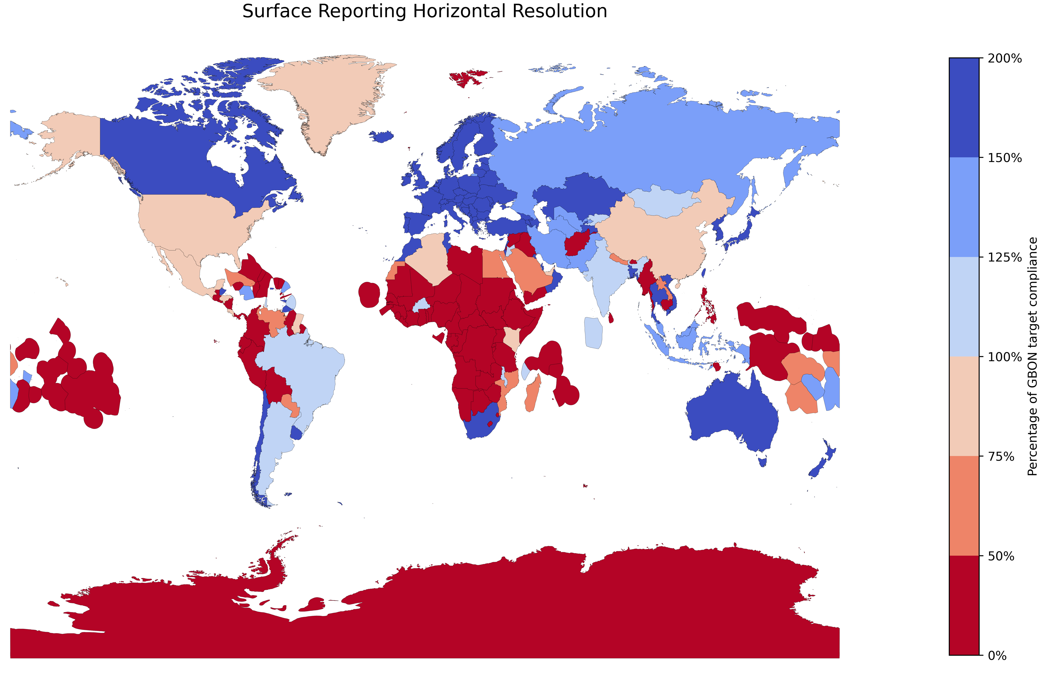
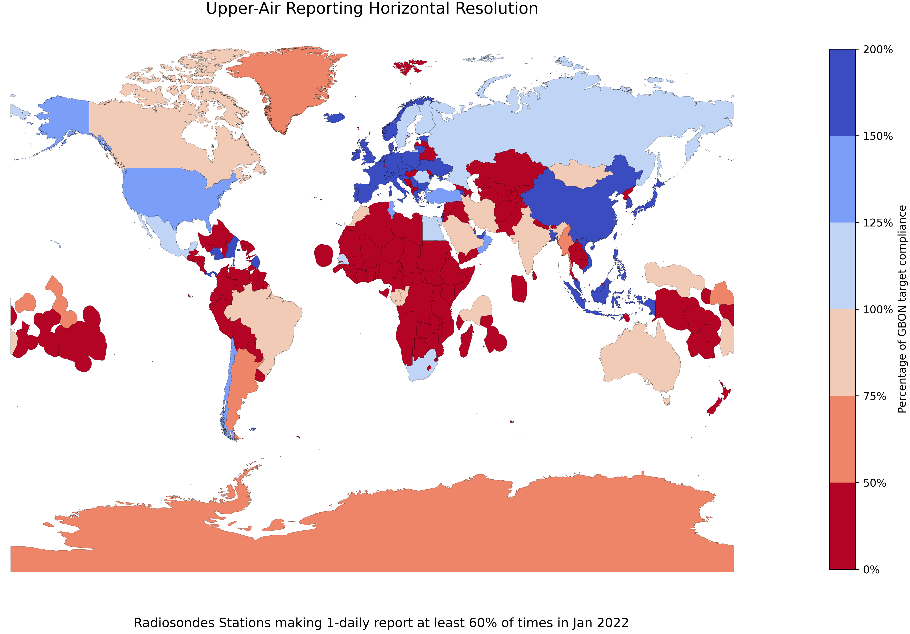
GBON Gap, January 2022
Surface observations
Upper air observations
Gap in SIDS and LDCs (standard density): 596 surface stations; existing network (actively reporting) delivers roughly 9% of required number of observations;
Gap in SIDS and LDCs (standard density): 139 upper air stations; existing existing network delivers roughly 8% of required number of observations;

Slide 9
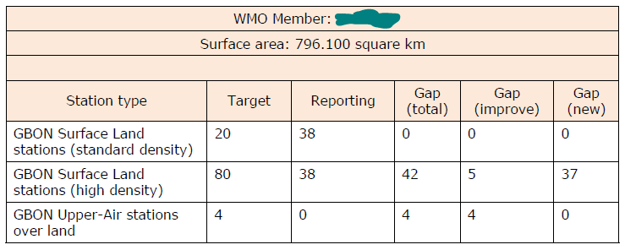
Letter to Members on Implementation of GBON
Global Gap Analysis (Annex 4, example)
Based on January 2022 baseline
Estimates of how many surface and UA stations needed
Some notes, caveat and disclaimer

Slide 10
GBON National Gap Analysis
A starting phase for the national implementation of the GBON regulations
Identifies the number of existent observing stations that are compliant with the GBON requirements and the number of stations that need to be installed or improved to become compliant with the mandatory requirements
Guidance for a step-by-step process for defining the national GBON gap
Template given for completing the analysis
Serves as the basis for the GBON National Contribution Plan
=> See more detailed slides below

Slide 11
National GBON Contribution Plan
Guideline to the NMHSs to develop the national GBON Contribution Plan. Consists of 5 Modules which list recommended activities and their expected deliverables:
Module 1. National GBON Target: National target towards GBON compliance that considers country’s circumstances;
Module 2. GBON institutional capacity development: Institutional capabilities required to operate, maintain and manage the GBON observing network;
Module 3. GBON infrastructure development: Observing network infrastructure required to achieve the national target and compliance with the GBON regulations;
Module 4. GBON human capacity development: Human capacity needed to manage, operate, and maintain the GBON observing network; and
Module 5. Risk Management: Observing network operational risks and required mitigation measures.
=> See more detailed slides below

Slide 12
Claiming exemption to meeting GBON requirements
Some Members may face practical difficulties to meeting GBON requirements – e.g. large remote geographic areas; difficulty to do 2 soundings a day or to report hourly observations of the manned stations pending their automation, etc.
Members may invoke exemption to meeting GBON requirements by invoking Article 9 of WMO Convention
Requires Members writing to WMO Secretary General with indication of:
  The reasons for claiming exemption e.g. for network density in some parts of their territory, or for a sub-set of their observing stations not being able to report at the required frequency
  The requested duration of exemption
  A plan for improving the situation in the future
Members wishing to claim exemption invited to write to Secretary General before 19th Congress (May 2023) and start of effective compliance monitoring of GBON
INFCOM ad hoc Committee will review cases & advise whether exemption is receivable
  If receivable, Country will be regarded as being GBON compliant
  INFCOM president will report to Executive Council on such exemptions
See details in GBON Guide

Slide 13
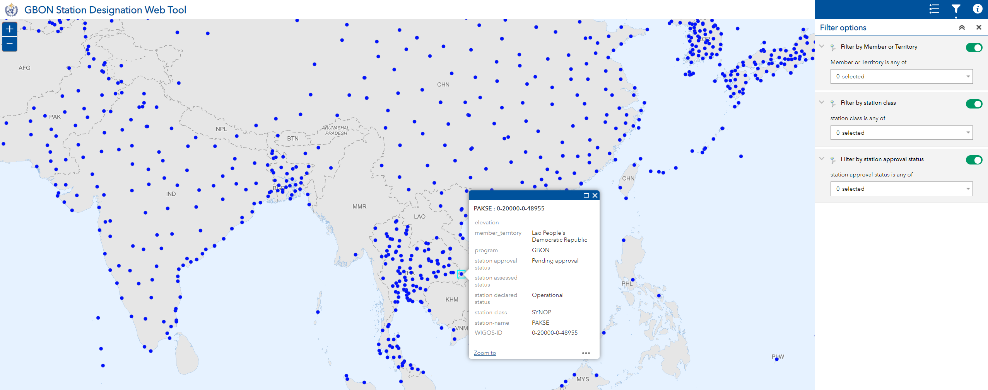
GBON Station Designation Web Tool
Synchronized automatically with OSCAR/Surface
Filter by Country, Station Class, Approval Status
Gives global view on all designated stations
All designations/un-designation to be done in OSCAR/Surface only
Will be used as reference by Congress to decide on initial composition of GBON
Can download list
of filtered stations

Slide 14
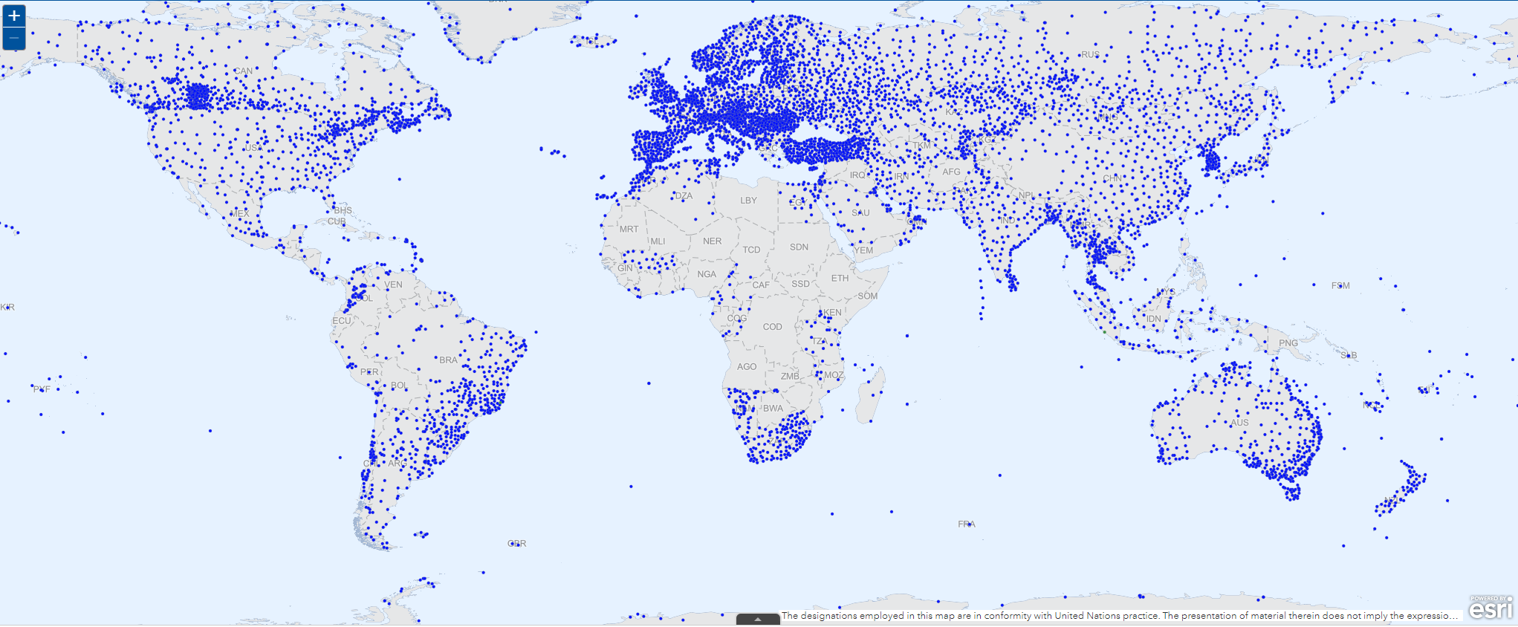
Designated GBON Surface Land Stations (as of 3 January 2023)

Slide 15
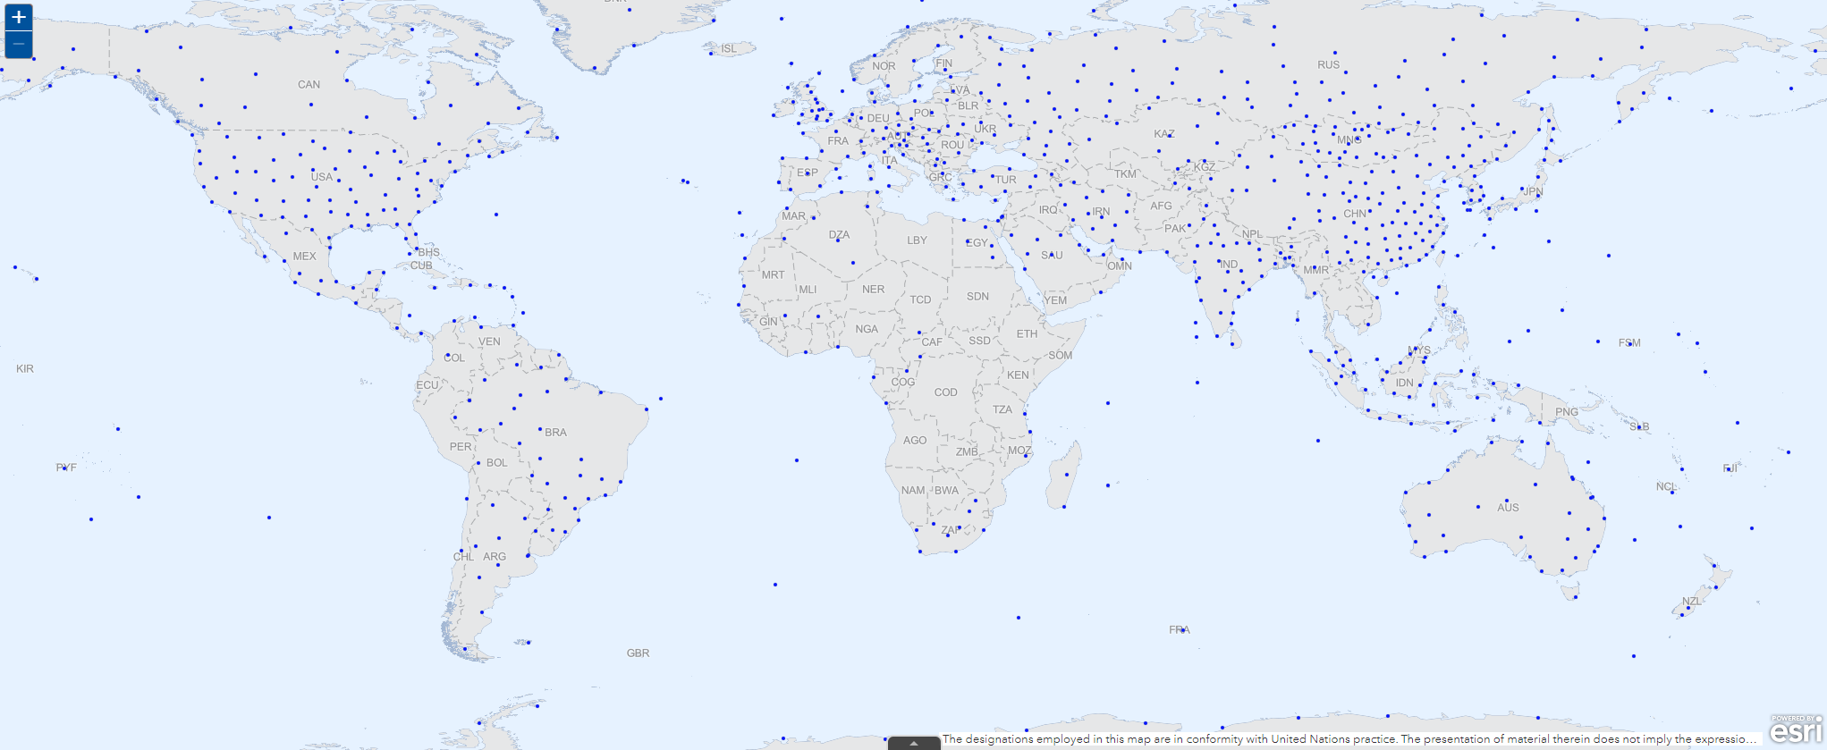
Designated GBON Upper Air Stations (as of 3 January 2023)

Slide 16
Next steps for GBON implementation
Until 15 January 2023 (hard deadline):
  Members working on their designation of GBON stations
Nov. 2022 – Feb. 2023: Finalize GBON Guide
Early 2023: P/INFCOM to recommend initial composition of GBON (i.e. list of GBON stations)
22 May - 2 June 2023, 19th Congress expected to adopt:
  Updated regulatory & guidance material (including new GBON Guide)
  Initial composition of GBON
After June 2023:
  GBON Compliance Monitoring
  INFCOM to discuss if we have the right tools and how they should evolve
  Maintenance of GBON by INFCOM and Members

Slide 17
Key points to remember
Global Gap Analysis is an indication of gaps as of January 2022; Members are encouraged to do a national gap analysis
Initial seeding done by the Secretariat is our first guess; Members are urged to check and update the list of designated stations according to their understanding of the Country capacity
Members can add/delete affiliation to GBON while in "Pending Approval" mode. This can still be done beyond the 15 November 2022 deadline but no later than 15 January 2023
National gap analysis and contribution plan are encouraged; not mandatory; templates are provided in case Members wish to use them
Congress in May/June 2023 will decide on the final list of stations
Compliance against GBON requirements at Station level and Country level will be assessed after 19th Congress and all Members informed about remaining gaps
The Least Developed and SIDSs can apply for SOFF funding for their GBON network; developing countries can apply for SOFF technical assistance (contact: Markus Repnik of SOFF Secretariat: mrepnik@wmo.int, see also https://alliancehydromet.org/soff/)
Guidance material available here: https://community.wmo.int/activity-areas/wigos/gbon/implementation-global-basic-observing-network-gbon/defining-initial-composition-gbon (we are working at fixing some broken links)
GBON Webtool: https://community.wmo.int/global-basic-observing-network-gbon-station-designations-map
Material from this Webinar is available here: https://etrp.wmo.int/course/view.php?id=146
Further questions: check FAQ; otherwise ask echarpentier@wmo.int

Slide 18
Thank You

Slide 19
What is GBON ?
New observing network replacing the former Regional Basic Synoptic and Climatological Networks (RBSN and RBCN)
  Introduces more stringent requirements which WMO Members shall meet
  Focused on surface land stations, upper air stations, and marine stations in Exclusive Economic Zones
Addresses the requirements of Global Numerical Weather Prediction (GNWP) and Climate Data re-Analysis
  Filling the identified gaps
  Making data of existing stations available
Composition of GBON to be decided by World Meteorological Congress
  Cg-19 in June 2023
Complements the new Regional Basic Observing Network (RBON)
  All GBON stations are also RBON stations by definition
  RBON stations addressing additional requirements as decided by the regional associations
Technical Regulations in WMO-No-1160, Manual on the WIGOS, section 3.2.2

Slide 20
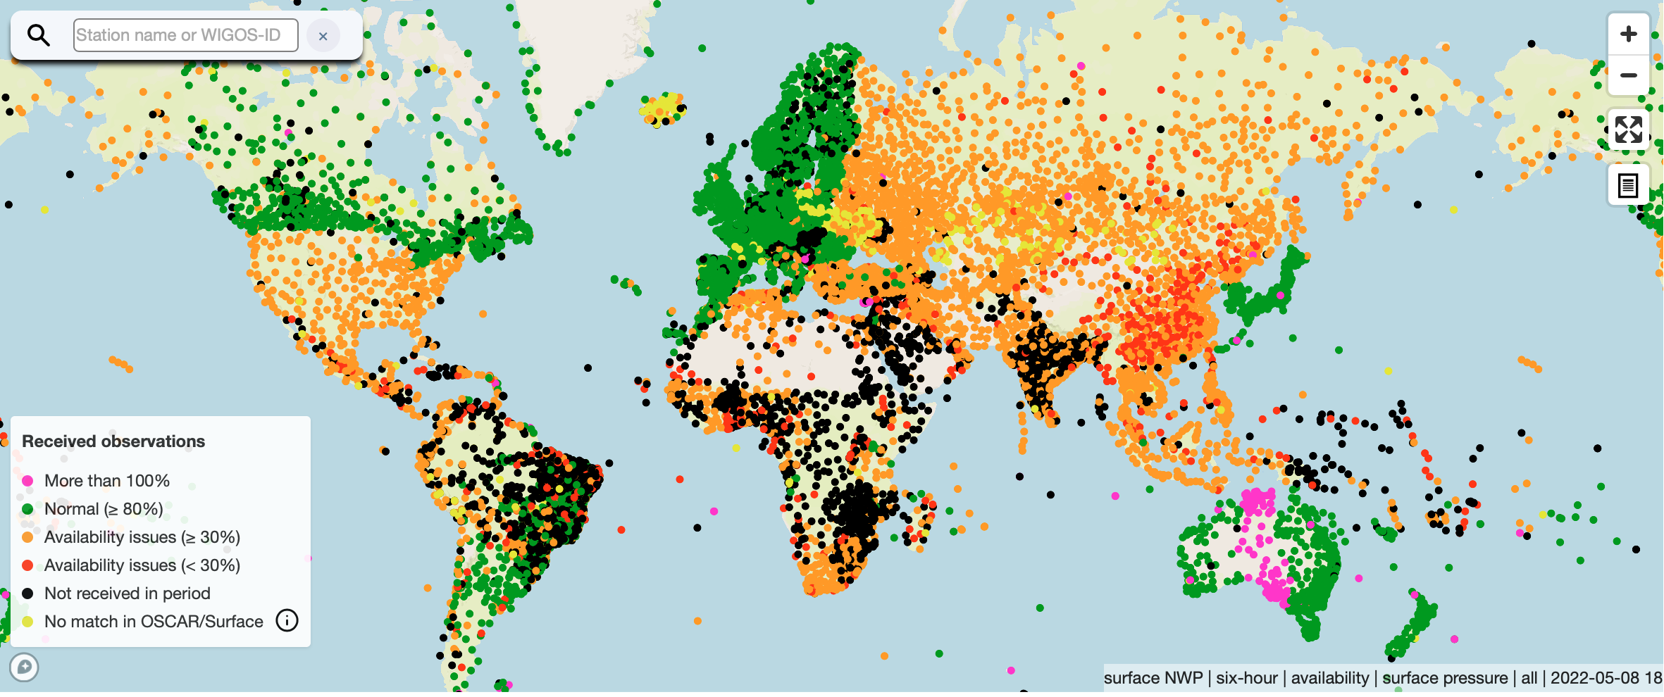
1. The persistent problem of insufficient observational data coverage
Especially in areas dominated by red or black, quality of model data used for weather and climate prediction and monitoring will be relatively poor, and the possibility of verification will be limited
Surface pressure observations received by global NWP Centers on May 8 2022, 18Z)
(source: WIGOS Data Quality Monitoring System)
Notes:
Consistency of the maps

Slide 21
GBON compliance criteria
Based on stations registered in OSCAR/Surface with GBON affiliation
Designated GBON stations assumed to provide required horizontal spacing
Monitor only BUFR reports
By station:
  Based on SLP reports for surface stations
  Based on T profiles for upper air stations
  Computed using monthly monitoring of GBON availability statistics per station for
    Availability (>80% of required reports per month)
    Timeliness (<5% late reports i.e. after cut off)
    Quality (<5% rejected reports)
By WMO Member:
  Designated GBON stations assumed to provide the required horizontal spacing
  Counting the number of compliant stations
  Monthly assessment computed on quarterly basis
  Each Member assessed against the quarterly reports on annual basis

Slide 22
Process for the designation of GBON stations
Initial Composition of GBON (2022-2023):
Initial seeding based on OSCAR/Surface & WDQMS
Global Gap Analysis
Members setting national targets & gap analysis
Members defining their contribution plan
OSCAR/Surface NFPs designating stations in OSCAR/Surface
Review of conditional designations by INFCOM
Secretariat drafting INFCOM Recommendation
P/INFCOM to decide on draft Recommendation on behalf of INFCOM
Consultation of INFCOM in writing (3-month notice) – draft composition available in webtool
Cg-19 deciding on initial composition of GBON based on information in webtool
Maintenance of GBON (2024 – ):
Compliance monitoring results
Consultation with Members
Members adjusting national targets & gap analysis
Members updating their contribution plan
OSCAR/Surface NFPs designating stations n OSCAR/Surface
Review of conditional designations by INFCOM
Secretariat drafting INFCOM Resolution (3 month notice) – draft composition available in webtool
INFCOM Session deciding on updated composition of GBON based on information in webtool

Slide 23
Webinars on the process for the designation of GBON Stations
6 and 7 October 2022
National GBON Gap Analysis
Minna Huuskonen
Secretariat, Scientific Officer, Observing Networks and
Measurement Division

Slide 24
GBON National Gap Analysis – Objective
A starting phase for the national implementation of the GBON regulations
Identifies the number of existent observing stations that are compliant with the GBON requirements and the number of stations that need to be installed or improved to become compliant with the mandatory requirements
Guidance for a step-by-step process for defining the national GBON gap
Template given for completing the analysis
Serves as the basis for the GBON National Contribution Plan

Slide 25
GBON National Gap Analysis –
Step 1 Analysis of requirements
Review of the WMO global GBON gap analysis results
Review of the estimate of surface and upper-air stations required based on the GBON mandatory horizontal resolution requirements (target)
  Number of stations reporting as per the WIGOS Data Quality Monitoring System (WDQMS) tool
  The total national GBON gap
GBON target adjusted by the Member
  Number of reporting stations confirmed
  Gaps can be initially taken as a default per Global Gap Analysis
Output of the Step 1 – country example
GBON requirements | GBON target | Reporting | Gap improve | Gap new | Gap total
Surface stations – standard density | 15 | 2 | 3 | 9 | 13
Surface stations –high density | 33 | 2 | 3 | 28 | 31
Upper-air stations | 3 | 0 | 0 | 3 | 3
Marine | 2 | 0 | 0 | 2 | 2
Caveats:
The reporting threshold for GBON upper-air stations over land was one daily sounding
The surface area was computed based on a geographic information system model and may slightly deviate from official records.

Slide 26
GBON Gap Analysis –
Step 2 Existing stations
The number of existent surface, upper-air and marine observing stations are assessed, according to:
NMHS stations
3rd party stations
Whether the station is reporting to WIS / to be improved
Which GBON variables the station is measuring
Reporting cycle: how often is the station reporting
Output of Step 2a
GBON requirements | Existing observation stations (# of stations)
 | NMHS network |  | 3rd party networks
 | Reporting | Improve | Reporting | Improve
SURFACE STATIONS Standard density | 2 | 25 | 0 | 38
SURFACE Stations High density | 2 | 25 | 0 | 38
UPPER-AIR STATIONS Over land Over marine | 0 | 1 | 0 | 1
MARINE SURFACE STATIONS | 0 | 0 | 0 | 0

Slide 27
GBON Gap Analysis –
Step 2 Existing stations
Step 2b
Step 2a
Station name | Station type (S/UA) | NMHS/ 3rd party station | GBON variable measured |  |  |  |  |  | Reporting cycle | GBON Compliance (Yes/No)
 |  |  | SLP | T | H | W | P | SD
Station 1 | S | NMHS | x | x | x | x | x | - | 24 | Y
Station 2 | S | NMHS | x | x | x | x | - | - | 8 | N
Station 3 | U | NMHS | N/A | x | x | x | N/A | N/A | 0 | N
Station 4 | U | 3rd party | N/A | - | - | x | N/A | N/A | 1 | N
Station 5 | S | NMHS | x | x | x | - | - | - | 4 | N
Station 6 | S | NMHS | x | x | x | x | x | - | 24 | Y
Station 7 | S | 3rd party | - | - | - | - | x | - | 1 | N
Station 8 | S | 3rd party | - | - | - | - | x | - | 1 | N
Station 9 | S | 3rd party | x | x | x | x | x | - | 13 | N
etc.
GBON requirements | Existing observation stations (# of stations)
 | NMHS network |  | 3rd party networks
 | Reporting | Improve | Reporting | Improve
SURFACE STATIONS Standard density | 2 | 25 | 0 | 38
SURFACE Stations High density | 2 | 25 | 0 | 38
UPPER-AIR STATIONS Over land Over marine | 0 | 1 | 0 | 1
MARINE SURFACE STATIONS | 0 | 0 | 0 | 0

Slide 28
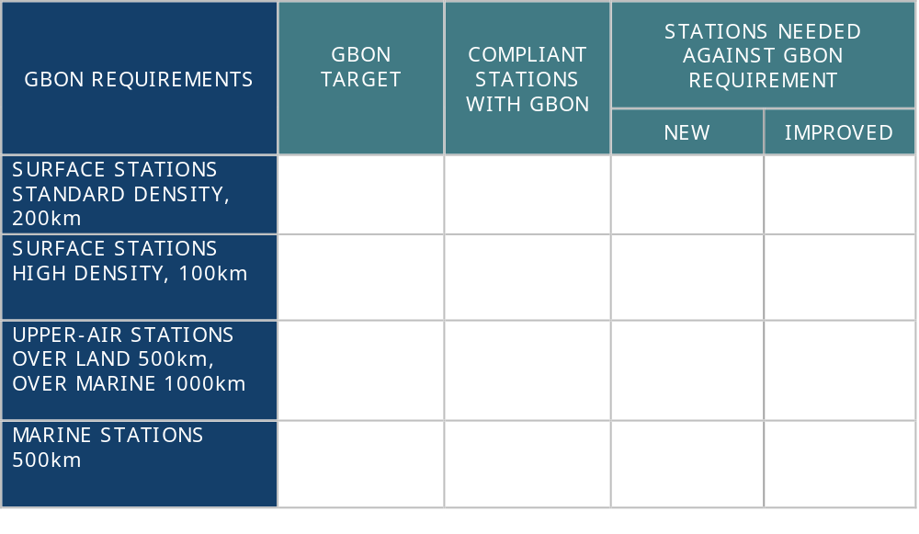
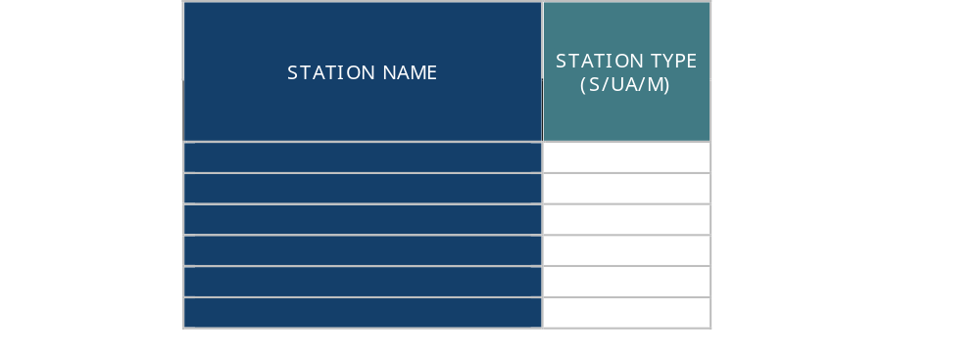
GBON Gap Analysis – Step 3 Results
Step 3a and 3b
The Steps 1 and 2 are summarized:
        # of confirmed target stations
        # of stations currently compliant with GBON requirements
        # of new and improved GBON stations needed to comply with GBON requirements
        Compliant stations are listed for designation to GBON network by registering the stations in OSCAR/Surface
        The results of the gap analysis are incorporated into the National Contribution Plan and used as the basis to define the National GBON target

Slide 29
Webinars on the process for the designation of GBON Stations
6 and 7 October 2022
National GBON Contribution Plan
Minna Huuskonen
Secretariat, Scientific Officer, Observing Networks and
Measurement Division

Slide 30
GBON National Contribution Plan – Objective & Structure
Identifies the infrastructure, human, institutional and financial capacity needed to close the GBON gap and how to operate stations compliant with the GBON requirements
Defines the activities required to implement GBON under a gradual/phased approach
Fives modules provide a standard approach which can be adjusted based on the national needs and expectations
  Key components defined to implement GBON
  Modules are undertaken in parallel
The activities are planned to meet the National Target toward GBON compliance in each Module.
The Plan should be reviewed regularly with an aim to advance the activities defined for meeting the full GBON compliance in a sustainable manner
Simple template report given

Slide 31
Module 1. Set a National GBON Target
NMHS sets a National GBON Target towards progressive GBON compliance.
The target reflects the level of ambition of the NMHS, taking into account the gradual process, national circumstances and the feasibility of implementing the activities to achieve such a target.
The target should be progressive so that the elements of the target are increased periodically for aiming the NMHS to achieve full GBON compliance in a reasonable period of time.
The target is set in terms of number of new/improved stations and percentage of reports exchanged.

Slide 32
Module 2. Institutional and financial capacity development
Assessment of stakeholders and partnerships for supporting operations of GBON, nationally and (sub-)regionally
Development of a financial management plan, including
  Current NMHS financial model
  Financial plan of operating modernized infrastructure – including O&M and life cycle considerations
  Business plan over 5 to 10 years - a plan supporting an increase in financing for the capital purchase and operations of the network
Assessment of existing NMHS strategies for developing and improving observing networks
Assessment of the national legislation in terms of GBON regulations
  Review of the legislation related to procurement, importation and customs processes to enable fluent implementation of the Plan

Slide 33
Module 3. Infrastructure development
Define the surface and upper-air observing network design, including the networks ran by third parties, technical specifications and an operating plan for network operations and management
Define the ICT infrastructure and services design (per WIS 2.0)
Define the data management system design
  Data storage, acquisition of data to and from WIS, metadata management, monitoring of data

Slide 34
Module 3 – WMO technical regulations
Examples of the guidance material available as references for outputs required in Module 3
Manual on the WMO Integrated Global Observing System (WMO-No.1160)
Guide to Instruments and Methods of Observation (WMO-No. 8)
Manual on the WMO Information System (WMO-No. 1060)
Manual on Codes (WMO-No. 306)
Manual on the Global Telecommunication System (WMO-No. 386)
Guide to Competency (WMO-No. 1205)
Guidelines for Trainers in Meteorological, Hydrological and Climate Services (WMO- No. 1114)
Guide to the Implementation of Education and Training Standards in Meteorology and Hydrology, (WMO- No. 1083)
Guide to the Implementation of Quality Management Systems for National Meteorological and Hydrological Services and Other Relevant Service Providers (WMO-No. 1100)

Slide 35
Module 4. Human capacity development
Assessment of current human capacity to operate and maintain GBON, incl. staff skills, education levels and technical and managerial capacity gaps
Recommendations on capacity development activities for technical and management staff, including training activities and recruitments

Slide 36
Module 5. Risk management
Identification and assessment of the most relevant risks including the operation and maintenance of GBON
Recommendations for risk mitigation activities for successful implementation of the Plan – focus on operational sustainability

Slide 37
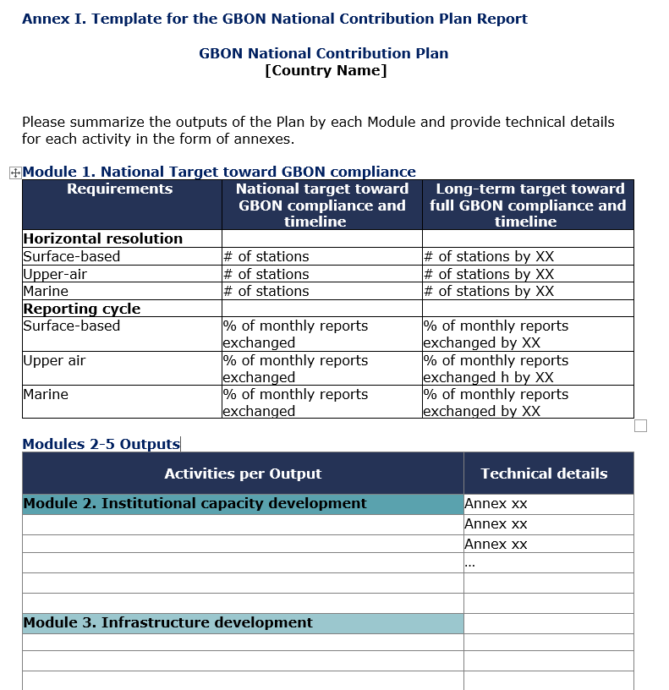
Final Report Template
Annex I provides a template where the national target and technical documentation can be summarized

Slide 38
Thank You

