Slide 1

The WIGOS Station Identifiers (WSI)
Yongqing Chen
RAP, WMO Secretariat

Slide 2
YASAWA-I-RARA(Fiji)
Old Station Index: 91660
WIGOS Identifier : 0-20000-0-91660

Slide 3
Structure of WSI
0 - 20000 - 0 - 91660
1st block (number) | 2nd block (number) | 3rd block (number) | 4th block (character)
WIGOS Identifier Series | Issuer of Identifier | Issue number | Local Identifier
Allows future expansion | Allows to distinguish between identifiers issued by different organizations | Allows sub-delegation | Allocated to station
0 | 0…65534 | 0…65534 | 16 characters
1st block (number) | 2nd block (number) | 3rd block (number) | 4th block (character)
WIGOS Identifier Series | Issuer of Identifier | Issue number | Local Identifier
Allows future expansion | Allows to distinguish between identifiers issued by different organizations | Allows sub-delegation | Allocated to station
0 | 0…65534 | 0…65534 | 16 characters
1st block (number) | 2nd block (number) | 3rd block (number) | 4th block (character)
WIGOS Identifier Series | Issuer of Identifier | Issue number | Local Identifier
Allows future expansion | Allows to distinguish between identifiers issued by different organizations | Allows sub-delegation | Allocated to station
0 | 0…65534 | 0…65534 | 16 characters
1st block (number) | 2nd block (number) | 3rd block (number) | 4th block (character)
WIGOS Identifier Series | Issuer of Identifier | Issue number | Local Identifier
Allows future expansion | Allows to distinguish between identifiers issued by different organizations | Allows sub-delegation | Allocated to station
0 | 0…65534 | 0…65534 | 16 characters

Slide 4
1st block ：WIGOS identifier series
(number)
Only the WIGOS identifier series 0 has been defined. This series is used to identify observing stations.

Slide 5
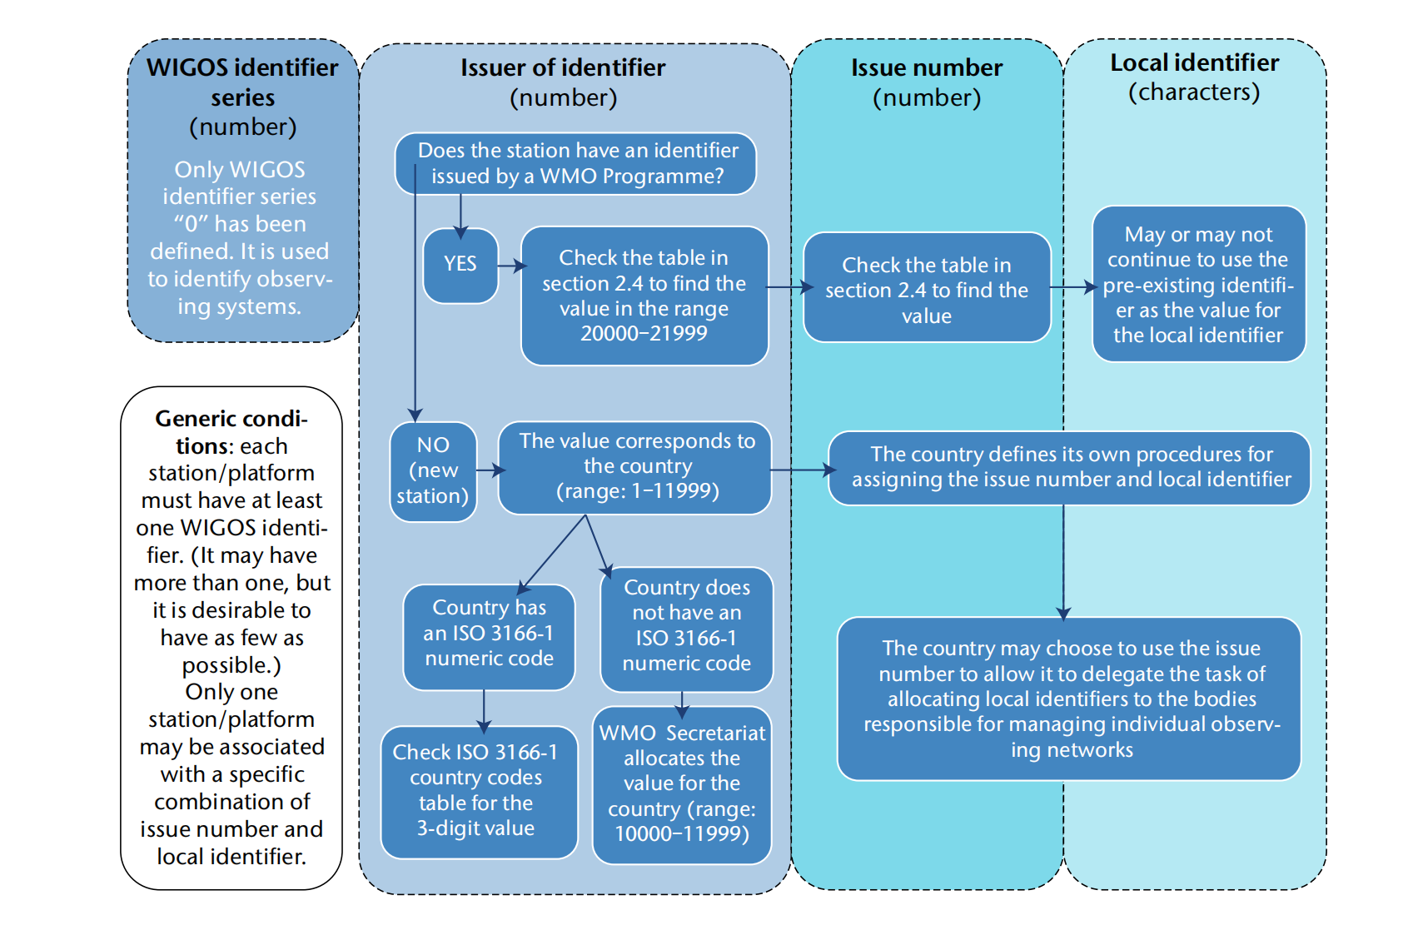
Assigning WIGOS identifiers to observing stations

Slide 6
Assigning WIGOS identifiers to observing stations

Slide 7
2^{ed} block ：Issuer of identifier
(number)
Observing stations that had been allocated identifiers by a WMO Programme before the introduction of WIGOS identifiers (that is, before 1 July 2016)
  should continue to use those identifiers and are not required to have additional ones created for them.
  For these observing facilities, the WIGOS identifier can be deduced from the pre‑existing identifier.
If the station take on new responsibilities (such as an aviation station starting to report World Weather Watch synoptic information), the WIGOS identifier can also be used in that new context, even though it was derived from a WIGOS identifier associated with a different programme (in this example, the synoptic report could use the WIGOS identifier derived from the ICAO location/airfield indicator2).

Slide 8
2^{ed} block ：Issuer of identifier
(number)
Only a WMO Member for which there is an ISO 3166–1 numeric country code can assign its country code as the issuer of identifier value for its newly established observing stations. For example, the Korea Meteorological Administration can use “410” as the issuer of identifier number. (i.e. 0–410–0-XXXX).
The WMO or partner programmes that were delegated with the authority to issue WIGOS identifiers (hereafter/thereafter referred to as “WSI issuers”), such as the Comprehensive Nuclear-Test-Ban Treaty Organization (CTBTO), as well as the relevant authority of Global Atmosphere Watch (GAW), Global Cryosphere Watch (GCW), and GCOS Reference Upper-air Network (GRUAN), may use specific issuer of identifier values for issuing WIGOS identifiers for observing stations that contribute to the relevant network on behalf of Members under circumstances specified in the Manual on the WMO Integrated Global Observing System (WMO-No. 1160)

Slide 9
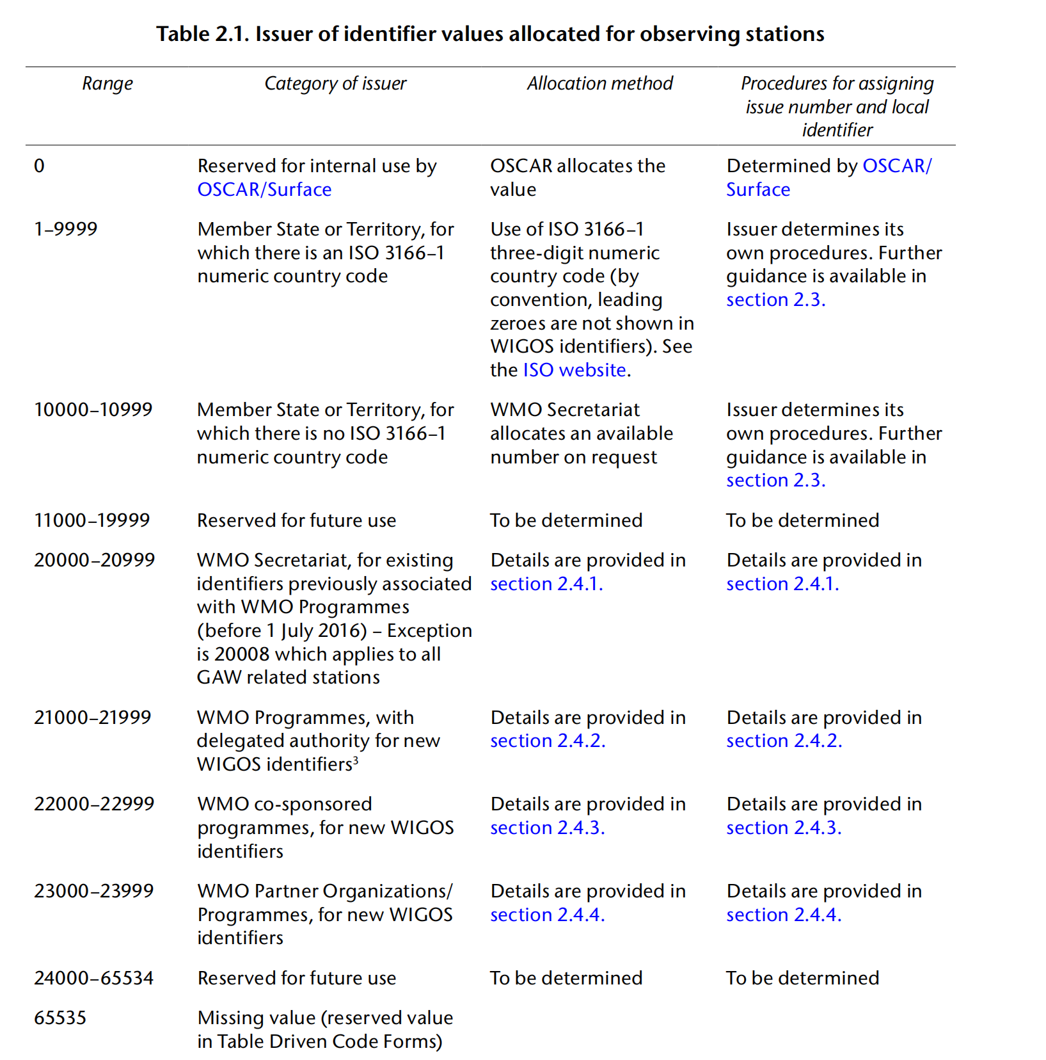


Slide 13
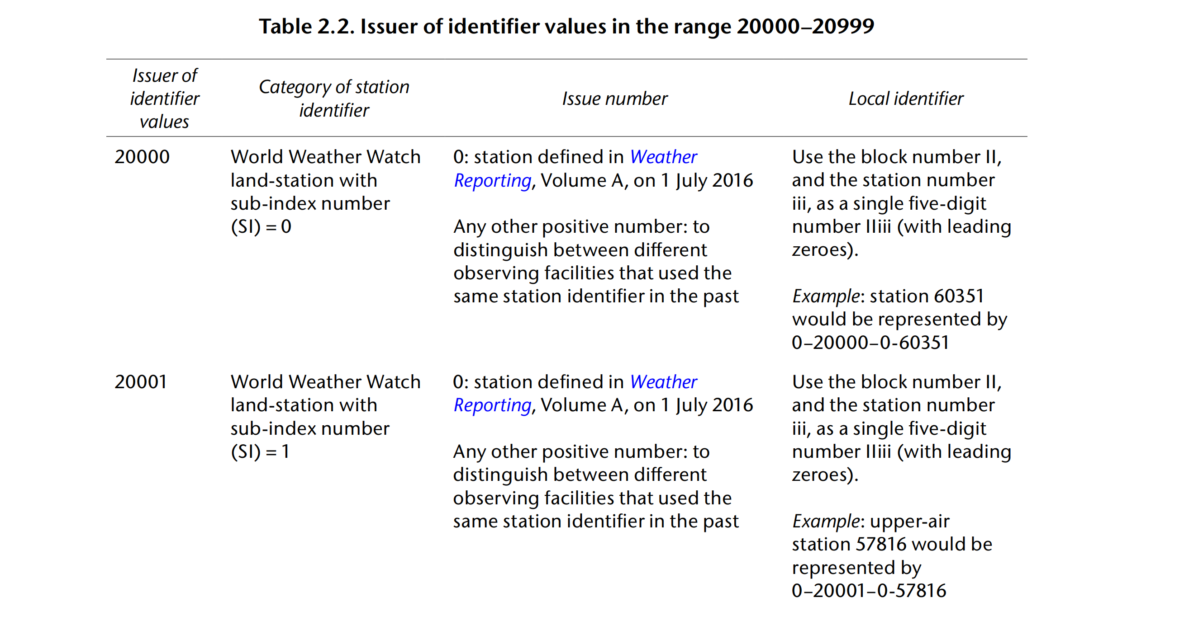

Slide 14
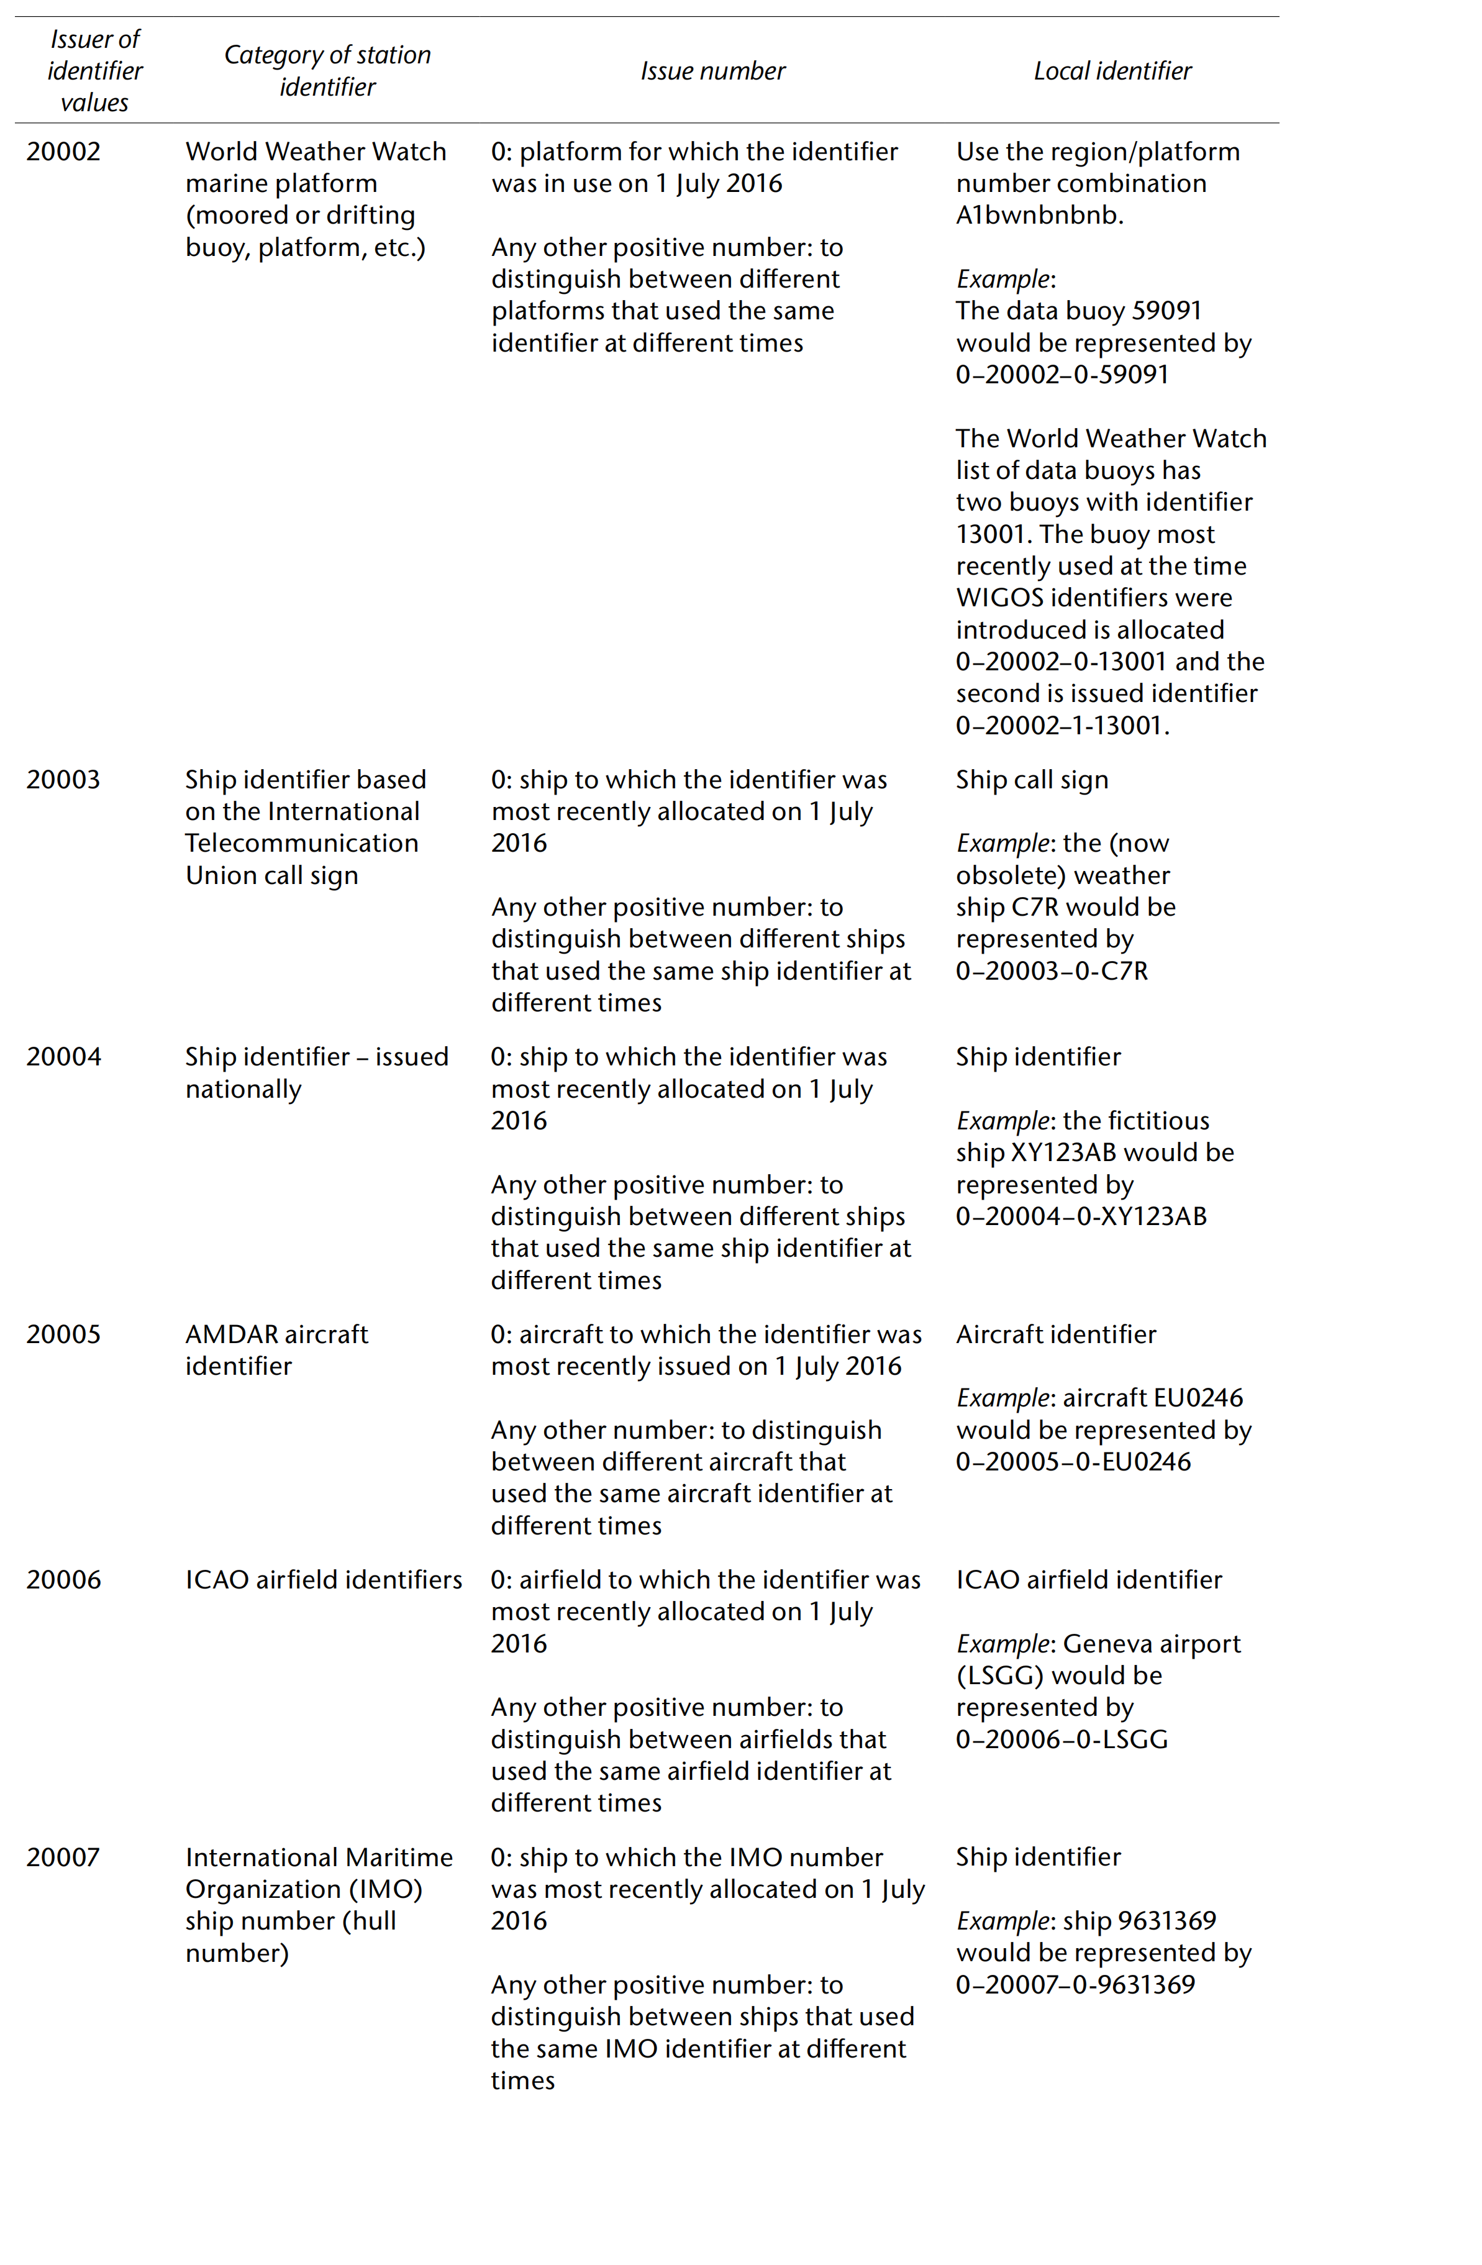

Slide 15
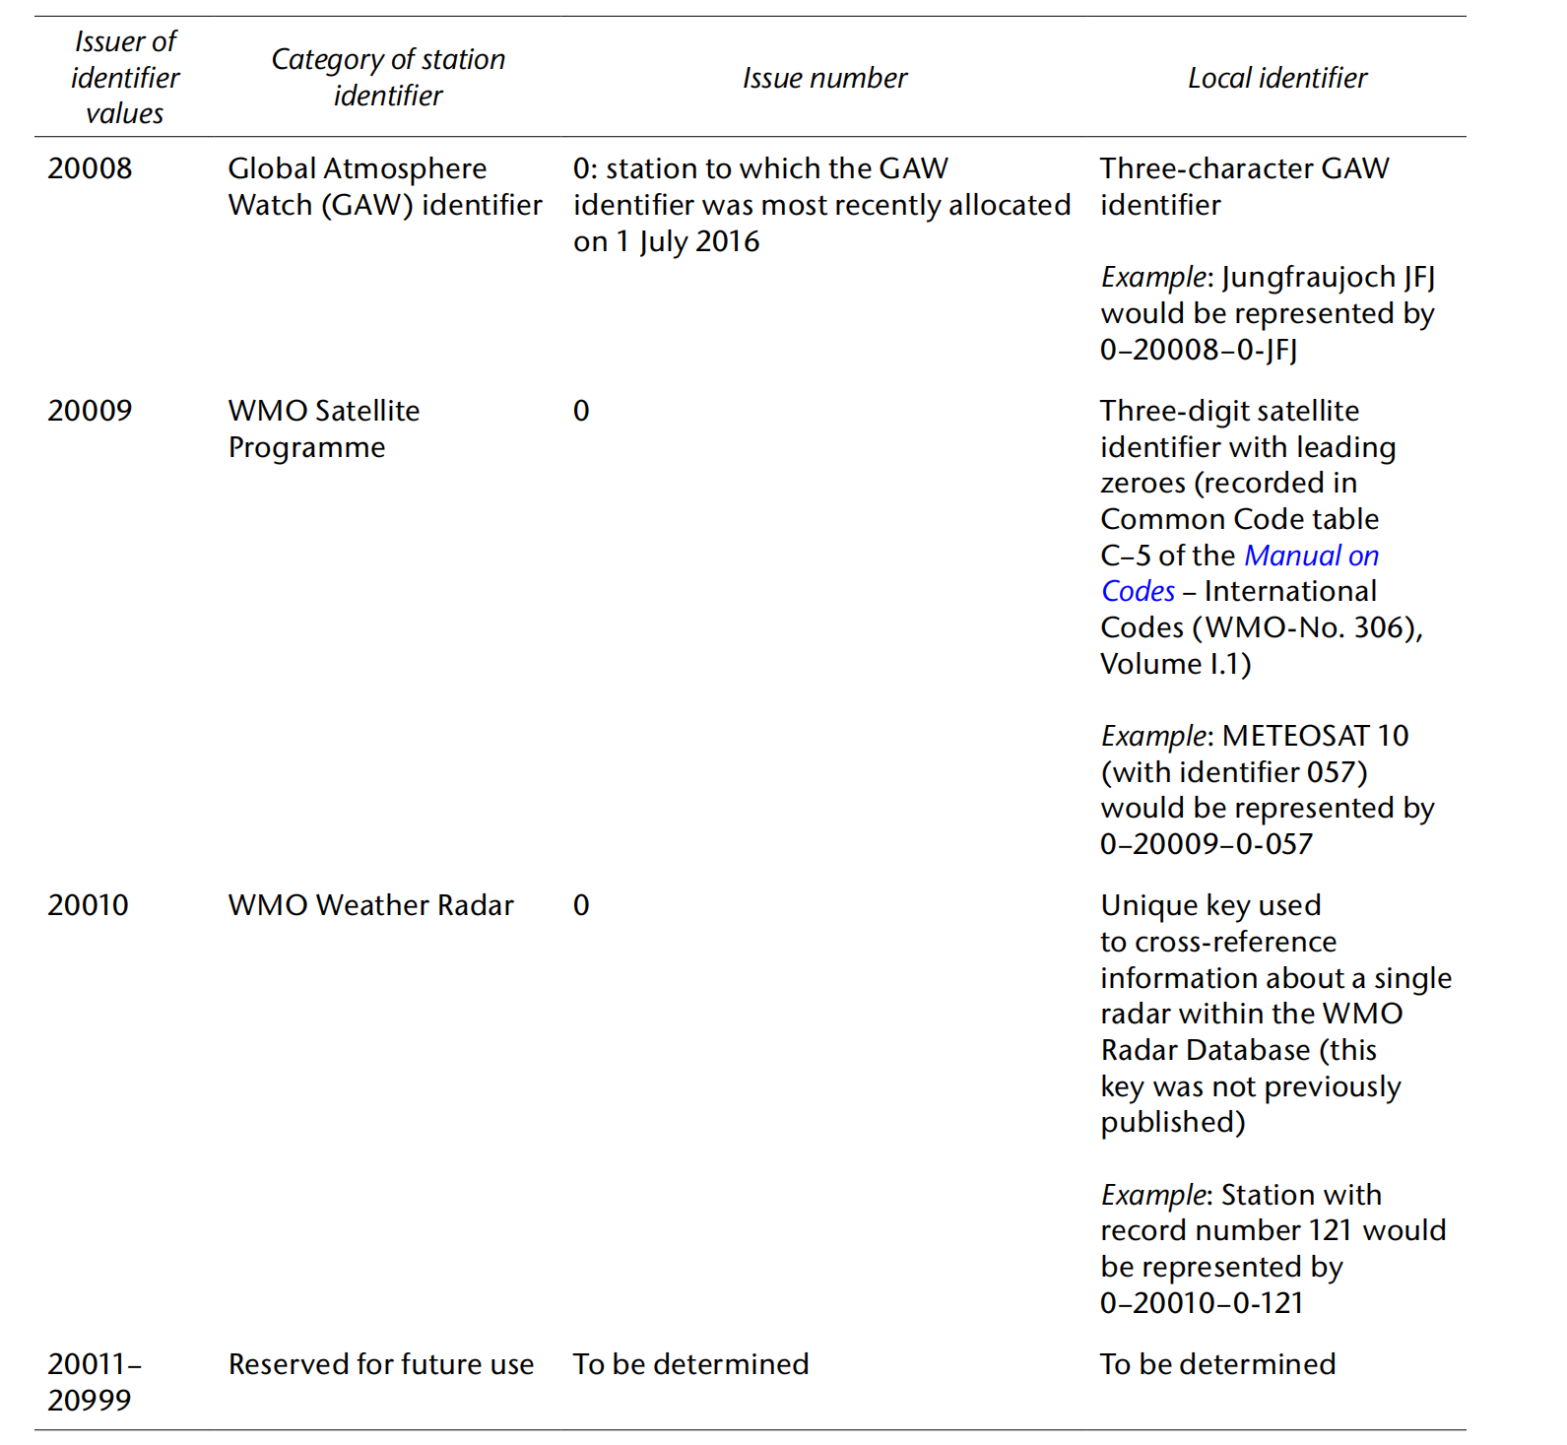

Slide 17
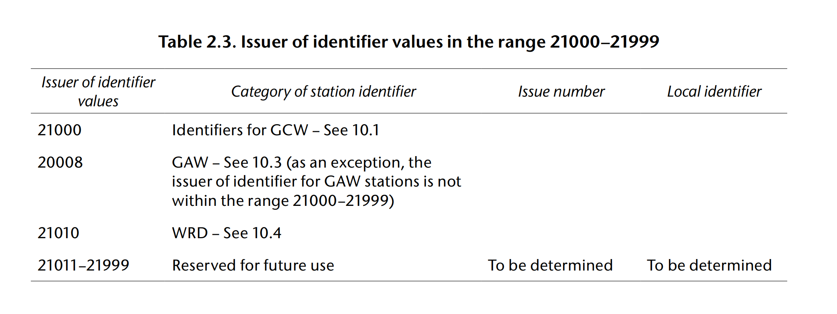

Slide 19
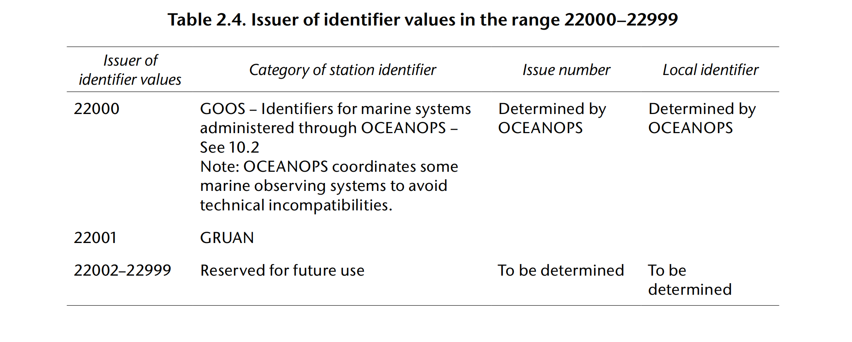

Slide 21
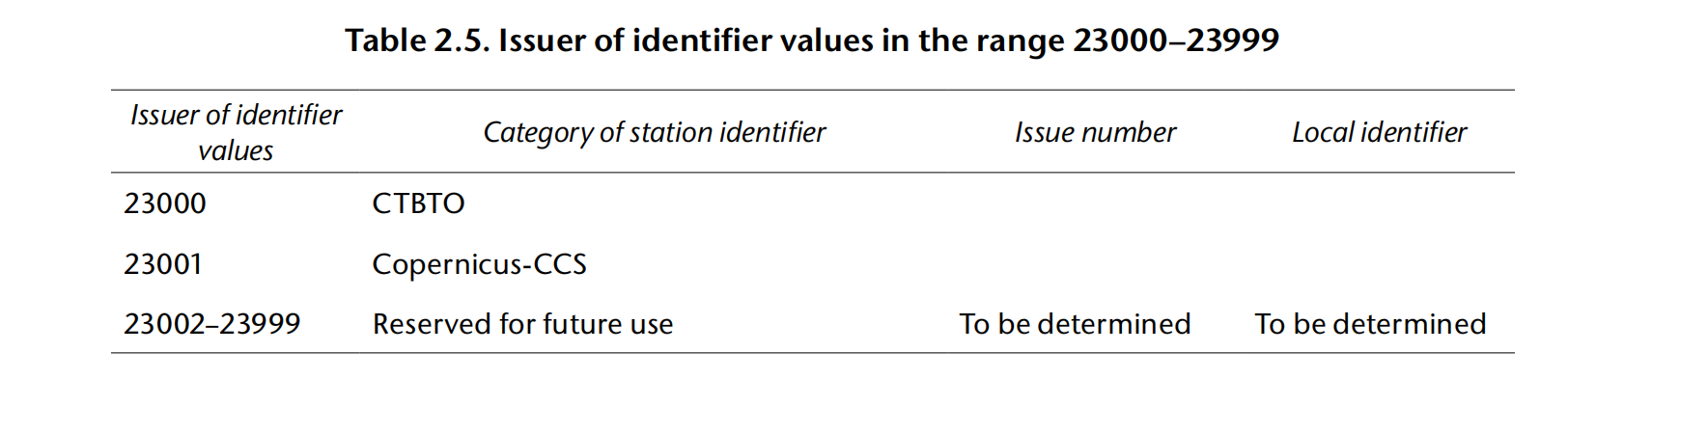

Slide 22
Assigning WIGOS identifiers to observing stations

Slide 23
3rd block ：Issue number
(number)
Members are recommended to develop their national schema for assigning WSIs with agreed procedures for allocating the issue number and local identifier, taking into account their national organizational structure and requirements.
A WSI national schema
  may define specific ranges (for the issue number) for delegating national authority for issuing WSIs to identified organizations for the observing facilities they operate.
  may also define procedures for the allocation of local identifiers.
Members may decide whether the implementation and maintenance of the national schema for allocating WSIs is centrally managed by a single organization or is distributed across various national organizations receiving delegated ranges for assigning WSIs, via the issue number.

Slide 24
3rd block ：Issue number
(number)
Issuers of identifiers are responsible for guaranteeing that no two observing stations share the same WIGOS identifier.
  may choose to use the issue number to allow them to delegate the task of allocating local identifiers to other organizations responsible for managing individual observing networks. Assigning each organization a different issue number will allow those organizations to allocate local identifiers for their observing facilities.
  has to record which issue numbers have been allocated and which organization is responsible for managing local identifiers for each.

Slide 25
Assigning WIGOS identifiers to observing stations

Slide 26
4th block ：Local Identifier
(character)
The local identifier
  may be up to 16 characters long. It must not contain or be preceded by blanks, and any blanks added to the end of the identifier by IT systems must be ignored.
  may contain only alphanumeric characters. These are a set of 62 characters including all the uppercase and lowercase letters from a to z and all the digits from 0 to 9. Symbols and special characters are not allowed in the set of alphanumeric characters to be used for the local identifier.
  Leading zeroes in a local identifier are significant and must be treated as part of the character string. (Note that this differs from the treatment of leading zeroes in the issuer of identifier and issue number parts of the WIGOS identifier, which are omitted from the WIGOS identifier.)

Slide 27
4th block ：Local Identifier
(character)
The organization must maintain a record of the local identifiers (and issue numbers) it has allocated (it may choose to use OSCAR for this)
Historically, station identifiers may have been reused when observing facilities closed and new ones opened. If the organization has been allocated a range of issue numbers, it may wish to consider using different issue numbers to distinguish between the different locations, allowing the local identifier to retain the link to the other location.
Although a single WIGOS identifier must not be issued to more than one observing facility, it is permitted for a station to have more than one WIGOS identifier.
The WIGOS identifier for a closed observing facility must not be reused unless the observing facility reopens

Slide 28
Principles of WIGOS identifiers
Before issuing a WIGOS identifier, it is important to search OSCAR/Surface to make sure that it has not already been allocated, and to register that WSI in OSCAR/Surface first, before exchanging any reports with such WSI.
Each observing station must have at least one WIGOS identifier (WSI). A WSI can only be associated with one observing station.
The station WIGOS identifier(s) link(s) the station to its WIGOS metadata.
Users should use the WMO global compilations of WIGOS metadata as the official sources, such as OSCAR/Surface, to look up the metadata for the station associated with the identifier.
The organization responsible for allocating the WIGOS identifier should ensure that the operator of the observing facility has committed to providing and maintaining WIGOS metadata for that facility.
WIGOS identifiers do not have meaning in themselves, so users must not interpret any patterns they see in these identifiers.
Members and organizations issuing WIGOS identifiers are strongly advised to document their procedures for allocating WIGOS identifiers in their quality management systems.

Slide 29
Recording the WIGOS identifier in observation reports (in the WMO standard reporting formats)
WIGOS identifiers cannot be represented in the traditional alphanumeric code forms, such as FM-12 SYNOP or FM-35 TEMP.
The Table Driven Code Form equivalents have to be used (FM-94 BUFR or FM-95 CREX, or, in the future, model driven code forms).
Centres that are unable to process Table Driven Code Forms will not be able to access the reports from stations that have only WIGOS identifiers.

Slide 30
General requirements for assigning WSIs
Members are requested to implement WSIs following the:
  WMO Technical Regulations (WMO-No.49) - Regulatory material
  Manual on WIGOS (WMO-No.1160) - Regulatory material
  Guide to WIGOS (WMO-No.1165) - Guidance material
Members shall:
  issue WSIs for stations/platforms within their geographic area of responsibility that contribute to a WMO or co-sponsored programme
  ensure that no WSI is issued to more than one station
  make available to WMO the updated metadata each time a new WSI is issued
Members should (before issuing a station identifier):
  ensure that the operator of a station/platform has committed to providing and maintaining WIGOS metadata for that station/platform

Slide 31

Thank you

