Slide 1

RA V Training Workshop on WDQMS for RWCs
Nadi, Fiji, 12 – 14 October 2022
How to Use the Incident Management System

Slide 2


WIGOS Tools and NFPs
Member
OSCAR/Surface
WIGOS NFP
RWC
OSCAR/Surface NFP
WDQMS Webtool
WIGOS Monitoring Centres
WDQMS NFP
IMS
OSCAR/Surface, an official repository of WIGOS metadata for all surface-based observing stations and platforms, https://oscar.wmo.int/surface/
WDQMS webtool, a webtool to monitor the performance of all WIGOS observing components, https://wdqms.wmo.int/
Incident Management System (IMS), for the registration and follow-up of WDQMS (WIGOS data quality monitoring system) issues identified in the quality evaluation process, https://jira.ecmwf.int/projects/RWC (can be accessed by registered users only)

Slide 3
What is IMS for RWC?
Incident Management is one of the functions of RWC to resolve issues, a part of the WDQMS process
IMS for RWC is one of the main operational tools used by RWCs, in addition to OSCAR/Surface and WDQMS Webtool
IMS for RWC is configured according to the Incident Management Process – WMO-No.1224, Technical Guidelines for RWC on WDQMS
IMS for RWC is hosted by the European Centre for Medium-Range Weather Forecasts (ECMWF) in JIRA Software, a work management tool for all kinds of uses cases
It has been operating in pilot mode since July 2020: RWC EAC, RWC Morocco, RWC Southern Africa, RWC Beijing, RWC Tokyo, RWC Argentina, RWC Brazil, RWC Indonesia and RWC Singapore

Slide 4
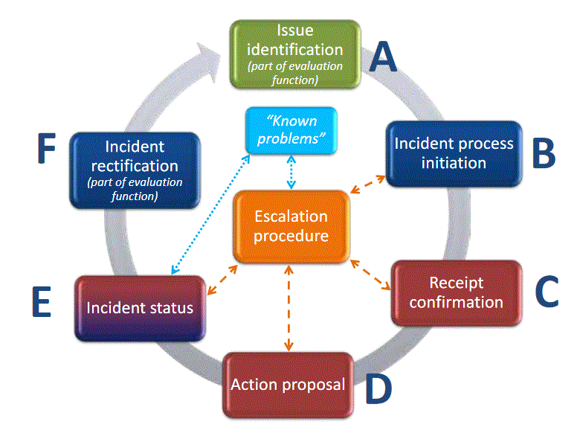
WIGOS IMP – interaction with countries
The issue might be closed again before initiating an incident managment process if the performance improved.
Responsbility
RWC or data user
Responsbility RWC
Responsbility RWC
Responsbility RWC
Responsbility
country
Responsbility Contact country → RWC
Responsbility country
Potential need to close IMP and open new IMP due to incident cause by different activator

Slide 5
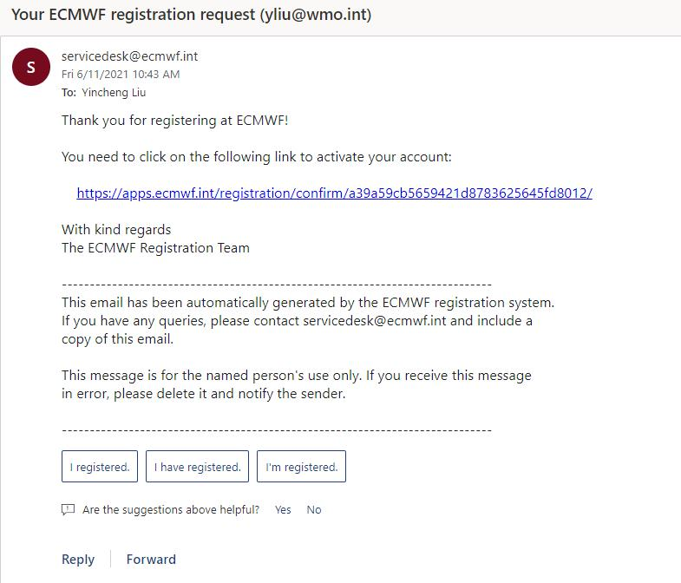
Users registration
WDQMS NFP of the country has been nominated in the WMO community platform, https://contacts.wmo.int/. Related guidance is available here: https://community.wmo.int/activity-areas/community-platform
For RWC, inform the RWC’s email address to WMO Secretariat. RWCs are encouraged to create an account in the IMS using a generic email addresses that can be accessed by all RWCs staff
Secretariat will create account and an activation email will be sent to registered email. Please also check your spam folder

Slide 6
Users registered in the IMS
Regional WIGOS Centres, RWCs is responsible to monitor and manage the tickets for observations that is within their area of responsibility. RWCs can update ticket status and close ticket
National Focal Points on WDQMS, NFP on WDQMS is representing their countries to respond tickets assigned to them, coordinate issues within their organization/countries and provide as many updates related to the tickets as possible in the system
WIGOS Monitoring Centres (DWD, ECMWF, JMA, NCEP), WIGOS Monitoring Centres can report issues or open tickets in the system, provide input to an ongoing tickets, and in some cases, tickets can be assigned to them
CBS Lead Centre (new, March 2022), CBS Lead Centre for GCOS (RA VI) is willing to collaborate with RWCs in identifying any data issues on the GCOS observation networks. The centre has been responsible for monitoring performance of GCOS networks (GSN and GUAN). Monitoring results of GCOS networks (GSN and GUAN) have been made available in the WDQMS Webtool since the launch of version 1.3 in November 2020.

Slide 7
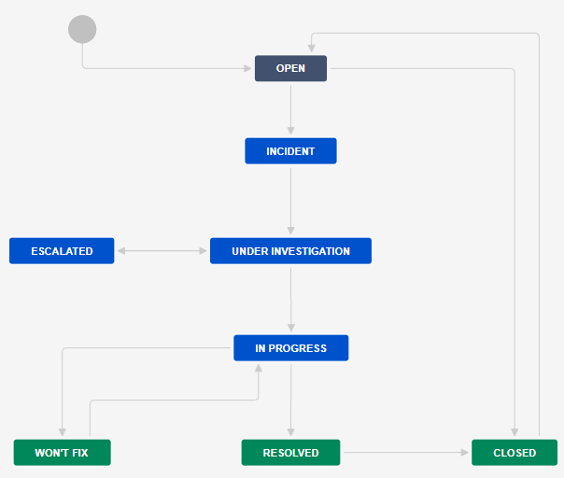
IMS workflow
The workflow of IMS for RWC is configured according to the Incident Management Process – WMO-No.1224, Technical Guidelines for RWC on WDQMS
Tickets opened in the system are grouped by RWC. Tickets and their details are visible to all registered users regardless of their region
Only RWCs accounts can update ticket status and close tickets. All users can open a new ticket and add comments
The system is in English but users can use a different languages (UN languages) in their ticket details, including in comments

Slide 8
Ticket evolution in the IMS
A new ticket opened
All users can open a new ticket and RWC will evaluate the ticket
RWC will update the ticket status into “Incident ” and assign the ticket to relevant WDQMS NFP or close the ticket if the issue has been resolved or has disappeared
When assigned a ticket, WDQMS NFPs must inform RWC that they are aware with the ticket by writing acknowledgement in the comment field, RWC will update the ticket status into “under investigation”
WDQMS NFP should continuously provide information relevant to the ticket, including propose actions resolving the issue and RWC will update the ticket status into “under investigation”
RWC will update the ticket status into “resolved, then close the ticket if the issue has been resolved
Incident
Under investigation
In progress
Wont’fix
Resolved/closed

Slide 9
Won’t fix and escalated tickets
RWC may put a ticket into the log of “Won’t fix” if they found that an incident cannot be rectified because no (immediate) action can be taken. RWC and/or NFP must regularly monitor the ticket put in “Won’t fix” and whenever it is found that an action can be taken to rectify the incident, RWC will bring the ticket back to “in progress”.
If there is no response from WDQMS NFP in IMS, RWCs can escalate the ticket to a WMO Secretariat, that will assist in contacting the Member concerned or bring the ticket to a higher level (e.g. PR). RWCs are encouraged to contact WDQMS NFP using other means of communication before escalating a ticket

Slide 10
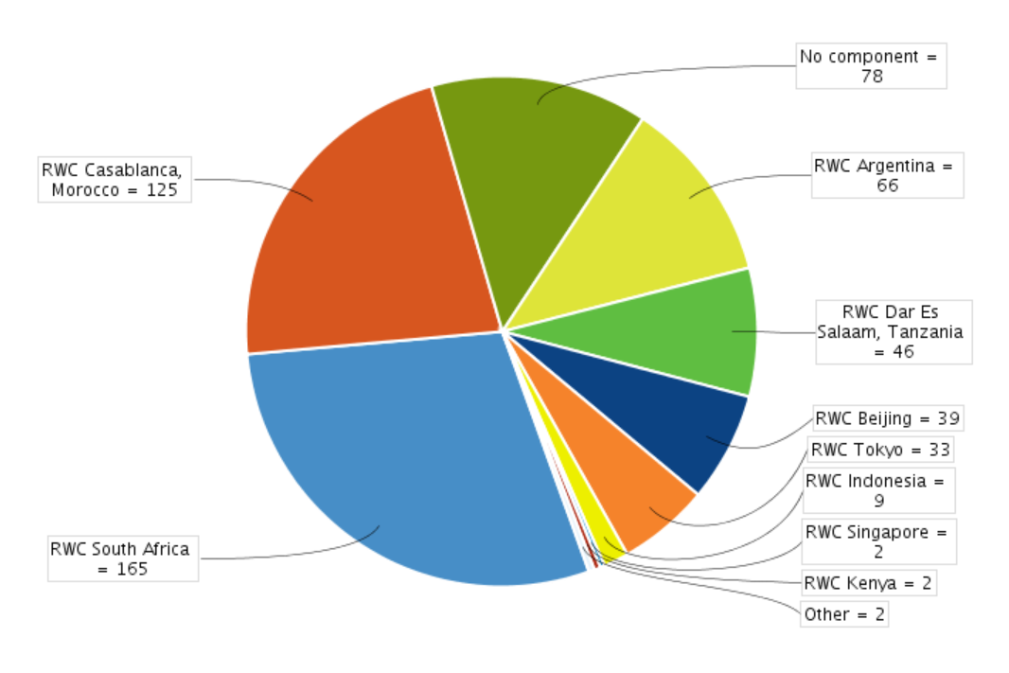
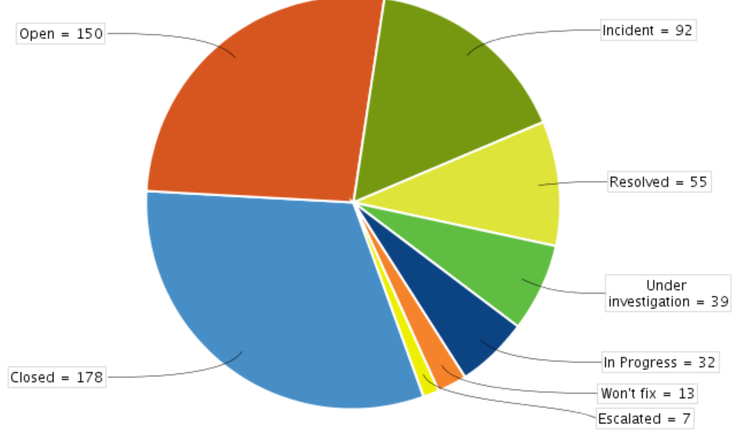
Number of tickets per RWC, 13 October 2022
Ticket status, 13 October 2022

Slide 11
Plan for IMS
WMO has its own JIRA Software license, so tickets, users and workflow from the current project hosted by ECMWF will be migrated to JIRA software hosted WMO
Recommendations from RWC Global workshop (25-27 July 2022) on IMS configuration will be considered in the new IMS JIRA Software hosted by WMO

Slide 12

Thank you

