Slide 1

OJT & QMS
Alexandru Hozoc, MET expert

Slide 2

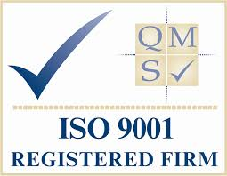

  OJT @ QMS
poursuivront un développement durable grâce aux meilleurs services possible, tant sur terre qu’en mer et dans les airs
YES

Slide 3
  OJT @ QMS
poursuivront un développement durable grâce aux meilleurs services possible, tant sur terre qu’en mer et dans les airs
and here are some reasons…

Slide 4
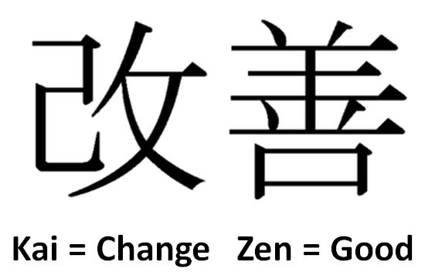
  OJT @ QMS
poursuivront un développement durable grâce aux meilleurs services possible, tant sur terre qu’en mer et dans les airs
a reason

Slide 5


Slide 6
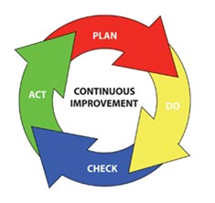
  OJT @ QMS
poursuivront un développement durable grâce aux meilleurs services possible, tant sur terre qu’en mer et dans les airs
In other words…
(re)Train
Assess
Continuous
improvement

Slide 7

  OJT @ QMS
poursuivront un développement durable grâce aux meilleurs services possible, tant sur terre qu’en mer et dans les airs
Third party / External verification
3-rd party
assessment
(external)
Associated to trainings
Periodic on site inspections
On the job assessment

Slide 8
  OJT @ QMS
poursuivront un développement durable grâce aux meilleurs services possible, tant sur terre qu’en mer et dans les airs
Even more reasons…

Slide 9
  OJT @ QMS
Feedback
According to ISO 9001, collecting feedback is a main source of info. in the PDCA cycle
In Competency assessment feedback from both assessor and assessed person is critical.

Slide 10
  OJT @ QMS
Confidentiality
ISO 9001, confidentiality - “just culture“: commitment mandatory for any external auditor
Individual results obtained when applying a Competency assessment scheme should not be public; advisable to be used for personal development and for identifying training needs

Slide 11
  OJT @ QMS
Aknowledgement
ISO 9001 certification is an acknowledgement of the ability to achieve and maintain the highest q-ty. standards in line with customer expectations and the commitment to the pursuit of customer satisfaction.
Applying a Competency assessment scheme is essential for the acknowledgement of the level of competency of the AMP in the organization.

Slide 12
  OJT @ QMS
Process documenting
ISO 9001:2008, clause 4.1 General requirements:
“establish, document, implement, and maintain a QMS“
Competency assessment needs to be documented and records be kept:
reports
tests, evaluation tables/lists, portfolios,
feedback forms

Slide 13
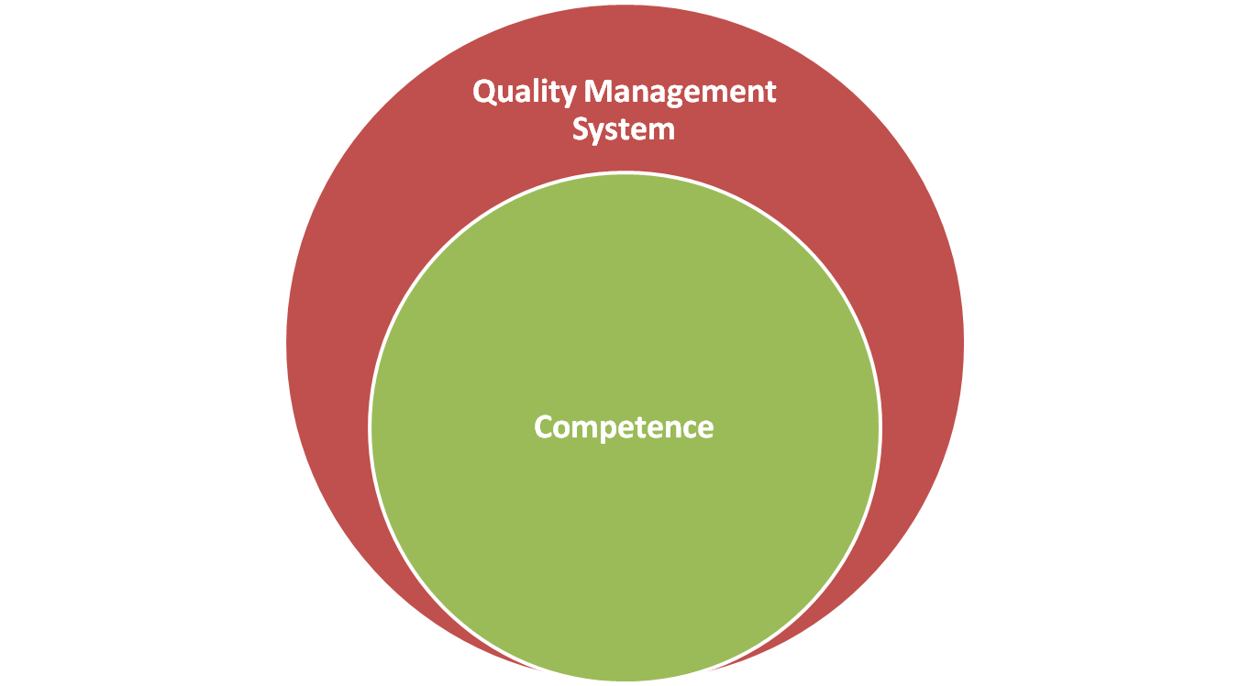
  Concluding
Competency assessment

Slide 14
Thank you

