Slide 1

How to exchange data from newly registered stations in OSCAR/Surface into GTS
Hassan HADDOUCH
09 May 2022

Slide 2
WIS/GTS current situation
In accordance with Res. 40, Essential data is freely accessible from GISC portals
Additional data and Other data require GISC (or originating centers) to provide credentials/dedicated access method
NCs are part of GTS and get Essential data and some of Additional and Other data.
 | Essential | Additional | Other (Aviation, satellite, NWP …)
Volume | 26 GB | 1.3 GB | 19 GB
Files | 700 000 | 100 000 | 600 000

Slide 3

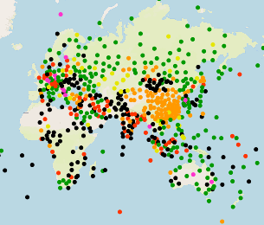
Declaration of new station process
Define the WIGOS identifier
Register your station on OSCAR
Notify the RTH and your principal GISC
Notify the WMO secretariat( wis@wmo.int)
Convert to BUFR format
Publish to GTS/WIS(RTH and GISC)
Cheek with RTH and GISC
BUFR
WIGOS Identifier
OSCAR
WDQMS
RTH
GISC

Slide 4
Monitoring: For WDQMS, GBON and Res.1
Thanks to GBON, Res.1 and WIS2:
The need for bilateral agreements will diminish
It is also planned to monitor at the acquisition level in addition to the assimilation level to assess the transition and the effectiveness of GBON and Res. 1
Eventually, monitoring results will be identical
Ad-hoc bilateral
agreements
Current situation for WDQMS:
Statistics are done at the “assimilation database” level, combining GTS Data and ad-hoc ones
Depending on the number of ad-hoc arrangements and quality control mechanism the result for different WDQMS Centers will be very different!
WIS2
GTS
Other sources
Filtering
Quality Control
Assimilation Database
Geo JSON
CSV
Database
WDQMS Portal
Geo JSON
Database
Monitoring Portal

Slide 5
Thank you!

