Slide 1
Activities of the
Regional WIGOS Centre-Southern Africa

Slide 2
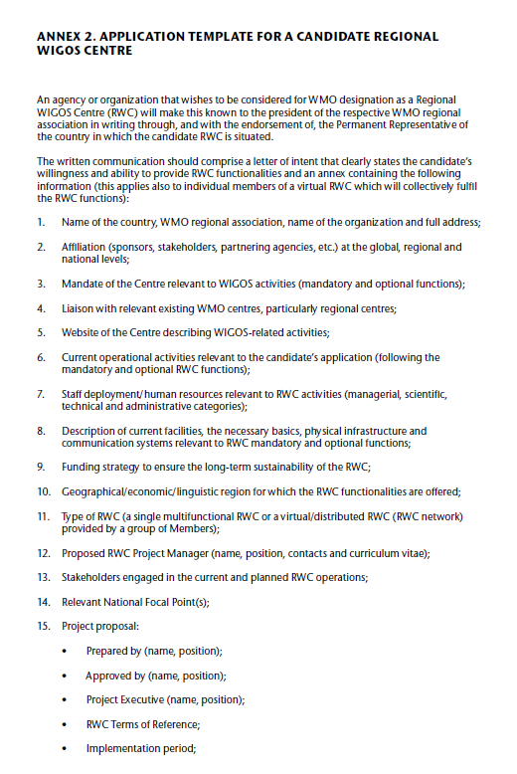
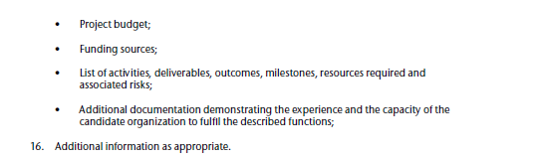
Outline
Guide to the WMO Integrated Global Observing System (WMO-No 1165)
Background
  Institutional set-up
  National Focal Points and # Stations
Mandatory functions
  Data availability
  Station Metadata
  Data quality
  Tickets: Incident Management System
Optional functions
  Capacity development: Operation of WIGOS Tools

Slide 3
Background
The Regional WIGOS Centre-Southern Africa (RWC-SA) has been performing RWC pilot phase functions since March 2021 for the Southern African Development Community (SADC).
The mandatory RWC functions performed are to:
Support Members with the management of metadata in OSCAR/Surface
Assist with following up on quality issues identified via the WIGOS Data Quality Monitoring System.
Optional functions of technical assistance related to the operation of WIGOS tools.
Services are provided in English, Portuguese, and French

Slide 4
Institutional set‑up
South African Weather Service
Office of PR
Division:
Infrastructure and Information Systems
Department:
Information and Communication Technology
RWC-Southern Africa
ErrorQ Team

Slide 5
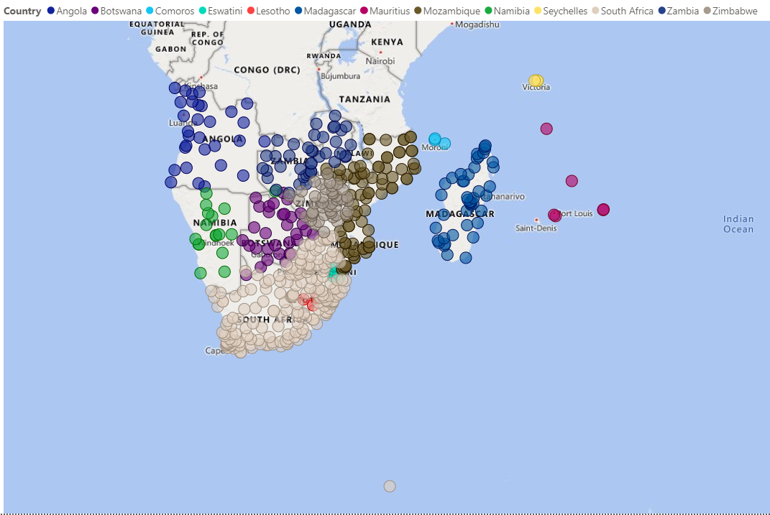
National Focal Points and #Stations
NFP registration in SADC
Number of stations
Country | Country code | WDQMS | OSCAR/Surface
Angola | AGO | ✓ | ✓
Botswana | BWA | ✓ | ✓
Comoros | COM | ✓ | ✓
Lesotho | LSO | ✓ | ✓
Madagascar | MDG | ✓ | ✓
Mozambique | MOZ | ✓ | ✓
Mauritius | MUS | ✓ | ✓
Malawi | MWI | ✓ | ✓
Namibia | NAM | ✓ | ✓
Seychelles | SYC | ✓ | ✓
Eswatini | SWC | ✓ | ✓
South Africa | ZAF | ✓ | ✓
Zambia | ZMB | ✓ | ✓
Zimbabwe | ZWE | ✓ | ✓
CountryCode | OSCAR/Surface | WDQMS
AGO | 32 | 18
BWA | 32 | 18
COM | 3 | 2
LSO | 3 | 3
MDG | 44 | 44
MOZ | 83 | 79
MUS | 6 | 6
MWI | 70 | 70
NAM | 17 | 15
SHN | 1 | 1
SWZ | 11 | 8
SYC | 3 | 1
ZAF | 176 | 166
ZMB | 40 | 40
ZWE | 43 | 41
Total | 564 | 512

Slide 6
Mandatory Functions

Slide 7
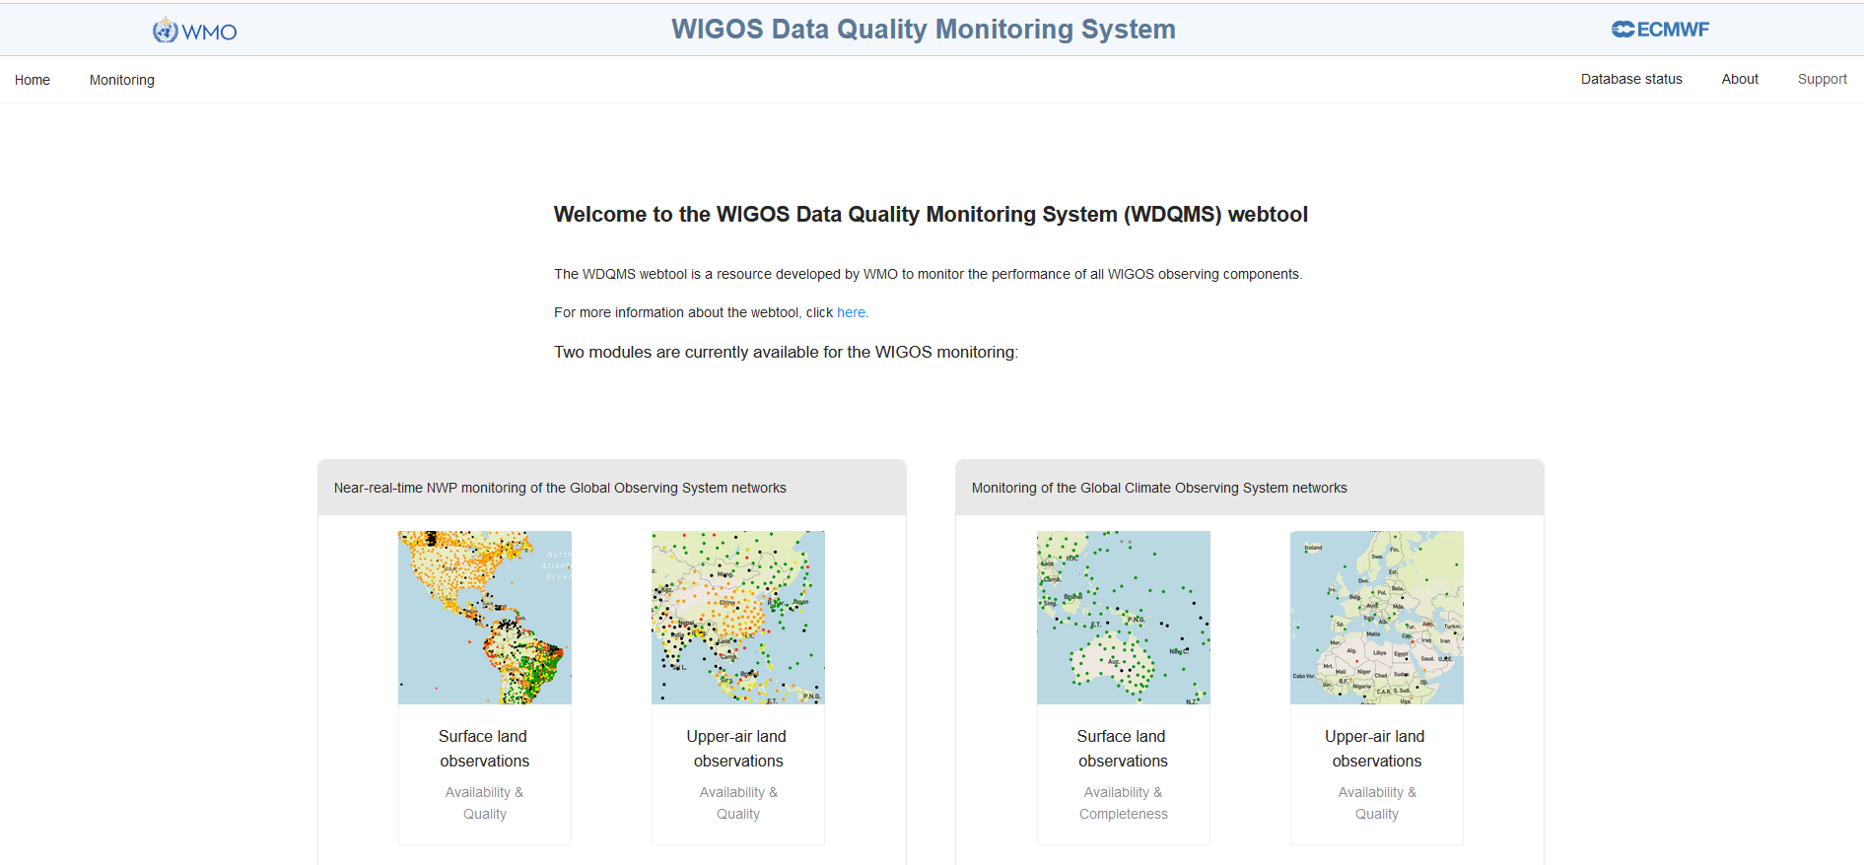
Data availability
Surface land stations

Slide 8
Data availability
Surface land stations – Monthly performance
RWC-SA reported an average performance of <40% for May 2021 to February 2022

Slide 9
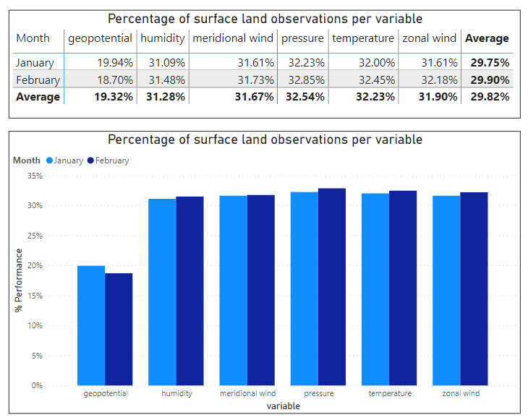
Data availability
Surface land stations – Monthly performance
RWC-SA reported an average performance of <35% for January and February 2022

Slide 10
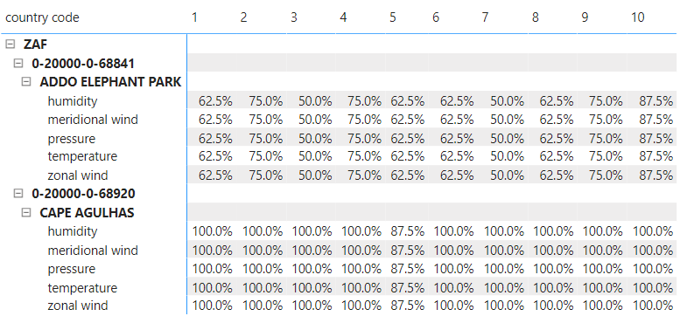
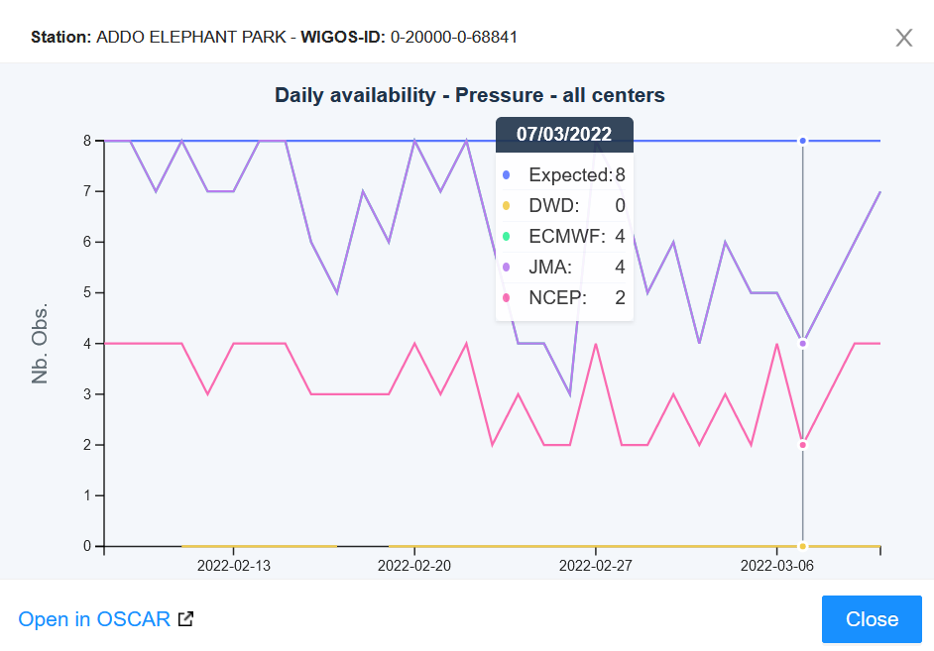
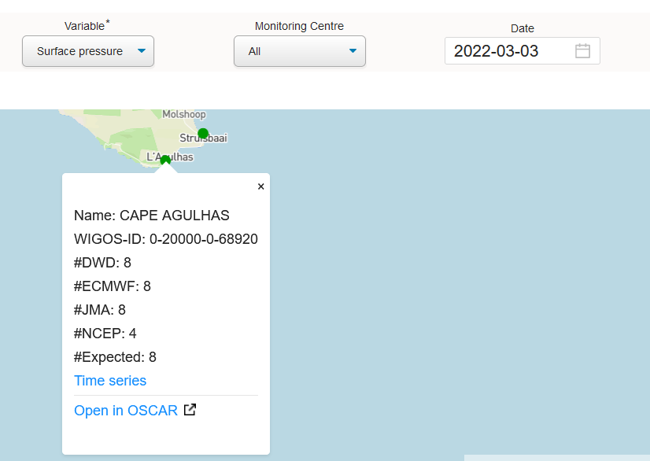
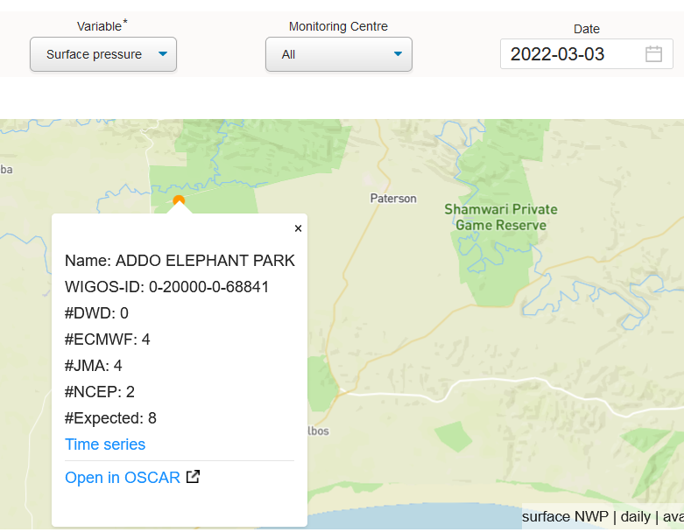
Data availability
Surface land stations – Daily performance

Slide 11
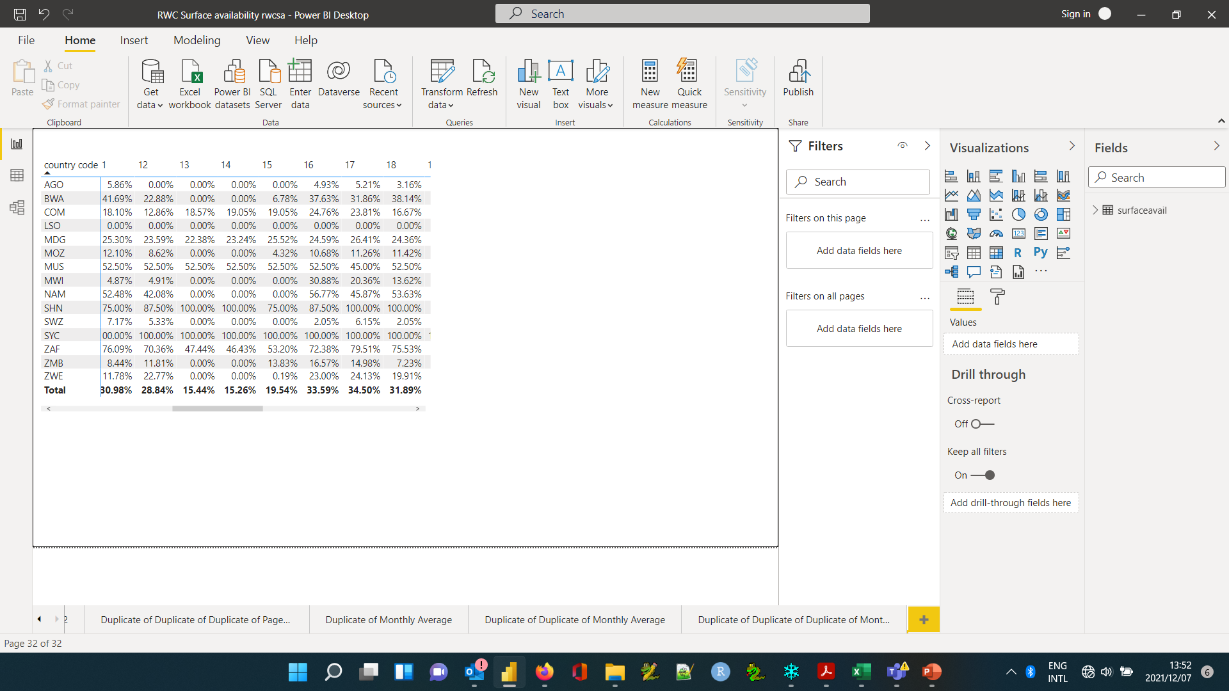
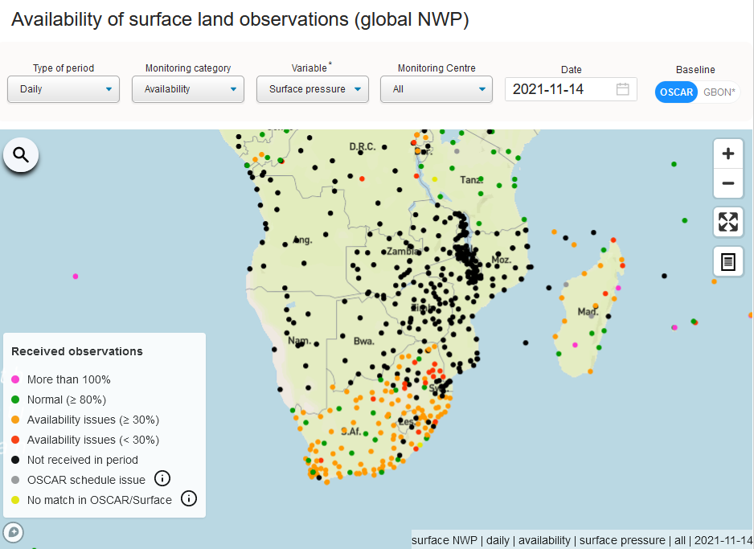
Data availability
Surface land stations – GISC Outage
GISC Data outage 13 to 15 November 2021
GISC Outage due to system upgrade
Most countries reported 0% data availability 13 to 15 November 2021
- Improved data availability for most countries on 16 November

Slide 12
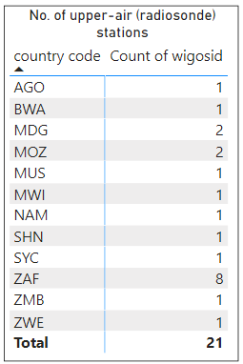
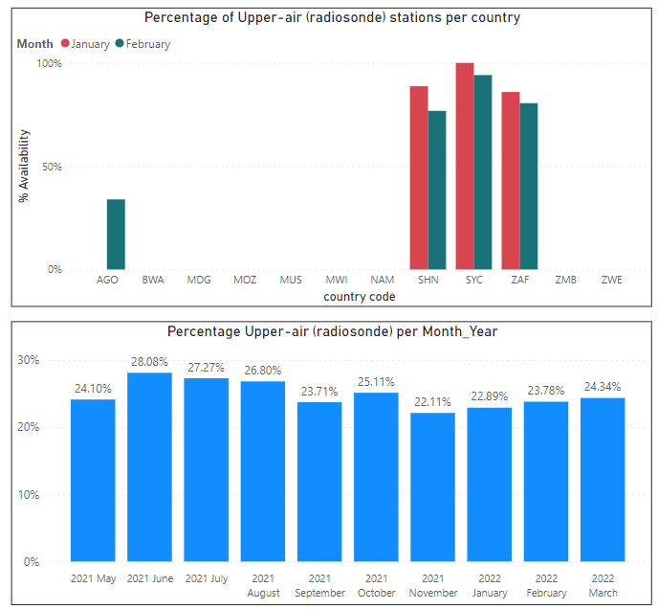
Data availability
Upper air stations (Radiosondes)
RWC-SA reported an average performance of <30% for May 2021 to February 2022
12 Countries with Upper stations of which only 4 Countries report upper-air data.
Station metadata of non-reporting stations is to be updated in OSCAR/Surface

Slide 13
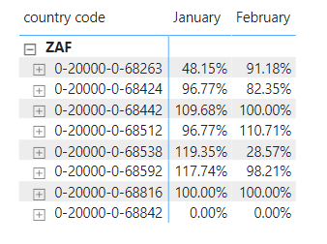
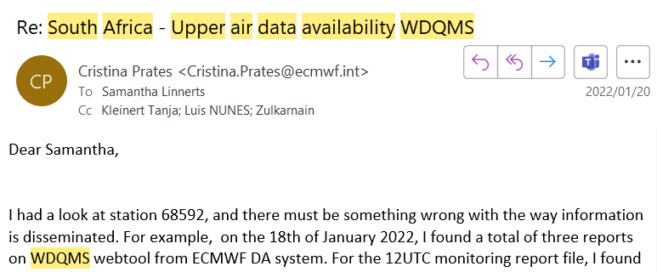
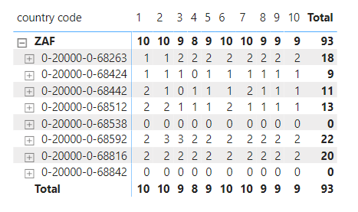
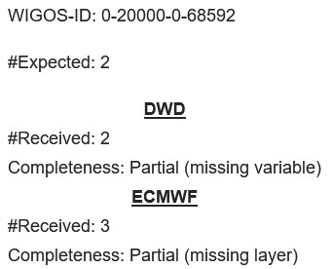
Data availability
Upper air stations (Radiosondes)
Incorrect data dissemination = incorrect number of reports received
Actual Monthly performance % 0-20000-0-68592 | January | 100
 | February | 91

Slide 14
Possible reasons for low data availability
OSCAR/Surface
  Incorrect reporting interval/schedules
  Silent/Non-reporting stations
Technical/data transfer challenges at the site
Expected in WIS bit no data available
  e.g., new stations registered in OSCAR/Surface, AMSS yet to be configured)

Slide 15
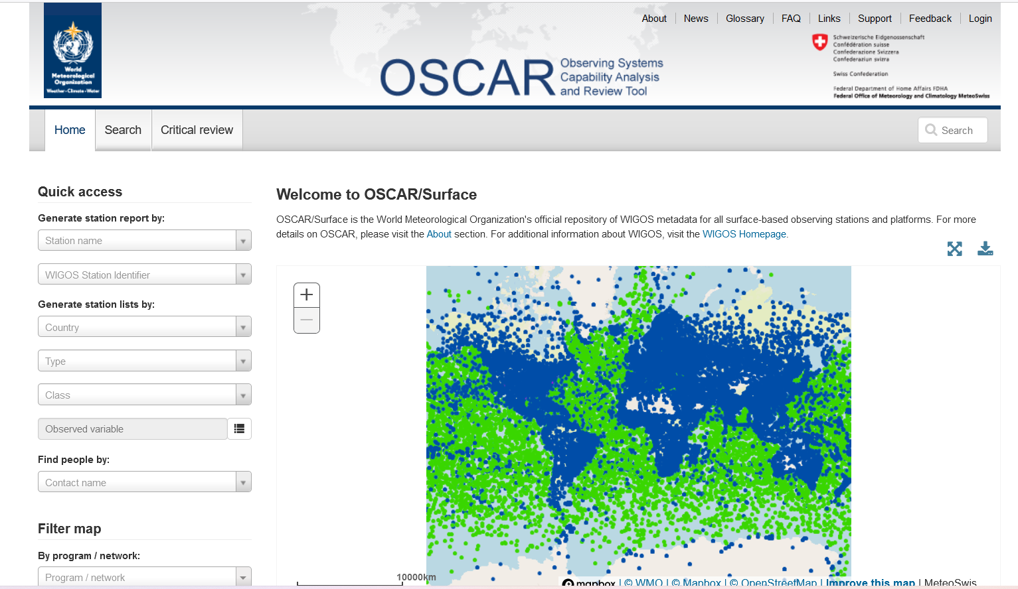
Station metadata

Slide 16
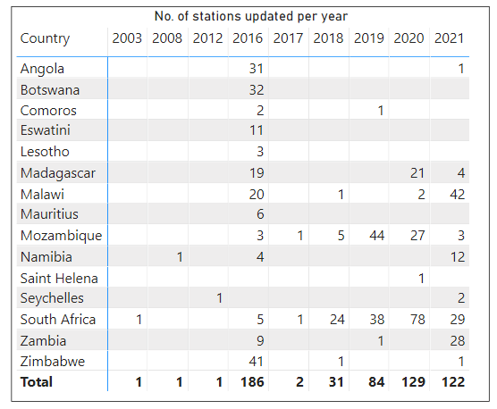
Station metadata
Some countries has not updated their stations since the launch of OSCAR/Surface in 2016

Slide 17
Station metadata
Black dots
Number of Silent/Non-reporting stations
CountryCode | ID | May | June | July | August | September | October | November
AGO | 0-20000- | 6 | 6 | 6 | 6 | 8 | 7 | 7
BWA | 0-20000- | 2 | 2 | 3 | 3 | 2 | 2 | 2
COM | 0-20000- | 2 | 2 | 0 | 0 | 0 | 0 | 0
LSO | 0-20000- | 2 | 2 | 2 | 2 | 2 | 2 | 2
MDG | 0-20000- | 1 | 1 | 1 | 1 | 1 | 1 | 1
MOZ | 0-20000- | 8 | 8 | 9 | 9 | 8 | 9 | 9
MUS | 0-20000- | 0 | 0 | 0 | 0 | 0 | 0 | 0
MWI | 0-20000- | 0 | 0 | 0 | 1 | 0 | 0 | 0
NAM | 0-20000- | 6 | 6 | 5 | 1 | 2 | 2 | 2
SHN | 0-20000- | 0 | 0 | 0 | 0 | 0 | 0 | 0
SWZ | 0-20000- | 1 | 1 | 6 | 1 | 2 | 2 | 2
SYC | 0-20000- | 2 | 3 | 1 | 0 | 0 | 0 | 0
ZAF | 0-20000- | 1 | 1 | 0 | 0 | 0 | 0 | 2
ZMB | 0-20000- | 2 | 1 | 3 | 3 | 4 | 0 | 2
ZWE | 0-20000- | 6 | 3 | 2 | 0 | 0 | 0 | 0
 | Total | 39 | 36 | 38 | 27 | 29 | 25 | 29
Metadata to be updated in OSCAR/Surface
Metadata updated
CountryCode | ID | May | June | July | August | September | October | November
MDG | 0-450-0- | 21 | 21 | 21 | 21 | 21 | 21 | 21
MOZ | 0-508-3 | 43 | 43 | 42 | 42 | 41 | 41 | 42
MWI | 0-454-2 | 44 | 44 | 45 | 45 | 45 | 45 | 42
NAM | 0-516-0 | 0 | 0 | 1 | 1 | 1 | 1 | 1
SWZ | 0-748-0 | 0 | 0 | 0 | 0 | 3 | 3 | 2
ZMB | 0-894-1 | 1 | 1 | 1 | 1 | 1 | 1 | 3
 | Total | 109 | 109 | 110 | 110 | 112 | 112 | 111
AMSSs to be configured.
Bulletins to be updated

Slide 18
Station metadata
Pink dots
>100% Availability: Received>Expected
Metadata to be updated in OSCAR/Surface
CountryCode | WIGOSID | May | June | July | August | September | October | November
MDG | 0-20000-0-67072 |  |  |  |  |  |  | 106.58
MOZ | 0-20000-0-67323 |  |  | 128.28 | 126.55 | 123.45 | 146.75 | 138.80
MUS | 0-20000-0-61989 | 175.00 | 174.17 | 150.16 | 170.55 | 174.14 | 175.00 | 174.03
 | 0-20000-0-61995 | 112.22 | 111.17
MWI | 0-454-2-AWANAMBUMA |  |  |  |  |  |  | 281.67
 | 0-454-2-AWSBALAKA |  |  |  |  |  |  | 140.83
 | 0-454-2-AWSCHIKANGAWA |  |  |  |  |  |  | 280.83
 | 0-454-2-AWSMALOMO |  |  |  |  |  |  | 151.67
 | 0-454-2-AWSNKHOMA |  |  |  |  |  |  | 130.00
NAM | 0-20000-0-68098 |  |  | 107.22 | 127.99 | 131.61 | 132.32 | 115.38
 | 0-20000-0-68005 | 116.07 | 147.92
 | 0-20000-0-68010 | 114.56 | 148.61
 | 0-20000-0-68098 | 111.73 | 121.67
 | 0-20000-0-68116 | 125.55 | 154.86
 | 0-20000-0-68212 | 124.18 | 154.17
ZAF | 0-20000-0-68400 | 111.78 | 103.41
 | 0-20000-0-68718 | 164.29 | 160.33
 | 0-20000-0-68447 |  | 712.50
 | 0-20000-0-68927 |  | 106.96
ZMB | 0-20000-0-67666 |  |  |  |  |  |  | 281.25
First country in SADC to exchange data using WIGOS Station Identifier

Slide 19
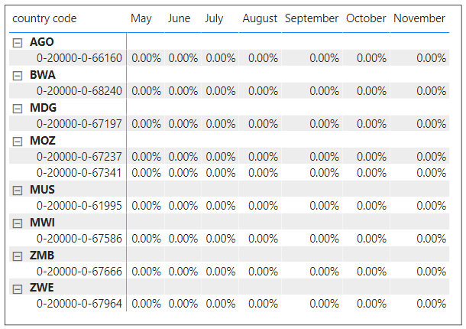
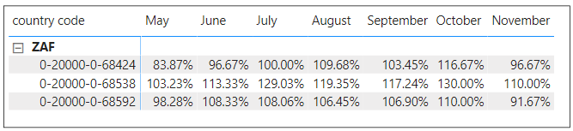
Station metadata
Upper air stations (Radiosondes)
Silent/Non-reporting stations
Metadata to be updated in OSCAR/Surface
>100% availability
Incorrect data dissemination and not an OSCAR/Surface schedule problem

Slide 20
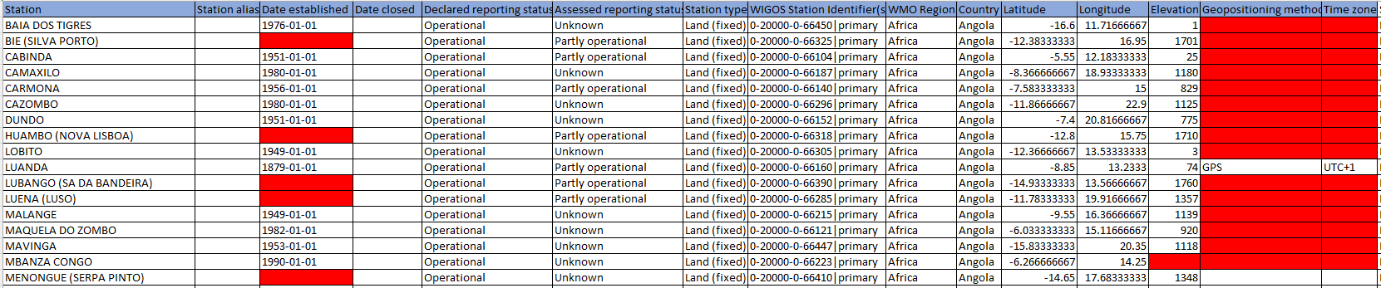
Station metadata
Check metadata completeness
Verify station coordinates (Latitude and Longitude)

Slide 21
Data quality
Surface land stations

Slide 22
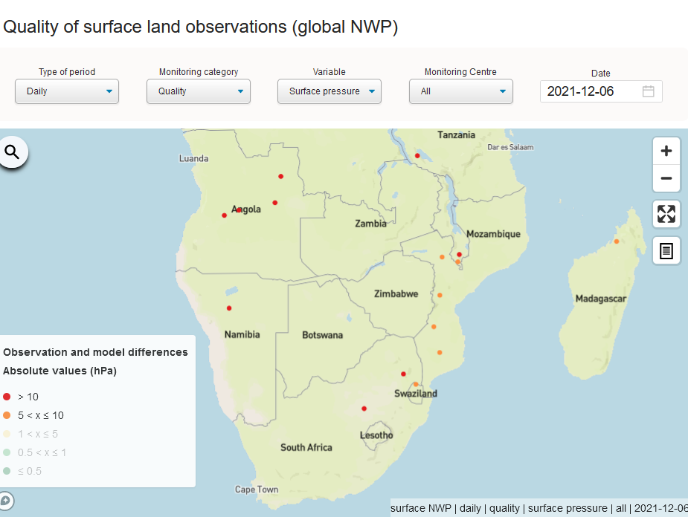
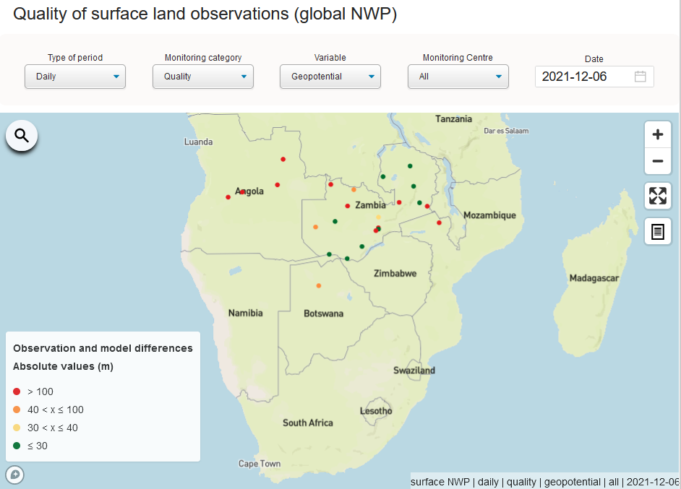
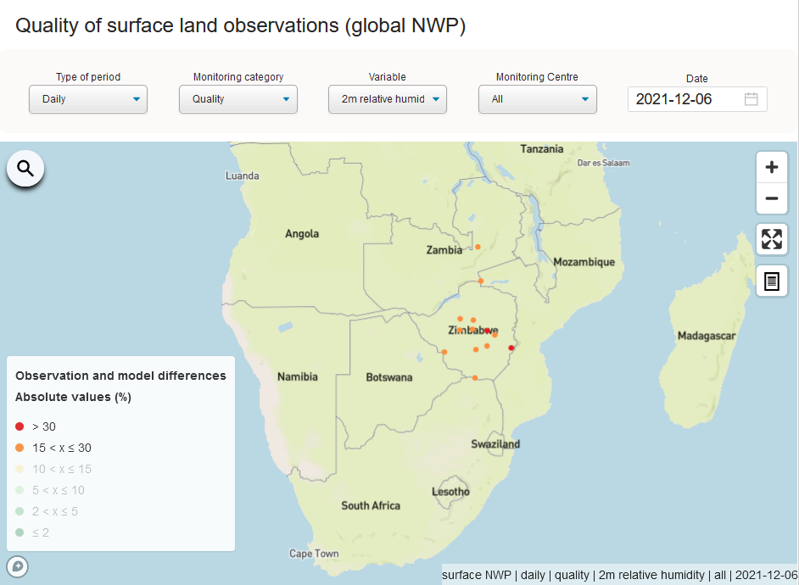
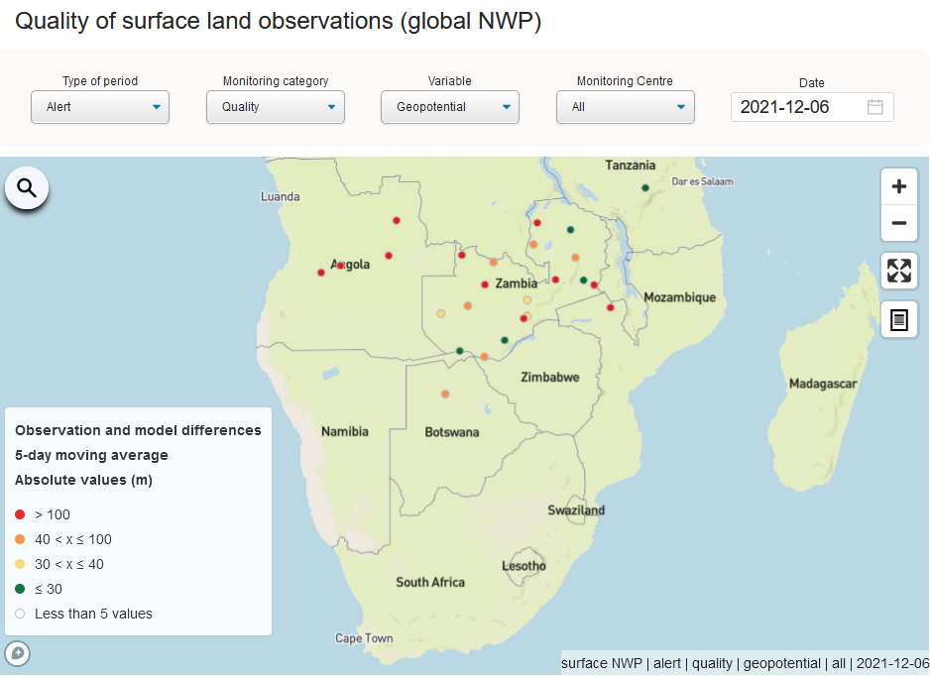
Data quality
Surface land stations

Slide 23
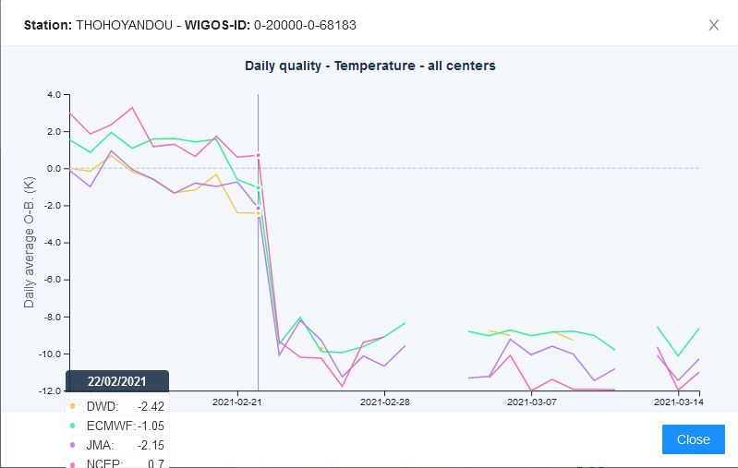
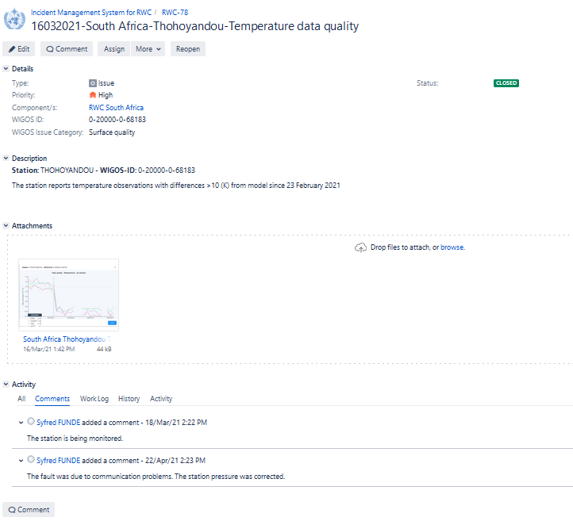
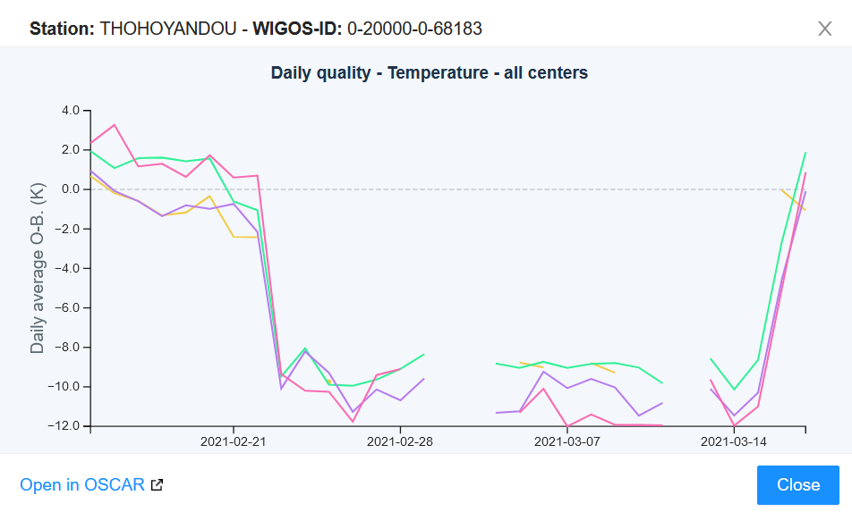
Data quality
Surface land stations
Before
After

Slide 24
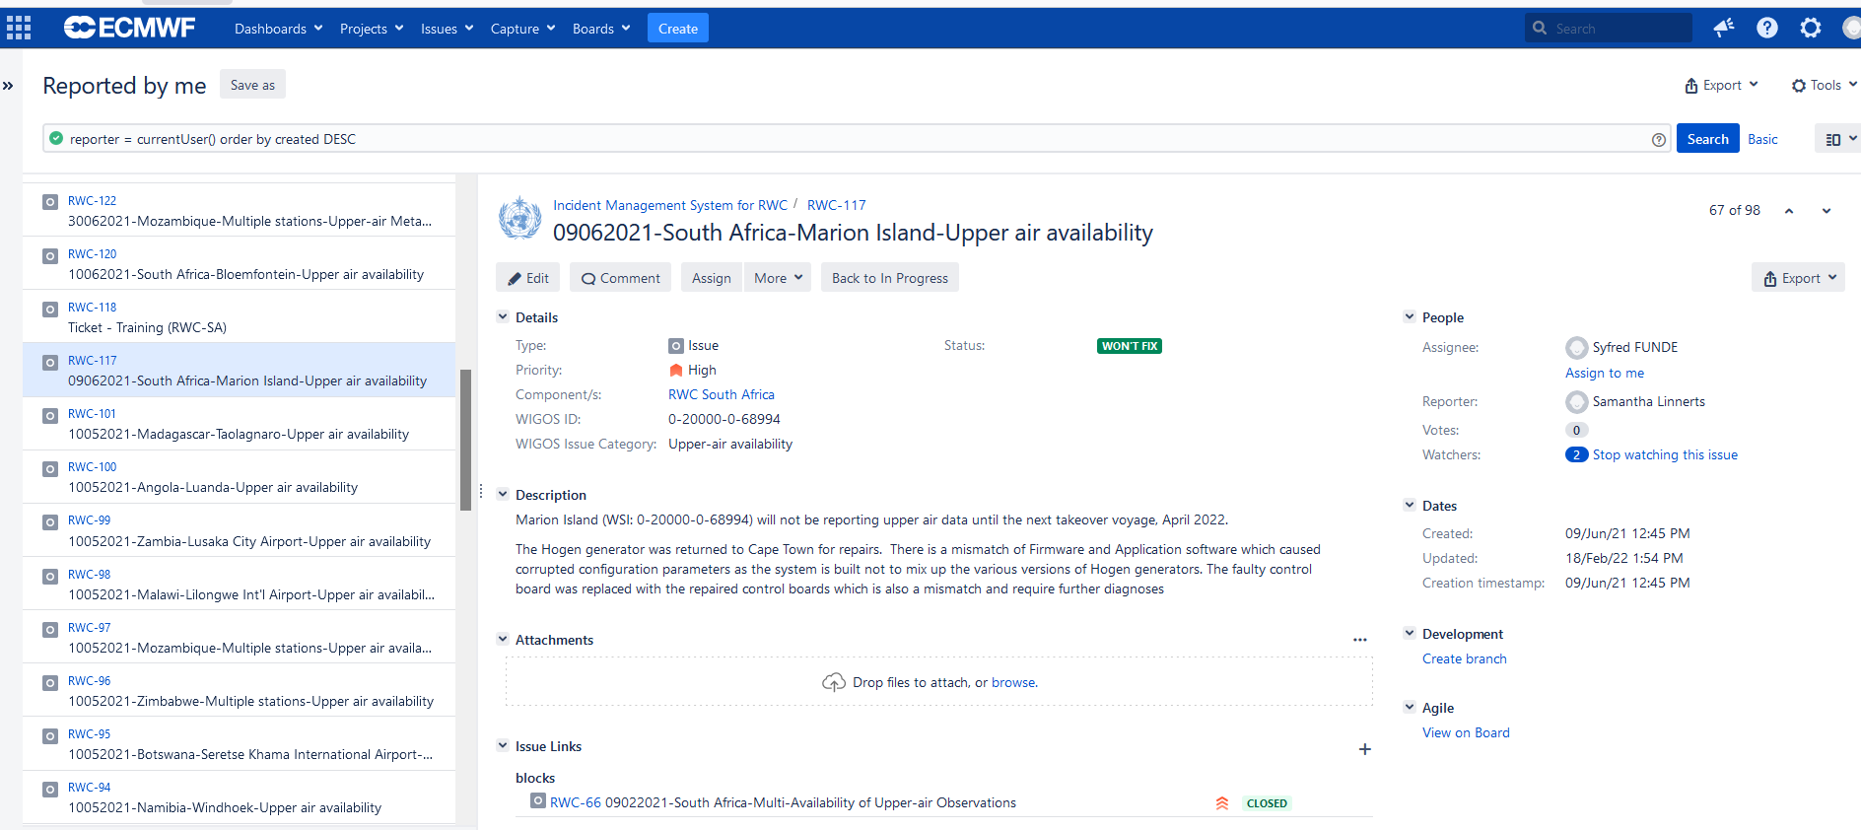
Incident Management System

Slide 25
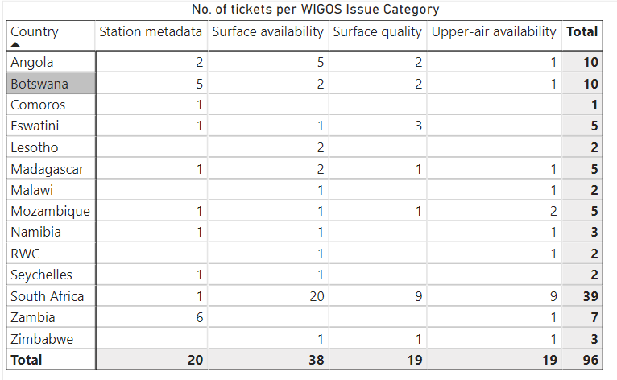
Incident Management System
Number of tickets issued per monitoring category

Slide 26
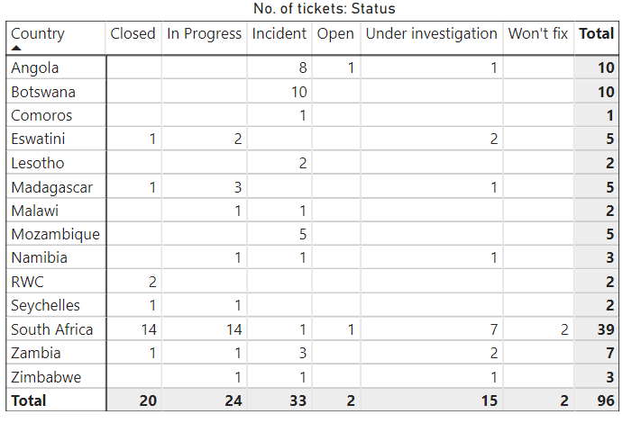
Tickets: Incident Management System
Status | %
Closed | 21
Open | 2
Incident | 34
Under investigation | 16
In progress | 25
Won’t fix | 2
34% of tickets have not been acknowledged by NFP: WDQMS
- Decrease of 15% since November 2021.

Slide 27
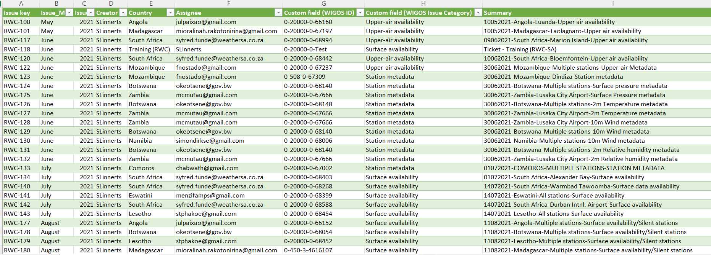
Tickets: Incident Management System
Register for monitoring tickets – Updated at the end of each month
- shared with NFPs to assist them in managing their tickets

Slide 28
Optional Functions

Slide 29
Capacity Development
Coaching sessions were held with the NFPs: OSCAR/Surface and WDQMS on:
Updating of metadata (e.g., reporting schedules)
Registering of new stations
Monitoring of data availability and quality (WDQMS)
Managing tickets (IMS)

Slide 30
Thank you
Samantha Linnerts
RWC-SA
Samantha.linnerts@weathersa.co.za
Mobile: +2782 498 9870
Or
Office: +2712 367 6153

