Slide 1

A Free, Cloud-based
Tool for Creating and Publishing CAP Alerts
Notes:
The title of this presentation is “A Free, Cloud-based Tool for Creating and Publishing CAP Alerts”. I will present a simple software tool that makes it very easy to start up a CAP-enabled alerting system.
Please be aware that people responsible for issuing alerts already have various systems in place, and these may have been around for many years. Those alerting systems have their own work flows and business rules.
It would be ideal to have CAP alerts generated and published through a process tacked onto existing procedures and alerting systems. But, a tool such as this may be the next best thing.
Today, the CAP Editor tool is initialized for 360 alerting authorities across 200 countries or territories, and it currently supports 22 languages. The CAP Editor tool is in operational use by twenty alerting authorities; 34 other alerting authorities have it in testing status.

Slide 2
Learning Objectives
On completion of this session, you should be able to:
Describe how an alerting authority gets access to the cloud-based CAP Editor in a particular language.
Describe how composers and approvers use the cloud-based CAP Editor to maintain a CAP news feed.
Discuss ways in which an alerting authority can leverage its CAP news feed to enhance alert dissemination.
Notes:
Here are the Learning Objectives for this session.

Slide 3
Presentation Outline
206.1 Overview of Tool for Creating CAP Alerts
206.2 The Role of Composer and the Role of Approver
206.3 Exercise: Saving a Draft and Publishing an Alert
206.4 Using the CAP Feed to Reach More People
Notes:
Here is an outline of the major topics in this presentation.
The first topic is:
Overview of Tool for Creating CAP Alerts

Slide 4
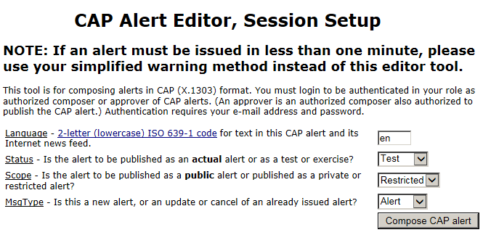
Tool for Creating CAP Alerts
Notes:
This is the entry point to the freeware known as "CAP Editor".
CAP Editor opens to an authorized person upon entry of his/her email address and associated password.
Here is where the CAP alert language, status, scope and msgType are set.
Then, hit the "Compose CAP Alert" button to continue.

Slide 5
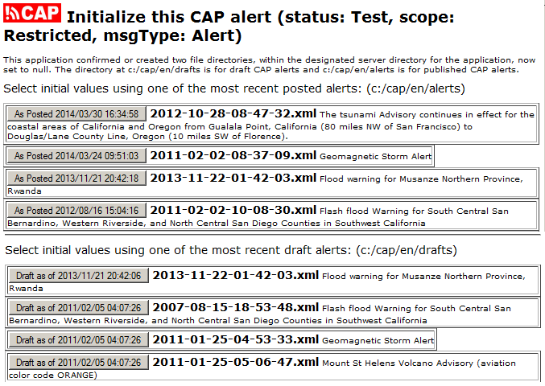
Tool for Creating CAP Alerts (selector)
Notes:
In this application, the composer is able to start from any previously entered CAP message, whether that message was actually posted
or only drafted. This is a useful because a new event is often similar
to a prior event.
It this is to be not a new alert but an update, cancel, or error of a previous alert, the composer would select the particular posted alert. This allows the software to generate the reference to that posted alert.
Here, a composer can scan the dates and headlines of most recent
CAP alerts.
Putting the mouse over an entry shows text of the description and instruction elements for that alert.
We’ll assume this is a new alert and the composer wants to start with a previously posted alert concerning an advisory for the Mount St Helens volcano.
Next we will see the main editing screen for a CAP alert, initialized from this previous alert.

Slide 6
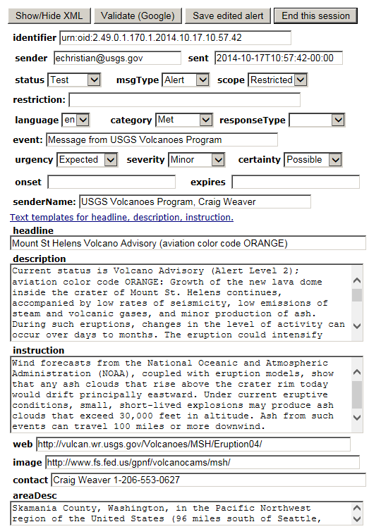
Tool for Creating CAP Alerts (draft) (draft)
Notes:
The composing screen has Web form fields with pull-down selections
and input areas for text. The composer can mouse over any field
to see a tip about what values are expected.
The composer can choose text from templates for the headline, description, and instruction. This choice opens a new window so
text can be copied and pasted as needed.
As the alert is being composed, the composer can choose at any
time to validate the draft alert.
The composer can also save a copy of the draft alert.

Slide 7
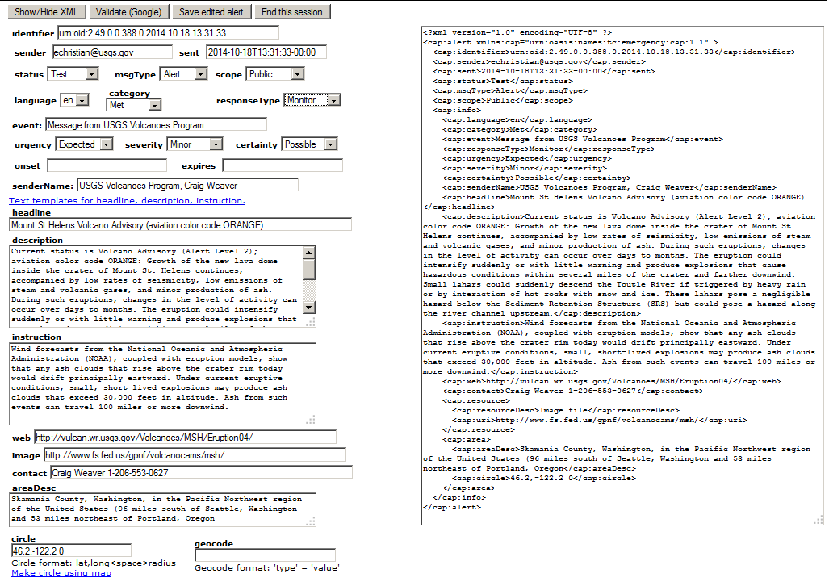
Tool for Creating CAP Alerts
Make circle using map
Notes:
The composer can choose to show the CAP alert in XML format.
When the composer changes anything in the Web form and leaves that field, the CAP message XML changes as well.
Here, we see XML on the right side of the screen.
The composer can also use a map tool to specify a circle and/or
a polygon for the alerting area.

Slide 8
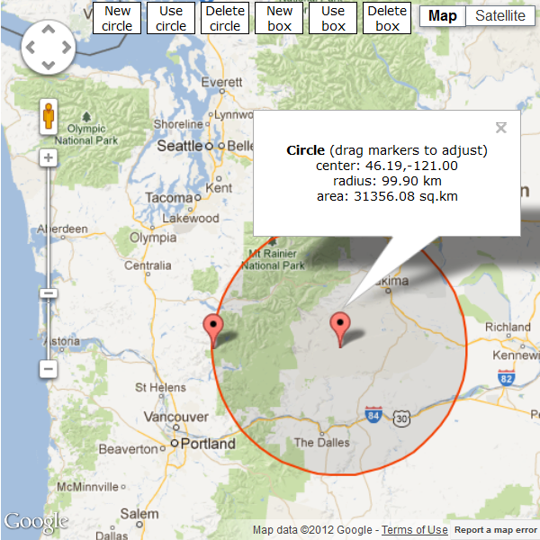
Mapping Tool
Mount
St. Helens volcano
Notes:
Here, the composer has used the mapping tool to specify the center
point and radius of a circle that defines the alerting area of this
CAP alert message.
This circle is an area extending about 200 km east of the Mount
St Helens volcano.

Slide 9
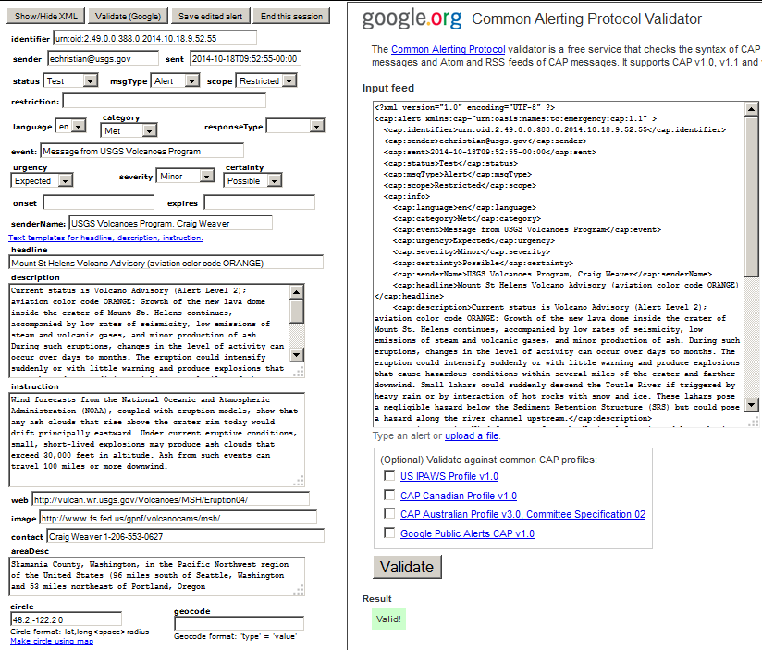
Tool for Creating CAP Alerts (validate)
CAP alert
is valid
Notes:
Here, we see what happens when the composer hits the "Validate" button.
In this case, the Google CAP validator reports that this CAP alert is valid. If there had been any errors, those would have been listed.

Slide 10
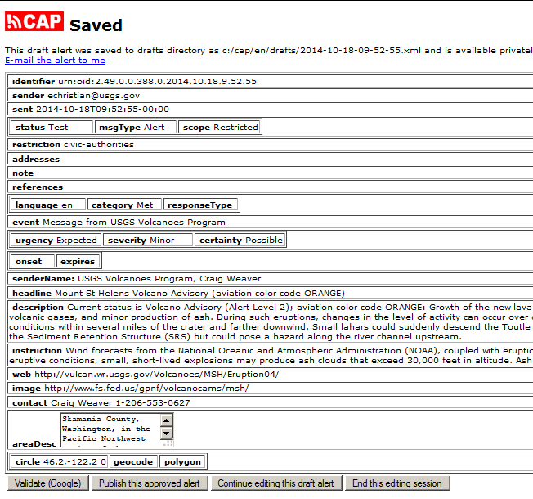
Editing Tool for CAP Alerts (published)
Tool for Creating CAP Alerts (published)
Publish
CAP alert
Notes:
Here, we see what happens when the composer hits the "Save" button.
When the composer receives confirmation that the draft CAP alert message has been saved, he or she can send a link to the draft alert
via e-mail to the composer's e-mail address. In this way, the composer
can use his or her e‑mail system to get others to review the alert, or
to send the CAP message to a notification mailing list.
If the person composing the alert is authorized in the role of approver,
he or she can actually publish the alert. The tool copies the alert into
the publicly accessible directory of posted CAP alerts.
The tool also updates the RSS news feed.

Slide 11
RSS Feed for CAP Alerts
<?xml version="1.0" encoding="UTF-8"?>
<rss version="2.0" xmlns:atom="http://www.w3.org/2005/Atom">
<channel>
<title>Latest alerts from Uganda National Meteorological Authority</title>
<link>https://cap-sources.s3.amazonaws.com/ug-unma-en/rss.xml</link>
<description>Latest alerts from Uganda National Meteorological Authority</description>
<language>en</language>
<copyright>public domain</copyright>
<pubDate>Thu, 06 Dec 2018 12:48:39 +0000</pubDate>
<lastBuildDate>Thu, 06 Dec 2018 12:48:39 +0000</lastBuildDate>
<docs>http://blogs.law.harvard.edu/tech/rss</docs>
<image>
<title>Latest alerts from Uganda National Meteorological Authority</title>
<url>https://alert-hub.s3.amazonaws.com/images/ug-unma-en.png</url>
<link>https://cap-sources.s3.amazonaws.com/ug-unma-en/rss.xml</link>
</image>
<item>
[...]
</item>
</channel>
</rss>
Notes:
The news feed points to the CAP alerts as a publicly accessible directory of posted alerts, with the most recent first.
Subscribers to the RSS news feed can get the alert automatically delivered.

Slide 12
Presentation Outline
206.1 Overview of Tool for Creating CAP Alerts
206.2 The Role of Composer and the Role of Approver
206.3 Exercise: Saving a Draft and Publishing an Alert
206.4 Using the CAP Feed to Reach More People
Notes:
Now let’s look at the
The Role of Composer and the Role of Approver

Slide 13
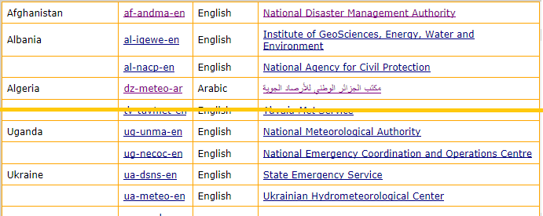
Uganda at https://cap.alert-hub.org
Editor Tool for UNMA in English
CAP news feed for UNMA in English
Notes:
We are using Uganda as an example of the cloud-based CAP Editor
in operational use.
Uganda National Meteorological Authority (UNMA) is responsible for sending out emergency alerts for weather conditions in Uganda. Like
most other alerting authorities have done for decades, UNMA would
send an alert as a text bulletin, disseminating it via e-mail, fax, and
phone calls to local radio and television broadcasters.
Text-based dissemination has a range of shortcomings. Broadcast media reaches fewer people today as online media replaces mass media. This means that many people who should have been alerted are missed. Also, broadcast media are imprecise and this means that many people outside the alerting area are alerted unnecessarily. A further shortcoming is that the alerting process may be too slow for a sudden-onset emergency such as a flash flood.
Let's consider how UNMA can use the free CAP Editor tool to create and publish CAP alerts.
The web page at https://cap.alert-hub.org shows Uganda UNMA as one
of hundreds of initialized alerting authorities. The page provides a link for creating UNMA alerts and a link for the news feed containing already published UNMA alerts. In this case, the CAP Editor interface is in English only, but it can support any language, as is apparent in the links for other alerting authorities.

Slide 14
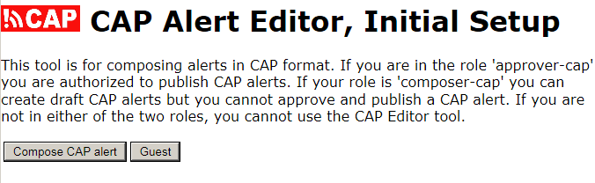
https://cap.alert-hub.org/login.php?sourceId=ug-unma-en
Click here to preview the CAP Editor Tool in the role of "Guest"
Notes:
Anyone can preview the CAP Editor tool at any alerting authority by simply entering as "Guest".

Slide 15
Composers and Approvers
The head of the alerting authority head must designate "composers" and "approvers"
Composers can save a draft alert
Approvers can also publish an alert
The username must be an e-mail address
Each composer and approver is registered
to the user group, not specific to a language
Notes:
A Guest user cannot save a draft alert or publish an alert. Those actions require a password. That password is set only after the alerting authority head has designated a person who is allowed to perform those actions.
In the CAP Editor tool, authorized users are people defined in either the "composer-cap" or the "approver-cap" role. An "approver-cap" user has
all composer abilities plus the "publish alert" ability.
Note that the username must be the user's e-mail address.
The username and password for each composer and approver is registered to the user group defined for UNMA in Amazon Web Services. The group is not specific to a language. That means, a composer or approver can work with all languages for the particular alerting authority.

Slide 16
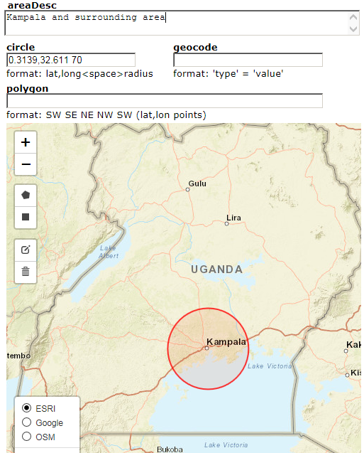
Composing a UNMA alert
Notes:
The tool provides a Web form that prompts the composer to enter, for this specific emergency, the key facts (What? Where? How soon? How bad? How certain?), plus recommended actions. The Web form provides a mapping tool for delineating the alerting area, and it validates that all required data and information is in the CAP alert.

Slide 17
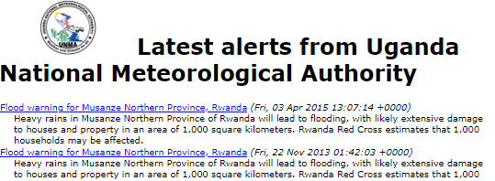
Publishing an Alert Updates the Feed
https://cap-sources.s3.amazonaws.com/ug-unma-en/rss.xml
Notes:
As soon as a CAP alert is composed and approved by UNMA, the associated CAP alert news feed is updated.
Now, I mentioned that the alerting authority head must designate specific persons who can act in the role of composer or approver. Let me explain briefly how that process works.

Slide 18
From 'testing' to 'operating'
Once the alerting authority head designates composers and approvers, each one gets
an e-mail about setting his/her password
Feed is in "testing" (allows only "Test" or "Exercise" CAP alerts) until alerting authority head says to change status to "operating"
Then, feed set to empty, ingest by alert hubs, "Actual", "Update", and "Cancel" CAP alerts
Add feed to WMO Register of Alerting Authorities
Notes:
The alerting authority head sends an e-mail to the system administrator to designate specific persons as composers or approvers. Then, each one gets an e-mail explaining how to set his/her password for using the tool.
The tool starts out with the feed in "testing" status, which means the composers and approvers are only allowed to publish "Test" or "Exercise" CAP alerts. Next, the alerting authority head will tell the system administrator to change the feed status to "operating".
At that point, all published Test and Exercise alerts are removed from the feed so that it is empty and ingest by alert hubs can begin. Composers and approvers can begin to publish "Actual", "Update", and "Cancel" CAP alerts as well as "Test" or "Exercise" CAP alerts.
This is also the time for the alerting authority head to have the CAP feeds URL entered into the record in the WMO Register of Alerting Authorities.
So, we have seen that publishing a CAP alert is as easy as using a Web browser to fill out a Web form.
Doing so allows the alerting authority to have its emergency alerts become part of a vast network of dissemination capabilities. Yet, throughout this global network of alert dissemination, attribution of the originating authority can be preserved.
Most importantly, this amazing boost to alert dissemination comes at no cost to the alerting authority

Slide 19
Presentation Outline
206.1 Overview of Tool for Creating CAP Alerts
206.2 The Role of Composer and the Role of Approver
206.3 Exercise: Saving a Draft and Publishing an Alert
206.4 Using the CAP Feed to Reach More People
Notes:
Now we are going to run an exercise, using the cloud-based CAP Editor.
We will walk through what is entailed in saving a draft CAP alert and publishing a CAP alert.

Slide 20
Imagine a Scenario and Draft an Alert
Imagine an emergency is happening now and UNMA needs to issue a CAP Alert
Key facts for this specific emergency:
What is it (think in terms of "impact")?
Where is it?
How soon do people need to act ("urgency"?
How bad is it ("severity")?
How sure are the experts ("certainty")?
What actions should people take?
Notes:
Together, we will come up with a scenario wherein an emergency
is happening and UNMA needs to issue a CAP Alert.
As we fill in the draft CAP alert, we need to focus on the Key facts
for this specific emergency:
What is it? As we write the description, think in terms of
"impact" on people and property.
Where is it (so we can draw the alerting area polygon)?
How soon do people need to act (the "urgency" level)?
How bad is it (the "severity" level)?
How sure are the experts (the "certainty" level)?
What actions should people take (the "instruction" element)?

Slide 21
Presentation Outline
206.1 Overview of Tool for Creating CAP Alerts
206.2 The Role of Composer and the Role of Approver
206.3 Exercise: Saving a Draft and Publishing an Alert
206.4 Using the CAP Feed to Reach More People
Notes:
We turn now to the last topic in this presentation:
Using the CAP Feed to Reach More People.

Slide 22
Reaching People via the News Feed
"Look for alerts here": link to the CAP news feed from agency Web site in order to leverage
  sister agencies (e.g., civil protection authorities at national and city levels)
  non-government organizations,
  in-country and international news media
  (print, radio, television, etc.)
Cell phone services send SMS or cell broadcast
Amateur radio operators help disseminate alerts
High-priority alerts automatically sent by satellite
Notes:
The alerting authority can put a link to its CAP news feed on its own
Web site and invite customers to pick up its emergency alerts from there. This "look for my alerts here" approach works well for:
sister agencies in the country (e.g., civil protection authorities
at national and city levels)
non-government organizations,
in-country and international news media (print, radio, television, etc).
The alerting authority can extend this same approach to have cell phone services show the alerts as SMS or cell broadcast messages. It might be feasible to have alerts displayed on digital signage throughout the area.
The alerting authority might engage or amateur radio operators to help disseminate the alerts even when all other telecommunications are out of service.

Slide 23
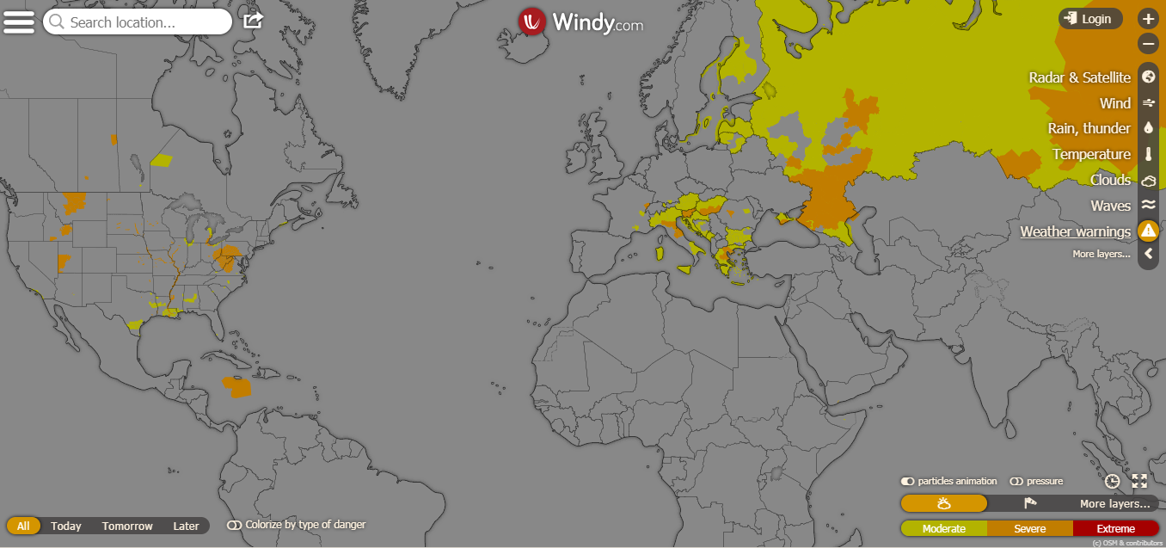
Aggregators of CAP Alert News Feeds
Notes:
We noted that publishing a CAP alert to a news feed allows the alerting authority to have its emergency alerts become part of a vast network of dissemination capabilities.
The CAP news feed is immediately useful because anyone can get these emergency alerts by just subscribing to the news feed.
The news feed is automatically aggregated to the WMO Alert Hub. It is also aggregated by various other global-scale Alert Hubs. Examples include the "Windy" site (shown here), plus aggregators operated by Accuweather, the Weather Company, the IFRC Hazards App, and Google Public Alerts.

Slide 24


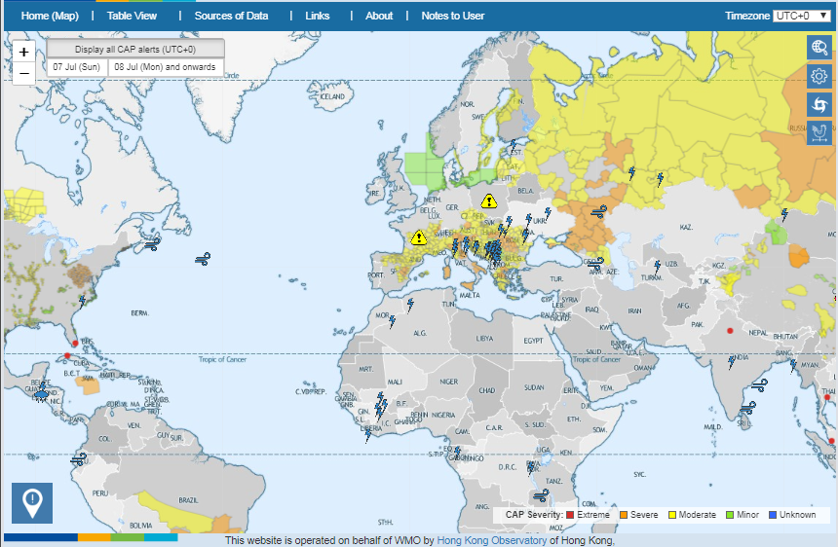
Aggregators of CAP Alert News Feeds
Notes:
Here we see another aggregator of CAP alerts: the Severe Weather Information Service operated by WMO's Hong Kong Observatory.
All of the these CAP feed subscribers can immediately relay any
high-priority emergency alert, and thereby help the alerting authority
to quickly reach more of the people in the precisely delineated alerting area.
If it is a high-priority alert, it is automatically sent by satellite as well.

Slide 25
Review of Key Points
Overview of Tool for Creating CAP Alerts
The Role of Composer and the Role of Approver
Exercise: Saving a Draft and Publishing an Alert
Using the CAP Feed to Reach More People
Notes:
Just to review, these are the Key Points covered in this presentation
Overview of Tool for Creating CAP Alerts
The Role of Composer and the Role of Approver
Exercise: Saving a Draft and Publishing an Alert
Using the CAP Feed to Reach More People

Slide 26
What have you learned?
Describe how an alerting authority gets access to the cloud-based CAP Editor in a particular language.
Describe how composers and approvers use the cloud-based CAP Editor to maintain a CAP news feed.
Discuss ways in which an alerting authority can leverage its CAP news feed to enhance alert dissemination
Notes:
Now that you have completed this session, you should be able to perform the objective tasks.

Slide 27
Reference Links
CAP Introduction (15 minute video)
CAP Implementations by Country
CAP References (PrepareCenter.Org)
CAP Training Courses - contact me
Eliot Christian eliot.j.christian@gmail.com
Notes:
Here are some key reference links concerning CAP.

