Slide 1

Communicating warnings and advice to the Public:
What to expect and how to react
  Dr. Amit Savir
  Head of forecasting, IMS
  saviram@ims.gov.il

Slide 2
IMS representative to:
Meteoalarm
WGCEF
HOF
Storm naming – SEG
TT-Warn

Slide 3

Communicating warnings and advice to the Public
What is the public?
First responders
Emergency forces
Municipalities
Governmental agencies
General public

Slide 4
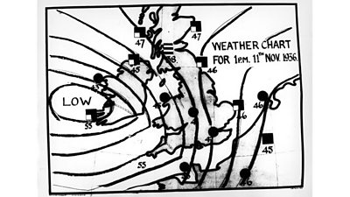
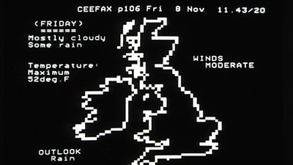

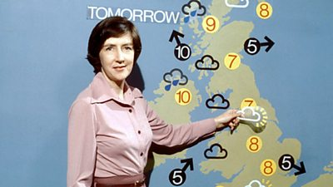
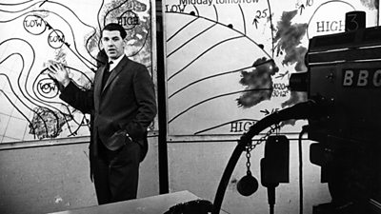
How did it all start?

Slide 5
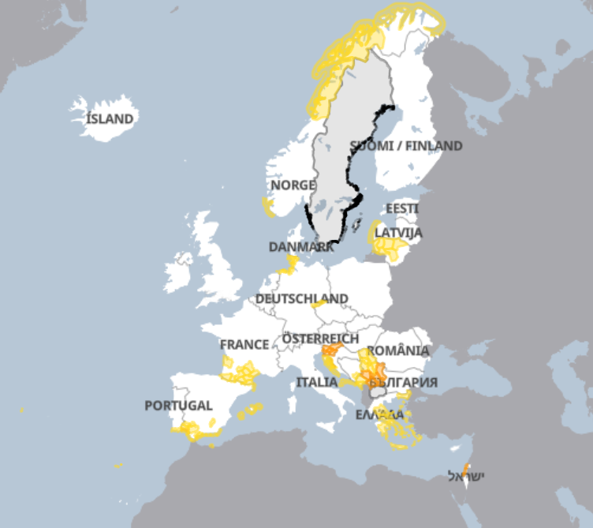
Meteoalarm
  Simply understandable at one glance also for non experts, therefore using graphical symbols
  All warning levels (colors) should be impact and damage related
  Colors are preferably assigned according to the table adopted by the EMMA/Meteoalarm Expert members from all participating NMS’s. Your national climatological return period database should be able to help you to match the right parameter criterion with the appropriate color
  Primarily targeted at the General Public and National authorities
  Also targeted to the Forecasters at the bench. The forum on the intranet allows them to have discussions during the onset phase of a severe weather event

Slide 6
Color related to impact threat
Green = No threats
Yellow = Be Aware
Orange = Be Prepared
Red = Take Action

Slide 7
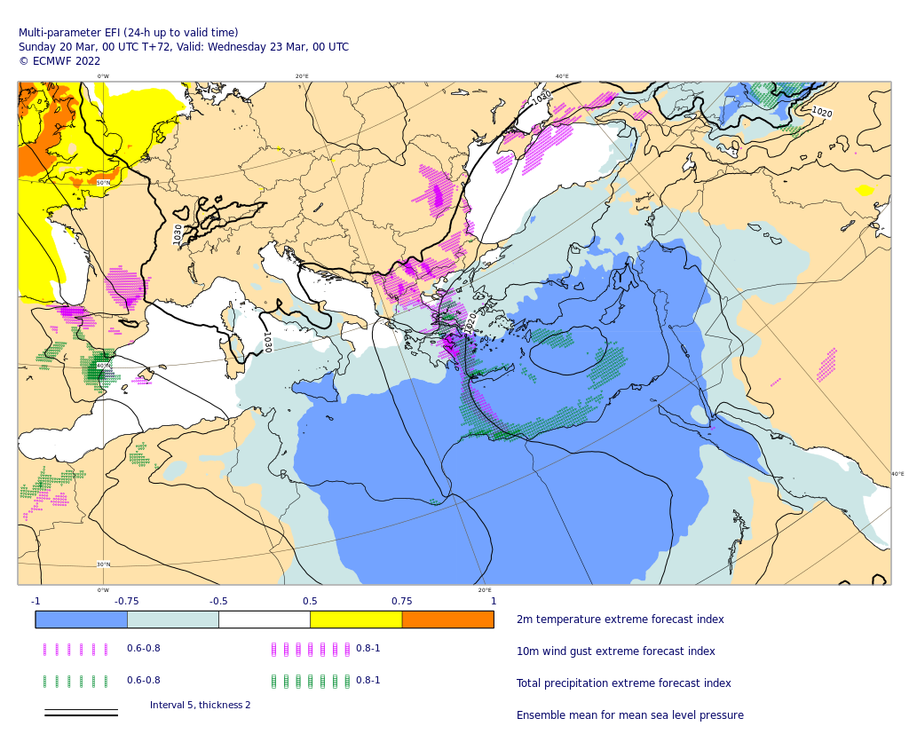
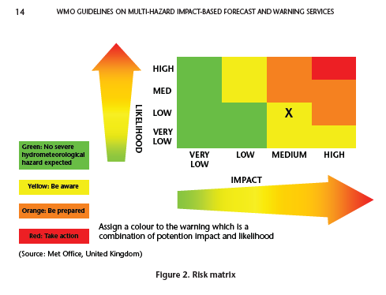
Impact description and Risk Matrix

Slide 8

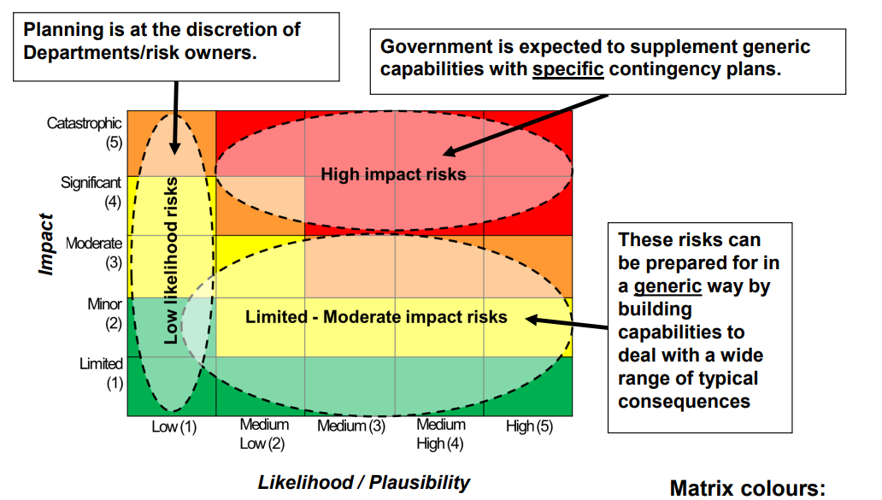

Slide 9
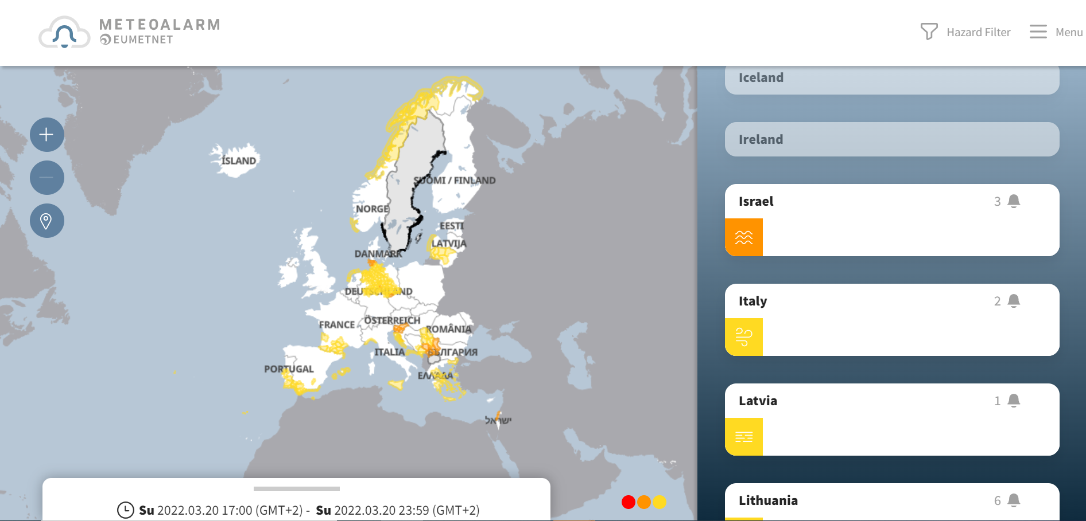
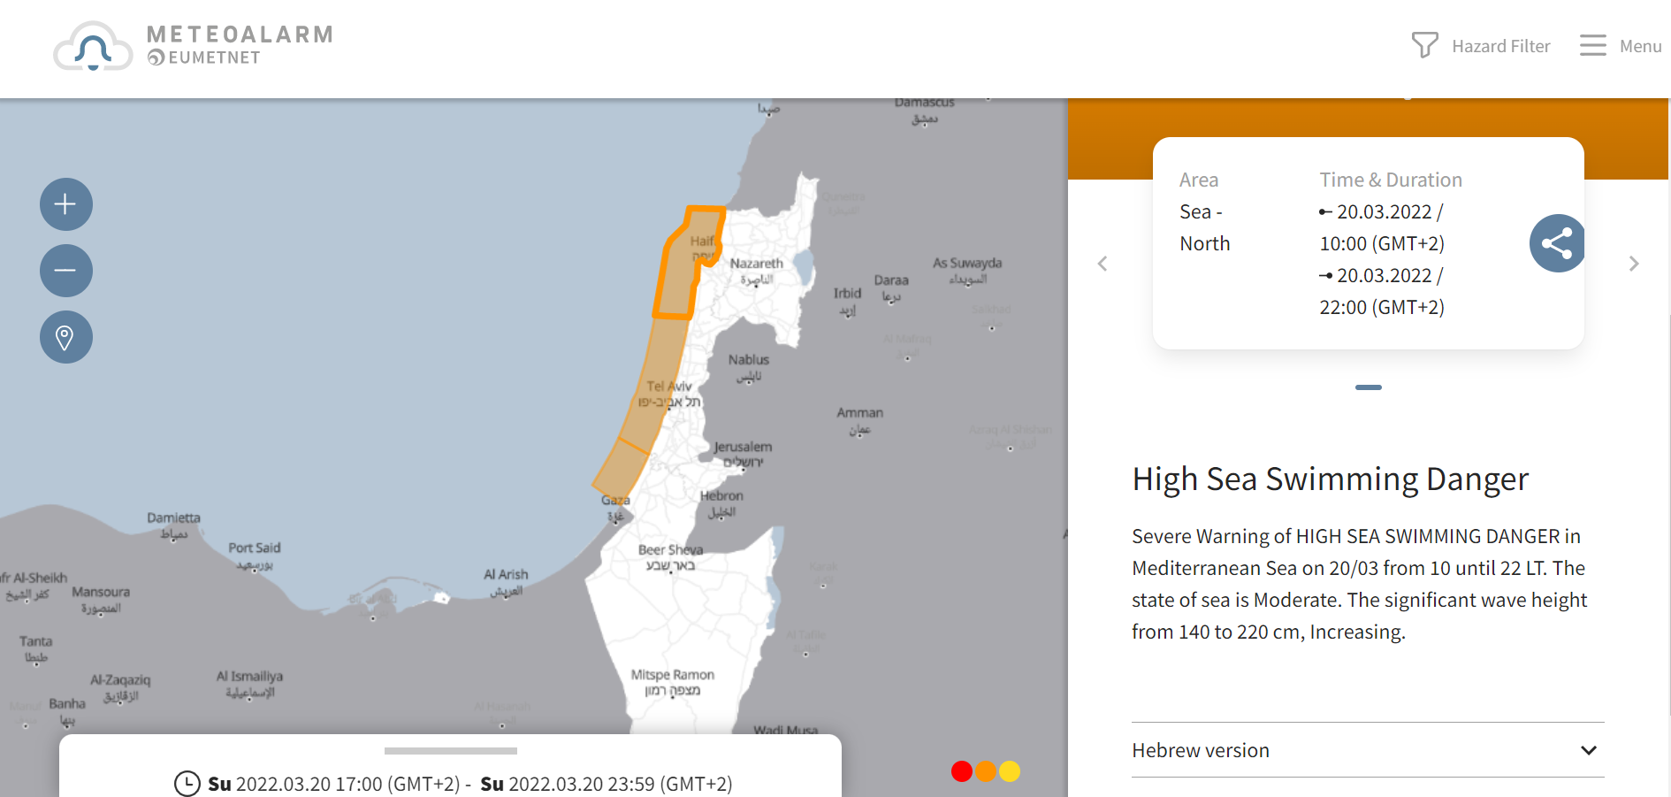

Slide 10
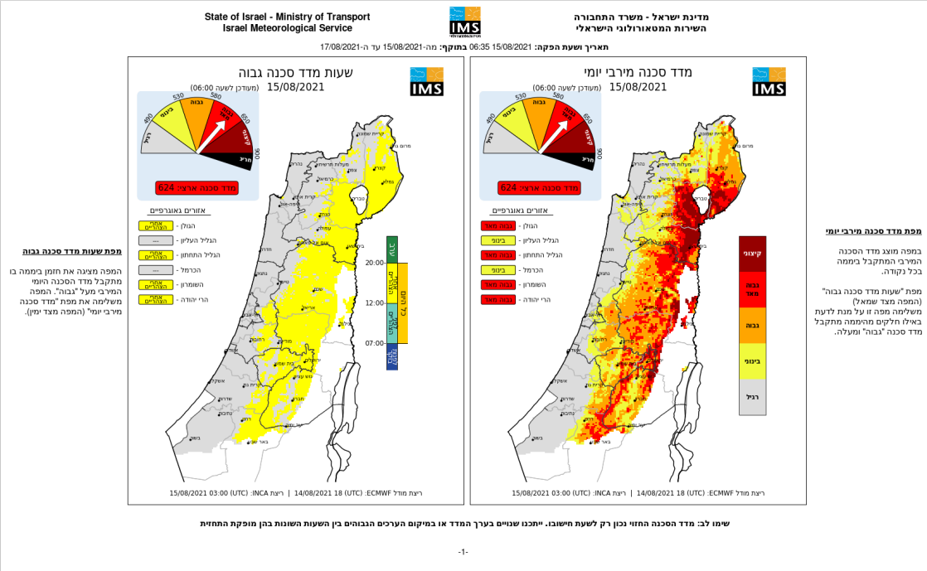
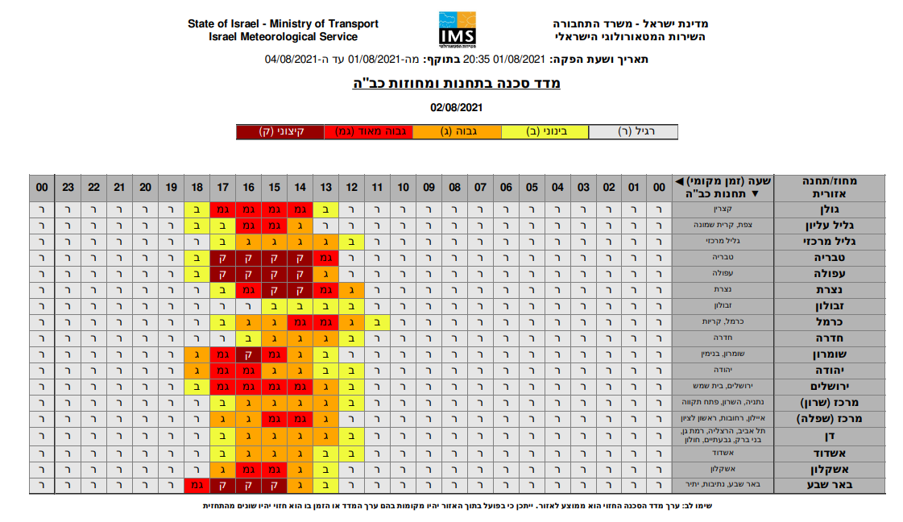
More examples of the Matrix

Slide 11
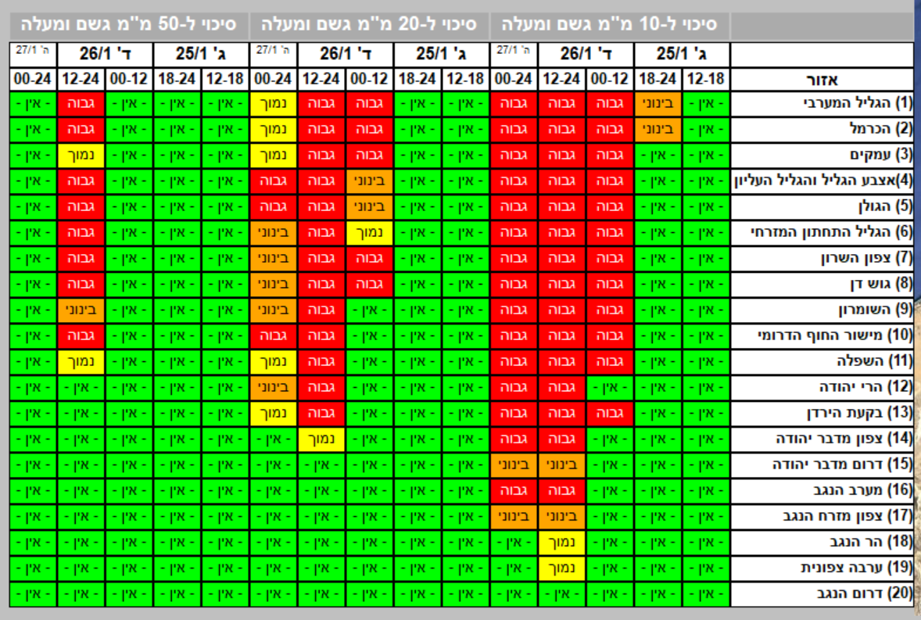
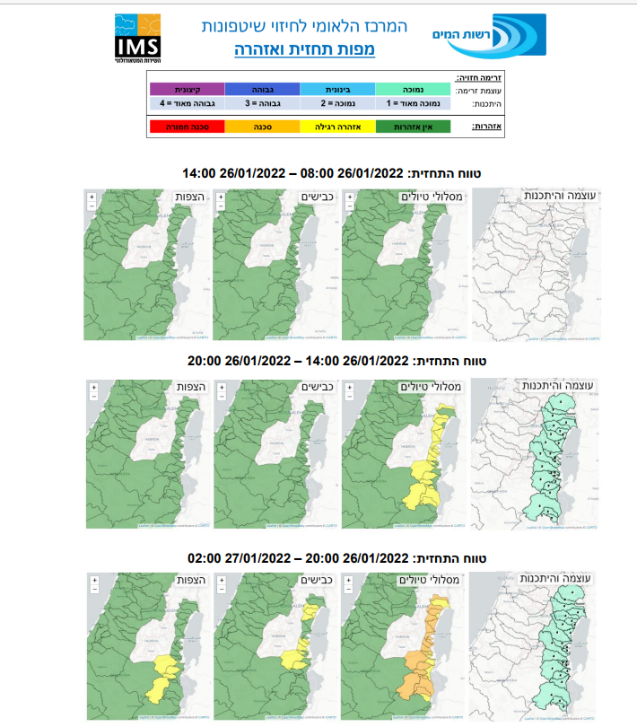
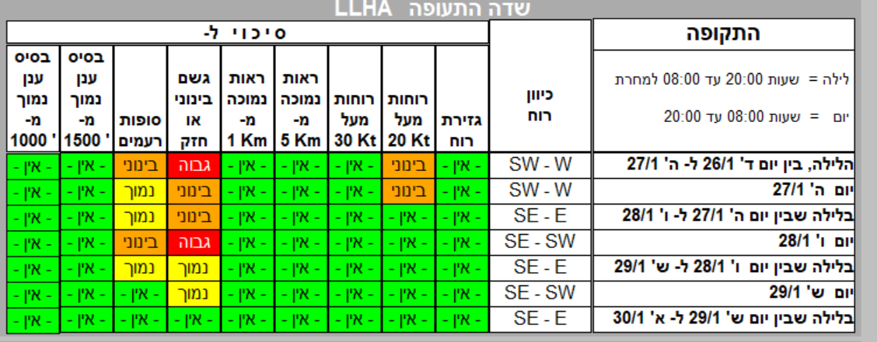

Slide 12
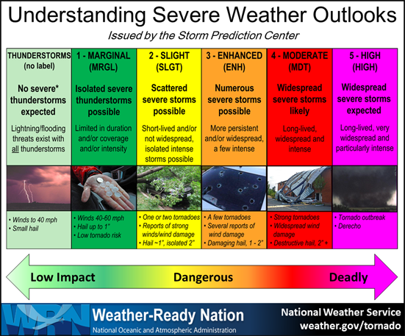
Improve presentation of warnings and information

Slide 13
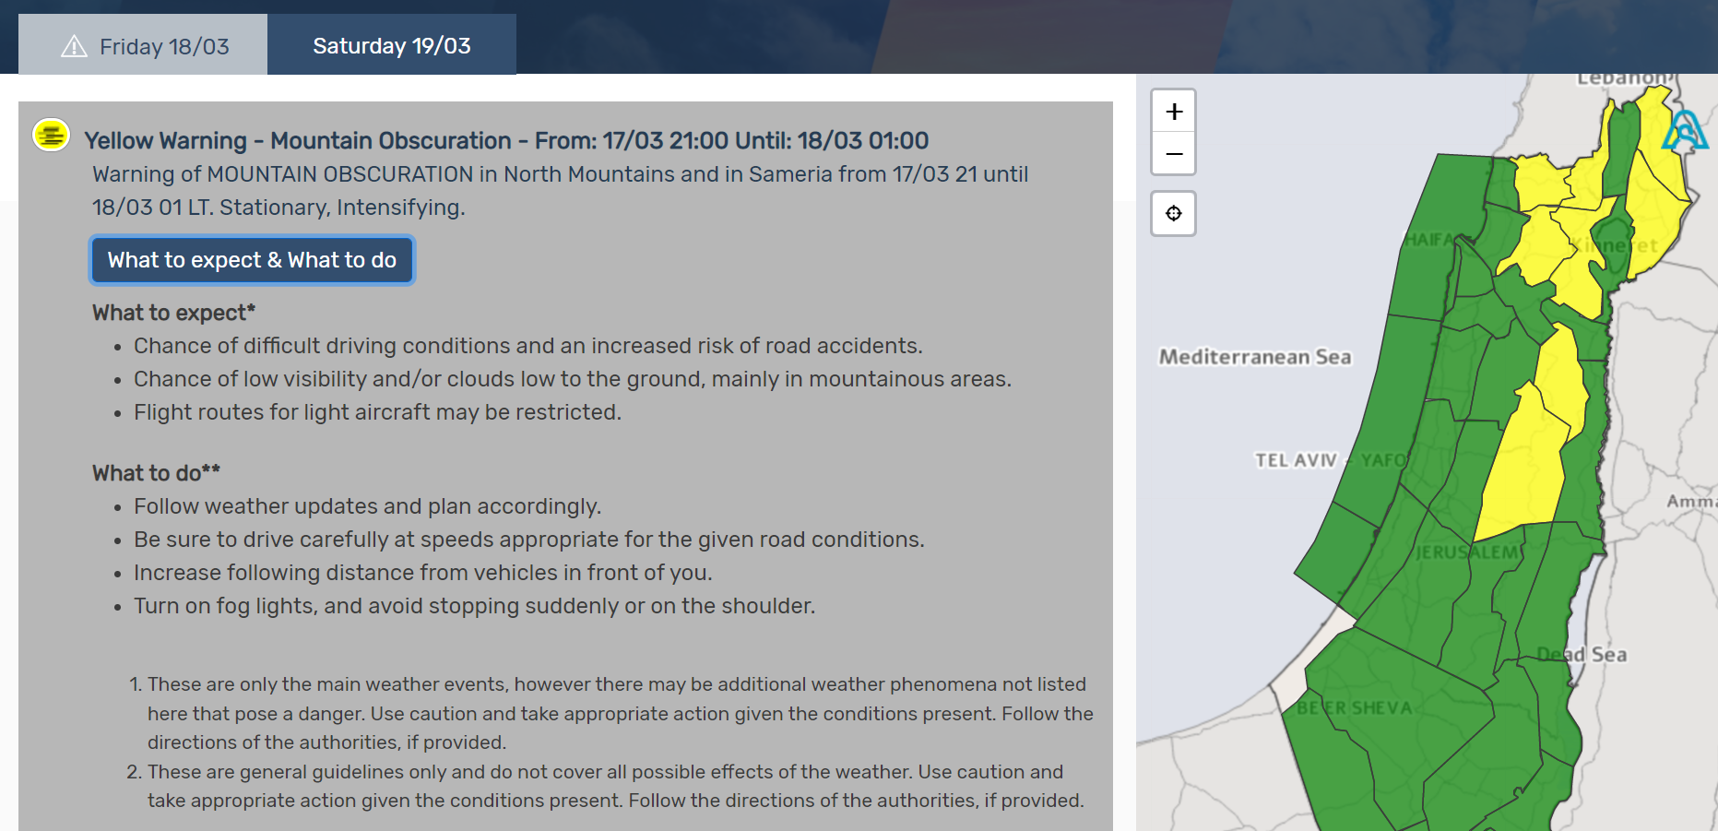
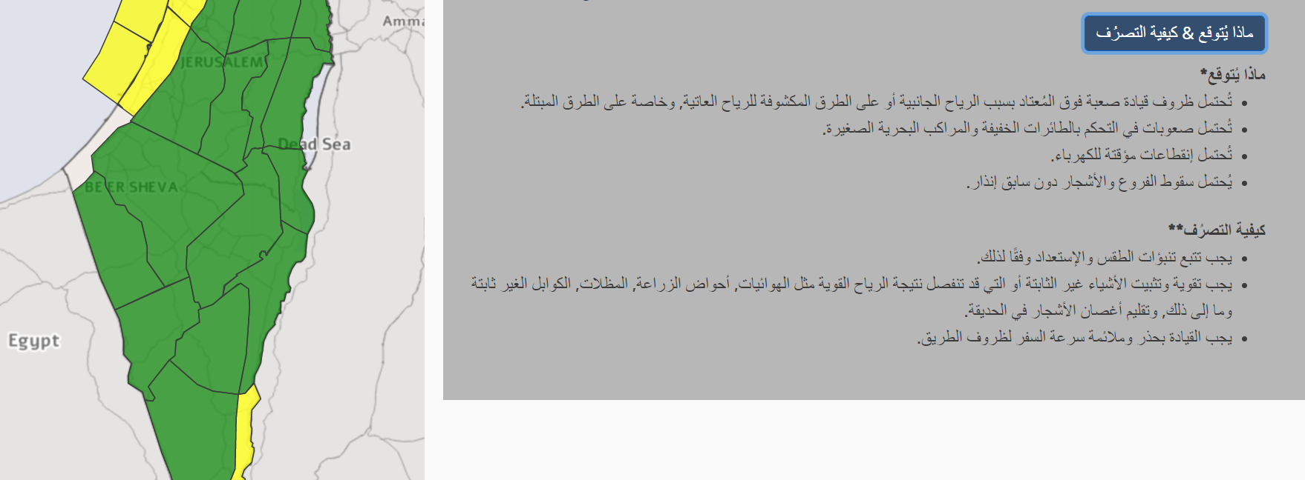

Slide 14
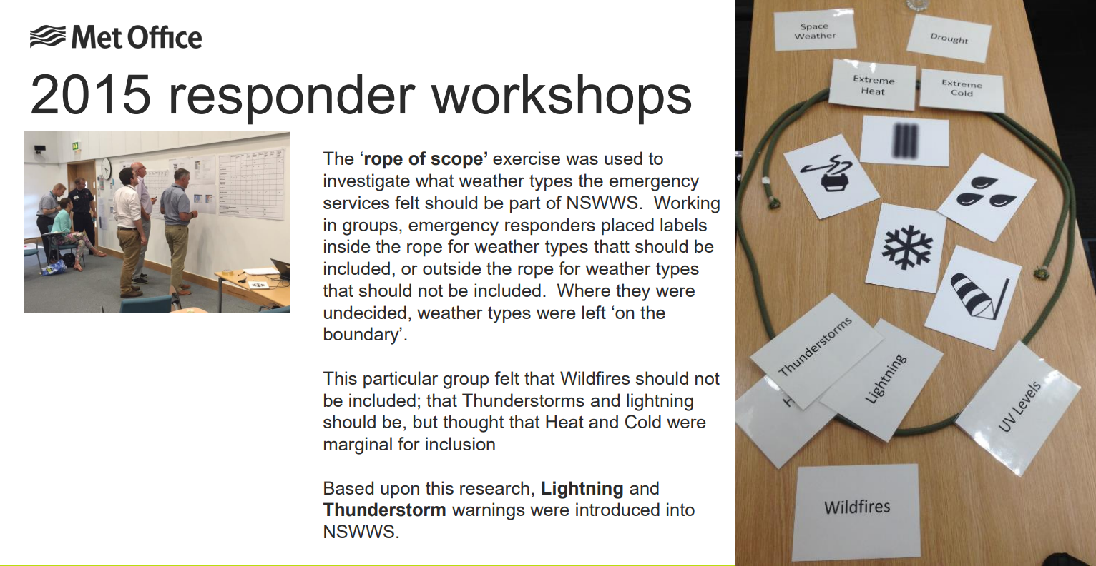
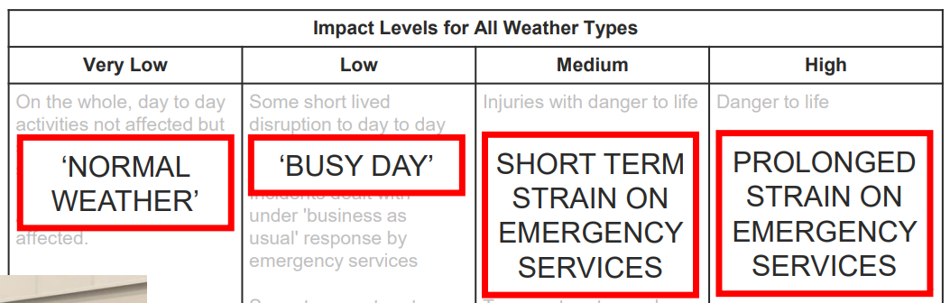

Slide 15


Slide 16
Storm naming
Authoritative Voice Single name
Communication: ‘hashtag culture’ Collaboration with adjoining NMS’s, Useful post-event for reference
Based on Warnings in the Meteoalarm framework ORANGE or RED, impact-based and/or thresholds
Can be for wind, rain or snow
NMS which first issues the warning or the NMS who expects high impacts names the Storm in consultation with other partners.

Slide 17
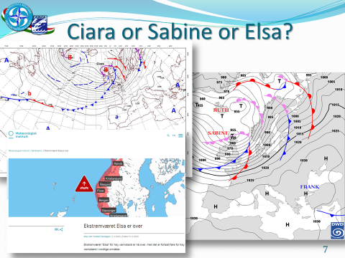

Slide 18
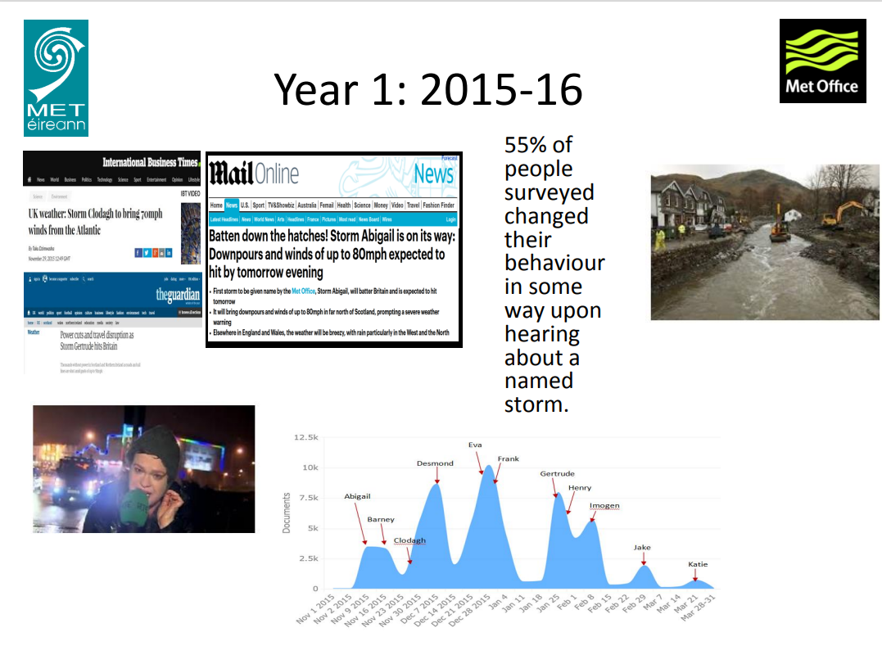
איזה מידע מכילות תחזיות האינדקסים?

Slide 19
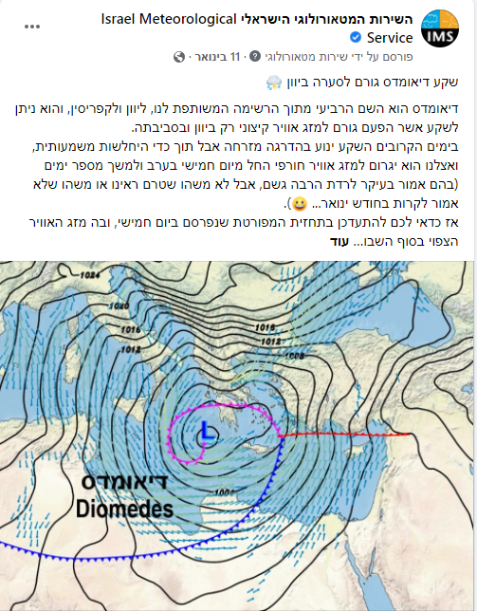
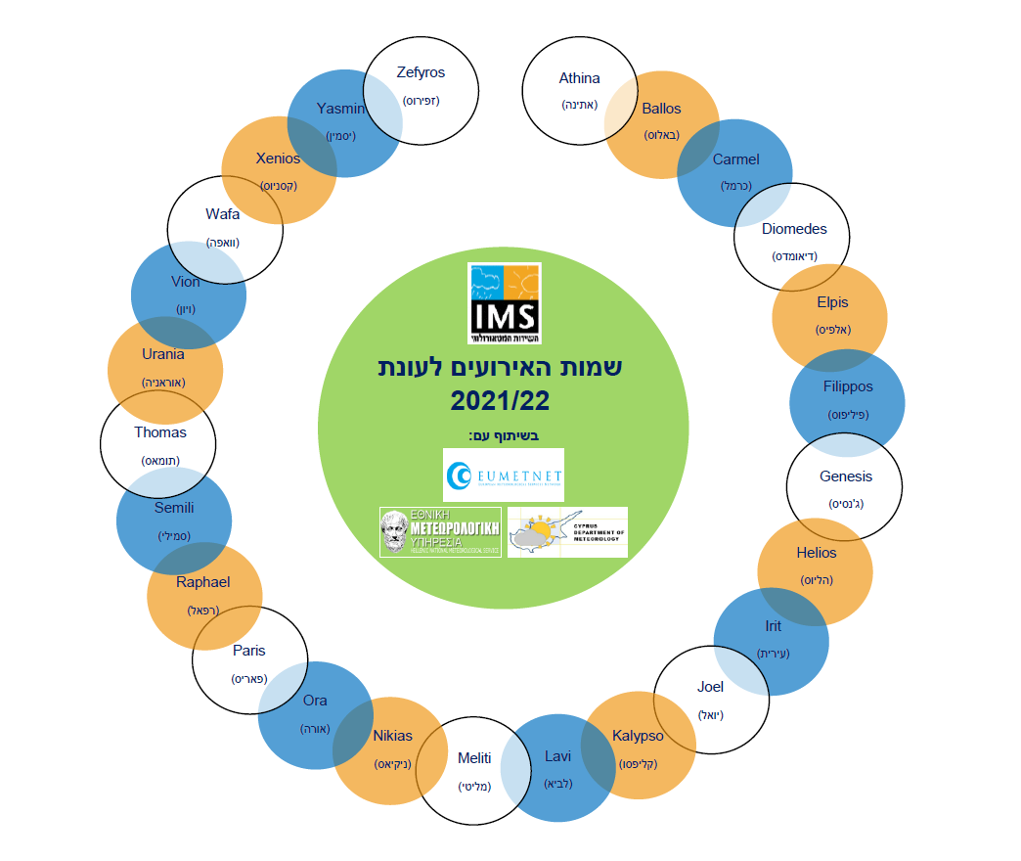

Slide 20
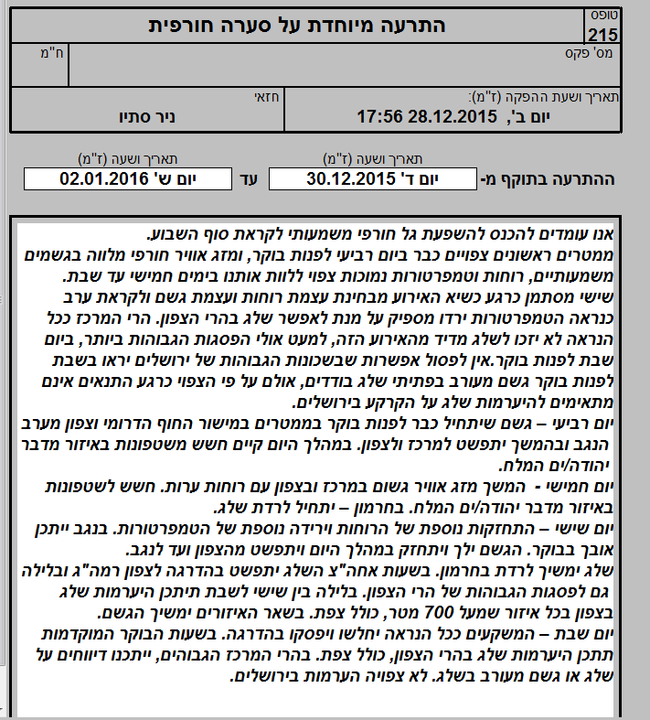
Preliminary “red flag” for the first responders and governmental agencies

Slide 21
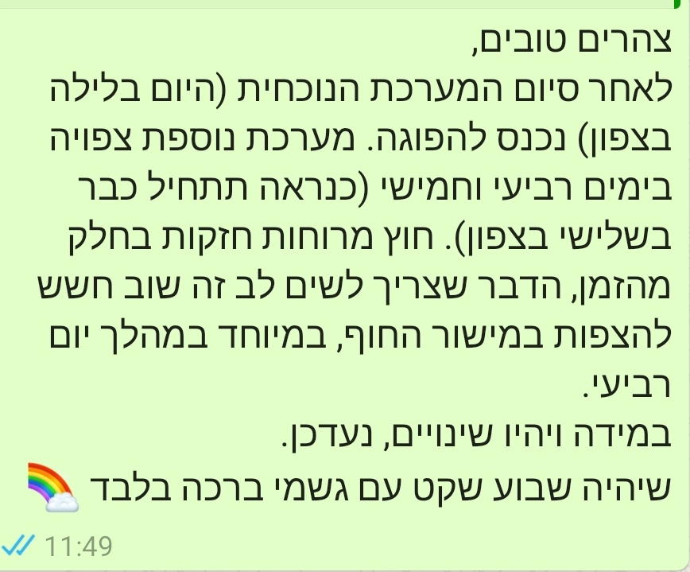
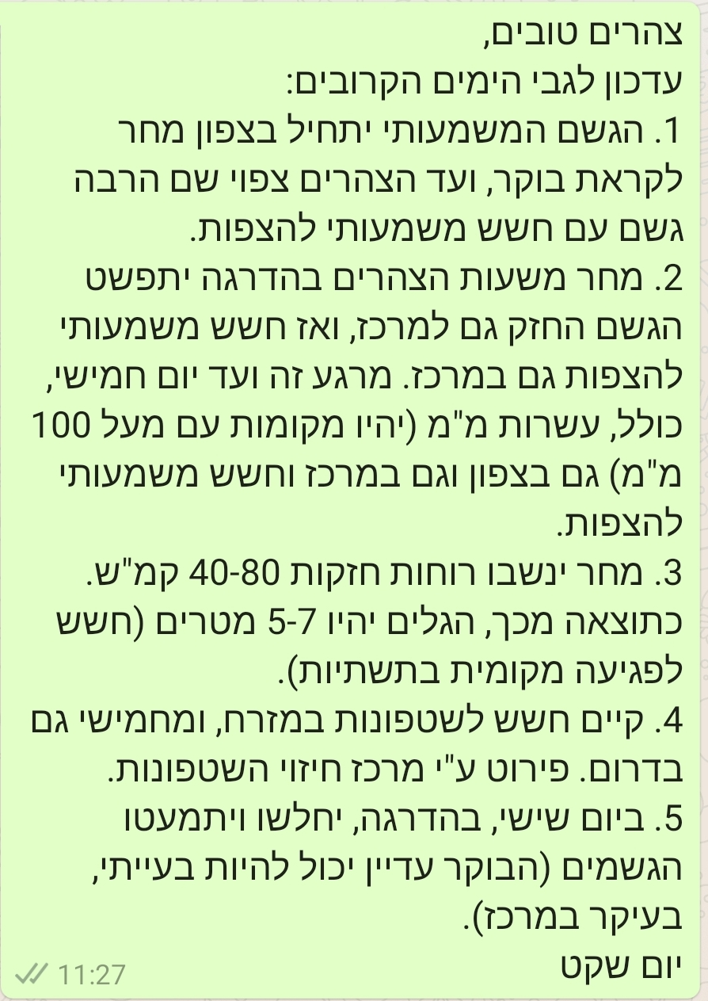

Slide 22
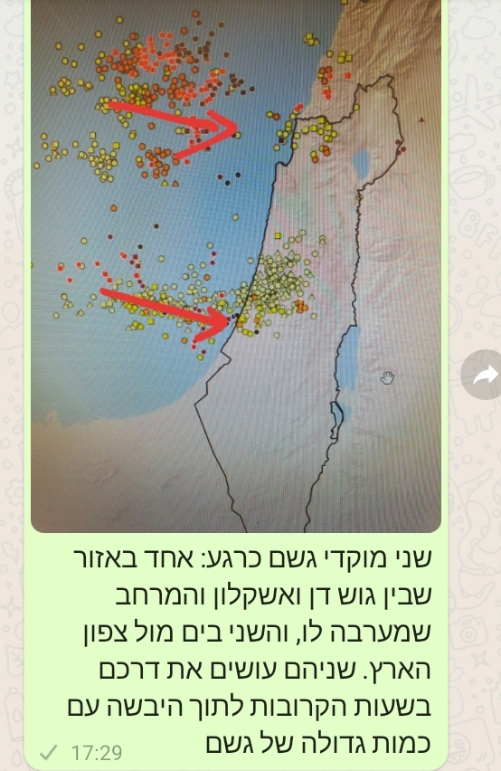
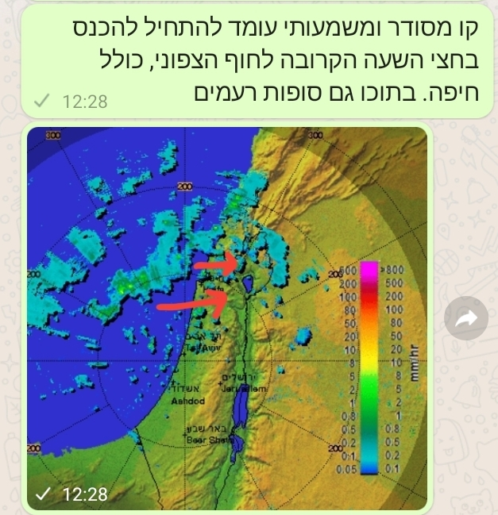
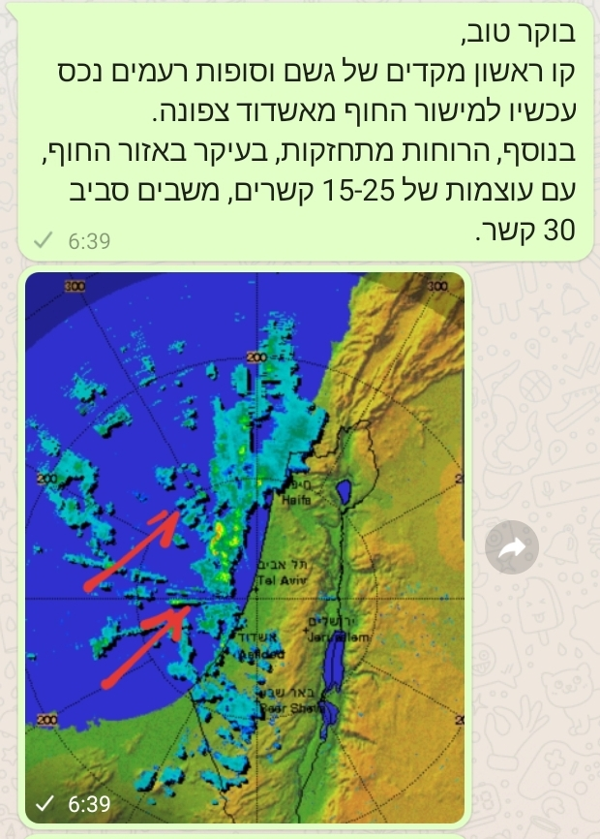
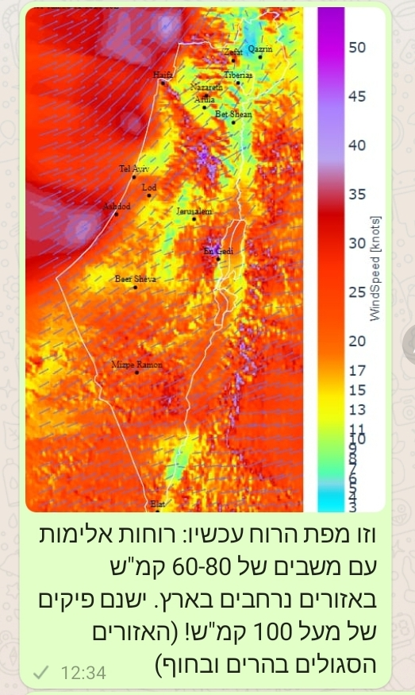
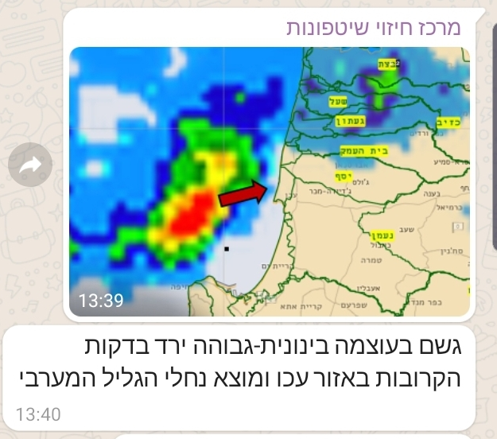
Operational WhatsApp groups- real time updating

Slide 23
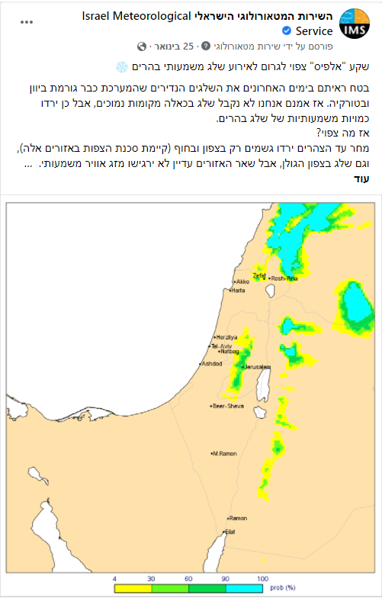
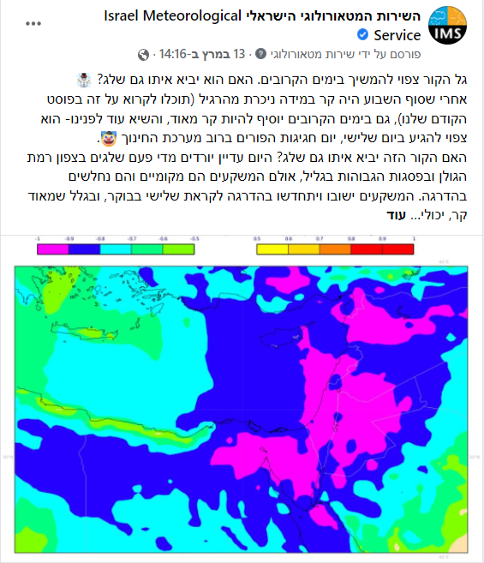
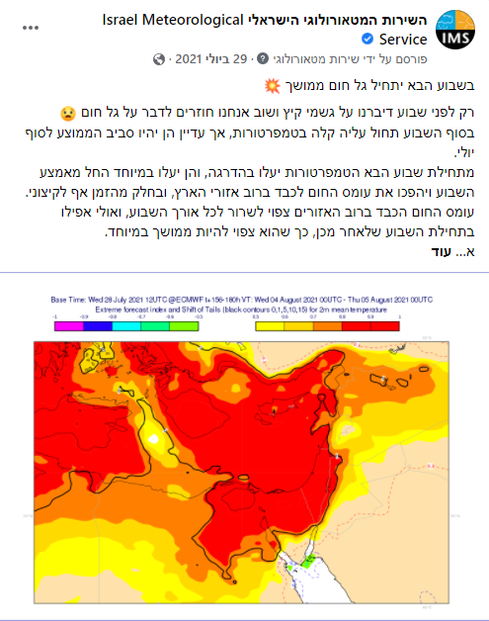
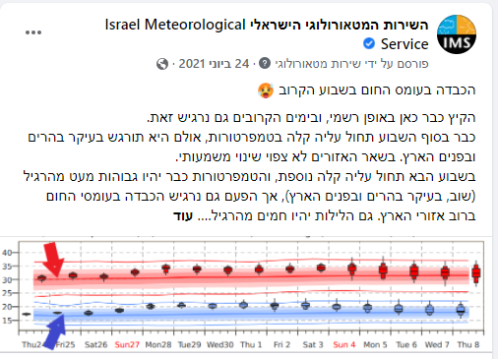
Using the FB to give information about extreme events

Slide 24
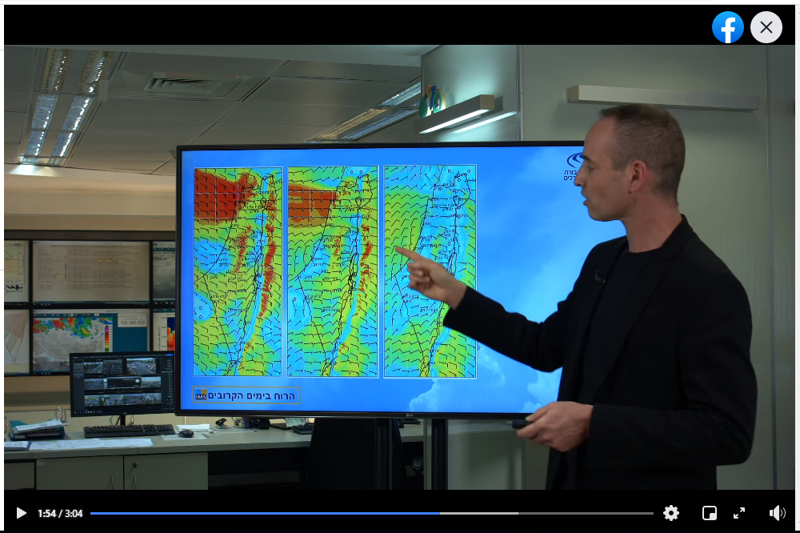
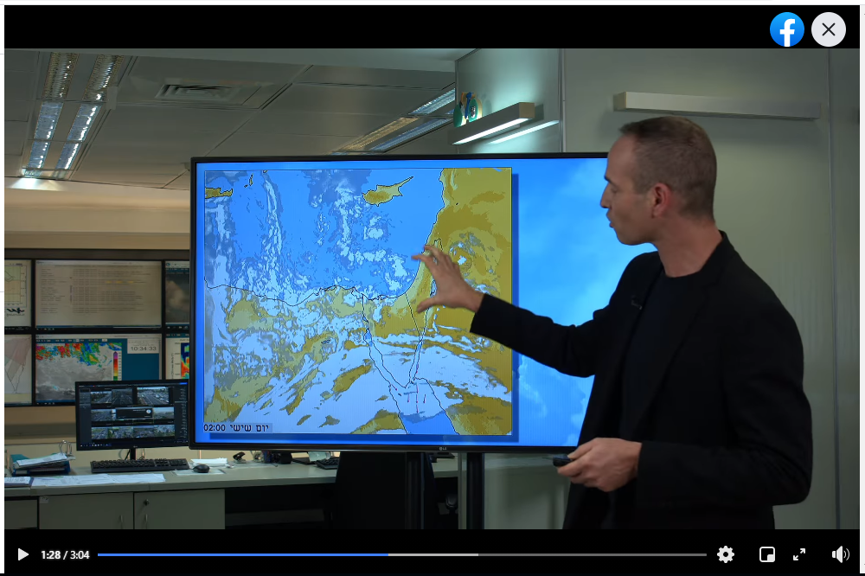

Slide 25
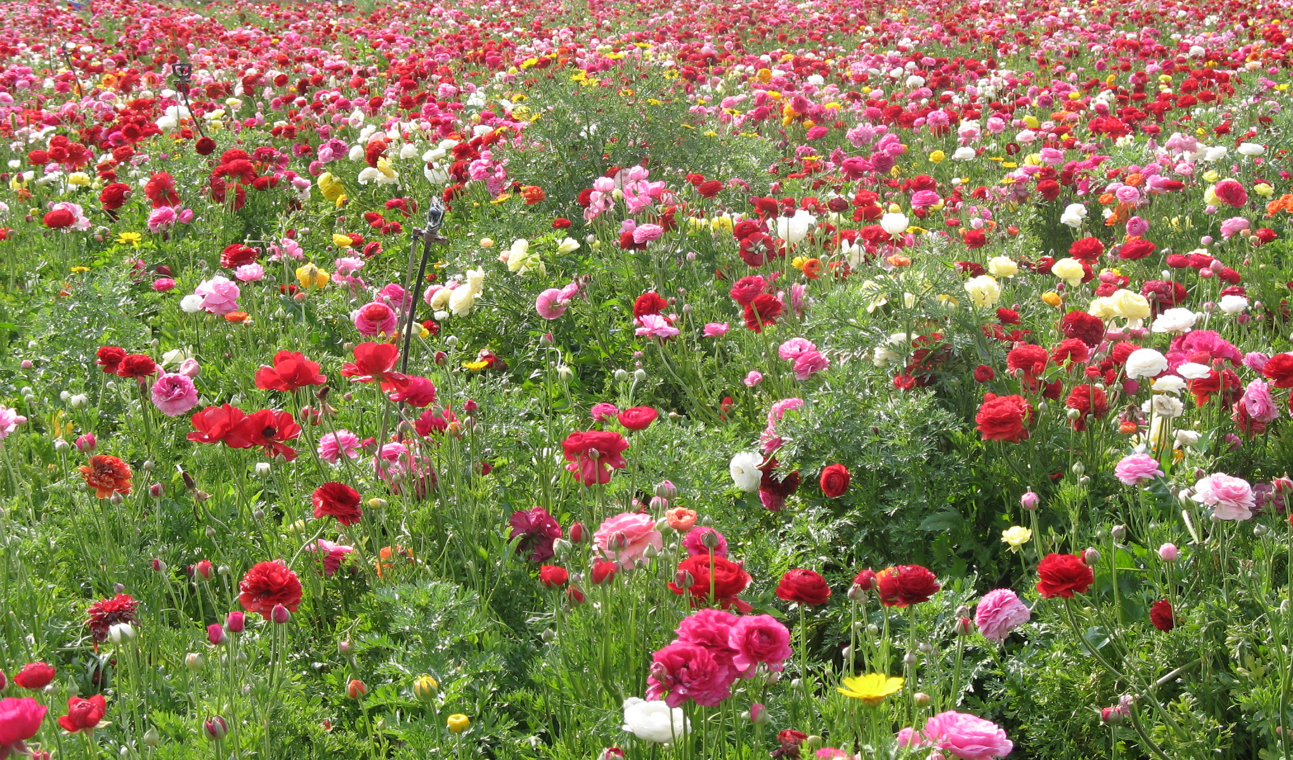
Thanks for your attention

