Slide 1


COMET® - world-wide leader in support of education and training for the environmental sciences
MetEd - free collection of hundreds of training resources intended for the geoscience community

Slide 2


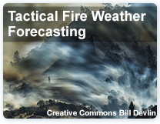
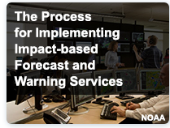

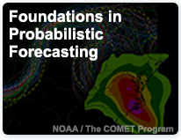

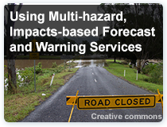

Slide 3
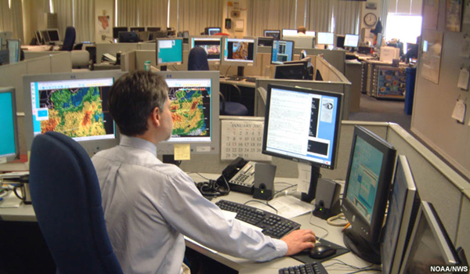
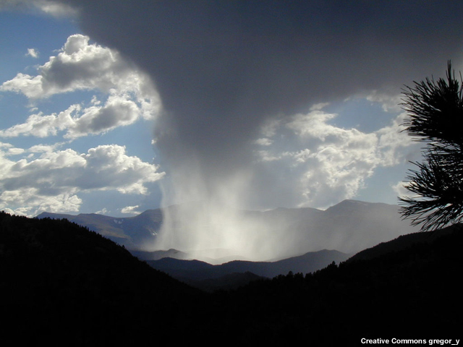
You are a visiting hydrologist at Main country flood center

Slide 4
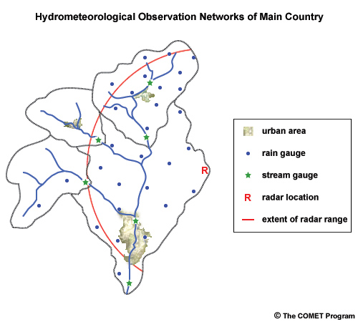
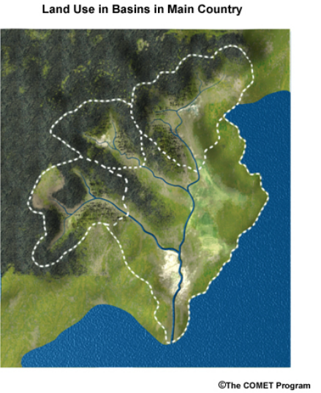
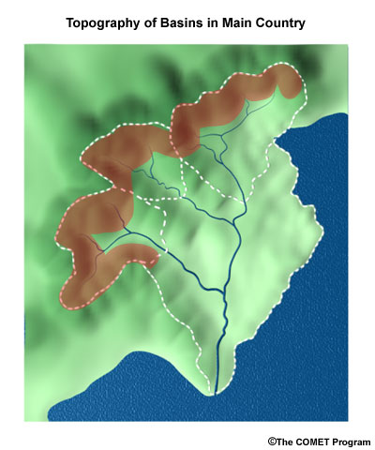
This is your basin
What is the difference between the case study area and their region?
1000 km²

Slide 5
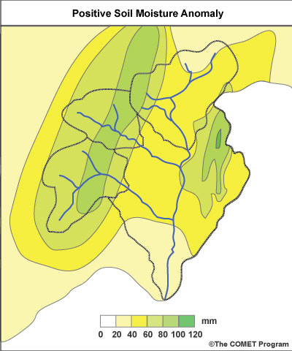
Soil moisture
Are antecedent soil moisture conditions are important in our region?
How can you estimate them?

Slide 6
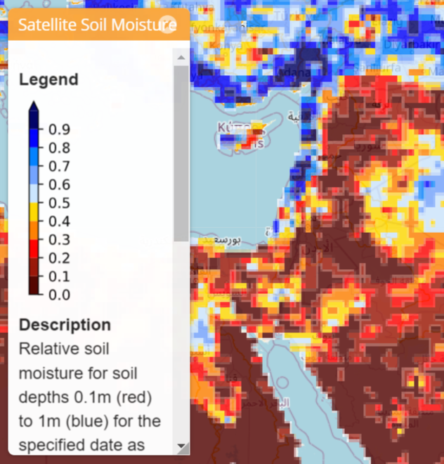
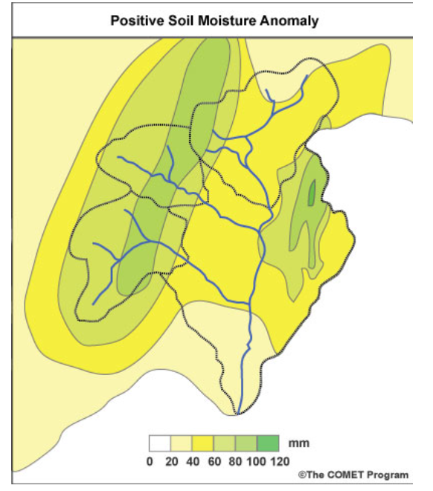
Satellite based soil moisture

Slide 7
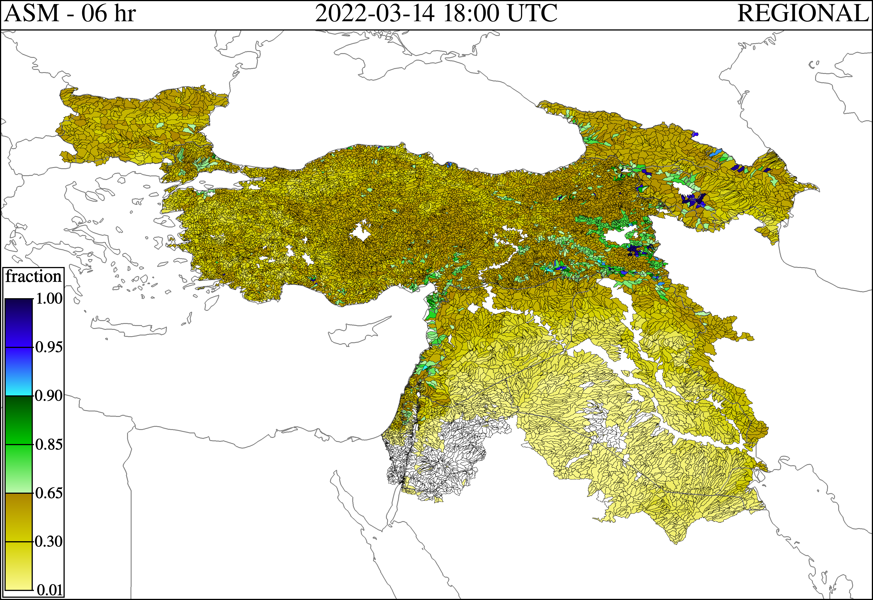
Model based soil moisture

Slide 8
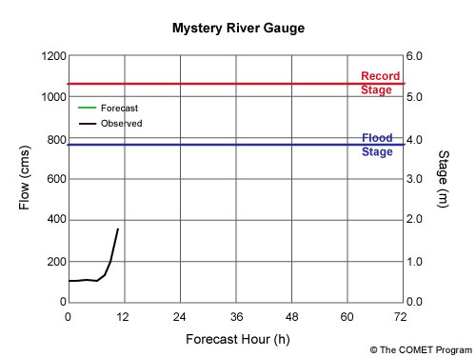
Rain measurements and discharge
290 m³/s
300 m³/s
500 m³/s
How can we compensate for lack of measurements in our region?
100 m³/s
800 m³/s
1000 m³/s
Do you have observers/ cooperation with people at the field?

Slide 9
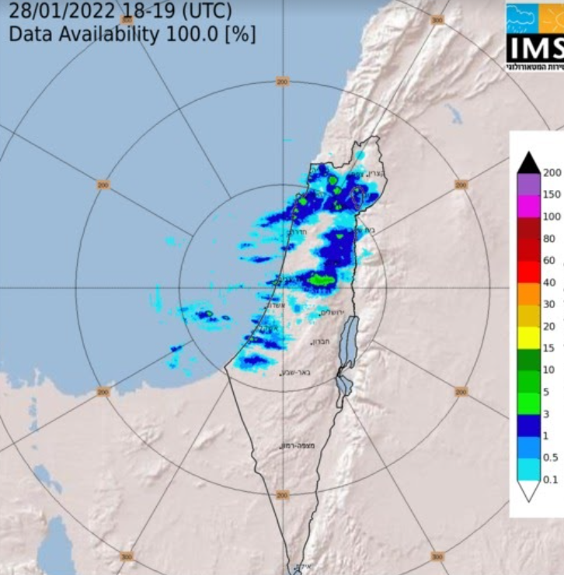
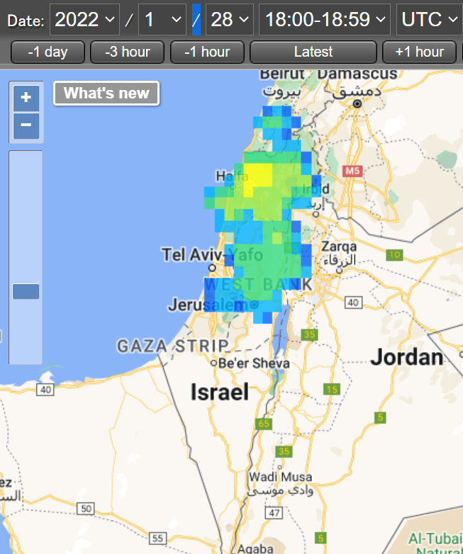
Satellite products
https://sharaku.eorc.jaxa.jp/GSMaP

Slide 10
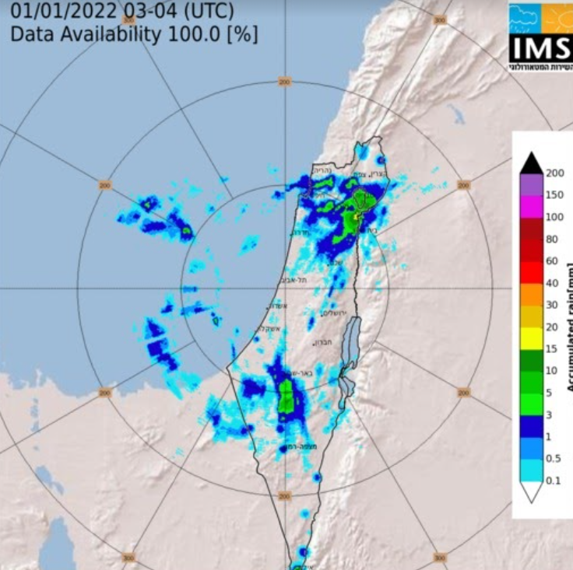
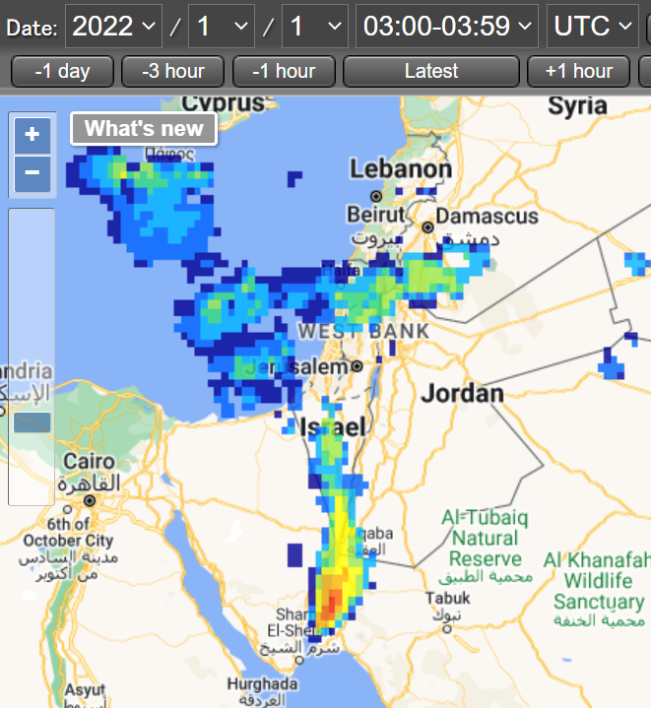
Satellite products
https://sharaku.eorc.jaxa.jp/GSMaP

Slide 11
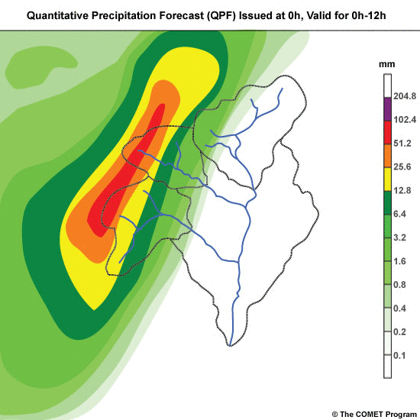
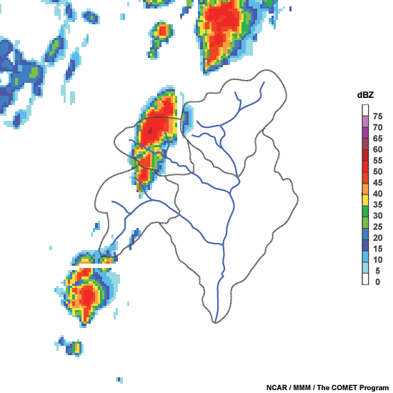
Local NWP model
Rain forecast
QPE – from global model
What is the estimated model uncertainty in our region?
How does the NWP model uncertainty in reflected in the hydrological models?

Slide 12
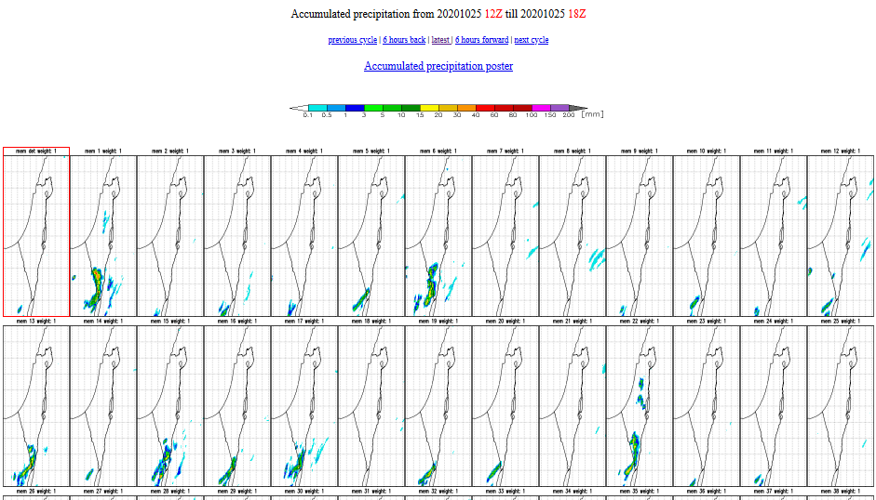
Rain forecast - uncertainty

Slide 13
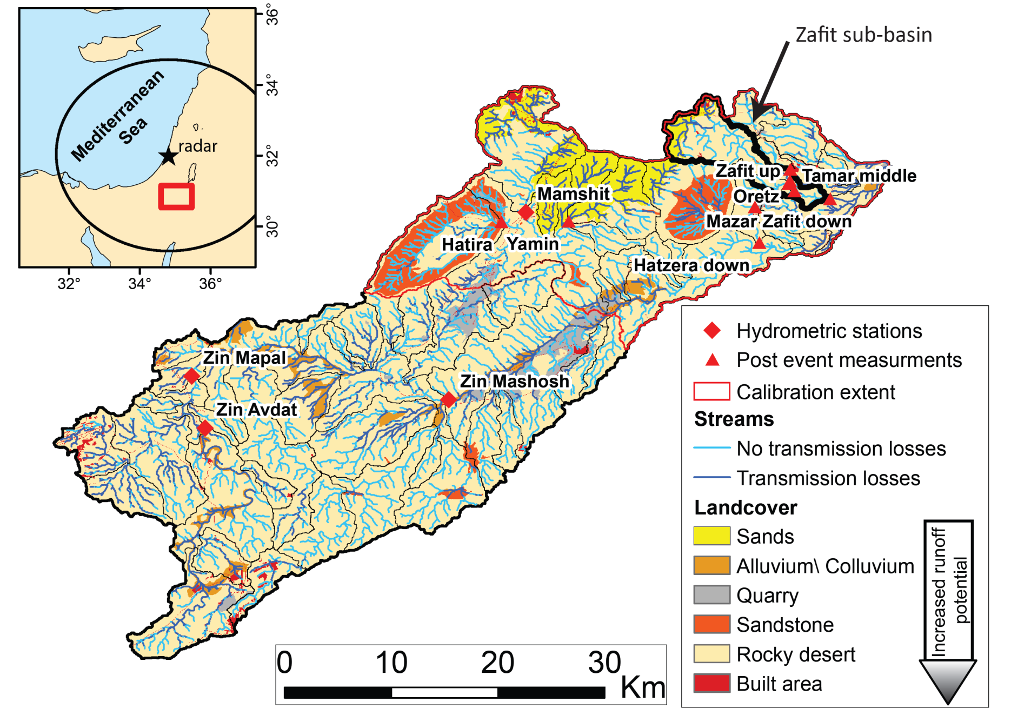
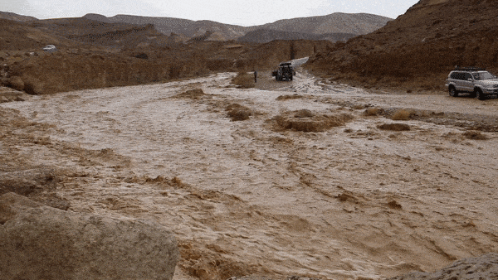
Rain forecast - uncertainty

Slide 14
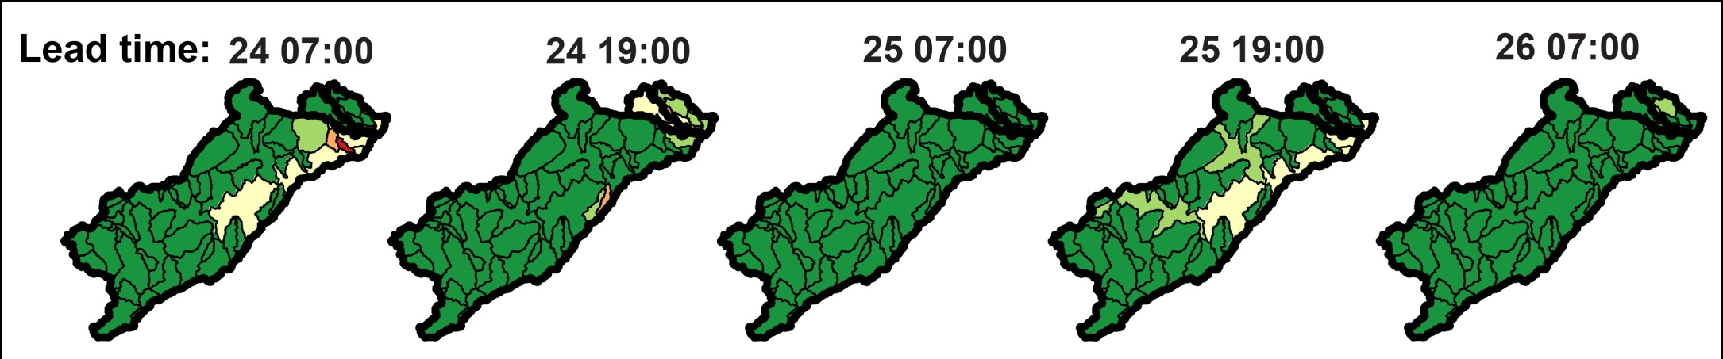
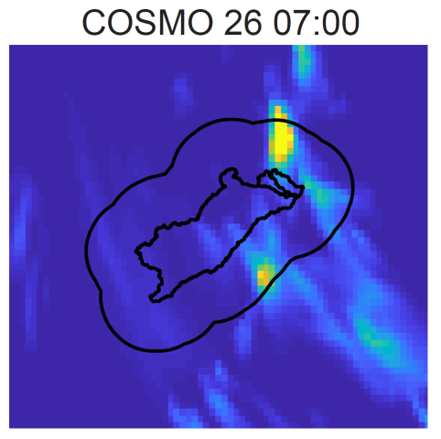
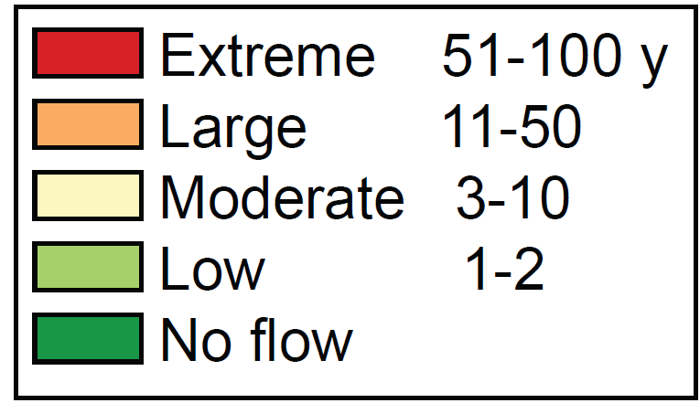
Rain forecast - uncertainty
How to communicate the uncertainty to the public and civil protection forces?

Slide 15
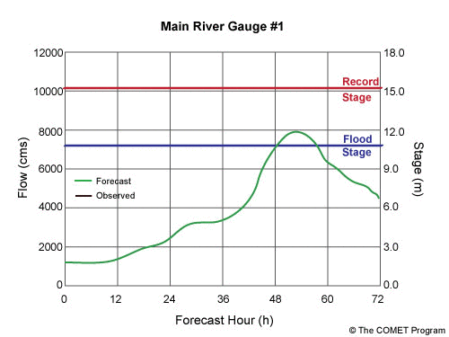
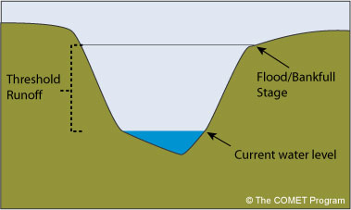
Measured and modeled discharge
- Do you have rainfall or discharge flood-threshold?

Slide 16
Additional topics
What do they think lacks the most in your region?
  Better NWP model?
  Hydrological models?
  Rain gages?
  Discharge gages?
  Hydrological data?
How do you communicate with the public? The civil protection forces?
What are your main hazards?

