Slide 1
Regional WIGOS Centre Tokyo
MINEMATSU Hiroaki
RWC Tokyo
Japan Meteorological Agency
14 February 2022
WIGOS Webinar #29
Notes:
https://www.jma.go.jp/jma/jma-eng/jma-center/rwc/

Slide 2
Contents
Introduction
Regional WIGOS Centres in RA II
Mandatory function – WDQMS implementation
Optional function – Capacity development

Slide 3
I. Introduction

Slide 4
Regional WIGOS Centre Tokyo (RWC Tokyo)
Development
  Jun. 2018: Designated as a RWC in pilot mode
  Mar. 2019: Hold the RA II WIGOS Workshop in Tokyo
  Nov. 2019: Host the OSCAR/Surface Training Course in Tokyo
  Jul. 2021: Begin joint operation with RWC Beijing
  Sep. 2021: Designated as an operational RWC
Operation
  Mainly run by the Observation Division of JMA
  Closely liaising with related WMO Centres
    e.g. RSMC Tokyo, RIC Tsukuba, GISC Tokyo and TCC (RCC)
Notes:
https://www.jma.go.jp/jma/en/Background/organization.html
https://www.jma.go.jp/jma/en/NMHS/indexe_nmhs.html

Slide 5
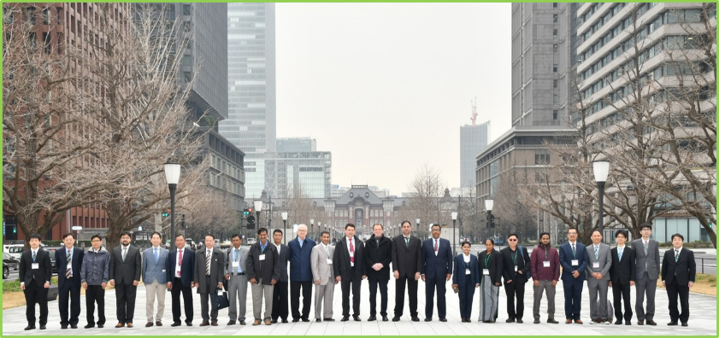
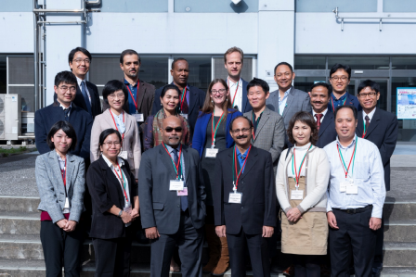
Activities of RWC Tokyo in pilot mode
RA II WIGOS Workshop - Regional WIGOS Centres and its services for Members (Tokyo, 6 – 9 March 2019)
  Attended by 17 NMHSs in RA II and V and WMO
  Learning WIGOS key issues and discussing collaboration between RWCs and Members
OSCAR/Surface Training Course for the RA-II East Asia Subregion (Tokyo, 13 – 15 November 2019)
  Attended by 14 NMHSs in RA II and WMO
  Learning WIGOS Metadata and OSCAR/Surface
Attendees of the workshop (Mar. 2019)
Attendees of the training course (Nov. 2019)
Notes:
https://www.jma.go.jp/jma/en/photogallery/RWCws_2019.html
https://www.jma.go.jp/jma/en/photogallery/OSCAR_Surface_Training_201911.html

Slide 6
II. regional wigos centres in ra ii

Slide 7
WIGOS Tools to achieve integrated framework
OSCAR – Observing Systems Capability Analysis and Review tool
  Knowing where, how and why observations are made helps better planning of network evolution and allows users understand their data.
WDQMS – WIGOS Data Quality Monitoring System
  Monitoring of data ensures the data and products are reliable and correspond to agreed needs.
RWCs – Regional WIGOS Centres
  RWCs help Members with the management of metadata in OSCAR and assist with following up on quality issues coming out of WDQMS.
  RWCs coordinate regional projects and build Members’ capacity.
Notes:
https://wmoomm.sharepoint.com/:b:/s/wmocpdb/EX3MzYzQwgNOliIFVlaGrVcB-L3GtevNDoDGFm7SLhIOtg?e=nngJYs

Slide 8
RWC functions in RA II (RA II MG-16)
Mandatory functions
  Regional WIGOS metadata management (to work with data providers to facilitate collection, updating and provision of quality control for WIGOS metadata in OSCAR/Surface)
  Regional WIGOS performance monitoring and incident management (WDQMS) and follow-up with data providers on availability/quality issues
Optional functions
  Assistance with the coordination of regional/sub-regional WIGOS projects
  Assistance with regional and national observing network management
  Support for regional capacity development activities

Slide 9
Joint operation of RWCs in RA II (RA II MG-16)
RWC Beijing and RWC Tokyo take turn to cover their responsible area not only by period but also by RA II Members and share the work of mandatory functions during each period.
The term for each period is 6 months.
  From 1 January to 30 June and 1 July to 31 December every year

Slide 10
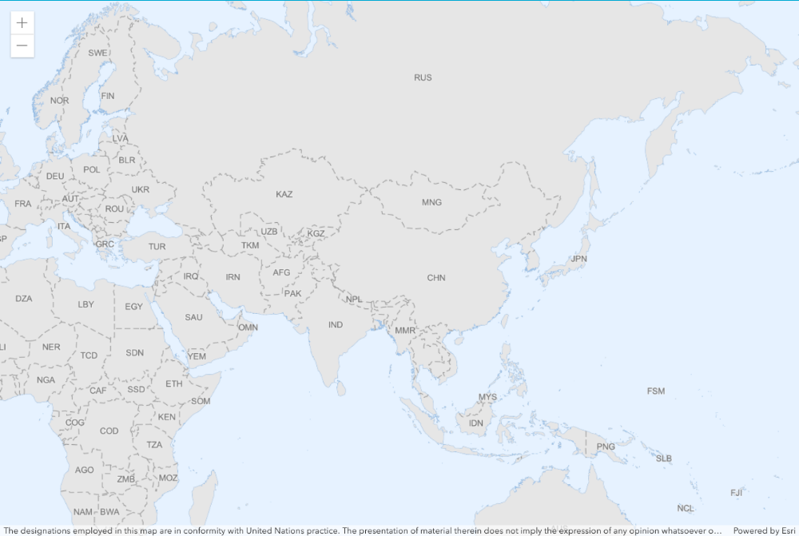
Responsible areas for mandatory functions
Group B (16 Members) RWC Beijing: 1 Jan. - 30 Jun. RWC Tokyo: 1 Jun. - 31 Dec.
Cambodia
Democratic People’s Republic of Korea
Hong Kong, China
Kazakhstan
Kyrgyzstan
Lao People’s Democratic Republic
Macao, China
Mongolia
Myanmar
Republic of Korea
Russian Federation
Tajikistan
Thailand
Turkmenistan
Uzbekistan
Viet Nam
Region II (Asia)
Group B
RWC Beijing
RWC Tokyo
Group A
Group A (17 Members) RWC Tokyo: 1 Jan. - 30 Jun./ RWC Beijing: 1 Jun. - 31 Dec. | Group A
Afghanistan | Islamic Republic of Iran | Qatar
Bahrain | Kuwait | Saudi Arabia
Bangladesh | Maldives | Sri Lanka
Bhutan | Nepal | United Arab Emirates
India | Oman | Yemen
Iraq | Pakistan
*Among RA II Members, China and Japan are not involved in the Groups.
Notes:
https://community.wmo.int/

Slide 11
III. Mandatory functions
– wdqms implementation

Slide 12
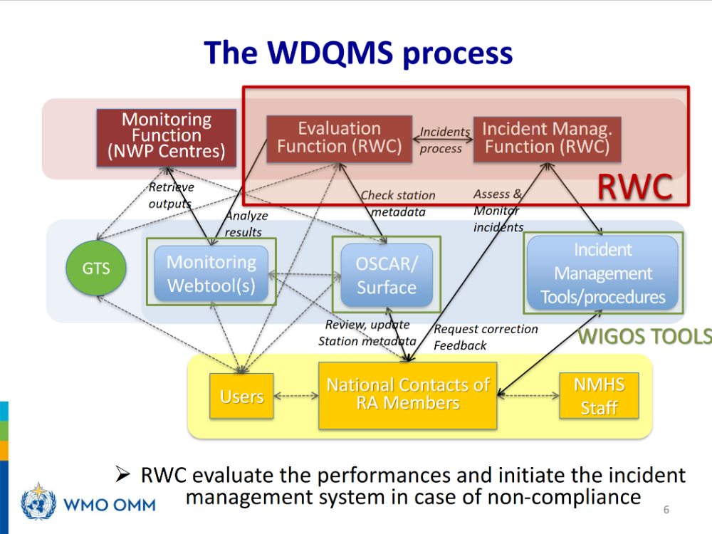
WDQMS Implementation of RWC Tokyo
WDQMS consists of
three functions;
  Monitoring Function
  Evaluation Function
  Incident Management Function
RWC Tokyo engages in WDQMS;
  Monitoring of availability, timing and quality of observation data provided by RA II Members using the WDQMS monitoring webtool
  Members encouragement for response to incidents and related handling via the Incident Management System for WDQMS (JIRA ECMWF)

Slide 13
WDQMS Implementation of RWC Tokyo (cont.)
As an initial stage of WDQMS implementation, RWC Tokyo considers it’s important;
  To make Members to get used to participating in WDQMS activities by using JIRA and OSCAR/Surface.
  To raise each Member with appropriate amount of incidents at once to avoid excessive work.
RWC Tokyo uses the WDQMS web tool to identify incidents and chooses limited number of stations.
  During this very early period, daily availability of surface observation is prioritized.

Slide 14
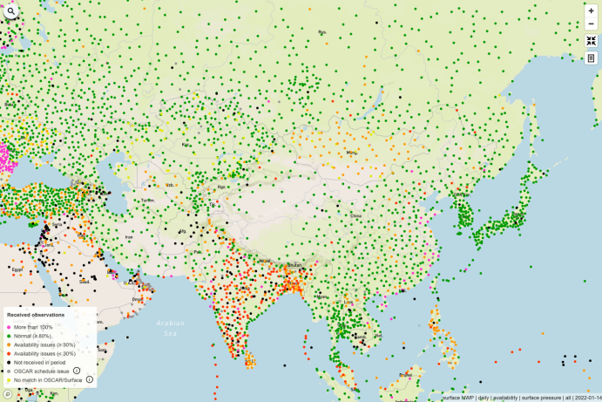
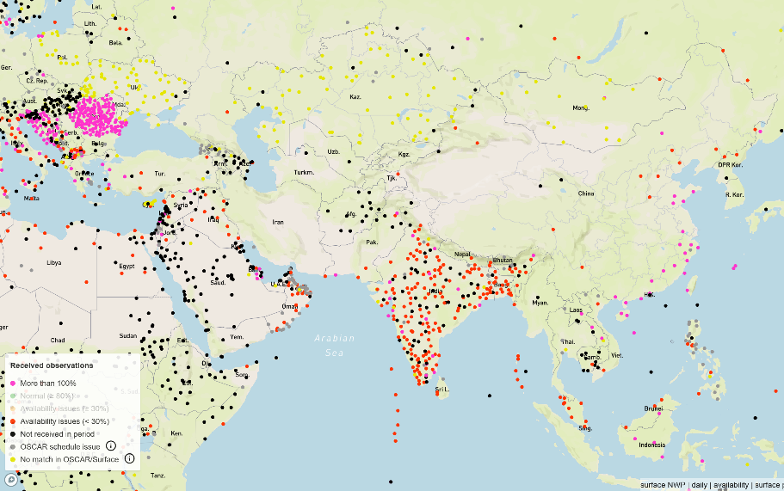
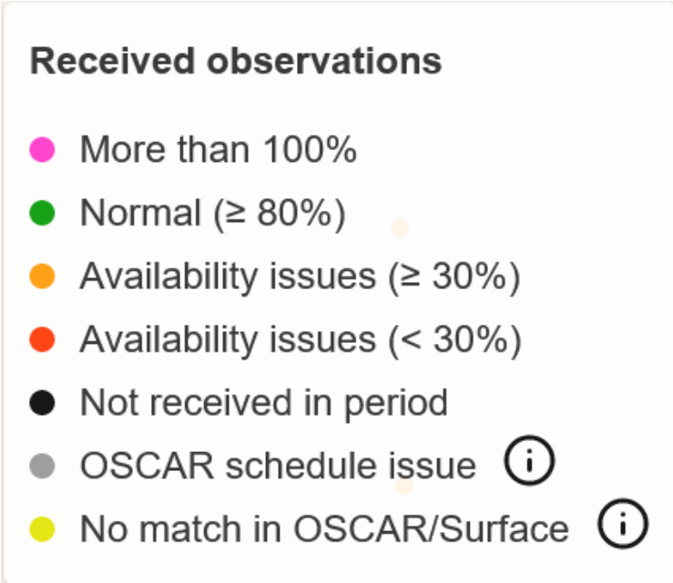

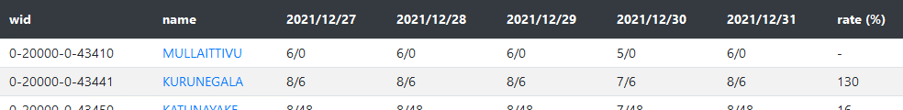
Monitoring and Evaluation Function
Availability
  The results are based on the comparison between the report schedule registered in OSCAR/Surface with the actual acquisition by WIGOS Monitoring Centres.
All observing stations
Extracted stations by reporting results
Internal tool showing the alerted station list

Slide 15
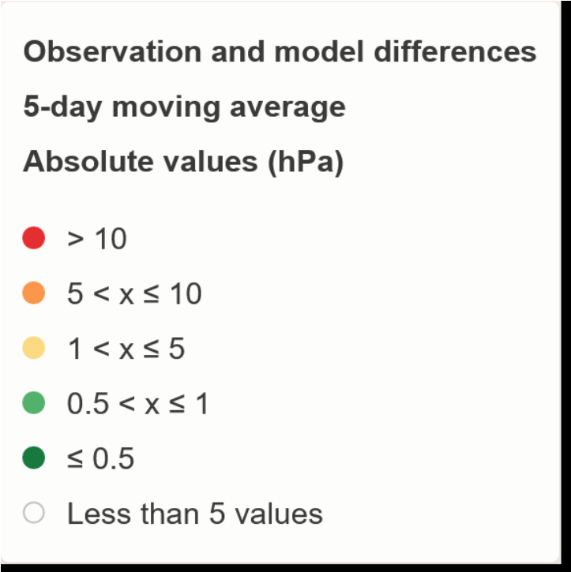
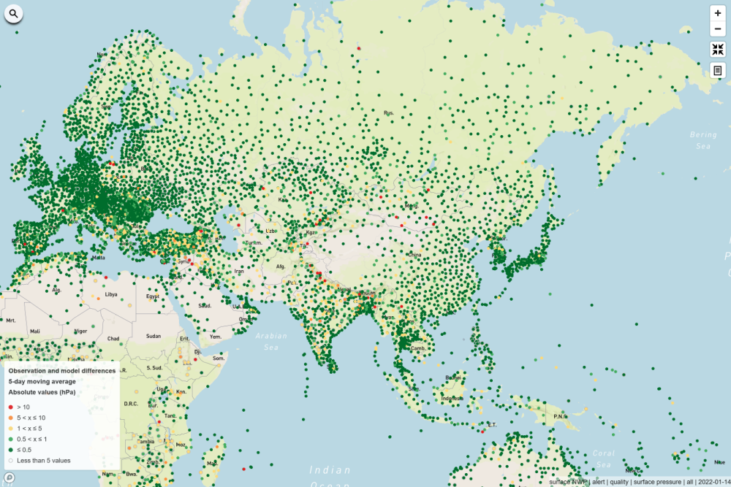
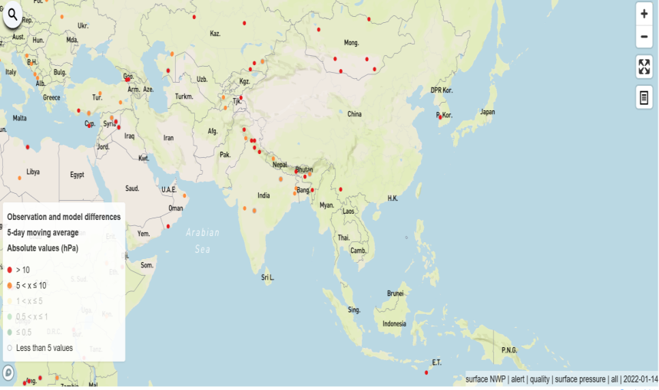
Monitoring and Evaluation Function (cont.)
Quality
  The results are show the value of “Observation against Background” (O-B) averaged over 6-hourly or daily obtained by WIGOS Monitoring Centres.
Extracted stations by O-B results
All observing stations

Slide 16
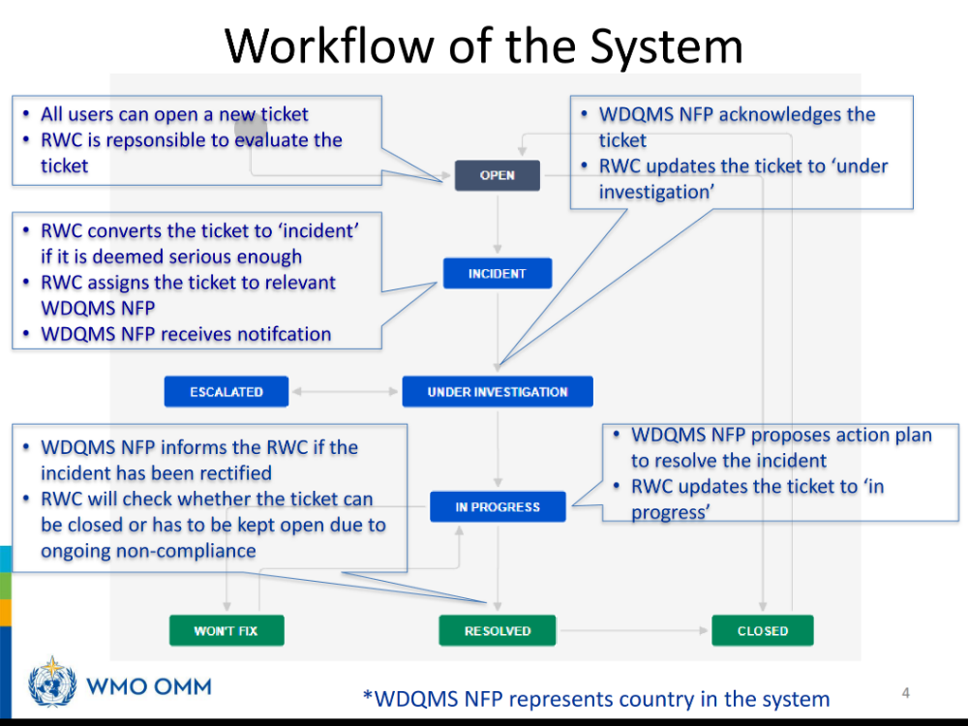
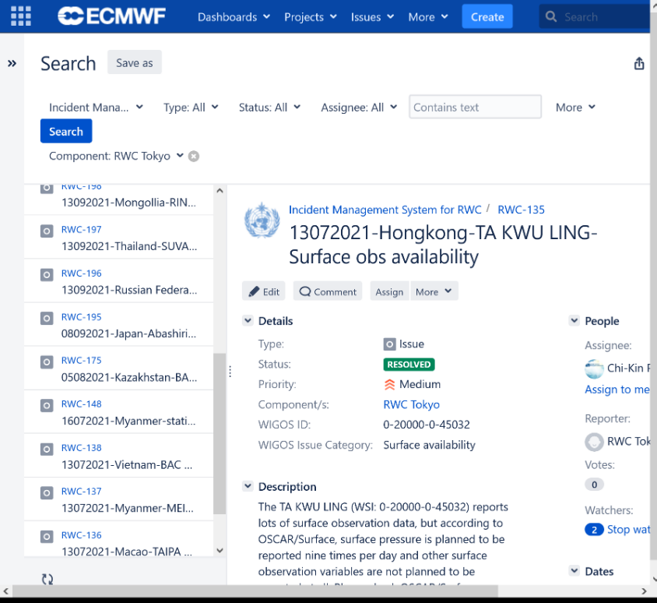
Incident Management Function
Incidents are managed on JIRA hosted by ECMWF.
Incident ticket list on JIRA
Workflow of the Incident Management System

Slide 17
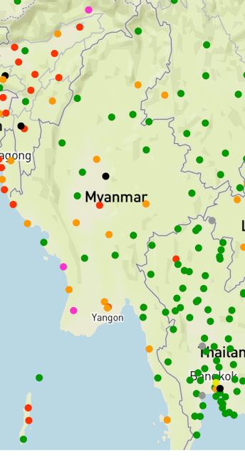
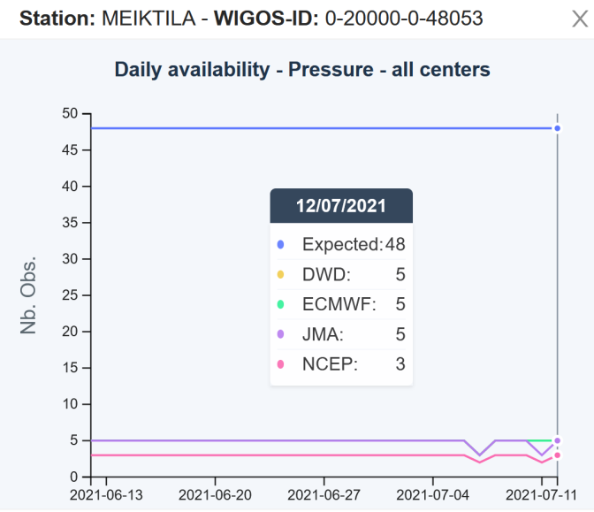
Example 1: Surface availability incident
Availability issues at a part of stations in Myanmar were found in July 2021 on the WDQMS web tool.
One station whom availability constantly exceeded 100% was chosen among the stations.
  Report number: Expected = 48, Actual < 5
  Possibly, the reporting
  interval needed to be
  fixed.
Availability of surface pressure

Slide 18
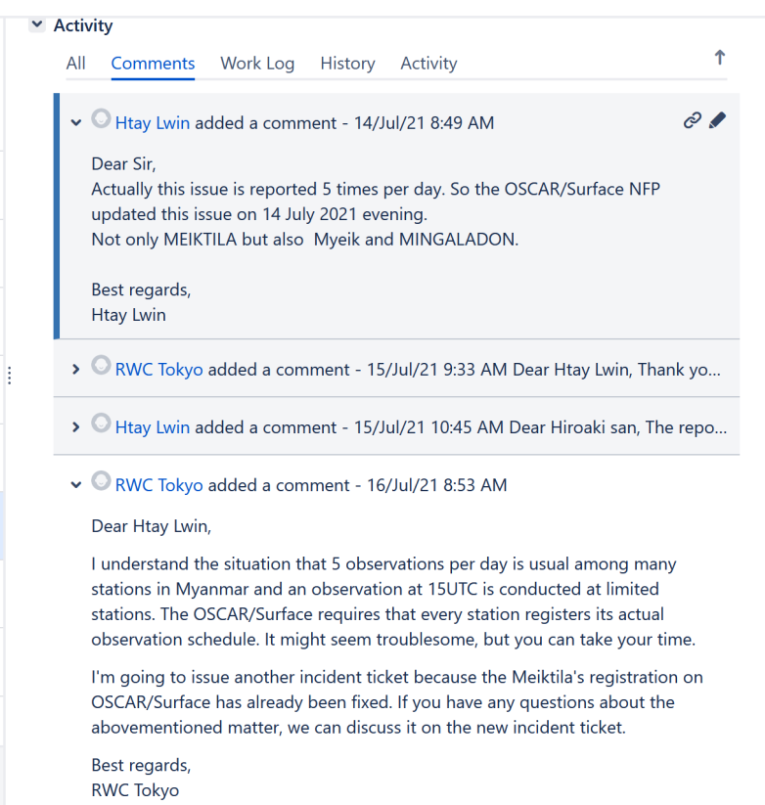
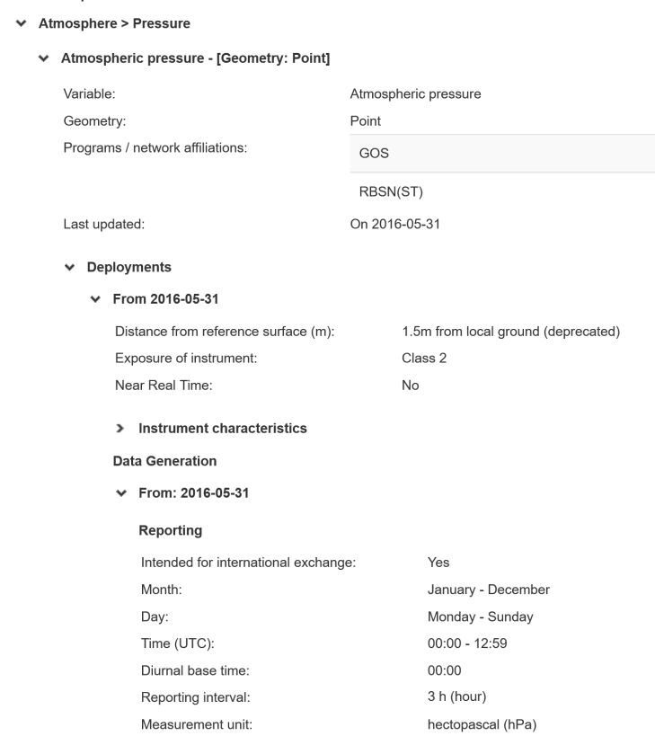
Example 1: Surface availability incident (cont.)
The station’s registration of “Time” and “Reporting interval” on OSCAR/Surface have been fixed after communication between WDQMS NFP and RWC Tokyo via JIRA.
Every single observed variable has its own details.
(e.g., reporting and coordinate)
“Time” and “Reporting interval” were corrected.
Communication on JIRA
OSCAR/Surface

Slide 19

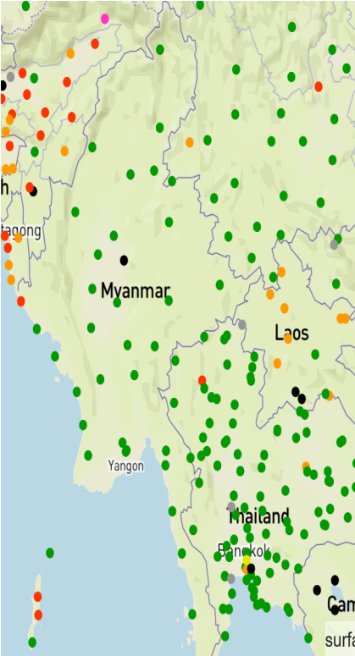
Example 1: Surface availability incident (cont.)
Similar incidents at other stations were also fixed just after the NFP solved the first one.
Availability of surface pressure

Slide 20
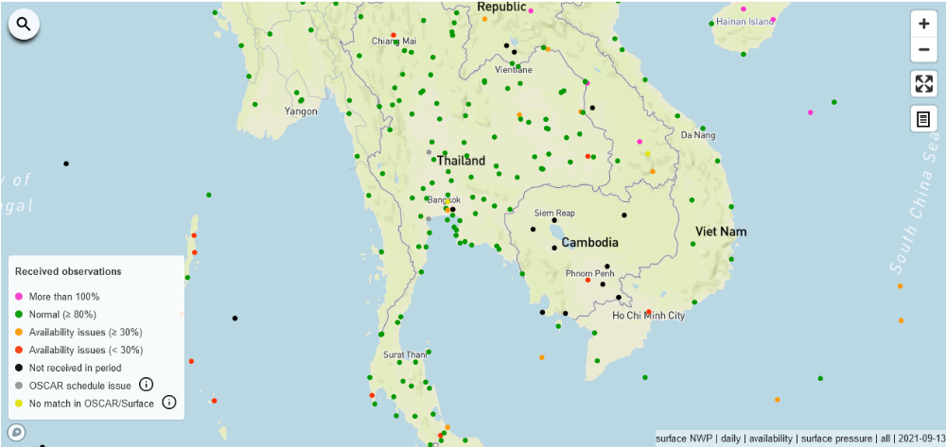
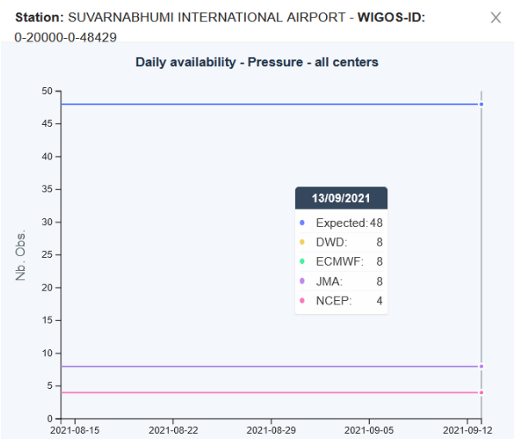
Example 2: Surface availability incident
Availability issues were found in Thailand in September 2021 although most of stations performed well.
RWC Tokyo chose one station and worked with WDQMS NFP, from activating JIRA account to solving the incident.
  The first contact with NFP who
  has already been nominated
  was made via an email.
  The JIRA account was activated
  by support of WMO WIGOS
  Branch.
Availability of surface pressure

Slide 21
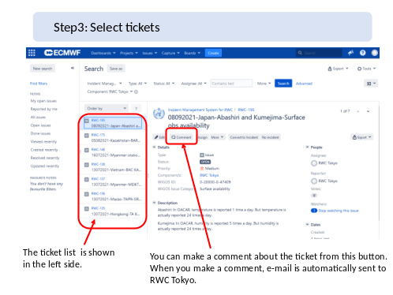
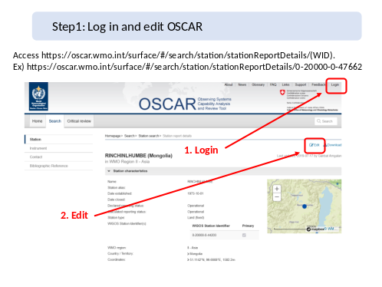
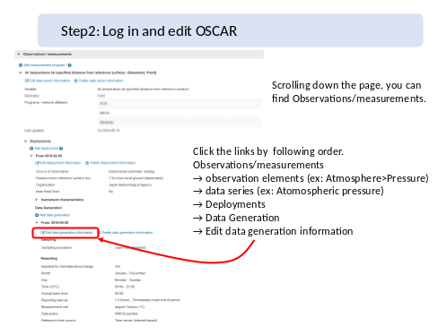
Example 2: Surface availability incident (cont.)
Some screenshots explaining how-to use JIRA and OSCAR/Surface were sent to the NFP to help the rectification work.
The communication conducted using emails were logged on JIRA by RWC Tokyo later.
Screenshot of JIRA and OSCAR/Surface sent to NFP

Slide 22
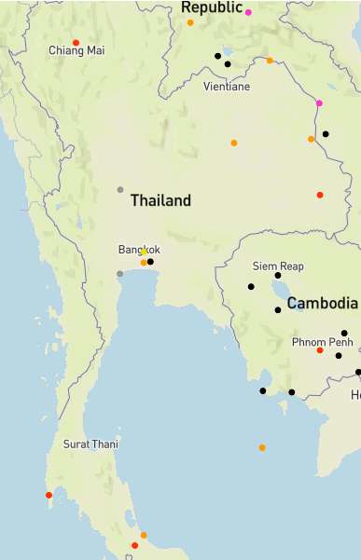
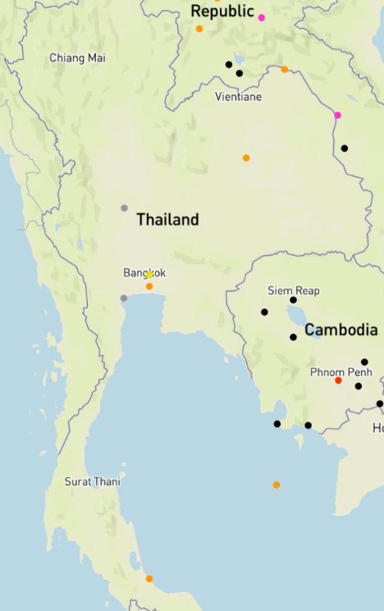
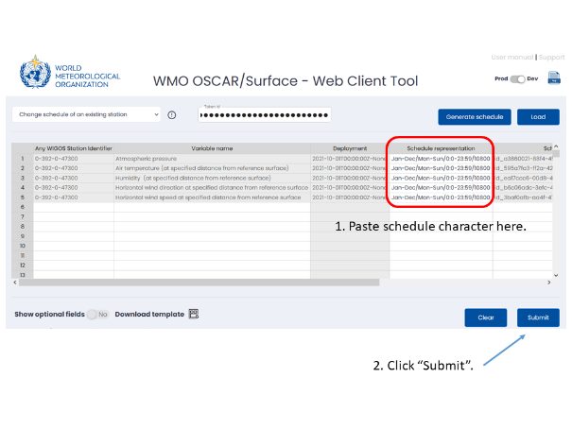
Example 2: Surface availability incident (cont.)
Similar problems at other stations were also fixed after the first one was resolved.
  The Web Client Tool of OSCAR/Surface can be used to fix multiple stations efficiently.
A screenshot of the Web Client Tool sent to NFP
Availability of surface pressure other than well-performing stations

Slide 23
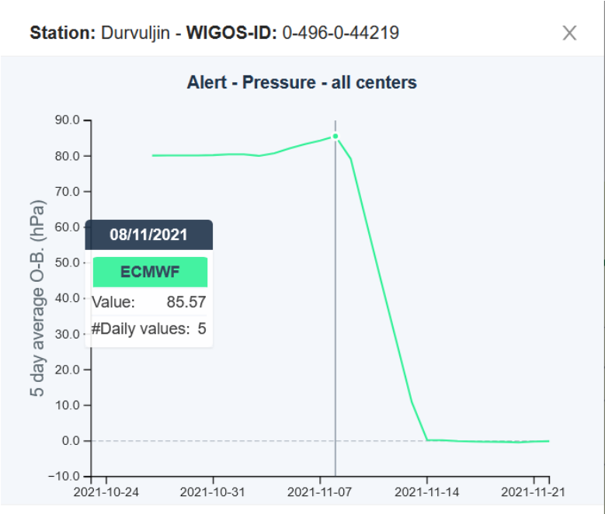
Example 3: Surface quality incident
In October 2021, ECMWF (WDQMS Monitoring Centre) found possible incidents about barometer height at a part of stations in Mongolia, and the notice was sent to RWC Tokyo via the WMO WIGOS Branch.
After an incident management
process in cooperation with
the NFP, O-B values of the
stations have been reduced
drastically.
Daily average of O-B (surface pressure)

Slide 24
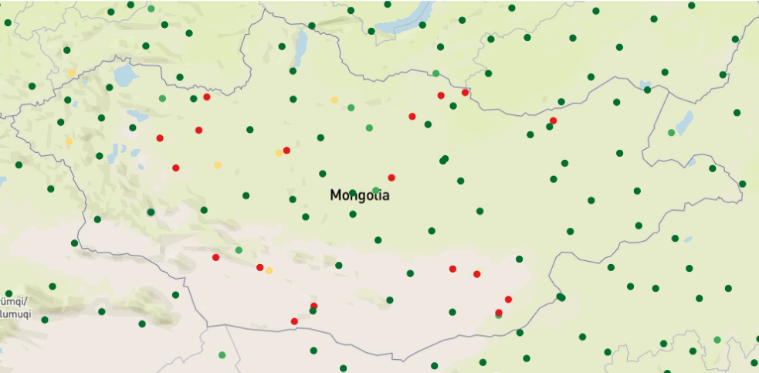
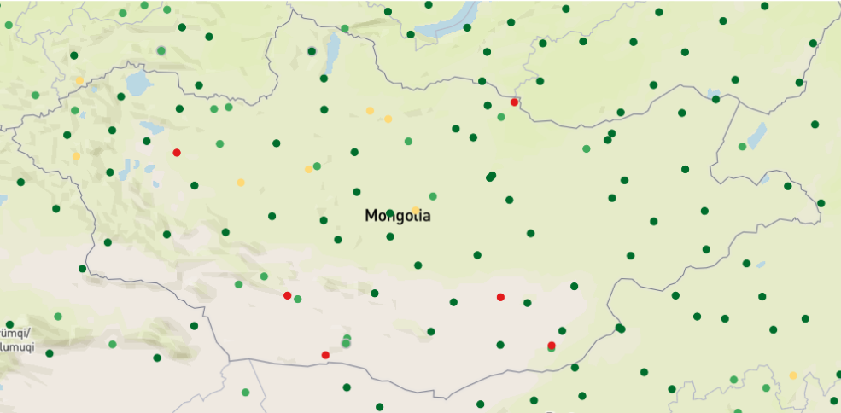
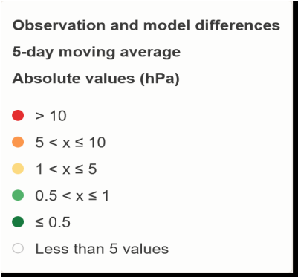
Example 3: Surface quality incident (cont.)
In total, the value of barometer height at 17 stations have been fixed on OSCAR/Surface
The quality map of surface pressure has improved visibly.
5-day average of O-B (surface pressure)

Slide 25
Summary: Results (July – December 2021)
Group B (16 Members) | Incident ticket (issued during 2H2021) |  |  | Rectified stations*
 | Resolved* | Won’t fix | Remained (Ongoing)
Cambodia
Democratic People’s Republic of Korea
Hong Kong, China | 1 |  |  | 1
Kazakhstan |  |  | 1 | 0
Kyrgyzstan
Lao People’s Democratic Republic
Macao, China | 1 |  |  | 1
Mongolia | 2 |  |  | 17
Myanmar | 2 |  |  | 9
Republic of Korea
Russian Federation |  | 1 |  | 0
Tajikistan
Thailand | 1 |  |  | 5
Turkmenistan
Uzbekistan
Viet Nam | 1 |  |  | 1
(*) Including resolved or rectified after Dec. 2021

Slide 26
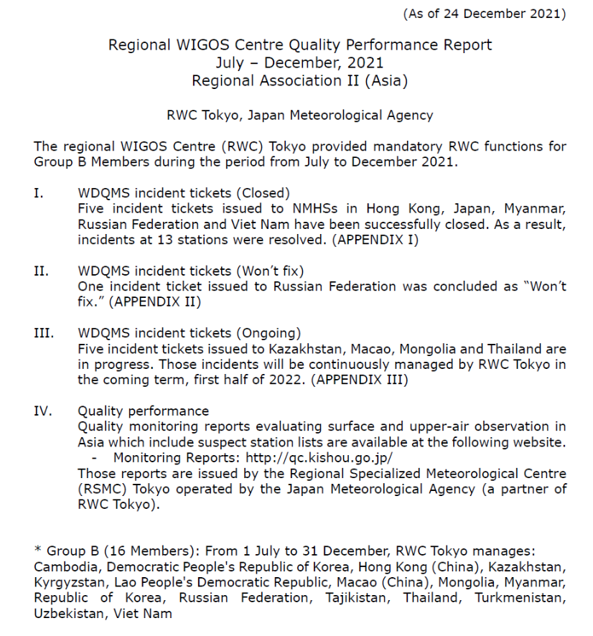
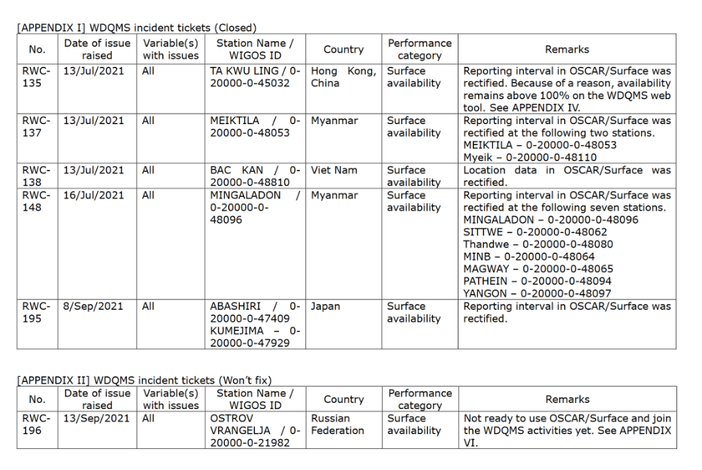
Summary: Quality performance report
RWC Tokyo provides monthly and semester-based quality performance reports. The content outlines availability and quality monitoring, and semester reports also cover incident management.
  Reports are published in collaboration with RSMC Tokyo.
Quality performance report
https://www.jma.go.jp/jma/jma-eng/jma-center/rwc/reports.html
Notes:
https://www.jma.go.jp/jma/jma-eng/jma-center/rwc/reports.html

Slide 27
Summary: Lessons and challenges
Generally,
Members are cooperative on engaging in WDQMS.
The WDQMS web tool and the Incident Management System (JIRA) can be utilized intuitively and useful.
On the other hand,
It often takes a few months to resolve one incident.
Not all Members have nominated WDQMS NFP and/or OSCAR/Surface NFP yet.
Not all Members are familiar with using OSCAR/Surface.
  WIGOS Learning Portal provides a lot of tutorial and informative materials. (https://etrp.wmo.int/course/view.php?id=146)
Notes:
https://etrp.wmo.int/course/view.php?id=146

Slide 28
IV. optional functions
– capacity development

Slide 29
Optional functions – Capacity building activities
RWC Tokyo provides services covering the RWC optional functions to Members in RA II.
  Assistance with coordination of regional/sub-regional and national WIGOS projects
  Collaboration with regional and national observation network management
  Support for regional capacity development
For coordinated service provision, RWC Tokyo liaises with related WMO Centres
  e.g. RSMC Tokyo, RIC Tsukuba, GISC Tokyo and TCC (RCC)

Slide 30
RA II WIGOS Projects
Leadership in RA II WIGOS Projects is a pillar of optional functions of RWC Tokyo.
  Enhancement of Data Availability and Quality Management for NMHSs in Surface, Climate and Upper-air Observations
    * This project was replaced with WDQMS-related activities in 2021.
  Capacity Building for Radar Techniques in Southeast Asia
  Development of Support for NMHSs in Satellite Data, Products and Training
Various activities have been conducted under the projects.
  Holding workshops and technical meetings
  Conducting surveys to collect Members’ capabilities in each fields
Notes:
https://www.jma.go.jp/jma/en/photogallery/qmws2018.html
https://www.jma.go.jp/jma/en/photogallery/Technicalmeeting_202111.html
https://www.jma.go.jp/jma/jma-eng/satellite/ra2wigosproject/ra2wigosproject-intro_en_jma.html

Slide 31
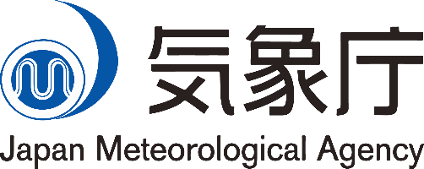
Thank you!
https://www.jma.go.jp/jma/jma-eng/jma-center/rwc/
rwc-tokyo@met.kishou.go.jp
Notes:
https://www.jma.go.jp/jma/jma-eng/jma-center/rwc/
rwc-tokyo@met.kishou.go.jp

