Slide 1
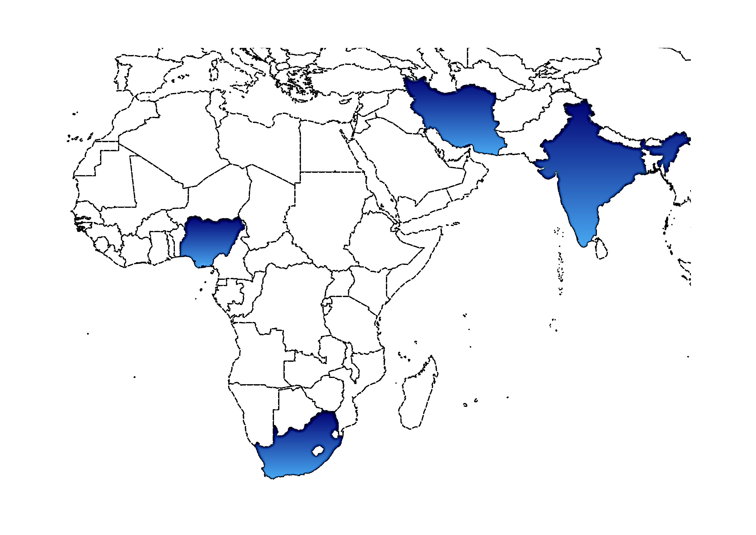





Climate information for adaptation (ClimAdapt) Workshop
As part of a training package developed in partnership between WMO and KMA
Next Steps
19 November, 2021
08:00 – 09:00 UTC
Jorge Luis Vazquez-Aguirre (WMO ET-CID)
Session 9
DAPSCLIM - LCA / UV

Slide 2
Make use tools, resources and readings provided or revisited at the workshop, such as climateinformation.org, climdex.org, WMO guidance documents.
Be aware of all actors and linkages included in the adaptation process apart from those related to climate
Assemble technical resources for climate risk assessment
Increase the visibility of NMHSs
Keep climate action designing clear and simple
Technical assistance from WMO or international agencies
Establish effective partnerships (internal/external, domestic/international) intended for developing adaptation
Contribute to National Adaptation Plans
Climate information for adaptation (ClimAdapt) Workshop
As part of a training package developed in partnership between WMO and KMA
19 November, 2021
08:00 – 09:00 UTC
Session 9
DAPSCLIM - LCA / UV

Slide 3
Climpact Workshop (virtual)
January 17-28, 2022
Calculation of sector-specific climate indices
CLIMPACT website: www.climpact-sci.org

Slide 4
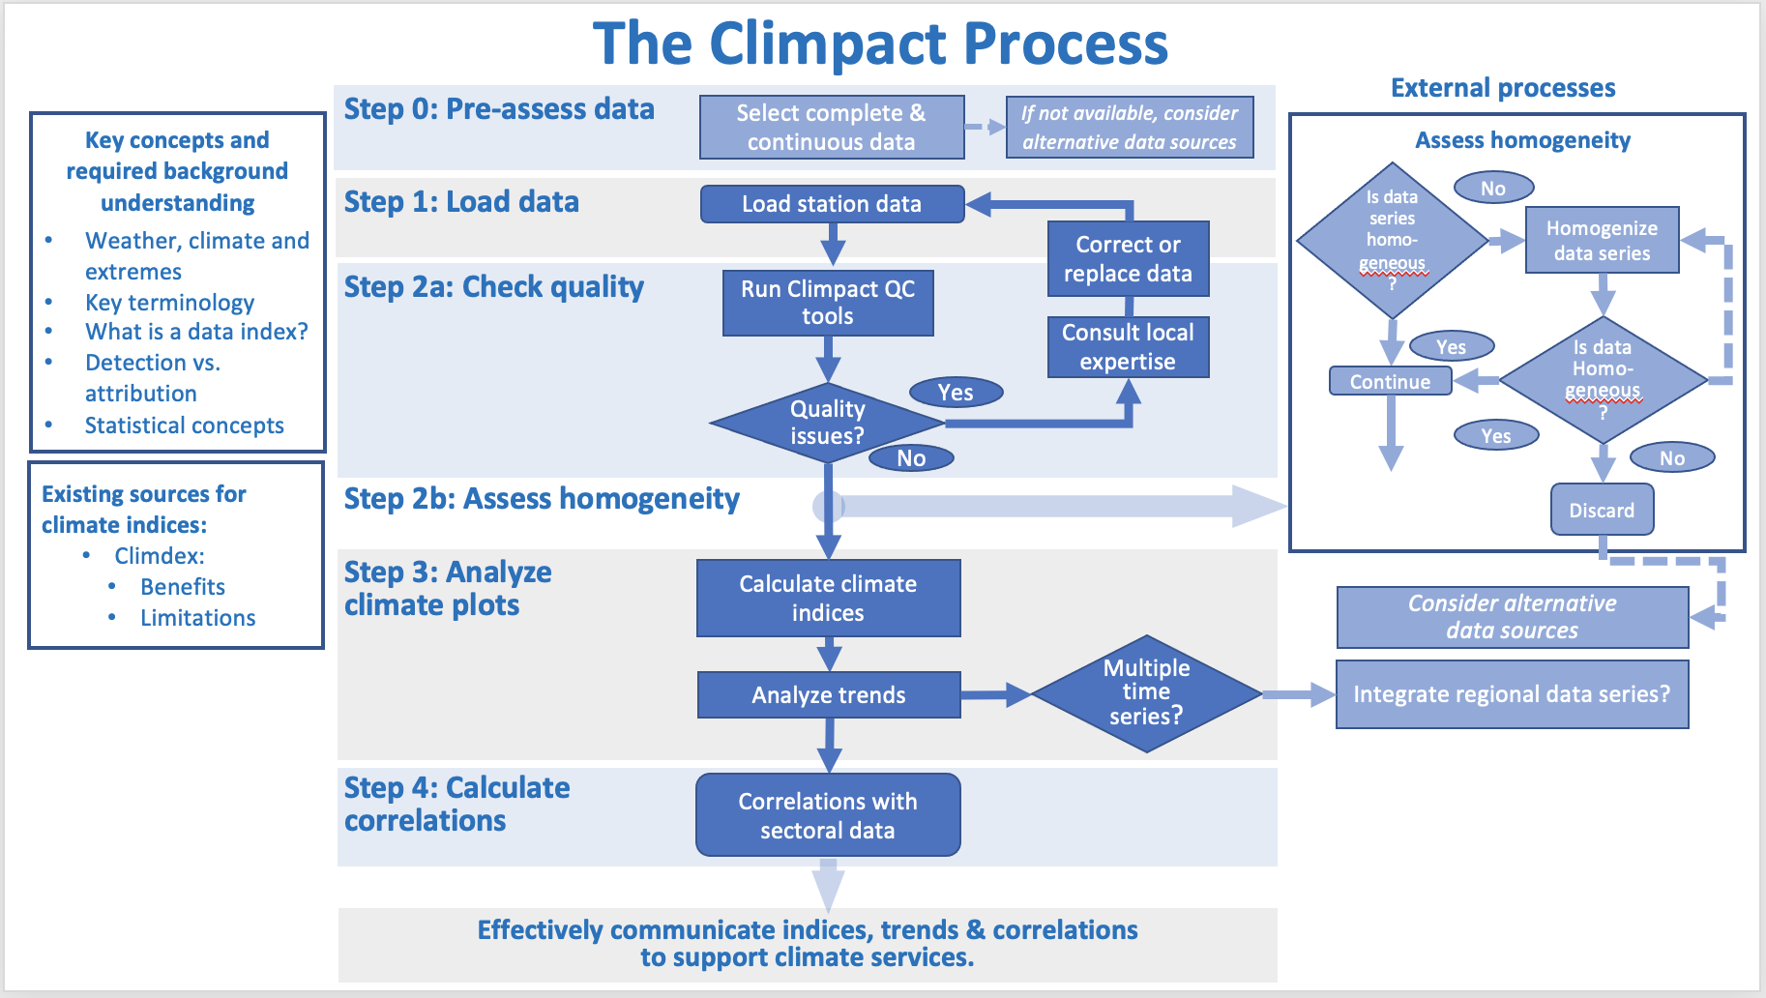
Climate information for adaptation (ClimAdapt) Workshop
As part of a training package developed in partnership between WMO and KMA
19 November, 2021
08:00 – 09:00 UTC
Session 9
DAPSCLIM - LCA / UV

Slide 5
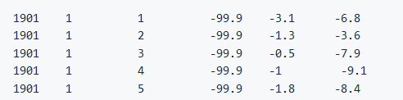
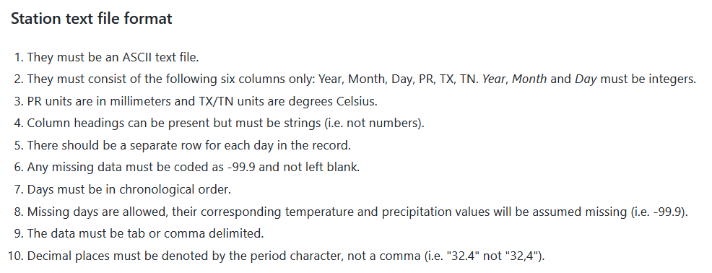
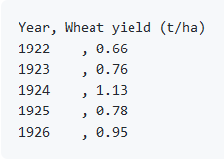
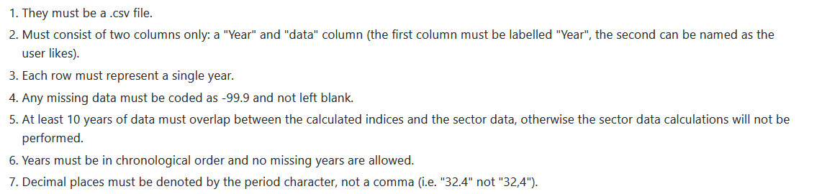
Data required for the Climpact Workshop
1. Daily timeseries (precipitation, maximum temperature, minimum temperature)
Climate information for adaptation (ClimAdapt) Workshop
As part of a training package developed in partnership between WMO and KMA
19 November, 2021
08:00 – 09:00 UTC
2. Sectoral data: Data relevant for each specific sector
Session 9
DAPSCLIM - LCA / UV

Slide 6
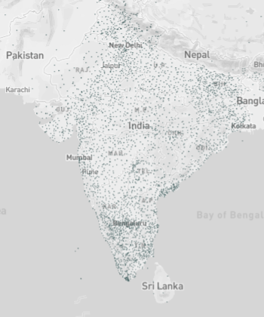
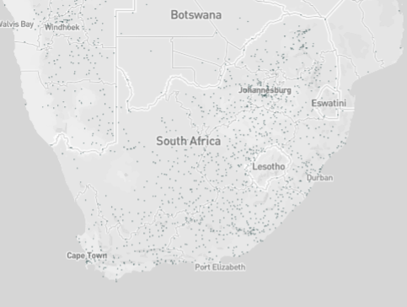

Slide 7
Thank you all for making the ClimAdapt workshop possible!
Climate information for adaptation (ClimAdapt) Workshop
As part of a training package developed in partnership between WMO and KMA
19 November, 2021
08:00 – 09:00 UTC
Session 9
DAPSCLIM - LCA / UV

