Slide 1
Theme #3
Micro-credentials and credit transfer, how could we proceed
SYMET-14
ChairS
Yan Ma, Chair of Reading-NUIST Academy;
Vieri Tarchiani, Istituto di BioEconomia - Consiglio Nazionale delle Ricerche

Slide 2
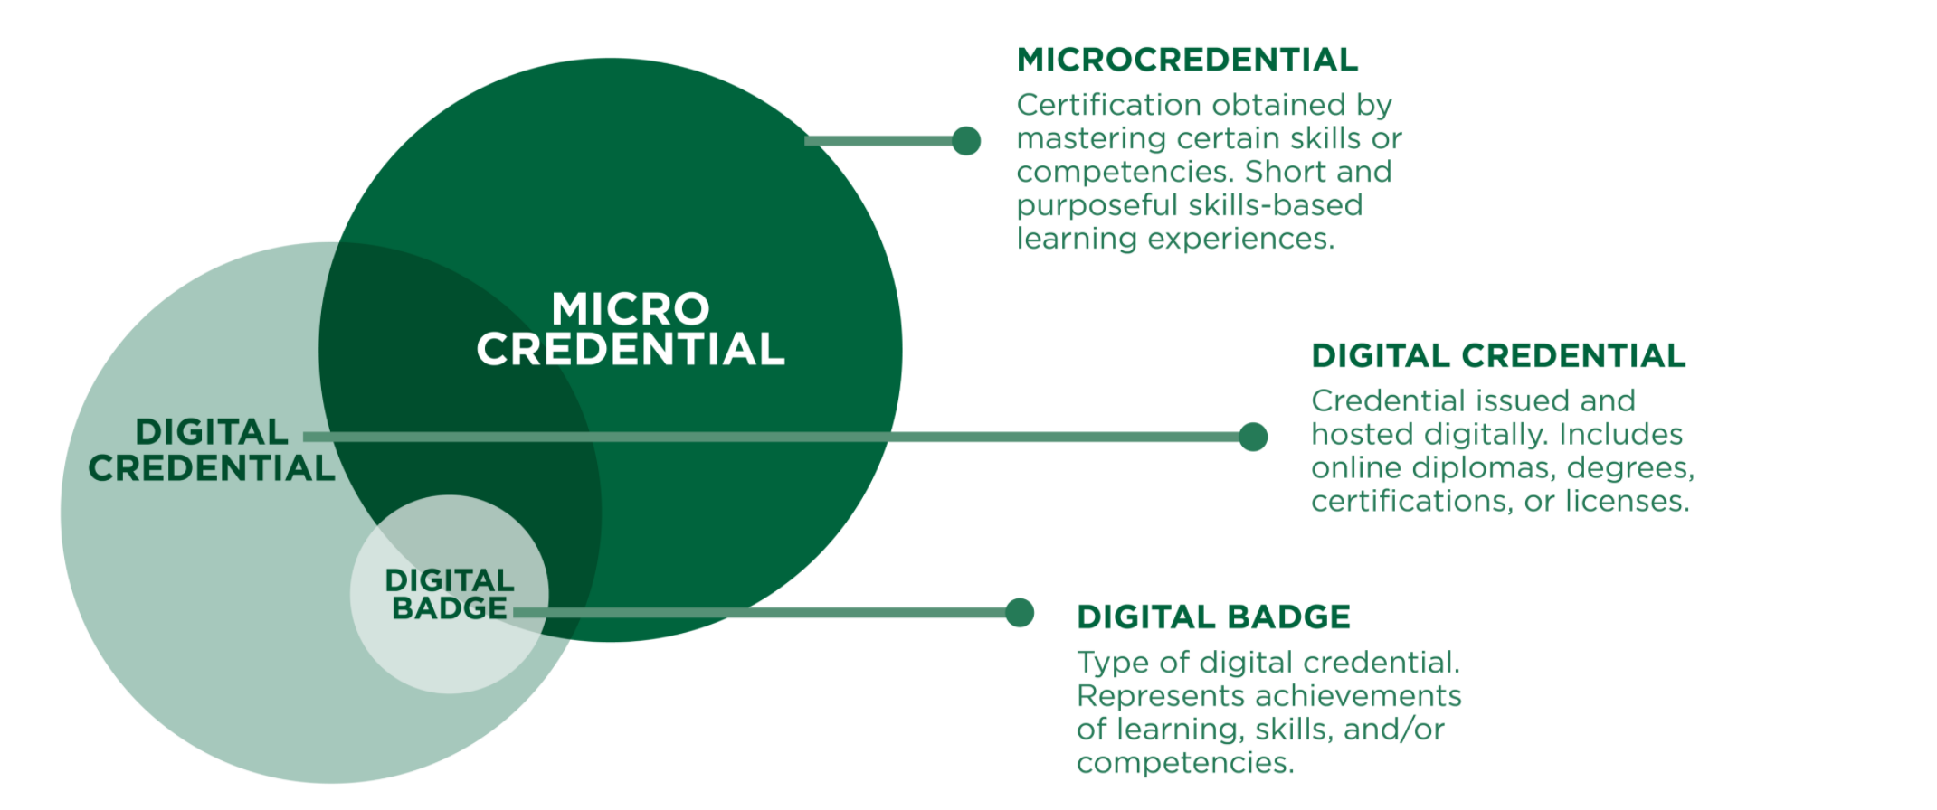
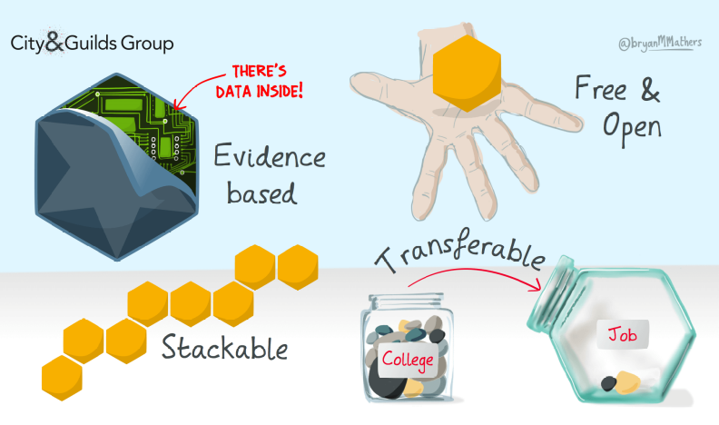
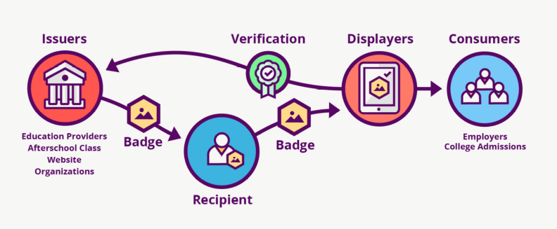
Background to the theme
Micro-credentials demonstrate accomplishment of short or non-formal learning.
Micro-credentials can be transferable and combinable through credit transfer agreements.
Digital open badges are a free and open technical standard that can be used by any organization.

Slide 3
How to encourage the adoption of the use of open digital badges as micro-credentials for training related to specific WMO or other recognized competency frameworks?
Participants to WG 3
Maria Mamaeva, State Hydrological Institute of ROSHYDROMET, Russia
Jeferson Zerrudo DOST-PAGASA, Philippine
Hillary Weller, Reading University, UK
Hanas Baz, Center of Meteorology, Saudi Arabia
With inputs from Mustafa Adiguzel and Luciane Veeck, WMO Secretariat
Chair and Rapporteur: Vieri Tarchiani, IBE-CNR, Italy

Slide 4
Challenges
Accreditation of issuing institutions: national level and international level both complicated and sensitive.
WMO is not an accrediting institution but can recognize institutions as RTCs or Contributing partners
Quality standards: how to be sure that quality standards are respected?
Technical standard to be adopted for micro-credential: who set them?
Which platform for sharing open badges to choose? free or charging
Competencies based Training: training courses should refer to a common CF and courses description, as well as micro-credentials, should include Skills & Knowledge, but not all CF of WMO are coherent or developed in the same way (for example CFCSP doesn’t have yet S&K defined). CF doesn’t exist for all profiles.

Slide 5
OpportunitiEs
Existing network of Institutions contributing to the WMO Global Campus
RTCs are recognized by WMO, and the confirmation process ensure some quality standards
Contributing partners with agreements with WMO can be also recognized
Some experience in using micro-credentials and open badges
Free platforms for open badges sharing: Badgr.io is an example already used and interoperable with Moodle, Blackboard and other e-learning platforms
Standards and CF provided (or potentially provided) by WMO
WMO could advise on standard to be used by the community
WMO could include this subject in the ToT courses

Slide 6
Collaboration
How can collaborative action contribute?
RTCs and Contributing Partners can voluntarily test the use of microcredentials and open badges, building on the experience of partners already doing
A first community of institutions recognized by WMO could start the process
The community of WMO RTCs could be the starting point.
The network could be further enlarged with other «contributing partners» having an agreement with WMO
WMO and partners already using Open badges can collaborate to define standards and provide some guidance or advise on how to proceed (standard procedures and metadata of open badges)
At the RA-I WMO Global Campus Meeting in Cairo, December 2019, AGRHYMET-RTC Niger, AEMET-RTC Spain, COMET, RTC South Africa had expressed interest in participating in a preliminary test of the use of open badges as core testing partners with the potential further participation of EAMAC, VLC Morocco, RTC Algeria and RTC Egypt,

Slide 7
What steps might be required?
  Defining the community: RTCs and collaborating partners
  Proposing a basic standard (community identification, compulsory metadata, sharing platform)
  Introduce voluntarily on partners training courses
Who is willing to take responsibility to contribute?
  As RTCs:
    DOST-PAGASA, Philippine
    IBE-CNR, Italy
  As contributing partners:
    Reading University, UK
    ROSHYDROMET, Russia
    To check if AGRHYMET-RTC Niger, AEMET-RTC Spain, COMET, RTC South Africa are still willing to participate
What contributions can offer?
  IBE-CNR and WMO could suggest the basic standard to set the badges
  All : Set-up badges in e-learning platforms (Moodle and Blackboard)
  All: Adopt Badgr.com as interoperable platform
  All: provide feedback and lessons learned within a year

Slide 8
Recommended Actions
Which recommendations does the group propose that could meet the chosen goals and contribute to the SYMET Statement?
Launch a Global Campus Open Badges initiative
Define a minimum set of standard metadata for badges and propose an open badges sharing platform such as Badgr.io
RTCs and collaborating partners are invited to participate in the community of open badges
RTCs and collaborating partners are invited to adopt the minimum standard metadata for setting badges in their e-learning platforms
Partners adopt voluntarily the open badges for some short term training courses as test nand provide feedbacks

