Slide 1
Agriculture
Collaboration between IMD and State Agriculture universities:
- Establish AMFU in each agroclimatic zone
Collaboration between IMD and ICAR:
- Establish DAMU in each district
Insurance
Collaboration with insurance sectors
- (NMHS, Mo Agriculture and insurance companies)
Academia
Capacity development
Collaboration between IITs, IITM, IIScs (R&D)

Slide 2
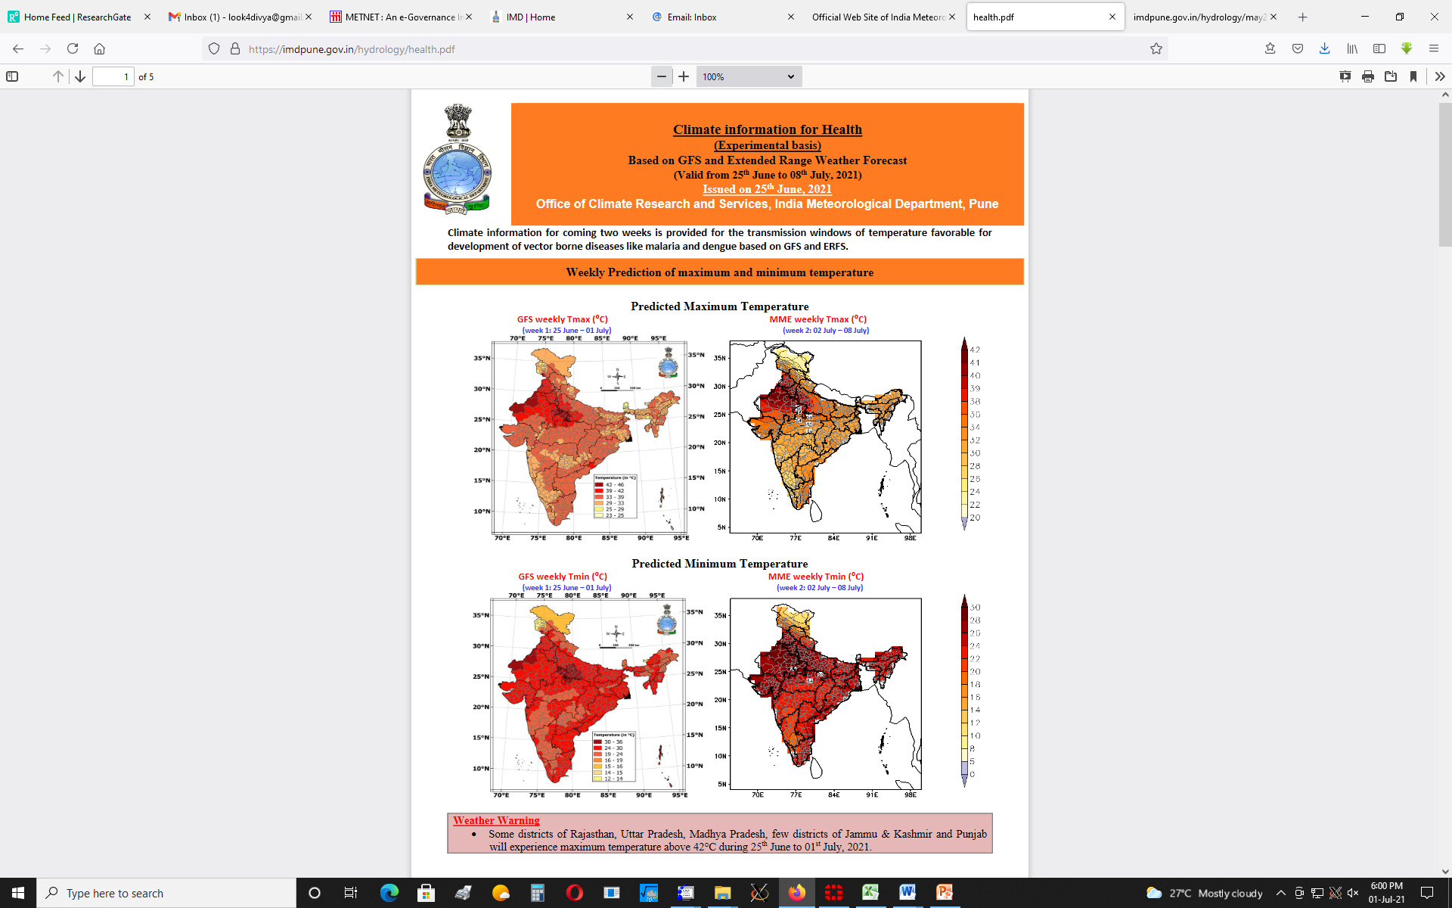
Health
Recently, “Malaria No More”, a non-governmental organization, collaborates with the India Meteorological Department (IMD) and the Indian Council of Medical Research (ICMR) in creating a multi-disciplinary India Interagency Expert Committee on Malaria and Climate (IEC) to explore and advance climate-based solutions for accelerating malaria elimination in India.
https://www.imdpune.gov.in/hydrology/health.html

