Slide 1
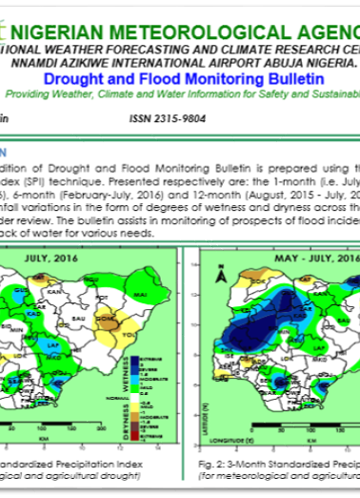

Climate Products and Services
Sector | Climate Information | Action
Agriculture | Soil Moisture, Growing degree days, rain days, NDVI, VHI, rainfall anomalies, temperature | Agromet Bulletin
 | Standardized Precipitation Index (SPI) | Drought and Flood Monitoring Bulletin

Slide 2
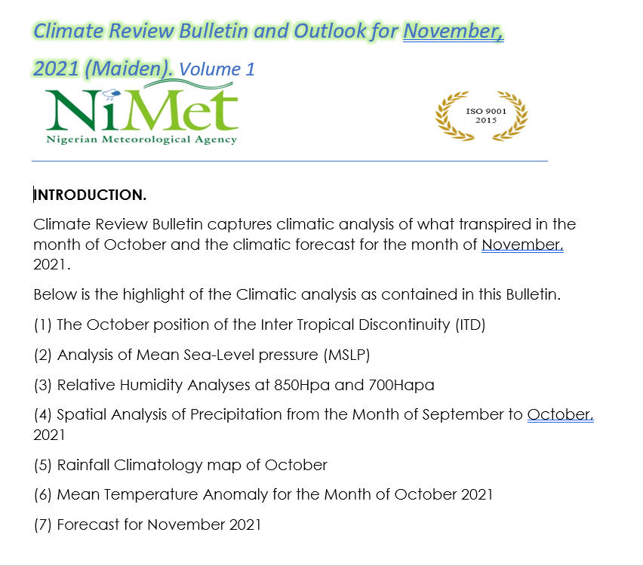

Climate Products and Services
Sector | Climate Information | Action
Health | Analysis of previous month and forecast for the next month on temperature rainfall and humidity | Climate Review and Outlook bulletin
 | temperature rainfall and humidity for Malaria and meningitis vigilance | Climate and Health Bulletin

Slide 3
Challenges
Poor distribution of weather station (number and coverage)
Dissemination and outreach to rural end users
High resolution forecast

