Slide 1
WMO Training Workshop - Integrating Climate Information for Adaptation (ClimAdapt): 8-19 November 2021-
Assignment
Country: Iran
Morteza Pakdaman, Zohreh Javanshiri, Sara Karami,
Ebrahim Asadi Oskouei, Farnaz Pourasghar, Yashar Flamarzi,

Slide 2
How you use climate products and services?
Generate seasonal forecast maps in different methods
-machine learning techniques for multi-model ensemble forecast of monthly mean precipitation
Dynamical downscaling of global data using RegCM
Combination of dynamical and statistical methods for postprocessing CFSV2

Slide 3
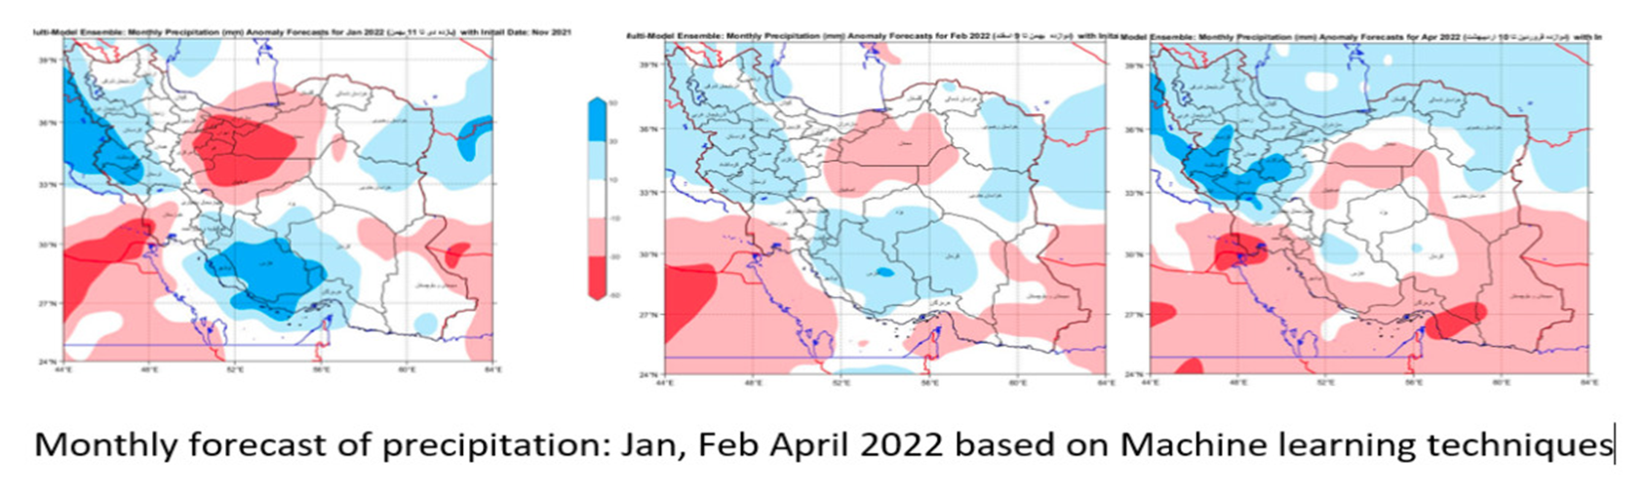
How you use climate products and services?

Slide 4
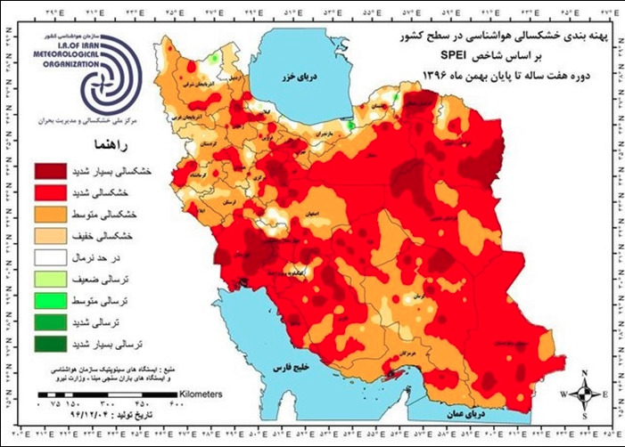
How you use climate products and services?
Drought monitoring by NDWMC
SPI, RDI, EDI, SPEI, ... Indecis

Slide 5
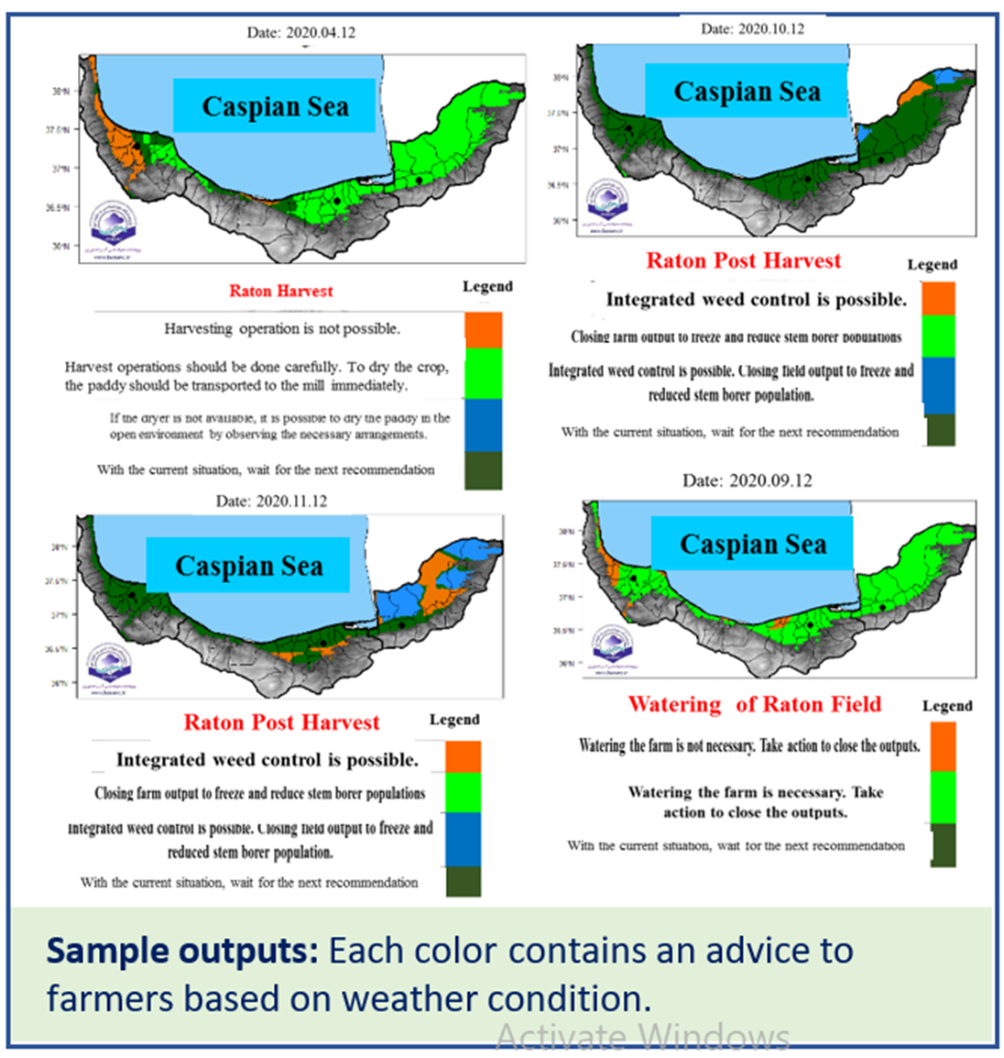
Producing maps for farmers

Slide 6
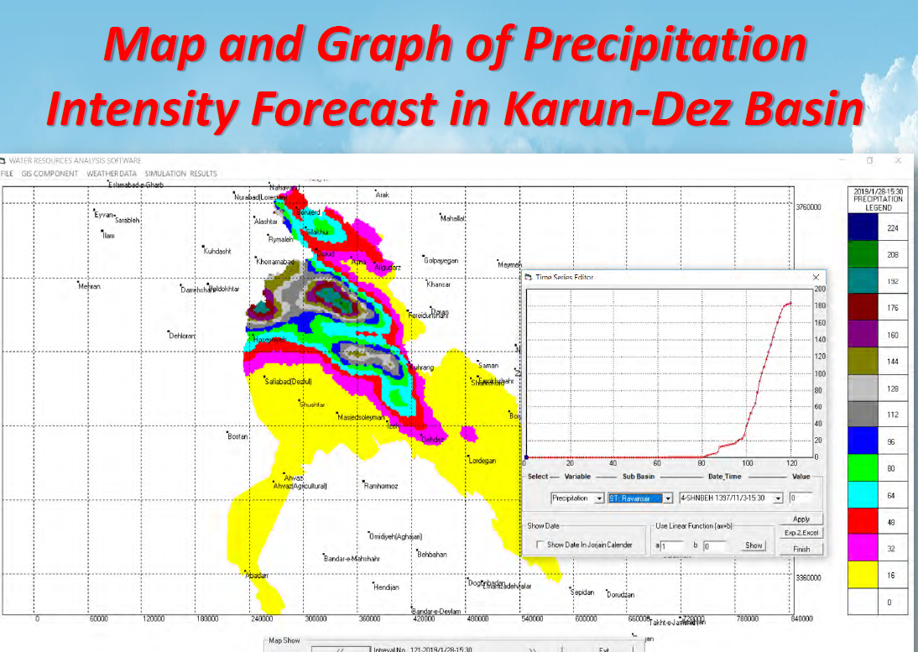
Flood forecast system based on numerical weather prediction

Slide 7
Problems you have in producing?
Computational power limitation
Limited access to new technologies ( radar, satellite image etc.)
Limited access to international weather data bases

