Slide 1
South Africa – products and services
Session 7
Lucky Dlamini
Lebohang Melato
Sandile Ngwenya
Innocent Mbokodo

Slide 2
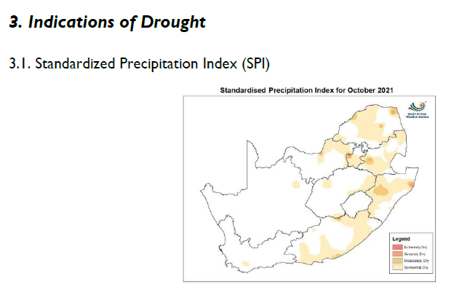
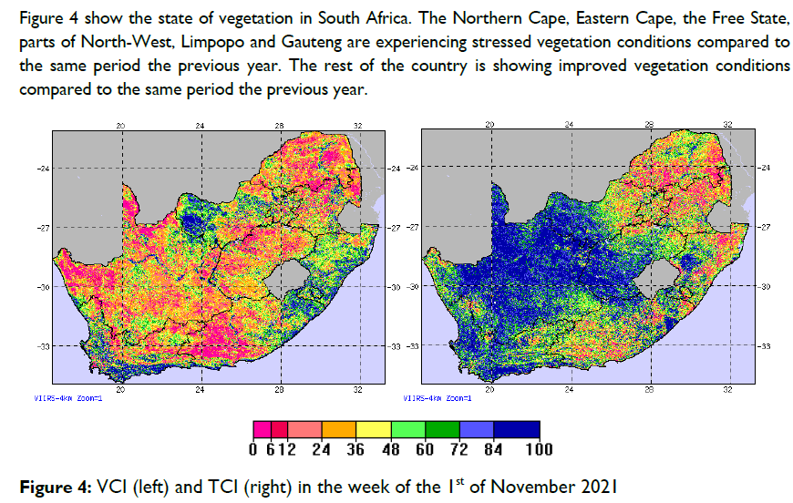
Climate outlook forums
Drought monitoring desk
  Drought bulletin is published monthly
  Using SPI, VCI and TCI

Slide 3
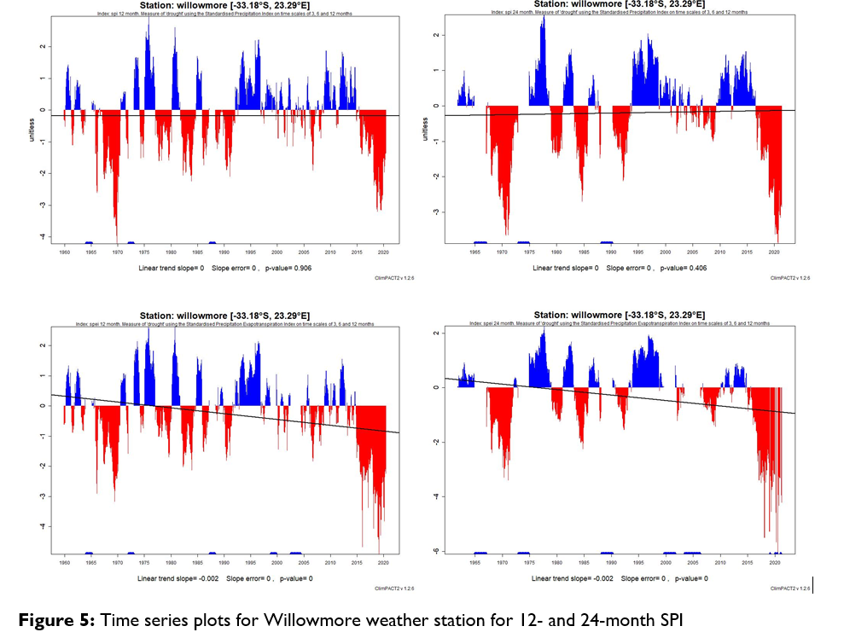
Drought monitoring desk
  We also zoom into the drought stricken Areas and calculate SPI and SPEI (12 and 24 months to better understand the dynamics the drought in regions.

Slide 4
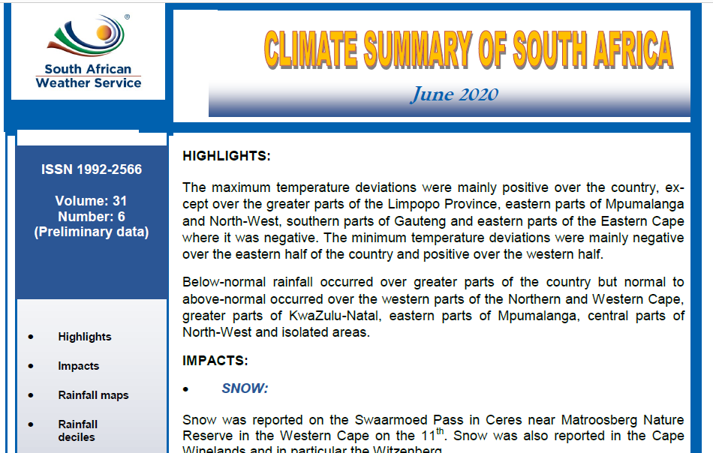
Climate Summary
  This publication gives a general overview of the climate of South Africa

Slide 5
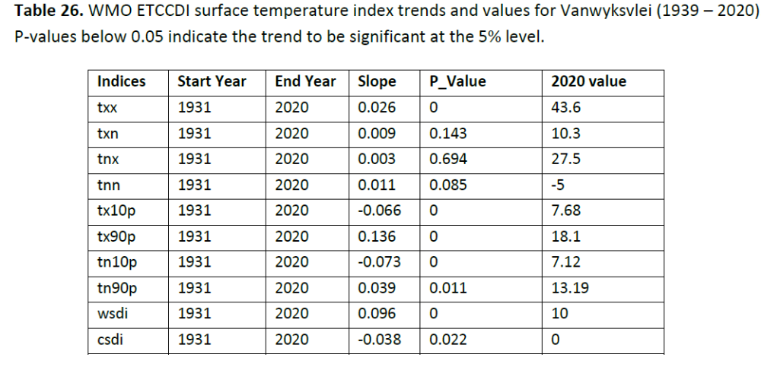
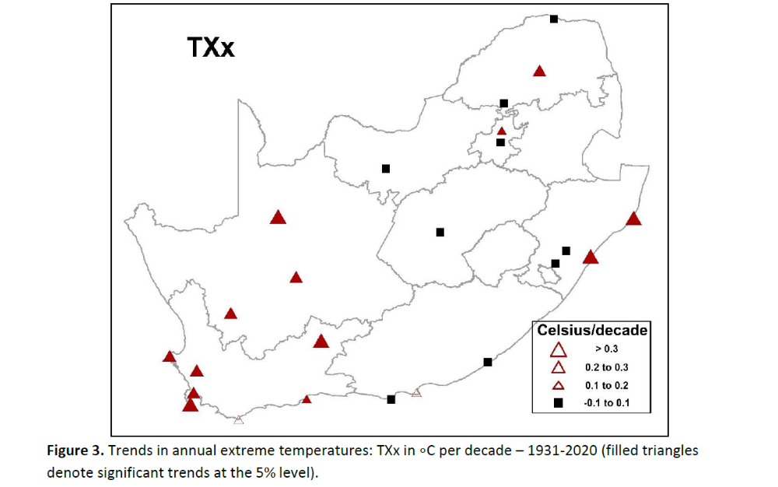
Extreme climate indices
  The South African Weather Service (SAWS) provides updates of the WMO Extreme Climate Indices on an annual basis.
  The indices provide a general impression of the trend in weather and climate extremes in South Africa, with the latest index values included in the report for comparative purposes.

Slide 6
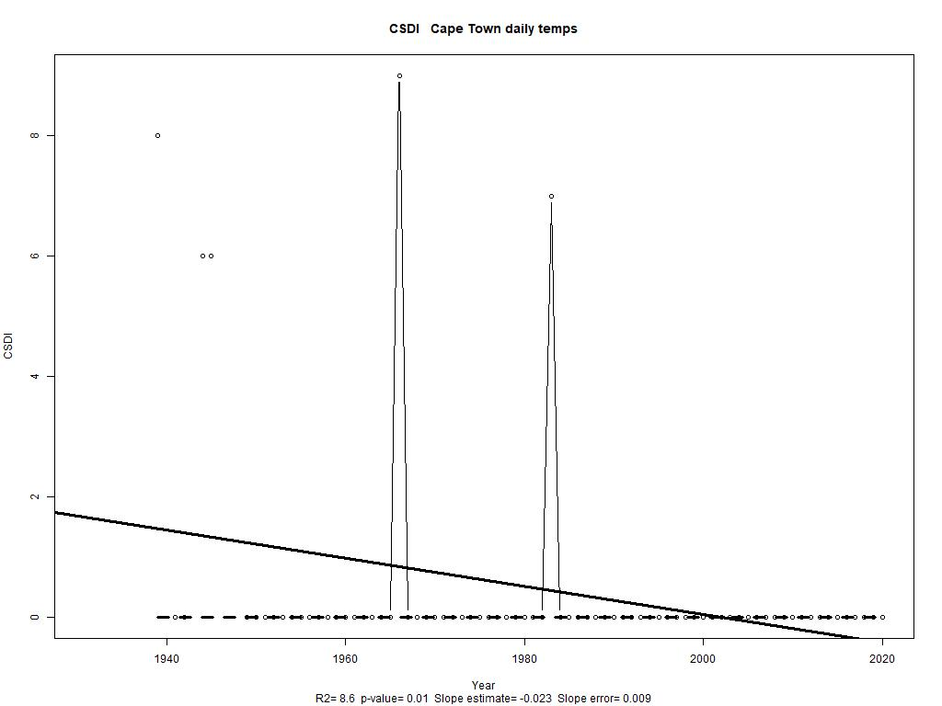
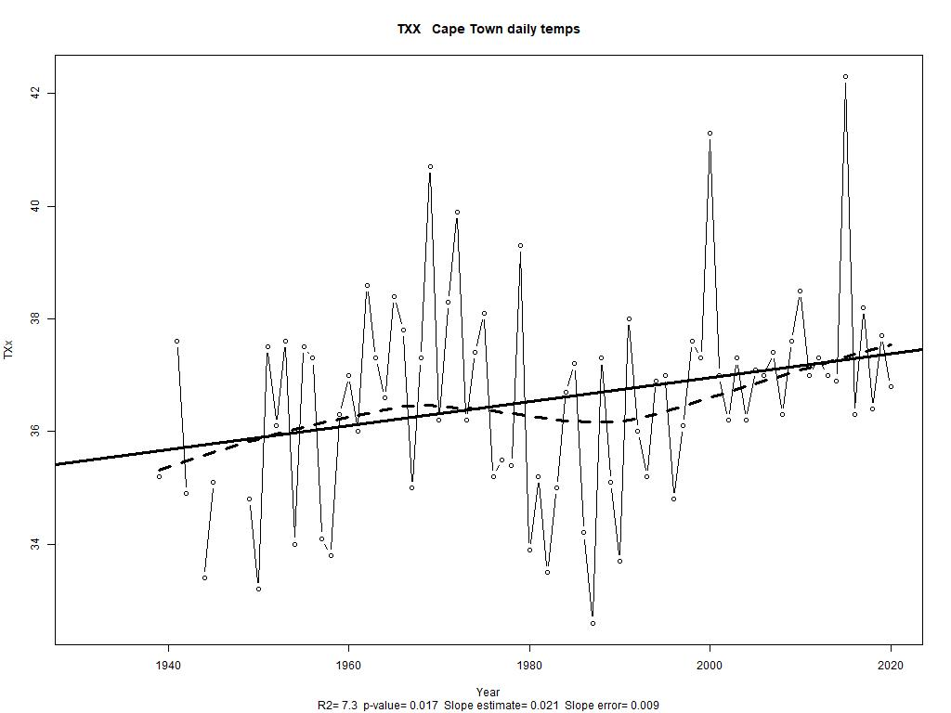
Examples of some of the Indices we calculate
Monthly maximum value of daily maximum temperature
Cold spell Duration Index

Slide 7
Regional product - Southern Africa Flash Flood Guidance Early Warning system.
QC processes for data used
  The QC process is based on the thresholds which are dependent on the location, climate of the region and altitude.
Do we rescue data:
  Information on the old climate returns (back dated to 1800) are being digitized.
  The challenges are that the data is first converted from the old units of measurement and that there is not enough capacity.
How is our data obtained by the public?
  On our website
  Via request from the Climate Information office

Slide 8
Other common challenges
For the manual stations, we have challenges to disseminate data in real time since we still need to transport all climate returns (Hard copies) from different regions across the country to SAWS offices where it will be captured, QC’ed and archived.
For automated stations, allocation of spares is a challenges with results in loss of data (Looking at a new strategy to minimize loss which is due to this).
Network challenges: Whenever our network providers (e.g. MTN) are down we also lose data.

