Slide 1
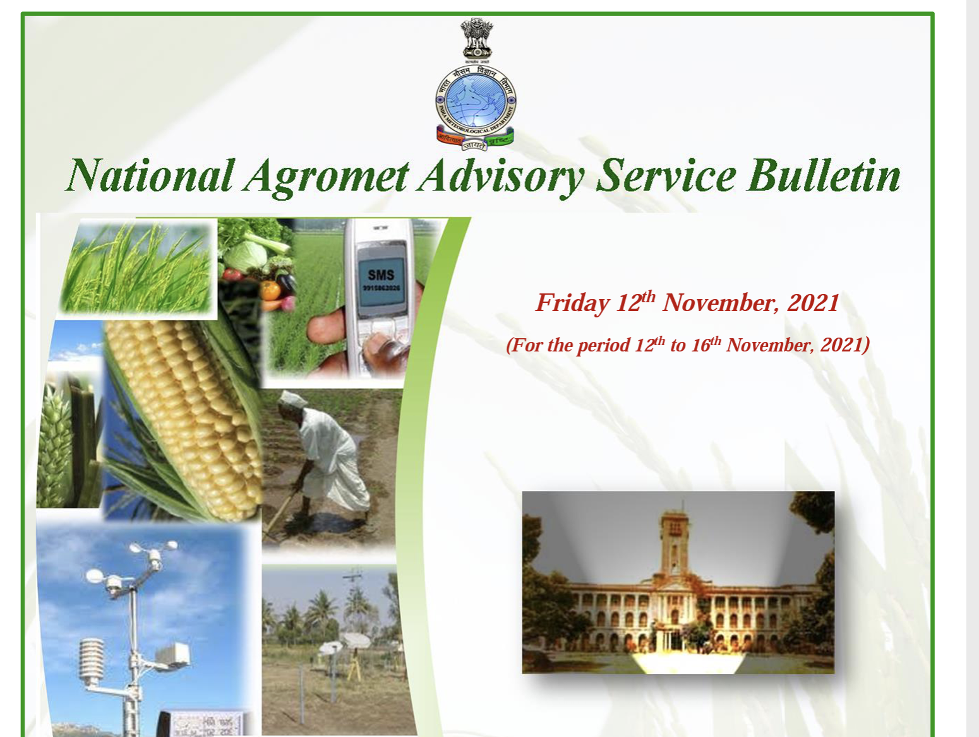
Climate products and services
Sectors | Products | Services
Agriculture | NDVI, Vegetation condition index, SPI and SPEI temperature condition index, soil moisture, ET | Agromet bulletin for farm advisory (communicating to farmers)

Slide 2
Problems and challenges
Challenges in the high resolution forecast
Observational network
Accuracy forecast
Outreach and dissemination of the information on real time

