Slide 1
South Africa
Session 6
Lucky Dlamini
Lebohang Melato
Sandile Ngwenya
Innocent Mbokodo

Slide 2
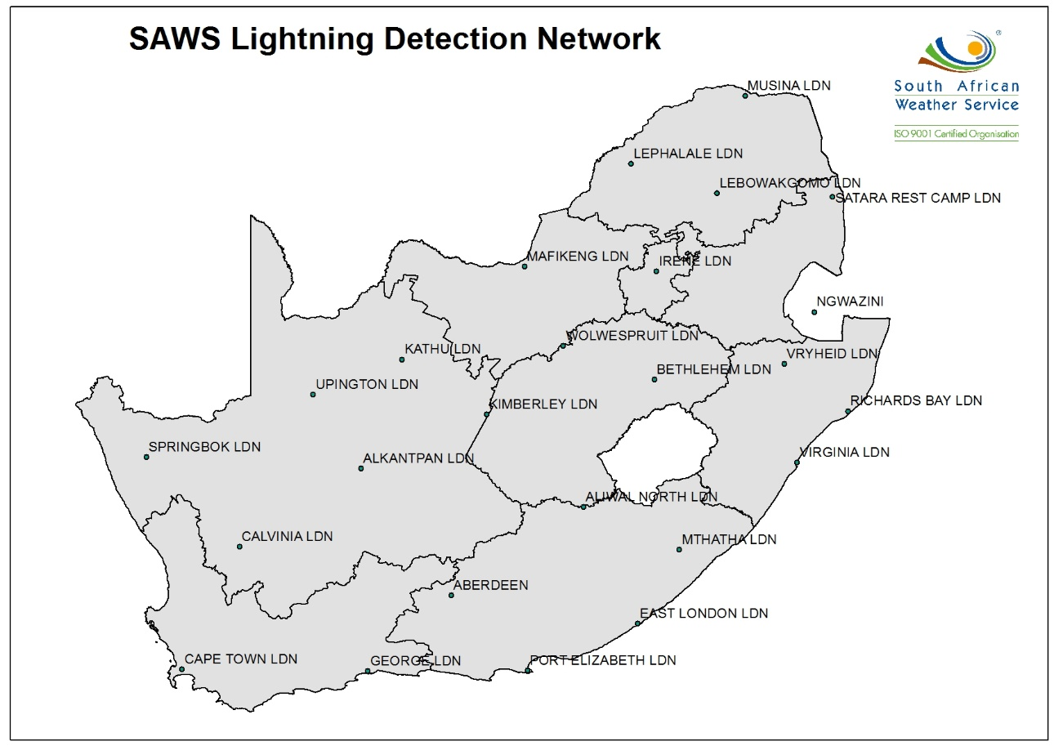
Products provided to the public
Lightning verification report
  25 lightning detection stations all over the country.
  FALLS Viasala software used to analyse the data.

Slide 3
Lightning verification report
  Mostly requested by Insurance companies (e.g. Santam) to determine whether to pay their clients claim out.
    Clients gave us feedback that our reports are too detailed and scientific and what they would really want is a report that says there was lightning or not, but what they fail to understand is that the information can be used by lightning specialist to further elaborate on whether the strike could have caused damage. This type of report is provided to clients who request and make payment for it.
  Data can also to used to determine whether a building needs lightning protection instruments to be installed to prevent lightning damage.

Slide 4
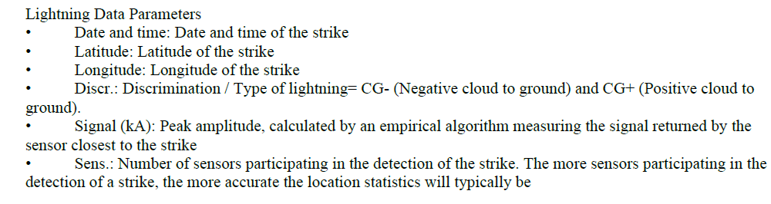
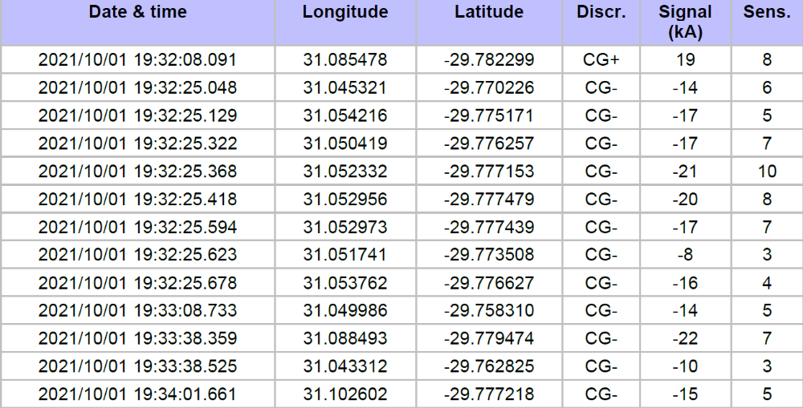
Example of a lightning verification report with lightning

Slide 5
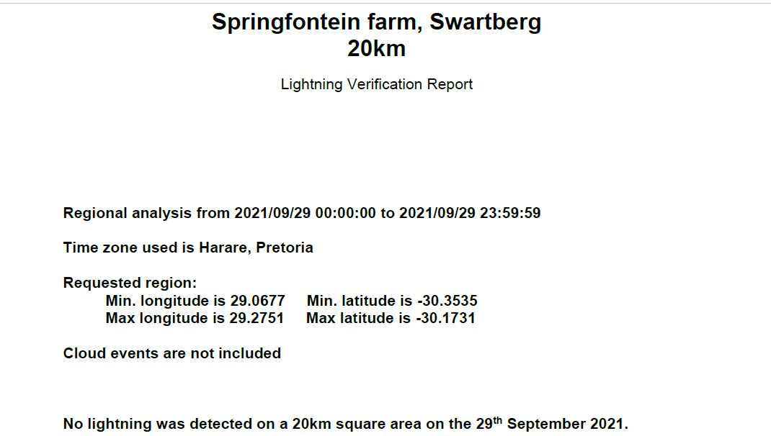
Example of a lightning verification report without lightning

Slide 6
Products provided to the public
SA Police Service
  They request rainfall data mainly to determine when a specific person was murdered. Due to heavy rainfall on the specific time when the body was found they might struggle to estimate the date of the incident as the body might have decomposed beyond recognition. So the rainfall data will be used to narrow down their time-line.
Construction
  They also use this information to claim back the number of days it rained, thus affecting their construction schedule.

Slide 7
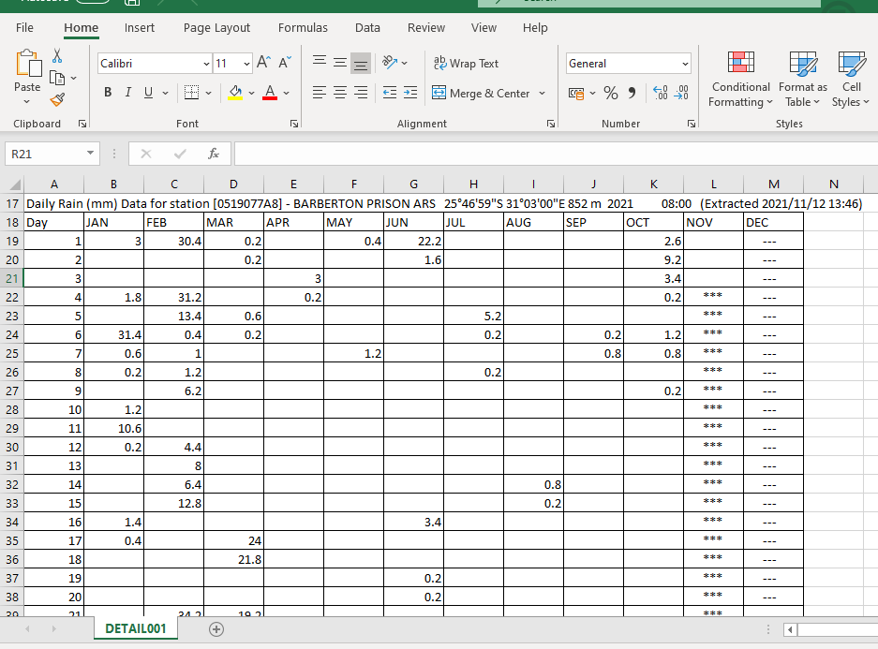
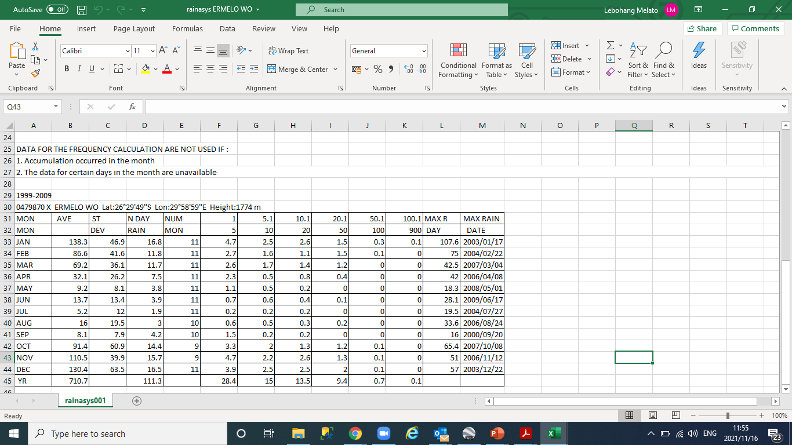
Example of rainfall report
Clients are very happy with this report as it is exactly what they need.

Slide 8
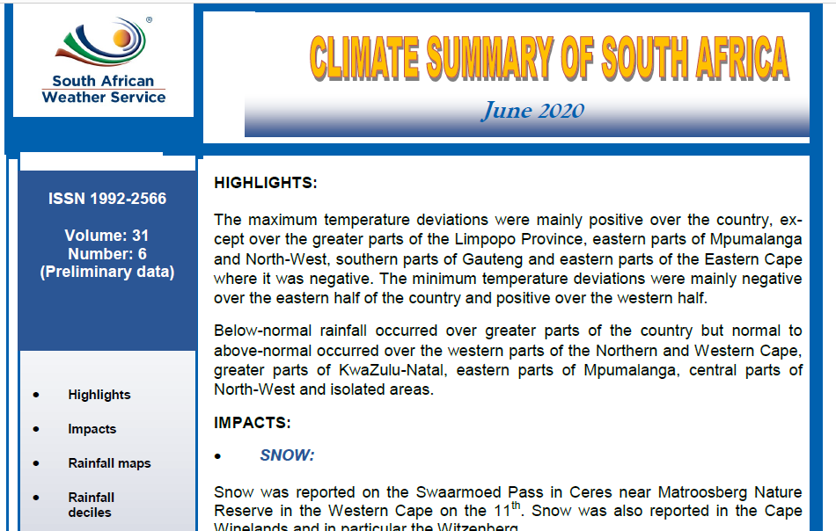
Products provided to the public
Climate summary
  Gives climate overview for the specific month issued

Slide 9
Product provided to
Agricultural Research Council, Universities, Libraries and Researchers

Slide 10
Products provided to the public
Caelum
  This report is where we recorded all reported weather events, impacts and locations .
  It is used to understand climate of South Africa and most dominant weather events and impacts at particular places. This helps decision makers (municipalities and governments) to make informed decisions.
  To conduct case studies
  To verify impact based forecast (warning and advises given prior)
  To be tailored based per sector

