Slide 1
Dealing with obstacles and action planning
Obstacles
Filling the gap between producers and users
Lack of proper dissemination
Scientific language to administrative decisions
Public awareness
Action planning
Inter-agency collaboration
Capacity building through universities (NGO workers, volunteers)
Involving Media
Every State government and city-level local governing bodies should start to work on improving issues towards changing climate that includes mitigation and adaptation.

Slide 2
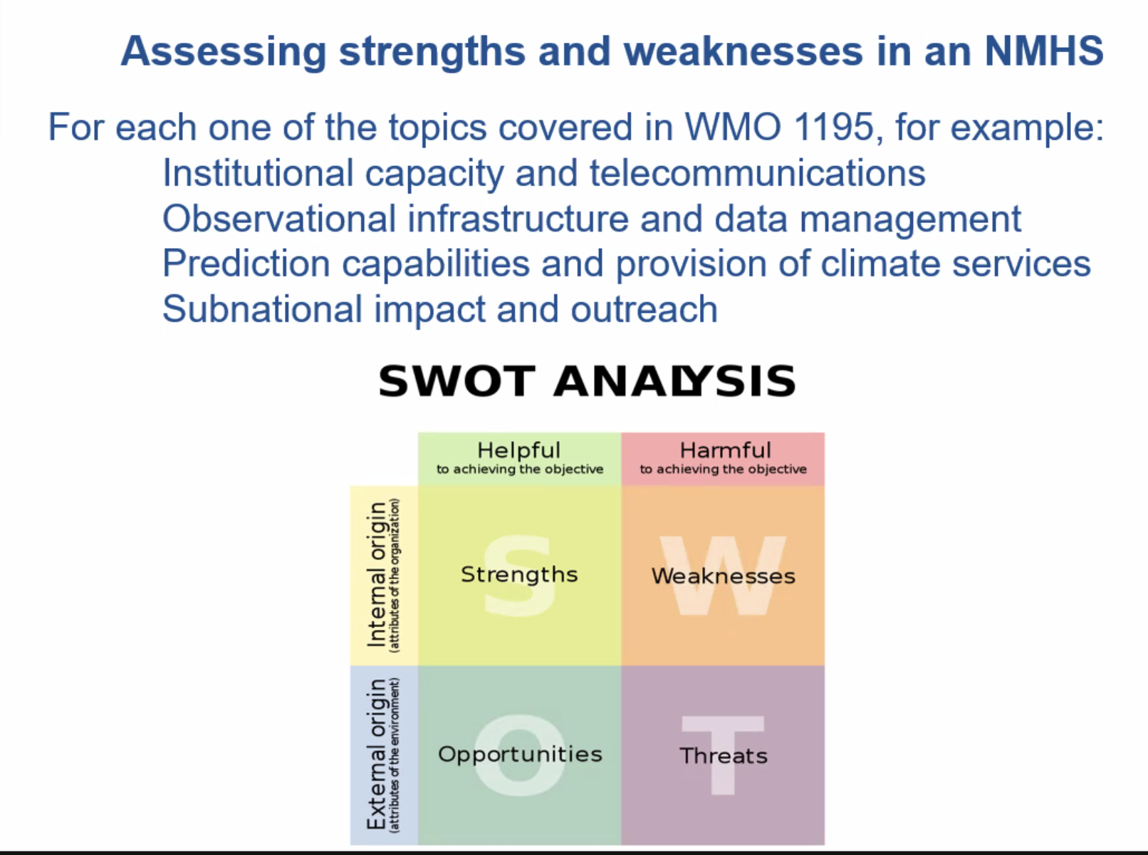
Assessing strength and weakness in NMHS
Strength
Coordination between RMC and MC (state offices), RCC
Observations: RADAR, satellite, AWS
Forecasts: various time and space scales, future projection
Social media
weakness
Demand for forecasts is high (location specific) which requires
Not having enough DEM data (all cities)
Forecast skills Long-lead forecast

