Slide 1

The WMO Reform to support the delivery of climate services: the role of the SERCOM Standing Committee on Climate Services (SC-CLI)
By Manola Brunet
SERCOM vice-president and Chair of the SERCOM/SC-CLI

Slide 2




WMO Strategic Plan
By 2030, a world where all nations, especially the most vulnerable, are more resilient to the socioeconomic impact of extreme weather, climate, water and other environmental events, and empowered to boost their
sustainable development through the best possible services, whether over land, at sea or in the air.
VISION 2030
OVERARCHING PRIORITIES
Enhancing preparedness for, and reducing losses of life and property from hydrometeorological extremes
Supporting climate-smart
decision-making to build resilience and adaptation to climate risk
Enhancing socioeconomic value of weather, climate, hydrological and related environmental services
CORE VALUES
Accountability for Results
and Transparency
Collaboration and Partnership
Inclusiveness and Diversity
LONG-TERM GOALS
Better serve
societal needs
Delivering authoritative, accessible, user-oriented and fit-for-purpose information and services
Enhance Earth system observations and predictions
Strengthening the
technical foundation
for the future
Advance targeted research
Leveraging leadership in science to improve understanding of the Earth system for enhanced services
Close the
capacity gap
Enhancing service delivery capacity of developing countries to ensure availability of essential information and services
Strategic realignment of WMO structure and programmes
Effective policy- and
decision-making and implementation
STRATEGIC OBJECTIVES
2020-2023 FOCUS
1.1 | Strengthen national multi-hazard early warning/alert systems and extend reach to better enable effective response to the associated risks
1.2 | Broaden the provision of policy- and decision-supporting climate information and services
1.3 | Further develop services in support of sustainable water management
1.4 | Enhance the value and innovate the provision of decision-supporting weather information and services
2.1 | Optimize the acquisition of observation data through the WMO Integrated Global Observing System
2.2 | Improve and increase access to, exchange and management of current and past Earth system observation data and derived products through the WMO Information System
2.3 | Enable access and use of numerical analysis and prediction products at all temporal and spatial scales from the WMO seamless Global Data Processing and Forecast System
3.1 | Advance scientific knowledge of the Earth system
3.2 | Enhance the science-for-service value chain ensuring scientific and technological advances improve predictive capabilities
3.3 | Advance policy-relevant science
4.1 | Address the needs of developing countries to enable them to provide and utilize essential weather, climate, hydrological and related environmental services
4.2 | Develop and sustain core competencies and expertise
4.3 | Scale-up effective partnerships for investment in sustainable and cost-efficient infrastructure and service delivery
5.1 | Optimize WMO constituent body structure for more effective decision-making
5.2 | Streamline WMO programmes
5.3 | Advance equal, effective and inclusive participation in governance, scientific cooperation and decision-making

Slide 3
SERCOM MG structure
SERCOM MG
Add MG members
A… Aura (RA 1)
B… Thompson (RA-4 pres)
C… Ungaro (RA5 &RB)
D… Xianghua (RA2)
E… RA5 TBC
P Lisk (6)
VP Simonov (6)
VP Brunet (6)
VP Stone (5)
SC-DRR
SC-HYD
SC-MMO
SC-AVI
SC-CLI
SC-AGR
Moraes (3)
Hasegawa (2)
Simonov (VP)
Quirno (3)
Cuff (4)
You (2) & Parker (4)
Lisk (P)
Khambule (1)
Johnson (4) [non-MG]
Brunet (VP)
XXX (X) & Driouech (1)
Stone (VP)
Mateescu (6)
ETs
CHE (Cataloguing Hazardous Events)
GMAS
WCM (Humanitarian)
MIE (Interoperability)
MTG (Tech guides)
GSD (PWS)
Focus Areas
Coordination with HCP
ETs
Coastal & Emergency Response
Maritime Safety
MO Requirements
Cap Dev & competencies
+ TT Cost Options
+ WWMIWS Sub-C
Coordination with JCB
ETs
ETC (Personnel)
MHS (Hazards)
CCV (Climate change impacts)
VSA (Volcanic)
+ Focal Points
ETs
CMA (Monitoring)
DRC (Requirements)
CSISO (Services & Ops)
CID (CLI iIfo for Decision making)
CDC (Cap Dev)
Coordination with CCP
ETs
AAS (Services)
ASC (Science)
DRG (Drought)
ARM (Risk Mgt)
ACD (Cap Dev)
+ TTs TBA
MG Composition
18 members (+VP & 1 additional TBC)
44% women
RA1 3
RA2 3
RA3 3
RA4 3
RA5 2
RA6 4
SG-HEA
SG-ENE
SG-URB
Trttanj (4) & Campbell-L (WHO)
Troccoli (5)
Fuchs (6)
Chair TBC
VC TBC
SC-CLI composition
21 members
43% women
RA1 3
RA2 2
RA4 5
RA5 4
RA6 6

Slide 4
Substructures of the Standing Committee on Climate Services (SC-CLI)
International leadership for WMO Climate Monitoring and Assessment activities at the Global and Regional scales & leadership for WMO flagship climate products
ET2 - Data Requirements for Climate Services (ET-DRC)
Responding to the increasing needs for high quality and fit-for -purpose data for various climate applications & achieving modern standards for climate data management…
ET3 - Climate Services Information
System Operations (ET-CSISO)
Climate products and services provision for policy and decision making through a Climate Services Information System at regional and national levels, guidance sector-specific and user-tailored climate products and services, CLIMPACT
ET4 - Climate Information for Decision-Making (ET-CID)
ET5 - Capacity Development for Climate Services and Communications (ET-CDC)
Development and implementation of user-centric approaches for generation and exchange of climate data, climate monitoring, climate prediction and climate projection products & guiding regional climate prediction, CST…
Human Resource Development, quality management and communication of Climate Services, BIP-CS, Competency Assessment, training materials...
ET1 - Climate Monitoring and Assessment (ET-CMA)

Slide 5
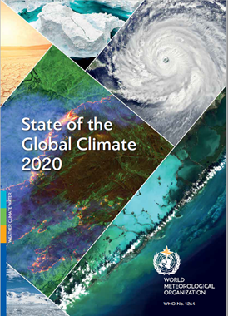
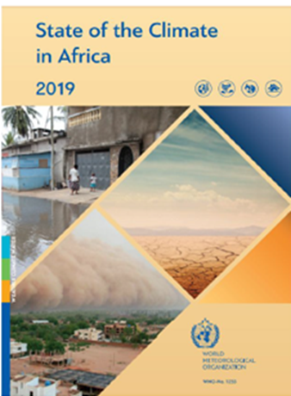
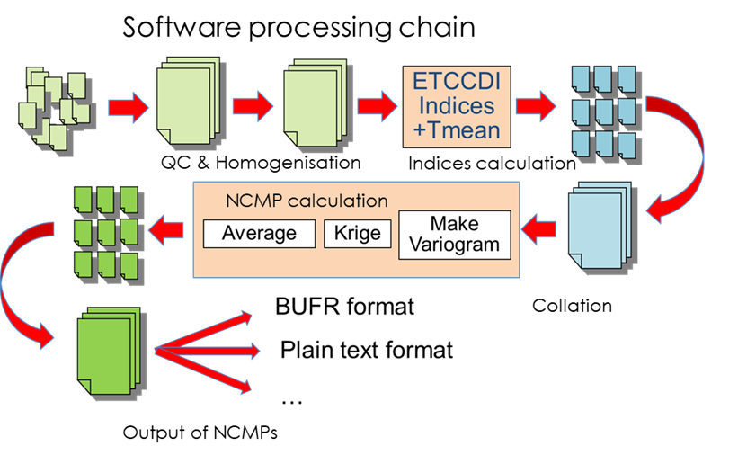
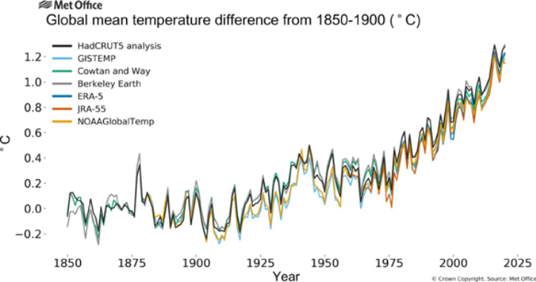
Objectives and some products supporting adaptation from ET1 - Climate Monitoring and Assessment
Promote fit-for-purpose climate monitoring applications including climate analysis, NCMPs and watches derived from in-situ observations, reanalysis, satellite and other emerging data sources
Provision of expert leadership for and review of the WMO flagship climate products in support of climate policy and actions globally, and guidance for similar publications produced at the regional and national levels

Slide 6
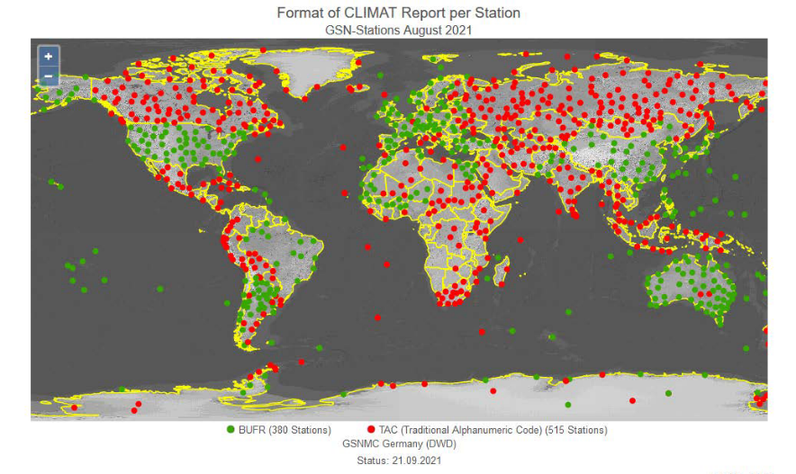
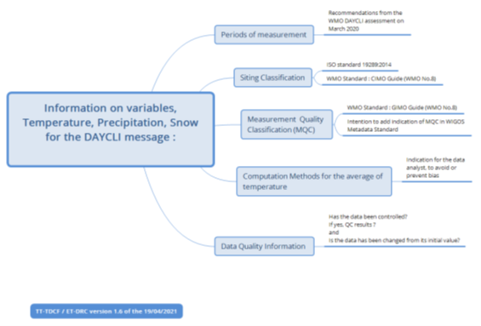
Activities and products from ET2 - Data Requirements for Climate Services
Recognition mechanism for long-term observing sites
Gathering and compiling climate normals (CLINO)
Implementing daily climate messages (DAYCLI)
Defining DARE Strategy
Updating the HQ-GDMFC Manual & reviewing WMO Climate Data Catalogue regionally and nationally
Developing OpenCDMS as a framework for working together to improve the Earth system data management

Slide 7
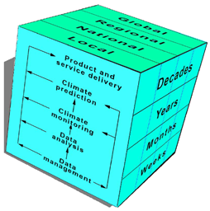
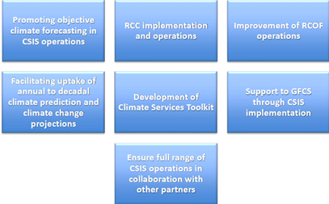
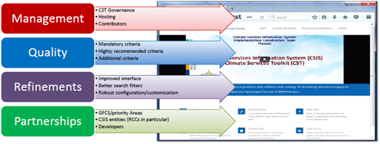
Activities and products for adaptation from ET3 - Climate Services Information System Operations
Producing the CSIS Technical Reference doc
Fostering CSIS Integration into GDPFS & Identifying National CSIS Focal Points
Guidance on establishment and operation of WMO RCCs & RCC Performance Assessment
Promoting next generation of RCOFs
Operationalization of the Global Seasonal Climate Update & Annual to Decadal Prediction, including ENSO Information System Portal
Fostering usage of the Climate Services Toolkit
Guidance on S2S Prediction at national levels

Slide 8
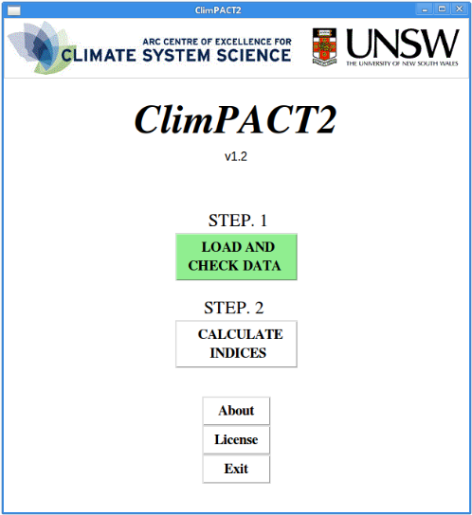
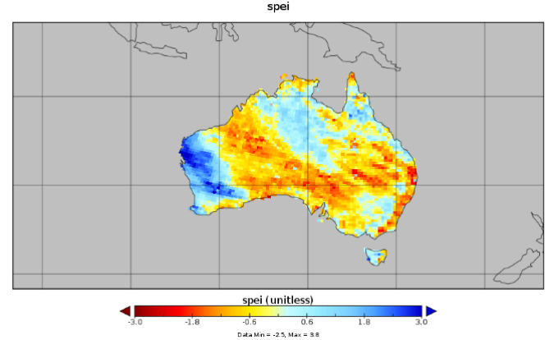
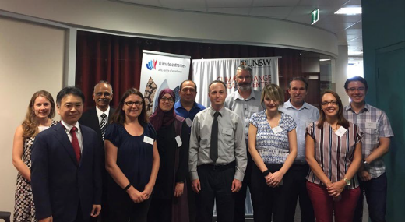
Objectives and tools to support adaptation from ET4 - Climate Information for Decision-Making
Provide climate products and services for policy and decision making through CSIS at regional and national levels
Guidance on sector-specific and user-tailored climate products and services
Making operational online version of ClimPACTv3, a software for quantifying climate extremes for sector applications
Concept and technical guidance for regional Climate Risk Management workshops
Guidance on establishment and operations of NCOFs/NCFs

Slide 9

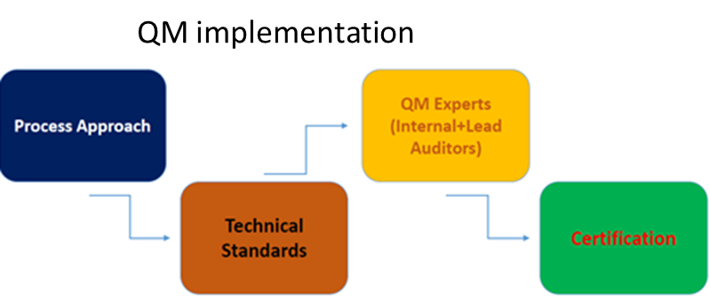
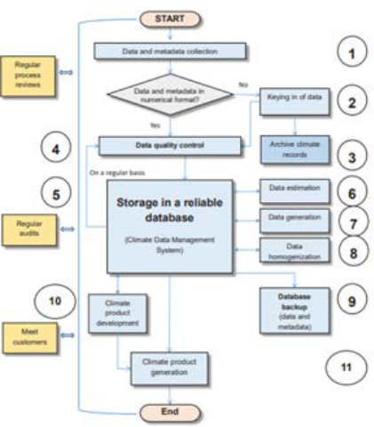
From ET5 - Capacity Development for Climate Services and Communications: training, communication and guidance
Basic Instructional Package for Climate Services (BIP-CS)
Guide to Competency Assessment Framework for Climate Services
Repository of Training Materials
4th Edition of the Guide to Climatological Practices (WMO 100)
Compiling Good Practices in Communication of Climate Information
Twinning experiment ISO certified NMHSs

Slide 10

Thank you

