Slide 1

Developing partnership for using climate data
WMO ClimAdapt Workshop 8-19 Nov. 2021
2021. 11. 18.
Jin Ho Yoo

Slide 2
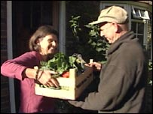

Using climate information
≠
By definition, it requires engagement of different players

Slide 3
Partnership
Partnership between climate groups
  Domestic
  International
Partnership between climate and other groups
  Domestic (mostly)
  International
Who are the players?

Slide 4
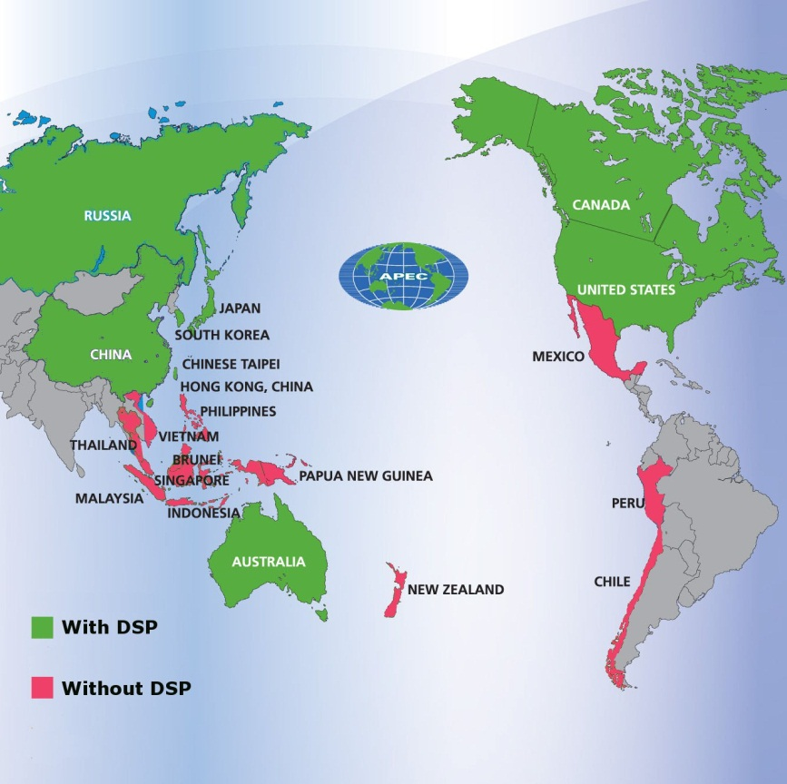
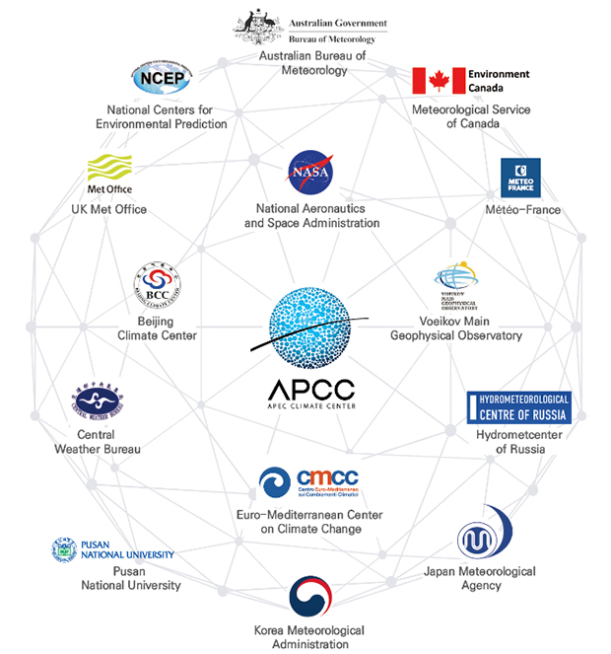
APEC Climate Center
Initiated as a Center for Climate Science and Predicton
  Facilitation of regional climate information exchange among APEC member economies
www.apcc21.org

Slide 5
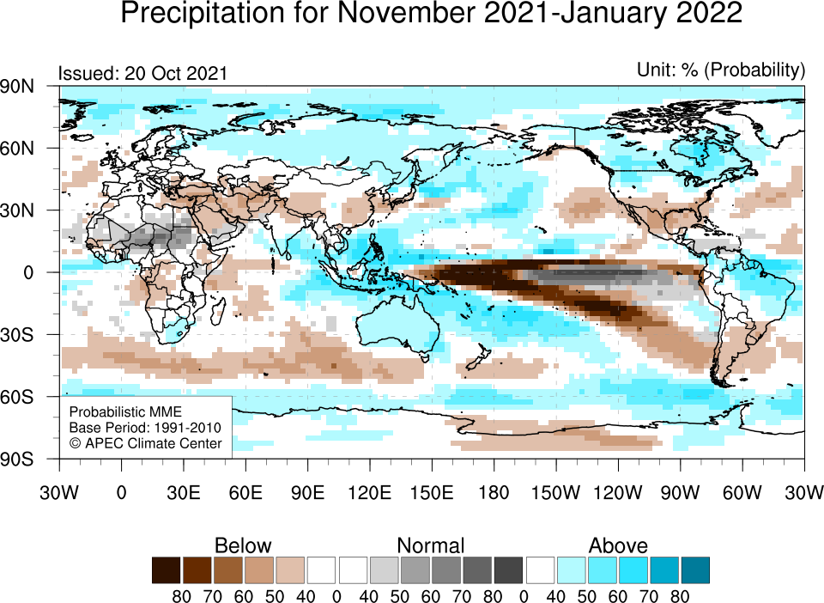
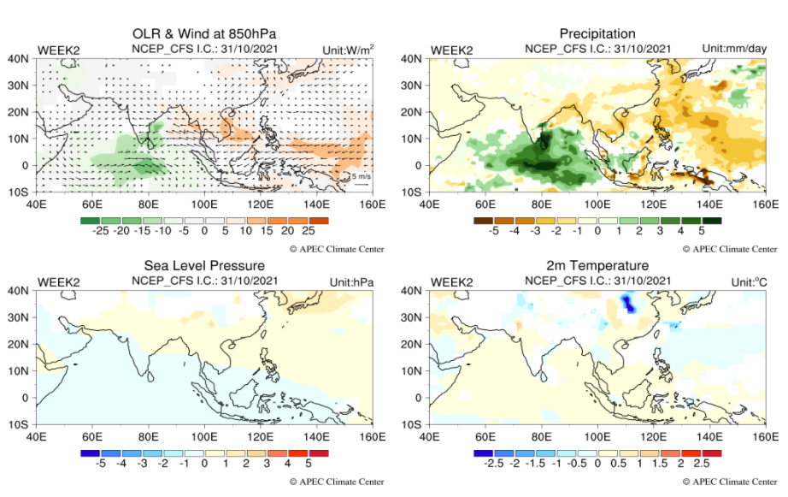
Products (seasonal and subseasonal)
• Multi Model Ensemble seasonal forecast (upto 6 months)
• BSISO (Boreal Summer Intraseasonal Oscillation) forecast

Slide 6
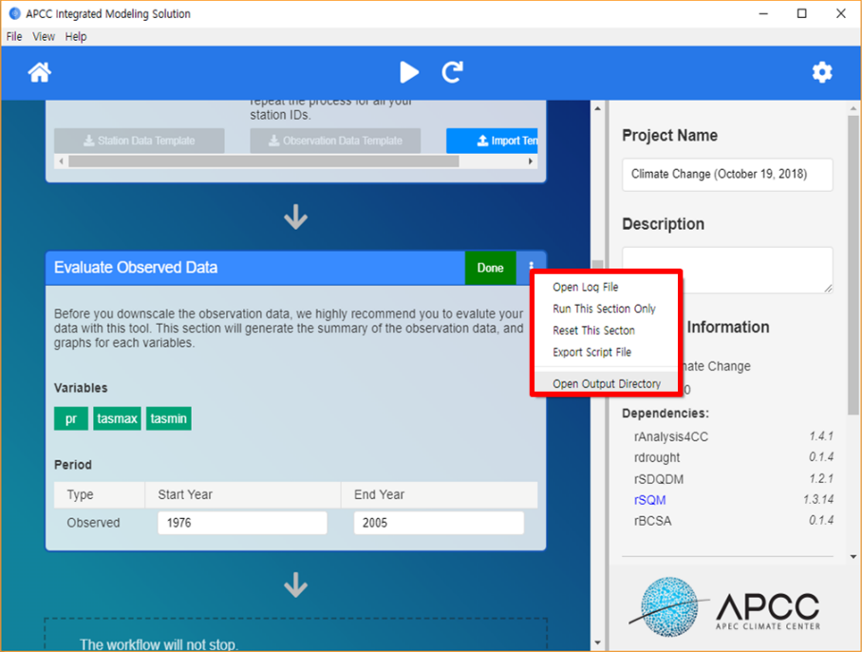
Tools
Online Downscaling tools and data provision
  CLIKs : Seasonal forecast (pattern driven regression based)
  AIMS : climate projection (for sector application)
APCC Integrated Modeling Solution
rSQM
rAnalysis4CC
rSDQDM
...
rDrought
BCCA
...
rS2S
SWAT
rSForecast
DSSAT
SBC, MWR,
CIR, MWR-Obs
Python

Slide 7
Partnership #1
Domestic Partnership between climate groups
KMA - APCC
APCC supports operational climate prediction activity of KMA via
  Climate monitoring/analysis/provision of forecast guidance (weekly discussion)
  Developing updated methods for long range forecast

Slide 8
Partnership #1
Domestic Partnership between climate groups
Sharing tasks/roles/support
NHMS, Academia
Pro : sustainability, communication
Con : sometimes being competitive, similar capacity

Slide 9
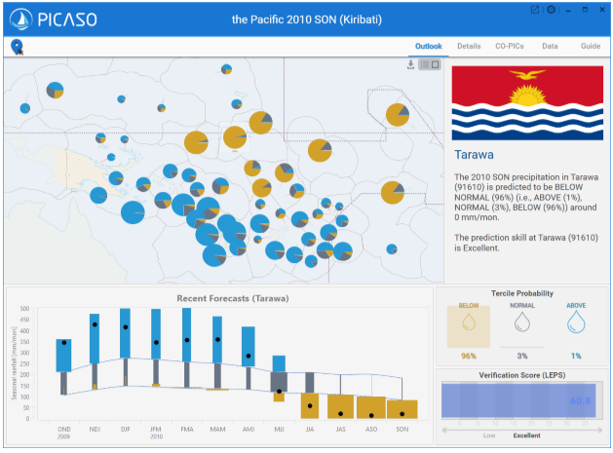
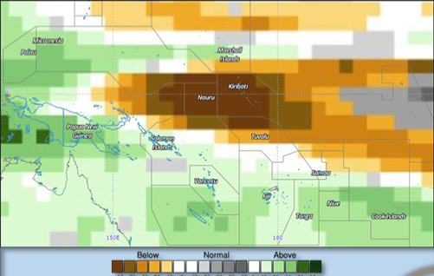
Partnership #2
International partnership between climate groups
APCC-NHMSs in Pacific Islands Countries
APCC developed seasonal rainfall forecast tool for Pacific (PICASO)

Slide 10
Partnership #2
Initiated by a 3yr-project
Ownership : PICASO run by Pacific agency
Sustaining mechanism : APCC involves RCOF as RCC partner
Follow up : high level recognition (Ministers) and GCF project for further development of the tool

Slide 11


Partnership #2
International partnership between climate groups
Technical support/Temporary role sharing
NHMSs, GPCs, Oversea Academia
Pro : Capacity building
Con : Sustainability, output
vs

Slide 12
Partnership #3
Domestic Partnership between climate and other group
APCC vs Water Resource manager
APCC provides downscaled rainfall forecast of next season to manage drought condition
KMA- WRM discussion is major channel
Not sure it is satisfactory (but they keep asking!)
  Probably, it is included their SOP
  They didn’t welcome further intervention such as developing methods of forecast based dam operation

Slide 13
Partnership #3
Domestic Partnership between climate and other group
Provider vs User
NHMS, Governments (other sectors), Public and Private sectors…
Pro : If it works well, that’s what we wanted
Con : Usually not working…

Slide 14
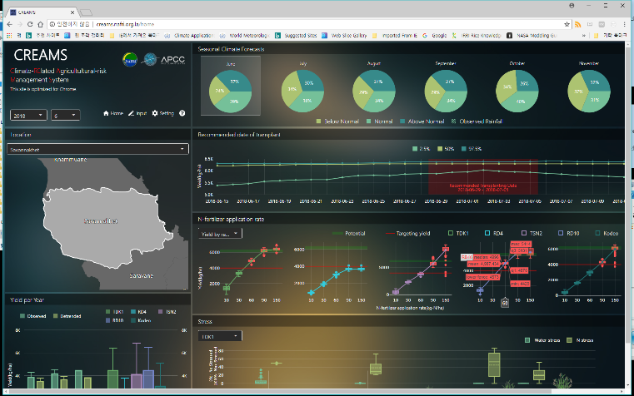
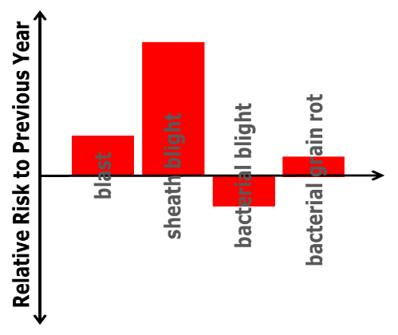
Partnership #4
International partnership between climate and other groups
CREAMS (Climate RElated Agricultural risk Management System) : 1vs1
Seasonal Pest outlook : Multi to Multi
Seasonal yield outlook
Provide crop management options
Monthly update for Agri. agency
Seasonal Pest Outlook
Seasonal Climate Forecasts
Rice Pest Model
Spatial/Temporal
Downscaling
Process-based/
Empirical Models
up to 3m lead
temp., prec., …

Slide 15
Partnership #4
International partnership between climate and other groups
Project based (mostly)
NHMSs, many players (Aid agency, Tech., Consultants…)
Pro : Capacity building/Experiencing end to end
Con : sustainability, delaying

Slide 16
Developing Partnership
between provider and user (3rd partnership)

Slide 17
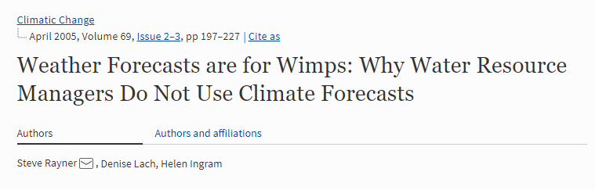
Barriers
Credibility (reliability) of forecast information
Relevance of information for the decision context
Awareness or Accessibility of information
Institutional tendency (culture?) of users
How to create “early adopters” of climate information? : clear reward

Slide 18
Tailoring climate information
Transforming information to enhance relevance (and reliability)
Scale : Climate info. >> user interest
  Statistical downscaling
Form (output) : lack of knowhow to use the info.
  Statistical analysis of model output
  Impact modeling
Anticipated Change
Assessing impact
Action

Slide 19
Issues in tailoring
Distortion of Information
  Mismatch between Downscaled information and Original information
  Maintain main “message” of Original output
  Cautious and Physically sound calibration (e.g. systematic error correction)
Uncertainty
  Impact model may add uncertainty (use multi models)
  Does it matter?
  Strategic communication and/or co-production

Slide 20

Review on ENSO may be interesting
Testbed for climate prediction in decision making
Climate info. without Tailoring
What make ENSO info. be perceived as ‘useful’ info.
  Celebrity
  well predicted (and studied)
  well evaluated impacts

Slide 21
We need to be prepared
To enhance uptake of climate information in decision making, transforming (tailoring) of information is needed
  Scales, Form of information matter
Not only information contents but also credibility and valuation are important
Fundamental aspect of forecast info.
Reward to create early adopters

Slide 22
To be clear
What do you want to achieve through the partnership?
  Small and clear victory is better
What does your partner want (can you give it to them?)
  You have to listen first and don’t be frustrated
(most important) How to maintain partnership?
  Meeting Mechanism (NFCS?)
  Key person (at least for initiation)
  Passion (minimal maintanence)
  Legislation/SOP

Slide 23

Thank you
jhyoo@apcc21.org

