Slide 1


Nigerian Meteorological Agency(NiMet) presentation

Slide 2
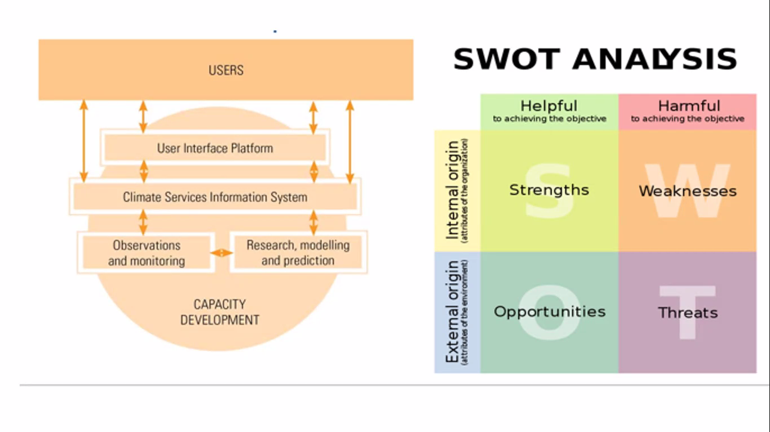
Technical resource
Nigerian Met. Agency(NiMet) is the custodian of weather and climate data and climatic information of Nigeria.
NiMet climate observation archive contains key indicators of state of climate at the earth surface, atmospheric composition and Ocean, these data include; Temperature, Precipitation, Marine information etc.

Slide 3
Technical recourses to access climate Risk
This Monitoring and forecasting covers wide range of Meteorological elements e.g. Seasonal Climate Forecast(SCP), Climate review and forecast bulletin, Climate and heath bulletin, monthly and seasonal climate forecast, Extreme weather bulletin, Agro-met bulletin, Drought monitoring bulletin, Marine Bulletin etc.

Slide 4
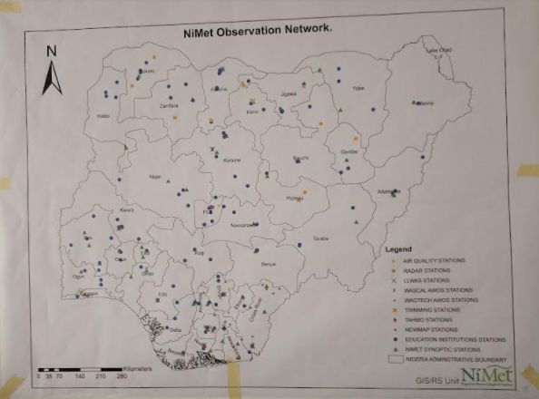
Weakness
More network of
station needed

Slide 5
Thank you for your audience!!

