Slide 1
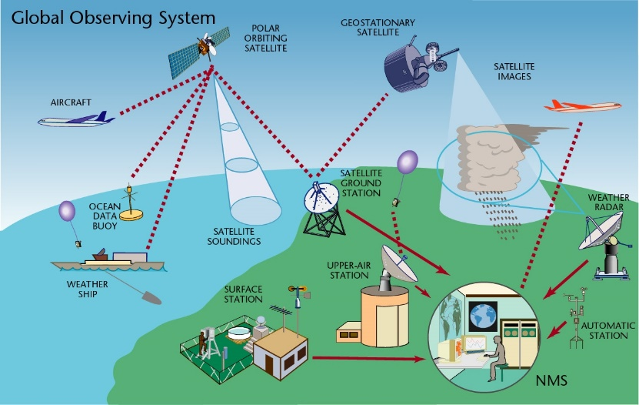


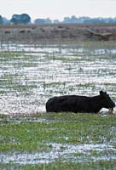
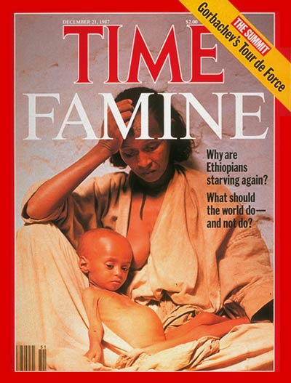
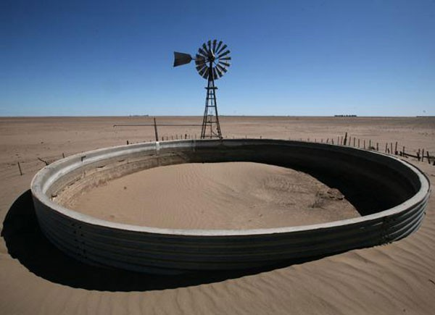

Growing demand for climate information

Slide 2
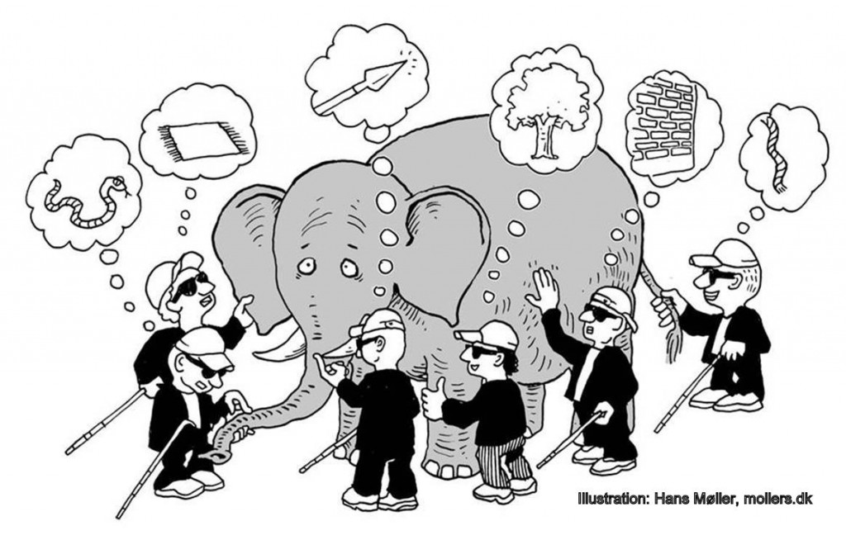
But… what is “climate information”?

Slide 3
What are climate services?
Climate services comprise scientific information and data on the climate of the past, present and future, as well as its consequences. These services serve as the basis for decision-making that takes account of climate issues. Climate services can help the government, political and business sectors and society to minimize climate-related risks, recognize opportunities and optimize benefits and costs.
Swiss National Center for Climate Services

Slide 4


Slide 5
Main points
Climate information that is not used has NO value (economic, social)
  “used” -> influence possible changes in decisions
Some conditions that enhance use of climate information?
  There are “entry points” for info
  Other decision contexts are considered (e.g., economic, technological, cultural)
  Relevant for decisions -> fits needs
Main interest is on likely impacts
  Collaboration with sectoral experts is needed

Slide 6
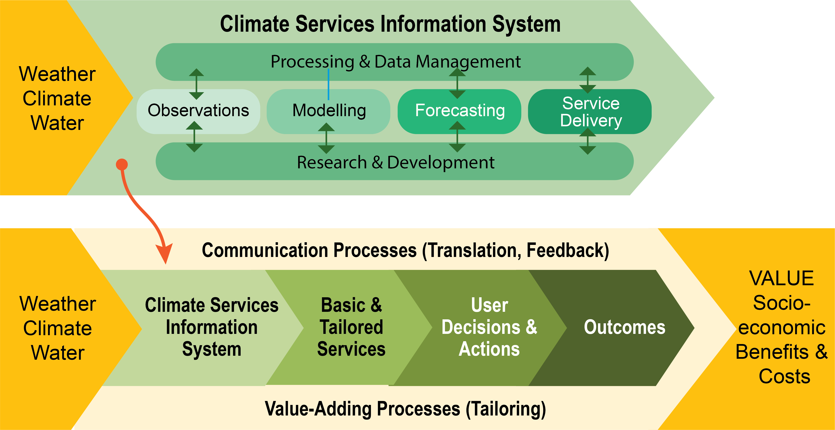
Climate information value chain

Slide 7
Main points
Climate information that is not used has NO value (economic, social)
  “used” -> influence possible changes in decisions
Some conditions that enhance use of climate information?
  There are “entry points” for information
  Do not ignore other decision contexts (e.g., economic, technological, cultural)
  Relevant for decisions -> fits needs
Main interest is on likely impacts
  Collaboration with sectoral experts is needed

Slide 8
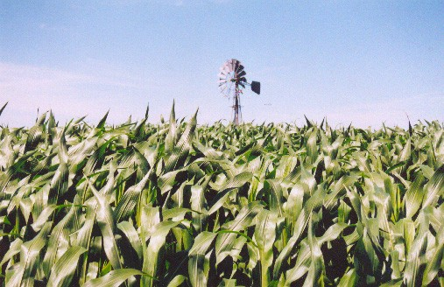
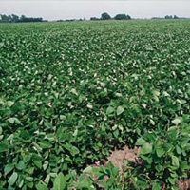
“Entry points” for climate information
Decision stages in an extensive cropping system in Argentina
Land
Allocation
Planting Date
Fertilization
Rate
…
High Fertilization
Early
Planting
…
Low Fertilization
Maize
Maize
Late
Planting
…
Soybean
Soybean
…

Slide 9
Interactions between decisions and climate
Climate Scenario A
Climate Scenario B
Decision
Contexts
…
…
Decision
Outcomes
Agronomic Decisions

Slide 10
Interactions between decisions and climate
Time of Decisions
Historical climate
Current conditions
Expected climate
(future conditions)
Climate Scenario A
Climate Scenario B
Decision
Contexts
…
…
Decision
Outcomes
Agronomic Decisions

Slide 11
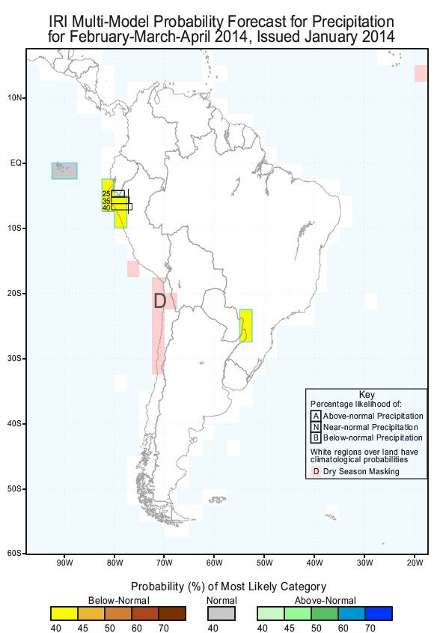
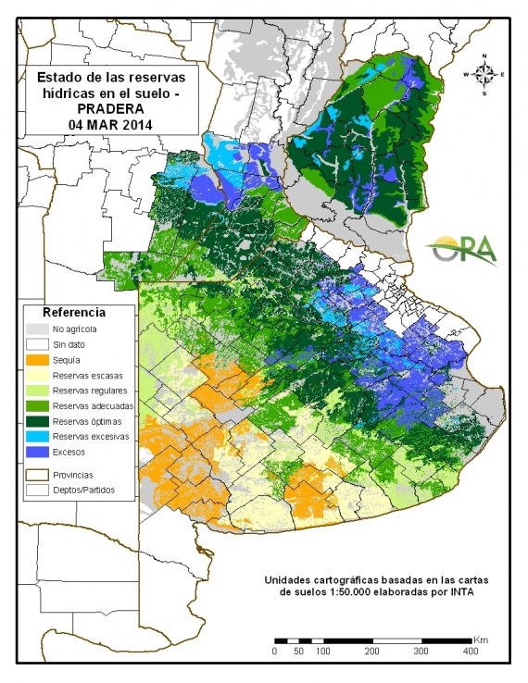
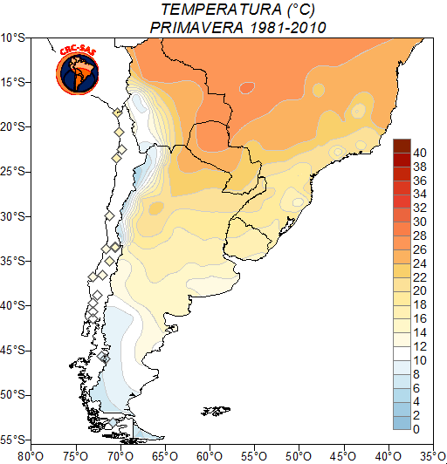
Various types of climate info are useful
Forecasts
Diagnostics
Beware of forecast-centric focus!
Historical record
Forecasts
Diagnostics
Historical record

Slide 12
Main points
Climate information that is not used has NO value (economic, social)
  “used” -> influence possible changes in decisions
Some conditions that enhance use of climate information?
  There are “entry points” for information
  Do not ignore other decision contexts (e.g., economic, technological, cultural)
  Relevant for decisions -> fits needs
Main interest is on likely impacts
  Collaboration with sectoral experts is needed

Slide 13

Just because we can…

Slide 14

What does “relevance” mean?
Climate services and products
Needs, expectations, current protocols

Slide 15
Main points
Climate information that is not used has NO value (economic, social)
  “used” -> influence possible changes in decisions
Some conditions that enhance use of climate information?
  There are “entry points” for info
  Do not ignore other decision contexts (e.g., economic, technological, cultural)
  Relevant for decisions -> fits needs
Main interest is on likely impacts
  Collaboration with sectoral experts is needed

Slide 16
Focus on impacts
Decision-makers interested on likely impacts, rather than climate variables or indices
We need to translate climate information into variables relevant to the various climate-sensitive sectors
This requires partnerships with sectoral experts
  Not often done by Met Services

Slide 17
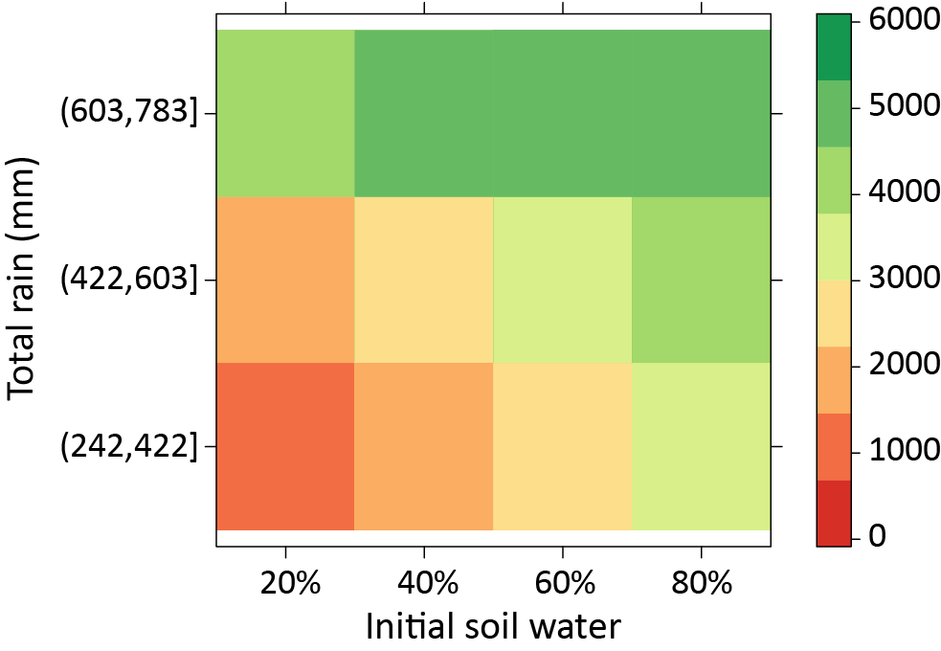


“Translation”: interactions between rainfall, soil water and yields
Soybean yield
(kg per ha)
Terciles of
total rainfall
during crop cycle
(mm)
Break-even
yield
Soybean in Pilar, Córdoba, Argentina
Courtesy of Federico Bert, AACREA

Slide 18
Main points
Climate information that is not used has NO value (economic, social)
  “used” -> influence possible changes in decisions
Some conditions that enhance use of climate information?
  There are “entry points” for info
  Do not ignore other decision contexts (e.g., economic, technological, cultural)
  Relevant for decisions -> fits needs
Main interest is on likely impacts
  Collaboration with sectoral experts is needed

Slide 20
What are climate services?
Climate services provide climate information in a way that assists decision making by individuals and organizations. Such services require appropriate engagement along with an effective access mechanism and must respond to user needs.
WMO Global Framework for Climate Services

Slide 21


Just because we can…

