Slide 1
Assembling technical resources to assess climate risk in India
Heavy rainfall events and floods

Slide 2
1. Think about what capacity needs you have identified
2. Discuss with colleagues how you can involve more people
3. Develop a stakeholders map
4. Make contact with other experts who can help with climate information capacity buildings

Slide 3
Heavy rainfall events and floods in India
Floods are the most common natural disaster in India.
Overall, it is estimated that 40 million hectares of land (roughly 12 per cent of India's geographical area) is prone to floods.
Extreme rainfall events are on the rise in India, driven by warming temperatures and it is predicted that floods will become more frequent in India.
Excess Rainfall cum flood affects extremely both urban and rural life.
Urban : transport sector and loss of life and properties
Rural : crop of the paddy fields, health

Slide 4
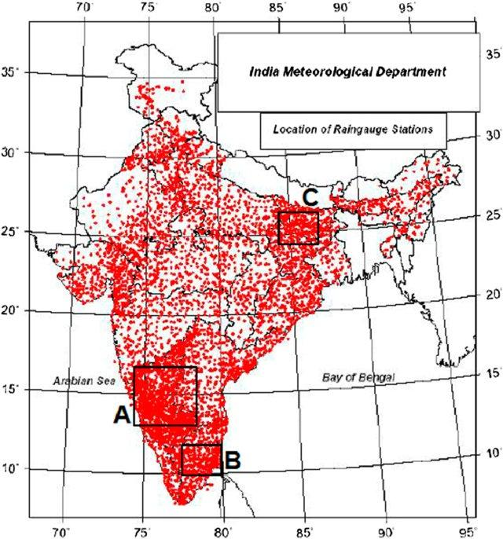
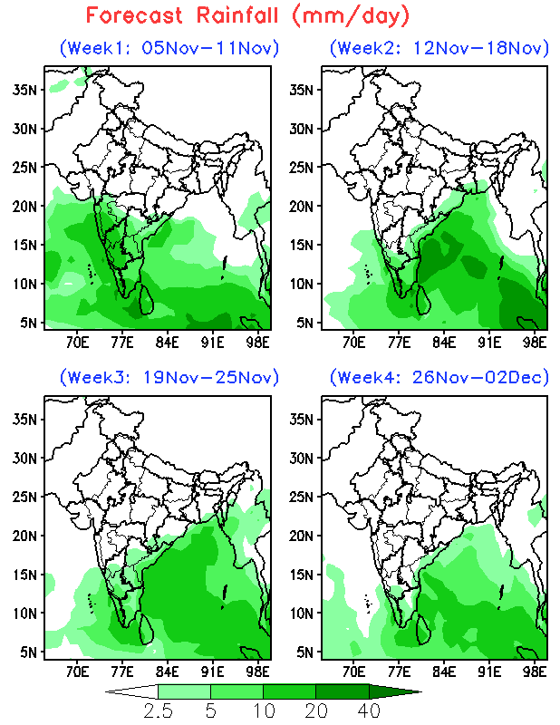
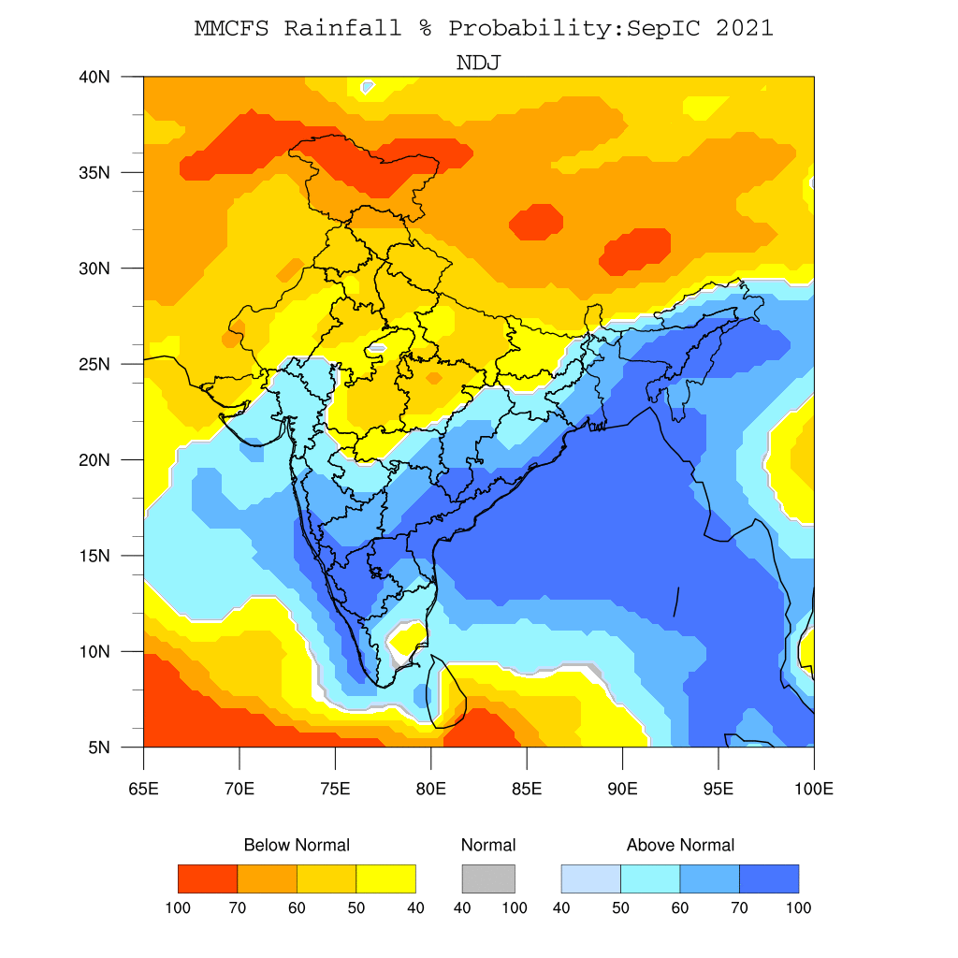
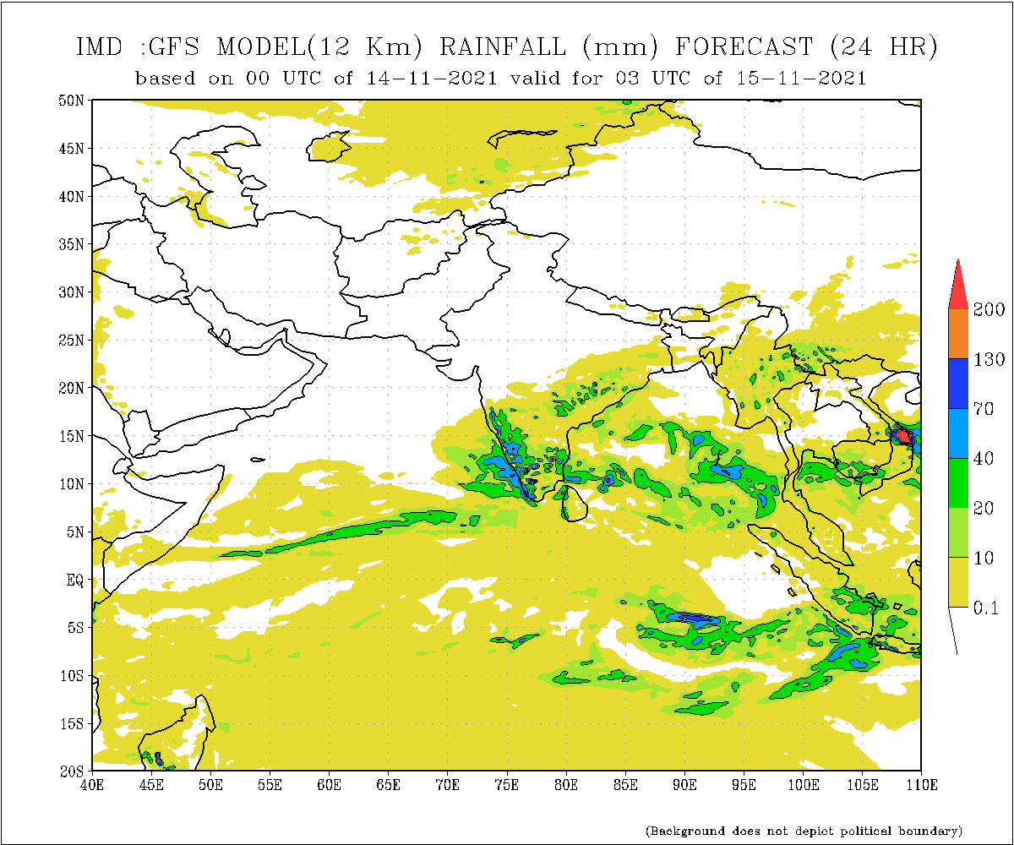
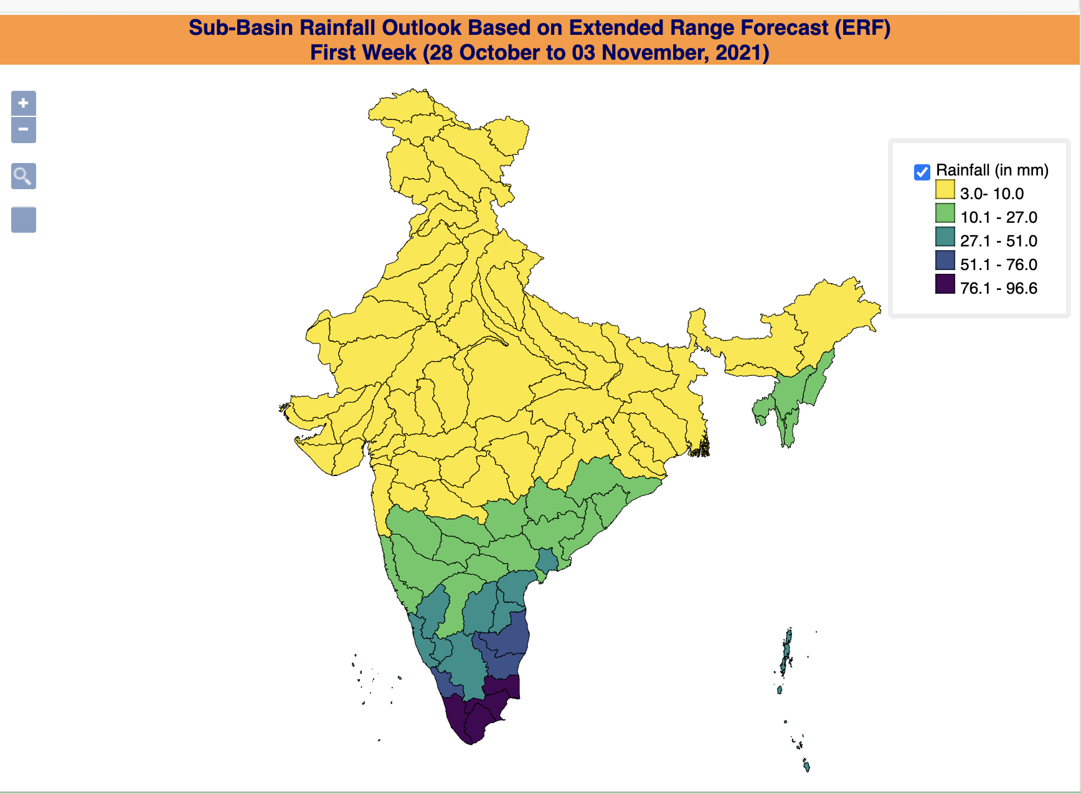
Think about what capacity needs you have identified
1. Observational network (rainfall monitoring)
2. Availability of forecasts at different time and space scales (rainfall forecast)
Short range/medium range
Extended range
Seasonal forecast
River basin rainfall forecast
3. National flood control programme by the Ministry of agriculture; Flood management programme by Ministry of Jal Shakti.

Slide 5
Discuss with colleagues how you can involve more people
1. Inter-agency collaboration
India Meteorological Department (IMD),
Department of Science and Technology (DST),
Ministry of Environment, Forest and Climate Change (MoEFCC),
Central Water Commission (CWC) under the Ministry of Jal Shakti,
Indian Space Research Organization (ISRO),
Ministry of home affairs (MHA),
Ministry of Earth Sciences (MoES),
Ministry of Agriculture, etc., )
2. State and local governments
3. NGOs

Slide 6
Develop a stakeholders map
Sectors responsible for preparedness, mitigation, rescue, relief and rehabilitation
Water
agriculture
health
transport
Infrastructure

Slide 7
Make contact with other experts who can help with climate information capacity buildings
Academic institutions (Universities, IITs, NITs, IISc)
State agencies
NGOs

Slide 8
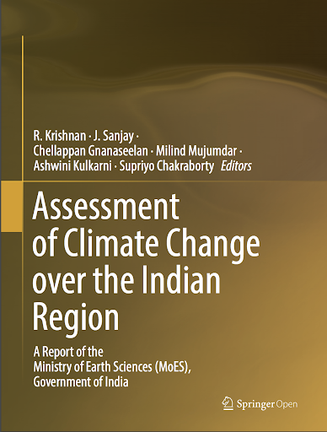
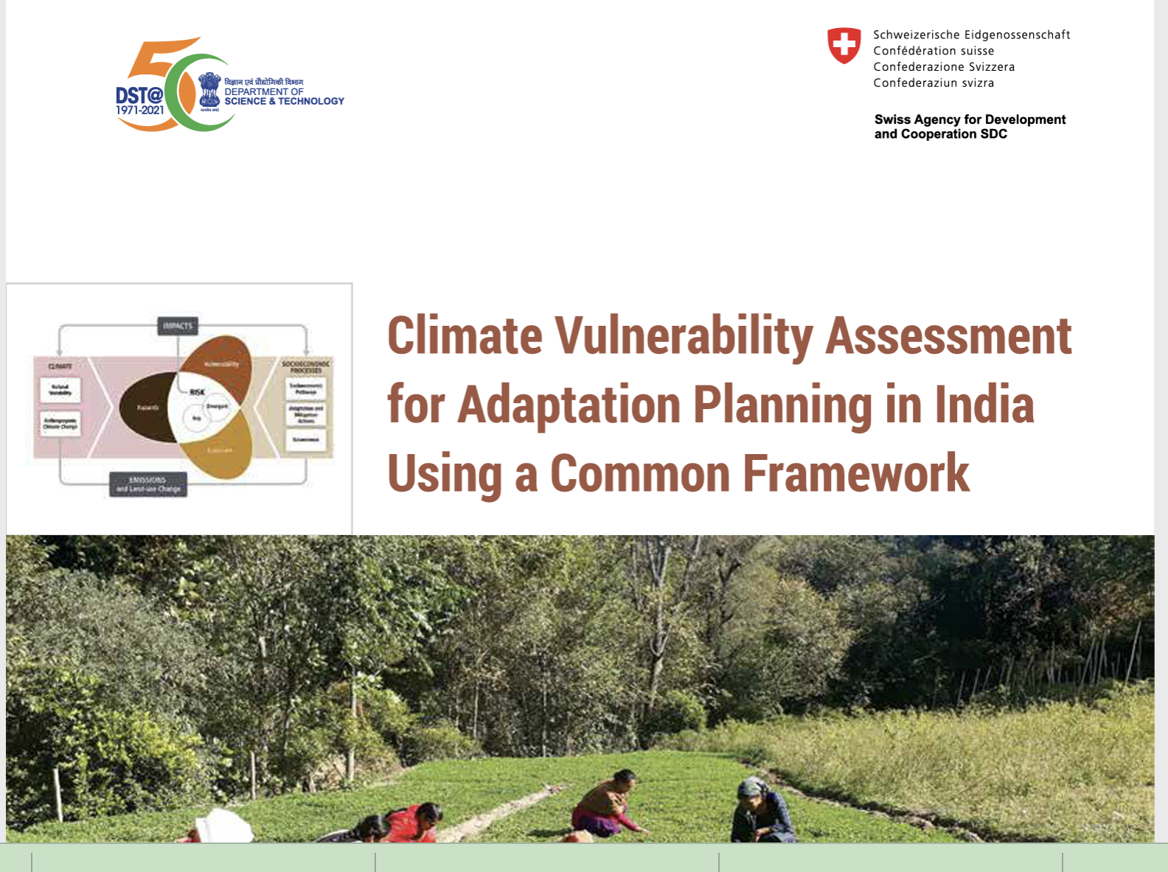
National climate change assessment report
The book discusses the influence of human-induced global climate change over the Indian subcontinent and the regional monsoon, the adjoining Indian Ocean and the Himalayas.
Climate Vulnerability Assessment
Development of all-India state-level and district level vulnerability maps.

