Slide 1

Assembling Technical Resources to Assess Climate Risks - technical skills needed to use climate information effectively
G Srinivasan, RIMES
ClimAdapt Workshop, Online Session, 10 November 2021

Slide 2


How can you help people weather a changing climate if you don’t fully understand all the ways, it affects them?
It’s vital to consider that perspective when creating solutions to protect communities
- especially given that, by 2030, nearly one in four people could be exposed to a climate hazard severe enough to affect their lives or livelihoods.
— Torea Frey, managing editor, Seattle, The Daily Read

Slide 3
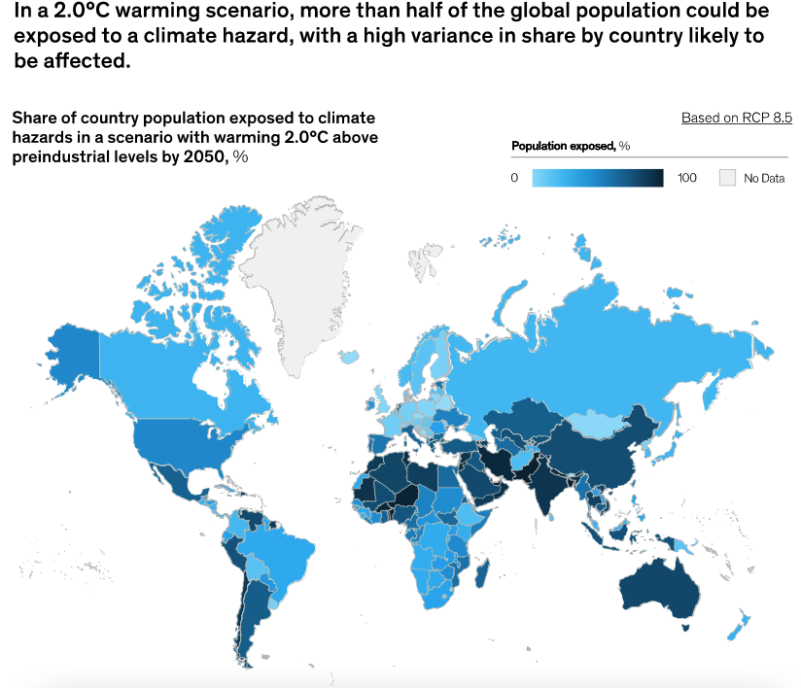
Pilot Program for Climate Resilience (PPCR)
Bangladesh - Capacity Development Technical Assistance Project
Protecting people from a changing climate: The case for resilience, McKinsey Global Institute, November 8, 2021, on McKinsey.com.

Slide 4
Strengthening the Resilience of the Urban Water Supply, Drainage, and Sanitation to Climate Change in Coastal Towns – Bangladesh
To assess the impacts of climate change on urban water supply, sanitation, drainage systems, water availability and salinity.
To recommend practical and effective options for the location of water-intake works, the appropriate design of drainage systems, urban wastewater discharge and the location of sanitation infrastructure.
To identify structural and other options, and prioritize them in a participatory manner
To enhance the capacity of relevant central and local government to better adapt to climate change
Implementation Team: Climate Expert, Hydrological Engineer, Urban planner, GIS specialist, Water supply and sanitation experts, Financial expert, social scientist, geologist – ground-water, hydrological modeler, mathematical modelling expert

Slide 5
Steps to implement in the three coastal
Pourashavas (Townships)
Understanding the context (location/sector specific) – institutional, operations, policies, socio-economic details
Institutions: Local Municipalities, Local Govt Engineering Dept, Bangladesh Water Development Board, Ministry of Planning, Dept of Public Health and Engineering, Disaster Management Agency, Bangladesh University of Engineering and Technology, Dhaka, Water Resources and Planning Organization, Water Management Institute
Assessing present climate trends/variability and future climate change scenarios
Assessing impacts on sector and location specific activities – translating climate information
Consultations with local agencies (Municipalities) and communities, technical assessment – identify options
Capacity Development/Awareness across all levels

Slide 6
Components of the Analysis framework

Slide 7
Sample of the adaptation options prioritized
 | Sub-sector | Adaptation Options considered
1 | Water Supply | Structural Sustained sources of quality freshwater that can meet future growth demands from groundwater aquifers Sustained sources of quality freshwater that can meet future growth demands from surface-water sources Mix of piped water and deep hand tube wells to cover and sustain a broader coverage throughout the township Non-structural Financial Management of water supply system Programme to sensitize the community regarding safe and economical water use and hygienic practices
2 | Drainage System and Flood Control/Disaster Management | Structural Re-excavate drainage canals, Increasing the height of flood and road embankments O&M of Drainage Infrastructures, Important infrastructures in raised flood proof areas e.g. townships’s, power station, school, hospital, fuel station etc. Increase Channel Capacity, Embankment Erosion Protection, Increase Tidal Outfall Capacities Non-structural Improved Flood Warning Flood Zoning Preservation of Water Retention Areas, e.g. ponds and wetlands

Slide 8

Concluding thoughts
Climate information needs be properly contextualized for use at different levels
Identify and engage with key sectoral partners to collaboratively develop adaptation solutions and arrange to provide the best possible science inputs in terms of climate data and information
Uncertainties and confidence levels of climate information being used for planning to be clearly indicated
Adaptation options – Non-structural & soft measures, no regrets and structural measures
Awareness & Capacity Dev, consultation and feedback

Slide 9

Thank you
srini@rimes.int

