Slide 1

WIGOS Webinar #27
OSCAR/Surface release 1.7.1
WMO Secretariat & MeteoSwiss

Slide 2
Outline
Implementation of assessed statuses in OSCAR/Surface
  New features in the GUI
    The new GUI layout
    How WDQMS produces an assessed status
    The new filter map and the info box
    The search tab
    The Programs / network affiliations table
  Station status vs. program status
Changes for NFPs and MEs
  New option to edit station names
  Automatic assignment of machine user role
Summary and final remarks

Slide 3
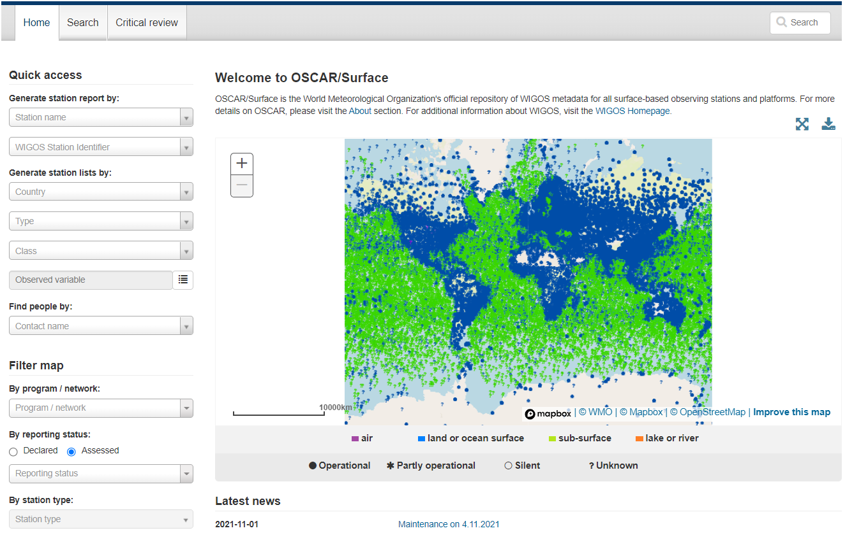
1. Implementation of assessed statuses
1.a.i. The new GUI layout
Assessed status is now available in the filter map menu
Calculation based on availability of observations received from WDQMS

Slide 4
1. Implementation of assessed statuses
1.a.ii. How WDQMS produces an assessed status
  WDQMS-webtool processes and transfers the stations assessed status, currently regarding data availability only, to OSCAR/Surface via a web API
  The results are aggregated over each calendar month, and delivered to OSCAR/Surface at the beginning of each month referring to the previous one
  OSCAR/Surface will keep historic records of the monthly assessed values
  Aggregation over variables (temperature, wind, pressure and humidity):
    The maximum number of daily observations per variable across all monitoring centers is calculated and summed up over the month of interest,
    The assessed status is “operational” if:
      for surface stations all variables have at least 90% of expected observations,
      for upper-air stations all variables have at least 90% of the expected observations and all have reached levels above 100hPa (GOS)
    The assessed status is “Silent” if all variables have 0% of expected observations
    The assessed status is “Partly Operational” otherwise
    The assessed status is “unknown” if the station is categorized in WDQMS as having metadata issues, such as the “pink dots” (more than 100%) and “grey dots” (schedule issues).
  Only variables that the station is expected to exchange internationally are considered
    Thus the assessed status could be based on only a subset of the variables

Slide 5
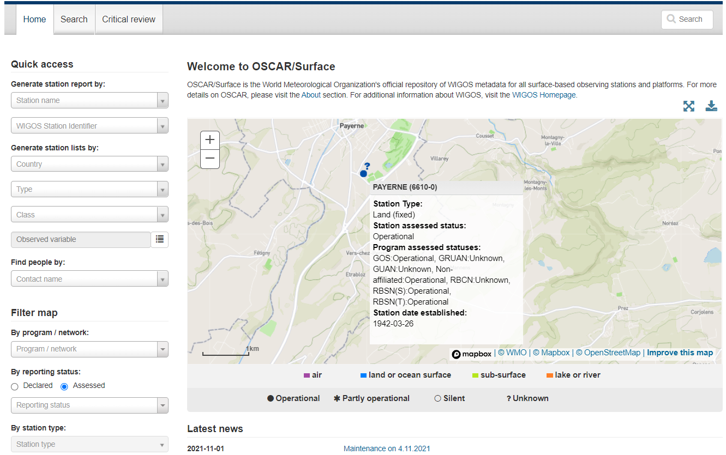
1. Implementation of assessed statuses
1.a.iii. The new filter map and the info box
When hovering over a station on the filter map the info box now contains also information on all assessed statuses

Slide 6
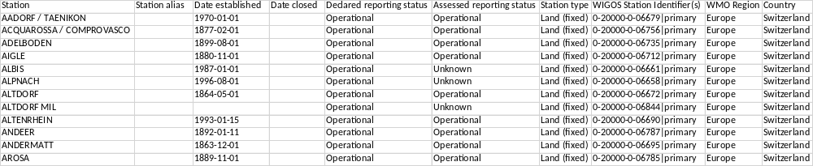
1. Implementation of assessed statuses
1.a.iv. The search tab
The search tab in OSCAR/Surface does not allow to search for assessed statuses
After a search has been conducted a .csv file can be downloaded to get information on the assessed reporting status

Slide 7
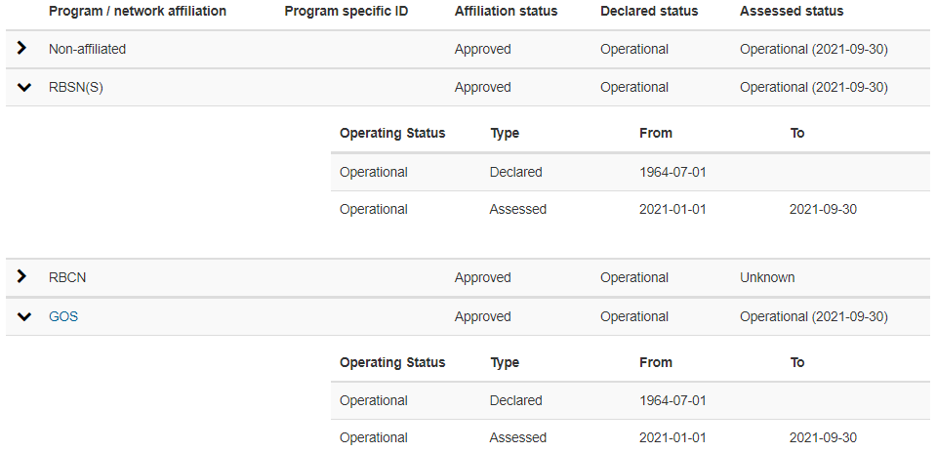
1. Implementation of assessed statuses
1.a.v. Programs / network affiliations table
The programs / network affiliations table in the station report now contains information on the assessed status in addition to the declared status
By opening the dropdown menu of an affiliation its history is shown
The reference date of the last period where data from WDQMS was received is shown in brackets behind the status

Slide 8
1. Implementation of assessed statuses
1.b. Station status vs. program status
  When is a program status «unknown»?
    Two cases are to be distinguished:
      The program status is not assessed and therefore «unknown».
      The program status was assessed but WDQMS did not deliver a status recently. 40 days after the last assessment, the status is set to «unknown».
  How is a station status calculated from the program statuses?
    «Optimistic» algorithm for calculating the station assessed status:
      Operational > Partly operational > Unknown > Silent
      (equally for the declared reporting status)

Slide 9
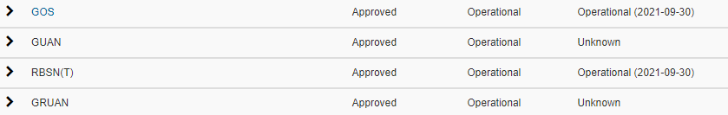
1. Implementation of assessed statuses
1.b. Station status vs. program status
  How is a station status calculated from the program statuses?
    Example:
      «Operational» & «Unknown» → Station assessed status is «Operational»

Slide 10
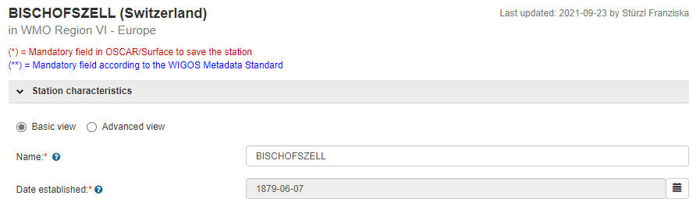
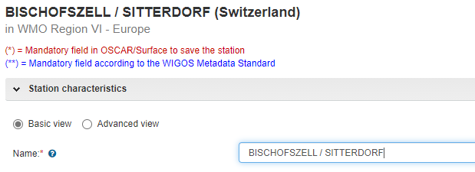
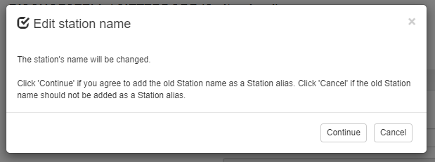
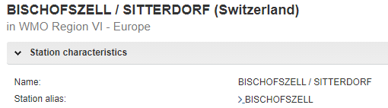
2. Changes for NFPs and MEs
2.a. New option to edit station names
  Editing a station name in the GUI:
  Recommended praxis: Keep the track of old station name as «station alias»
insert new name
save station record
updated record

Slide 11

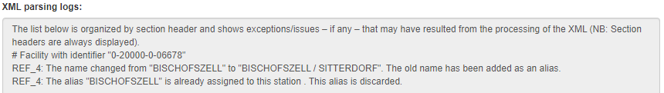
2. Changes for NFPs and MEs
2.a. New option to edit station names
  Editing a station name via XML upload:
  station name and station alias both use the XML-element <gml:name> with the Xpath /WIGOSMetadataRecord/facility/ObservingFacility/name
  Rule: first element is used as the station name, all the following are added as aliases
  Example:

Slide 12
2. Changes for NFPs and MEs
2.b. Automatic assignment of machine user role
  New and existing National Focal Points and Metadata Editors automatically get the rights to create and edit station records via WMDR XML (no more specific request necessary).
  API endpoint «wmd/upload» with security token
  (new!) GUI: Management → XML submission
  For information on WMDR XML, please consult:
  Blog post on GitHub: https://github.com/wmo-im/docs/blob/master/XML%20station%20representation%20in%20OSCAR.ipynb
  User manual chapter «HOW TO REGISTER OR EDIT A STATION VIA XML UPLOAD»

Slide 13
3. Other new features
  API Pagination
    Search results have a maximum number of stations (50.000 by default)
    Example: https://oscar.wmo.int/surface/rest/api/search/station?programAffiliation=Argo {"totalCount":16177,"pageCount":1,"pageNumber":1,"itemsPerPage":50000,"stationSearchResults“:…}
  Custom reports
    API call URL: https://oscar.wmo.int/surface/rest/api/customReports/...
  Removal of program affiliation triggers an e-mail to the program focal point

Slide 14
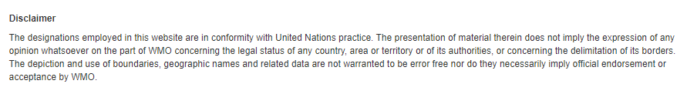
3. Other new features
  Disclaimer
  Newly included in the «About» section:

Slide 15
4. Summary
  Assessed statuses
  Edit station names
  Automatic assignment of machine user role for NFPs and MEs
  API Pagination
  Custom reports
  Removal of program affiliation triggers an e-mail to the program focal point
  Disclaimer

Slide 16

Thank you
For further information:
WIGOS Learning Portal https://etrp.wmo.int/course/view.php?id=146
WIGOS Webpage
https://community.wmo.int/activity-areas/wigos

