Slide 1

WIGOS Webinar #26
Registration processes and roles in OSCAR/Surface
WMO Secretariat & MeteoSwiss

Slide 2
Outline
Users registration in OSCAR/Surface and NFP nomination in WMO Community Platform
  Nomination of NFP in WMO Community Platform (PR, NFP, others)
    Nomination of NFP by PR -> WMO CPDB (Community platform)
    Delegation as ME editor by NFP
  Registration process in OSCAR/Surface
Main (user) roles in OSCAR/Surface
  National Focal Point
  Metadata Editor
  Station contacts
  Program focal points
  Data centres
  Instrument expert
The various platforms of OSCAR/Surface
  Purpose and contents of DEPL versus PROD
  Registration in each platform
Summary and final remarks

Slide 3
Registration of a New Expert in the WMO Experts Database
NFPs on OSCAR/Surface must be listed in the MWO Experts Database and must have access to OSCAR/Surface to carry out their duties and roles.
A newly nominated NFP should first be registered in the WMO Experts Database, if not already registered
Members (PRs or agency approvers) register their new NFP or expert in the WMO Experts Database, https://contacts.wmo.int/ or https://community.wmo.int/
Experts will have access to the WMO Experts Database using the email registered by agency approver and they can update their profile

Slide 4
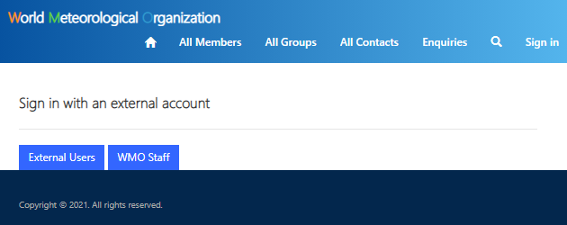
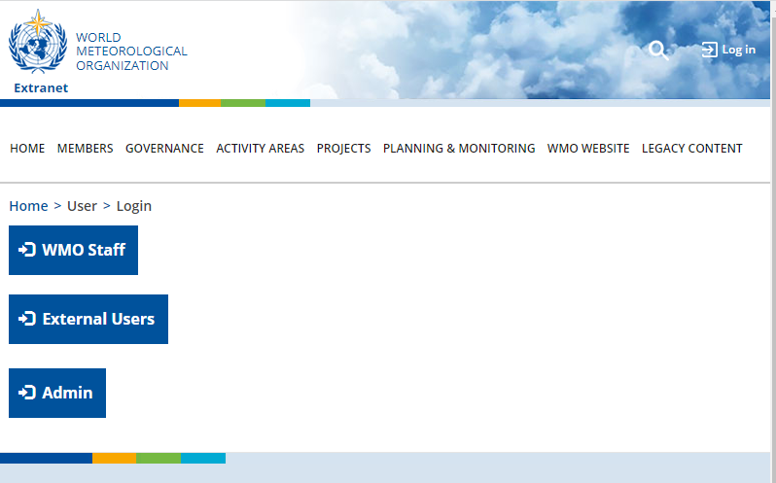
Login to the WMO Experts Database
https://contacts.wmo.int/
https://community.wmo.int/user/login/

Slide 5
Nomination of NFP for
OSCAR/Surface by PR
Nominate expert as a National Focal Point for OSCAR/Surface
Members (PRs or agency approvers) nominate their experts to “National Focal Points for OSCAR/Surface” group, through the WMO Experts Database
In some cases Members may nominate their NFP through nomination letter/email to WMO Secretariat; they may also request Secretariat to register their expert in the WMO Experts Database.
WMO Secretariat approves the registration of a nominated NFP
Secretariat officer in charge of “National Focal Points for OSCAR/Surface” Group in WMO Experts Database approves the registration
Some related guidance is available here https://community.wmo.int/activity-areas/community-platform and https://contacts.wmo.int/

Slide 6
Delegation as Metadata Editor by NFP
National focal points can delegate their role in OSCAR/Surface to a Metadata Editor (ME) to another contact who will then be able to perform the same technical functions as the national focal point, without the formal title
Delegation as ME is done by NFP directly on OSCAR/Surface
ME has the same roles and access rights as NFP, except for deleting/deactivating users

Slide 7
Users registration in OSCAR/Surface
Registration process
Registration process in two steps:
Registration as a contact in OSCAR/Surface
by the Administrators or National Focal Points or other user from the same country
2. Creation of an account on eIAM
  by the user before the first login

Slide 8
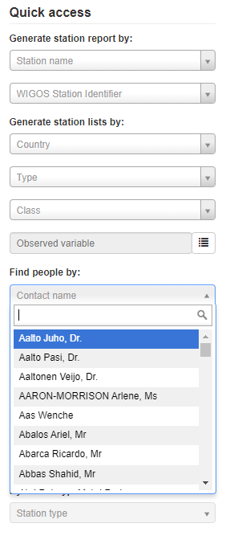
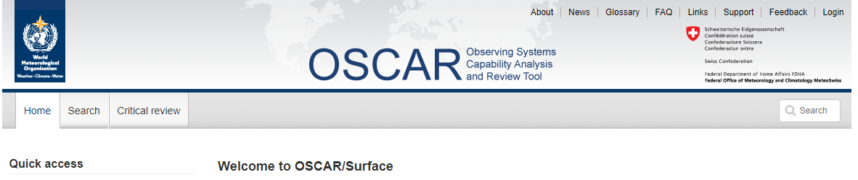
Users registration in OSCAR/Surface
Registration process
1. Check if you are already registered in OSCAR/Surface
if yes:
2. Use the “Login” button to initiate the registration on eIAM

Slide 9
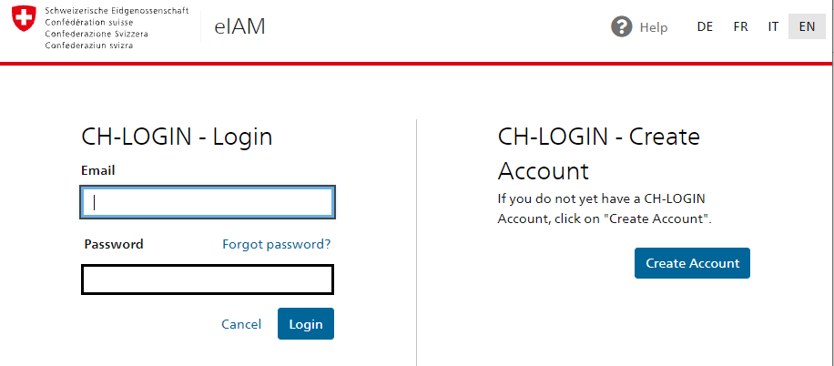
Users registration in OSCAR/Surface
Registration process
  Click on «Create Account» and continue.
  Fill out the form with your name, surname, e-mail address and a password of your choice
  Important: Use the same e-mail address as in OSCAR!
  You will receive a confirmation code via e-mail. Enter this code and continue.

Slide 10
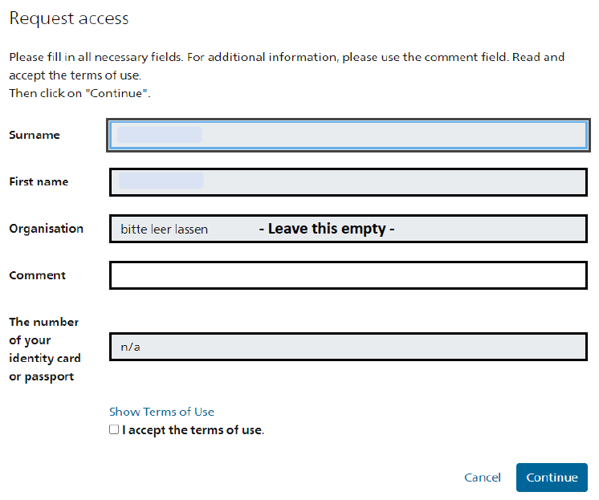
Users registration in OSCAR/Surface
Registration process
  Request access by filling out the form with name and surname, accept the terms of use.
  Go back to the application and login.

Slide 11
Users registration in OSCAR/Surface
Registration process
Consult for help:
OSCAR FAQ: https://oscar.wmo.int/surface/#/faq/
Detailed workflow: https://oscar.wmo.int/oscar/docs/OSCAR_EIAM_short_workflow_V18.00.pdf
WIGOS Learning Portal: https://etrp.wmo.int/mod/resource/view.php?id=13747
Support: https://oscar.wmo.int/surface/#/support
Management of your eIAM account:
https://www.myaccount.eiam.admin.ch

Slide 12

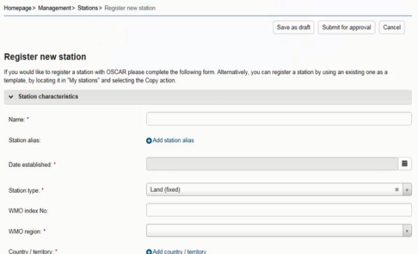
Main (user) roles in OSCAR/Surface
UI roles:
Delegate rights
Metadata editor
(NFP deputy)
Register
Register
Admin
NFP
Register
Station contact
Instrument expert

Slide 13
Main (user) roles in OSCAR/Surface
National Focal Point
User role assigned by Administrators (WMO)
Access rights:
  Register stations for their country
  Edit all stations in their country
  Create and edit users for their country
  Appoint metadata editors (to delegate NFP rights)
Rights to use the XML submission

Slide 14
Main (user) roles in OSCAR/Surface
Metadata Editor
User role assigned by the National Focal Point
Access rights:
  Register stations for their country
  Edit all stations in their country
  Create, edit users for their country
Rights to use the XML submission

Slide 15
Main (user) roles in OSCAR/Surface
Station contacts
created by National Focal Points, Metadata Editors or other station contacts
Access rights:
  Register stations for their country
  Edit own stations
  Create users for their country

Slide 16
Main (user) roles in OSCAR/Surface
Program focal point
User role assigned by Administrators (WMO)
Access rights:
  Register stations affiliated with their program
  Edit all stations affiliated with their program
  Create users for their country
  Affiliate existing station to their network

Slide 17
Main (user) roles in OSCAR/Surface
Data centres
User role assigned by Administrators
Machine user linked to a regular user
M2M equivalent to Program Focal Point (UI)

Slide 18
Main (user) roles in OSCAR/Surface
Instrument expert
User role assigned by National Focal Points or Metadata Editors
Access rights:
  Manage instrument catalogue (add/edit instruments)

Slide 19
The various platforms of OSCAR/Surface
Purpose and contents of DEPL versus PROD
Productive environment «PROD» https://oscar.wmo.int/surface
Testing environment «DEPL» https://oscardepl.wmo.int/surface
  Platform for testing and training events
  Same features as PROD
  Overwritten weekly (every Monday)
  Internally: used for testing of new releases
  Open to all OSCAR users
  Not the same login credentials as for PROD, second registration on eIAM needed

Slide 20
The various platforms of OSCAR/Surface
Registration on each platform
Registration process on DEPL:
Registration as a contact in OSCAR/Surface
  Registered contact on PROD will appear as a contact on DEPL after the next synchronization
Creation of an account on eIAM
  Again, by the user before the first login
  Same procedure as for PROD

Slide 21
Summary and final remarks
NFPs on OSCAR/Surface must be registered in WMO Experts Database and in OSCAR/Surface
Registration and nomination in WMO Experts database, https://contacts.wmo.int/ or https://community.wmo.int/ , are done by Members (using agency approver account)
Once a NFP is registered in WMO Experts Database, administrator will register him/her in OSCAR/Surface and he/she will receive a link to complete the registration
  NFPs on OSCAR/Surface have access right to update, including register and delete, all stations metadata and users registered in their country
  NFPs on OSCAR/Surface can delegate their roles to ME and station contact
  ME has the same roles and access rights as NFP, except for deleting/deactivating users
  Station contacts can register stations in their country but can only edit their own stations
  There are two platforms exists in OSCAR/Surface, which is productive environment, https://oscar.wmo.int/surface/#/ and testing environment, https://oscardepl.wmo.int/surface/#/

Slide 22

Thank you
For further information:
WIGOS Learning Portal= https://etrp.wmo.int/course/view.php?id=146
WIGOS Webpage =
https://community.wmo.int/activity-areas/wigos

