Slide 1
Latest Updates on the WDQMS webtool
Cristina Prates
cristina.prates@ecmwf.int
With thanks to :
Pierre Vernier and Timo Pröscholdt
Reading, 7 June 2021

Slide 2
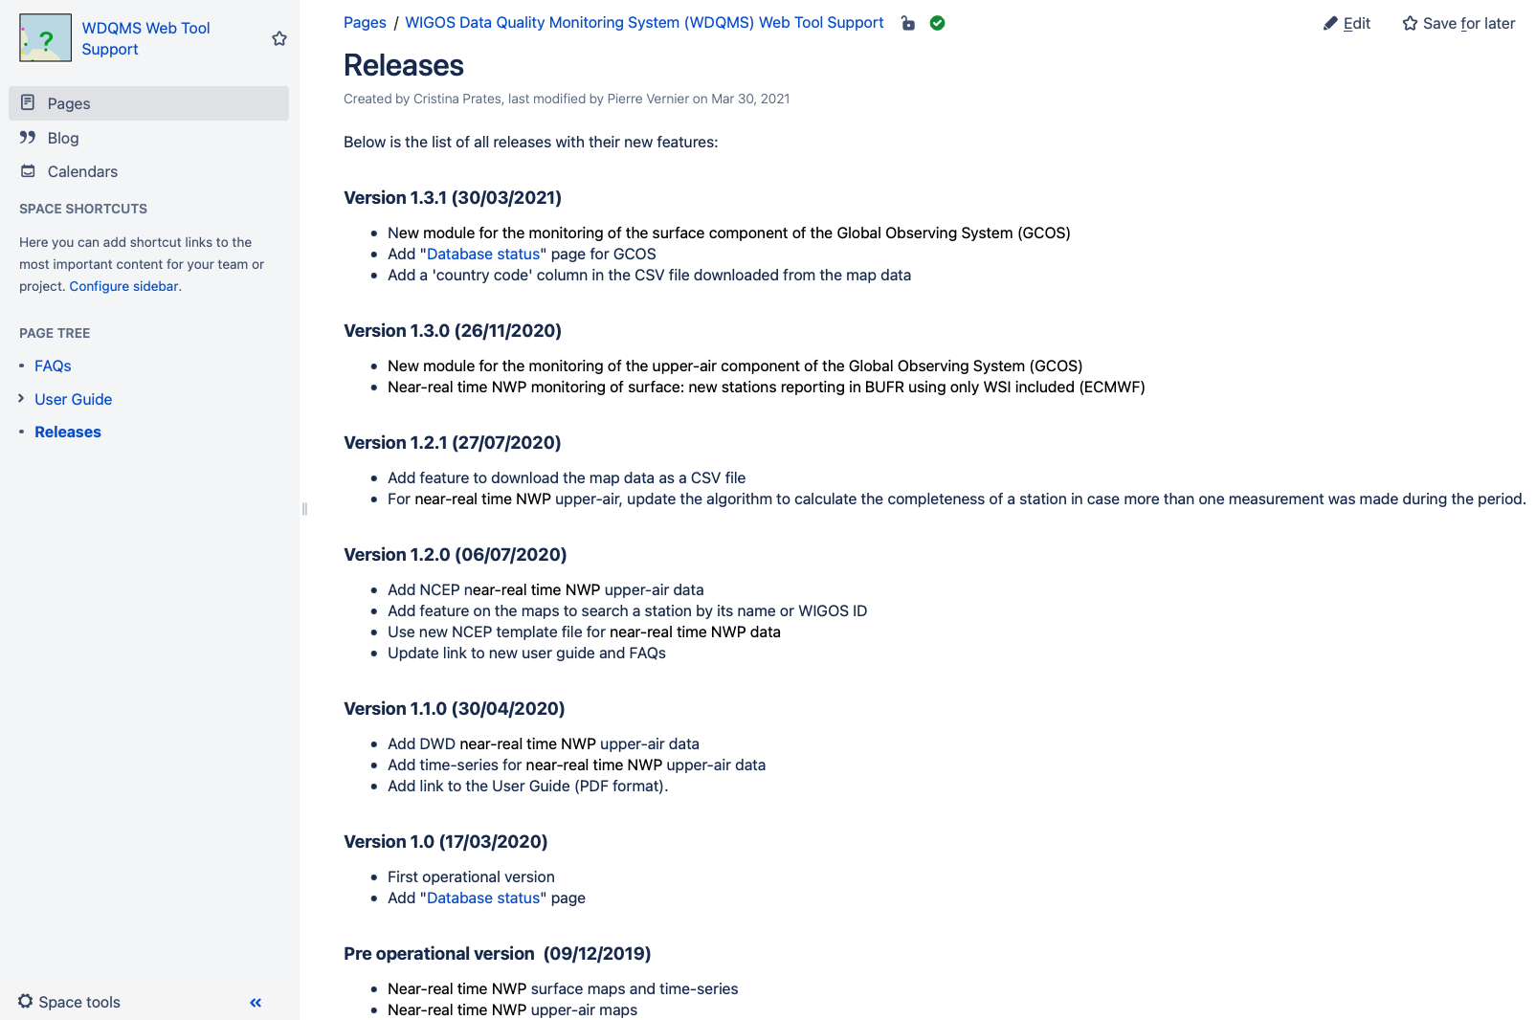
WDQMS Web Tool Support Pages: Releases
https://confluence.ecmwf.int/display/WIGOSWT/Releases

Slide 3
WDQMS Web Tool Support Pages: Releases
https://confluence.ecmwf.int/display/WIGOSWT/Releases

Slide 4
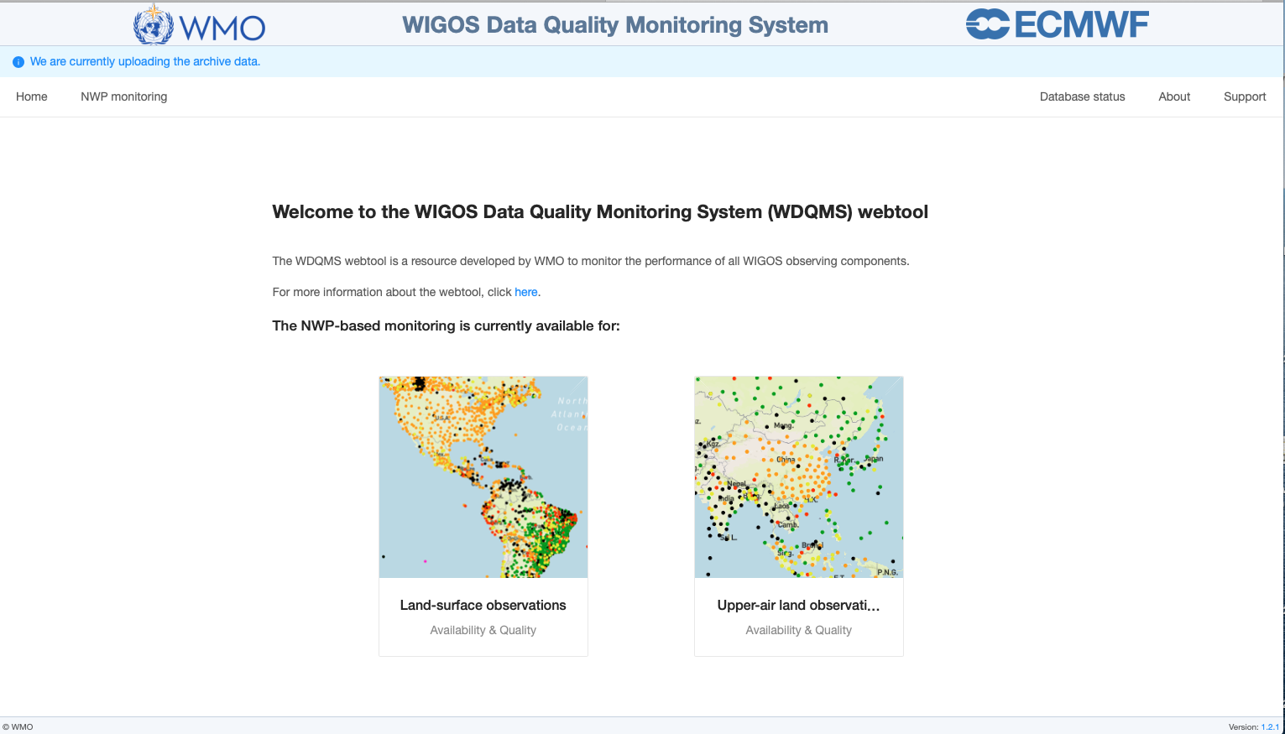
WDQMS Web Tool: Operational version
Version 1.0 (17/03/2020) - Monitoring of GOS networks:
https://wdqms.wmo.int/

Slide 5
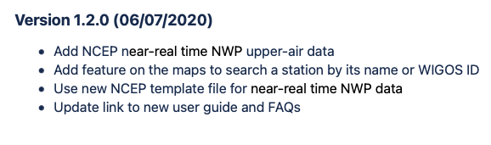
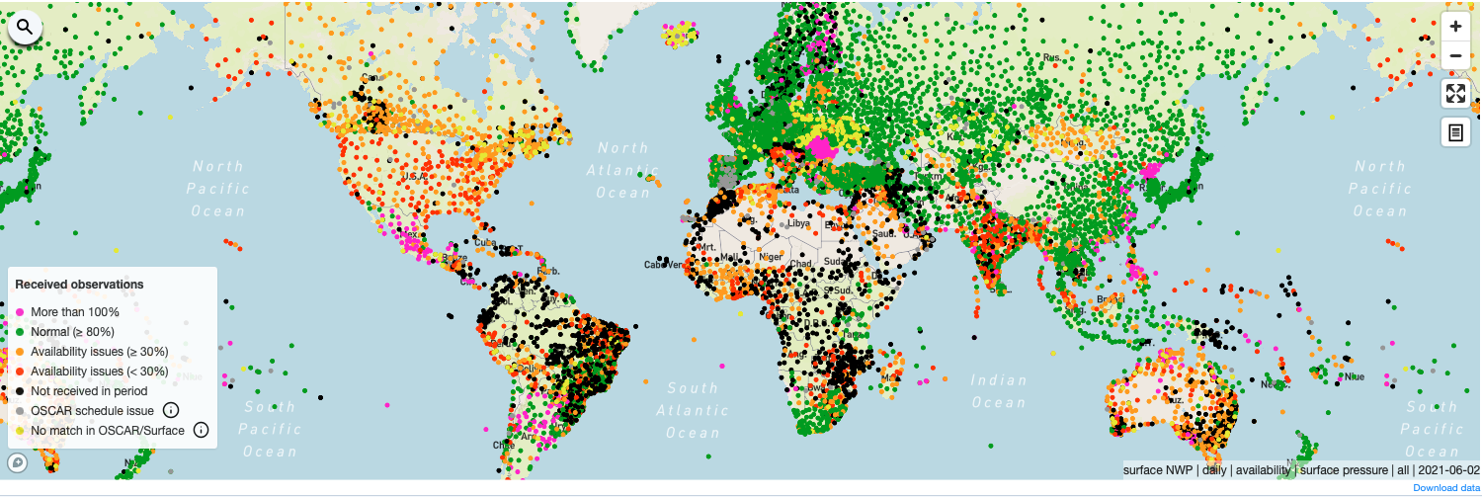
WDQMS Web Tool: Operational version
Version 1.2.0 – Important feature added:
Search stations by name or WIGOS ID

Slide 6
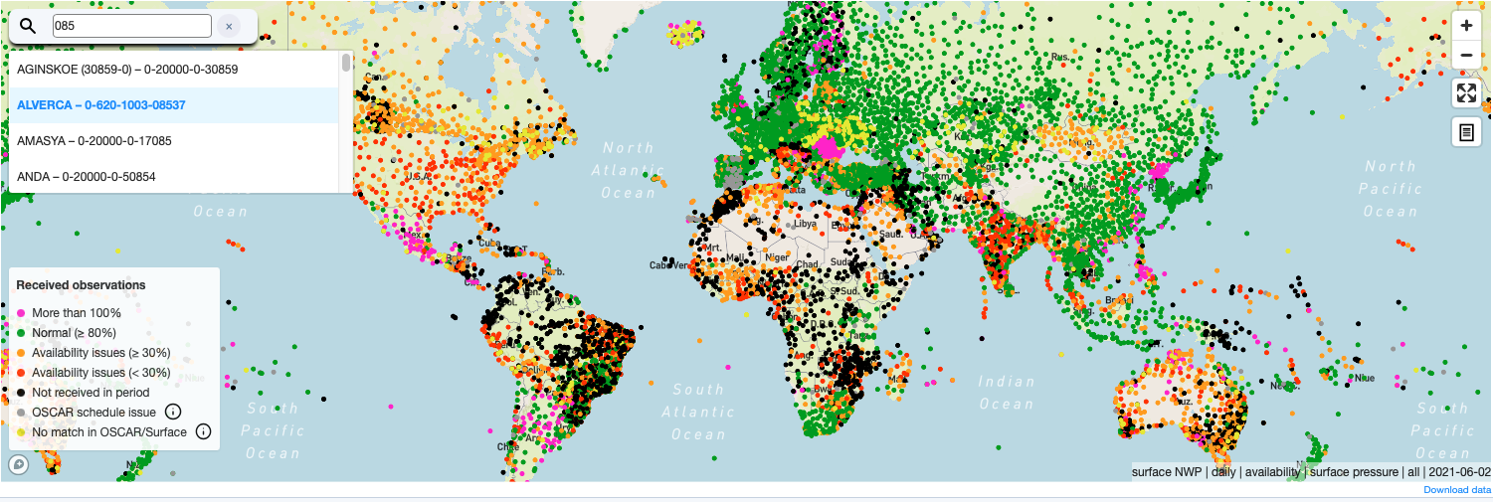
WDQMS Web Tool: Operational version
Version 1.2.0 – Important feature added:
Search stations by name or WIGOS ID

Slide 7
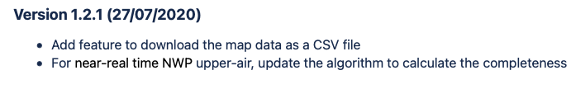
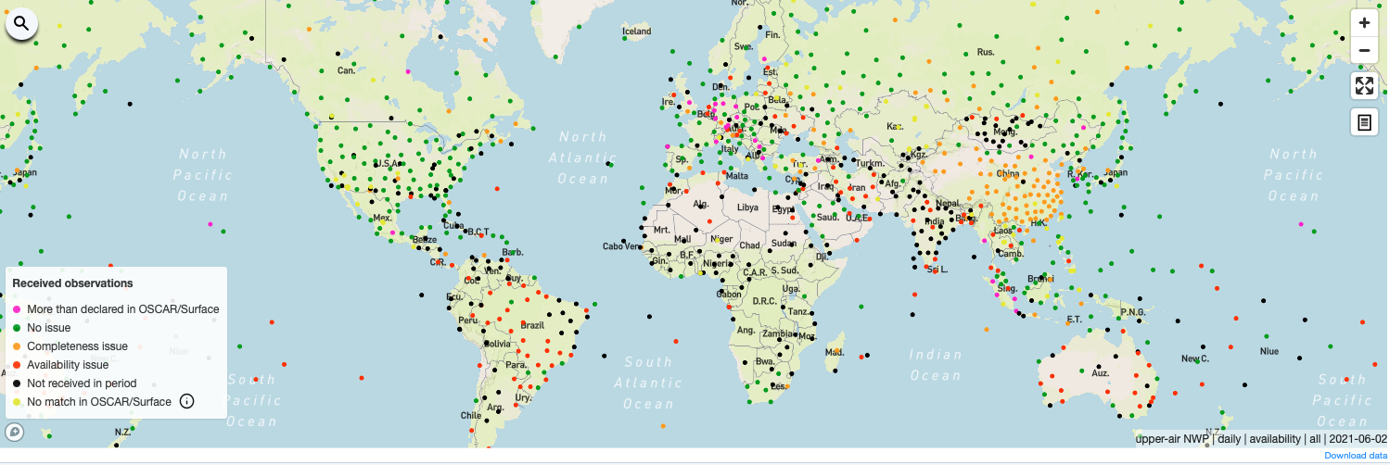
WDQMS Web Tool: Operational version
Version 1.2.1 – Important feature added:
Download map data as CSV file

Slide 8
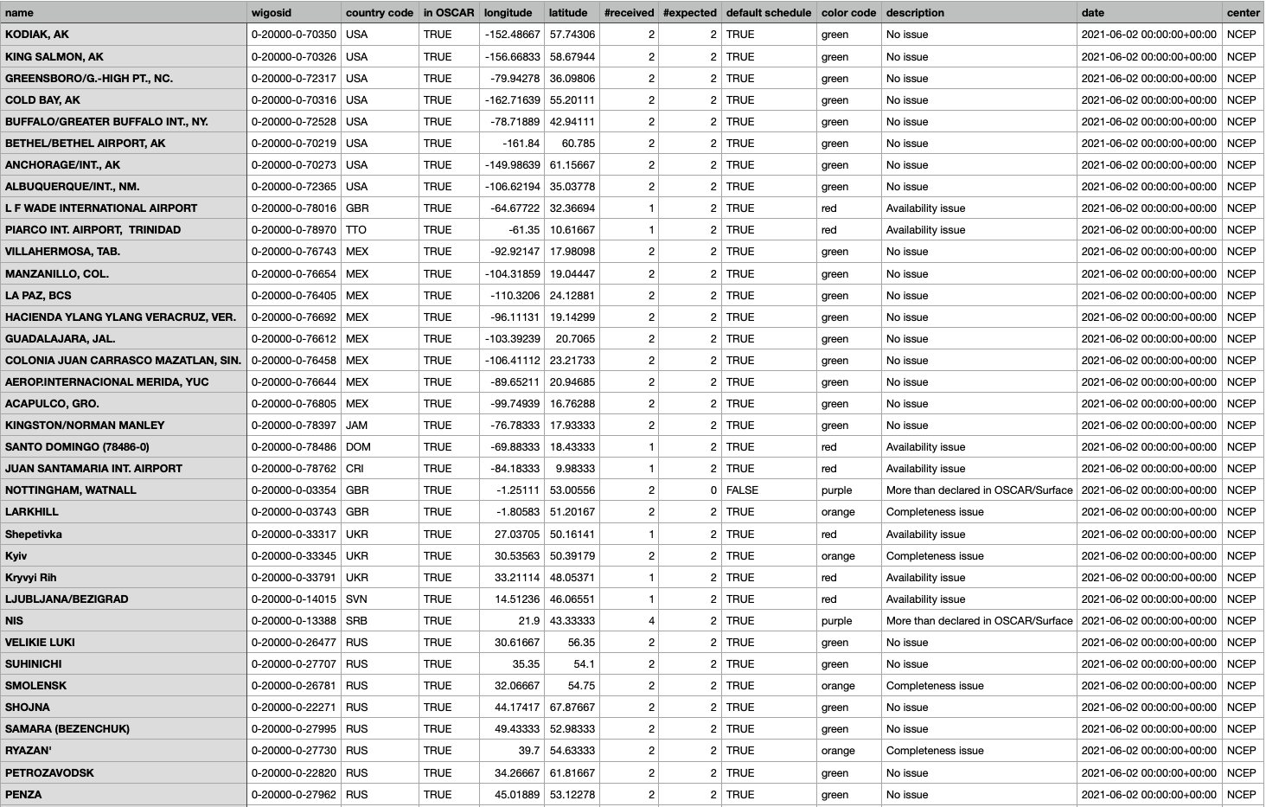
WDQMS Web Tool: Operational version
Download map data as CSV file: wdqms_temp_availability_daily_2021-06-02.csv

Slide 9

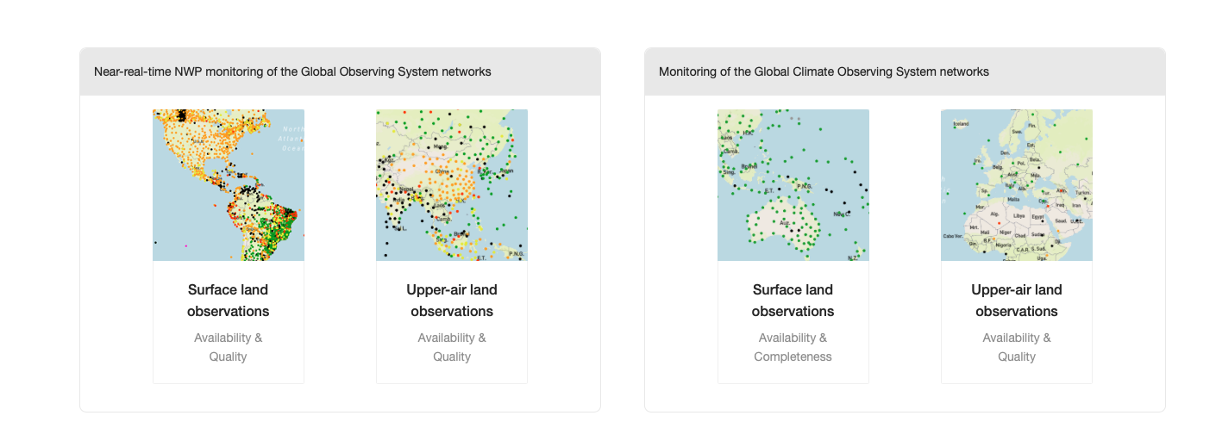
WDQMS Web Tool: Operational version
Version 1.3.0 - Monitoring extended to GCOS networks:
          Upper-air land observations

Slide 10
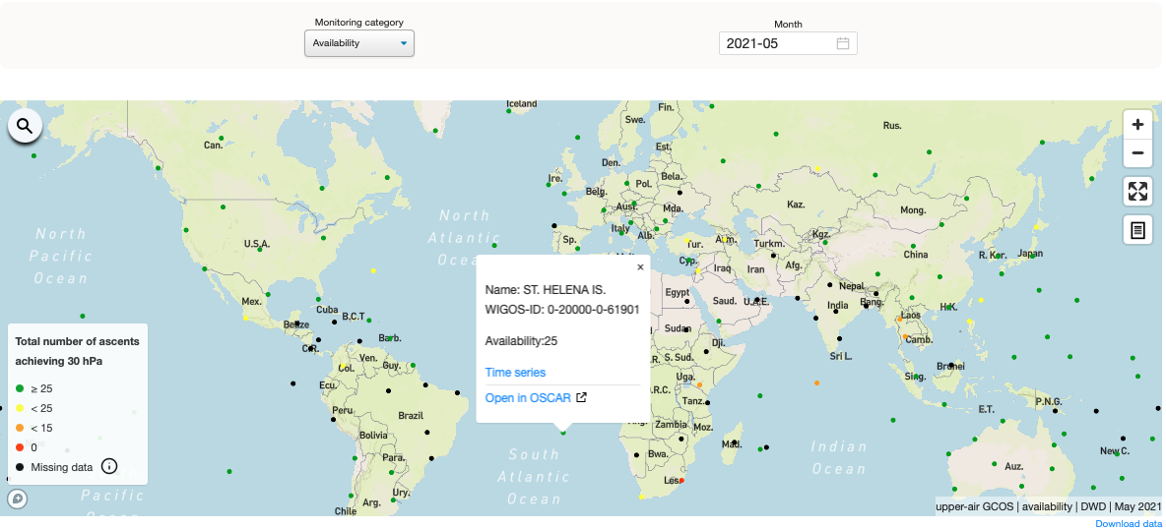
WDQMS webtool: Upper-air component of GCOS
Availability performance map for GUAN stations:
Monitoring reports are provided by DWD based on the observations made available to their DA.
The monthly differences in reporting performances according to the GCOS minimum requirements (25 daily soundings up to 30hPa).
The map highlights:
Stations not reporting during the period (black);
Reporting below requirements (yellow, orange and red);
Fully reporting (green).
Distinguish the stations not reporting (black) from the stations that sent reports that never reached 30hPa (red) within the selected month.

Slide 11
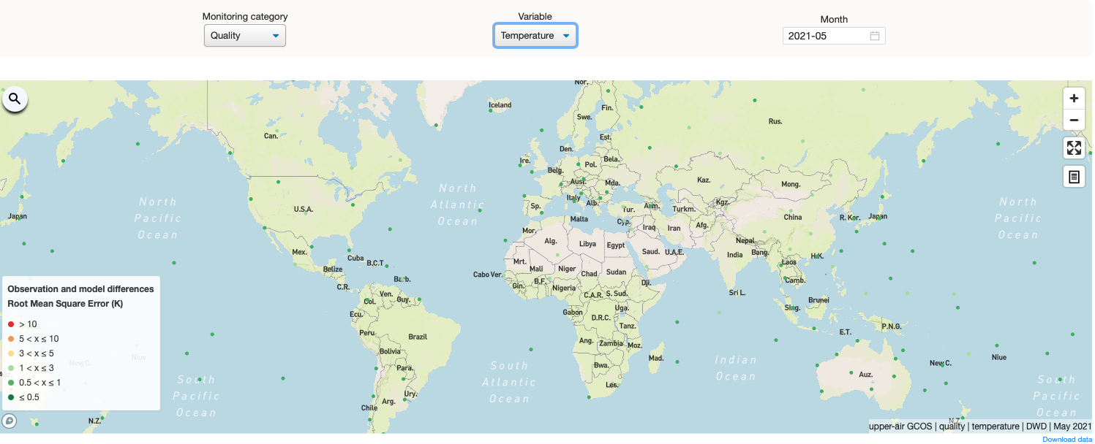
WDQMS webtool: Upper-air component of GCOS
Quality performance map for GUAN stations:
Monitoring reports provided by DWD and based on ECMWF O-B departures.
The rmse calculated for the month and variable of interest (air temperature, wind and humidity).
The map highlights:
Stations with observations considered useful for Climate purposes (greenish dots);
Stations with observations that deviate from the model forecasts quite significantly (yellow, orange and red dots) and exceed the limits set as “threshold” requirements

Slide 12
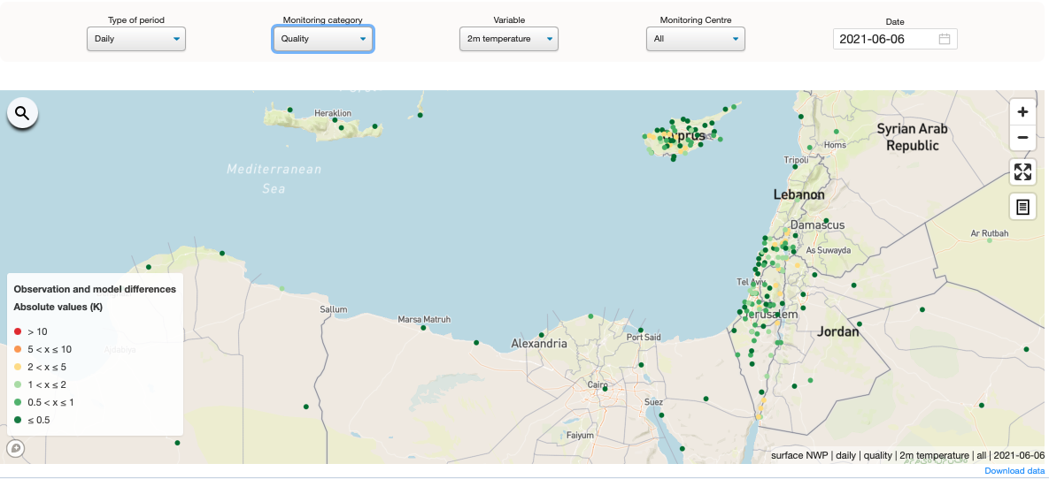
WDQMS webtool: stations with only WSI
Surface land component of the Near-real-time NWP monitoring module:
The 1.3.0 release allows for the display of surface observation monitoring results provided by stations that are reporting in BUFR, using only the WIGOS Station Identifier, i.e. stations that do not have a traditional 5-digit WMO ID.

Slide 13
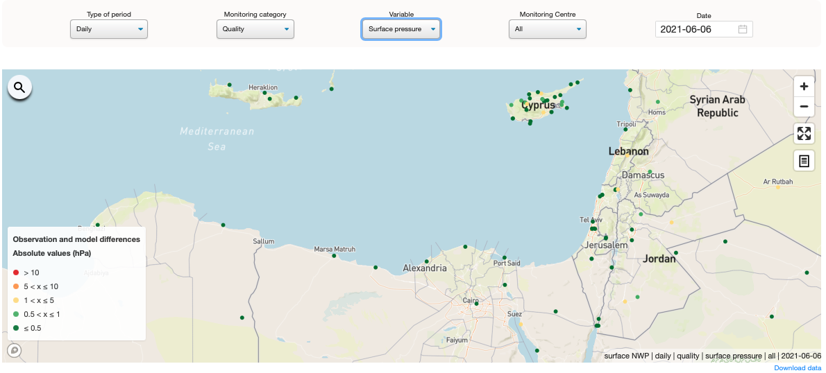
WDQMS webtool: stations with only WSI
Surface land component of the Near-real-time NWP monitoring module:
The 1.3.0 release allows for the display of surface observation monitoring results provided by stations that are reporting in BUFR, using only the WIGOS Station Identifier, i.e. stations that do not have a traditional 5-digit WMO ID.

Slide 14
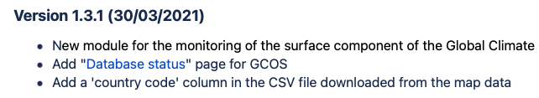
WDQMS Web Tool: Operational version
Version 1.3.1 - Monitoring extended to GCOS networks:
          Surface land observations

Slide 15
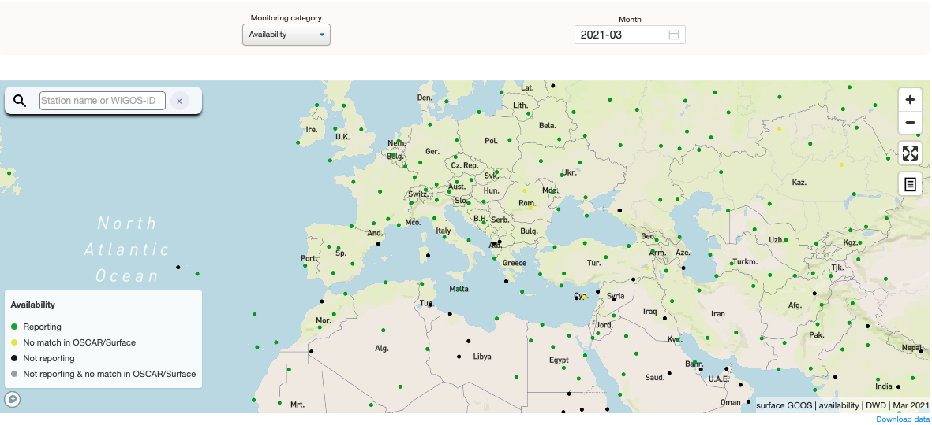
WDQMS webtool: Surface component of GCOS
Availability performance map for GSN stations:
Monthly based monitoring of the surface climate observations (CLIMAT reports) provided by DWD based on DWD and JMA monitoring results.
Differences in reporting performances as well as issues related to the station metadata recorded in OSCAR/Surface.
The map highlights:
Stations reporting (green);
Not reporting (black);
Reporting but not registered in OSCAR/Surface (yellow);
Not reporting and not registered in OSCAR/Surface (grey).
Metadata issues: the station Id is in the monitoring report provided by DWD, but it can not be matched to a station in the GSN station baseline used in WDQMS web tool (retrieved from OSCAR/Surface and updated monthly).

Slide 16
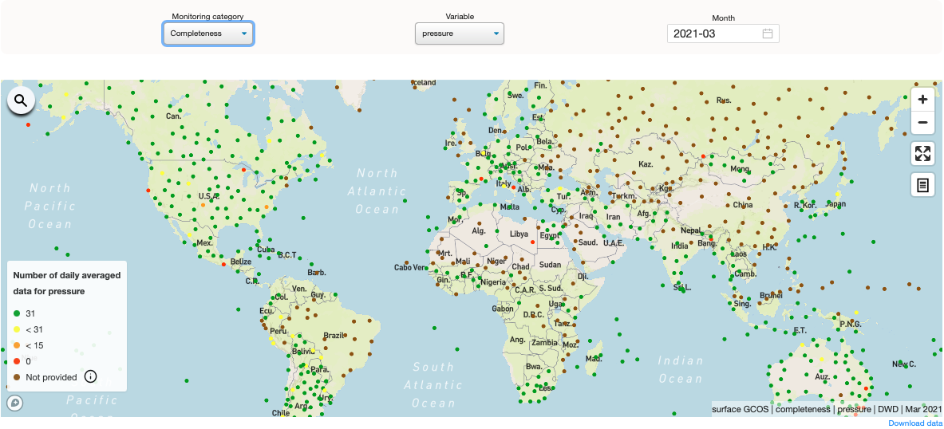
WDQMS webtool: Surface component of GCOS
Completeness performance map for GSN stations:
Monitoring report provided by DWD with the monthly reported number of days missing for data of variables: daily mean surface pressure, daily mean air temperature, daily maximum air temperature, daily minimum air temperature, daily mean water vapour, total daily precipitation and total daily sunshine duration
Calculates the number of daily averaged data for the variable of interest.
The map highlights:
stations whose CLIMAT reports contain average based on the full month of data (green);
stations with monthly average based on incomplete dataset (yellow, orange and red).
Distinguish the stations with no information of the number of days missing for data - not mandatory in the CLIMAT reports - in the selected month (brown) from the stations that reported not having included the observation (red).

Slide 17
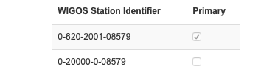
WDQMS webtool: forthcoming developments
Multiple WSIs:
  Handle of multiple WSIs. Some countries are changing the primary Id.
Near-real-time NWP monitoring module: monthly aggregation for availability and quality monitoring performance of surface and upper-air observations.
Exchange of results on reporting status from WDQMS webtool into OSCAR/Surface: develop and implement the algorithm to generate the Station Reporting Status based on the monthly availability performance results following the request/guidelines from ET-WT.

Slide 18
WDQMS webtool: forthcoming developments
WDQMS OSCAR exchange interface – Station Reporting Status in csv file:
program affiliation | WIGOS ID | category | status | period | center
GOS | 0-20000-0-06610 | availability | operational | 1.1.2021-31.1.2021 | WDQMS
GOS | 0-20000-0-65510 | availability | partlyOperational | 1.2.2020-29.2.2020 | WDQMS
GOS | 0-20000-0-47595 | availability | nonReporting | 1.12.1990-31.12.1990 | WDQMS
GOS | 0-724-0-0000000000008212 | availability | metadataIssues | 1.12.1990-31.12.1990 | WDQMS

Slide 19
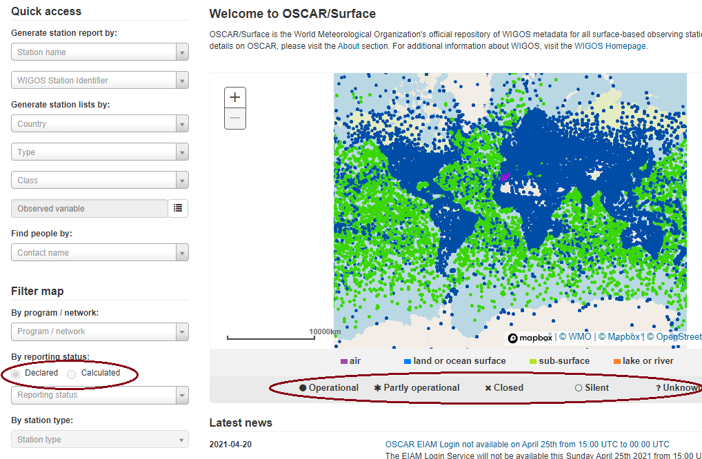
WDQMS webtool: forthcoming developments
WDQMS OSCAR exchange interface – Station Reporting Status in csv file:
Showing calculated/WDQMS status on OSCAR/Surface maps:
program affiliation | WIGOS ID | category | status | period | center
GOS | 0-20000-0-06610 | availability | operational | 1.1.2021-31.1.2021 | WDQMS
GOS | 0-20000-0-65510 | availability | partlyOperational | 1.2.2020-29.2.2020 | WDQMS
GOS | 0-20000-0-47595 | availability | nonReporting | 1.12.1990-31.12.1990 | WDQMS
GOS | 0-724-0-0000000000008212 | availability | metadataIssues | 1.12.1990-31.12.1990 | WDQMS
  Activate the option for selecting the calculated/WDQMS status instead of the declared one on the default map of the main page
Possible entries for calculated/WDQMS status are:
  - operational,
  - partly operational,
  - [closed is not provided by WDQMS]
  - silent (“non-reporting” in WDQMS),
  - unknown (“metadata issues” flagged by WDQMS)

Slide 20
Thank You for listening!
Questions?

