Slide 1

Infrastructure Commission first Session, Part III
(Virtual Session, 12-16 April 2021)
INFCOM-1(III) – Side event on WIGOS Tools
Chair: Tanja Kleinert
(Chair, Expert Team on WIGOS Tools)
Standing Committee on
Earth Observing Systems and
Monitoring Networks (SC-ON)

Slide 2
Outline
Opening and introduction to WIGOS tools (Tanja Kleinert)
New releases and features of WIGOS tools (Alexander Scheid / Timo Pröscholdt)
WIGOS Learning Portal (Zulkarnain/Ran Zhang)
Assigning of WIGOS Station Identifiers (Luis Nunes)
Key-take away messages (Tanja Kleinert)

Slide 3
Outline
Opening and introduction to WIGOS tools (Tanja Kleinert)
New releases and features of WIGOS tools (Alexander Scheid / Timo Pröscholdt)
WIGOS Learning Portal (Zulkarnain/Ran Zhang)
Assigning of WIGOS Station Identifiers (Luis Nunes)
Key-take away messages (Tanja Kleinert)

Slide 4
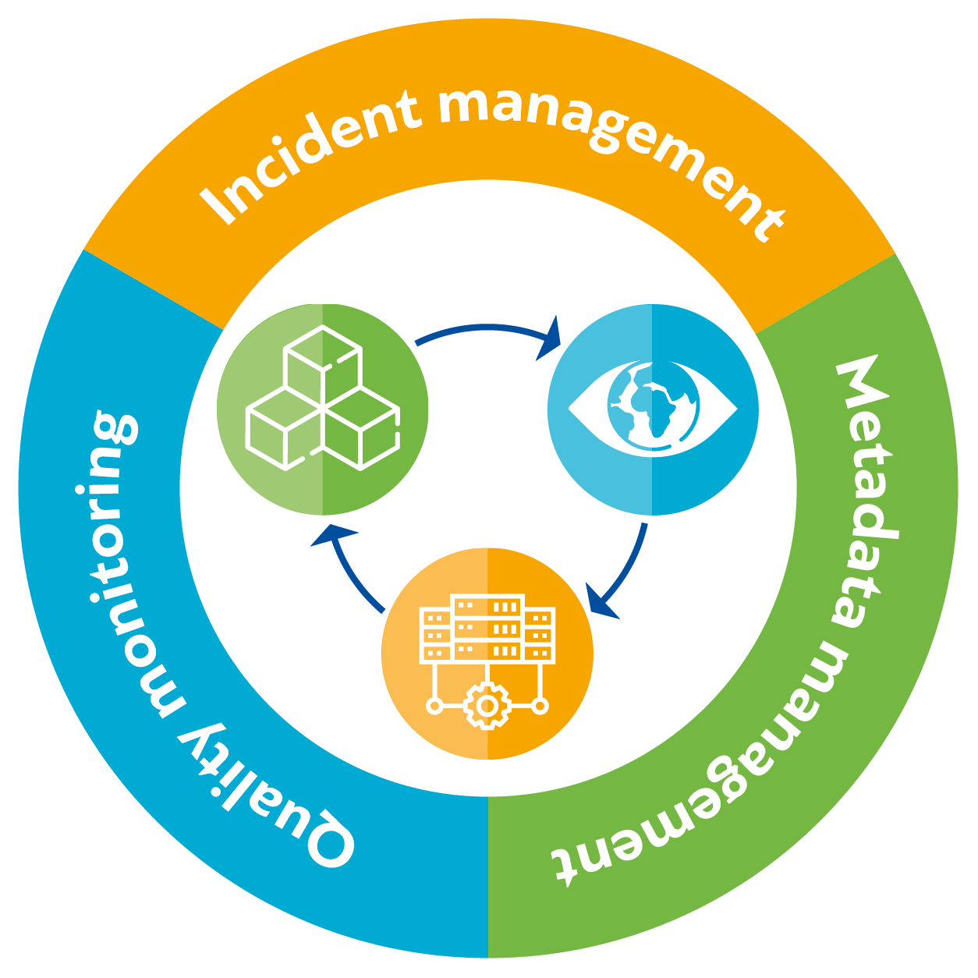
1. Opening and introduction to WIGOS tools (1)
WIGOS tools comprise of
  Metadata repository OSCAR/Surface
  WIGOS Data Quality Monitoring
  System (WDQMS) web-tool for
  quality monitoring and evaluation
  WDQMS Incident Management
  System (IMS) web-tool
Regional WIGOS Centres (RWCs) are key users of the WIGOS tools;
However, all Members are requested to make use of the WIGOS tools as well.

Slide 5
1. Opening and introduction to WIGOS tools (2)
The WIGOS tools are listed in the 6 highest priorities of the WIGOS Initial Operational Phase (WIOP) 2020-2023:
  (1) National WIGOS implementation;
  (2) Fostering a culture of compliance with the WIGOS technical regulations;
  (3) Implementation of the GBON and the RBON;
  (4) Operational deployment of the WDQMS;
  (5) Operational implementation of regional WIGOS centres;
  (6) Further development of the OSCAR databases.
The WIGOS Station Identifiers (WSI) are also a critical and common element of WIGOS tools and its implementation plan is also described in the WIOP

Slide 6
Outline
Opening and introduction to WIGOS tools (Tanja Kleinert)
New releases and features of WIGOS tools (Alexander Scheid / Timo Pröscholdt)
WIGOS Learning Portal (Zulkarnain/Ran Zhang)
Assigning of WIGOS Station Identifiers (Luis Nunes)
Key-take away messages (Tanja Kleinert)

Slide 7
2. New releases and features of WIGOS tools
OSCAR/Surface
Observing Systems Capability Analysis and Review Tool
WDQMS
WIGOS Data Quality Monitoring System
IMS
Incident Management System
In pilot mode operations since July 2020
Operational
Operational
Several new releases expected per year
Current release 1.6.0 includes Station Templates and Web Client Tool
Several new releases expected per year
Current release 1.3.1 includes monitoring the GCOS networks and other added features

Slide 8
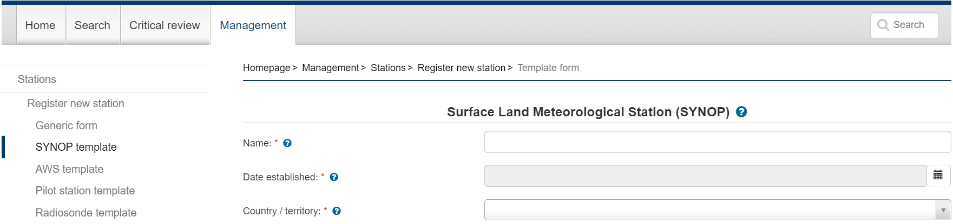
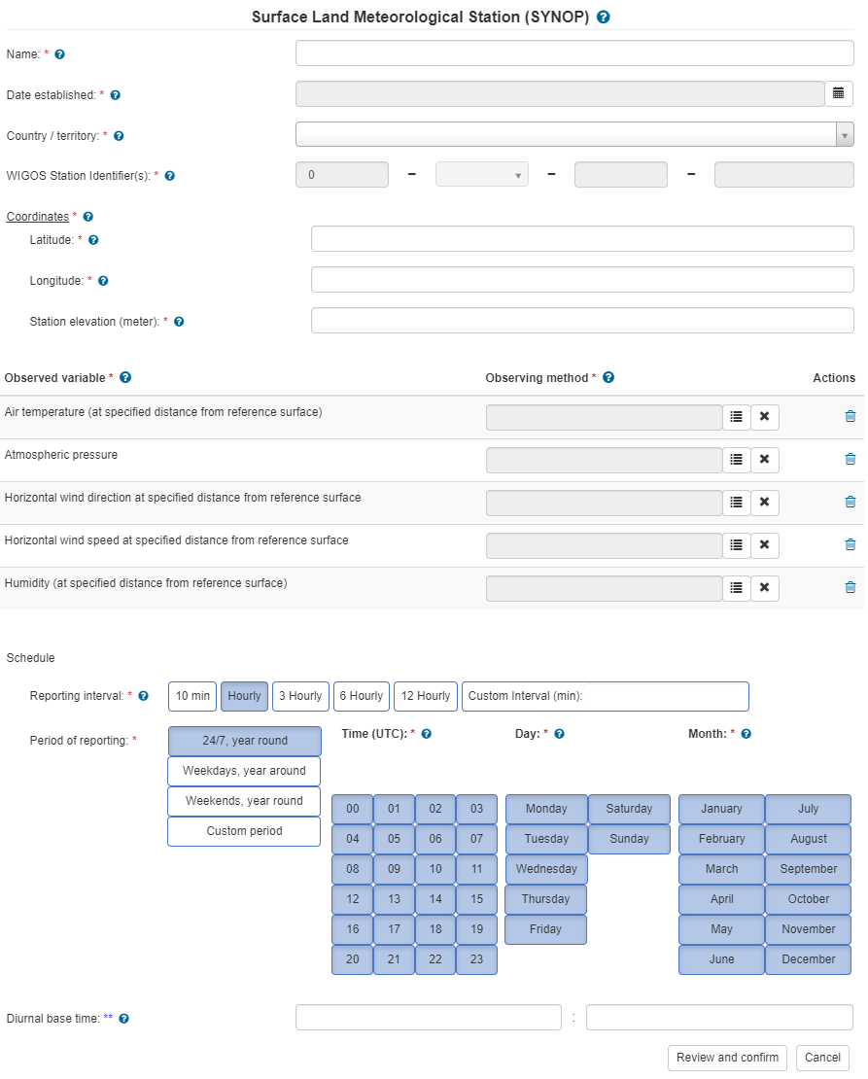
OSCAR/Surface Station Templates
(available to registered users from OSCAR/Surface website)

Slide 9
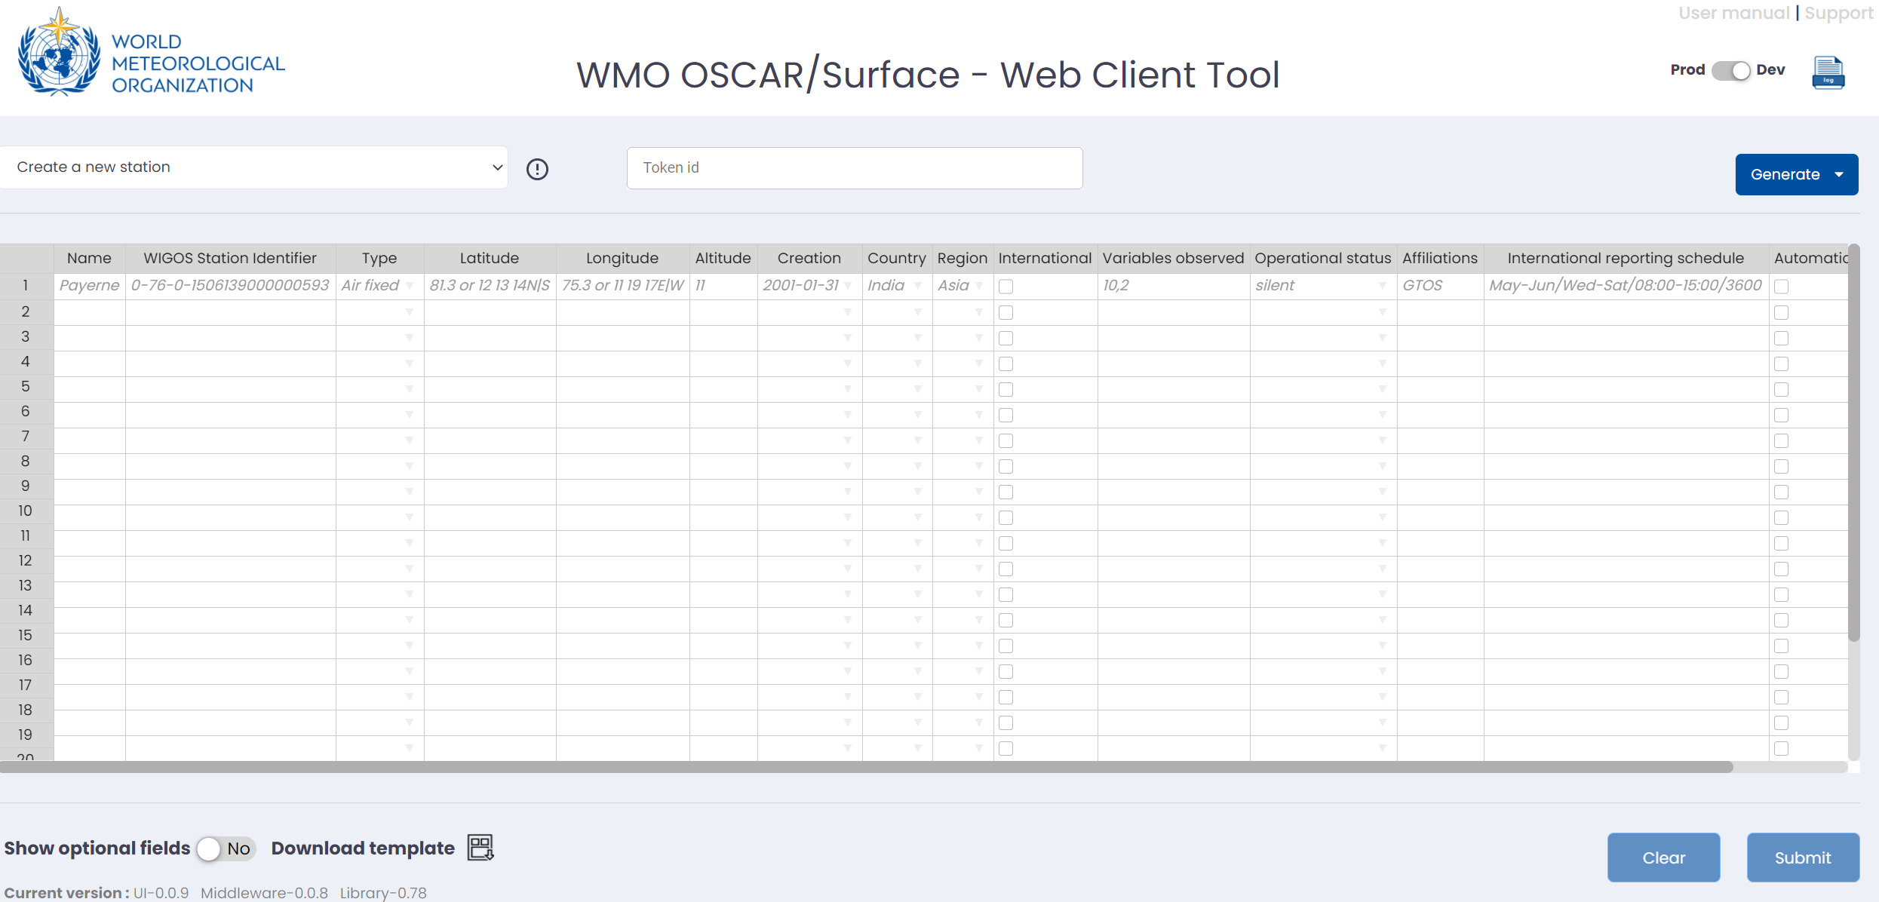
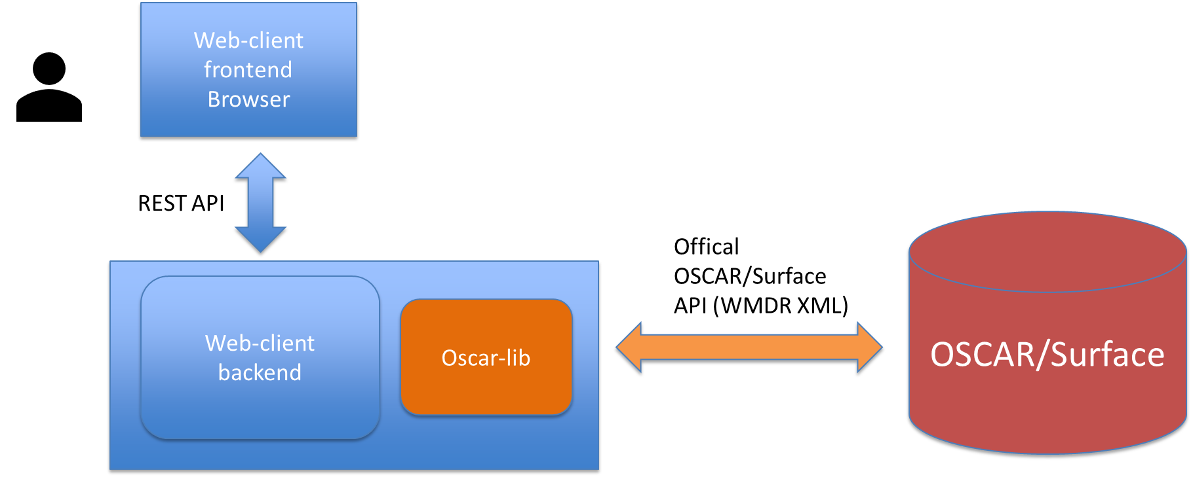
OSCAR/Surface Web Client Tool
Perform batch operations in OSCAR/Surface
Good to import large number of stations
Currently supported operations
  Create stations
  Change WIGOS IDs
  Add affiliation
  Change schedules

Slide 10
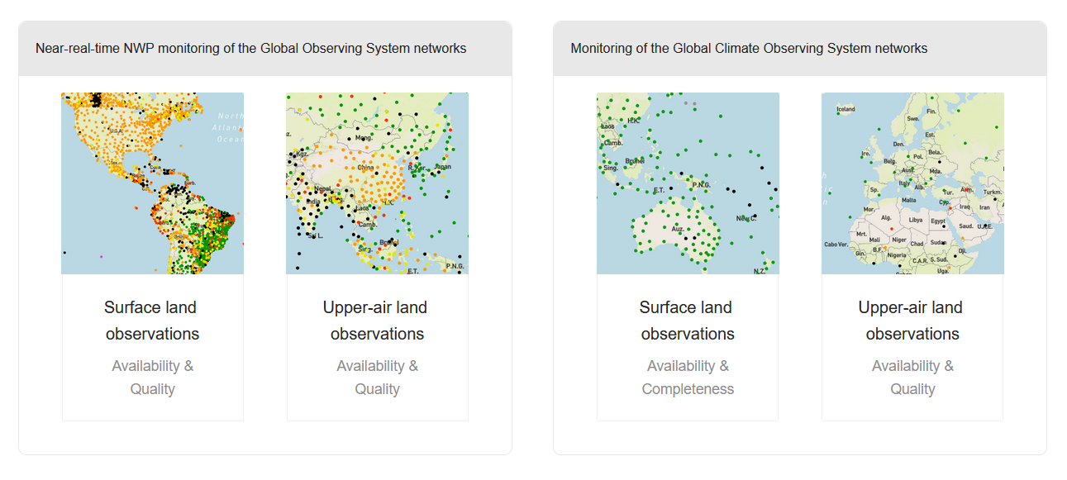
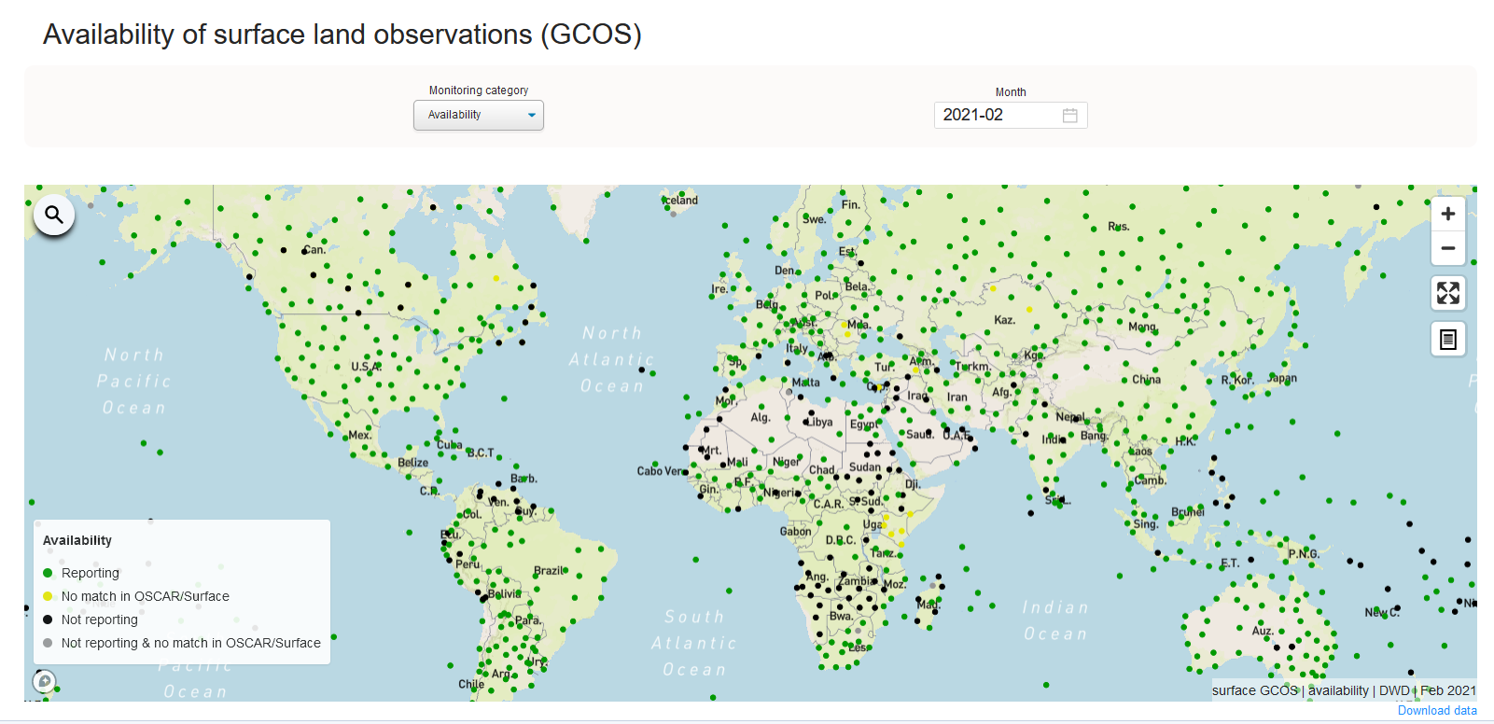
WDQMS webtool: New module for the monitoring of the Global Observing System (GCOS) Networks
  Release 1.3.1
  (30 Mar 2021)
    New module for the monitoring of the GCOS surface network
    Other added features

Slide 11
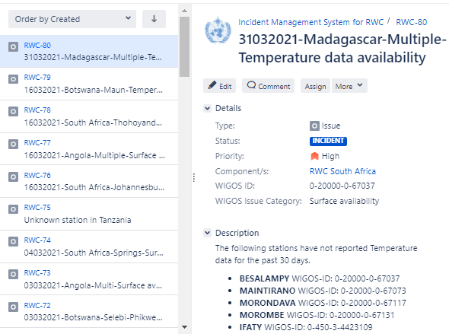
The prototype of Incident Management System (IMS) for RWC
A ticket system that follows the WDQMS incident management procedure
Allows interaction between RWC, members and the WIGOS Monitoring Center to address issues of availability and quality of observational data
The prototype of IMS is hosted by ECMWF
RWC Kenya, RWC Tanzania, RWC Southern Africa, RWC Argentina and RWC Brazil have implemented the WDQMS Incident Management Procedure with this system

Slide 12
Outline
Opening and introduction to WIGOS tools (Tanja Kleinert)
New releases and features of WIGOS tools (Alexander Scheid / Timo Pröscholdt)
WIGOS Learning Portal (Zulkarnain/Ran Zhang)
Assigning of WIGOS Station Identifiers (Luis Nunes)
Key-take away messages (Tanja Kleinert)

Slide 13
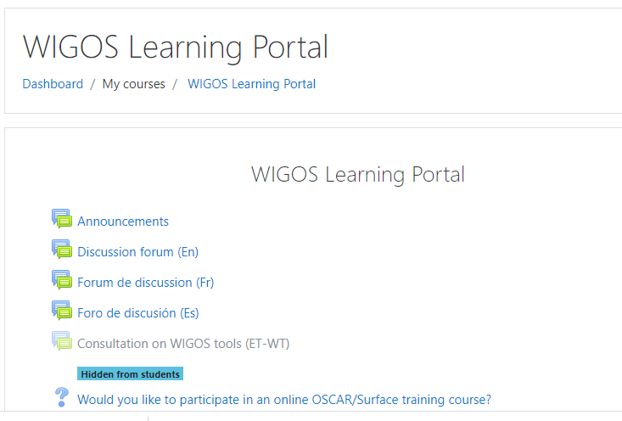
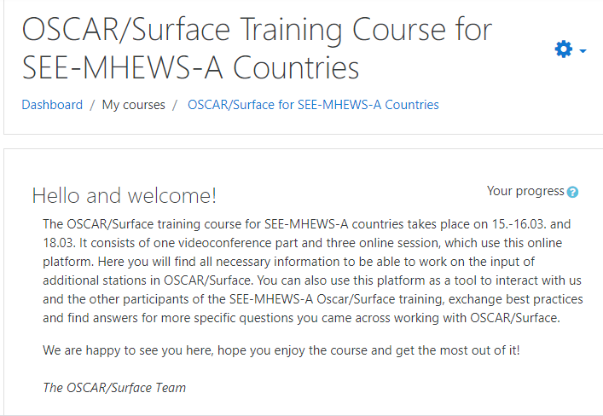
3. WIGOS Learning Portal
Enhanced online learning materials and development of online course, in WMO/ETRP Moodle, to adapt to New Normal
WIGOS Learning Portal is visible to everyone without any login. NFPs (WIGOS, OSCAR/Surface and WDQMS) are encouraged to register https://etrp.wmo.int/course/view.php?id=146
20 April 2020, WDQMS Resources Portal for RWC
14 October 2020, “WIGOS Learning Portal”, a merger of the “OSCAR/Surface Resources Portal” & the “WDQMS Resources Portal for RWCs”
25 June 2018, OSCAR/Surface Resources Portal
Furthermore:
- Remote coaching for RWCs and NFPs;
- Example: case of East Africa Community (EAC), from Nov 2020 – Feb 2021

Slide 14
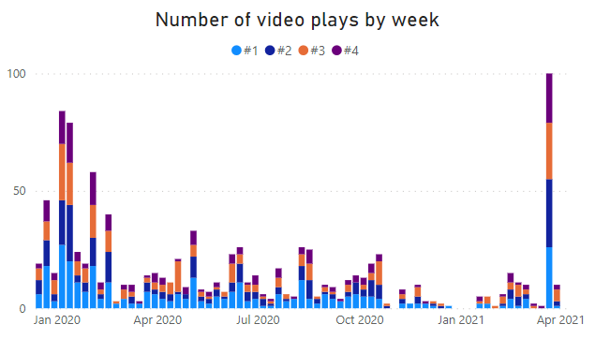
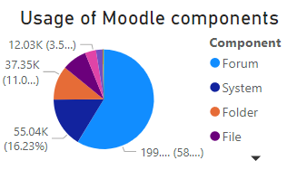
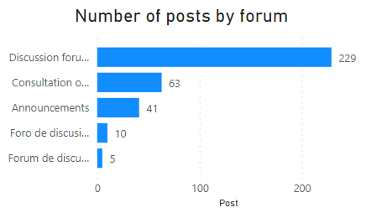
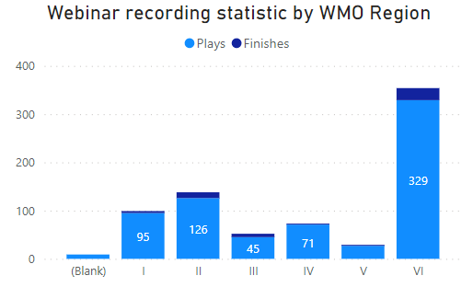
Insights from WIGOS learning resources analysis
One week after OSCAR/Surface Training Course for SEE-MHEWS-A Countries
OSCAR/Surface tutorial videos work as effective supplement for online training.
English Forum is the most frequently used component of the Moodle course, where questions are proposed and answered.
Since Sep 2018, 22 WIGOS related webinars have been held, with 598 total attendance. The recordings are all available online and being watched.
With data from multiple sources, Business Intelligence tools could help organizers track performance, hence improve future activities and provide impact-based services.

Slide 15
Outline
Opening and introduction to WIGOS tools (Tanja Kleinert)
New releases and features of WIGOS tools (Alexander Scheid / Timo Pröscholdt)
WIGOS Learning Portal (Zulkarnain/Ran Zhang)
Assigning of WIGOS Station Identifiers (Luis Nunes)
Key-take away messages (Tanja Kleinert)

Slide 16
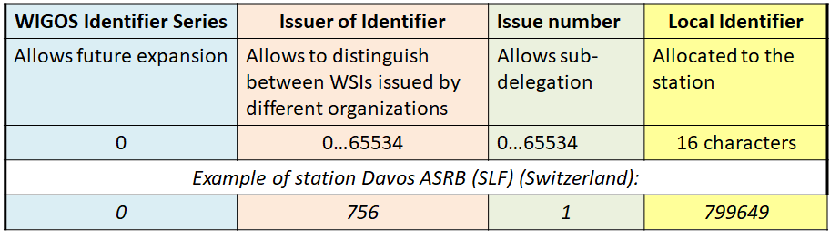
4. Assigning of WIGOS Station Identifiers (1)
According to the Technical Regulations - WSIs are in force since 1st July 2016
• Members shall:
  – issue WSIs for stations within their geographic area of responsibility that contribute to a WMO or co-sponsored programme
  – ensure that a WSI is issued to one station only
  – make available to WMO the updated metadata each time a new WSI is issued
• Members should:
  – provide and maintaining WIGOS metadata for that station/platform

Slide 17
4. Assigning of WIGOS Station Identifiers (2)
According to the guidance & recommended practices
Members need to:
  Develop their national schema for assigning WSIs
    Examples are available from the WIGOS Website: https://community.wmo.int/wigos-station-identifier
    It can be as simple as: giving each national organization its own Issue number
  For each new WSI assigned, register the station in OSCAR/Surface
    To ensure uniqueness of the WSI
For exchanging data internationally, WSIs are not compatible with TAC format reports
  – BUFR encoding is required to report data with WSIs

Slide 18
Outline
Opening and introduction to WIGOS tools (Tanja Kleinert)
New releases and features of WIGOS tools (Alexander Scheid / Timo Pröscholdt)
WIGOS Learning Portal (Zulkarnain/Ran Zhang)
Assigning of WIGOS Station Identifiers (Luis Nunes)
Key-take away messages (Tanja Kleinert)

Slide 19
5. Key-take away messages (1)
WIGOS tools are operational (besides IMS) but are still evolving to facilitate the work of Members and Regional WIGOS Centres
Work is in progress to further improve the performance of the tools
Plans are being developed to integrate further networks / WIGOS components, based on the priorities identified:
  OSCAR/Surface: first priority GCW, second priority Hydrology
  for WDQMS: marine and aircraft based observations
  for IMS: surface observations
WSIs are a critical, common element for all WIGOS tools, which will help to increase the number of stations exchanging observations internationally for the benefit of all Members and users

Slide 20
5. Key-take away messages (2)
WIGOS learning material and support for Members/NFPs:
Members are encouraged to make use of the user manuals available in the WIGOS web-tools.
The WIGOS Learning portal is the main source for WIGOS related learning resources providing a large variety of learning material and forum for questions.
Webinars are organized every month and recordings are made available on the WIGOS Learning portal
RWCs should also be able to support Members/NFPs

Slide 21
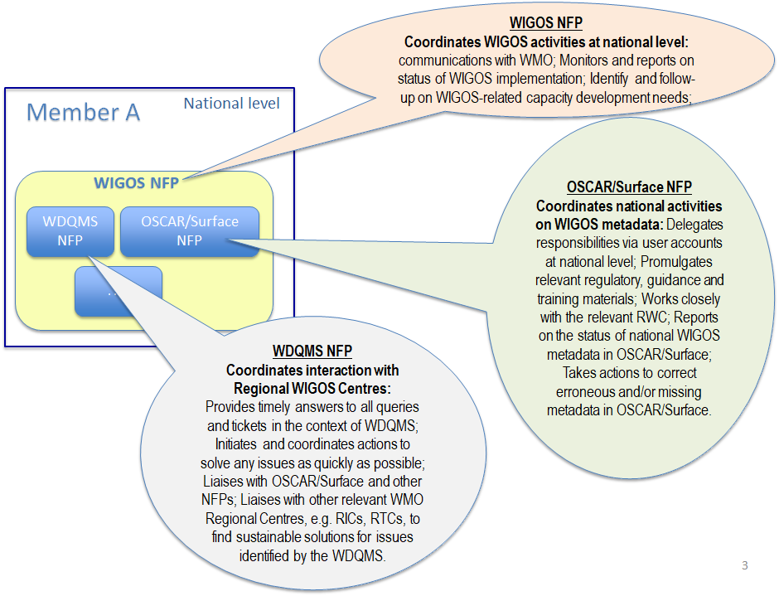
5. Key-take away messages (3)
National Focal Points are key to the
uptake of WIGOS Tools by Members

Slide 22
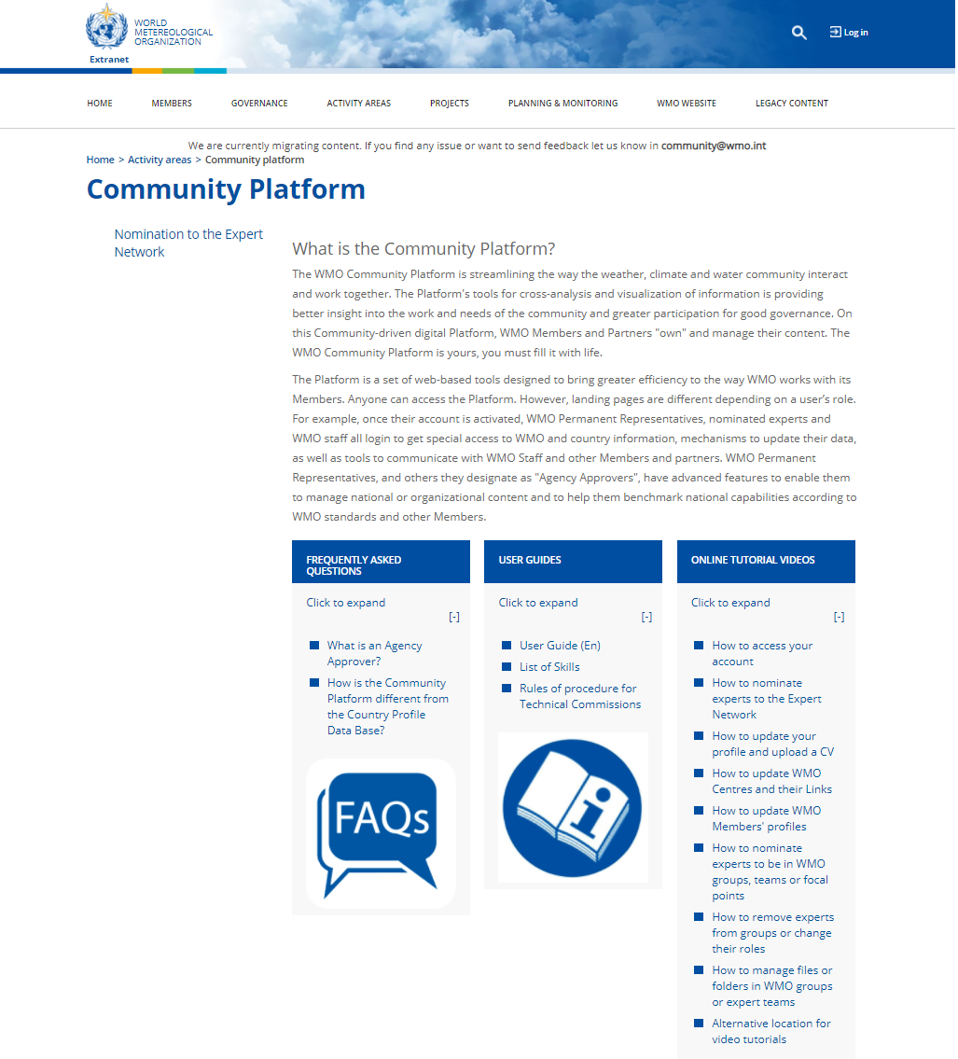
Guidance on nominations
https://community.wmo.int/activity-areas/community-platform

Slide 23

Thank you
Merci

