Slide 1
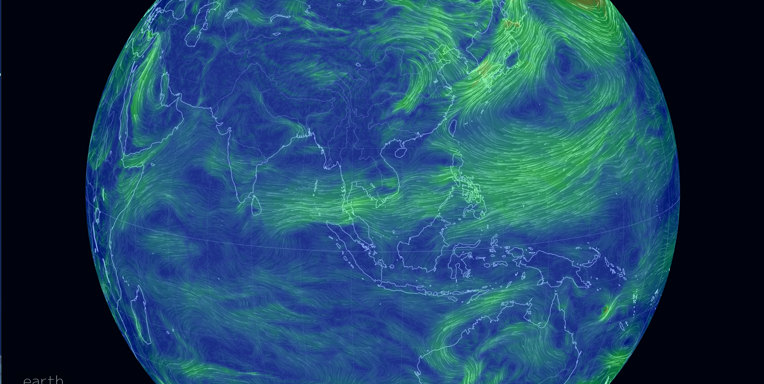
WMO Global Campus Report: RTC-Philippines
(PAGASA)
21 January 2021 x Zoom

Slide 2
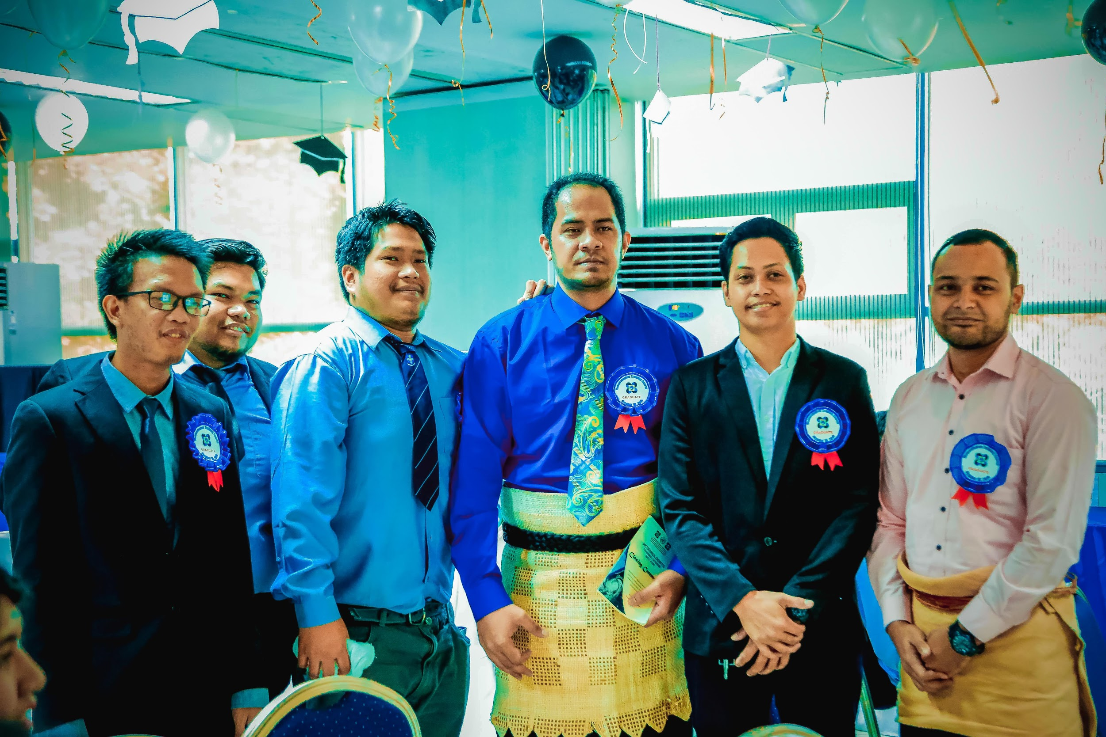
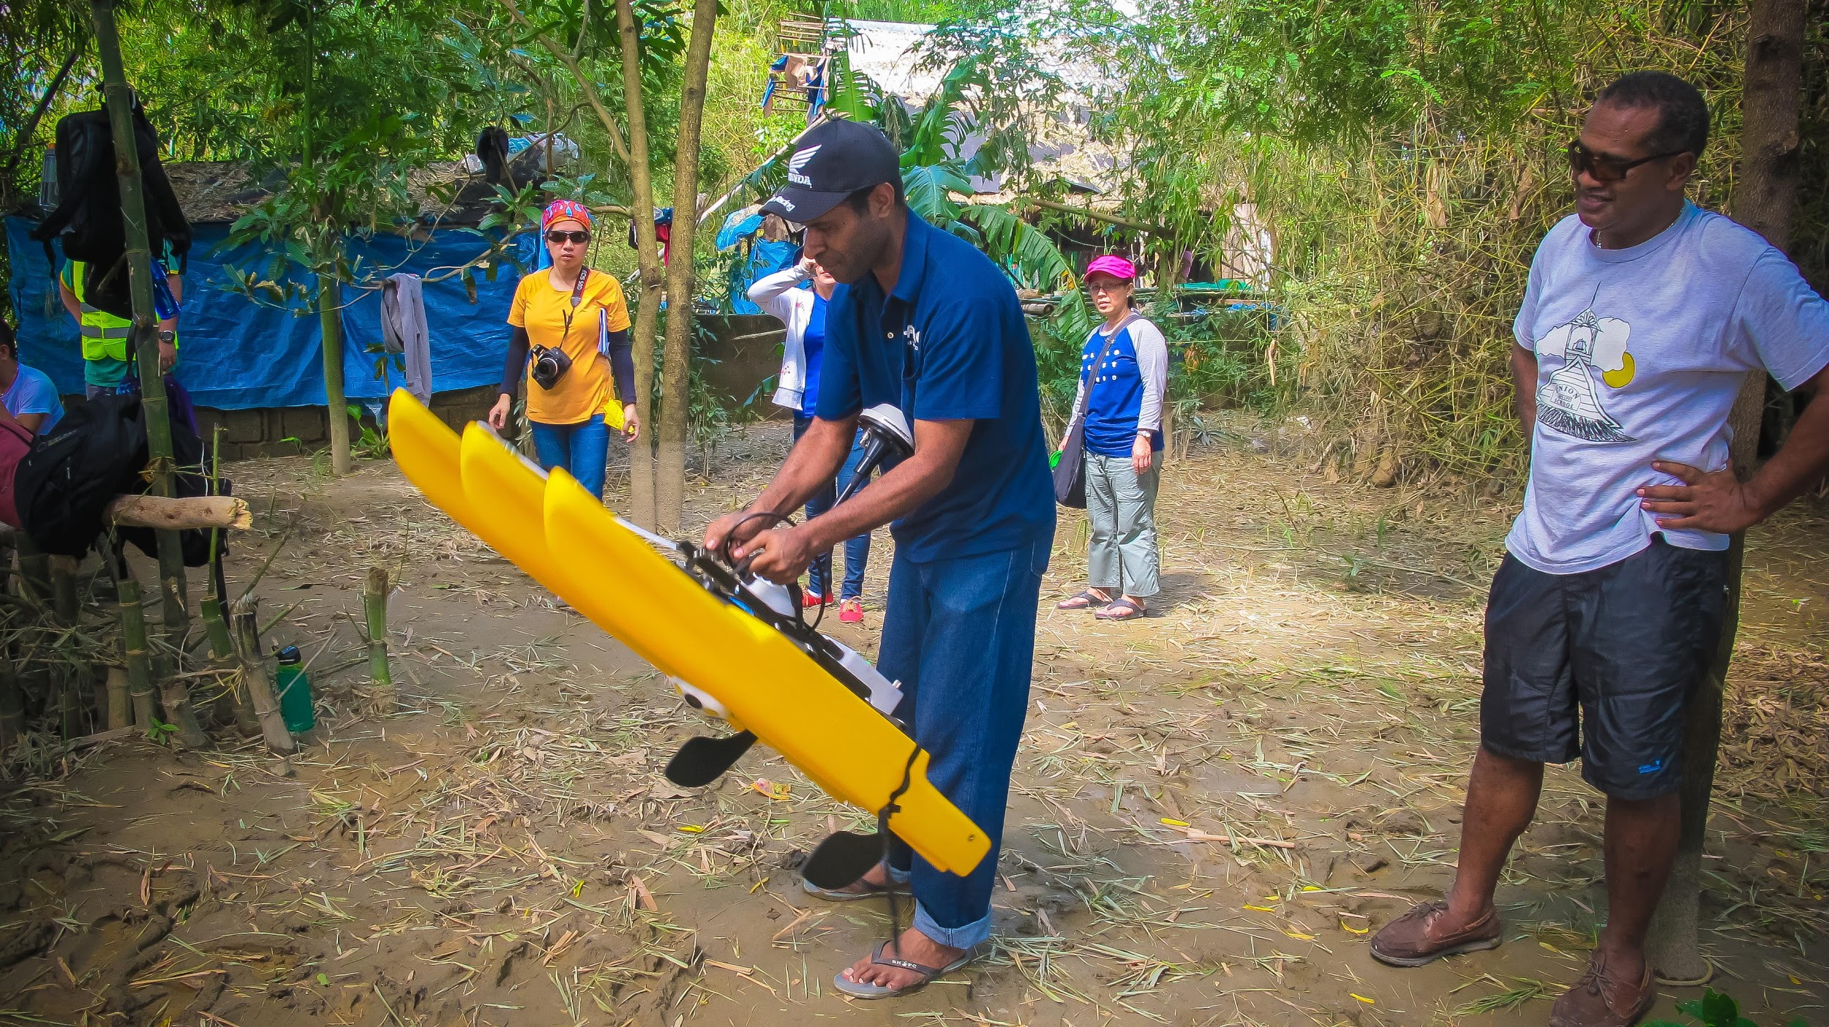
Challenges
Pedagogy shift (including assessment and evaluation)
Tech infrastructure (servers, software, apps, tools, etc.)
Pluriculturality in DL
Notes:
will resonate well with RTCs who are still building capacity/infrastructure
RTC-Philippines PAGASA had limited capacity/infrastructure to take on shift
need to update the training approach to adhere to the identified effective practices by education institutions
RTC was in the middle of BIP-M course at the onset of COVID

Slide 3
Highlights
Assess readiness in the shift in training approach
Improve technological infrastructure
Capacitate instructors in the transition to online learning modality
Finalize migration to online/distance learning
Implement the Meteorologist Training Course (equivalent to BIP-M)
Evaluate the transition to online/distance learning approach
Participated in the WMO Online Course on Education and Training Innovations (May to July 2020)
Action Plan for transition to DL
S/W on Instructional Design
Online meeting with RTC-ARG
Notes:
The WMO Online Course on Education and Training Innovations held from May to July this year was a very welcome initiative, especially given the current circumstances related to the global COVID health crisis. Since traditional face-to-face classes were essentially prohibited due to social distancing measures, training institutions were forced to re-think or re-imagine the implementation of their programs, the course was a good resource for platforms or innovations that we can follow or model our efforts off of.

Slide 4
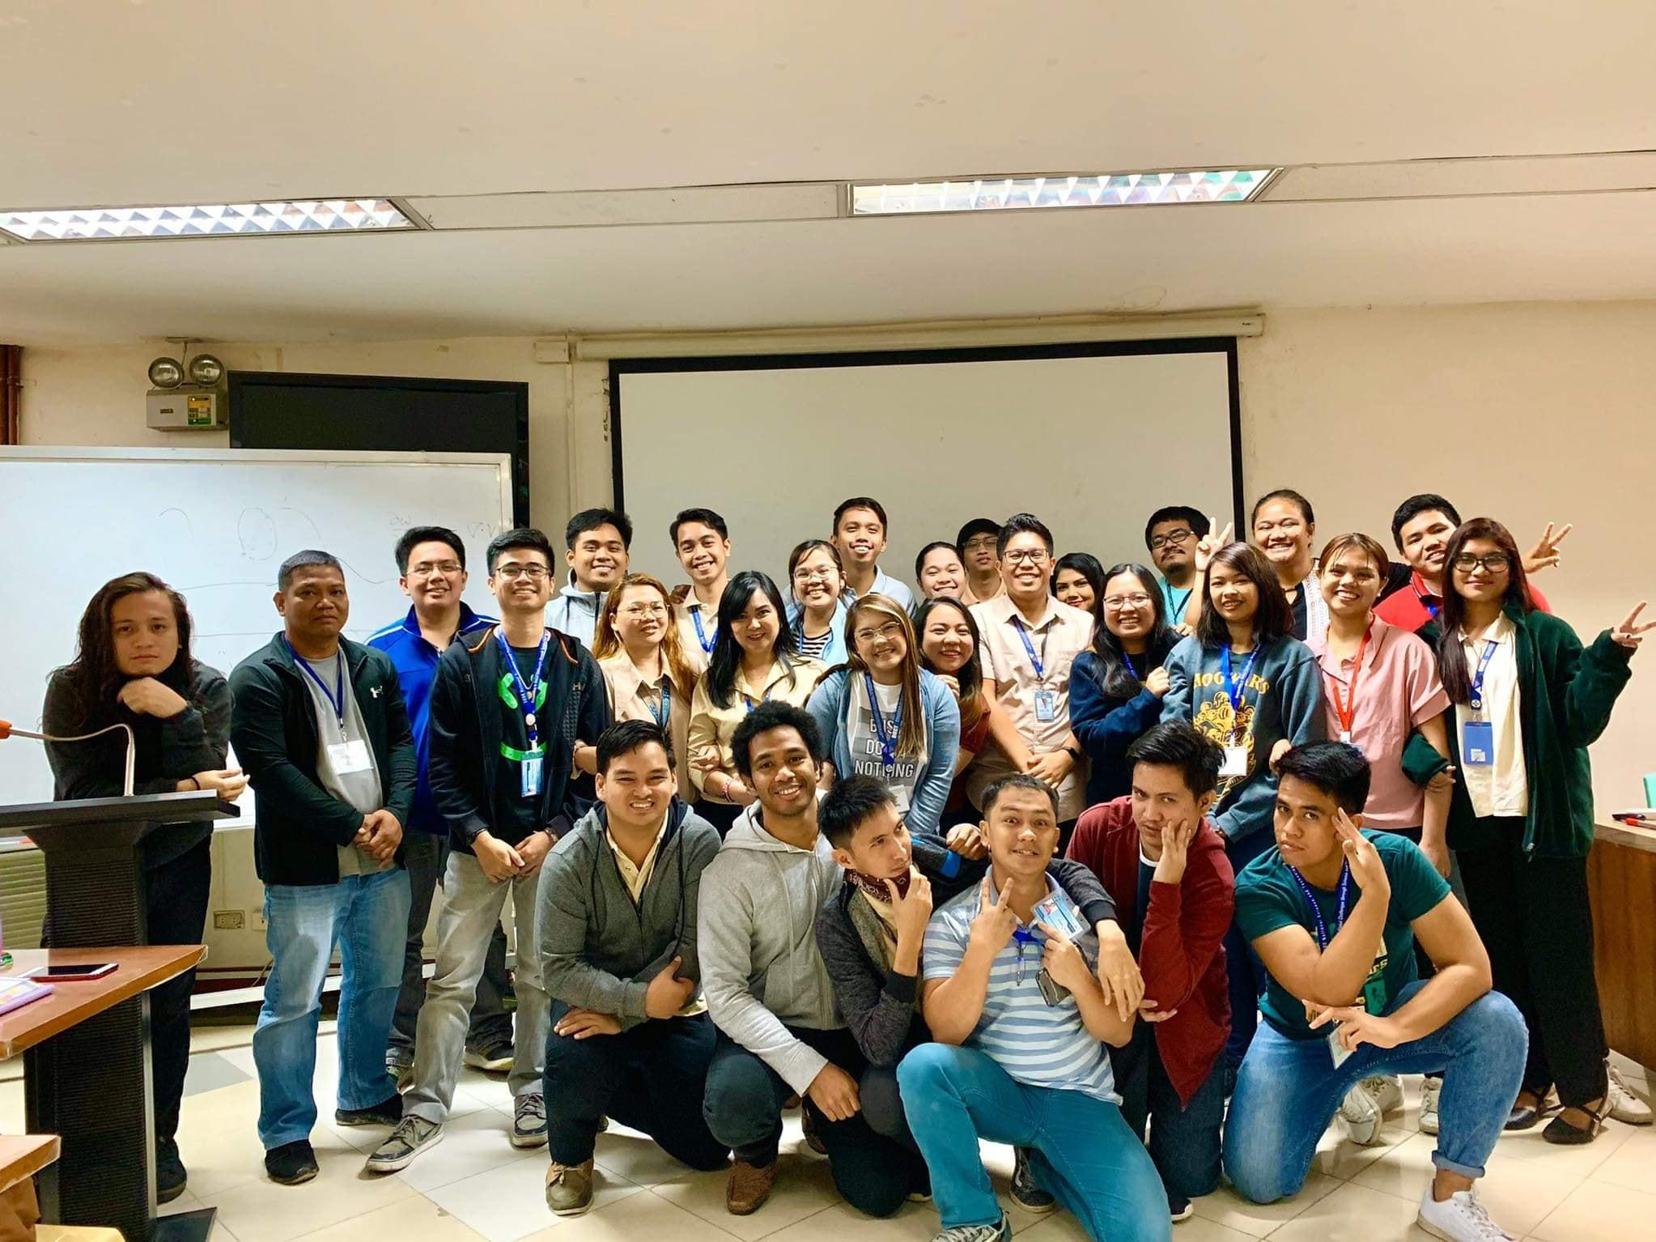
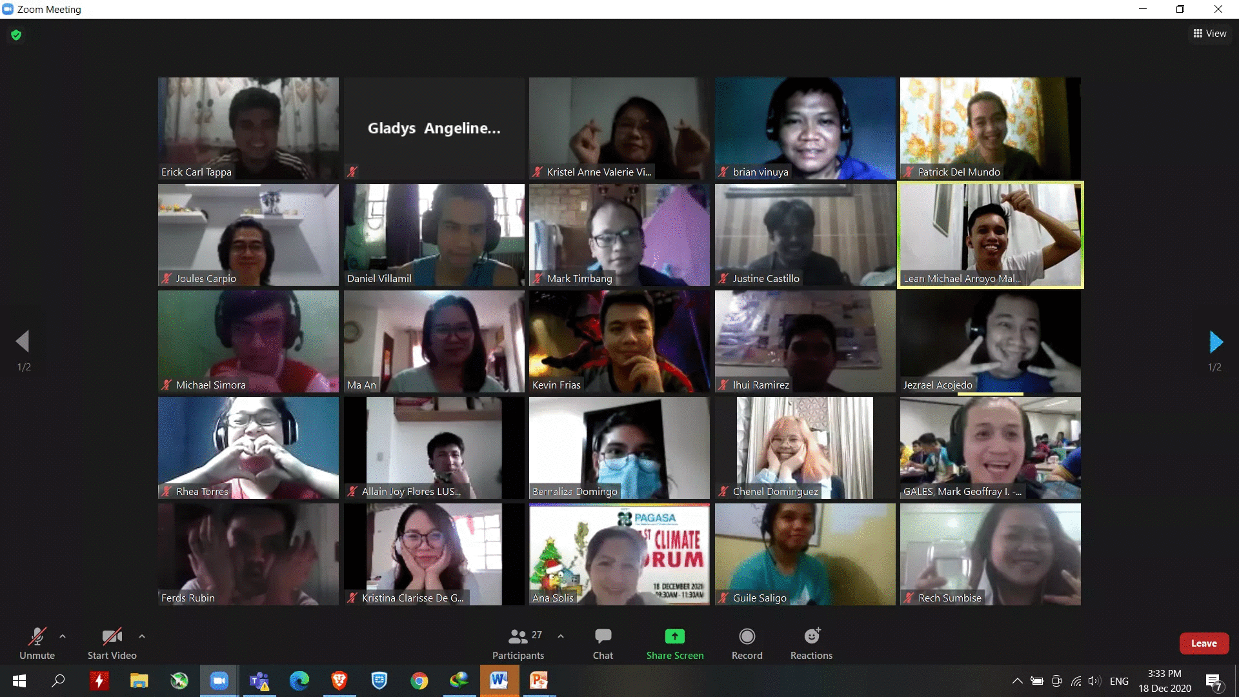
Notes
BIP-M concludes in a few weeks; interested to see evaluation
Impact on future course design
Expect higher training application/ participation

Slide 5
SALAMAT PO!
Thank you

